Slide 1

Noncompetitive Reimbursement Grant Mandatory Training 2023-2025
The ODE Farm to CNP Grant for Reimbursement of Oregon Grown & Processed Foods
Notes:
Hello, and welcome to the Oregon Farm to Child Nutrition Programs Noncompetitive Reimbursement Grant Training for the 2023 to 2024 biennium. This webinar is intended for all Farm to CNP Noncompetitive Reimbursement Grant Awardees who are current NSLP, CACFP and/or SFSP Sponsors in good standing across all child nutrition programs, and viewing is required for both new and past Awardees planning to participate. The information presented will be valuable for anyone involved in ODE Farm to CNP business, purchasing, or programming, as it will cover significant changes to the Grant, as well as provide an overview of the Grant as a whole.

Slide 2

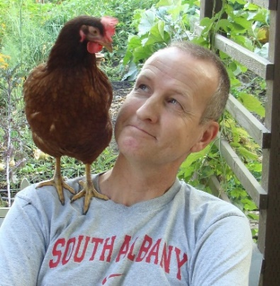


ODE Farm to CNP Team
Rick Sherman
Farm to CNP Program Analyst
Rick.Sherman@ode.Oregon.gov
Amy Lahrman
Administrative Specialist
Amy.Lahrman@ode.Oregon.gov
Emily Griffith
Office Specialist
Emily.Griffith@ode.Oregon.gov
FarmtoCNP@ode.Oregon.gov
www.bit.ly/f2sor
Notes:
Rick Sherman is the Farm to CNP Program Analyst, Amy Lahrman is the Farm to CNP Administrative Specialist, and Emily Griffith is the Farm to CNP Office Specialist. We are all available to assist you with any Farm to CNP Grant Program needs. You can reach us individually, or via our Farm to CNP team inbox. You can also find all materials covered in this webinar by visiting the Farm to CNP webpage and clicking the Oregon Farm to CNP Grant hyperlink.

Slide 3
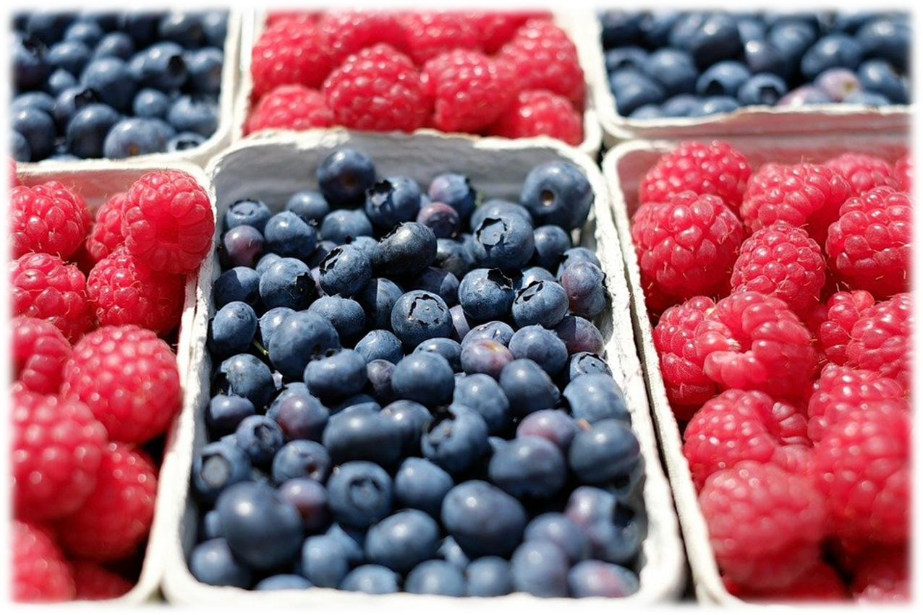
Overview What is the Farm to CNP Grant Program?
ODE awards grants to reimburse for:
Costs incurred purchasing Oregon foods meeting a certain criteria;
Costs associated with food-based, agriculture-based and garden-based educational activities; Costs essential to providing technical assistance to Farm to CNP Sponsors; and
Farm to CNP Grants:
The Farm to CNP Noncompetitive Reimbursement Grant
The Farm to CNP Competitive Reimbursement Grant
The Farm to CNP Education Grant
Notes:
Under House Bill 2579, ODE awards grants to eligible NSLP, CACFP and/or SFSP Sponsors, as well as other eligible entities, to reimburse for costs incurred purchasing Oregon foods meeting a certain criteria; costs associated with food-based, agriculture-based and garden-based educational activities; costs essential to providing technical assistance to Farm to CNP Sponsors; and to provide ODE with a Farm to CNP Grant Program evaluation.
Within the Farm to CNP Grant Program are six separate components, but only three that we will mention here: the Noncompetitive Reimbursement Grant, the Competitive Reimbursement Grant, and the Education Grant.
This webinar will only address the Noncompetitive Reimbursement Grant, and will touch on the Competitive Reimbursement Grant. The Education Grant will be addressed in a separate training.

Slide 4

2023-2025 Biennium
$10.4 million allocated for entire Farm to CNP Grant Program
$4 million designated for Noncompetitive Reimbursement Grant
Eligible NSLP, CACFP and/or SFSP Sponsors in good standing (not Seriously Deficient) automatically opted-in
Public Oregon School Food Authority participating in the National School Lunch Program (NSLP)
Center-based Sponsor of Child and Adult Care Food Program (CACFP)
Charter schools participating in NSLP
Awards start at $3,500
Awards calculated based on total meal counts from July 1, 2022 – Mar. 31, 2023
Breakfast: 3=1 meal
Snack: 4=1 meal
Lunch: 1=1 meal
Supper: 1=1 meal
New this biennium!
Notes:
For the 2023/2025 biennium, which includes the 23-24 and 24-25 school years, ODE has $10.4 million dollars allocated for the Farm to CNP Grant Program. $4 million dollars are designated for the Noncompetitive Reimbursement Grant.
Eligible Child Nutrition Program Sponsors are automatically opted in to receive a noncompetitive award. Eligible entities are any public Oregon School Food Authority participating in NSLP, and any center-based Sponsor of a Child and Adult Care Food Program (CACFP). Sponsors participating in SFSP are also eligible.
Charter schools are able to participate only if the school participates in NSLP.
New this biennium, Noncompetitive Reimbursement Grant minimum awards will start at $3500. This is an increase of $3000! Awards are calculated using a formula based on the Sponsor’s meal counts from July 1, 2022-March 31, 2023.
Sponsors in good standing across all child nutrition programs are eligible to participate. Sponsors who hold “Seriously Deficient” status are not eligible to receive an award until they are in full compliance with CNP.

Slide 5

Getting Started
New Grantees
*Email FarmtoCNP@ode.oregon.gov for list ASAP
Institution ID
EGMS Access Request
W-9
Direct Deposit
Submit Baseline Report
Returning Grantees
Update EGMS contacts
Including access privileges
Submit Final Report
All Grantees
View webinar
New employees view webinar
Submit attestation
Link on webpage under Trainings
Update CNPweb contacts
On CNPweb or through your Specialist
Sign up for Listserv
Add new employees to Farm to CNP Listserv
Listserv link on Farm to CNP mainpage
Award email went out to your current CNPweb contacts in July
Submit signed agreement ASAP
Notes:
If your district or organization is new to Farm to CNP you will have a few action items to complete before you are able to claim against your award. This may include getting set up in the Electronic Grant Management System, better known as EGMS. Please email the Farm to CNP team as soon as possible for a checklist of action items tailored to your district or organization.
If you are a returning Farm to CNP grantee, your to do list will be a bit shorter, however some action items are still required before you are able to claim against your award. Please note that if you have had turnover within your Nutrition Services Department, you may have some updates to make to CNPweb, EGMS, or both.
All Grantees, new and returning, must view this mandatory training. After viewing, Grantees must submit an attestation verifying this. Information on how to submit this will be provided at the end of the training.
All Grantees should update their CNPweb contacts as needed. Depending on your access level, this can be done on CNPweb, or through your ODE Nutrition Specialist.
To participate in the Farm to CNP Grant Program you must also be signed up on the Farm to CNP Listserv. Returning Grantees – if you have had turnover in your Nutrition Services Department lately you may have newer employees to add. The link to sign up is on the Farm to CNP main page. This is very important, as our Listserv is our primary communication avenue for important announcements.
An email was sent out in July with your initial award amount. You will receive a grant agreement from an ODE Grants and Contracts Specialist in the coming weeks. Please sign and return this agreement as soon as you receive it.

Slide 6

Program Requirements & Timeline
Must be in compliance across CNP
Farm to CNP award held until Seriously Deficient status lifted
Required reporting
Links and PDFs on webpage under Reporting
Claiming requirements
Adequate progress
First claim due December 29st, 2023
Award is retroactive to July 1st, 2023
Unspent awards moved to Competitive Reimbursement Grant allocation balance
Timeline on webpage under Timeline
Timeline is subject to change
July 2023 - Informal notification of awards
Summer/Fall 2023- Formal notification from ODE Procurement, including new grant agreement
12/29/23 - First claim due
December 2023 – Competitive Reimbursement Grant applications open
9/30/24 - Progress Report due
6/30/25 - All funds must be spent by this date
7/29/25 - All funds should be processed in EGMS
9/30/25 - Final Report due
Notes:
Grantees must be in good standing across all child nutrition programs. Any Sponsor that holds Seriously Deficient status will not be issued an award until they are in compliance with their ODE child nutrition program. Should a Grantee go into Seriously Deficient status some time during the grant period, they will not be permitted to make additional claims against their award until they are in compliance.
There are reporting requirements to participate in the Farm to CNP Reimbursement Grant. ODE collects Grantee food program and spending data via online survey three times during the biennium. Using the data collected, the Oregon Legislature determines if the Program will continue to be funded, and to what degree, making this data crucial to the future and success of the Farm to CNP Grant Program. As such, these reports are required of all Grantees to access their awards. Links to these reports can be found on the Noncompetitive Reimbursement Grant page under Reporting.
For new Grantees the Baseline report is due before you submit your first claim.
For returning Grantees, the Final report for last biennium is due Sept. 30, 2023.
All Grantees will have a Progress report due Sept. 30th 2024, as well as a Final report due at the end of the biennium, on Sept. 30th, 2025.
We do not require monthly claim submissions for the Farm to CNP Reimbursement Grant, however Grantees must show adequate claiming progress to support the Grant’s goal. What this means is that Grantees’ claim progress must reflect the duration of the time they have had to make claims. For instance, halfway through the biennium, at the end of the 23-24 school year, a Grantee should have claimed at least 50% of their initial award. Three quarters of the way through the biennium, halfway through the 24-25 school year, a Grantee should have claimed at least 75% of their initial award.
Grantees must make their first claim by December 29th, 2023 to demonstrate that they are using their funds. It is important to note here that qualifying purchases made after July 1st, 2023 can be claimed retroactively.
If a Grantee does not show adequate progress, a portion, or all of their award can be pulled and will be added to the Competitive Reimbursement Grant allocation balance. This is not something that happens without warning. There will be multiple notifications and communication attempts before any action is taken. It is important that you, the Grantee, are responsive to these attempts.
If a Grantee notifies us of a solid spending plan for the funds, we may allow an exception here. Please note, proposing to simply spend the funds in the future does not constitute a plan. A clear strategy must be communicated.
Once a Grantee exhausts their initial Noncompetitive Reimbursement Grant award they are eligible to apply for additional funds through the Competitive Reimbursement Grant. The first round of applications are projected to open December 2023. We will talk more about the Competitive Reimbursement Grant in a future slide.
All funds *should* be processed in EGMS by July 29, 2025. Your agreement will have a date of 45 days past June 30, 2025 for the last day to claim funds, which should be August 14, 2025.. However we suggest you don’t wait that long to submit claims. We get into issues during this August timeframe that makes it difficult to reconcile funds, so we encourage Sponsors to get their claims entered into EGMS well before that date.
All important dates and deadlines can be found on the Grant webpage under Timeline.

Slide 7

Allowable & Unallowable
The intention of the Farm to CNP Reimbursement Grant is to empower Grantees to increase their purchasing capacity of Oregon grown, produced and processed foods, as well as benefit the local economy, job market and environment by cycling State dollars back into communities around Oregon.
We encourage Grantees to seek out products that they may not have had the resources to purchase before, and to cultivate new relationships with Oregon producers and processors.
Grant funds are not intended to be used to supplant purchases that would routinely be served in Grantees’ food service programs. We count on you, the Grantee, to demonstrate the intention of the awarded funds through how you choose to spend them, however, there are a few items that are not reimbursable under the Farm to CNP Reimbursement Grant.
Notes:
The intention of the Farm to CNP Reimbursement Grant is to empower Grantees to increase their purchasing capacity of Oregon grown, produced and processed foods, as well as benefit the local economy, job market and environment by cycling State dollars back into communities around Oregon.
We encourage Grantees to seek out products that they may not have had the resources to purchase before, and to cultivate new relationships with Oregon producers and processors.
Grant funds are not intended to be used to supplant purchases that would routinely be served in Grantees’ food service programs. We count on you, the Grantee, to demonstrate the intention of the awarded funds through how you choose to spend them, however, there are a few items that are not reimbursable under the Farm to CNP Reimbursement Grant.

Slide 8
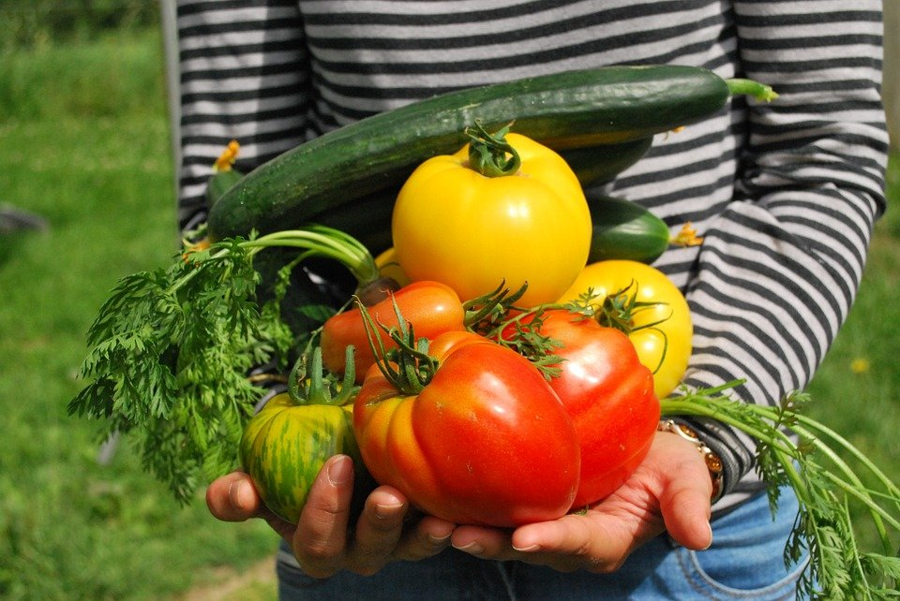
Allowable & Unallowable
A comprehensive list can be found on the Reimbursement Grant webpage under Allowable and Unallowable Products
Must use at least 75% of award on food
Up to 25% may be used for other reasonable costs
Growing
Harvesting
Transporting
Procuring
Processing
Packaging
Agriculture-based, food and nutrition-based education
Kitchen smallwares
Delivery fees
Miscellaneous supplies
Notes:
A comprehensive list of allowable and unallowable items can be found on the Reimbursement Grant webpage under Allowable and Unallowable Products. This resource also explains some common misconceptions, as well as some grey areas. We encourage you look over the document and to bookmark the page for reference.
Grantees must use at least 75% of the award for food purchases. Up to 25% of the award may be used for other reasonable costs incurred for growing, harvesting, transporting, procuring or processing foods served in your food service programs, as well as for agriculture-based or food and nutrition-based education. Costs could include kitchen smallwares, packaging, delivery fees, and other miscellaneous supplies.

Slide 9
Allowable
Produced in Oregon:
Products that are grown, raised or caught in Oregon
Oregon-grown fruits, vegetables, legumes, grains, etc., Oregon-raised meats, Oregon-caught seafood
This includes products that could have been processed outside of Oregon, but made with at least some Oregon-produced ingredients.
Processed in Oregon
Products that are more than minimally processed* in Oregon
Items grown, caught or raised out of state, but processed into a usable product in Oregon.
Flours, noodles, tamales, salsa, tofu, pizza, sauces, etc.
Produced AND Processed in Oregon
Items grown, caught or raised in Oregon and processed in Oregon.
Notes:
Allowable items are those that were produced, processed, or produced AND processed in the State of Oregon.
Produced products are grown, raised or caught in Oregon. These could include Oregon-grown fruits, vegetables, legumes and grains, and Oregon-raised meats and Oregon-caught seafood.
This includes products that could have been processed outside of Oregon, but made with at least some Oregon-produced ingredients.
Processed products are those that are more than minimally processed in Oregon. These items could be grown, caught or raised out of state, but processed into a usable product here in Oregon. Some examples include flours, noodles, tamales, salsa, sauces and pizza.
Produced and Processed items could include Tofu processed in Oregon from Oregon-grown soy, or dairy products produced in Oregon from milk from Oregon-raised cows.
Example: Tofu processed in Oregon from Oregon-grown soy.
Example: Flours processed in Oregon from Oregon-grown grains.
*”minimally processed” means that the food product was processed in a manner that does not fundamentally alter the product and the product retains its inherent character. The term includes, but is not limited to, butchering livestock and poultry, cleaning fish, dicing meats, slicing produce, forming ground food products into patties, grinding meats, drying or dehydrating food products, and washing produce.

Slide 10

Unallowable
Items routinely served in food service programs
Milk in half pints or bulk milk for drinking
Alternative milks for drinking to cater to special dietary needs are allowable
Bread, buns, rolls
Sandwich bread, hot dog buns, hamburger buns, dinner rolls, hoagie rolls
Fruits and vegetables grown outside of Oregon but only minimally processed* in Oregon
Jicama grown out of state, but chopped in Oregon
Other unallowable items
Oil
Pan spray
Butter/margarine
Salad dressing
Unallowable items commonly found on claims:
Tropical fruits - Pineapple, mango, bananas
Citrus - Oranges, lemons, limes, grapefruit
Notes:
Unallowable items are items that are routinely served in food service programs, such as milk for drinking, and bread, buns and rolls.
Also unallowable are fruits and vegetables grown outside of Oregon and only minimally processed in Oregon, like jicama grown out of state, but chopped in Oregon, or carrot coins sliced in Oregon, but grown out of state.
Other unallowables include oil, pan spray, butter and margarine, and salad dressing. Some unallowables commonly found on claims are tropical and citrus fruits.
If you have any questions regarding what is considered reimbursable that cannot be answered by the comprehensive list available on the webpage, please reach out to the Farm to CNP team.

Slide 11
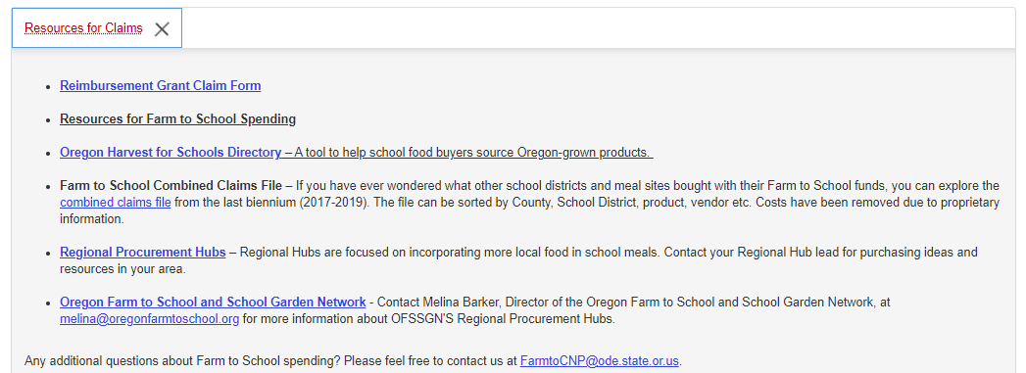
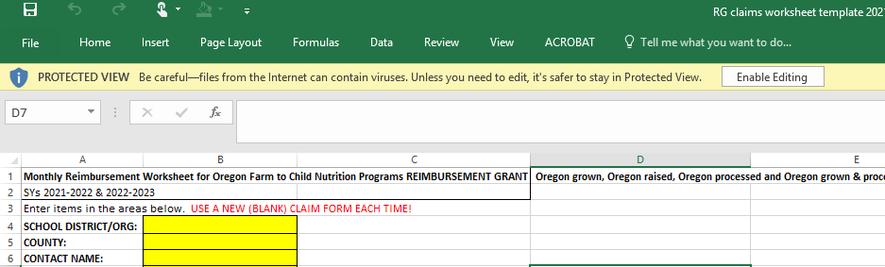
Claims Procedure
Download the Reimbursement Grant Claim Form from the Reimbursement Grant webpage under Resources for Claims
Save as new file
Notes:
To submit a claim, download the most recent version of the claim form template. This can be found on the Reimbursement Grant webpage under Resources for Claims. For those of you less familiar with Excel, after downloading and opening the file, you will need to click enable editing in the yellow bar at the top of the page, then save as. Now you are ready to fill out the claim form template.
We recommend you download a new sheet for each claim, as the claim form template can change. Please note: If you submit a claim on an outdated version of the claim form template, or on a template that has been altered or edited in a way that breaks formulas, you will be asked to resubmit the claim on the current template.

Slide 12
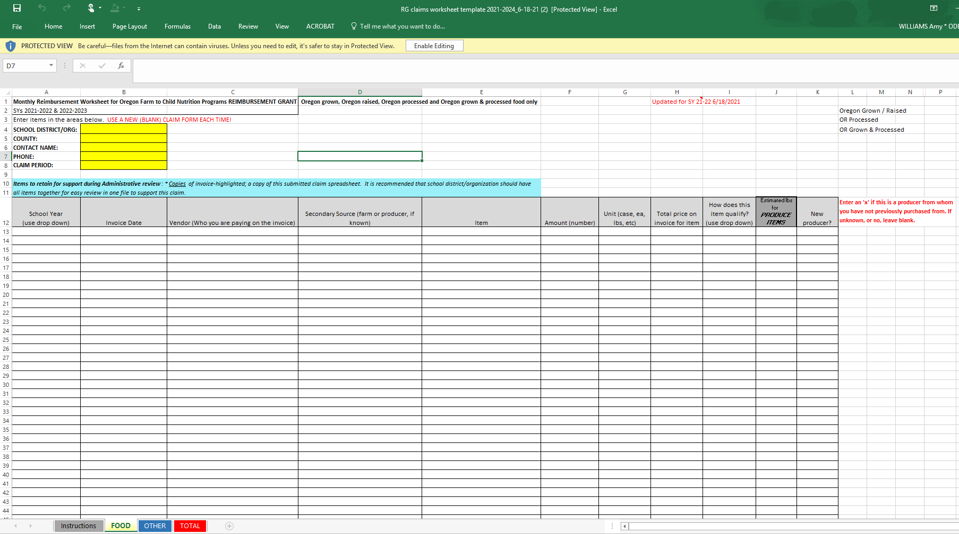
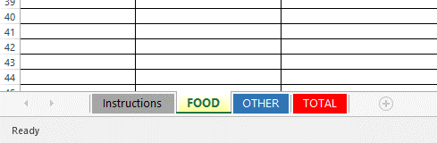
Claims Procedure
Notes:
This is what the template looks like (except with an updated date for this biennium). There are four tabs at the bottom of the form.

Slide 13
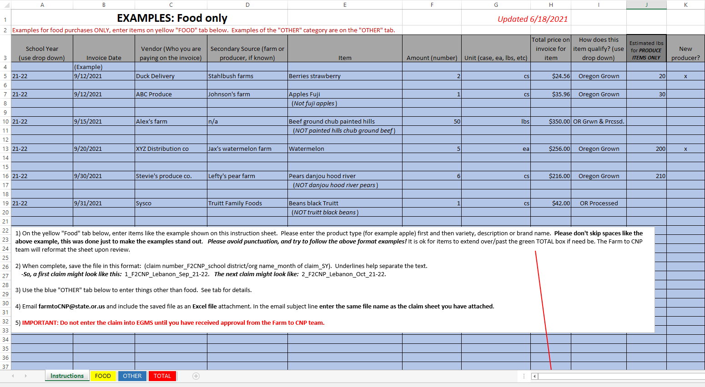
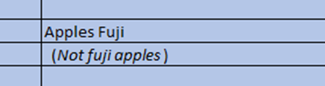

Claims Procedure
Notes:
The first is the instructions tab. Here you will find the guidelines for filling out the template, as well as some sample entries. Please pay special attention to the format we request you use when entering your items on the claim template, and please note the file name and email subject line formats.

Slide 14
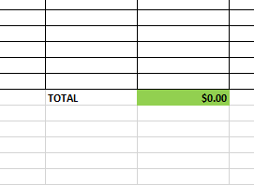
Claims Procedure
NO DOUBLE DIPPING
Notes:
The second tab is the food tab. Complete the yellow fields and enter your reimbursable items by completing the fields under each grey column heading. You may enter items from different months and invoices on one claims worksheet. If you have so many items that they surpass the green total field near the bottom of the sheet, that’s ok. We will reformat the sheet when we review the claim.
If there are unallowable items on the food tab, these will be highlighted and removed during review.
Please note that if you are claiming an item against your Farm to CNP Reimbursement Grant, this same item may not be claimed against any other grant (double dipping), like Fresh Fruit and Vegetable Program or DOD Fresh.

Slide 15
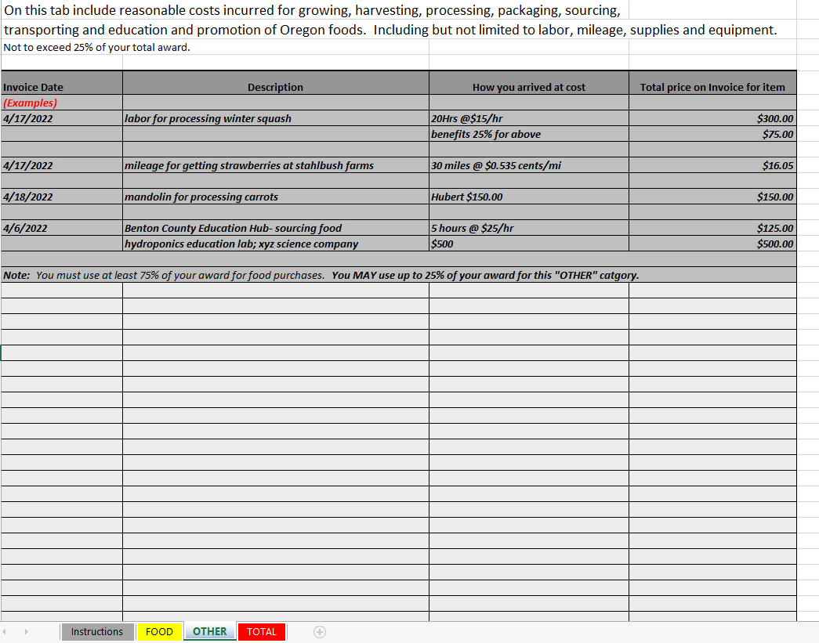
Claims Procedure
Notes:
The third tab is the other expenses tab. This is where you will enter any non-food costs, up to 25% of your total award. Non-food costs can include reasonable costs incurred for growing, harvesting, processing, sourcing, transporting, and education and promotion of Oregon foods. Including, but not limited to labor, mileage, supplies and equipment.

Slide 16
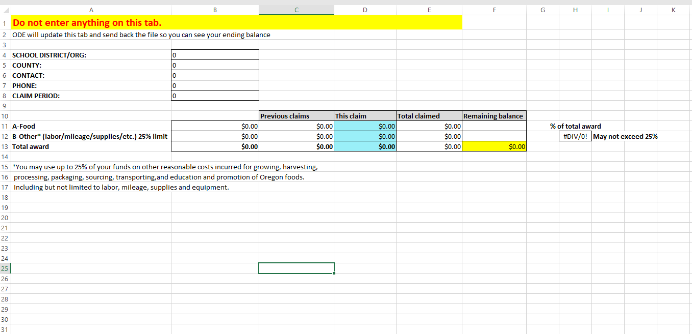
Claims Procedure
Please do not enter or change anything on the TOTAL tab.
Notes:
Your totals from the food and other tabs auto populate to the totals tab. Please do not enter or change anything on this tab. This is for ODE internal use only.

Slide 17
Claims Procedure
Save claim worksheet as requested
Email as Excel file attachment to FarmtoCNP@ode.Oregon.gov
Email subject the same as file name
Do not submit invoices
Retain for records
Farm to CNP team will review, update totals, send edited claim sheet back with pre-approval or edit requests
DO NOT ENTER CLAIMS INTO EGMS WITHOUT PRE-APPROVAL
Claims entered into EGMS before they are pre-approved will be rejected
Claims are reviewed in the order in which they are received
Up to two week turnaround
Once you have received the pre-approval email the claim is ready to enter into EGMS
Notes:
Save your claims worksheet using the format requested and submit your claims to farmtocnp@ode.Oregon.gov. You do not need to submit invoices with your claims, but you will need to retain them for your records, as we randomly select a handful of Grantees to undergo a desk audit. These are specific to Farm to CNP, and are not associated with other CNP reviews.
Once the claim has been reviewed, the Farm to CNP team will update the totals tab with your year-to-date totals and ending balance and attach the file to the claim pre-approval email for your records. Should there be any errors on the claim submission, we will send it back to you for the necessary edits.
It is important to remember that CLAIMS MUST BE REVIEWED AND PRE-APPROVED BY THE FARM TO CNP TEAM BEFORE THEY ARE ENTERED INTO EGMS. Claims entered into EGMS before they are pre-approved will be automatically rejected. Claims are reviewed in the order in which they are received. This can take up to two weeks.
Once you have received the pre-approval email the claim is ready to enter into EGMS.

Slide 18

For Food Service Management Companies
The purpose of the Reimbursement Grant is to benefit the school food authority, not the Food Service Management Company
Since FSMCs have a fixed cost per meal, all costs associated with that fixed cost must be in that meal
The FSMC may not bill the costs back to the school district or client
The FSMC should figure in these reimbursements when calculating their bid
Notes:
This slide pertains only to Food Service Management Companies.
The purpose of the Reimbursement Grant is to benefit the school food authority, not the Food Service Management Company.
Since Food Service Management Companies have a fixed cost per meal, ALL costs associated with that fixed cost must be in that meal.
Therefore, the Food Service Management Company may not bill the costs back to the school district or client.
The Food Service Management Company should figure in these reimbursements when calculating their bid. [click]

Slide 19

Competitive Reimbursement Grant
The process ODE uses to distribute extra or unspent funds to Grantees who have exhausted their initial awards.
Budget a portion of Farm to CNP Grant Program allocation
Additional funds available through reductions and liquidations
Applications open December 2023
Must be at $0 to be eligible to apply
Functions exactly like Noncompetitive Reimbursement Grant
Webinar announced this winter via Listserv
Notes:
The Competitive Reimbursement Grant is the process ODE uses to distribute extra or unspent funds to Grantees who have exhausted their initial awards. We budget a certain portion of our total Farm to CNP Grant Program allocation, and, as explained earlier, funds reduced or liquidated from Grantees unable to spend, or who are not demonstrating adequate progress, are added to this allocation.
Applications for the first round of Competitive Reimbursement Grants are projected to open sometime in December of 2023. To be eligible to apply, a Grantee must have exhausted their Noncompetitive Reimbursement Grant and be at a $0 balance.
The Competitive Reimbursement Grant functions exactly like the Noncompetitive Reimbursement Grant. It has the same rules, guidelines and claim procedure. There is no max to how many rounds you can apply for, the only eligibility requirement is that you are at a $0 balance.
This grant will have its own webinar closer to the time the first round of applications open where we will dive deeper into the intention of the grant and the application process. This will be announced via a Listserv communication.

Slide 20
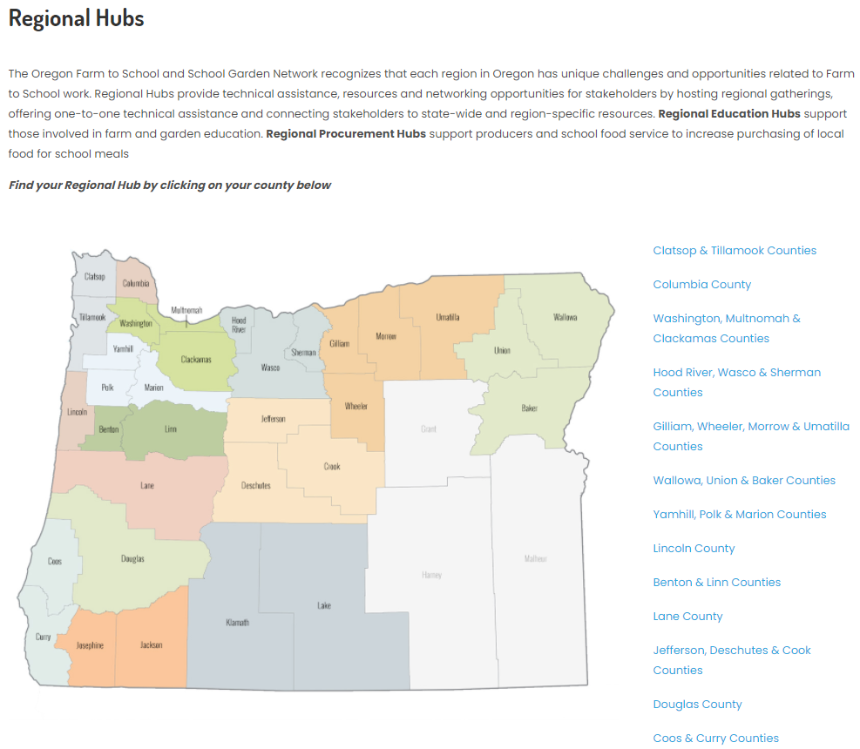
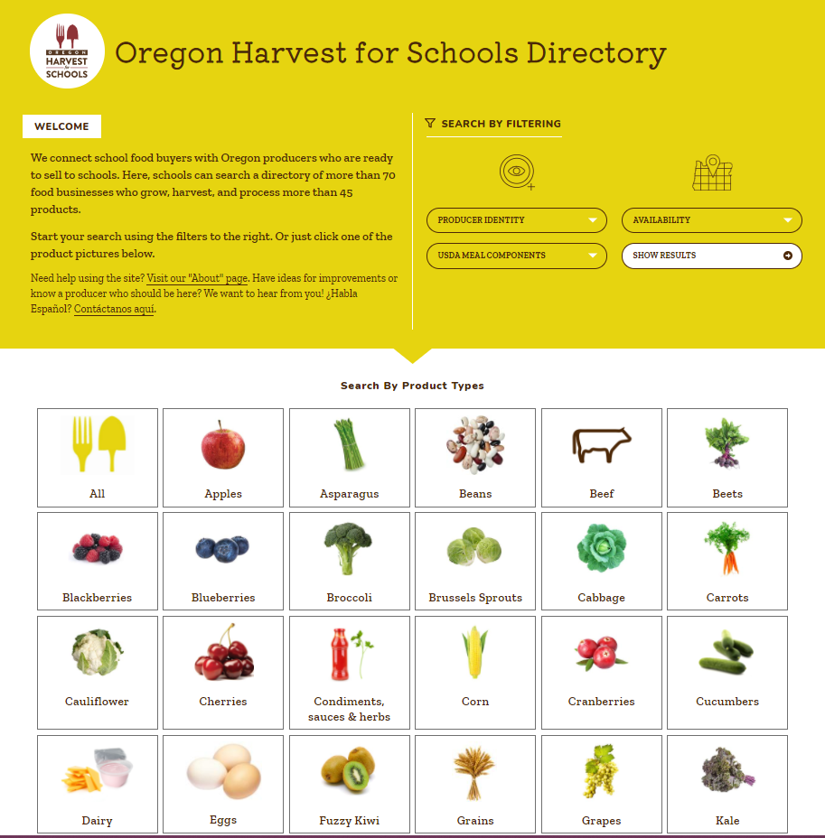
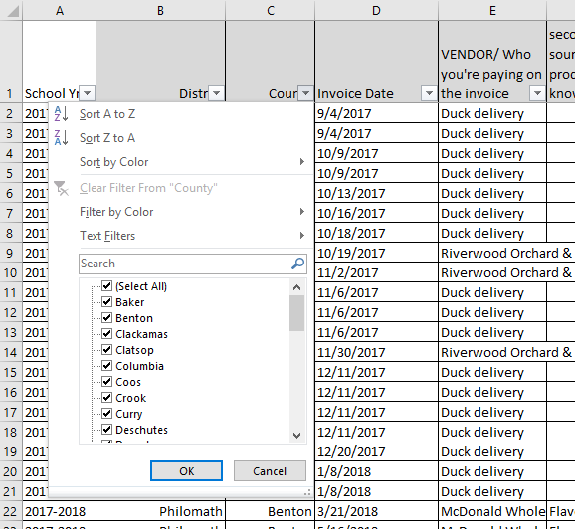
Resources
Contact the distribution company you currently use
Ask for a list of Oregon products
Oregon Farm to School and School Garden Network
www.oregonfarmtoschool.org
Regional procurement hubs
www.oregonfarmtoschool.org/regional-hubs/
Oregon Harvest for Schools Directory
www.portal.oregonharvestforschools.com
ODE Farm to CNP webpage
www.bit.ly/f2sor
Farm to CNP team
FarmtoCNP@state.or.us
Notes:
Lastly, there are many resources available to assist you in successfully utilizing your Farm to CNP grant funds. For one, you can ask your current distribution company for a list of Oregon products available to you.
The Oregon Farm to School and School Garden Network is a local nonprofit dedicated to the success of Farm to School around Oregon. They have many resources on their website, and can put you in touch with your regional procurement hub.
The Oregon Harvest for Schools Directory is a search tool for finding Oregon foods. Using this tool you can sort by category, including product type, producer identity, USDA meal component, and regional availability.
The Farm to CNP webpage also has multiple resources for getting started, promotion and education, purchasing and more, including links to the resources previously mentioned.
On the Noncompetitive Reimbursement Grant webpage under Resources for Claims, we have the Combined Claims file. This is a large Excel sheet that lists what Grantees purchased with their Farm to CNP Reimbursement Grant funds in previous school years. The data can be sorted by county, district, product, and vendor.

Slide 21

Thank you!
Submit attestation
Notes:
Thank you for viewing this training. Please do not hesitate to reach out to the Farm to CNP team, or any of the resources mentioned, if you have additional questions regarding the Farm to CNP Noncompetitive Reimbursement Grant. Please now submit the mandatory training attestation. https://app.smartsheet.com/b/form/cd66d0d0d35f45d8b7ab5baa174121a7

Slide 22

Oregon Department of Education “Our Why”
Equity and Excellence for Every Learner
The Oregon Department of Education works in partnership with school districts, education service districts and community partners;
Together, we serve over 580,000 K-12 students;
We believe every student should have access to a high-quality, well-rounded learning experience;
We work to achieve the Governor’s vision that every student in Oregon graduates with a plan for their future.
Notes:
Equity and Excellence for Every Learner
The Oregon Department of Education works in partnership with school districts, education service districts and community partners;
Together, we serve over 580,000 K-12 students;
We believe every student should have access to a high-quality, well-rounded learning experience;
We work to achieve the Governor’s vision that every student in Oregon graduates with a plan for their future.

Slide 23
Oregon Department of Education Education Equity Stance
Education equity is the equitable implementation of policy, practices, procedures, and legislation that translates into resource allocation, education rigor, and opportunities for historically and currently marginalized youth, students, and families including civil rights protected classes. This means the restructuring and dismantling of systems and institutions that create the dichotomy of beneficiaries and the oppressed and marginalized.
Notes:
Education equity is the equitable implementation of policy, practices, procedures, and legislation that translates into resource allocation, education rigor, and opportunities for historically and currently marginalized youth, students, and families including civil rights protected classes. This means the restructuring and dismantling of systems and institutions that create the dichotomy of beneficiaries and the oppressed and marginalized.

