Slide 1

Oregon Farm to School Education Grant Webinar for Grantees
Notes:
Welcome to the Oregon Farm to School Education Grant Webinar for grantees!

Slide 2


Presented By:
Rick Sherman
Oregon Department of Education
Child Nutrition Programs
Farm to School/School Garden Analyst
Notes:
I’m your host, Rick Sherman. I’m the Farm to School Analyst with the Oregon Department of Education Child Nutrition Programs.

Slide 3
Congratulations on Receiving an Award!
You’re here because you received an email with initial instructions, an award amount and general information.
Notes:
Congratulations on receiving an award! You’re here because you received an email with initial instructions, an award amount and general information

Slide 4
TODAY’S AGENDA
Housekeeping & Overview
Advances
Agreement & Insurance
EGMS
Allowable/Unallowable Costs
Reimbursement Process (Claims) & Requirements
Review process
Reporting
Questions
Notes:
Today’s agenda:
Housekeeping & Overview
Advances
Agreement & Insurance
EGMS
Allowable/Unallowable Costs
Reimbursement Process (Claims) & Requirements
Review process
Reporting
Questions

Slide 5
Housekeeping:
ALL MATERIALS-including the slides from this webinar-can be found on the ODE Farm to School website: www.bit.ly/f2sor
Click on the “Oregon Farm to School Grant” section at the top
Notes:
ALL MATERIALS-including this recorded webinar-can be found on the ODE Farm to School website: www.bit.ly/f2sor
Click on the “Oregon Farm to School Grant” section at the top

Slide 6
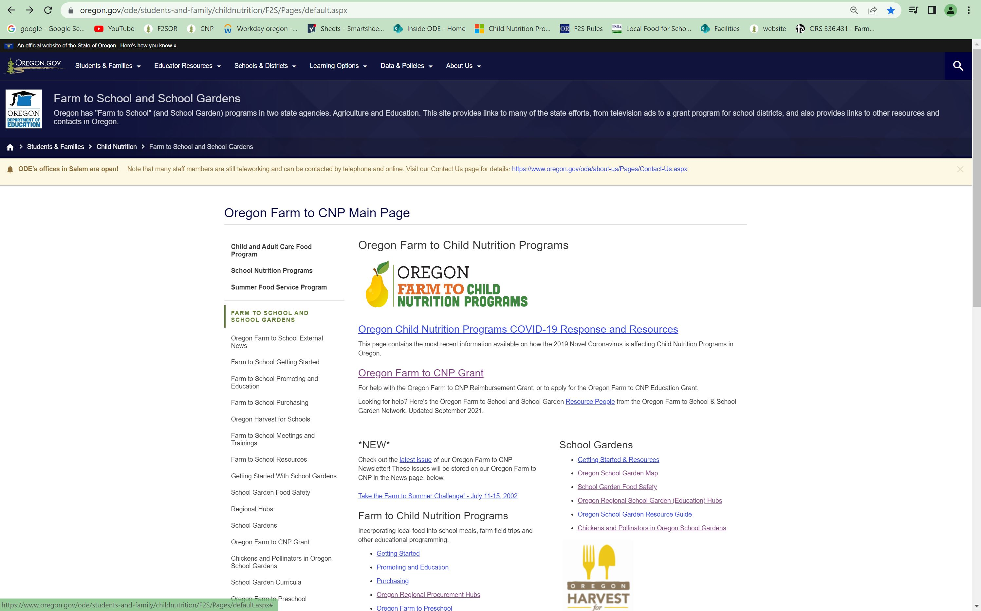
slide
Notes:
When you go to the website the top link is for the Oregon farm to school grant

Slide 7
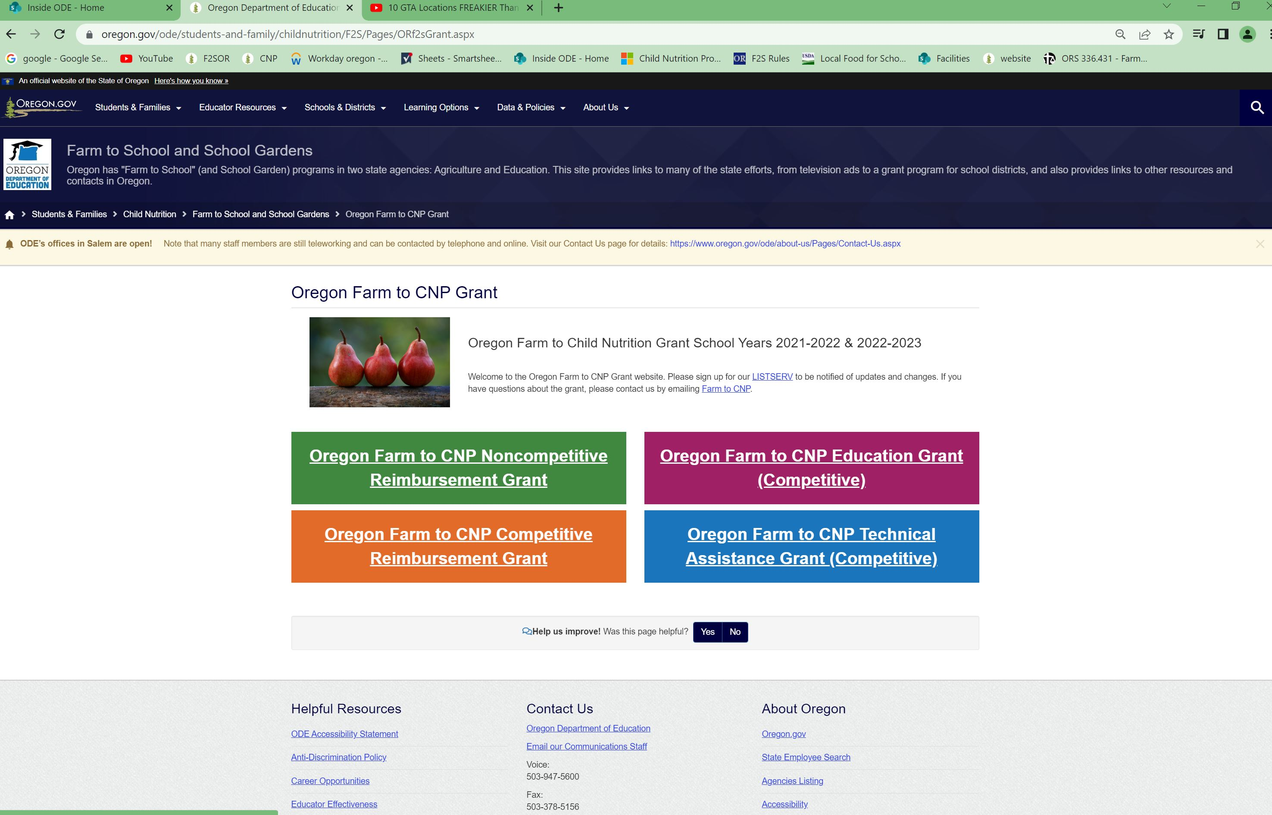
slide
Notes:
Then click on the purple box in the upper right hand corner

Slide 8
MOST IMPORTANT:
Keep checking the website for updates as things change
Click on the “join us” link on the grant webpage to sign up for our listserv (over 3,000 subscribers!)
This is a requirement to participate in the grant, as it is the preferred method to communicate to the field for important changes.
Notes:
Keep checking the website for updates as things change
Click on the “join us” link on the grant webpage to sign up for our listserv (over 3,000 subscribers!)
This is a requirement to participate in the grant, as it is the preferred method to communicate to the field for important changes.

Slide 9
Housekeeping:
email for help!- This will go to myself, Amy and Alicia: farmtoCNP@ode.Oregon.gov
You can still email us individually:
rick.sherman@ode.oregon.gov
amy.williams@ode.oregon.gov
alicia.loebl@ode.oregon.gov
Notes:
email for help!- This will go to myself, Amy and Alicia: farmtoCNP@ode.Oregon.gov
You can still email us individually:
rick.sherman@ode.oregon.gov
amy.williams@ode.oregon.gov
alicia.loebl@ode.oregon.gov

Slide 10
Housekeeping:
This grant is for the rest of this school year (2022-2023).
All funds must be spent by June 30, 2023.
This is not retroactive. Meaning, you can get reimbursed for activities from the time your agreement is signed until June 30, 2023.
Notes:
At the time of this recording, This grant is for the rest of this school year (2022-2023).
All funds must be spent by June 30, 2023.
This is not retroactive. Meaning, you can get reimbursed for activities from the time your agreement is signed until June 30, 2023

Slide 11

Overview: Timeline
June 30, 2023 – All funds must be spent and accounted for.
July 31, 2023 – All funds must be processed in EGMS. AFTER ~ JULY 31, ALL UNCLAIMED FUNDS WILL BE LIQUDATED
September 30, 2023– Final report due
Notes:
June 30, 2023 – All funds must be spent and accounted for.
July 31, 2023 – All funds must be processed in EGMS. AFTER ~ JULY 31, ALL UNCLAIMED FUNDS WILL BE LIQUDATED
September 30, 2023– Final report due

Slide 12
Advance
This is a reimbursement grant
However, some of you may elect to request up to 25% of your award in the form of an advance. The deadline to declare an advance is November 30, 2022. To declare and advance, send an email to farmtoCNP@ode.Oregon.gov.
We have to stick to this deadline because an advance triggers a different agreement for those Sponsor receiving one.
Notes:
This is a reimbursement grant
However, some of you may elect to request up to 25% of your award in the form of an advance. The deadline to declare an advance is November 30, 2022. To declare and advance, send an email to farmtoCNP@ode.Oregon.gov.
We have to stick to this deadline because an advance triggers a different agreement for those Sponsor receiving one.

Slide 13
Advance
If you did receive an advance, you will have to have it justified by the following process:
Save all documentation (receipts and invoices) associated with things you bought with your advance.
Record all your purchases on the excel reimbursement claim worksheet.
Notes:
If you did receive an advance, you will have to have it justified by the following process:
Save all documentation (receipts and invoices) associated with things you bought with your advance.
Record all your purchases on the excel reimbursement claim worksheet.

Slide 14
Advance
3. Send scanned copies to our us at farmtoCNP@ode.Oregon.gov along with the worksheet.
4. We will perform a desk audit on the advance purchases, and email you the results.
5. You then may submit regular claims. You can’t start claiming funds until your advance is justified.
Notes:
3. Send scanned copies to our us at farmtoCNP@ode.Oregon.gov along with the worksheet.
4. We will perform a desk audit on the advance purchases, and email you the results.
5. You then may submit regular claims. You can’t start claiming funds until your advance is justified.

Slide 15
Agreement
An agreement is in the process of being sent to you. Once the following things happen, you we can start processing reimbursements:
Agreement letter is signed and returned
Sponsor is set up in EGMS
Insurance is in place
Attestation form that says you watched this training (or viewed the slides) is returned
Notes:
An agreement is in the process of being sent to you. Once the following things happen, you we can start processing reimbursements:
Agreement letter is signed and returned
Sponsor is set up in EGMS
Insurance is in place
Attestation form that says you watched this training is returned

Slide 16
Insurance
ODE requires these insurance policies for the ED grant:
Workers compensation
Commercial General Liability
Automobile liability insurance (Commercial, not simply personal)
Directors, officers and organization liability
Physical abuse and molestation insurance.
Notes:
ODE requires these insurance policies:
Workers compensation
Commercial General Liability
Automobile liability insurance (Commercial, not simply personal)
Directors, officers and organization liability
Physical abuse and molestation insurance.

Slide 17
Insurance
ODE can not legally give advice or suggest specific insurance companies or policies.
For help: refer to the “insurance resources” document in the resources section on the grant webpage. The Oregon Farm to School and School Garden Network has stepped up and worked with the round one grantees to solve the issues Sponsors were having with getting affordable insurance policies.
Notes:
ODE can not legally give advice or suggest specific insurance companies or policies.
For help: refer to the “Insurance Resources” document in the resources section on the grant webpage. The Oregon Farm to School and School Garden Network has stepped up and worked with the round one grantees to solve the issues Sponsors were having with getting affordable insurance policies.

Slide 18
EGMS
In order to get your funds, you must be in our Electronic Grant Management System (EGMS)
EGMS packet is available on our website. There are some forms to fill out and return to us.
Please be patient with this process! There are a number of behind-the-scene things that have to take place to build this (put you into the system)
Notes:
In order to get your funds, you must be in our Electronic Grant Management System (EGMS)
EGMS packet is available on our website. There are some forms to fill out and return to us.
Please be patient with this process! There are a number of behind-the-scene things that have to take place to build this (put you into the system)

Slide 19
EGMS
NOTE: you may receive automated emails generated by EGMS. Typically toward the end of the grant period, EGMS generates these emails and they confuse people because they may have DIFFERENT (i.e. later) dates than what I just shared.
Notes:
NOTE: you may receive automated emails generated by EGMS. Typically toward the end of the grant period, EGMS generates these emails and they confuse people because they may have DIFFERENT (i.e. later) dates than what I just shared

Slide 20
EGMS
But, because the law for this grant stipulates that the grant funds have to be used during the school year, we have to establish different dates than the system has.
Notes:
But, because the law for this grant stipulates that the grant funds have to be used during the school year, we have to establish different dates than the system has.

Slide 21
Allowable/Unallowable Costs
At least 75% of your award MUST be directly related to implementing food-; Ag-; or garden-based educational activities
The other 25% may be used for other reasonable costs related to (but not actually implementing) the program
Typically Administering/overhead; indirect costs- Conference fees, etc.
Notes:
At least 75% of your award MUST be directly related to food-; Ag-; or garden-based educational activities
The other 25% may be used for other reasonable costs directly related to administering the program

Slide 22
Allowable/Unallowable Costs
Labor: full positions (FTE)cannot be funded; however broken out labor expenses can be; must be listed as hours x wage rate + benefits.
Equipment: permanent (Capital) equipment is not allowed. Moveable/transportable items could be.
Insurance coverage: is an allowable cost for this grant.
Notes:
Labor: full positions (FTE)cannot be funded; however broken out labor expenses can be; must be listed as hours x wage rate + benefits.
Equipment: permanent (Capital) equipment is not allowed. Moveable/transportable items could be.
Insurance coverage: is an allowable cost for this grant.

Slide 23
Allowable/Unallowable Costs
You submitted an excel budget worksheet and a narrative. If there are major programmatic changes to your budget, you must revise your budget and send it in to us.
Notes:
You submitted an excel budget worksheet and a narrative. If there are major programmatic changes to your budget, you must revise your budget and send it in to us.

Slide 24
Reimbursement
GRANTEE MUST:
Fill in items on excel worksheet
Submit excel worksheet to ODE
(Keep invoices, receipts, etc. on hand to justify worksheet -do NOT send those to ODE!)
ODE looks over and lets the grantee know that it’s ok to put $ amount in EGMS.
*DO NOT simply put the $ amount in EGMS first!
Notes:
GRANTEE MUST:
Fill in items on excel worksheet
Submit excel worksheet to ODE
(Keep invoices, receipts, etc. on hand to justify worksheet -do NOT send those to ODE!)
ODE looks over and lets the grantee know that it’s ok to put $ amount in EGMS.
*DO NOT simply put the $ amount in EGMS first!

Slide 25
Reimbursement
Again, DO NOT simply go to EGMS and put the $ amount in first without sending us the excel reimbursement sheet!
If there are problems, we will have to reject the claim and it can get messy!
Notes:
Again, DO NOT simply go to EGMS and put the $ amount in first without sending us the excel reimbursement sheet!
If there are problems, we will have to reject the claim and it can get messy!

Slide 26
Reimbursement
Suggest submitting monthly claim
Retain the backup documentation (receipts, invoices)
Notes:
Suggest submitting monthly claim
Retain the backup documentation (receipts, invoices)

Slide 27
Reimbursement
Keep the copies of invoices to support the claim you’re submitting in one file with a copy of your claim
Start a new file for the next claim
Notes:
Keep the copies of invoices to support the claim you’re submitting in one file with a copy of your claim
Start a new file for the next claim

Slide 28
Reimbursement
Remember, Excel reimbursement claim worksheet is located in the RESOURCES section on the grant website.
Here’s what the sheet looks like this year:
Notes:
Remember, Excel reimbursement claim worksheet is located in the RESOURCES section on the grant website.
Here’s what the sheet looks like this year:

Slide 29
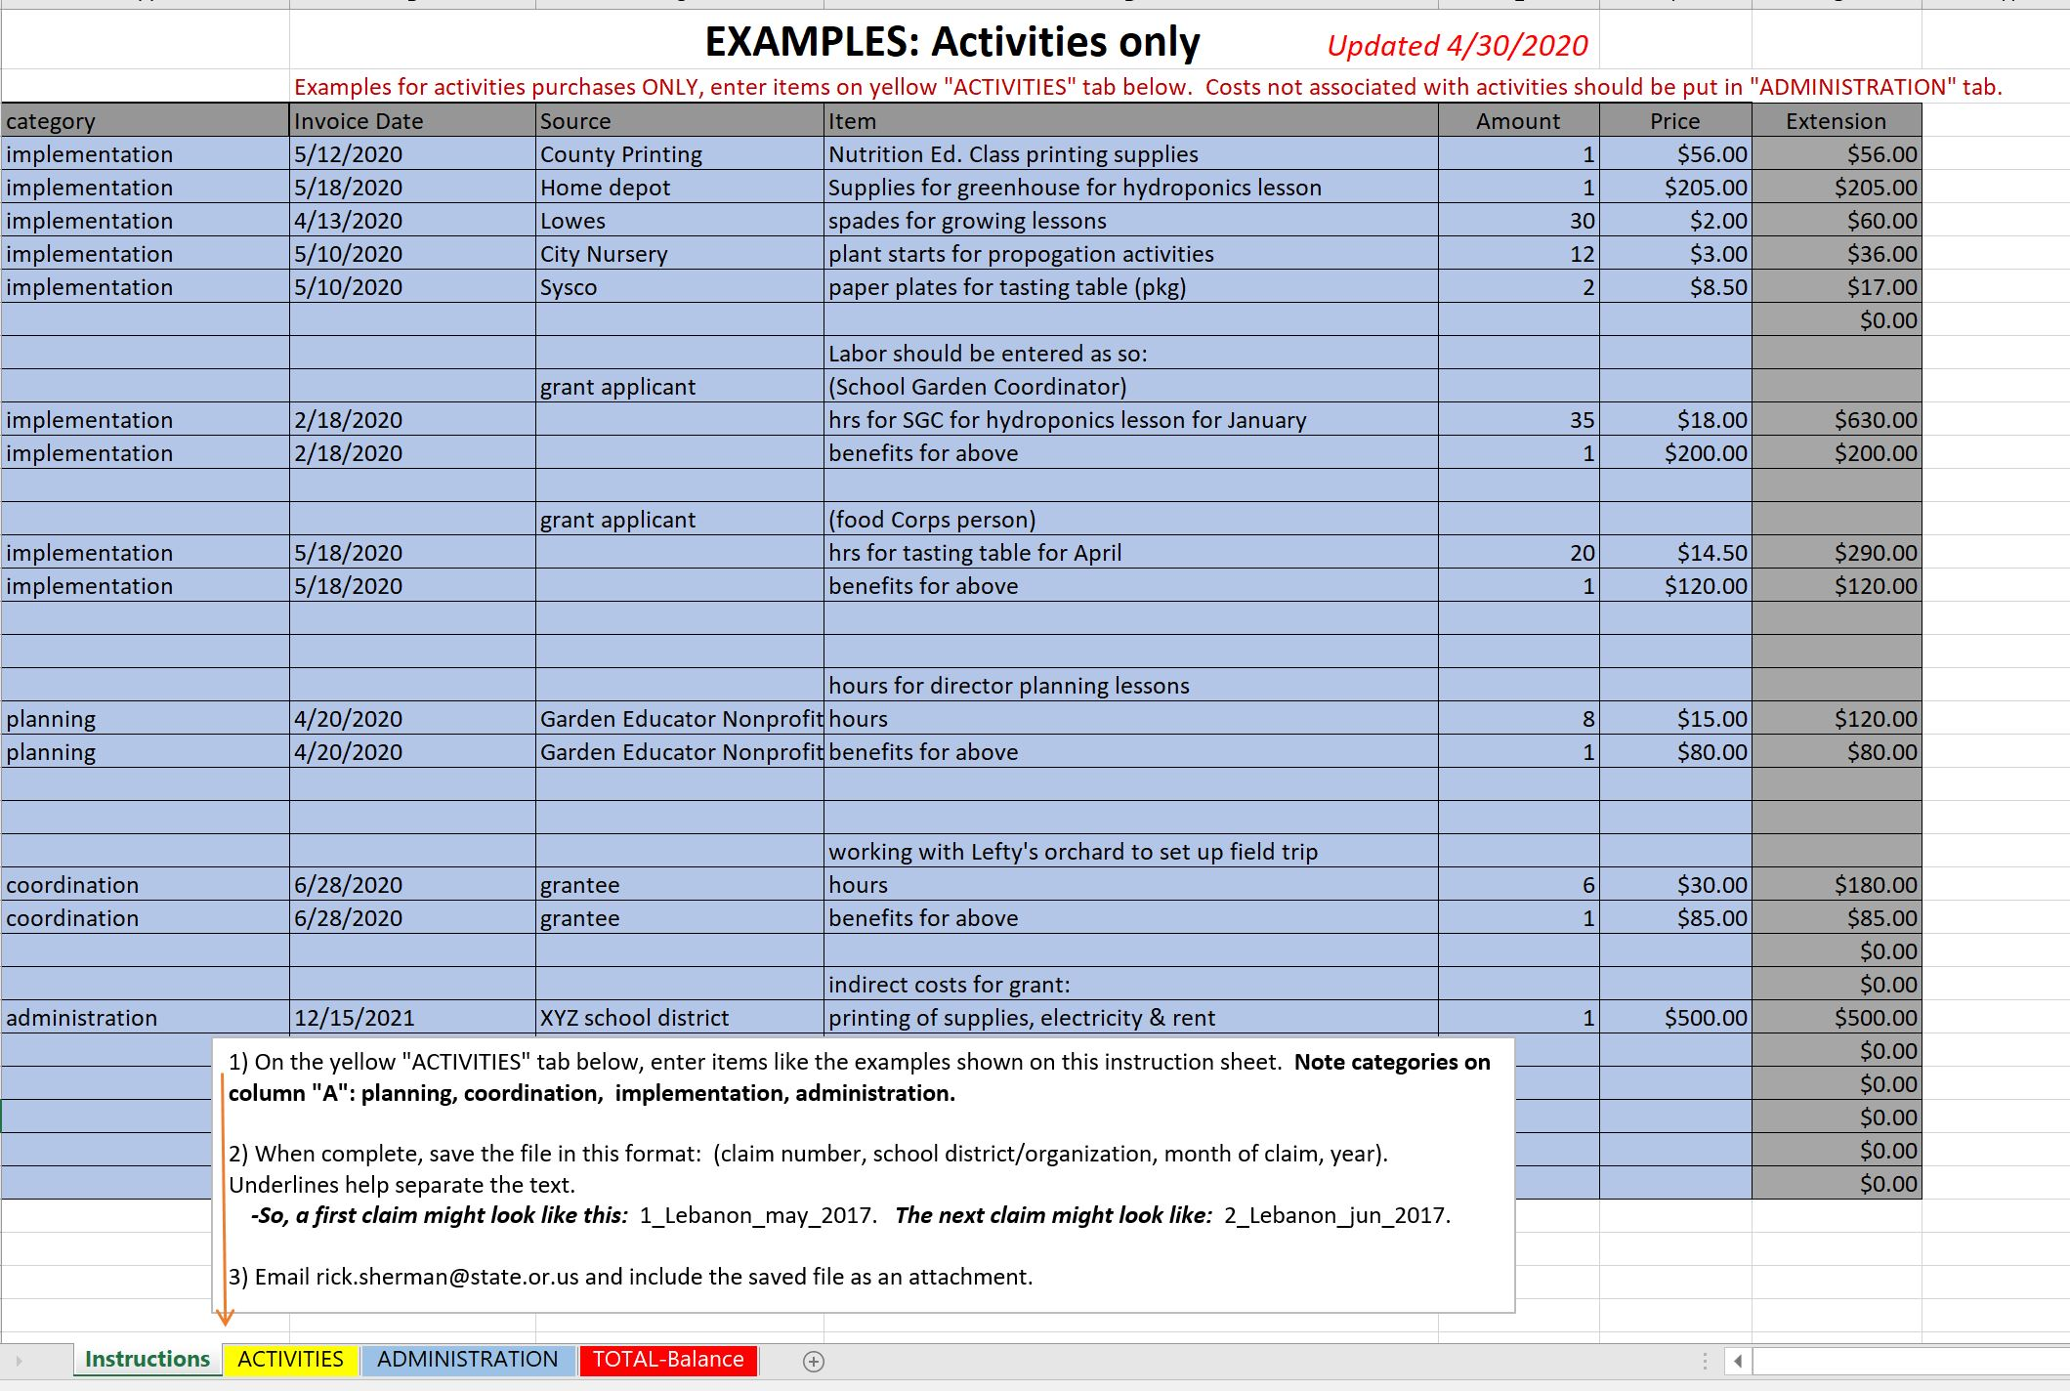
Reimbursement
Examples on instructions tab
Notes:
Examples on instructions tab

Slide 30
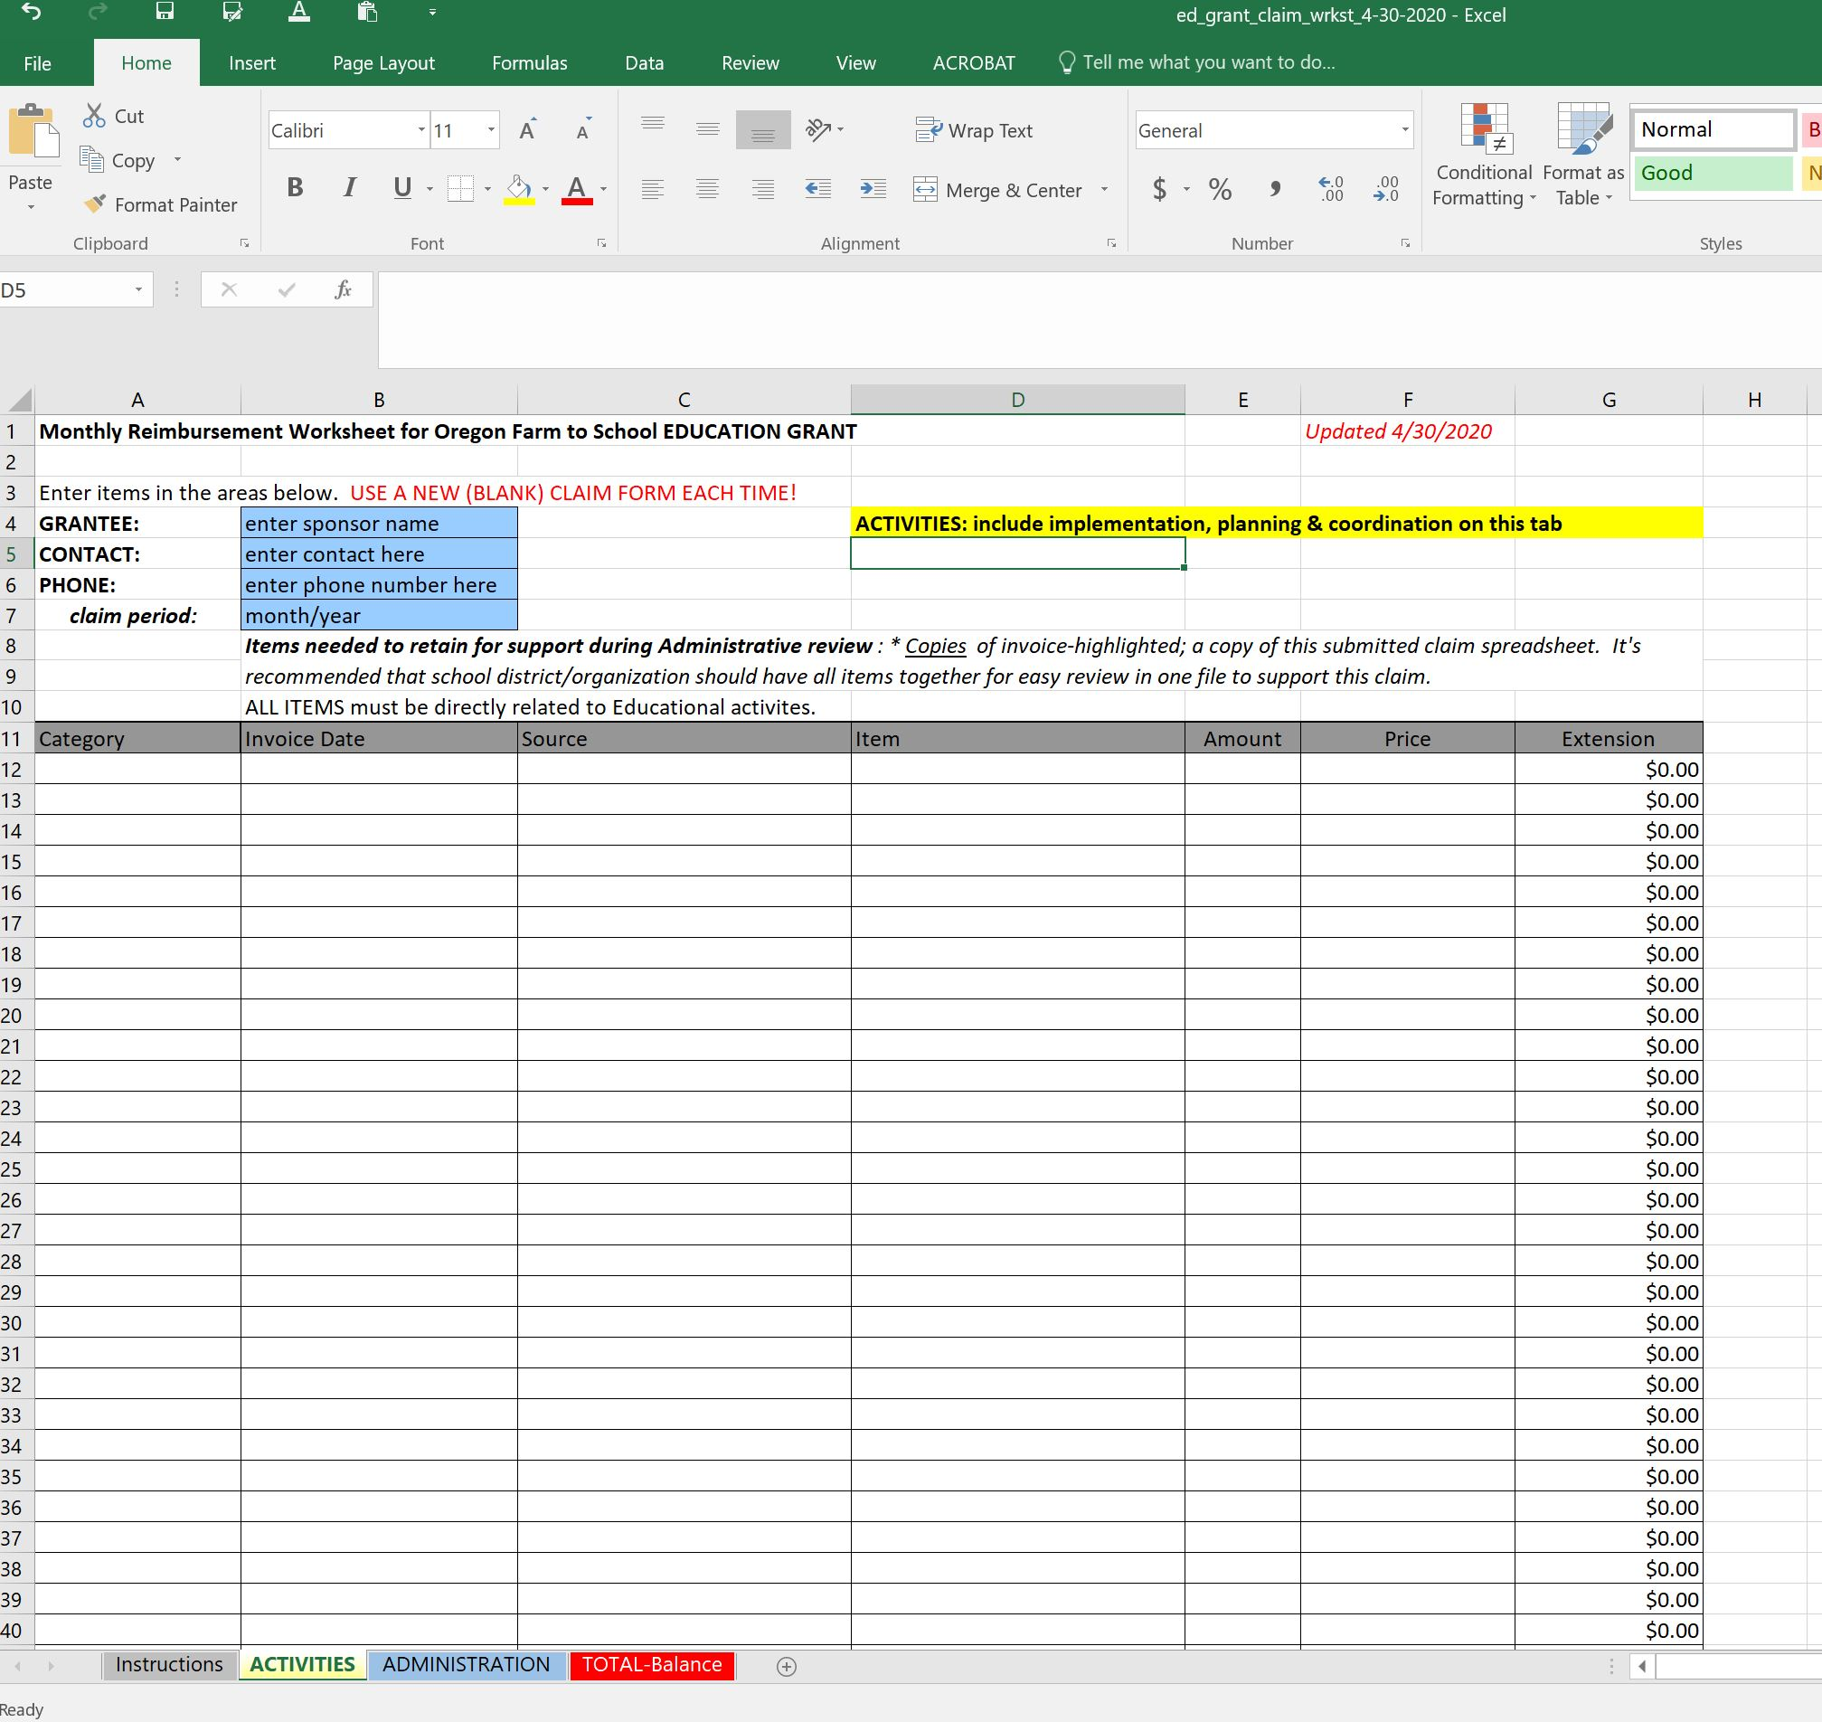
Reimbursement
This is the “activities” tab
Notes:
This is the “activities” tab
All items relating to instructional activities go on this tab. Everything but things not directly relating to the lessons.

Slide 31
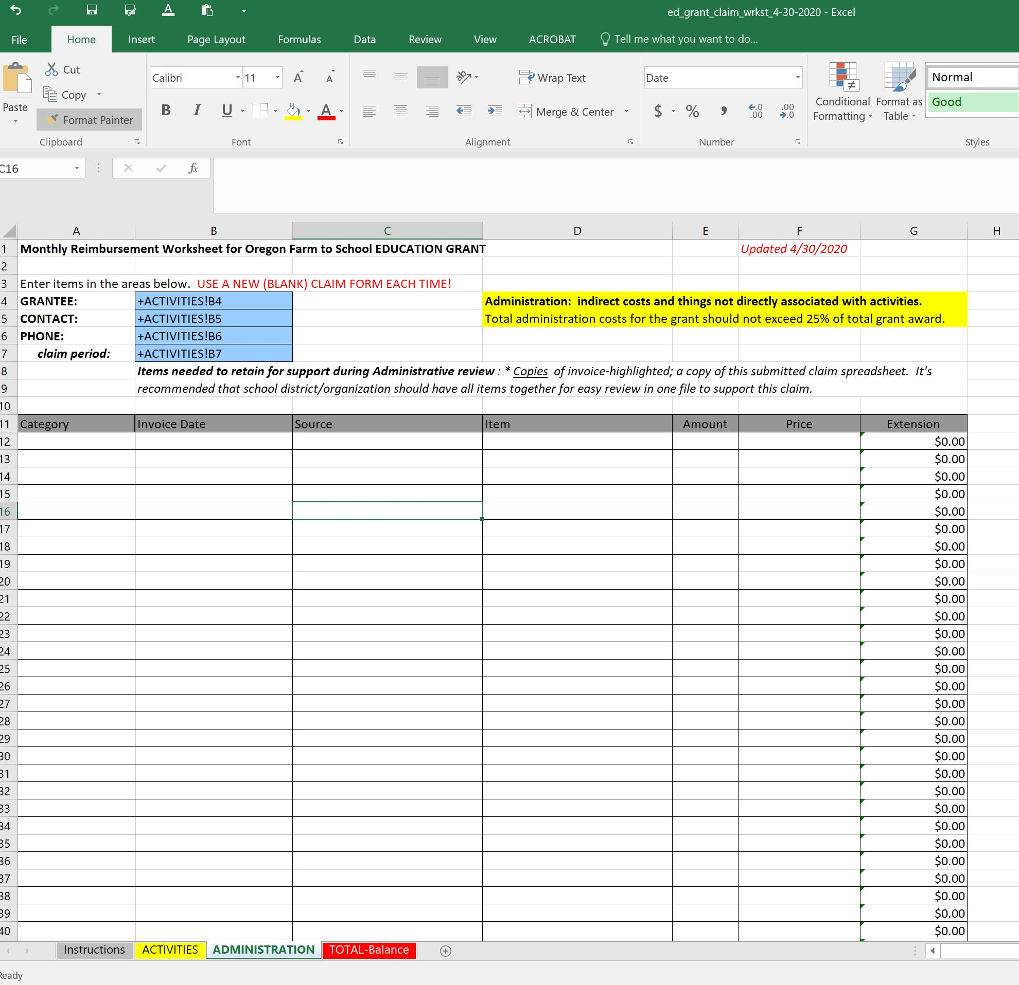
Reimbursement
This is the “administration” tab
Notes:
This is the “administration” tab- used for things not directly relating to instructional activities.
Examples: overhead, rent, indirect costs.

Slide 32
Reimbursement
All items will roll up to the “Totals” tab
ODE will enter previous claims and make sure your balance is correct,
and send the file back to you by email - instructing you to enter the total dollar amount into EGMS.
Notes:
All items will roll up to the “Totals” tab
ODE will enter previous claims and make sure your balance is correct,
and send the file back to you by email - instructing you to enter the total dollar amount into EGMS.

Slide 33
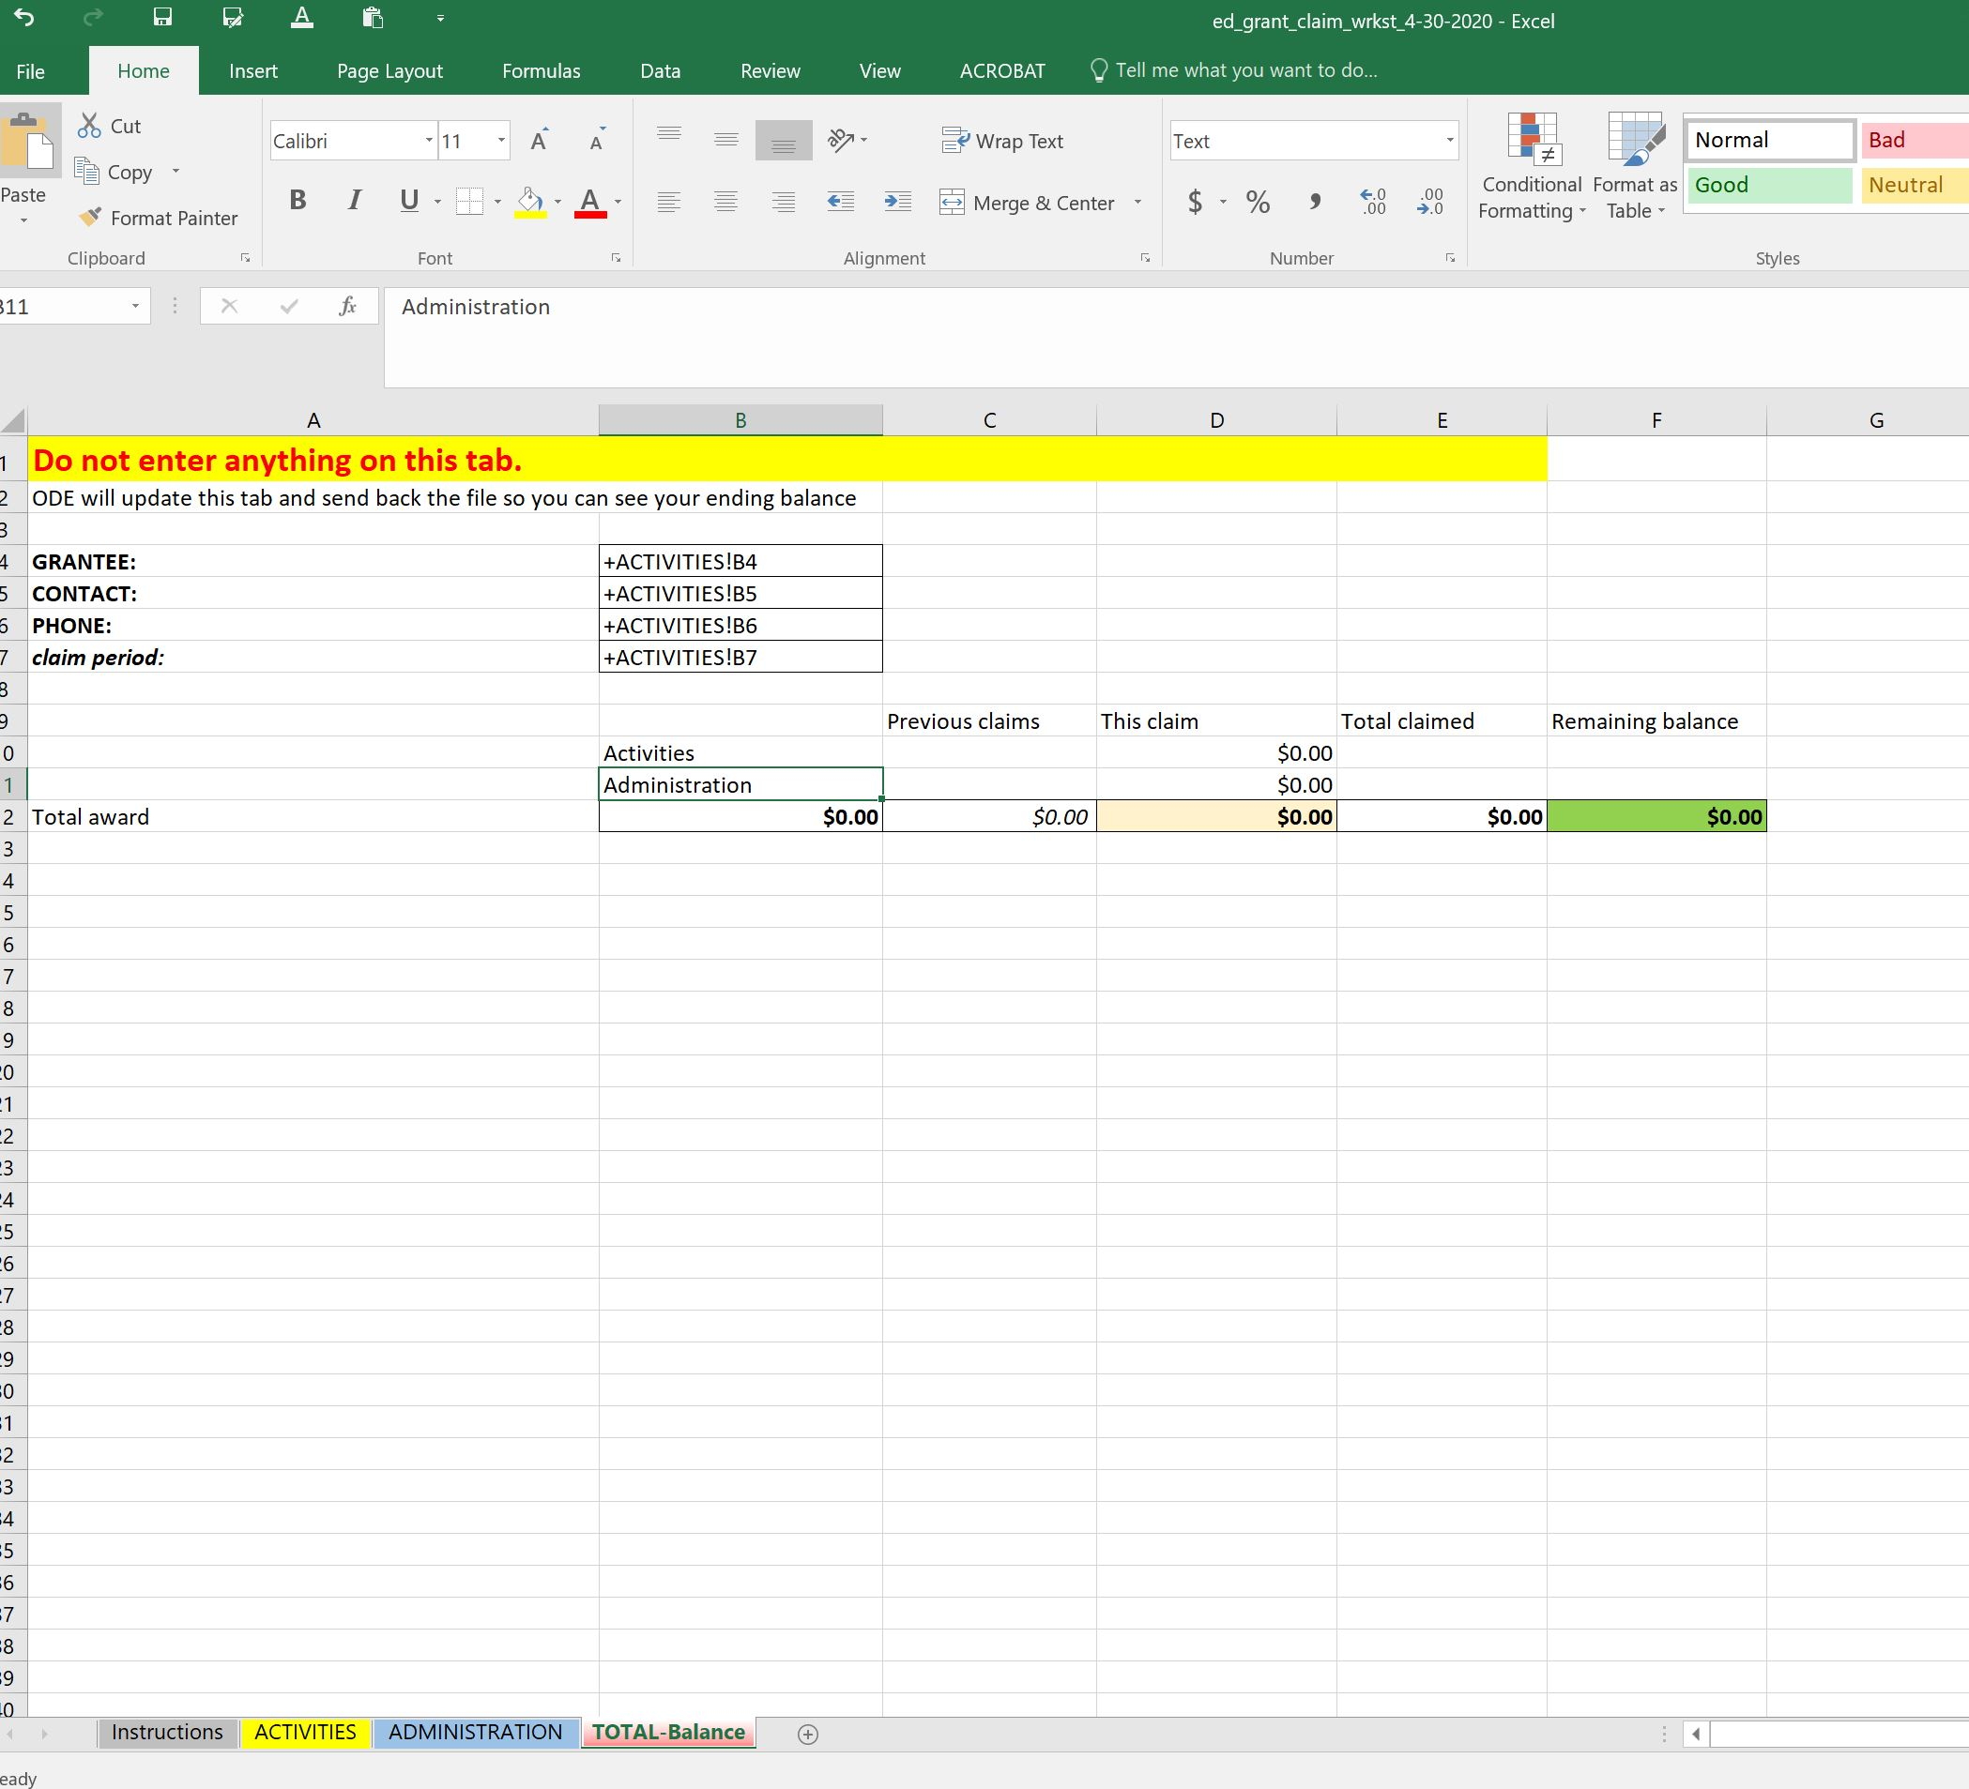
Reimbursement
All roll up to the “Totals” tab
Notes:
All roll up to the “Totals” tab

Slide 34
ADEQUATE PROGRESS
ODE needs to ensure that these funds are spent
If adequate progress isn’t being made, GRANT FUNDS WILL BE TAKEN BACK and redistributed to other sponsors!
Adequate progress = AT LEAST ½ money spent ½ way through; ¾ spent ¾ the way through, etc.
We had problems with this last biennium!
Notes:
ODE needs to ensure that these funds are spent
If adequate progress isn’t being made, GRANT FUNDS WILL BE TAKEN BACK and redistributed to other entities!
Adequate progress = AT LEAST ½ money spent ½ way through; ¾ spent ¾ the way through, etc.

Slide 35
Review
Randomly selected desk audit; not associate with other CNP reviews. If you’re selected,
ODE will select one claim to verify
Copy/scan invoices associated with that claim and send to us at farmtoCNP@ode.Oregon.gov
Notes:
Randomly selected desk audit; not associate with other CNP reviews. If you’re selected,
ODE will select one claim to verify
Copy/scan invoices associated with that claim and send to us at farmtoCNP@ode.Oregon.gov

Slide 36
REPORTING
We have to report back to the legislature of the progress and final outcome of this grant, and this enables us to do so.
Final report survey due September 30, 2023
Notes:
We have to report back to the legislature of the progress and final outcome of this grant, and this enables us to do so.
Progress report survey due September 30, 2023
Final report survey due September 30, 2021
Google link to take survey, and PDF copies of the reports will be posted on the grant webpage.

Slide 37
REPORTING
Due to this grant being late, no progress report will be required.
For the final report, a link to take survey appears at end of summer 2023
PDF copy of the report will be posted on the grant webpage.
Can print out the pdf copy to refer to it as you collect data required for the report.
Notes:
Due to this grant being late, no progress report will be required.
For the final report, a link to take survey appears at end of summer 2023
PDF copy of the report will be posted on the grant webpage.
Can print out the pdf copy to refer to it as you collect data required for the report.

Slide 38
Questions?
Our team can help! Although you can reach any of the Farm to School Team by sending an email to farmtoCNP@ode.Oregon.gov **you can also reach us individually at:
Rick.sherman@ode.Oregon.gov
Amy.williams@ode.Oregon.gov
Alicia.loebl@ode.Oregon.gov
Notes:
Our team can help! Although you can reach any of the Farm to School Team by sending an email to farmtoCNP@ode.Oregon.gov **you can also reach us individually at:
Rick.sherman@ode.Oregon.gov
Amy.williams@ode.Oregon.gov
Alicia.loebl@ode.Oregon.gov

Slide 39
Questions?
REMEMBER to check out our Frequently Asked Questions (FAQ) doc in our resources section on the grant website!!
Notes:
REMEMBER to check out our Frequently Asked Questions (FAQ) doc in our resources section on the grant website!!

Slide 40

Oregon Department of Education “Our Why”
Equity and Excellence for Every Learner
The Oregon Department of Education works in partnership with school districts, education service districts and community partners;
Together, we serve over 580,000 K-12 students;
We believe every student should have access to a high-quality, well-rounded learning experience;
We work to achieve the Governor’s vision that every student in Oregon graduates with a plan for their future.
Notes:
Equity and Excellence for Every Learner
The Oregon Department of Education works in partnership with school districts, education service districts and community partners;
Together, we serve over 580,000 K-12 students;
We believe every student should have access to a high-quality, well-rounded learning experience;
We work to achieve the Governor’s vision that every student in Oregon graduates with a plan for their future.

Slide 41
Oregon Department of Education Education Equity Stance
Education equity is the equitable implementation of policy, practices, procedures, and legislation that translates into resource allocation, education rigor, and opportunities for historically and currently marginalized youth, students, and families including civil rights protected classes. This means the restructuring and dismantling of systems and institutions that create the dichotomy of beneficiaries and the oppressed and marginalized.
Notes:
Education equity is the equitable implementation of policy, practices, procedures, and legislation that translates into resource allocation, education rigor, and opportunities for historically and currently marginalized youth, students, and families including civil rights protected classes. This means the restructuring and dismantling of systems and institutions that create the dichotomy of beneficiaries and the oppressed and marginalized.
Thank you, this concludes this webinar.

