Slide 1

Education Grant Webinar: Introduction

Slide 2


Presented By:
Rick Sherman
Oregon Department of Education
Child Nutrition Programs
Farm to CNP Analyst
Notes:
Welcome to the farm to Oregon Department of Education Child Nutrition Program Education grant for the NSLP. I’m your host, Rick Sherman.

Slide 3


Housekeeping:
The purpose of today’s webinar is for the “EDUCATION” Grant.
For the Reimbursement Grants (for reimbursement of Oregon grown or processed food), there is a separate recorded webinar. Refer to the grant webpage for info on the Reimbursement Grants.
Notes:
The purpose of today’s webinar is for the “EDUCATION” grant.
For the reimbursement grant (for reimbursement of Oregon grown or processed food), we have a separate recorded webinar about that one as well. Refer to the grant webpage for info on that one.

Slide 4
Housekeeping:
This is a recording, so we don’t have the opportunity to field “live” questions.
BUT, don’t worry, we have a Frequently Asked Questions document that probably has your specific question on it. I’ll show you how to access it in a bit. Also, if your question isn’t on there, I’ll tell you how you can get in touch with us to ask.
Notes:
This is a recording, so we don’t have the opportunity to field “live” questions.
BUT, don’t worry, we have a Frequently Asked Questions document that probably has your specific question on it. I’ll show you how to access it in a bit. Also, if your question isn’t on there, I’ll tell you how you can get in touch with us to ask.

Slide 5
Housekeeping:
ALL MATERIALS-including this recorded webinar-can be found on the ODE Farm to CNP website:
www.bit.ly/f2sor
Click on the “Oregon Farm to CNP Grant” section at the top
Notes:
ALL MATERIALS-including this recorded webinar-can be found on the ODE Farm to School website: the fastest way to get here is to go to www.Bit.ly/orf2s . Click on the “Oregon Farm to School Grant” section at the top

Slide 6
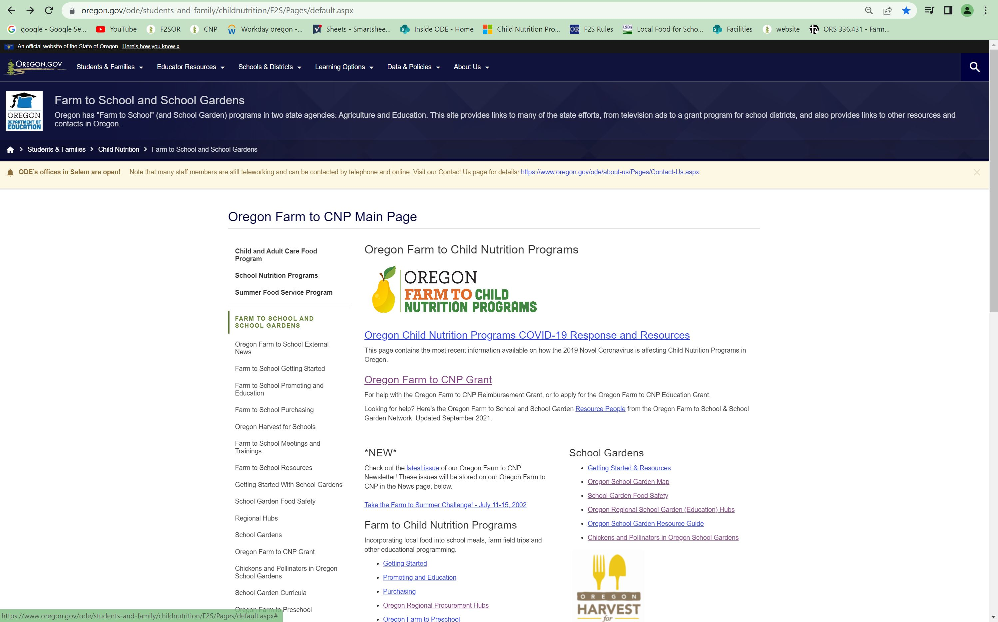
Reimbursement Requirements
Notes:
When you go to the website the top link is for the Oregon farm to school grant

Slide 7
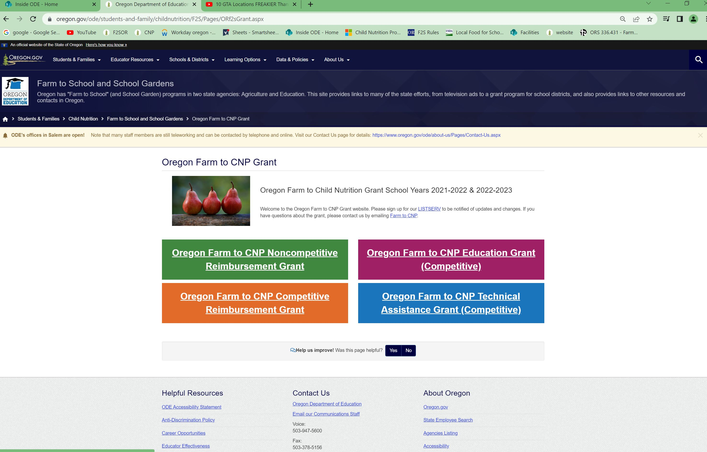
slide
Notes:
Then click on the purple box in the upper right hand corner

Slide 8

MOST IMPORTANT:
Keep checking the website for updates - things change
Click on the “listserv” link on the grant webpage to sign up for our listserv (3,000 subscribers and counting! )
This is a requirement to participate in the grant, as it is the preferred method to communicate to the field for important changes.
Notes:
Keep checking the website for updates as things change. Click on the “join us” link on the grant webpage to sign up for our listserv. This is a requirement to participate in the grant, as it is the preferred method to communicate to the field for important changes

Slide 9
Housekeeping:
Email for help- This will go to the Farm to CNP team - Rick, Amy and Alicia: farmtoCNP@ode.Oregon.gov **
You can still email us individually:
rick.sherman@ode.Oregon.gov
amy.williams@ode.Oregon.gov
Alicia.loebl@ode.Oregon.gov
This grant ends at the end of next school year:
2022-2023 (the rest of this summer and next school year)
Notes:
New email for help! This will go to myself, AJ and yet-to-be-hired second assistant: farmtoCNP@state.or.us
You can still email us individually: rick.sherman@state.or.us amy.williams@state.or.us Alicia.loebl@ode.Oregon.gov
This grant ends at the end of next school year:
2022-2023 (the rest of this summer and next school year)

Slide 10
AGENDA
Overview / Intro
Application process / Timeline
Requirements for application / Scoring
Allowable/unallowable costs
Reimbursement process & requirements
Reporting
Notes:
Overview / Intro
Application process/timeline
Requirements for application, scoring
Allowable/unallowable costs
Reimbursement Process & Requirements
Reporting
Questions

Slide 11
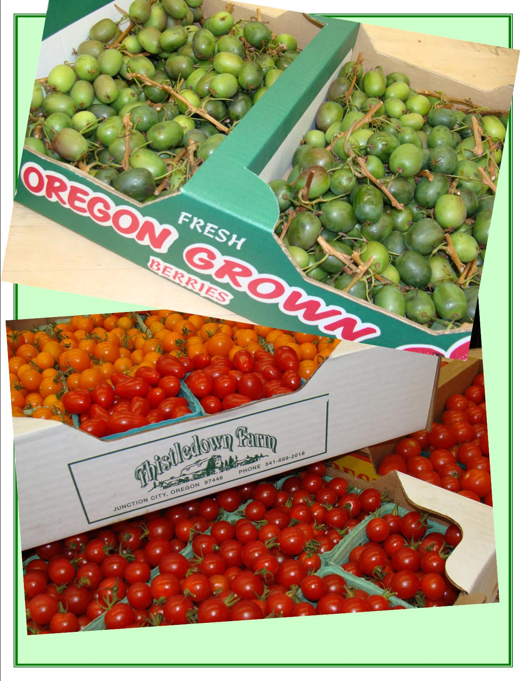
House Bill 2579
Directs ODE to award grants to Oregon school districts and other eligible orgs. for (reimbursement of costs incurred in purchasing Oregon food products that meet certain criteria) and for coordinating and implementing food-based, agriculture-based and garden-based educational activities
Notes:
HB 2579 was from the previous biennium (2019-2021), which the budget for this was renewed. Directs ODE to award grants to Oregon school districts for (reimbursement of costs incurred in purchasing Oregon food products that meet certain criteria) and for funding food-based, agriculture-based and garden-based educational activities

Slide 12
House Bill 2579
This is a COMPETITIVE GRANT!
Notes:
This is a Competitive Grant!

Slide 13
Who’s Eligible?
Eligible sponsors:
School Districts
Nonprofit organizations
Commodity commissions or councils
ESD’s
Federally recognized Indian Tribes
Schools overseen by the Bureau of Indian Education
Soil & Water Conservation Districts
Notes:
Eligible sponsors:
School Districts
Nonprofit organizations
Commodity commissions or councils
ESD’s
Federally recognized Indian Tribes
Schools overseen by the Bureau of Indian Education
Soil & Water Conservation Districts

Slide 14
Who’s Eligible?
Eligible sponsors:
Providers of center-based programs for children in the Child and Adult Care Food Program (CACFP)
Producers of food produced or processed in (Oregon) including farmers, ranchers and seafood harvesters (more on this next slide)
-Organizations may partner with each other
Notes:
Eligible sponsors:
Providers of center-based programs for children in the Child and Adult Care Food Program (CACFP)
Producers of food produced or processed in (Oregon) including farmers, ranchers and seafood harvesters (more on this next slide)
-Organizations may partner with each other

Slide 15

Who’s Eligible?
Notes:
For those of you who are producers or work with producers such as non profit organizations, commodity commissions ,or farm associations this funding is available to provide agricultural, food and nutrition education to students and youth in early child care settings, summer food programs, and schools via indoor and outdoor classrooms, garden education environments, farm field trips and more.
Funds cover costs such as curricula and supplies, activity booklets/educational materials, farm field trip expenses such as hand washing stations, shade shelters, outdoor classroom expenses, mileage and transportation, and much more. Funds can also be used for personnel salaries/wages such as teachers, bus drivers, farmers’ time, and educators.
Past grantees include the Albacore Commission, Central Oregon Locavore, Capaces Anahuac Farm, Oregon Ag Link, Oregon Beef Council and Zenger Farm (although many of these were also nonprofit organizations as well) The key here is that the organization in whatever form, must work with an eligible school or childcare center to provide the educational programming.

Slide 16
Who’s Eligible?
Eligible sponsors:
Nonprofits (especially- but everyone):
You MUST be registered with the State of Oregon Business Registry BEFORE you are awarded funds.
Please use that OFFICIAL name when filling out the application. Sometimes sponsors go by MANY different names!
Notes:
Eligible sponsors:
Nonprofits (especially- but everyone):
You MUST be registered with the State of Oregon Business Registry BEFORE you are awarded funds.
Please use that OFFICIAL name when filling out the application. Sometimes sponsors go by MANY different names!

Slide 17
Intro
$10.2 million dollars are allocated for the overall farm to school grant.
$3 million is budgeted for this education grant portion this round
This is a competitive grant
Mini Grants: Up to 20 awarded of $2,000-$10,000 each*
Full grants: Up to 28 awarded of $10,001 - $100,000.*
Notes:
$10.2 million dollars are allocated for the overall farm to school grant.
$3 million is budgeted for this education grant portion this round
This is a competitive grant
Mini Grants: Up to 20 awarded of $2,000-$10,000 each
Full grants: Up to 28 awarded of $10,001 - $100,000.

Slide 18
Intro
*NOTE: This is a somewhat fluid estimate. We anticipate a lot of applications. We reserve the right to award more or less awards based on
Quality of applications received
Quantity of applications received
Dollar amounts of applications received (many times applicants do not request full amounts)
Leftover budget amounts from other subgrants
Notes:
*NOTE: This is a somewhat fluid estimate. We anticipate a lot of applications.. We reserve the right to award more or less awards based on
Quality of applications received
Quantity of applications received
Dollar amounts of applications received (many times applicants do not request full amounts)
Leftover budget amounts from other subgrants

Slide 19
Intro
We get this question all the time, so here goes:
For Full Grants, the last time we awarded $100,000 awards, The average award funded last time was $69,908;
For Mini Grants: Average: $8,523
Notes:
We get this question all the time, so here goes:
For Full Grants, the last time we awarded $100,000 awards, The average award funded last time was $69,908;
For Mini Grants: Average: $8,523

Slide 20
Intro
AGREEMENT
Once again, our Procurement department handles this application process and the following agreement.
INSURANCE REQUIREMENT
Notes:
AGREEMENT
Once again, our Procurement department handles this application process and the following agreement
INSURANCE REQUIREMENT

Slide 21
Intro
We have a Agreement Template posted on our grant website. You should familiarize yourself with that before applying
If you are successful in getting an award, before you can begin your work you will have to have a signed agreement in place
One of the stipulations is to have insurance in place for that agreement
Notes:
We have a Agreement Template on our grant website posted, you should familiarize yourself with that before you decide to apply
If you’re successful in getting an award, before you can begin your work you will have to have a signed agreement in place
One of the stipulations is to have insurance in place for that agreement

Slide 22
Intro
INSURANCE:
Insurance is required, including:
Workers comp
Commercial General Liability
Automobile liability insurance**
Directors, officers and organization liability
Physical abuse and molestation insurance
See “Exhibit B” at the end of the agreement template & the resources section of the webpage
Notes:
INSURANCE:
Insurance is required, including:
Workers comp
Commercial General Liability
Automobile liability insurance**
Directors, officers and organization liability
Physical abuse and molestation insurance
Check out “Exhibit B” at the end of the agreement template & the resources section of the webpage.

Slide 23
Intro
INSURANCE:
We will have another webinar for successful awardees of the ED grant.
In that webinar and on our website, we will have resources available to help you with the insurance requirements.
(School Districts already have this insurance requirement in place)
Notes:
INSURANCE:
We will have another webinar for successful awardees of the ED grant.
In that webinar and on our website, we will have resources available to help you with the insurance requirements.
(School Districts already have this insurance requirement in place)

Slide 24
Grant Application Process
Must Submit:
RFA (Application)
Budget (Excel)
Budget Narrative (Word) All must be done in original format (no hand-written copies)
All items can be found on grant website in the APPLICATION MATERIALS section.
The EDUCATION GRANT GUIDELINES is a guide that will give you more information to complete the RFA, found in the application materials section.
Notes:
Must Submit:
RFA (Application)
Budget &
Budget Narrative
All items can be found on grant website in the APPLICATION MATERIALS section.
The EDUCATION GRANT GUIDELINES is a step by step guide to complete the RFA, found in the application materials section.

Slide 25
Grant Application Process
This webinar is intended to be an OVERVIEW
The EDUCATION GRANT GUIDELINES doc contains many pages. We will not be going through that page by page, it is your responsibility as an applicant to go through this document.
Notes:
This webinar is intended to be an OVERVIEW
The EDUCATION GRANT GUIDELINES doc contains many pages. We won’t be going through that page by page, it’s your responsibility as an applicant to go through this document.

Slide 26
Grant Application Process
Supporting Resources:
Frequently Asked Questions (FAQ) Document
EGMS (Electronic Grant Management System) instructions
Budget worksheet example
Budget narrative example
Insurance requirements & resources
Examples of previous funded projects
Notes:
Supporting Resources:
Frequently Asked Questions (FAQ) Document
EGMS (Electronic Grant Management System) instructions
Budget worksheet example
Budget narrative example
Insurance requirements & help
Examples of previous funded projects

Slide 27
TIMELINE
Friday, August 5, 2022
Last day to ask questions
Friday, August 12, 2022, 5pm
Completed application due (ODE will email receipt)
Thursday, Sept. 1, 2022–Awards announced- Funds available as soon as we receive signed agreement and you are set up in EGMS
Notes:
Friday, August 5, 2022
Last day to ask questions
Friday, August 12, 2022, 5pm
Completed application due (ODE will email receipt)
Thursday, Sept. 1, 2022–Awards announced- Funds available as soon as we receive signed agreement and you are set up in EGMS

Slide 28
TIMELINE
December 30, 2022 – Progress report due
June 30, 2023 – All funds must be spent and all products must be received
July 24, 2023 – All funds must be processed in EGMS. AFTER JULY 24, ALL UNCLAIMED FUNDS WILL BE LIQUDATED
September 30, 2023– Final report due
Notes:
December 30, 2022 – Progress report due
June 30, 2023 – All funds must be spent and all products must be received
July 24, 2023 – All funds must be processed in EGMS. AFTER JULY 24, ALL UNCLAIMED FUNDS WILL BE LIQUDATED
September 30, 2023– Final report due

Slide 29
Timeline
If successful in being awarded grant funds, an email will be sent to the applicant that includes:
Award amount; and links to
An agreement letter to be signed and returned to ODE
Excel claim reimbursement form
EGMS info and instructions
Once the agreement letter is signed and returned, and you are set up in EGMS, grantees can begin utilizing funds!
Notes:
If successful in being awarded grant funds, an email will be sent to the applicant that includes an:
Award amount; and links to
An agreement letter to be signed and returned to ODE
Excel claim reimbursement form,
EGMS info and instructions (more on this later)
Once the agreement letter is signed and returned, and you are set up in EGMS, grantees can begin utilizing funds!

Slide 30
Requirements
Anyone can fill out the application
The person who has signature authority or can enter into agreements has to be listed in the appropriate section of the application.
Since there could be multiple school districts and other applicants working together on one project, it is important that ALL PARTIES are aware of what is going on.
Notes:
Anyone can fill out the application
The person who has signature authority/can enter into agreements has to be listed in the appropriate section of the application. Since there could be multiple school districts and other applicants working together on one project, it’s important that ALL PARTIES are aware of what’s going on.

Slide 31
Requirements
Does everybody know about the project?
Food Service personnel?
Principals, Superintendent, Business Manager?
If a department or specific entity is proposed, they should be in the loop. EXAMPLE: we had an applicant who filled out the application receive an award. They promptly left their position and no one listed in their proposal were informed of the award.
Notes:
Does everybody know about the project?
Food Service personnel?
Principals, superintendent; business manager?
If a department or specific entity is proposed, they should be in the loop. EXAMPLE: we had an applicant who filled out the application receive an award. They promptly left their position, and everyone listed in their proposal weren’t informed of the award.

Slide 32
Scoring
I will go over the scoresheet in detail in a bit. It is located in the RFA, but in the meantime, here are some highlights:
We have improved the application process! It used to be that applicants wrote a LOT, and the scoring committee was charged with going through the apps with a fine-toothed comb, figuring out how to assign points.
Questions and scoresheets match exactly!
Notes:
I’ll go over the scoresheet in a bit in detail. It’s located in the RFA, but in the meantime, here are some highlights:
We’ve improved the application process! It used to be that applicants wrote a LOT, and the scoring committee was charged with figuring out how to assign points to go through with a fine-toothed comb.
Questions and scoresheets match exactly!

Slide 33
Scoring
The following sections correspond with the Bill that gives this grant authority:
Proposed project & activities are well designed and likely to succeed – 28pts (Note: *activities below should be with students!)
Project promotes healthy food activities* -7 pts
Project has clear educational activities* – 10 pts
Project involves parents and the community – 5 pts
Notes:
The following sections correspond with the Bill that gives this grant authority:
Proposed project & activities are well designed and likely to succeed – 28pts (Note: *activities below should be with students!)
Project promotes healthy food activities* -7 pts
Project has clear educational activities* – 10 pts
Project involves parents and the community – 5 pts

Slide 34
Scoring
Educational activities are tied to school district’s Farm to CNP Reimbursement Grant activities – 10 pts
Proposed activities are culturally relevant to the students served -10 pts
Project should serve a high percentage of children who qualify for free and reduced -up to 15 pts
Notes:
Educational activities are tied to school district’s farm to school procurement activities – 10 pts
Proposed activities are culturally relevant to the students served -10 pts
Project should serve a high percentage of children who qualify for free and reduced -up to 15 pts (see next slide)

Slide 35
Scoring
Educational activities are tied to school district’s Farm to CNP Reimbursement Grant activities – 15 pts:
Schools where these educational activities take place must benefit High F+R schools.
Schools must be at least 40%
BUT, this is an AVERAGE for all the schools in your project.
Notes:
Educational activities are tied to school district’s farm to school procurement activities – 15 pts:
Schools where these educational activities take place must benefit High F+R schools.
Schools must be at least 40%
BUT, this is an AVERAGE for all the schools in your project.

Slide 36
Scoring
We use January 2020 data
You used to be able to look up your school(s)
That service is no longer available
Contact us at farmtoCNP@ode.Oregon.gov to request this information.
Notes:
We use January 2020 data
You used to be able to look up your school(s)
That service is no longer available
Contact us at farmtoCNP@ode.Oregon.gov to request this information.

Slide 37
Scoring
Bonus points:
First time applicant (5 pts)
Tribal (10 pts)
ESD/Producer (5 pts)
Innovative/high priority funding (5 pts)
Notes:
Bonus points:
First time applicant (5 pts)
Tribal (10 pts)
ESD/Producer (5 pts)
Innovative/high priority funding (5 pts)

Slide 38
Scoring
TIP: Do’s and Don’ts:
DO just answer the questions! Answer the question, show how you will accomplish the question, get the points! Keep it simple.
DON’T write five pages of flowery text explaining how awesome you are! Don’t make the scorer SEARCH for the answer. Be succinct and to the point.
Notes:
TIP: Do’s and Don’ts:
Just answer the questions! Answer the question, and show how you will accomplish the question, get the points! It’s that simple. Keep it simple.
Don’t write five pages of flowery text explaining how awesome you are! Don’t make the scorer SEARCH for the answer. Be succinct and to the point.

Slide 39
Reimbursement Requirements
Notes:
This is a screenshot of the first half of the scoresheet the scores use to score your application. A copy of it is in the RFA guidelines/instructions doc.

Slide 40
Reimbursement Requirements
Notes:
This is a screenshot of the second half of the scoresheet.

Slide 41
Allowable/Unallowable Costs
Expenses must fall under the following:
Implementation, planning & coordination
Administration
At least 75% of your award MUST be directly related to food-; Ag-; or garden-based educational activities
The other 25% may be used for other reasonable costs directly related to administering the program (administration)
Notes:
Expenses must fall under the following:
Implementation, planning & coordination
Administration
At least 75% of your award MUST be directly related to food-; Ag-; or garden-based educational activities
The other 25% may be used for other reasonable costs directly related to administering the program (administration)
Please refer to the Frequently Asked Questions document in the resources section on the grant webpage for specific examples

Slide 42
Allowable/Unallowable Costs
Administrative costs:
You must be specific when describing administrative costs. They should relate directly to the lesson or educational opportunity.
Notes:
Administrative costs:
These aren’t to be confused with overhead or Indirect costs, which aren’t allowed. You must be specific when describing administrative costs, they have to relate directly to the lesson or educational opportunity. You can’t claim internet costs, electricity, or general administrative cost

Slide 43
Allowable/Unallowable Costs
Labor: full positions cannot be funded; however broken out labor expenses can be; must be listed as hours x wage rate + benefits. See FAQ for examples.
Equipment: permanent (Capital) equipment is not allowed. Moveable/transportable items could be. See FAQ for examples.
Notes:
At least 80% of your award MUST be directly related to food-; Ag-; or garden-based educational activities
The other 20% may be used for other reasonable costs directly related to administering the program

Slide 44
Reimbursement
This is a reimbursement grant.
However, you may request 25% of your award in the form of an advance.
Thursday, Sept. 15, 2022 – Deadline to request advance
The award notification will have instructions on how to obtain an advance if desired.
You do not HAVE to get an advance.
Notes:
This is a reimbursement grant
However, you may request 25% of your award in the form of an advance.
The award notification will have instructions on how to obtain an advance if desired.
You don’t HAVE to get an advance

Slide 45
Reimbursement
If you do get an advance, you will have to provide documentation of all items that were purchased with those funds. (see “review process” )
There is a deadline of two weeks to request the advance after receiving notice of an award.
After the 25% is spent, the rest of the award converts to the regular “reimbursement” grant management.
Notes:
If you do get an advance, you’ll have to provide documentation of all items that were purchased with those funds. (see “review process” )
After the 25% is spent, the rest of the award converts to the regular “reimbursement” grant management.

Slide 46
Reimbursement Requirements
GRANTEE MUST:
Fill in items on claim worksheet
Submit claim worksheet to Farm to CNP team
Keep invoices, receipts, etc. on hand to justify claim. DO NOT send them in with claims.
Farm to CNP team reviews claim, notifies grantee claim is approved for EGMS entry.
*DO NOT enter claims into EGMS without approval.
Notes:
GRANTEE MUST:
Fill in items on excel worksheet
Submit excel worksheet to ODE
(Keep invoices, receipts, etc. on hand to justify worksheet -do NOT send those to ODE!)
ODE looks over and lets the grantee know that it’s ok to put $ amount in EGMS.
*DO NOT simply put the $ amount in EGMS first!

Slide 47
Reimbursement Requirements
Excel claim worksheet will be located in the RESOURCES section on the grant website.
We will post a new recorded webinar for awardees of the grant with detailed instructions on this process.
The above webinar will be mandatory for all successful awardees.
Notes:
Excel claim worksheet will be located in the RESOURCES section on the grant website.
We will schedule a new webinar for awardees of the grant for detailed instructions on how to do this process
The above webinar will be mandatory for all successful awardees.

Slide 48
Review Process
Randomly selected desk audit; not associate with other CNP reviews. If sponsor is selected,
Farm to CNP team will select one claim to verify.
Sponsor will copy/scan invoices associated with that claim and send to Farm to CNP team.
Notes:
Randomly selected desk audit; not associate with other CNP reviews. If sponsor is selected,
ODE will select one claim to verify
Sponsor will copy/scan invoices associated with that claim and send to ODE

Slide 49
Adequate Progress
ODE needs to ensure that these funds are spent
If adequate progress is not being made, GRANT FUNDS WILL BE TAKEN BACK and redistributed to other sponsors!
Adequate progress = AT LEAST ½ money spent ½ way through; ¾ spent ¾ the way through, etc.
Notes:
ODE needs to ensure that these funds are spent
If adequate progress isn’t being made, GRANT FUNDS WILL BE TAKEN BACK and redistributed to other entities!
Adequate progress = AT LEAST ½ money spent ½ way through; ¾ spent ¾ the way through, etc.

Slide 50
Reporting
We have to report back to the legislature of the progress and final outcome of this grant, and this enables us to do so.
Progress report survey due December 30, 2022
Final report survey due September 30, 2023
Link to survey and PDF copies of the reports will be posted on the grant webpage.
Notes:
We have to report back to the legislature of the progress and final outcome of this grant, and this enables us to do so.
Progress report survey due September 30, 2020
Final report survey due September 30, 2021
Google link to take survey, and PDF copies of the reports will be posted on the grant webpage.

Slide 51
Reimbursement Requirements
Our team can help! Although you can reach any of the Farm to CNP team by sending an email to farmtoCNP@ode.Oregon.gov
**you can also reach us individually at:
Rick.Sherman@ode.Oregon.gov
Amy.Williams@ode.Oregon.gov
Alicia.Loebl@ode.Oregon.gov
Notes:
Our team can help! Although you can reach any of the Farm to CNP team by sending an email to farmtoCNP@ode.Oregon.gov
**you can also reach us individually at:
Rick.Sherman@ode.Oregon.gov
Amy.Williams@ode.Oregon.gov
Alicia.Loebl@ode.Oregon.gov
Any new questions received will be added to our Frequently Asked Questions document on our resources section on the grant webpage.

Slide 52

Oregon Department of Education “Our Why”
Equity and Excellence for Every Learner
The Oregon Department of Education works in partnership with school districts, education service districts and community partners;
Together, we serve over 580,000 K-12 students;
We believe every student should have access to a high-quality, well-rounded learning experience;
We work to achieve the Governor’s vision that every student in Oregon graduates with a plan for their future.
Notes:
Equity and Excellence for Every Learner
The Oregon Department of Education works in partnership with school districts, education service districts and community partners;
Together, we serve over 580,000 K-12 students;
We believe every student should have access to a high-quality, well-rounded learning experience;
We work to achieve the Governor’s vision that every student in Oregon graduates with a plan for their future.

Slide 53
Oregon Department of Education Education Equity Stance
Education equity is the equitable implementation of policy, practices, procedures, and legislation that translates into resource allocation, education rigor, and opportunities for historically and currently marginalized youth, students, and families including civil rights protected classes. This means the restructuring and dismantling of systems and institutions that create the dichotomy of beneficiaries and the oppressed and marginalized.
Notes:
Education equity is the equitable implementation of policy, practices, procedures, and legislation that translates into resource allocation, education rigor, and opportunities for historically and currently marginalized youth, students, and families including civil rights protected classes. This means the restructuring and dismantling of systems and institutions that create the dichotomy of beneficiaries and the oppressed and marginalized.
This concludes our presentation.

