Slide 1
Oregon Farm to School Procurement Grant Webinar
10:00 am Wednesday, October 9
This webinar will begin shortly
Please keep your line muted
If you wish to ask a question you can use the chat feature
I’ll answer the questions at the end of the presentation

Slide 2
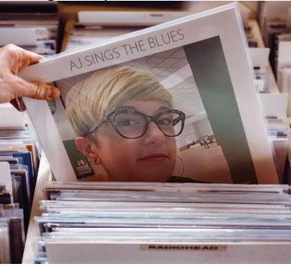
Presented By:
Rick Sherman
Oregon Department of Education
Child Nutrition Programs
Farm to School/School Garden Coordinator
Moderated By:
Amy Jean Williams
Oregon Department of Education
Child Nutrition Programs
Farm to School/School Garden Assistant
Notes:
Welcome to the farm to school procurement grant for the NSLP. I’m your host, Rick Sherman. AJ Williams is at the controls

Slide 3
Intro
The purpose of today’s webinar is for the “PROCUREMENT” grant available to all Oregon school districts and CACFP/SFSP Sponsors
If you’re here for the competitive education grant (for food-; Ag-; or garden-based educational activities ), we will be having a separate webinar about that one as well. Refer to the grant webpage for info on that one.
Notes:
The purpose of today’s webinar is for the “PROCUREMENT” grant available to all Oregon school districts and CACFP/SFSP Sponsors
If you’re here for the competitive education grant (for food-; Ag-; or garden-based educational activities ), we will be having a separate webinar about that one as well. Refer to the grant webpage for info on that one.

Slide 4
Housekeeping:
ALL MATERIALS-including this recorded webinar-can be found on the ODE Farm to School website:
Bit.ly/orf2s
Click on the “Oregon Farm to School Grant” section at the top
Notes:
ALL MATERIALS-including this recorded webinar-can be found on the ODE Farm to School website: Bit.ly/orf2s . Click on the “Oregon Farm to School Grant” section at the top

Slide 5
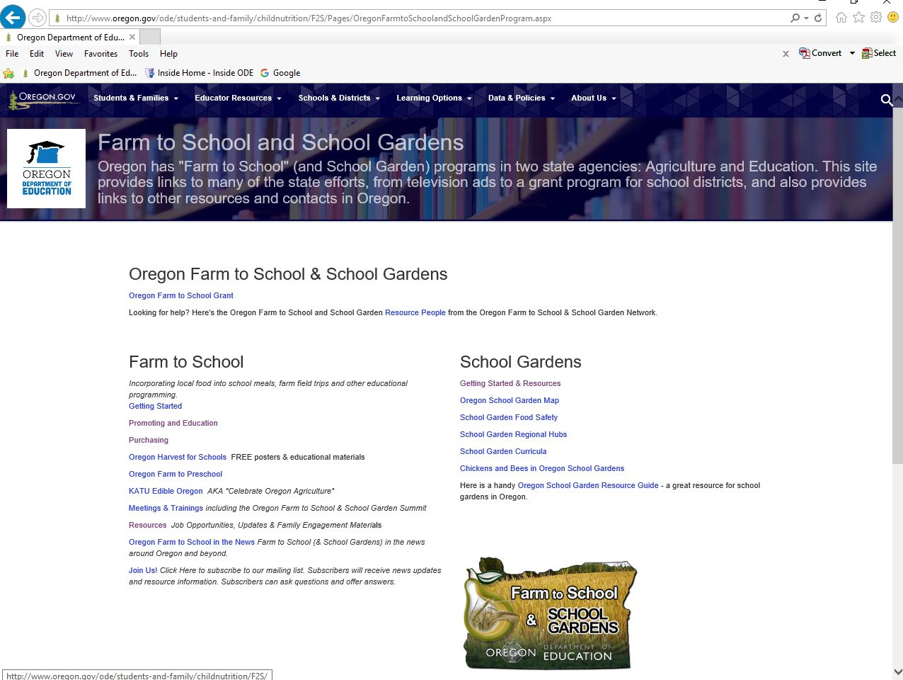
slide
Notes:
When you go to the website the top link is for the Oregon farm to school grant

Slide 6
MOST IMPORTANT:
Keep checking the website for updates as things change
Click on the “join us” link on the grant webpage to sign up for our listserv
This is a requirement to participate in the grant, as it is the preferred method to communicate to the field for important changes.
Notes:
Keep checking the website for updates as things change. Click on the “join us” link on the grant webpage to sign up for our listserv. This is a requirement to participate in the grant, as it is the preferred method to communicate to the field for important changes

Slide 7
Housekeeping:
New email for help! This will go to myself, AJ and yet-to-be-hired second assistant: farmtoCNP@ode.state.or.us
You can still email us individually: rick.sherman@state.or.us amy.williams@state.or.us
This grant is for BOTH school years:
2019-2020 & 2020-2021
Notes:
New email for help! This will go to myself, AJ and yet-to-be-hired second assistant: farmtoCNP@ode.state.or.us
You can still email us individually: rick.sherman@state.or.us amy.williams@state.or.us
This grant is for BOTH school years:
2019-2020 & 2020-2021

Slide 8
AGENDA
Overview: Changes from previous years
Program requirements
Resources, Timeline
Reimbursement Process & Requirements; allowable/unallowable costs
Reporting
Help in sourcing local items
Questions
Notes:
Overview: Changes from previous years
Program requirements
Resources, Timeline
Reimbursement Process & Requirements; allowable/unallowable costs
Reporting
Help in sourcing local items
Questions

Slide 9
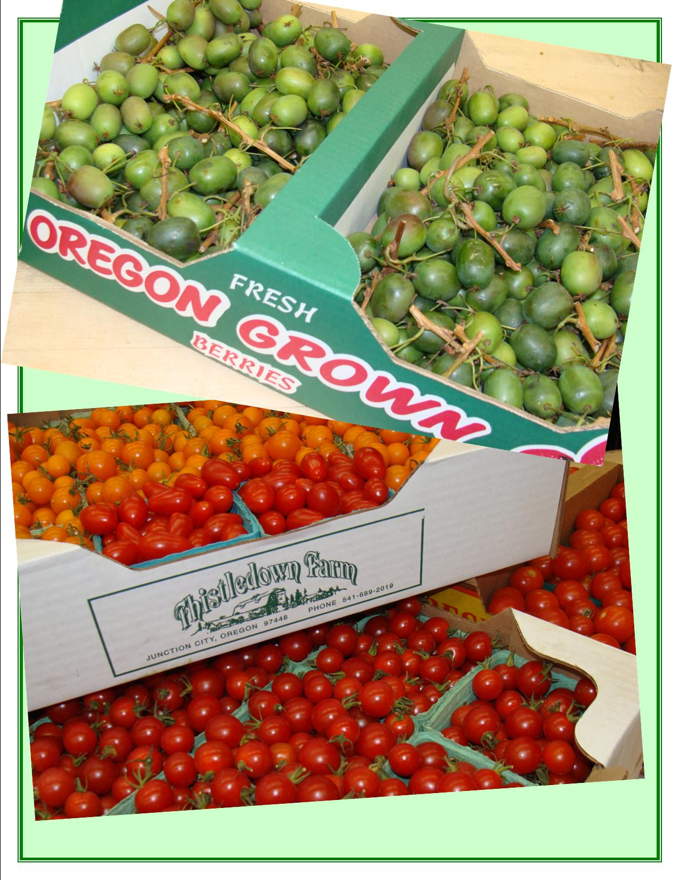
House Bill 2579
Directs ODE to award grants to Oregon school districts for reimbursement of costs incurred in purchasing Oregon food products that meet certain criteria (and for funding food-based, agriculture-based and garden-based educational activities)
Notes:
House bill 2579 Directs ODE to award grants to Oregon school districts for reimbursement of costs incurred in purchasing Oregon food products that meet certain criteria (and for funding food-based, agriculture-based and garden-based educational activities)

Slide 10
What’s new?
FIFTEEN MILLION DOLLARS Allocated for this grant in total!
Approx. $11M for this procurement grant
Automatically opted in everyone at the last minute
Calculation of all meals from last year instead of just lunches to determine award
Formula was lunches, breakfasts (2=1 meal) and snacks 4=1 meal)
Notes:
FIFTEEN MILLION DOLLARS Allocated for this grant!
Approx. $11M for this procurement grant
Automatically opted in everyone at the last minute
Calculation of all meals instead of lunches to determine award

Slide 11
What’s new?
Additional funds available in the form of a competitive procurement grant
Up to a flat 20% for all items that aren’t FOOD- labor, small equipment, delivery, etc.
Addition of CACFP & SFSP Sponsors
Notes:
Additional funds available in the form of a competitive procurement grant
Up to a flat 20% for all items that aren’t FOOD- labor, small equipment, delivery, etc.
Addition of CACFP & SFSP Sponsors

Slide 12
Who Can Participate?
Any public Oregon School Food Authority can participate that participates in NSLP.*
Charter schools can ONLY if they participate in the NSLP.
Any Center-based sponsor of a Child and Adult Food Care Program (CACFP)
Notes:
Charters: Only if language of their charter enables them to
*NOTE: in order to determine a fair and level playing field, NSLP numbers are used to determine the amount of funding for each school district. Therefore, if your district did not participate in NSLP, it cannot be eligible. -however, funds can be used in ANY CNP program: L, B, S, Summer meals.
*NOTE: in order to determine a fair and level playing field, NSLP numbers are used to determine the amount of funding for each school district. Therefore, if your district did not participate in NSLP, it cannot be eligible. -however, funds can be used in ANY CNP program: L, B, S, Summer meals.

Slide 13
Requirements
An email was sent out on around October 1st with your award amount, directing you to the grant webpage for the following:
An addendum agreement letter to be signed and returned to ODE - Note: NSLP sponsors only need to return the NSLP agreement
Attestation form that you’ve attended this training
Notes:
An email was sent out on ____ with your award amount, and links to the following:
An addendum agreement letter to be signed and returned to ODE - Note: NSLP sponsors only need to return the NSLP agreement
Attestation form that you’ve attended this training

Slide 14
Requirements
UPDATE: New requirements have had us to update our agreements. This works out anyway as we’ve had delays with EGMS and haven’t processed any claims yet as of 12/19/19. When you log in to EGMS on your first time, you will check a box to enter into the agreement with ODE.
Notes:
An email was sent out on ____ with your award amount, and links to the following:
An addendum agreement letter to be signed and returned to ODE - Note: NSLP sponsors only need to return the NSLP agreement
Attestation form that you’ve attended this training

Slide 15
Requirements
A baseline data report (for new grantees ONLY)
Most school districts are already set up on ODE’s Electronic Grant Management System (EGMS) , but in case, there’s an information packet on how to get set up on our web page.
A copy of the introductory email is also posted here in case you lost it.
Notes:
A baseline data report (for new grantees)
Most school districts are already set up on ODE’s Electronic Grant Management System (EGMS) , but in case, there’s an information packet on how to get set up on our web page.
If you participated last year, you don’t need to do the baseline data report

Slide 16
Requirements
The Sponsor can then start utilizing funds after all that is received, and begin submitting claims.
NOTE: Not retroactive prior to SY 2019-20.
Notes:
The Sponsor can then start utilizing funds after all that is received, and begin submitting claims.
NOTE: Not retroactive prior to SY 2019-20.

Slide 17
TIMELINE
Now:
Webinar / NSLP
This afternoon/ 1:30 pm
Webinar for CACFP & SFSP
We are no longer able to post webinars on our website due to accessibility regulations.
Notes:
Now:
Webinar / NSLP
This afternoon/ 1:30 pm
Webinar for CACFP & SFSP
This afternoon:
*or soon after, webinars will be posted on grant webpage

Slide 18
TIMELINE
October 30, 2019– Baseline report due
(For first-time grantees only)
September 30, 2020– Progress report due
June 30, 2021 – All funds must be spent and all products must be received
45 days after the above date– All funds must be processed in EGMS (funds liquidated after this date)
September 30, 2021–Final Report due
Notes:
October 30, 2019– Baseline report due
(For first-time grantees only)
September 30, 2020– Progress report due
June 30, 2021 – All funds must be spent and all products must be received
July 31, 2021– All funds must be processed in EGMS (funds liquidated after this date)
September 30, 2021–Final Report due

Slide 19
RESOURCES
On the grant webpage on the left hand side:
Reimbursement worksheet (Excel) claim form
Copies of progress and final reports
(Links will be posted to complete the reports closer to the time when they are required)
Notes:
On the grant webpage under the RESOURCES section:
Reimbursement worksheet (Excel) claim form
Summary of allowable expenses, grant reporting requirements, etc.
Copies of progress and final reports
Links will be posted to complete the reports closer to the time when they are required.

Slide 20
Reimbursement Process
Retain invoices. DON’T send them to me!
Make a copy of the invoice
Hopefully the vendor can list the food as “OREGON” on the invoice.
Highlight the item on the copy
Notes:
Retain invoices. DON’T send them to me!
Make a copy of the invoice
Hopefully the vendor can list the food as “OREGON” on the invoice.
Highlight the item on the copy

Slide 21
Reimbursement Process
There’s a NEW excel claim worksheet for this year, PLEASE USE IT!
Enter the items on the claim worksheet; Fill in all info
Send it to ODE - NEW Email:
farmtoCNP@ode.state.or.us
Notes:
There’s a NEW excel claim form for this year, PLEASE USE IT!
Fill in all info
NEW Email:
farmtoCNP@ode.state.or.us or send to me or Amy.

Slide 22
Reimbursement Process
ODE will look it over and tell you it’s ok to enter the dollar amount into EGMS.
ODE will send reply with the last tab filled out that will give you your balance.
I’ll show you what this looks like on an upcoming slide.
Notes:
ODE will look it over and tell you it’s ok to enter the dollar amount into EGMS.
ODE will send reply with the last tab filled out that will give you your balance.
i’ll show you what this looks like on an upcoming slide.

Slide 23
Reimbursement Process
You can claim an item for this grant, but you can’t claim the SAME individual item for:
FFVP
Pilot Project for Procurement of Fresh Fruits & Vegetables
Notes:
You can claim an item for this grant, but you can’t claim the SAME individual item for:
FFVP
Pilot Project for Procurement of Fresh Fruits & Vegetables

Slide 24
Reimbursement Process
Because not all items are available year-round, you don’t necessarily have to submit a monthly claim, but you must show:
ADEQUATE PROGRESS- basically ½ of your funds should be spend ½ way through the grant period and so on
Notes:
Because not all items are available year-round, you don’t necessarily have to submit a monthly claim, but you must show:
ADEQUATE PROGRESS- basically ½ of your funds should be spend ½ way through the grant period and so on

Slide 25
Reimbursement Process
ADEQUATE PROGRESS: if you haven’t been spending your funds based on this, you will be notified and warned
If we don’t hear back from you or there is still no activity after two warnings, FUNDS WILL BE REALLOCATED.
Last year we reallocated over $100,000. We were able to ensure all the money got spent by allocating it to successful sponsors.
Notes:
ADEQUATE PROGRESS: if you haven’t been spending your funds based on this, you will be notified and warned
If we don’t hear back from you or there is still no activity after two warnings, FUNDS WILL BE REALLOCATED.
Last year we reallocated over $100,000. We were able to ensure all the money got spent by allocating it to successful sponsors.

Slide 26
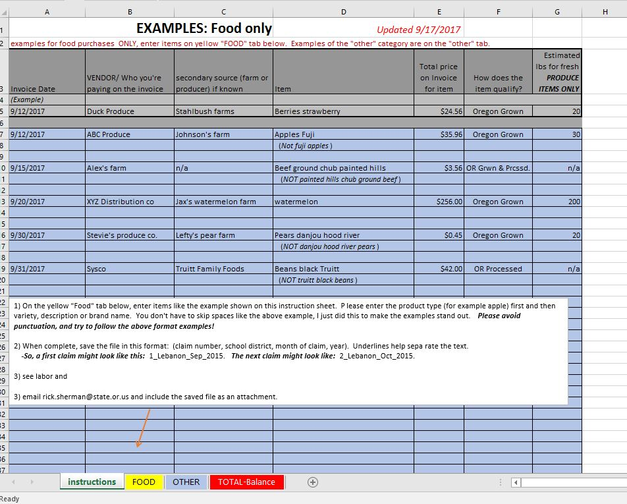
slide
Example on “instructions” tab
Notes:
On the excel claim worksheet, the first tab is the instruction tab. On that tab you’ll find examples of the proper way to enter and format the items. Please avoid punctuation, and enter the item first, then the descriptor. Please save the file as the example. ODE will rename your file in the proper format and send it back to you if you don’t.

Slide 27
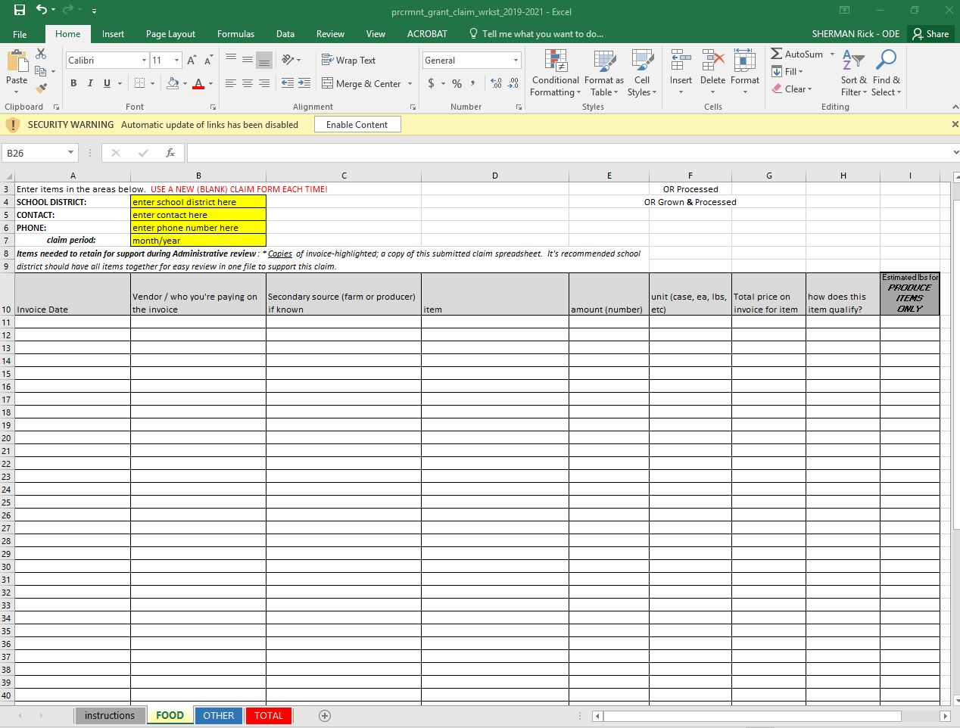
slide
Enter items on “FOOD” tab
Notes:
On the second tab, you’ll enter your food items here. Enter the invoice date, the main vendor – and please if you can the secondary vendor. If you’re buying directly from a farm, you would obviously use the first column (vendor) and leave the secondary source blank.
Put the item on the item column, the amount (like how many cases or lbs in the amount column, the unit or case or pound in column F, (MOST IMPORTANT)and the price on column G. select one of the three options form column H: Oregon Grown, OR Grown & Processed, or OR Processed. Please estimate the pounds for ONLY fresh produce in column H.
You can add lines if you want, it’s not password protected.
With over 400 sponsors, we have less time to redo things so will probably send things back for you to redo if information is left out!

Slide 28
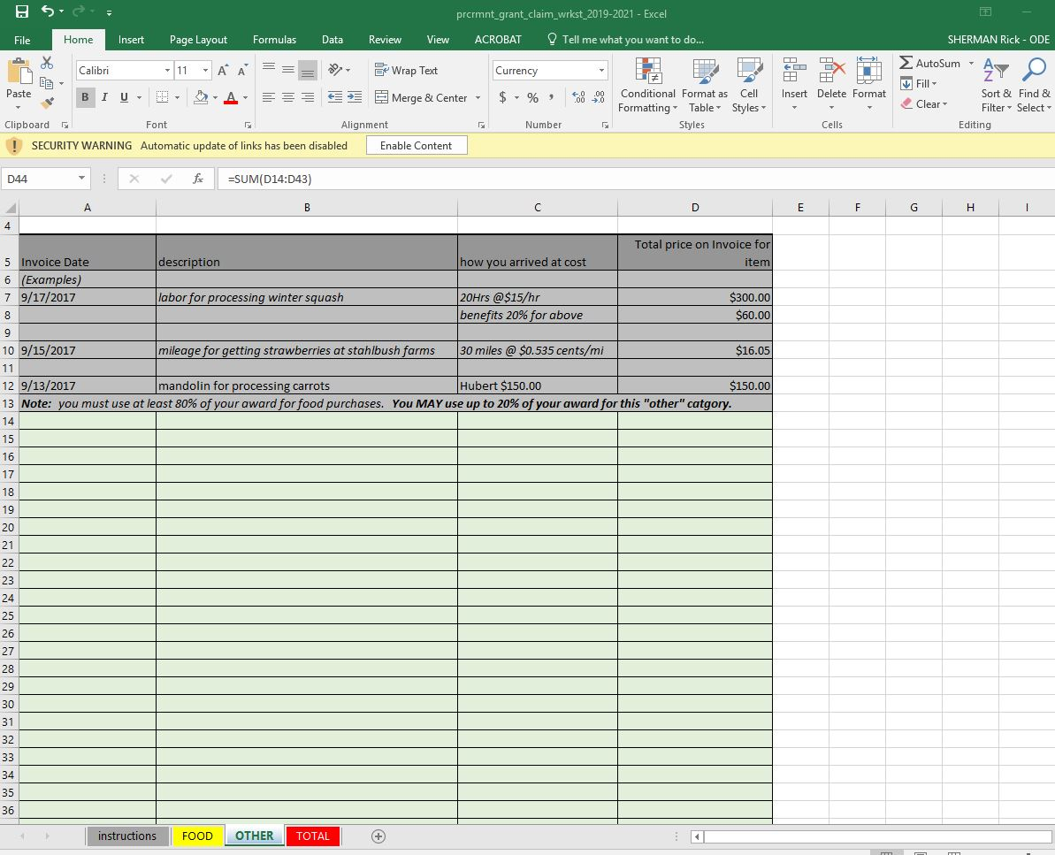
Reimbursement Process
New, simplified “OTHER” tab
Notes:
New simplified tab. Anything other than food goes here: mileage for delivery; labor for processing; small equipment. May use up to 20% of your award for this category.

Slide 29
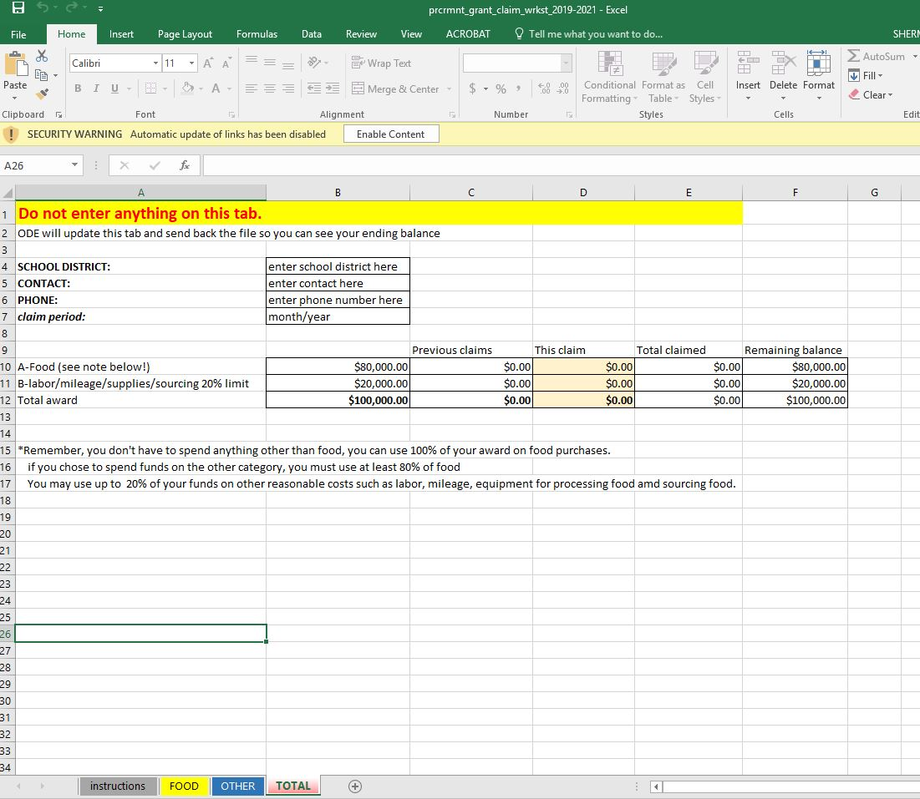
Reimbursement Process
Don’t enter anything on this tab, ODE will fill it out and send it back to you
Notes:
Please don’t put anything on this tab. We’ll do that for you and send it back! Most people get cute and change the formulae and it messes up the program. Your costs from the food and other tabs will flow to here, we will add in your previous claims to give you your remaining balance. This will also track your 20% “other” costs on this tab.

Slide 30
Allowable / Unallowable items
Produced (grown, raised, or caught) in the State of Oregon;
Processed in Oregon
Grown AND Processed in Oregon
Notes:
Produced (grown, raised, or caught) in the State of Oregon;
Processed in Oregon
Grown AND Processed in Oregon

Slide 31
Allowable / Unallowable items
Produced (grown, raised, or caught) in the State of Oregon;
Oregon-grown fruits and vegetables (whole F+V)
Oregon-raised meat
Oregon-caught seafood
Grains grown in Oregon

Slide 32
Allowable / Unallowable items
Processed in Oregon
Items grown, caught or raised OUTSIDE of Oregon, but processed here.
Notes:
Processed in Oregon
Items grown, caught or raised OUTSIDE of Oregon, but processed here.

Slide 33
Allowable / Unallowable items
Grown AND Processed in Oregon
Items grown, caught or raised in Oregon and processed here.
Notes:
Grown AND Processed in Oregon
Items grown, caught or raised in Oregon and processed here.
Some companies source their processed items from Oregon as well.

Slide 34
Allowable / Unallowable items
UNALLOWABLE:
Intent is not to supplant purchases; some items are exclusively local and are “already on the tray” – we don’t want to reimburse those items
Milk in half pints or bulk milk for drinking
Bread, buns rolls
Fruits/veg grown outside of Oregon but only minimally processed here (cut/chopped). Fully processed ok.
Oil, pan spray, butter/margarine, salad dressings.
Notes:
UNALLOWABLE:
Intent is not to supplant purchases; some items are exclusively local and are “already on the tray” – we don’t want to reimburse those items
Milk in half pints or bulk milk for drinking
Bread, buns rolls
Fruits/veg grown outside of Oregon but only minimally processed here (cut/chopped). Fully processed ok.
Oil, pan spray, butter/margarine, salad dressings.

Slide 35
Review Process
Randomly selected desk audit; not associated with other CNP reviews.
Will notify selected sponsors end of October
If you’re selected, ODE will select one claim to verify
Copy/scan invoices associated with that claim and send to farmtoCNP@state.or.us
Notes:
Randomly selected desk audit; not associated with other CNP reviews.
Will notify selected sponsors end of October
If you’re selected, ODE will select one claim to verify
Copy/scan invoices associated with that claim and send to farmtoCNP@state.or.us

Slide 36
HELP in getting items?
Call your distributor you already use
Local Non-profits
Regional procurement hubs
Oregon Farm to School and School Garden Network
Notes:
Call your distributor you already use
Local Non-profits
Regional procurement hubs
Oregon Farm to School and School Garden Network

Slide 37
HELP in getting items?
Farm to School Portal Harvest for Schools Portal
Also you can find the portal by going to the Oregon Harvest for Schools page on the ODE F2S website
Notes:
Farm to school portal is at http://portal.oregonharvestforschools.com

Slide 38
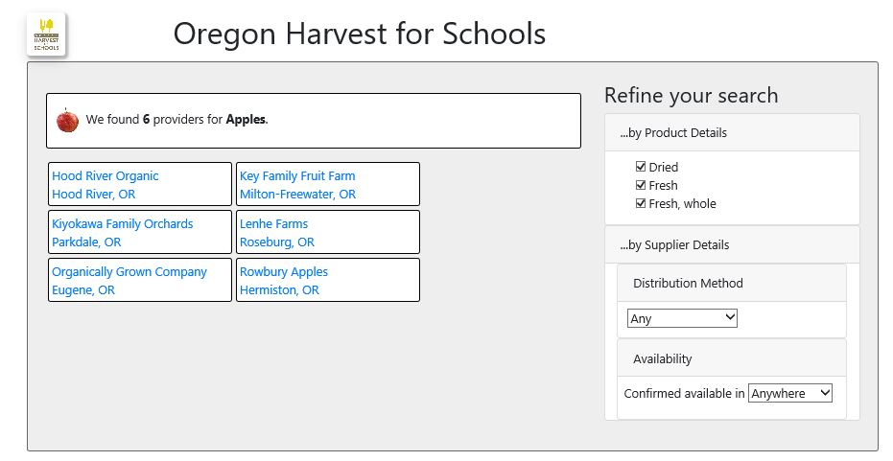
HELP in getting items?

Slide 39
Questions?
Our team can help! Although you can reach any of the Farm to School Team by sending an email to farmtoCNP@ode.state.or.us ** you can also reach us individually at:
Rick.sherman@state.or.us
Amy.williams@state.or.us
(soon to be hired second assistant)
Notes:
Our team can help! Although you can reach any of the Farm to School Team by sending an email to farmtoCNP@state.or.us you can also reach us individually at:
Rick.sherman@state.or.us
Amy.williams@state.or.us
(soon to be hired second assistant)

Slide 40
Questions?
All questions from this session will be put on our website on our Frequently Asked Questions (FAQ) document
Will be updated periodically as more questions are received.
Notes:
All questions from this session will be put on our website on our Frequently Asked Questions (FAQ) document
Will be updated periodically as more questions are received.

Slide 41
Oregon Department of Education “Our Why”
Equity and Excellence for Every Learner
The Oregon Department of Education works in partnership with school districts, education service districts and community partners;
Together, we serve over 580,000 K-12 students;
We believe every student should have access to a high-quality, well-rounded learning experience;
We work to achieve the Governor’s vision that every student in Oregon graduates with a plan for their future.
Notes:
Equity and Excellence for Every Learner
The Oregon Department of Education works in partnership with school districts, education service districts and community partners;
Together, we serve over 580,000 K-12 students;
We believe every student should have access to a high-quality, well-rounded learning experience;
We work to achieve the Governor’s vision that every student in Oregon graduates with a plan for their future.

Slide 42
Oregon Department of Education Education Equity Stance
Education equity is the equitable implementation of policy, practices, procedures, and legislation that translates into resource allocation, education rigor, and opportunities for historically and currently marginalized youth, students, and families including civil rights protected classes. This means the restructuring and dismantling of systems and institutions that create the dichotomy of beneficiaries and the oppressed and marginalized.
Notes:
Education equity is the equitable implementation of policy, practices, procedures, and legislation that translates into resource allocation, education rigor, and opportunities for historically and currently marginalized youth, students, and families including civil rights protected classes. This means the restructuring and dismantling of systems and institutions that create the dichotomy of beneficiaries and the oppressed and marginalized.

