Slide 1

Noncompetitive Reimbursement Grant for Oregon Grown & Processed Foods Mandatory Training
School years 2025/26 - 2026/27
Updated September 2025
Notes:
Welcome to the Oregon Farm to Child Nutrition Programs Noncompetitive Reimbursement Grant (NCRG) Training for the 2025-2027 biennium. This webinar is intended for all Farm to CNP Noncompetitive Reimbursement Grant Awardees who are current NSLP, CACFP and/or SFSP Sponsors in good standing across all child nutrition programs, and viewing is required for both new and past Awardees planning to participate in this grant. An alternative self-guided version is also offered as an option. The information presented will be valuable for anyone involved in ODE Farm to CNP business, purchasing, or programming, as it will cover significant changes to the Grant, as well as provide an overview of the Grant as a whole.

Slide 2
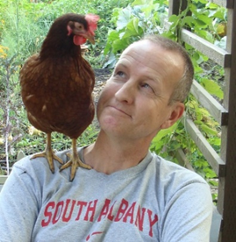


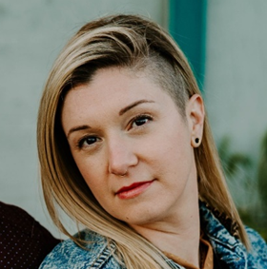
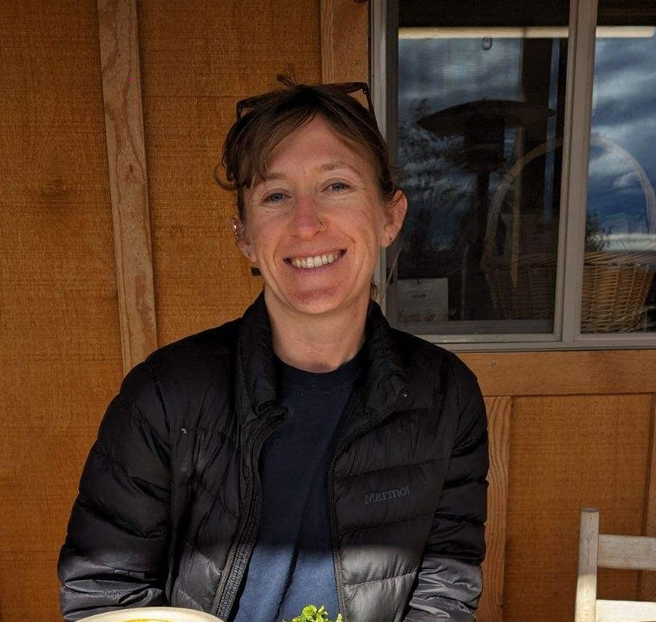
The ODE Farm to CNP Team
Rick Sherman
Program Analyst
Amy Lahrman
Program Analyst
Nadia Kelem
Office Specialist
Notes:
This is our Farm to CNP team here at ODE. We can be reached at the Farm to CNP team inbox at farmtoCNP@ode.oregon.gov.

Slide 3

Who We Serve
547,424 Students*
“My vision is to make sure every child in Oregon is successful and has a safe place to receive a high-quality public education. I’ve seen firsthand how a positive student-teacher relationship can set a child on a successful path for the rest of their life. When we collaborate and build partnerships with students, educators and families we can advance equity and lead all students toward success.”
- Dr. Charlene Williams
More than 360 languages spoken
89,249 Educators
Staff of Color
14% of Teachers
14% of Administrators
20% of Counselors
25% of Educational Assistants
197 Districts
1,270 Schools
131 Charter Schools
19 Education Service Districts
*Numbers represent 2023-24
Notes:
We want to share ODE Director Dr. Charlene Williams’ vision for Oregon’s students. This slide also highlights the diverse backgrounds and experiences of Oregon’s students and staff. By recognizing and respecting this diversity, we can build schools where everyone feels included, supported, and able to succeed.

Slide 4

What is the Farm to CNP Grant Program?
ODE awards these funds to reimburse for:
Costs incurred purchasing Oregon foods meeting a certain criteria
Costs associated with food, agriculture and garden-based educational activities
Costs of providing technical assistance to Farm to CNP Sponsors
Farm to CNP Grants:
Farm to CNP Noncompetitive Reimbursement Grant (NCRG)
Farm ot CNP Competitive Reimbursement Grant (CRG)
Farm to CNP Education Grant
Notes:
Under House Bill 2579, ODE awards grants to eligible NSLP, CACFP and/or SFSP Sponsors, as well as other eligible entities, to reimburse for costs incurred purchasing Oregon foods meeting a certain criteria; costs associated with food-based, agriculture-based and garden-based educational activities; costs essential to providing technical assistance to Farm to CNP Sponsors; and to provide ODE with a Farm to CNP Grant Program evaluation.Within the Farm to CNP Grant Program are six separate components, but only two that we will be concerned about here today - This webinar will only address the Noncompetitive Reimbursement Grant, and the Competitive Reimbursement Grant.
For the 2025-2027 biennium, which includes the 2025-26 and 2026-27 school years, ODE has $10.8 million allocated for the Farm to CNP Grant Program.
Of this amount, $3 million is designated for the Noncompetitive Reimbursement Grant, and $2 million is designated for the Competitive Reimbursement Grant.
The intent of the grant overall is to get Oregon Students access to local food, and to learn where and how it’s grown and ends up in the cafeteria. Oregon Farm to School Leadership is in the process of finalizing our 10 year goals, which will incorporate these grant programs. we will launch the 10-year plan during National Farm to School Month, in October 2025.

Slide 5
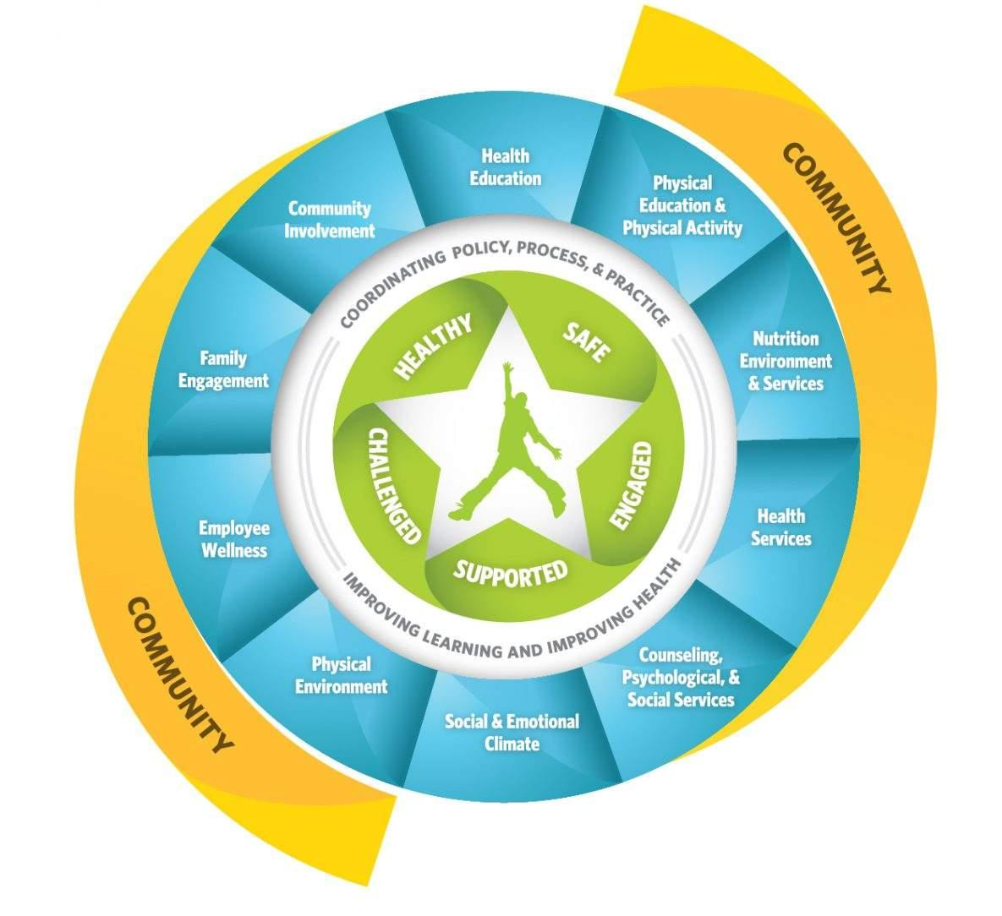
ODE Farm to CNP Grant Program and Whole Child Health
The Oregon Farm to CNP Grant Program supports the CDC's Whole School, Whole Community, Whole Child (WSCC) framework by aligning with several components:
Nutrition Environment and Services
Health Education
Physical Education and Activity
Family Engagement
Community Involvement
Notes:
ODE’s Oregon Healthy Schools work is largely grounded in the CDC’s Whole School, Whole Community, Whole Child (WSCC) framework. The WSCC framework emphasizes that student success depends on safe, supportive environments and coordinated efforts, and can guide schools, families and communities to work together to keep kids healthy, safe, and ready to learn.
Several of the WSCC’s components are supported through the Farm to CNP grant program
Nutrition Environment and Services: This grant program enhances school meals by supporting the incorporation of fresh, locally sourced fruits and vegetables to improve student nutrition.
Health Education: It encourages experiential learning opportunities about healthful eating, food systems, and sustainability through gardening and farm visits.
Physical Education and Physical Activity: Grant activities may promote physical activity through garden-based tasks and outdoor learning experiences.
Family Engagement: Families may be engaged through school garden activities and events, as well as workshops, and communications that encourage healthful eating habits at home.
Community Involvement: The grant program helps build partnerships with local farmers, food producers, and organizations to strengthen community ties and support local agriculture.

Slide 6
Eligibility
Eligible Child Nutrition Program Sponsors are automatically opted in to receive a Farm to CNP Noncompetitive Reimbursement Grant award.
Eligible entities are:
Public School Food Authorities (SFAs) participating in the National School Lunch Program (NSLP)
Center-based Sponsors of a Child and Adult Care Food Program (CACFP)
Sponsors participating in the Summer Food Service Program (SFSP)
“In good standing” in all ODE child nutrition programs
Notes:
Eligible CNP Sponsors are automatically opted in to receive a Noncompetitive Reimbursement Grant award. There is no application process.
Entities eligible are:
Public Oregon School Food Authorities participating in the National School Lunch Program (NSLP)
Center-based Sponsors of a Child and Adult Care Food Program, and
Sponsors participating in the Summer Food Service Program
These entities must be “In good standing” in all ODE child nutrition programs to utilize these grant funds.
If a Sponsor falls out of compliance with any of these programs during the grant period, grant funds may be withheld until the Sponsor regains good standing.

Slide 7
Awards
2025-2027 Grant Awards are:
Valid for the full two-year grant period, from July 1, 2025, through June 30, 2027.
Calculated based on Sponsor’s meal counts from July 1, 2024 - March 31, 2025.
Breakfast: 3=1 meal
Snack: 4=1 meal
Lunch: 1=1 meal
Supper: 1=1 meal
Minimum award $3,500
Notes:
Awards are calculated based on Sponsor meal counts using the meal equivalents shown here. For the 2025-2027 grant period, awards were calculated using meal counts from the period between July 2024 and March 2025.
The minimum noncompetitive award a Grantee will receive is $3,500. Because some Sponsors’ meal counts initially calculate to an award less than that, adjustments are necessary to ensure they receive the minimum award. To balance the grant budget after those increases, awards calculated above $3,500 are reduced by a percentage of their initial calculated amount. We reduce by the smallest percentage needed to ensure funds are distributed fairly and the grant’s impact is maximized for all awardees.

Slide 8
Timeline
July 2025: Informal notification of awards.
Fall 2025: Formal award notification and grant agreements.
Dec. 30, 2025: Adequate spending checkpoint. 25% of total award should be claimed.
Early 2026: Competitive Reimbursement Grant (CRG) app opens.
June 30, 2026: Adequate spending checkpoint. 50% of total award should be claimed.
Sept 30, 2026: Progress Report Due
Dec. 30, 2026: Adequate spending checkpoint. 75% of total award should be claimed.
June 30, 2027: All grant purchases must be made and received.
SATURDAY, Aug. 14, 2027: Grant period ends. All approved claims must be entered into EGMS.
Sept. 30, 2027: Final Report due.
Notes:
The timeline is subject to change. The timeline will be updated and available on the Farm to CNP Reimbursement Grant webpage under Grant Timeline.
-July 2025: Informal notification of awards. These went out to CNPweb contacts on July 21st.
-Fall 2025: Formal award notification and grant agreements.
-Dec. 30, 2025: Adequate spending checkpoint. 25% of total award should be claimed.
-Early 2026: Competitive Reimbursement Grant (CRG) app opens.
-June 30, 2026: Adequate spending checkpoint. 50% of total award should be claimed.
-Sept 30, 2026: Progress Report Due
-Dec. 30, 2026: Adequate spending checkpoint. 75% of total award should be claimed.
-June 30, 2027: All grant purchases must be made and received.
-SATURDAY, Aug. 14, 2027: Grant period ends. All approved claims must be entered into EGMS. Sometimes this date can be “squishy” -especially since this date falls on a saturday. PLEASE please please try to get claims in early. if there are problems in the eleventh hour of this timeframe, we won’t have time to correct errors.
-Sept. 30, 2027: Final Report due.

Slide 9
Other Notable Timing
September 30, 2025: For returning Grantees (participated during the 2023-2025 biennium), the 23-25 Final report is due.
2025-2027 grant period claims will not be reviewed until the 2023-2025 Final Report is submitted.
Report is available on our grant website. Google “ODE Farm to CNP Grant” then go to the first link (OR F2CNP Grant), click on the green box “Noncompetitive Reimbursement grant” then expand the “reporting” box.
Claims for the 2025–2027 grant period may be submitted retroactively for purchases made on or after July 1, 2025, the start of the grant period.
Notes:
On the ODE Farm to CNP grant webpage you can find this information under “Reporting.”

Slide 10
Program Requirements
Mandatory Training + Attestation
Link to attestation will be provided at the end of the training.
Grant Reporting
2023-2025 Final Report: Due Sept 30, 2025
Returning grantees (participated during 2023-2025)
Due Sept 30, 2025
Required to participate in 2025-2027 biennium
Progress Report: Due Sept 30, 2026
All grantees
Required before additional claims are approved
2025-2027 Final Report: Due Sept 30, 2027
Required to participate in 27-29 biennium
Notes:
There are requirements that must be met to participate in the Farm to CNP Reimbursement Grant - Participation in the mandatory grant training, grant reporting, and demonstrating "adequate claiming progress".
Only one attestation submission is required per district or organization; however, ODE strongly encourages all individuals involved in your organization's Child Nutrition Program operations and business functions to participate in one of the trainings.
Reporting: Data collection through grant reports help track progress across the biennium and inform the Oregon Legislature funding decisions. Accurate reporting is essential to the program’s future and is required for all Grantees to access their awards.
Links to these reports and current due dates can be found on the Noncompetitive Reimbursement Grant webpage under Grant Reporting.

Slide 11
Adequate Claiming Progress
Dec. 30, 2025 (1/4 through biennium):
Claim at least 25% of initial award
June 30, 2026 (halfway point of biennium):
Claim at least 50% of initial award.
December 30, 2026 (3/4 through biennium):
Claim 75% of initial award.
Notes:
We do not require monthly claim submissions for the Farm to CNP Reimbursement Grant. However, grantees must demonstrate adequate claiming progress to align with the goals of the grant. This means that claim activity should generally reflect the grant period and the time elapsed within it.
Reallocation of Funds
If a grantee does not show adequate claiming progress:
A portion or the full amount of the award may be redistributed for use by successful Competitive Reimbursement Grant (CRG) applicants.
This action will not occur without warning. Grantees will receive opportunities for technical assistance, and multiple notifications and communication attempts beforehand.
Grantees at risk of losing funds may request an exception by submitting a clear and feasible spending plan. In such cases, a spending plan template will be provided. The Farm to CNP team will review submitted plans to determine next steps.

Slide 12
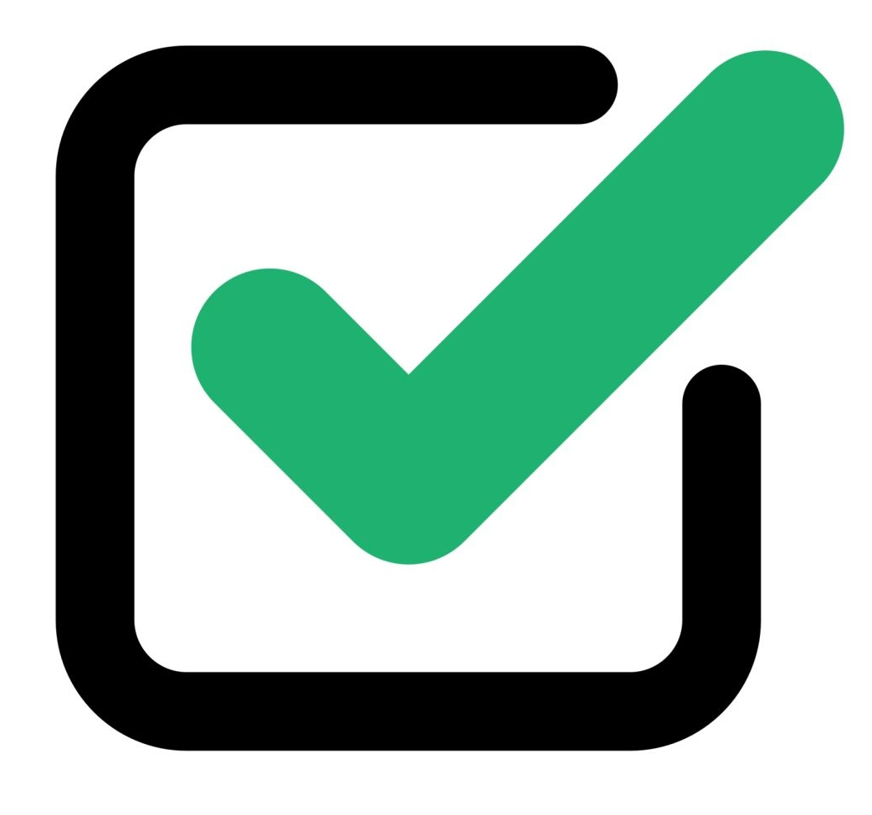
Getting Started
New Grantees (did not participate last grant period)
Returning Grantees (participated last grant period)
Grant payment set up:
ODE Institution ID
EGrant Management System (EGMS) access
Direct deposit
Contact us to find out if you need to get set up.
Grant training
Join the Farm to CNP mailing list
Final report
Grant training
Inform relevant staff of changes and updates
Add new staff to Farm to CNP mailing list
Notes:
Informal award announcements were emailed to your CNPweb contacts on July 21, 2025. These included potential next steps and links to various action items.
New Grantees (did not participate last grant period)
Action items may include getting set up in ODE’s EGrant Management System (EGMS). If you’ve never been paid out of this system before:
Requesting an ODE Institution ID
Requesting login access to (EGMS)
Setting up direct deposit
If you are unsure if your organization is set up in EGMS, contact our team.
Grant training
Join the Farm to CNP mailing list - requirement for NSDs.
Returning Grantees (participated last grant period)
Final report
Training
Inform relevant staff of changes and updates, or better yet, have them participate in a training.
Add appropriate new staff to mailing list.

Slide 13
Keep Your Contacts Up To Date
CNPweb (system of record)
Contact your assigned ODE CNP Specialist to update contacts.
If there are individuals not listed in CNPweb that should also receive Farm to CNP grant communications, email the Farm to CNP team inbox and they will be added to our team’s internal contact list.
EGMS (grant payment system)
This system is not associated with CNPweb.
Download and submit an EGMS Access Request Form to update contacts and/or individual login access. Search “ODE EGMS” for EGMS webpage.
Email ODE.EGMS@ode.oregon.gov or our team for a current list of contacts and individuals with login access.
Notes:
All grantees should ensure their CNPweb contacts are up to date. CNPweb is the system of record, and the Farm to CNP team relies on this information to manage grant agreements and other communications, so maintaining accurate contact details is essential.
To update your CNPweb contacts, please contact your assigned ODE CNP Specialist.
If there are individuals not listed in CNPweb that should also receive Farm to CNP grant communications, please email the Farm to CNP inbox and they will be added to our team’s internal contact list.
EGMS contacts should also be updated as needed. This system is not associated with CNPweb, so your EGMS contacts may differ from your CNPweb contacts. All EGMS-generated correspondence related to subgrants is sent to your EGMS contacts.
EGMS contacts do not necessarily have login access, and vise versa.
Email ODE.EGMS@ode.oregon.gov or our team for a current list of contacts and individuals with login access.
To add, remove, or modify EGMS contacts and login access levels, grantees must complete and submit an EGMS Access Request Form, available on the ODE EGMS webpage. Search “ODE EGMS” for EGMS webpage.

Slide 14
Grant Expenses
75% - Food purchases
(At least.. can be 100%)
25% can be used for reasonable costs incurred for:
Growing, harvesting, transporting, procuring, or processing foods served in your food service programs
Agriculture-based or food and nutrition-based education
Examples: kitchen smallwares, packaging, delivery fees
Notes:
AT least 75% of the award amount has to be spent on food purchases.
Up to 25% of your award can be used for reasonable allowable costs:
-Growing, harvesting, transporting, procuring, or processing foods served in your food service programs
-Agriculture-based or food and nutrition-based education
-Other common examples: kitchen smallwares like a cutting boards or a mandolin, packaging, delivery fees
Email farmtoCNP@ode.oregon.gov for any clarification on what is allowable or unallowable.

Slide 15
Allowable Items
Produced in Oregon (grown/raised/caught)
Processed in Oregon
Produced AND Processed in Oregon
Notes:
Produced products are grown, raised, or caught in Oregon—such as fruits, vegetables, grains, legumes, meats, and seafood. This includes items processed outside Oregon if they contain Oregon-produced ingredients.
Processed products are more than minimally processed* in Oregon, even if the ingredients were grown, caught, or raised out of state. Examples include flour, noodles, tamales, salsa, and sauces
Some items may qualify as both produced and processed if they meet criteria for both categories. For example, tofu made in Oregon from Oregon-grown soy, or dairy products made in Oregon from milk from Oregon-raised cows.
*minimally processed refers to food that has undergone processing that does not fundamentally alter its nature and allows it to retain its inherent character. This includes, but is not limited to: butchering livestock and poultry, cleaning fish, dicing meats, slicing produce, forming ground products into patties, grinding meats, drying or dehydrating foods, and washing produce.

Slide 16
Unallowable Items
Milk for drinking
Bread, buns and rolls
Oils
Pan spray
Butter and margarine
Salad dressings
Fruits and veggies grown outside of Oregon, only minimally processed in Oregon
Tropical fruits and citrus don’t grow in Oregon
NEW starting July 1, 2025
Pizza products (whole or slices, pockets, sticks, bites, crust, dough)
Tortilla products (hard and soft shells, wraps, chips)
Notes:
minimally processed refers to food that has undergone processing that does not fundamentally alter its nature and allows it to retain its inherent character. This includes, but is not limited to: butchering livestock and poultry, cleaning fish, dicing meats, slicing produce, forming ground products into patties, grinding meats, drying or dehydrating foods, and washing produce.
A comprehensive list of allowable and unallowable items can be found on the Farm to CNP Reimbursement Grant webpage under Claim Resources and Documents.

Slide 17
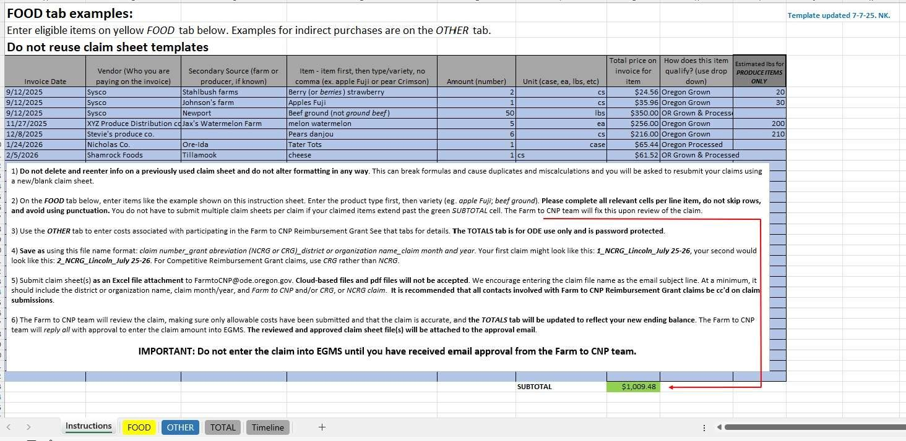
Instructions Tab
Notes:
White section includes Instructions and Guidance. Read through the information when preparing your claims until you are familiar with the claim process
Blue section includes examples of formatting items on the Food tab.

Slide 18
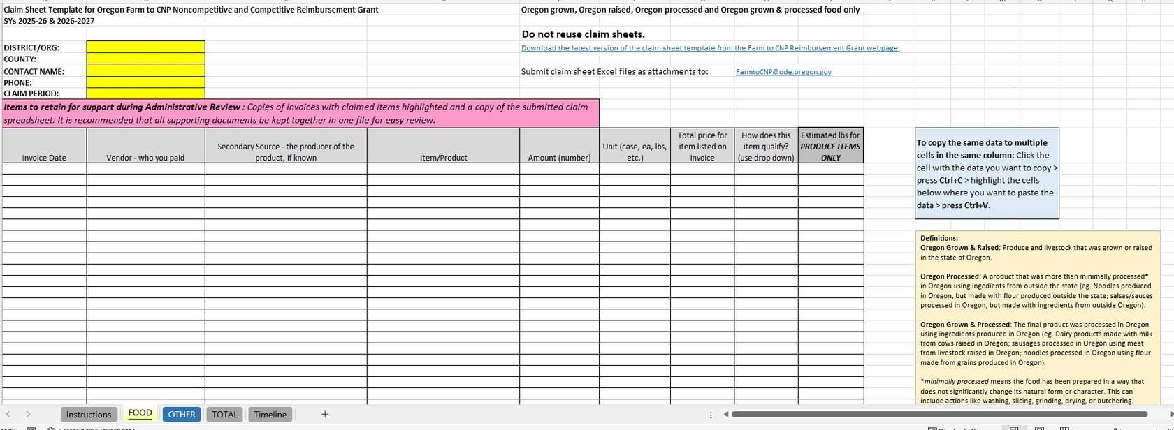
Food Tab
Notes:
All fields on the Food tab must be completed. Do not skip lines.
Make sure you are using the 2025-2027 claim template. Claims submitted on outdated templates will be sent back for resubmission on the new template.
Enter contact info and claim period in the yellow boxes
The light yellow box to the far rights has additional instructions and definitions
In the item/ product column: Enter Item first, then variety. Example: apple Fuji; beef ground. Avoid punctuation.

Slide 19
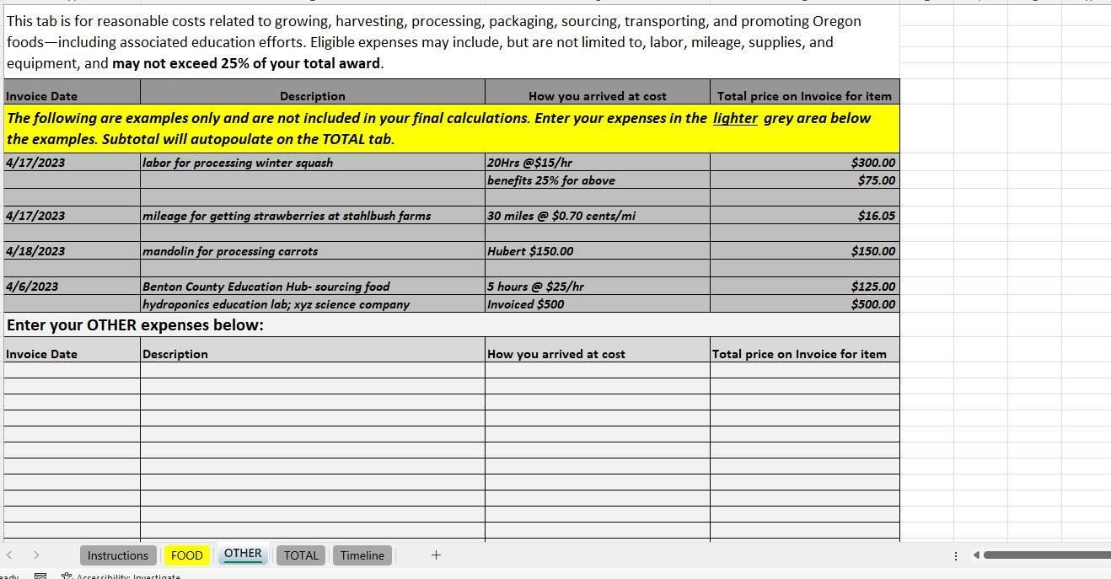
Other Tab
Notes:
Dark grey lines are examples only and are excluded from the subtotal
How you arrived at cost: Break it down. If claiming mileage, break down the calculation here. Other entries may include "as invoiced", or other explanations of how you arrived at the cost. See examples.

Slide 20
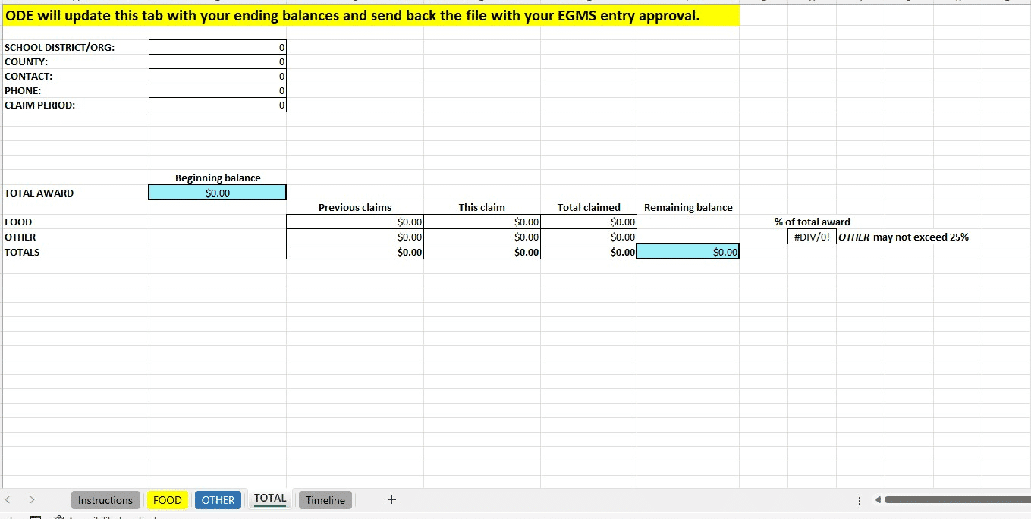
Total Tab
Notes:
ODE will review the claim and update this tab. The reviewed claim sheet, with the updated Totals tab, will be returned with your claim approval email.
Contact info entered on the Food tab will autopopulate on this tab
The year-to-date Other percentage will calculate in the “% of total award” area.. Cannot exceed 25% of total award.

Slide 21
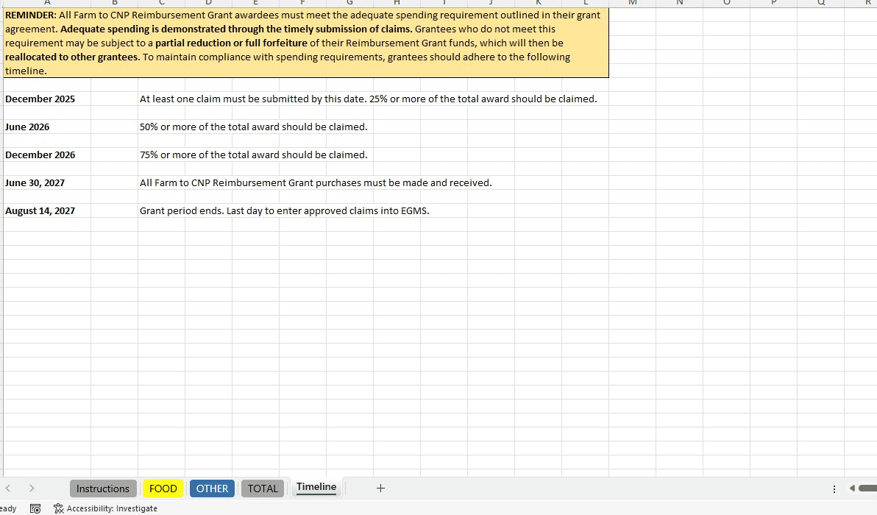
Timeline Tab
Notes:
The timeline tab is a reminder of the timeline of the grant biennium.
Adequate spending schedule
Important dates around the end of the grant period.

Slide 22
Steps to Submit a Claim
Download most recent version of the claim template workbook from the grant webpage under Claim Resources and Documents.
The 2025-2027 template is required.
Do not reuse previously submitted claim sheets.
Outdated or reused templates will be sent back for resubmission.
Complete each relevant tab and save the workbook according to the guidance on the Instructions tab.
Email the completed claim workbook as an Excel file attachment to FarmtoCNP@ODE.Oregon.gov. PDFs or cloud-based files will not be accepted.
It is recommended that all contacts involved with Farm to CNP Reimbursement Grant claims be cc'd on claim submissions.
Notes:
Download most recent version of Farm to CNP Reimbursement Grant claim template workbook from Farm to CNP webpage. You must submit your claims on the 2025-2027 claim template. You can ensure you are using the most updated version by downloading a new claim template for each claim. There are five sheets in the claim template workbook.
Email the claim template as an Excel file attachment to FarmtoCNP@ODE.Oregon.gov.
CC any pertinent contacts on your end that is also involved with FFVP claims.
How to name your file/ title your email is on the instructions tab.
Farm to CNP team reviews the claim and updates the “Total” tab with your current balance.
Farm to CNP team replies to all with approval to proceed:
THEN you may enter your approved claim into EGMS. (not before you receive approval!!)
claims must be submitted for review and pre-approved BEFORE EGMS entry. This is to avoid unnecessary delays in processing due to errors or claims with potential unallowable items or charges. If a claim has already been entered into EGMS and an error is discovered, the claim will have to be rejected, corrected, resubmitted, reapproved and reentered. To avoid this, do not enter claims into EGMS without first receiving approval.
Approved claims in EGMS are batched and processed weekly. Once fully processed, Farm to CNP Reimbursement Grant subgrant recipients are reimbursed through EGMS. Claim payments may take up to two weeks to process after submission.

Slide 23
Steps to Submit a Claim
The Farm to CNP team will review the claim, making sure only allowable costs have been charged and that the claim is accurate, and the Total tab will be updated to reflect your new ending balance.
The Farm to CNP team will reply all with approval to enter the claim amount into EGMS. The reviewed and approved claim workbook file will be attached to the approval email.
Only reviewed and approved claims may be entered into EGMS.
Claims may take up to two weeks to process after submission. Once approval is received you may enter your claim amount into EGMS. Unapproved claims entered into EGMS will be automatically rejected.
Approved claims in EGMS are batched and processed weekly. Once fully processed, Farm to CNP Reimbursement Grant subgrant recipients are reimbursed through EGMS.
Notes:
Download most recent version of Farm to CNP Reimbursement Grant claim template workbook from Farm to CNP webpage. You must submit your claims on the 2025-2027 claim template. You can ensure you are using the most updated version by downloading a new claim template for each claim. There are five sheets in the claim template workbook.
Email the claim template as an Excel file attachment to FarmtoCNP@ODE.Oregon.gov.
CC any pertinent contacts on your end that is also involved with NCRG claims.
How to name your file/ title your email is on the instructions tab.
Farm to CNP team reviews the claim and updates the “Total” tab with your current balance.
Farm to CNP team replies to all with approval to proceed:
THEN you may enter your approved claim into EGMS. (not before you receive approval!!)
claims must be submitted for review and pre-approved BEFORE EGMS entry. This is to avoid unnecessary delays in processing due to errors or claims with potential unallowable items or charges. If a claim has already been entered into EGMS and an error is discovered, the claim will have to be rejected, corrected, resubmitted, reapproved and reentered. To avoid this, do not enter claims into EGMS without first receiving approval.
Approved claims in EGMS are batched and processed weekly. Once fully processed, Farm to CNP Reimbursement Grant subgrant recipients are reimbursed through EGMS. Claim payments may take up to two weeks to process after submission.

Slide 24
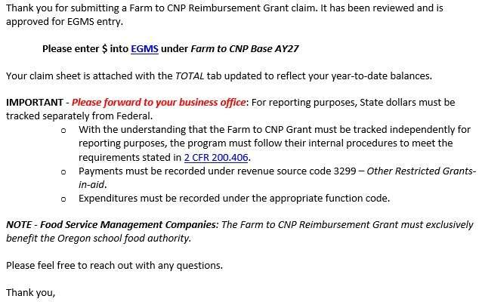
Approval for EGMS Entry
Notes:
Once your claim has been reviewed and approved for EGMS entry you will receive an email with your approval amount (sample email below). The reviewed claim sheet with the Total tabs updated showing your ending balances will be attached to the email for your records.
Claims must be reviewed and pre-approved before they are entered into EGMS.

Slide 25
Processing claims with Contracted Meal Providers
Food Service Management Company: The grantee has a contract with an FSMC and pays a fixed price per meal.
Vended Meals from another CNP Sponsor: Another CNP Sponsor provides the RG grantee with meals.
Vended Meals from Food Manufacturers: The grantee has contracted with a food manufacturer to provide their meals.
The claims process for all three scenarios may vary slightly, but certain requirements remain the same. In all cases, the records provided by the CMP to the grantee must accurately reflect the allowable costs claimed under the RG.
Notes:
Contracted Meal Provider (CMP) is an umbrella term for Food Service Management Companies, second parties, and Vended Meal Contracts. In some cases, grantees do not directly purchase or prepare the food served in their Child Nutrition Programs (CNPs) and instead rely on a contracted meal provider.
More detailed guidance can be found on the grant webpage under Claim Resources and Documents

Slide 26
Competitive Reimbursement Grant (CRG)
Notes:
The Farm to CNP Competitive Reimbursement Grant is an additional funding opportunity for grantees who have used all of their initial Noncompetitive Grant funds.
A portion of the total Farm to CNP Grant Program allocation, along with funds from adjusted awards of grantees who have opted out or are not demonstrating adequate claiming progress, is added to this funding reserve.

Slide 27
Competitive Reimbursement Grant
CRG for short
Unused NCRG funds gets redistributed to this funding stream.
Eligibility:
Sponsor must have received an NCRG award.
Must be at a $0 balance
Rules, claim process, allowables/unallowables are the same as the NCRG.
Separate grant agreement and EGMS subgrant.
RFA projected to open early 2026
Multiple application rounds until funds are exhausted
OR F2CNP Leadership (ODE, Network, Evaluation team) is reviewing the application process.
Expect some changes to application and award prioritization.
Watch the newsletter, listserv, and refer to the Farm to CNP Grant webpage for CRG updates.
Notes:
The Competitive Reimbursement Grant is intended to provide eligible Farm to CNP grantees with additional funding above their original Farm to CNP award amount. These funds are derived from a reallocation process in which the Oregon Department of Education (ODE) redistributes unspent Farm to CNP award dollars from grantees that have determined they are unable to exhaust their original awards.
To be eligible for these funds, applicants must have been awarded a Farm to CNP non-competitive Reimbursement Grant and have spent all of the non-competitive funds.

Slide 28


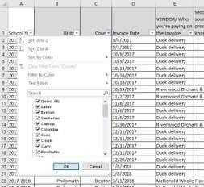

Resources
Oregon Farm to School Network
Regional Technical Assistance Coordinators
ODE's Farm to CNP webpage
Combined Claims Files
On the grant webpage under
Claim Resources & Documents
Filterable Excel file of grantees’ past purchases.
The Oregon Harvest for Schools Directory
Searchable directory of Oregon foods
Notes:
There are many resources available to assist you in successfully utilizing your Farm to CNP Reimbursement grant funds. The Farm to CNP webpage has multiple resources for getting started, promotion and education, purchasing and more, including links to the following resources.
More resources can be found on the ODE Farm to CNP main page
The Oregon Harvest for Schools Directory connects Oregon food producers—farmers, ranchers, fishers, tribal foods, and prepared food providers—with schools and early care sites that are actively searching for more local items to integrate into their meal programs. The Directory boasts more than 120 food businesses who produce more than 45 products.
The Oregon Farm to School Network is dedicated to supporting Farm to School efforts across the state. They have many resources on their website and they can put you in touch with your region's Technical Assistance Coordinator, who can link you with local producers and provide other aspects of Farm to School support.
The 'combined claims' file can be found on the Noncompetitive Reimbursement Grant webpage under Resources for Claims, is the Combined Claims file. This is a large Excel sheet that lists what grantees purchased with their Farm to CNP Reimbursement Grant funds in previous school years. The data can be sorted by county, district, product, and vendor.

Slide 29

An attestation is required for official participation in the grant training. This slide deck is only a reference resource. Grantees must complete the self-guided online training, with the attestation linked at the end.
Notes:
Thank you for completing this training and for all you do to ensure Oregon kids are happy, healthy, and fed!

