Slide 1
Contracting with Food Service Management Companies
All Child Nutrition Programs
7 CFR 210.16
7 CFR 225.15(m)
7 CFR 226.21
7 CFR 250 Subpart D

Slide 2
Benefits of this Training
Varying program regulations
Requests for clarification
Increased AR findings
Opportunity for conversation
Notes:
There are always great reasons to bring sponsors and food service management company contractors together. First, many of the sponsors that currently contract with a Food Service Management Company are School Food Authorities and often sponsor multiple child nutrition programs. Each of the Child Nutrition Programs administered through ODE CNP have varying regulations and requirements pertaining to contracted services. That is often the reason we receive requests for clarification of the roles and responsibilities of sponsors versus those of contractors. In addition, in recent years, findings have increased in areas for which regulation clearly defines the responsible party. With mounting questions and requests, ODE CNP has decided to provide an opportunity to define the roles and responsibilities that USDA has detailed in regulation and also offer space for conversation surrounding those responsibilities.

Slide 3
Objectives
Define Food Service Management Company (FSMC)
School Food Authority (Sponsor) Responsibilities vs. FSMC Responsibilities
Partnership Best Practices
Q & A
Notes:
Keeping that in mind, the objectives for this training is to present the definition of Food service management company from each of the federal Child Nutrition Programs; provide some clarity around the responsibilities of the Sponsor vs. those of the FSMC; to offer best practices for building a successful program partnership, and allow space for questions and discussion.

Slide 4
What defines a Food Service Management Company?
Food Service Management Company (FSMC) means:
NSLP/SBP – A commercial enterprise or a nonprofit organization that is or may be contracted with by the Sponsor to manage any aspect of the school food service. [7 CFR 210.2]
SFSP -Any commercial enterprise or nonprofit organization with which a sponsor may contract for preparing unitized meals, with or without milk, for use in the Program, or for managing a sponsor's food service operations in accordance with the limitations set forth 7 CFR 225.15.
CACFP - An organization other than a public or private nonprofit school, with which an institution may contract for preparing and, unless otherwise provided for, delivering meals, with or without milk, for use in the Program. [7 CFR 226.2]
USDA Foods – A commercial enterprise, nonprofit organization, or public institution that is, or may be, contracted with by a recipient agency to manage any aspect of a recipient agency's food service, in accordance with 7 CFR part 210, 225, or 226. [7 CFR 250.2]
Notes:
For each Child Nutrition Program, the definition of Food Service Management Company varies slightly:
The most important thing to remember is that the sponsor and the FSMC must follow the regulation, specific to the program they are working within. To offer a quick example of the differences in regulations we can look at the definition of a Food Service Management Company.
For National School Lunch and School Breakfast Programs – An FSMC is a commercial enterprise or a nonprofit organization that is or may be contracted by the Sponsor to manage any aspect of the school food service. This is per 7 CFR 210.2 For the Summer Food Service Program – an FSMC is any commercial enterprise or nonprofit organization with which a sponsor may contract for preparing unitized meals, with or without milk, for use in the Program, or for managing a sponsor's food service operations in accordance with the limitations set forth in 7 CFR 225.15.
And for the Child and Adult Care Food Program – an FSMC is an organization other than a public or private nonprofit school, with which an institution may contract for preparing and, unless otherwise provided for, delivering meals, with or without milk, for use in the Program7. as it says in 7 CFR 226.2
In USDA Foods. Food service management company means a commercial enterprise, nonprofit organization, or public institution that is, or may be, contracted with by a recipient agency to manage any aspect of a recipient agency's food service, in accordance with 7 CFR part 210, 225, or 226, or, with respect to charitable institutions, in accordance with this part. To the extent that such management includes the use of donated foods, the food service management company is subject to the applicable requirements in this part. However, a school food authority participating in NSLP that performs such functions is not considered a food service management company. Also, a commercial enterprise that uses donated foods to prepare meals at a commercial facility, or to perform other activities that meet the definition of processing in this section, is considered a processor. (7 CFR 250.2)

Slide 5
What defines a Program Sponsor?
Program Sponsor (Sponsor) means:
School Food Authority
Local Education Agency
Non-Profit Organization
For-Profit Organization
Holds agreement with ODE CNP to operate a Child Nutrition Program
Notes:
One final piece that we would like to define is the term Program Sponsor or “Sponsor”. This is a term that Oregon uses specifically when speaking of a School Food Authority, a Local Education Agency, or a Non or For Profit organization that signs and holds agreements with ODE CNP to operate Child Nutrition Programs. You will hear us refer to sponsors throughout the presentation. When we do, we are referring to the organization that holds that agreement with ODE to operate the Nutrition program.

Slide 6





Agreements and Contract
Federal Procurement Requirements
State Agency Contract Template
State Agency Contract Review
Agreement
Responsible Party
Sponsor is responsible for monitoring and ensuring adherence to the agreement.
Notes:
When an organization decides that they would like to operate any of the child nutrition programs, they must enter into an agreement with ODE CNP. This agreements lays out the overall federal and state requirements of the sponsor. The agreement is made directly between the State and the Sponsor, making the Sponsor the ultimate responsible party for ensuring that all requirements of the agreement are met. Sponsors that have signed an agreement with the state may then decide that they would like to contract out pieces of the foodservice requirements to another organization; a food service management company. Because the USDA has regulations pertaining to contracting foodservices, the sponsor must follow the appropriate federal procurement requirements and use the State Agency Contract Template. In addition, the procurement documentation, contract and resulting award of the contract must be reviewed and approved by the state agency. It is not; however, the state agency’s responsibility to manage either the overall procurement process or the FSMC contract.
In addition, if a sponsor is currently contracting with an FSMC for food service management of a child nutrition program, such as National School Lunch Program, and wishes to add another child nutrition program, such as the At-Risk Afterschool Meals Program – this will constitute as a material change and the sponsor must contact their child nutrition specialist to discuss the procurement implications.
The state agency is responsible for administering and monitoring the adherence to the agreement signed by Sponsor and the sponsor is responsible for monitoring and ensuring adherence to the agreement signed by the Food Service Management company.
But what is the overall breakdown of responsibilities when it comes to the everyday operation of child nutrition programs? Federal regulations provide an answer.

Slide 7
Sponsors Responsibilities
Notes:
Let’s review the Sponsor’s responsibilities

Slide 8
Sponsor Responsibilities – Part 1
The Sponsor should employ a qualified staff person with significant experience in managing Child Nutrition Programs to monitor the contract.
Management of the Program(s)
  May not contract out management of program
  Administrative and Financial responsibility for operation
  Retain signature authority
  Submit claim to State for reimbursement
  Receive and maintain backup documentation for menus, meal claims.
  Maintain applicable health certification for sponsor sites
  Set meal prices and establish a policy for providing meals to students without adequate funds.
Notes:
As a reminder, this is a broad overview of the responsibilities found in regulations. If a sponsor or FSMC has a question as to their responsibilities within a child nutrition program, they should reference the specific programs regulations to ensure they have the most accurate and detailed information.
First, the sponsor (Sponsor) needs to employ a qualified staff person with experience in managing child nutrition programs to monitor the FSMC contract. This person is often the main contact for the State and is the person that is placed in the Food Program Coordinator or Program Manager position in CNPweb. Some of you may ask why this person needs experience in Child Nutrition Programs if the sponsor is contracting out the foodservice management.
The clear answer is that Child Nutrition Programs are much more than just foodservice and the overall management of the program may not be contracted out; therefore knowledge and experience of the programs is essential to ensure that regulations are being met.
Ultimately, the administrative and financial responsibilities remain with the sponsor as does the signature authority. The sponsor is required to submit the claim for reimbursement to the State, collect and maintain all backup documentation for those claims, ensure health and safety certifications are completed at sponsor sites, set meal prices and charging policies.

Slide 9
Sponsor Responsibilities – Part 2
Management of the Program(s)
  Distribute and collect parent letter and free/reduced-price meal application
    Determine eligibility and verify applications*
    Conduct hearings related to determinations
    Maintain confidentiality of all eligibility determinations
  Create and monitor advisory committee made of parent, staff and students to assist in menu planning
  Meet Professional Standards and other training requirements for all staff with child nutrition program duties
  Approve special diets for students where medically necessary
  Implement internal controls and ensure resolution of program review and audit findings.
Notes:
The sponsor must understand the program in order to manage the distribution and certification of free and reduced price applications, process yearly verification of applications, handle appeal hearings and ensure confidentiality of all eligibility determinations.
The sponsor must also set up and monitor a menu advisory committee to assist with menu planning, making sure that there are diverse voices on that committee: parents, staff and students.
The sponsor must manage and ensure that all staff with program related duties meet training requirements for each child nutrition program; and every program has different requirements
Sponsors are responsible for approving special diets for students when medically necessary. This could be through the use of the medical accommodation forms or through 504 plans or IEPs
And when programs are reviewed and findings with corrective action given, the sponsor must implement internal controls to ensure that the findings are resolved and corrective action completed.

Slide 10
Sponsor Responsibilities – Part 3
Oversight of Program(s)
  Monitor program operations as required by each program*
  Review menus to ensure compliance with program requirements
  Examine meal acceptability, wholesomeness
  Review monthly FSMC invoice and compare to primary source documentation
  Ensure all FSMC staff with child nutrition program duties have met annual training requirements
  Maintain all documentation as required for 3 years plus current year
Notes:
In addition to overall management of the program, the sponsor is responsible for oversight of the Food Service Management Company’s adherence to the contract and program requirements. This is done through the following:
Monitoring visits of program sites. Each program has different regulations surrounding the number and kind of site monitoring that must occur, but it is the sponsor’s responsibility to conduct these visits and complete the necessary forms.
Reviewing menus and ensuring that they meet program meal pattern requirements as well as examining meals for acceptability and wholesomeness
Reviewing the monthly FSMC invoice, comparing that invoice to the contracted terms as well as primary source documentation such as meal counts and menus.
Making sure that all FSMC staff have also met program training requirements
And maintaining all documentation of the program for three years plus the current year.

Slide 11
Sponsor Responsibilities – Part 4
Oversight of Program(s)
  Ensure entire allotment of USDA Foods entitlement funds has been allocated/ordered for the year. Coordinate with FSMC to USDA Foods programs-
    Direct Delivery
    Diversion/Processing
    USDA DoD Fresh
    Unprocessed Fruit & Vegetable Pilot
  Ensure USDA Foods are used only for program and are safeguarded by FSMC
  Reconcile (at least annually) to ensure value of USDA Foods received has been credited
  Ensure Sponsor is benefiting from USDA Foods
  Maintain Sponsor contact information (WBSCM)
Notes:
General management and oversight of USDA Foods can never be delegated to an FSMC. The sponsor is responsible for ensuring that the entire entitlement allotment for the year has been spent on any or all of the four USDA Foods programs. The sponsor should coordinate the ordering in consultation with the menu planner for the FSMC. The four programs are Direct Delivery, Diversion/Processing, USDA DoD Fresh, and the unprocessed F&V pilot.
The sponsor is also responsible for ensuring that USDA Foods are used only to benefit children and that the FSMC has basic measures in place to safeguard USDA Foods. Examples could include inventory, theft control measures, etc.
The sponsor must reconcile at least annually the FSMC USDA Foods value credited on the client invoice against ODE USDA Foods records. The required crediting frequency is based on agreement between the sponsor and FSMC, but is typically monthly.
Sponsors must ensure that they are financially benefiting from USDA Foods. Because Oregon doesn’t allow anything other than fixed price per meal contracts, USDA Foods must be tracked for proper crediting. Let’s look at an example. A case of USDA Foods direct delivery peaches are $24. This is what the FSMC would have to credit the sponsor. However, the FSMC can purchase a similar case of peaches from their broad line distributor for $20. The FSMC could gain four dollars for not using the USDA Foods peaches, and the sponsor could lose if USDA Foods funds were not spent on other products. Between the four USDA Foods programs, there are literally thousands of fresh, frozen, and dry products available and even some locally produced items, so there really is no reason for funds to not be fully utilized.
It is imperative that sponsor contacts are maintained in the USDA Foods ordering system along with any FSMC staff that have been delegated ordering privileges. ODE currently uses the Federal WBSCM system rather than its own.
ODE provides general oversight of the USDA Foods program and is tasked by USDA to enforce program regulations. If ODE discovers that a FSMC is deficient in USDA Foods program regulations, it will reach out to the sponsor for technical assistance or corrective action.

Slide 12
FSMC Responsibilities
Notes:
Since this is a partnership, the Food Service Management Company also has responsibilities as dictated by the contract and federal regulations.

Slide 13
FSMC Responsibilities – Part 1
The FSMC shall provide sufficient and qualified management and professional employees to manage the food service operations and supervise all employees therein.
Food Service Management
  Prepare and serve wholesome, high quality meals for contracted sites
  Provide meals that meet all USDA meal pattern requirements for reimbursement
  Ensure that any food products purchased for use in child nutrition programs meet “Buy American” requirements (NSLP/SBP, SMP and USDA Foods)
  Maintain health certifications for any sites used for food preparation, not covered by Sponsor
Notes:
First, the FSMC will provide qualified management professionals with experience and understanding to manage the food service operations and supervise employees of those operations.
But what does that overall management piece look like?
It means preparing and serving high quality wholesome meals that meet USDA meal pattern requirements in order to ensure that those meals may be claimed for reimbursement.
And they must ensure that all products meet Buy American requirements.
FSMCS must also maintain health certifications for any facilities not covered by the sponsor

Slide 14
FSMC Responsibilities – Part 2
Food Service Management
  Adhere to 21-day cycle menu agreed upon – changes may be made with Sponsor approval
  Maintain confidentiality of participants receiving free/reduced-price meals
  Submit meal counts and supporting documentation monthly to Sponsor
  Collect gross cash receipts for cash paid meals, a la carte, etc. and submit to Sponsor
  Supply special diets for students where medically necessary
  Cooperate with and/or participate in advisory committee set up by Sponsor
Notes:
On a day-to-day, week-to-week basis the Food Service Management Company is responsible to adhering to the 21-day cycle menu agreed upon during contracting and running any changes of that menu by the Sponsor for approval.
Of course, through service of meals to participants, the FSMC is required to maintain confidentiality of participant eligibility status, submit meal counts with supporting documentation to the Sponsor on a monthly basis, as well as gross cash receipts for paid meals, a la carte and other sales.
The FSMC should work closely with families and the sponsor to accommodate special diet requests to ensure that participant needs are met and representatives from the FSMC are encouraged to participate in the menu advisory committee created by the sponsor

Slide 15
FSMC Responsibilities – Part 3
Food Service Management
Direct and supervise foodservice employees
Ensure that all staff with child nutrition program duties meet Professional Standards annual training requirements
Conduct on-going nutrition awareness in cooperation with Sponsor
Maintain all documentation as required for 3 years plus current year
Notes:
Of course to create and maintain a well run foodservice operation, the FSMC has a responsibility to direct and supervise food service employees, ensuring that staff are trained and meet the requirements of the child nutrition programs in which they participate. This includes working with the sponsor on policies and procedures to meet program requirements.
In addition in cooperation with the sponsor, the FSMC provides on-going nutrition awareness and education to program participants
Finally, just as the sponsor is required to maintain documentation, so is the FSMC. The documentation must be maintain for at least three years plus the current year and made available upon request during and administrative review or audit.

Slide 16
FSMC Responsibilities – USDA Foods
Food Service Management
  Allocate/order entire allocation of USDA Foods entitlement funds in coordination with sponsor
  Use USDA Foods items in child nutrition program meals
  Comply with regulatory requirements for USDA foods
  Credit value of USDA Foods received
  Reimburse service/delivery fees
Notes:
Earlier we talked about sponsor responsibilities with regards to USDA Foods. The requirements for the FSMC are very similar.
The FSMC should work in coordination with the sponsor to ensure all USDA Foods entitlement funds are spent on any or all of the four USDA Foods programs. The FSMC should coordinate the ordering in consultation with the sponsor. The four programs are Direct Delivery, Diversion/Processing, USDA DoD Fresh, and the Unprocessed F&V pilot.
The FSMC must use all of the sponsors USDA Foods that have been ordered in their child nutrition programs. Ensure proper crediting value based on ODE and USDA published values.
The FSMC must also comply with all regulatory requirements as outlined in regulations and USDA policy directive memos FD-080 and FD-110. These directives cover crediting, inventory, and safe guarding requirements.
The FSMC is required to credit the value of USDA Foods received at frequency required by sponsor, generally monthly. It should be outlined in contract between sponsor and FSMC.
Finally, in fixed price per meal contracts, all costs are included in the fixed price. Because ODE takes USDA Foods service and delivery fees away from monthly sponsor claims for reimbursement, these fees should be reimbursed back the sponsor.
It should be noted that all revenue received, whether it be through food sales or reimbursement grants such as the child nutrition programs, farm to school programs, or fresh fruit and vegetable program, must go to the sponsor and the non-profit food service account.

Slide 17
Flow of Communication
Notes:
Clear and consistent flow of communication is important for ensuring success in the Child Nutrition Programs.

Slide 18
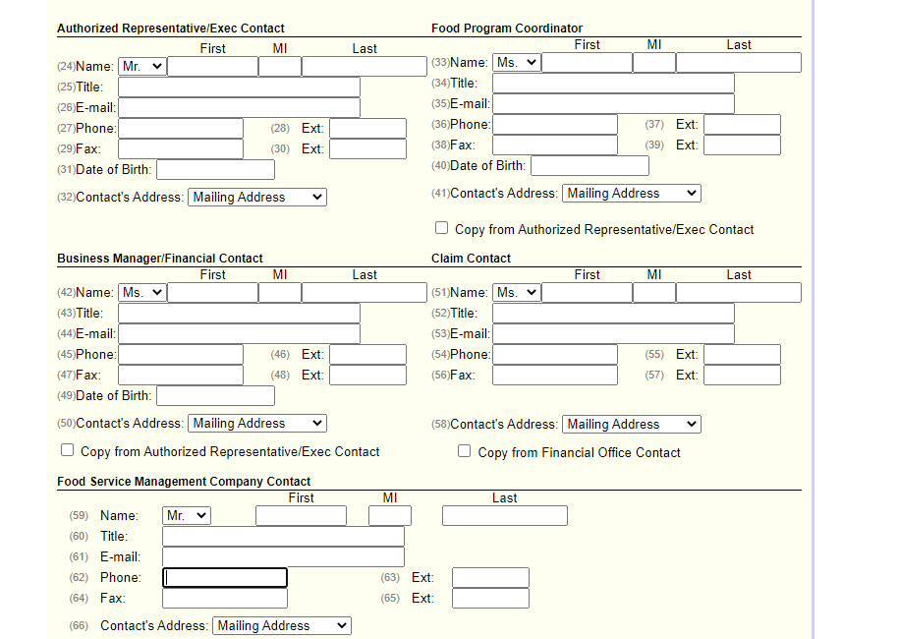
CNPweb Contacts – CACFP and SFSP
Notes:
To understand how communication flows from ODE CNP and to whom, let’s first look at CNPweb and the roles for each program.
For SFSP and CACFP, the four main contacts – the Authorized Representative, Food Program Coordinator, Business Manager or Financial Contact and the Claim Contact are all required to be employees of the sponsor and will manage the sponsor responsibilities of the programs that we discussed earlier. The main contact for the programs will be the Food Program Coordinator. This is the individual that should have experience and knowledge of child nutrition programs and it will definitely be the individual that should provide communications to and receive communications from the FSMC contact. The Food Service Management contact, is listed separately and is often the foodservice director.

Slide 19
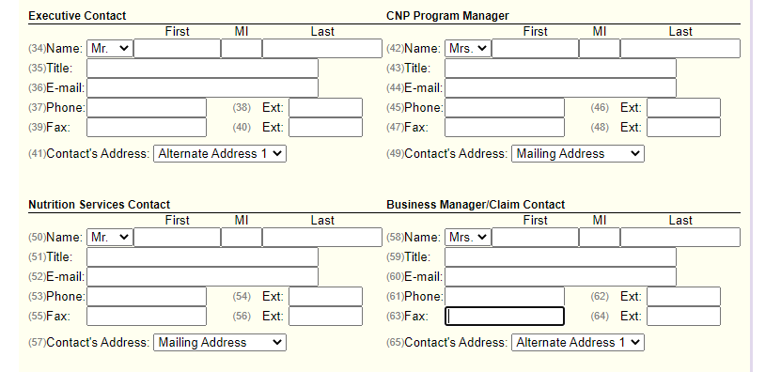
CNPweb Contacts – NSLP, SBP, and SSO
Notes:
For NSLP and other School Nutrition programs, CNPweb is laid out differently. The Executive Contact, CNP Program Manager and Business Manager or Claim Contact are all required to be employees of the sponsor and again will manage the sponsor responsibilities. The key contact for school programs is the Program Manager and just as was mentioned for the Food Program Coordinator, this should be a person with understanding and experience in the child nutrition programs. The FSMC contact is listed in the Nutrition Services Contact, again often the foodservice director.
For all programs, it is critical that CNPWeb is up-to-date at all times. If a sponsor has a staffing change in any of the key contacts listed in CNPWeb, sponsors must contact their child nutrition specialist as soon as the change occurs to update information in the system and gain user authorization for the new sponsor staff taking over child nutrition program responsibilities. These new staff will be required to complete training to get up to speed on child nutrition program requirements and to ensure that there is no interruptions in program service or meal reimbursements.
In addition, sponsor staff needing User Access in CNPWeb, must submit a user authorization form. User Access to the system is specific to each individual and user names and passwords may not be shared with other sponsor or FSMC staff.

Slide 20
Working with ODE CNP
Communication from ODE to Sponsor Contact(s)
Agreements
Renewals
Claims
Administrative Reviews
Memos
Newsletters
Training Announcements
Q & A
Communication from ODE to FSMC Contact
Administrative Reviews
Memos
Newsletters
Training Announcements
Q & A
Administrative and Financial Management of Programs
Notes:
Now when discussing communication sent from ODE CNP, we can look at topic areas. Though there are some variances between programs, the general rule when it come to communication from ODE to a sponsoring program is as follows:
When dealing with any of the areas that concern administrative or financial management of programs , ODE CNP will always communicate directly with the Food Program Coordinator or Program Manager.
In some instances, particularly around agreements and administrative reviews, the Authorized Representative or Executive Contact may be included. When claims or financial questions are involved, the claim contact may be included.
ODE CNP includes the Food Service Management contact in communications that include foodservice operations. This will often include Administrative Review, Memos, Newsletters, Training information and Q & As.

Slide 21
Partnership
Regulation
Compliance
Policy
Requirements
Notes:
While it is simple to define the contractual and federal responsibilities of the sponsor and the FSMC in a presentation, ODE CNP recognizes that in practice, during day-to-day operations, those duties, activities and responsibilities can become intertwined, overlapping, and indistinct.
Because the federal regulations do require specific and distinct roles, ensuring that certain actions or duties are performed by the sponsor versus the food service management company, it is extremely important that the agreement between the sponsor and the FSMC be seen as a Partnership.
The state agency, takes the role of communicator and compliance officer – communicating the regulations of each child nutrition program, detailing the policies that must be met and requirements for meeting those policies and ultimately reviewing programs to ensure that there is compliance of those policies. When policies are not met, the State Agency issues corrective action and technical assistance to aid programs in coming back into compliance
As two pieces to one program, the sponsor and the FSMC must work together in partnership to ensure that policies are met and that there is compliance with federal regulations.
ODE CNP has seen the greatest success with this when there is consistent communication between the sponsor and the FSMC. While ODE provides specific pieces of information to both sponsor and FSMC contacts, there are instances based on regulation of certain programs, when information must go directly to the sponsor and the sponsor must then ensure that the information is shared with the FSMC.
When the flow of communication between the sponsor and the FSMC stops or breaks down, there is a greater instance of findings on administrative review.

Slide 22
Recap of what we have learned
The different definitions of an FSMC in various CNP Programs
The definition of what Sponsor is
Who can enter into an ODE CNP agreement
When a Sponsor wants to contract out pieces of the foodservice requirements
CNP responsibilities for the Sponsor and the FSMC
USDA Foods responsibilities for the Sponsor and the FSMC
The flow of communication from ODE CNP
The importance of a strong partnership between the Sponsor and FSMC
Notes:
Let’s take a look at what we have learned today. First, we reviewed the different definitions of an FSMC in a variety of Child Nutrition Programs. Next, we looked at the types of entities that could be a Sponsor in the Child Nutrition Program and who can enter into an agreement with ODE CNP. Then, we discussed the requirements that a Sponsor has to complete when they wish to contract out pieces of the foodservice to an FSMC. We also outlined the responsibilities of the Sponsor and the FSMC for the CNP and USDA Foods programs. Then, we provided some clarification on how information flows from ODE CNP to the Sponsor and when the FSMC would be included in that communication. Lastly, we discussed the importance of developing strong partnerships that include a solid line of communication between the Sponsor and the FSMC.

Slide 23
USDA Nondiscrimination Statement
In accordance with federal civil rights law and U.S. Department of Agriculture (USDA) civil rights regulations and policies, this institution is prohibited from discriminating on the basis of race, color, national origin, sex (including gender identity and sexual orientation), disability, age, or reprisal or retaliation for prior civil rights activity.
Program information may be made available in languages other than English. Persons with disabilities who require alternative means of communication to obtain program information (e.g., Braille, large print, audiotape, American Sign Language), should contact the responsible state or local agency that administers the program or USDA's TARGET Center at (202) 720-2600 (voice and TTY) or contact USDA through the Federal Relay Service at (800) 877-8339.
To file a program discrimination complaint, a Complainant should complete a Form AD-3027, USDA Program Discrimination Complaint Form which can be obtained online at: https://www.usda.gov/sites/default/files/documents/ad-3027.pdf, from any USDA office, by calling (866) 632-9992, or by writing a letter addressed to USDA. The letter must contain the complainant's name, address, telephone number, and a written description of the alleged discriminatory action in sufficient detail to inform the Assistant Secretary for Civil Rights (ASCR) about the nature and date of an alleged civil rights violation. The completed AD-3027 form or letter must be submitted to USDA by:
mail:
U.S. Department of Agriculture
Office of the Assistant Secretary for Civil Rights
1400 Independence Avenue, SW
Washington, D.C. 20250-9410; or
fax:
(833) 256-1665 or (202) 690-7442; or
email:
Program.Intake@usda.gov
This institution is an equal opportunity provider.

