Slide 1
Contracting with small, minority, women’s business enterprises, veteran-owned businesses, and labor surplus area firms.
2 CFR 200.321
Notes:
Welcome to the ODE CNP Procurement training, Part 4-Contracting with small businesses, minority businesses, women's business enterprises, veteran-owned businesses, and labor surplus area firms. This provisions applies to all sponsors participating in Child Nutrition Programs.

Slide 2
How to Include
Must use Affirmative Steps when possible:
Inclusion on solicitation lists
Solicited when potential sources
Dividing total requirements when feasible
Establishing delivery schedules to encourage participation
Use Small Business Administration and Minority Business Development Agency
If subcontracting, subcontractors follows steps 1-5
Notes:
2 CFR 200.321 gives provisions for contracting with small, minority, women’s business enterprises, veteran-owned businesses, and labor surplus area firms.
When possible, the Program Sponsor should ensure that small businesses, minority businesses, women's business enterprises, veteran-owned businesses, and labor surplus area firms (See U.S. Department of Labor's list) are considered as set forth below.
Placing qualified small businesses, minority businesses, women’s business enterprises, veteran-owned businesses, and labor surplus area firms on solicitation lists;
Assuring that small and minority businesses and women's business enterprises are solicited whenever they are potential sources
Dividing total requirements, when economically feasible, into smaller tasks or quantities to permit maximum participation by small and minority businesses and women’s business enterprises
Establishing delivery schedules, where requirement permit, which encourage participation by small and minority businesses, and women’s business enterprises
Using the services and assistance, as appropriate, of such organizations as the small Business Administration and the Minority Business Development Agency of the Department of Commerce
Requiring the prime contractor, if subcontracts are to be let, to take the affirmative steps listed in 1-5

Slide 3
Business Oregon’s COBID
Certification Office of Business Inclusion and Diversity (COBID)
What does COBID do?
COBID certifies minority-owned, women-owned, and service-disabled veteran-owned business owners and emerging small businesses interested in contracting with state, county, and city government agencies. Our goal is to foster an environment where every small business in Oregon can compete fairly regardless of ethnicity, gender, disability, or size. We strive to help owners of disadvantaged and emerging small businesses access opportunities to compete for public contracting opportunities—a field where minorities, women, service-disabled veterans, and emerging small businesses encounter barriers. When firms owned by disadvantaged individuals participate in contracting, these historically underserved businesses advance, helping enhance and strengthen our local, regional, and state economy.
Notes:
The link on this slide is a link to the Certification Office For Business Inclusion and Diversity (COBID). This link provides access to a listing of small, minority, women, veteran owned business and labor surplus area Firms. The next slides will show how to use this website to identify minority, women or small businesses.

Slide 4
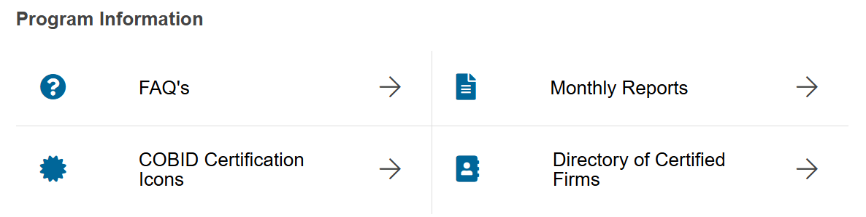
Using the Office for Business Inclusion and Diversity
Directory of Certified Firms
Notes:
The Office for Business Inclusion and Diversity webpage can be used to locate minority, women or emerging small businesses. By searching this webpage for your town, city or county, you will be able to determine if there are minority, women or emerging small businesses, which should be included on your solicitation lists.
Clicking on the link in this slide will take you to the webpage pictured on the slide. Click on the Directory of Certified Firms in the green box at the right.

Slide 5
Searching Methods
Search by Certification Type
Airport Concessionaire Disadvantaged Business Enterprise (ACDBE)
Disadvantaged Business Enterprise (DBE)
Disadvantaged Business Enterprise (FAA Only) (DBE (FAA Only))
Emerging Small Business (ESB)
Minority Business Enterprise (MBE)
Veteran Business Enterprise (VBE)
Women Business Enterprise (WBE)
Search by Business Name or DBA
Search by Business Description
Search by Commodity Code
Search by Contact Person
Search by Location
City
Zip Code
Distance
Sate
County
Phone Area Code
Search by Reference
Ethnicity
Gender
Service Disabled
Construction
General Location
ESB Tier Level
Additional Firm names
OR Cert ID
Notes:
COBID allows users to search their directory in a variety of ways, to achieve their desired information.
Note: Certification and the information listed within this directory is not a guarantee of a firm's capacity or ability to perform specific tasks or services. Users of this information are advised to conduct their own due diligence when engaging any listed entities. Prior to contracting, it is the prime contractor's responsibility to ensure a subcontractor is ready, willing and able to perform the defined scope of work.

Slide 6
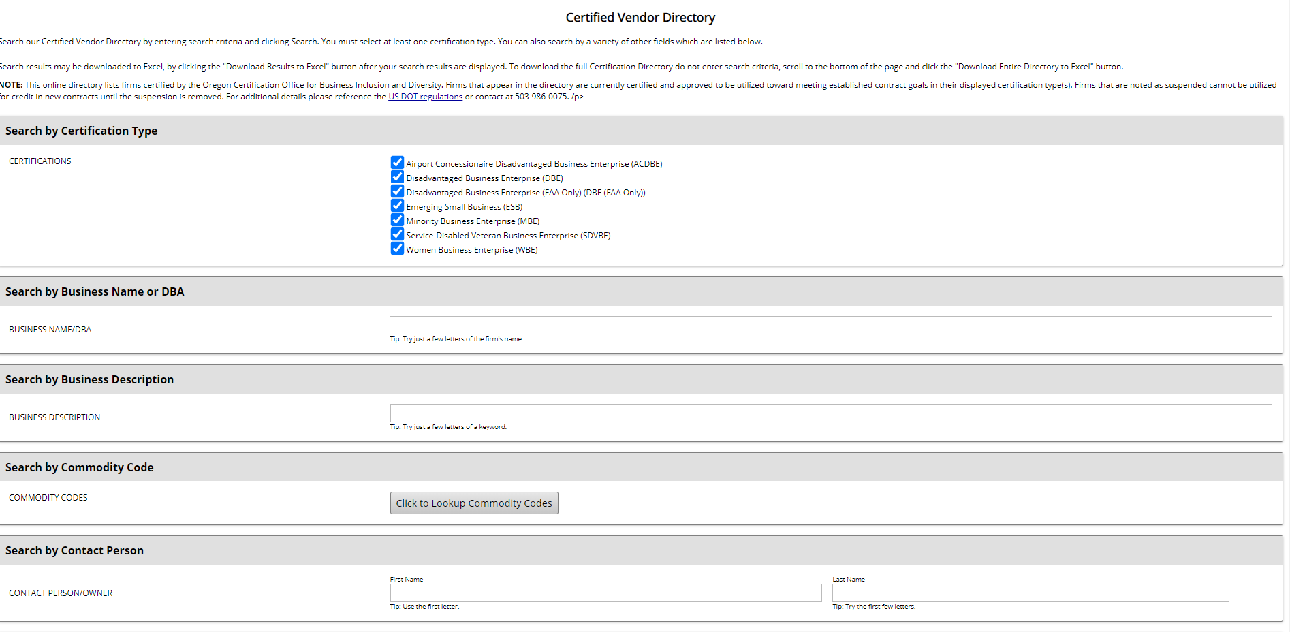

Conducting a search – Part 1
Notes:
You will next see a page to conduct a search. Let us run through an example search using the Commodity Code search method. First, select “Click to Lookup Commodity Codes”.

Slide 7
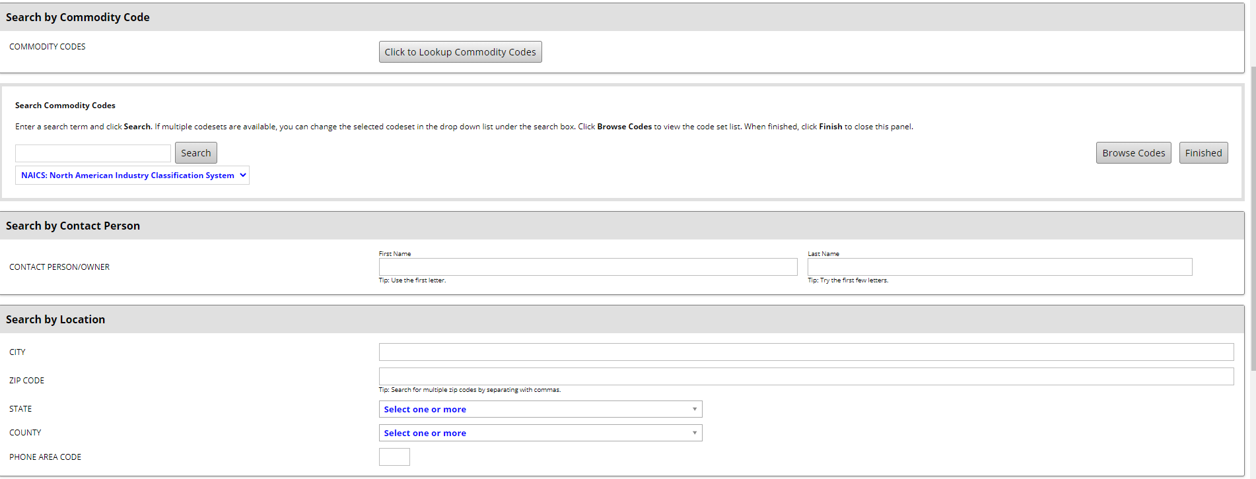

Conducting a search – Part 2
Notes:
When you click on “Lookup Commodity Code” you will see a search page like what is pictured on this slide. Next click on “Browse Codes”

Slide 8
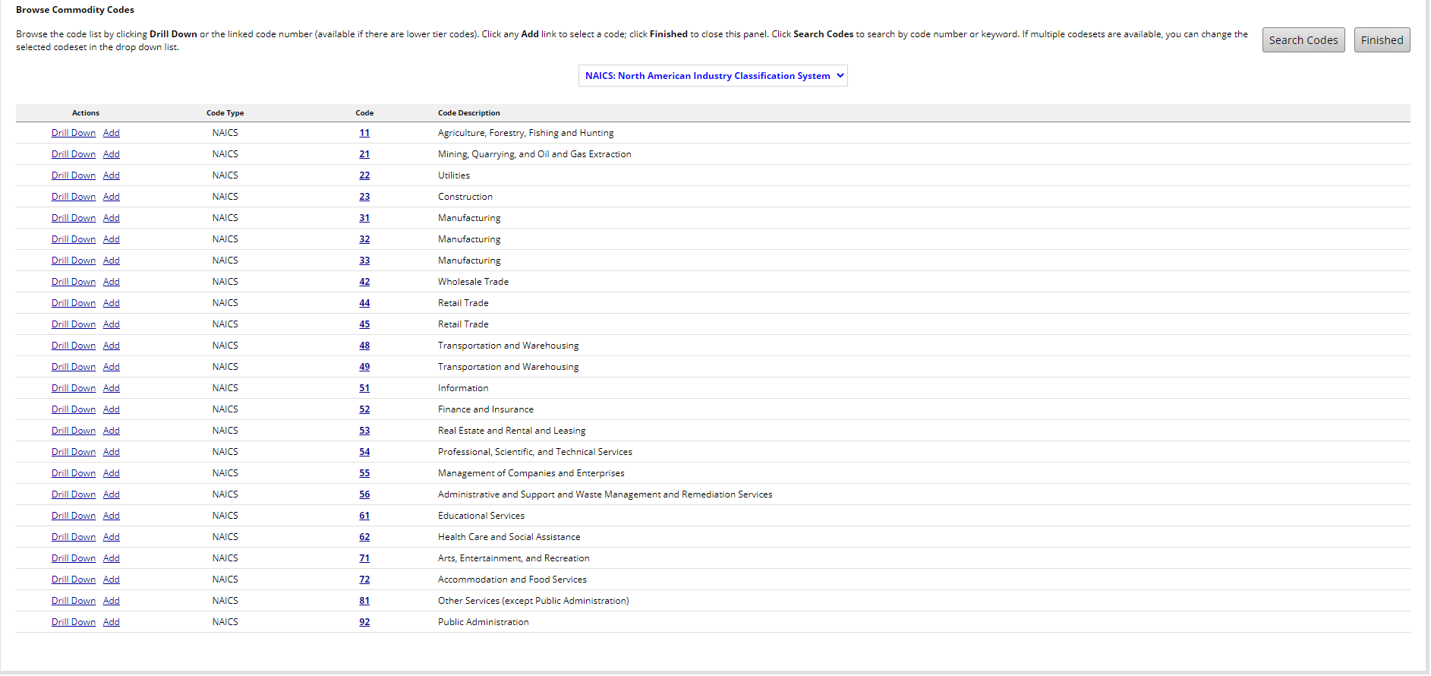
Conducting a search – Part 3
Notes:
A listing of commodity codes will appear.

Slide 9


Conducting a search – Part 4
Notes:
Scroll down the list until you find “Retail Trade” or “Accommodation and Food Services”. The code numbers are 44 and 72 . By clicking on the number “44” you will find food product retailers. By clicking on number “72” you will be able to drill down to more specific Food service vendors.

Slide 10
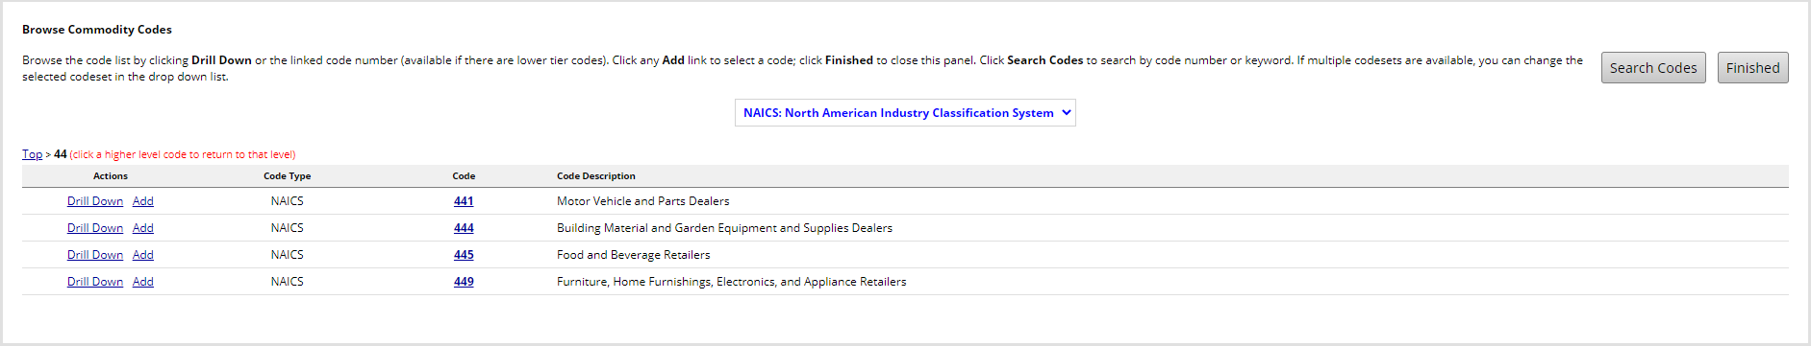

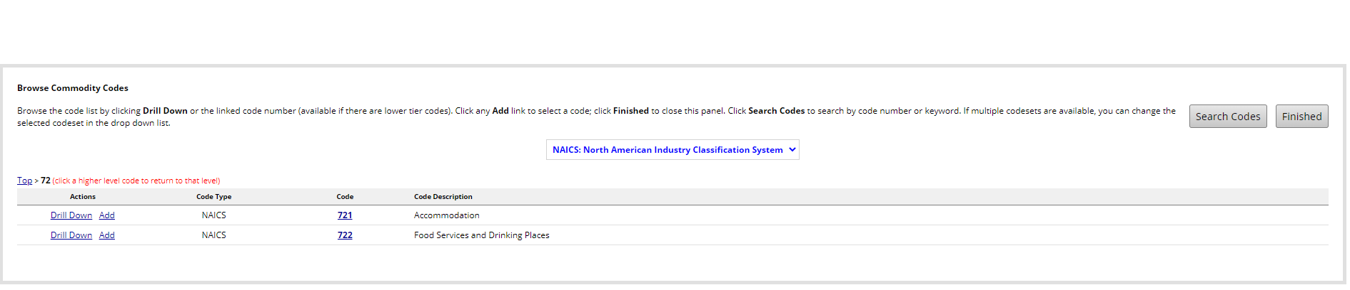
Conducting a search – Part 5
Notes:
The first time you click on code #44 you will see four additional Choices and # 72 you will see two additional choices. Code #445 is for Food and Beverage Retailers. Code #722 is for Food services and Drinking places. Click on Drill Down for code #445 or code #722.

Slide 11
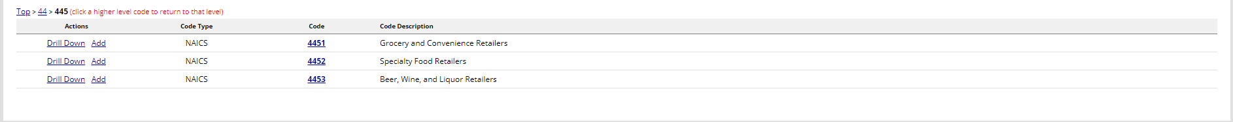

Conducting a search – Part 6
Notes:
Click on code #4451 for Grocery Retailers, #4452 for Commodities Retailers or #7223 for Food Services Contractors.

Slide 12
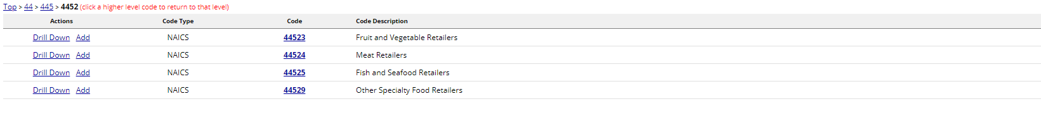
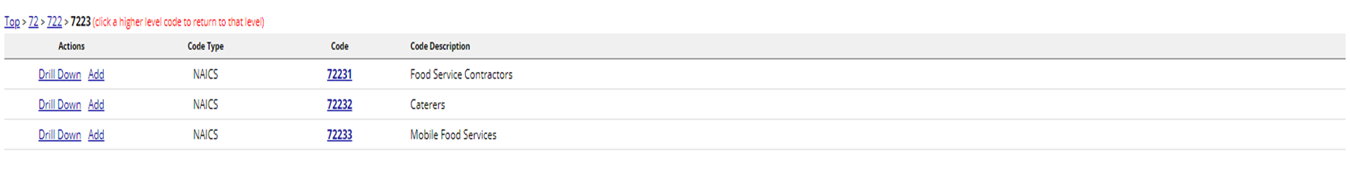
Conducting a search – Part 7
Notes:
Click on “Add” to select a codes that may be able to meet your requirements.

Slide 13
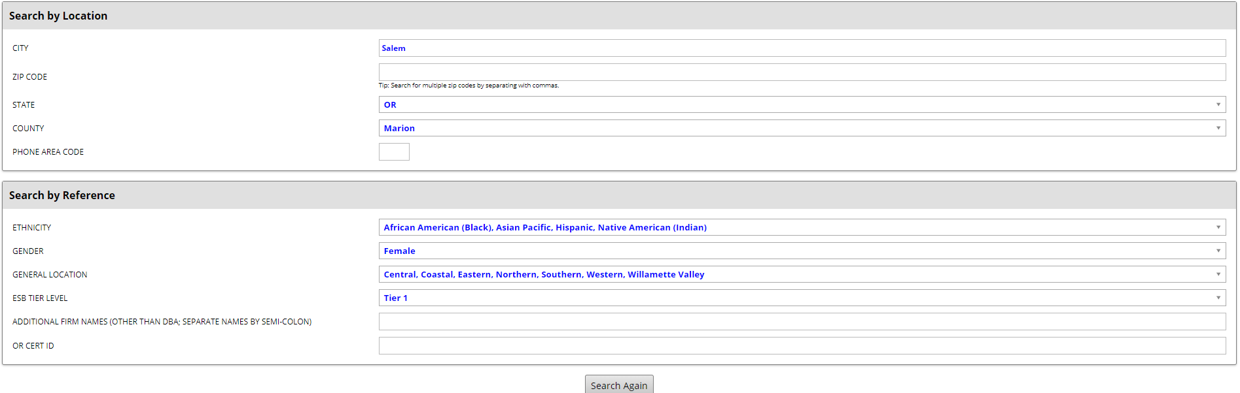
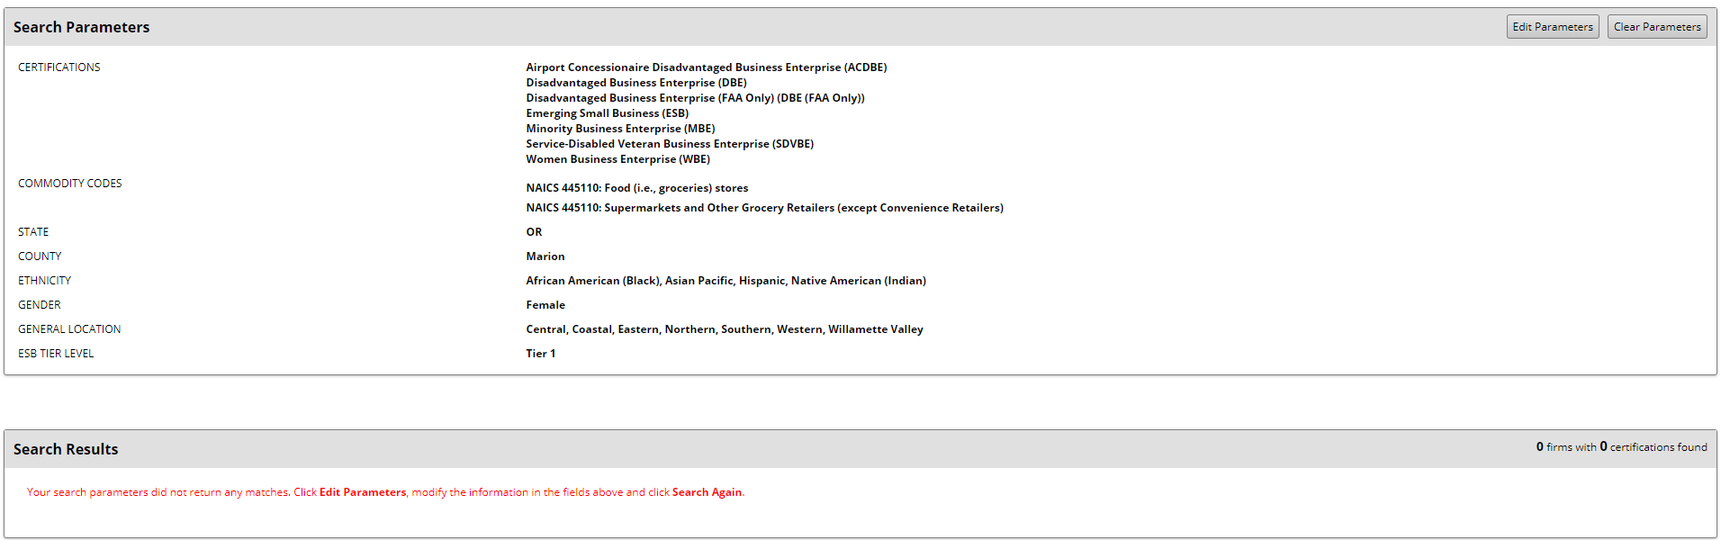
Conducting a search – Part 8
Notes:
When you choose Commodity Code #445110 by clicking “Add” you will return to the original search document. Now search by location. When you type in “Salem” and click search, the results show there are no matches. In other words, there are no minority, women or emerging small businesses that are Supermarkets or Grocery Retailers. Therefore, you will not add a minority, women or small business to your solicitation list. Save this documentation as part of your procurement files.

Slide 14
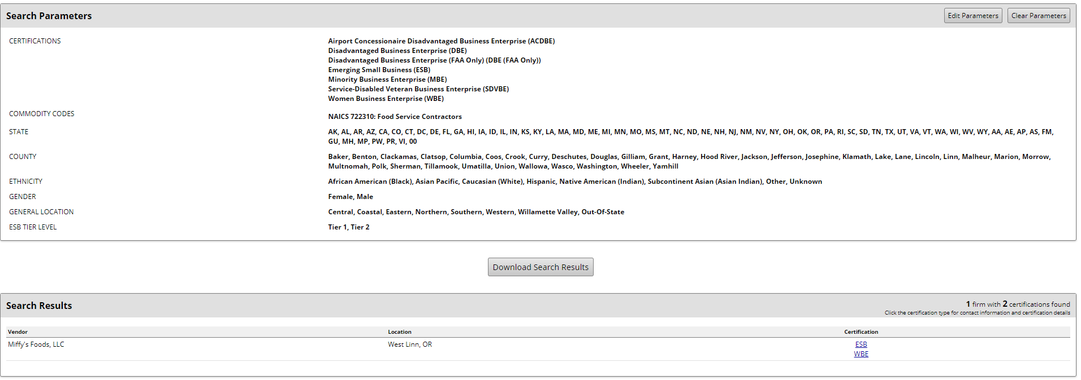
Conducting a search – Part 9
Notes:
In this search, we found one vendor, you would need to investigate whether this vendors will meet your need as a supplier and include them in your solicitation if possible. Save this documentation as part of your procurement files.

Slide 15
Resources
ORS 279A.107 - Certification as disadvantaged business enterprise, minority-owned business, woman-owned business, veteran-owned business or emerging small business during term of public contract
2 CFR 200.321 - Contracting with small businesses, minority businesses, women's business enterprises, veteran-owned businesses, and labor surplus area firms.
Certification Office for Business Inclusion and Diversity
Click on Directory of Certified Firms

Slide 16
USDA Nondiscrimination Statement
In accordance with federal civil rights law and U.S. Department of Agriculture (USDA) civil rights regulations and policies, this institution is prohibited from discriminating on the basis of race, color, national origin, sex (including gender identity and sexual orientation), disability, age, or reprisal or retaliation for prior civil rights activity.
Program information may be made available in languages other than English. Persons with disabilities who require alternative means of communication to obtain program information (e.g., Braille, large print, audiotape, American Sign Language), should contact the responsible state or local agency that administers the program or USDA's TARGET Center at (202) 720-2600 (voice and TTY) or contact USDA through the Federal Relay Service at (800) 877-8339.
To file a program discrimination complaint, a Complainant should complete a Form AD-3027, USDA Program Discrimination Complaint Form which can be obtained online at: https://www.usda.gov/sites/default/files/documents/ad-3027.pdf, from any USDA office, by calling (866) 632-9992, or by writing a letter addressed to USDA. The letter must contain the complainant's name, address, telephone number, and a written description of the alleged discriminatory action in sufficient detail to inform the Assistant Secretary for Civil Rights (ASCR) about the nature and date of an alleged civil rights violation. The completed AD-3027 form or letter must be submitted to USDA by:
mail: U.S. Department of Agriculture Office of the Assistant Secretary for Civil Rights 1400 Independence Avenue, SW Washington, D.C. 20250-9410; or
fax: (833) 256-1665 or (202) 690-7442; or
email: Program.Intake@usda.gov
This institution is an equal opportunity provider.

