Slide 1
Micro-Purchases
Procurement in Child Nutrition Programs
2 CFR 200.320(a)(1)
Notes:
Today we will talk about the micro-purchase procurement method as outlined in 2 CFR 200.320(a)(1). This is an informal noncompetitive procurement method that may be used for the acquisition of goods or services if the cost is deemed reasonable and the aggregate dollar amount does not exceed the micro-purchase threshold in accordance with Federal, State, Tribal, or local statues. Purchase cards can be used for micro-purchases if procedures are documented and approved by the Program Sponsor.

Slide 2
Method of Procurement to be Followed
The Program Sponsor must have and use its own Documented Procurement Procedures.
Procedures must be consistent with the standards outlined in:
  2 CFR 200.318 through 200.327;
  Applicable program regulations; and
  State, local, or tribal laws or regulations.
Notes:
The Program Sponsor must have and use their own documented procurement procedures, consistent with the standards of 2 CFR 200.318 through 200.327 and applicable program regulations when using the micro-purchase method for the acquisition of goods or services required under the Federal award.

Slide 3
Micro-Purchase Thresholds
The current micro-purchase threshold identified in the Federal Acquisition Regulation (FAR) is set at $15,000.00.
There is a provision in 2 CFR 200.320(a)(1)(iv) that allows a Program Sponsor to establish a threshold higher than the micro-purchase threshold identified in the FAR if they meet one of the three self-certification listed in 2 CFR 200.320(a)(1)(iv)
The Program Sponsor is responsible for determining and documenting an appropriate micro-purchase threshold based on internal controls, an evaluation of risk, and its documented procurement procedures.
The micro-purchase threshold used by the Program Sponsor must be authorized or not prohibited under State, local, or tribal laws or regulations.
Notes:
The Program Sponsor is responsible for determining and documenting an appropriate micro-purchase threshold based on internal controls, an evaluation of risk, and its documented procurement procedures.
The micro-purchase threshold used by the Program Sponsor must be authorized or not prohibited under State, local, or tribal regulations.
The current Federal micro-purchase threshold identified in the Federal Acquisition Regulation (FAR) is $15,000.00, this is periodically adjusted due to inflation.
There is a provision in 2 CFR 200.320(a)(1)(iv) that allows a Program Sponsor to establish a threshold higher than the micro-purchase threshold identified in the Federal Acquisition Regulation (FAR) if they meet one of the three self-certification listed in 2 CFR 200.320(a)(1)(iv).

Slide 4
Self-Certification of a Higher Threshold
Must not conflict with or be prohibited under State, local, or tribal laws or regulations.
Must meet any of the following requirements:
  A qualification as a low-risk auditee in accordance with the criteria in 2 CFR 200.520 for the most recent audit;
  (B) An annual internal institutional risk assessment to identify, mitigate, and manage financial risks; or,
  (C) For public institutions, a higher threshold consistent with State law.
Notes:
2 CFR 200.320(a)(1)(iv) was update in November 2021 and now includes a provision that allows Program Sponsors the ability to increase their micro-purchase threshold up to $50,000.00 as long as it’s not prohibited by State, Tribal, or local requirements.
Oregon State Senate Bill 1047 became operative January 1, 2024 which increased the State threshold for this procurement method up to $25,000.00.
This means a public institution may increase their micro-purchase threshold up to $25,000.00 in accordance with 2 CFR 200.320(a)(1)(iv)(C). Private nonprofit institutions would have to maintain documentation to be made available to the Federal awarding agency, pass through agency, and auditors in accordance with 2 CFR 200.334 that they meet the self-certification requirements outlined in 2 CFR 200.320(a)(1)(iv)(A) or (B).

Slide 5
Reasonable Cost
A cost is reasonable if, in its nature and amount, it does not exceed that which would be incurred by a prudent person under the circumstances prevailing at the time the decision was made to incur the cost.
Notes:
In determining reasonableness of a given cost, consideration must be given to 5 factors:
Whether the cost is of a type generally recognized as ordinary and necessary for the operation of the Program Sponsor or the proper performance of the Federal award.
The restraints or requirements imposed by such factors as: sound business practices; arm's-length transactions; regulations; and terms and conditions of the Federal award.
Market prices for comparable goods or services for the geographic area.
Whether the individuals concerned acted with prudence in the circumstances considering their responsibilities to the Program Sponsor and the Federal Government.
Whether the Program Sponsor significantly deviates from its established practices and policies regarding the incurrence of costs, which may unjustifiably increase the Federal award's cost.

Slide 6
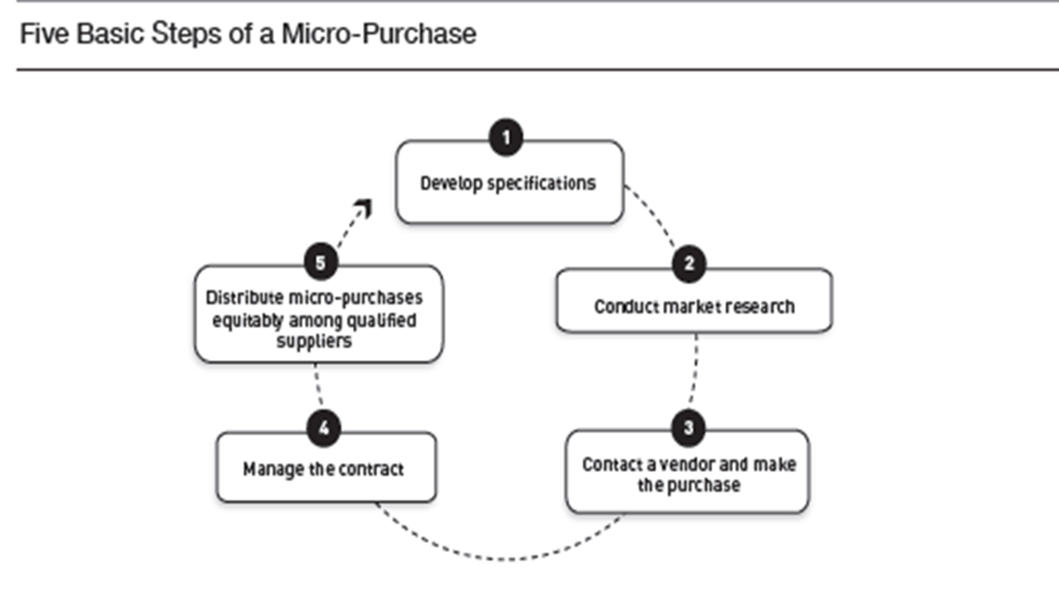
Micro-Purchase Method
Notes:
When using the micro-purchase methods, Sponsors must develop written specifications in accordance with 2 CFR 200.319(d) and document all purchases.
They must conduct their market research to ensure the price is reasonable in accordance with 2 CFR 200.404.
Sponsors should use the same process to determine whether a micro-purchase falls under the micro-purchase threshold as they would to determine if a purchase falls under the small-purchase threshold, meaning that they must forecast for the program period based on menu planning and their daily participation rates.
For example, if a Program Sponsor needs to make a one-time purchase of a product and the purchase is valued under the micro-purchase threshold, it may purchase the product without soliciting quotes. However, if the Program Sponsor needs to purchase $8,500 worth of lettuce ten times throughout the program year, the school should plan its needs over a period of time and use a competitive procurement method because the aggregate value of the purchase lies above the micro-purchase threshold.
Once the Program Sponsor determines that the micro-purchase is the appropriate procurement method, they need to contact a qualified vendor to make the purchase.
The Program Sponsor will need to ensure that the vendor provides all the goods and service at the agreed upon fix price and that they distribute future micro-purchases equitably among all qualified sources to the maximum extent practicable.

Slide 7
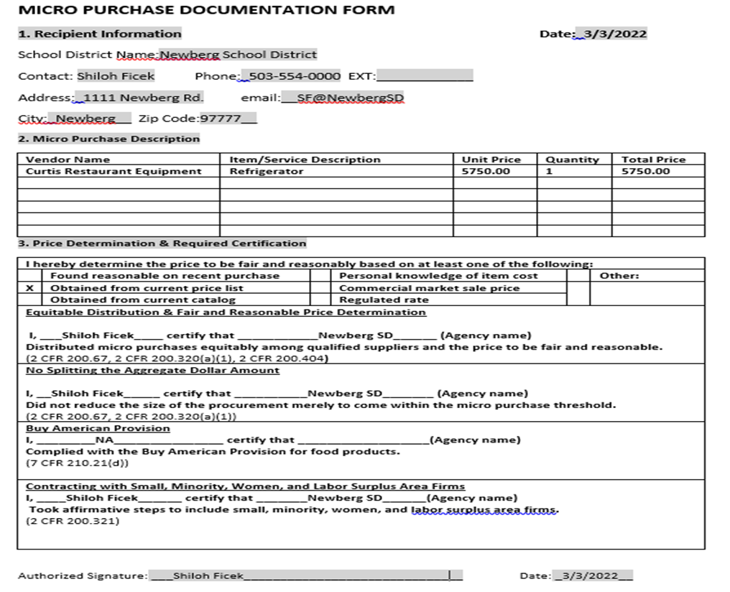
Example Micro-Purchase Documentation
Notes:
Here is an example of a very basic form use to document a Sponsor’s micro-purchase.

Slide 8
Summary of Micro-Purchases
  Enable sponsor to purchase supplies or services without soliciting competitive quotes.
  Aggregate amount does not exceed $15,000, unless the Program Sponsor has established a higher threshold in accordance with 2 CFR 200.320(a)(1)(iv).
  A Sponsor may not artificially divide or fragment a procurement so as to constitute a micro-purchase.
  A Sponsor should distribute purchases equitably among qualified suppliers to the maximum extent practicable.
    For example, a sponsor must not make all purchases from one source rather; the Sponsor should make purchases from all qualified sources equally.
  Prices must be reasonable
  Purchase cards can be used for micro-purchases if procedures are documented and approved by the non-Federal entity.
Notes:
The micro-purchases method enable Program Sponsors to purchase supplies or services without soliciting competitive quotes, if the Sponsor considers the price reasonable.
The aggregate amount does not exceed $15,000, unless Program Sponsor has established a higher threshold in accordance with 2 CFR 200.320(a)(1)(iv).
A Sponsor may not artificially divide or fragment a procurement so as to constitute a micro-purchase.
Program Sponsors should distribute purchases equitably among all qualified suppliers to the maximum extent practicable.
Purchase cards can be used for micro-purchases if procedures are documented and approved by the Program Sponsor.

Slide 9
References
2 CFR 200.319(d)
2 CFR 200.320(a)(1)
2 CFR 200.404
Oregon Department of Education Child Nutrition Program Procurement Resources

Slide 10
Non-Discrimination Statement
In accordance with federal civil rights law and U.S. Department of Agriculture (USDA) civil rights regulations and policies, this institution is prohibited from discriminating on the basis of race, color, national origin, sex (including gender identity and sexual orientation), disability, age, or reprisal or retaliation for prior civil rights activity.
Program information may be made available in languages other than English. Persons with disabilities who require alternative means of communication to obtain program information (e.g., Braille, large print, audiotape, American Sign Language), should contact the responsible state or local agency that administers the program or USDA's TARGET Center at (202) 720-2600 (voice and TTY) or contact USDA through the Federal Relay Service at (800) 877-8339.
To file a program discrimination complaint, a Complainant should complete a Form AD-3027, USDA Program Discrimination Complaint Form which can be obtained online at: https://www.usda.gov/sites/default/files/documents/ad-3027.pdf, from any USDA office, by calling (866) 632-9992, or by writing a letter addressed to USDA. The letter must contain the complainant's name, address, telephone number, and a written description of the alleged discriminatory action in sufficient detail to inform the Assistant Secretary for Civil Rights (ASCR) about the nature and date of an alleged civil rights violation. The completed AD-3027 form or letter must be submitted to USDA by:
mail:
U.S. Department of Agriculture
Office of the Assistant Secretary for Civil Rights
1400 Independence Avenue, SW
Washington, D.C. 20250-9410; or
fax:
(833) 256-1665 or (202) 690-7442; or
email:
Program.Intake@usda.gov,
This institution is an equal opportunity provider

