Slide 1
Simplified Acquisition Procedures
Procurement in Child Nutrition Programs
2 CFR 200.320(a)(2)
Notes:
Good Morning, today we will talk about the simplified acquisition (formerly knows as the small purchase procurement method) as outlined in 2 CFR 200.320(a)(2). This is an informal competitive procurement method that may be used for the acquisition of goods or services if the aggregate contract or purchase value does not exceed the most restrictive of Federal, State, or local simplified acquisition thresholds.

Slide 2
Method of Procurement to be Followed
The Program Sponsor must have and use its own Documented Procurement Procedures.
Procedures must be consistent with the standards outlined in:
2 CFR 200.318 through 200.327;
Applicable program regulations; and
State, local, or tribal laws or regulations.
Notes:
The Program Sponsor must have and use their own documented procurement procedures, consistent with the standards of 2 CFR 200.318 through 200.327, applicable program regulations, and State statute when using the simplified acquisition procedures for goods or services required under the Federal award.

Slide 3
Fragmentation
A Program Sponsor may not artificially divide or fragment a procurement so as to constitute a less restrictive procurement method.
Notes:
A Program Sponsor may not arbitrarily split the aggregated dollar amount, artificially divide, or fragment the procurement to constitute a simplified acquisition in accordance with 2 CFR 200.320(a)(2) and ORD 279B.070.

Slide 4
Simplified Acquisition Threshold
The Program Sponsor is responsible for determining and documenting an appropriate simplified acquisition threshold based on internal controls, an evaluation of risk, and its documented procurement procedures.
The simplified acquisition threshold used by the Program Sponsor must be authorized or not prohibited under State, local, or tribal laws or regulations.
Oregon Senate Bill 1047 states: a contracting agency may use this procurement method if the award does not exceed $250,000.00.
Notes:
The Program Sponsor is responsible for determining and documenting an appropriate simplified acquisition threshold based on internal controls, an evaluation of risk, and its documented procurement procedures.
The simplified acquisition threshold used by the Program Sponsor must be authorized or not prohibited under State, local, or tribal regulations.
The current Federal simplified acquisition threshold is $350,000.00.
State of Oregon Senate Bill 1047 was signed by the Governor in April 2023 and updated the State simplified acquisition threshold from $150,000.00 to $250,000.00. Oregon Revised Statute 279B.070 states a contracting agency shall seek at least three informally solicited competitive price quotes or competitive proposals from prospective contractors for the procurement of goods or services that does not exceed $250,000.00.

Slide 5
Specification
Incorporate a clear and accurate description of the technical requirements for the material, product, or service to be procured.
The description may include a statement of the qualitative nature of the material, product or service to be procured and, when necessary.
Must set forth those minimum essential characteristics and standards to which it must conform if it is to satisfy its intended use.
Identify all requirements which the offerors must fulfill and all other factors to be used in evaluating bids or proposals.
Notes:
The Program Sponsor documented procedures must ensure that all solicitations:
Incorporate a clear and accurate description of the technical requirements for the material, product, or service to be procured. Such description must not, in competitive procurements, contain features which unduly restrict competition. The description may include a statement of the qualitative nature of the material, product or service to be procured and, when necessary, must set forth those minimum essential characteristics and standards to which it must conform if it is to satisfy its intended use. Detailed product specifications should be avoided if at all possible. When it is impractical or uneconomical to make a clear and accurate description of the technical requirements, a “brand name or equivalent” description may be used as a means to define the performance or other salient requirements of procurement. The specific features of the named brand which must be met by offers must be clearly stated; and
Identify all requirements which the offerors must fulfill and all other factors to be used in evaluating quotes, bids or proposals in accordance with 2 CFR 200.319(d).

Slide 6
Requirements
Shall seek at least three informally solicited competitive price quotes from prospective contractors.
Shall keep a written record of the sources of the quotes or proposals received.
Shall include any applicable contract provisions
Shall award to the contractor whose is the most responsive, responsible at the lowest fixed price.
Notes:
When conducting a simplified acquisition, a Program Sponsor shall seek at least three informally solicited competitive price quotes or competitive proposals from prospective contractors.
The Program Sponsor shall keep a written record of the sources of the quotes or proposals received. If three quotes or proposals are not reasonably available, fewer will suffice, but the Program Sponsor shall make a written record of the effort the contracting agency makes to obtain the quotes or proposals.
Program Sponsor must take affirmative steps to assure that small, minority, women, veteran-owned, and labor surplus firms are used when possible in accordance with 2 CFR 200.321.
Program Sponsor must include any applicable contact provisions in accordance with 2 CFR 200.327 and applicable program regulations.
The Program Sponsor shall award to the contractor whose is the most responsive, responsible at the lowest fixed price.

Slide 7
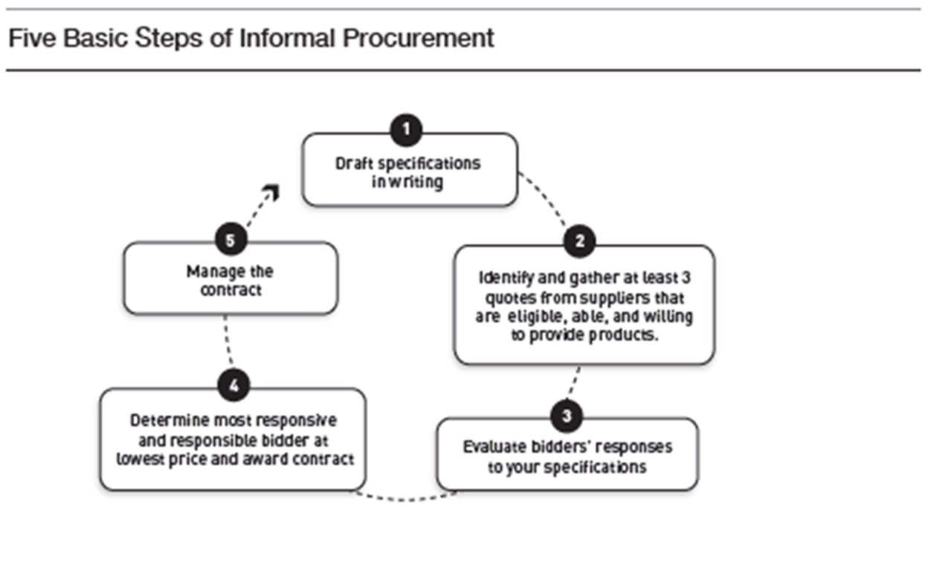
Simplified Acquisition Procedures
Notes:
The five steps to the simplified acquisition procedures.
1. Develop specifications, terms and conditions: Detail the requirements of the intended agreement, including delivery and packing conditions.
2. Identify sources: Contact potential vendors in a variety of ways (e.g., visiting a farmer’s market, calling on the phone, or emailing) and gather three bids. This is were a Program Sponsor should take affirmative steps to include small, minority, women, and labor surplus business when possible.
3. Evaluate responses: Ensure that responders are responsible and responsive in accordance with all aspects of the specifications. Document each bid even if it was offered in a face-to-face meeting or over the phone.
4. Award the contract: Determine which bidder offers the best value and award the contract to the bidder that is most responsive and responsible with the lowest fixed price.
5. Lastly, Manage the contract: Ensure the Program Sponsor receives everything from the vendor that the contract, agreement, or purchase order stipulates

Slide 8
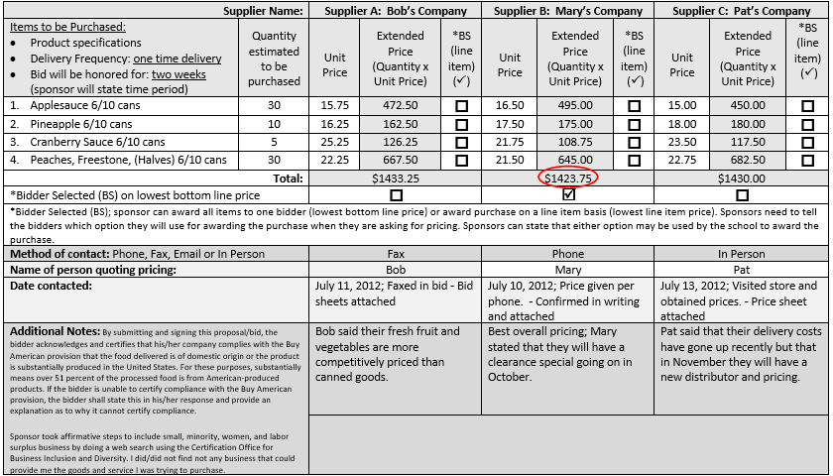
Example Simplified Acquisition Procedures
Notes:
Here is an example of a very basic form use to document a Sponsor’s simplified acquisition. As you can see, the Program Sponsor developed specifications, terms and conditions for the goods and services to be procured, received quotes from three sources, they documented how they contacted the sources, made notes detailing the response, and identified the winning source based on their evaluation of price.

Slide 9
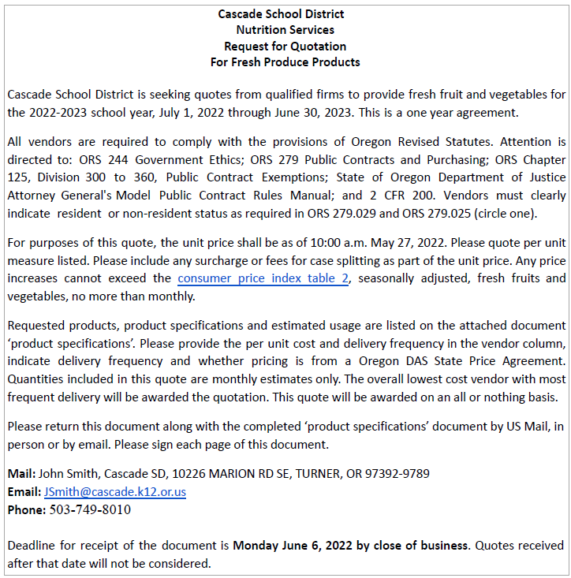
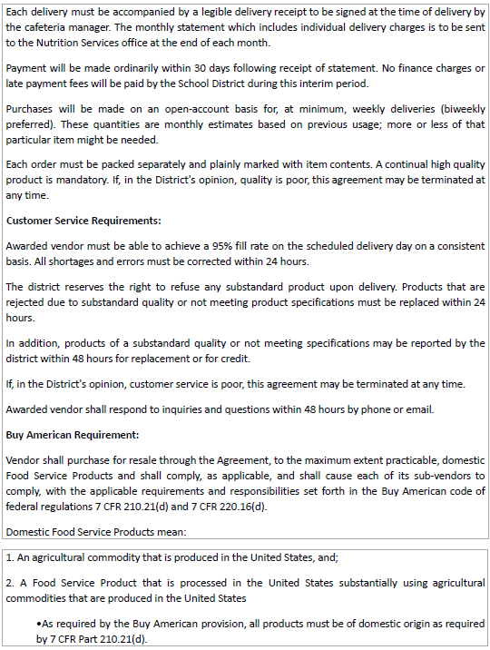
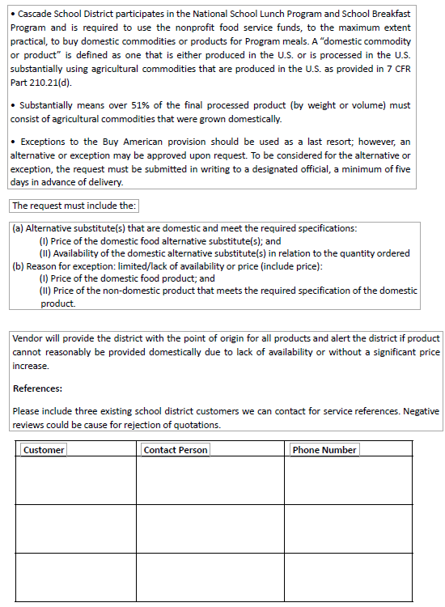
Example of a Simplified Acquisition Solicitation
Notes:
Here is another example of a simplified acquisition solicitation that might be sent to potential vendors. As you can see, the period of performance has been identified, required contract provisions, a price escalator, the point of contact, delivery, packaging, and the Buy American Provisions as required by NSLP.

Slide 10
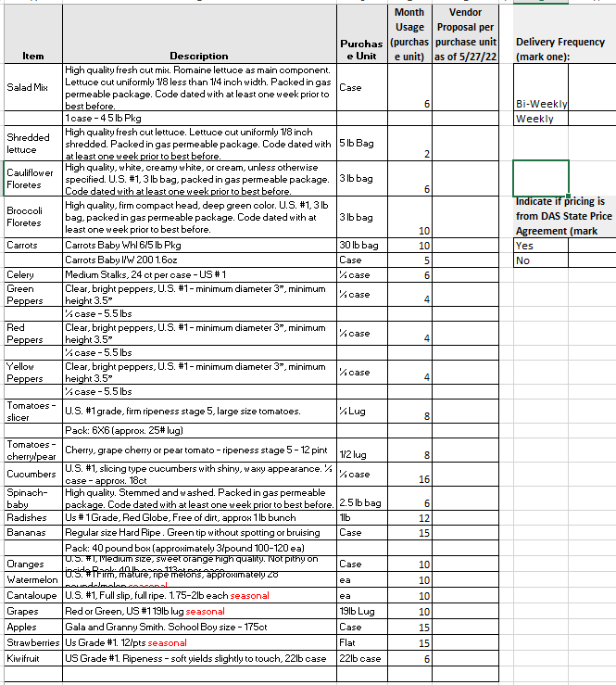
Example of a Simplified Acquisition Specification
Notes:
Here is example of a specification sheet for the solicitation on the previous slide that a potential vendor will use to provide pricing. As you can see, the item, description, unit of issue, forecasted volume are identified for the vendor to be able to provide pricing.

Slide 11
Summary of Simplified Acquisition Procedures
Enable Program Sponsor to purchase supplies or services without having to do a public notice.
Must provide the same specification to all contractors.
Must receive price or rate quotes from and adequate number of qualified contractor to achieve full and open competition.
Must keep written record detailing the procurement process.
Notes:
The simplified acquisition enable Program Sponsor to purchase supplies or services without having to do a public notice.
Program Sponsors must provide the same specification to all contractors.
Program Sponsors must receive price or rate quotes from and adequate number of qualified contractor to achieve full and open competition.
Program Sponsors must keep written record detailing the procurement process.

Slide 12
References
2 CFR 200.319(d)
2 CFR 200.320(a)(2)
ORS 279B.070
Oregon Department of Education Child Nutrition Program Procurement Resources

Slide 13
Non-Discrimination Statement
In accordance with federal civil rights law and U.S. Department of Agriculture (USDA) civil rights regulations and policies, this institution is prohibited from discriminating on the basis of race, color, national origin, sex (including gender identity and sexual orientation), disability, age, or reprisal or retaliation for prior civil rights activity. Program information may be made available in languages other than English. Persons with disabilities who require alternative means of communication to obtain program information (e.g., Braille, large print, audiotape, American Sign Language), should contact the responsible state or local agency that administers the program or USDA's TARGET Center at (202) 720-2600 (voice and TTY) or contact USDA through the Federal Relay Service at (800) 877-8339.
To file a program discrimination complaint, a Complainant should complete a Form AD-3027, USDA Program Discrimination Complaint Form which can be obtained online at: https://www.usda.gov/sites/default/files/documents/ad-3027.pdf, from any USDA office, by calling (866) 632-9992, or by writing a letter addressed to USDA. The letter must contain the complainant's name, address, telephone number, and a written description of the alleged discriminatory action in sufficient detail to inform the Assistant Secretary for Civil Rights (ASCR) about the nature and date of an alleged civil rights violation. The completed AD-3027 form or letter must be submitted to USDA by:
mail: U.S. Department of Agriculture Office of the Assistant Secretary for Civil Rights 1400 Independence Avenue, SW Washington, D.C. 20250-9410; or
fax: (833) 256-1665 or (202) 690-7442; or
email: Program.Intake@usda.gov,
This institution is an equal opportunity provider

