Slide 1
Sealed Bids Procurement Method
Procurement in Child Nutrition Programs
2 CFR 200.320(b)(1)
Notes:
Today we will talk about the sealed bids procurement method or commonly referred to as Invitation for Bids as outlined in 2 CFR 200.320(b)(1). This is a formal competitive procurement method in which bids are publicly solicited and a firm fixed-price contract (lump sum or unit price) is awarded to the responsible bidder whose bid, conforming with all the material terms and conditions of the invitation for bid, is the lowest in price.

Slide 2
Method of Procurement to be Followed
The Program Sponsor must have and use its own Documented Procurement Procedures.
Procedures must be consistent with the standards outlined in:
2 CFR 200.318 through 200.327;
Applicable program regulations; and
State, local, or tribal laws or regulations.
Notes:
The Program Sponsor must have and use their own documented procurement procedures, consistent with the standards of 2 CFR 200.318 through 200.327, applicable program regulations, and State statute when using the competitive sealed bid procurement method for the acquisition of goods or services required under the Federal award.

Slide 3
Fragmentation
A Program Sponsor may not artificially divide or fragment a procurement so as to constitute a less restrictive procurement method.
Notes:
A Program Sponsor may not arbitrarily split the aggregated dollar amount, artificially divide, or fragment the procurement so as to constitute a less restrictive procurement method.

Slide 4
Simplified Acquisition Threshold
The Program Sponsor is responsible for determining and documenting an appropriate simplified acquisition threshold based on internal controls, an evaluation of risk, and its documented procurement procedures.
The simplified acquisition threshold used by the Program Sponsor must be authorized or not prohibited under State, local, or tribal laws or regulations.
Federal simplified acquisition threshold is $350,000.00
State of Oregon simplified acquisition threshold is $250,000.00
Notes:
The Program Sponsor is responsible for determining and documenting an appropriate simplified acquisition threshold based on internal controls, an evaluation of risk, and its documented procurement procedures.
The simplified acquisition threshold used by the Program Sponsor must be authorized or not prohibited under State, local, or tribal regulations.
The current Federal simplified acquisition threshold is $350,000.00.
The current State of Oregon simplified acquisition threshold is $250,000.00.

Slide 5
Specification
Incorporate a clear and accurate description of the technical requirements for the material, product, or service to be procured.
The description may include a statement of the qualitative nature of the material, product or service to be procured and, when necessary.
Must set forth those minimum essential characteristics and standards to which it must conform if it is to satisfy its intended use.
Identify all requirements which the offerors must fulfill and all other factors to be used in evaluating bids.
Notes:
The Program Sponsor documented procedures must ensure that all solicitations:
Incorporate a clear and accurate description of the technical requirements for the material, product, or service to be procured. Such description must not, in competitive procurements, contain features which unduly restrict competition. The description may include a statement of the qualitative nature of the material, product or service to be procured and, when necessary, must set forth those minimum essential characteristics and standards to which it must conform if it is to satisfy its intended use. Detailed product specifications should be avoided if at all possible. When it is impractical or uneconomical to make a clear and accurate description of the technical requirements, a “brand name or equivalent” description may be used as a means to define the performance or other noticeable requirements of procurement. The specific features of the named brand which must be met by offers must be clearly stated and identify all requirements which the offerors must fulfill and all other factors to be used in evaluating bids in accordance with 2 CFR 200.319(d).

Slide 6
Conditions
A complete, adequate, and realistic specification or purchase description is available.
Two or more responsible bidders are willing and able to compete effectively for the business.
The procurement lends itself to a firm fixed price contract and the selection of the successful bidder can be made principally on the basis of price.
Notes:
In order for sealed bidding to be feasible, the following conditions should be present:
A complete, adequate, and realistic specification or purchase description is available;
Two or more responsible bidders are willing and able to compete effectively for the business; and
The procurement lends itself to a firm fixed price contract and the selection of the successful bidder can be made primarily on the basis of price.

Slide 7
Requirements
Invitation for Bids must be publicly advertised for a minimum of 14 days.
Must define the items or services in order for the bidder to properly respond.
Bids must be opened publicly at the time and place prescribed in the invitation for bids.
A firm fixed price contract award will be made in writing to the lowest responsive and responsible bidder.
Notes:
If sealed bids are used, the following requirements apply:
Program Sponsor must perform a cost or price analysis in connection with every procurement action in excess of $350,000.00 in accordance with 2 CFR 200.324(a).
Take affirmative steps to assure the small, minority, women, veteran and labor surplus firms are used when possible in accordance with 2 CFR 200.321.
Bids must be solicited from an adequate number of qualified sources, providing them sufficient response time prior to the date set for opening the bids. The invitation for bids must be publicly advertised for a minimum of 14 days in accordance with OAR 137-047-0300.
The invitation for bids, which will include any specifications and pertinent attachments, must define the items or services in order for the bidder to properly respond. It must also contain the applicable contract provisions described in 2 CFR 200 appendix II, applicable program regulations, and local regulatory requirements.
All bids will be opened at the time and place prescribed in the invitation for bids and must be opened publicly.
A firm fixed price contract award will be made in writing to the lowest responsive and responsible bidder. Where specified in bidding documents, factors such as discounts, transportation cost, and life cycle costs must be considered in determining which bid is lowest. Payment discounts will only be used to determine the low bid when prior experience indicates that such discounts are usually taken advantage of; and
Any or all bids may be rejected if there is a sound documented reason.

Slide 8
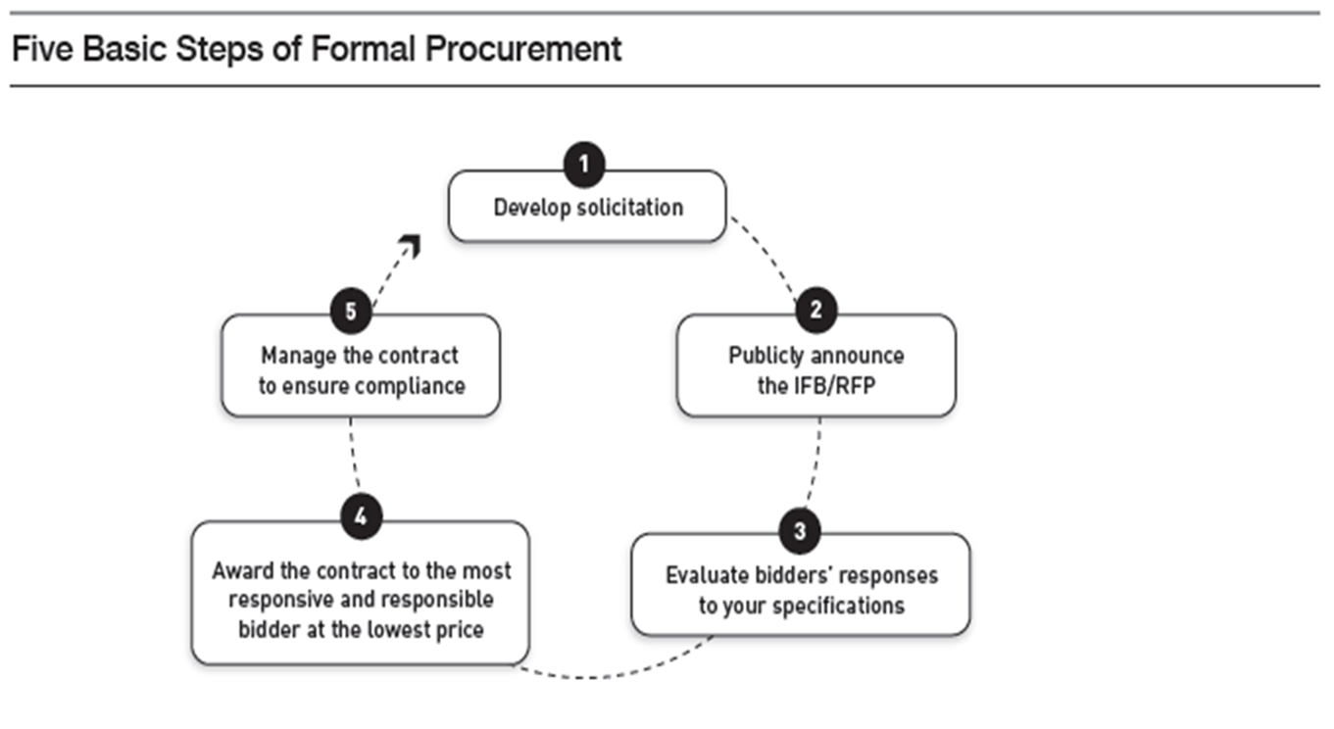
Sealed Bids Method
Notes:
The five steps to Competitive Sealed Bids.
Draft solicitation language that reflects the terms, conditions, and requirements of the intended agreement. This will include specification of products, services to be performed, delivery requirements, and packing conditions. Solicitations must also state the criteria against which the bidders will be evaluated. This is also where the NSLP and SBP Sponsors will include the Buy American Provision if purchasing food products in accordance with 7 CFR 210.21(d) and where a Program Sponsor can choose to include a geographic preference for unprocessed or minimally processed food products in accordance with applicable program regulations.
Announce the solicitation in print, such as in the newspaper of general circulation or an online electronic procurement system such as OregonBuys for a minimum of 14 days in accordance with OAR 137-047-0300. As long as the information is made publicly available, Program Sponsor may also contact known bidders that have expressed an interest to foster full and open competition. Program Sponsor must also take affirmative steps to include small, minority, women, and labor surplus firms when possible in accordance with 2 CFR 200.321.
Conduct your Public Opening and Evaluate responses using criteria outlined in the solicitation. Program Sponsor will need to objectively document the evaluation of every bid and make this documentation part of their procurement files. They may need to provide it if they are ever required to demonstrate full and open competition was maintained or receive a public information request.
Award a firm fix price contract to the lowest price, responsive and responsible vendor.
5. Lastly, manage the contract: Ensure the Program Sponsor receives everything from the vendor that the contract stipulates.

Slide 9
Summary of Sealed Bids
Invitation for bids must be publicly advertised.
A complete, adequate, and realistic specification or purchase description is available.
Two or more responsible bidders are willing and able to compete effectively for the business.
All bids will be opened at the time and place prescribed in the invitation for bids, and for local and tribal governments, the bids must be opened publicly.
The procurement lends itself to a firm fixed price contract and the selection of the successful bidder can be made principally on the basis of price.
Notes:
The Sealed bids procurement method in which bids are publicly solicited and a firm fixed-price contract (lump sum or unit price) is awarded to the responsible bidder whose bid, conforming with all the material terms and conditions of the invitation for bids, is the lowest in price. Program Sponsors must publicly advertise their solicitation and must publicly open all bids at the time and place set in the solicitation.

Slide 10
References
2 CFR 200.319(d)
2 CFR 200.320(b)(1)
ORS 279B.055
OAR 137-047-0255
OAR 137-047-0300
Oregon Senate Bill 1047
Oregon Department of Education Child Nutrition Program Procurement Resources

Slide 11
Non-Discrimination Statement
In accordance with federal civil rights law and U.S. Department of Agriculture (USDA) civil rights regulations and policies, this institution is prohibited from discriminating on the basis of race, color, national origin, sex (including gender identity and sexual orientation), disability, age, or reprisal or retaliation for prior civil rights activity. Program information may be made available in languages other than English. Persons with disabilities who require alternative means of communication to obtain program information (e.g., Braille, large print, audiotape, American Sign Language), should contact the responsible state or local agency that administers the program or USDA's TARGET Center at (202) 720-2600 (voice and TTY) or contact USDA through the Federal Relay Service at (800) 877-8339.
To file a program discrimination complaint, a Complainant should complete a Form AD-3027, USDA Program Discrimination Complaint Form which can be obtained online at: https://www.usda.gov/sites/default/files/documents/ad-3027.pdf, from any USDA office, by calling (866) 632-9992, or by writing a letter addressed to USDA. The letter must contain the complainant's name, address, telephone number, and a written description of the alleged discriminatory action in sufficient detail to inform the Assistant Secretary for Civil Rights (ASCR) about the nature and date of an alleged civil rights violation. The completed AD-3027 form or letter must be submitted to USDA by:
mail: U.S. Department of Agriculture Office of the Assistant Secretary for Civil Rights 1400 Independence Avenue, SW Washington, D.C. 20250-9410; or
fax: (833) 256-1665 or (202) 690-7442; or
email: Program.Intake@usda.gov,
This institution is an equal opportunity provider

