Slide 1
Request for Proposals Procurement Method
Procurement in Child Nutrition Programs
2 CFR 200.320(b)(2)
Notes:
Today we will talk about the competitive proposal procurement method or commonly referred to as Request for Proposals as outlined in 2 CFR 200.320(b)(2). This is a formal competitive procurement method in which proposals are publicly solicited and a fixed-price or cost reimbursable contract is awarded to the responsible offeror whose proposal is most advantageous to the Program Sponsor, with price and other factors considered in accordance with the written method for conducting the technical evaluations and making selections.

Slide 2
Method of Procurement to be Followed
The Program Sponsor must have and use its own Documented Procurement Procedures.
Procedures must be consistent with the standards outlined in:
2 CFR 200.318 through 200.327;
Applicable program regulations; and
State, local, or tribal laws or regulations.
Notes:
The Program Sponsor must have and use their own documented procurement procedures, consistent with the standards of 2 CFR 200.318 through 200.327, applicable program regulations, and State statute when using the Request for Proposal procurement method for the acquisition of goods or services required under the Federal award.

Slide 3
Fragmentation
A Program Sponsor may not artificially divide or fragment a procurement so as to constitute a less restrictive procurement method.
Notes:
A Program Sponsor may not arbitrarily split the aggregated dollar amount, artificially divide, or fragment the procurement so as to constitute a less restrictive procurement method.

Slide 4
Simplified Acquisition Threshold
The Program Sponsor is responsible for determining and documenting an appropriate simplified acquisition threshold based on internal controls, an evaluation of risk, and its documented procurement procedures.
The simplified acquisition threshold used by the Program Sponsor must be authorized or not prohibited under State, local, or tribal laws or regulations.
Federal simplified acquisition threshold is $350,000.00
State of Oregon simplified acquisition threshold is $250,000.00
Notes:
The Program Sponsor is responsible for determining and documenting an appropriate simplified acquisition threshold based on internal controls, an evaluation of risk, and its documented procurement procedures.
The simplified acquisition threshold used by the Program Sponsor must be authorized or not prohibited under State, local, or tribal regulations.
The current Federal simplified acquisition threshold is $350,000.00.
The current State of Oregon simplified acquisition threshold is $250,000.00.

Slide 5
Specification
Incorporate a clear and accurate description of the technical requirements for the material, product, or service to be procured.
The description may include a statement of the qualitative nature of the material, product or service to be procured and, when necessary.
Must set forth those minimum essential characteristics and standards to which it must conform if it is to satisfy its intended use.
Identify all requirements which the offerors must fulfill and all other factors to be used in evaluating proposals.
Notes:
The Program Sponsor documented procedures must ensure that all solicitations:
Incorporate a clear and accurate description of the technical requirements for the material, product, or service to be procured. Such description must not, in competitive procurements, contain features which unduly restrict competition. The description may include a statement of the qualitative nature of the material, product or service to be procured and, when necessary, must set forth those minimum essential characteristics and standards to which it must conform if it is to satisfy its intended use. Detailed product specifications should be avoided if at all possible. When it is impractical or uneconomical to make a clear and accurate description of the technical requirements, a “brand name or equivalent” description may be used as a means to define the performance or other salient requirements of procurement. The specific features of the named brand which must be met by offers must be clearly stated and identify all requirements which the offerors must fulfill and all other factors to be used in evaluating quotes, bids or proposals in accordance with 2 CFR 200.319(d).

Slide 6
Conditions
A complete, adequate, and realistic specification or purchase description is available.
Two or more qualified sources are willing and able to compete effectively for the business.
The procurement lends itself to a firm fixed price or cost reimbursable contract.
Generally used when conditions are not appropriate for the use of sealed bids.
Notes:
In order for competitive proposals to be feasible, the following conditions should be present:
A complete, adequate, and realistic specification or purchase description is available;
Two or more qualified offeror’s are willing and able to compete effectively for the business;
Either a fixed price or cost-reimbursement type contract is awarded, keep in mind that a cost plus a percentage of cost must not be used in accordance with 2 CFR 200.324(d); and
Conditions for the procurement are not appropriate for the use of sealed bids.

Slide 7
Requirements
Request for Proposals must be publicly advertised for a minimum of 30 days.
Must define the items or services in order for the proposer to properly respond.
Proposals will be scored in accordance with the written method for conducting technical evaluations of the proposals received and making selections.
A fixed price or cost reimbursable contract award will be made in writing to the responsible offeror whose proposal is most advantageous to the Program Sponsor, with price and other factors considered.
Notes:
If the competitive proposal procurement method is used, the following requirements apply:
Program Sponsor must perform a cost or price analysis in connection with every procurement action in excess of $350,000.00 in accordance with 2 CFR 200.324(a).
Take affirmative steps to assure the minority, women, and labor surplus firms are used when possible in accordance with 2 CFR 200.321.
Proposals must be solicited from an adequate number of qualified sources, providing them sufficient response time prior to the date set for proposals to be received. For local, and tribal governments, the request for proposals must be publicly advertised for a minimum of 30 days in accordance with OAR 137-047-0300;
The request for proposals, which will include any specifications and pertinent attachments, must define the items or services in order for the proposer to properly respond. It must also contain the applicable contract provisions described in 2 CFR 200 appendix II and program regulations.
A firm fixed price or cost reimbursable contract award will be made in writing to the offeror whose proposal is scored the highest in accordance with the technical evaluation. Keep in mind that USDA Policy Memo SP 12-2016; CACFP 05-2016, SFSP 09-2016 states that cost must be the primary factor in the scoring criteria; and
If a cost reimbursable contract is used, School Food Authorities must include the required contract provisions outlined in 7 CFR 210.21(f) and USDA Policy Memo SP 01-2011 Revised for the cost to be allowable.

Slide 8
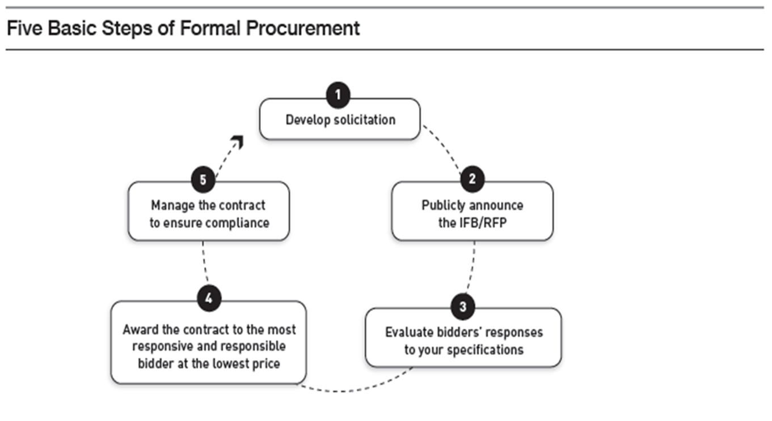
Request for Proposals Method
Notes:
The five steps to Competitive Proposals.
Draft solicitation language that reflects the terms, conditions, and requirements of the intended agreement. This will include specification of products, services to be performed, delivery requirements, and packing conditions. Solicitations must also state the criteria against which the bidders will be evaluated. This is where School Food Authorities will also include the Buy American Provision if purchasing food products in accordance with 7 CFR 210.21(d) and the required contract provisions if using a cost reimbursable contract in accordance with 7 CFR 210.21(f).
Announce the solicitation in print, such as in the newspaper or online procurement system for a minimum of 30 days. As long as the information is made publicly available, Program Sponsor may also contact known bidders to foster full and open competition. Program Sponsor must also take affirmative steps to include small, minority, women, and labor surplus firms when possible in accordance with 2 CFR 200.321.
Conduct your technical evaluation using criteria outlined in the solicitation. Program Sponsor will need to objectively document the evaluation of every proposal and make this documentation part of their procurement files. They may be need to provide it if they are ever required to demonstrate full and open competition was maintained or receive a public information request.
Award a firm fix price based on the best price or cost reimbursable contract to the highest scoring respondent.
5. Lastly, manage the contract: Ensure the Program Sponsor receives everything from the vendor that the contract stipulates.

Slide 9
Summary of the Request for Proposal
Request for Proposals must be publicly advertised.
A complete, adequate, and realistic specification or purchase description must be provided.
Two or more responsible proposers are willing and able to compete effectively for the business.
All proposals will be evaluated in accordance with the written method for conducting technical evaluations of the proposals received and making selections.
The procurement lends itself to a fixed price or cost reimbursable contract.
Notes:
The request for proposal procurement method in which proposals are publicly solicited and a firm fixed-price or cost reimbursable contract (lump sum or unit price) is awarded to the responsible respondent whose proposal, conforming with all the material terms and conditions of the request for proposal, is the most advantageous with price and other factors considered. Program Sponsors must publicly advertise their solicitation for 30 days. It is important to remember that cost reimbursable cost methods can only be used with the Request for Proposal procurement method. You must use a fix price cost method with the micro-purchases, small purchases, and IFBs procurement method.

Slide 10
References
2 CFR 200.319(d)
2 CFR 200.320(b)(2)
ORS 279B.060
OAR 137-047-0260
Oregon Department of Education Child Nutrition Program Procurement Resources

Slide 11
Non-Discrimination Statement
In accordance with federal civil rights law and U.S. Department of Agriculture (USDA) civil rights regulations and policies, this institution is prohibited from discriminating on the basis of race, color, national origin, sex (including gender identity and sexual orientation), disability, age, or reprisal or retaliation for prior civil rights activity. Program information may be made available in languages other than English. Persons with disabilities who require alternative means of communication to obtain program information (e.g., Braille, large print, audiotape, American Sign Language), should contact the responsible state or local agency that administers the program or USDA's TARGET Center at (202) 720-2600 (voice and TTY) or contact USDA through the Federal Relay Service at (800) 877-8339.
To file a program discrimination complaint, a Complainant should complete a Form AD-3027, USDA Program Discrimination Complaint Form which can be obtained online at: https://www.usda.gov/sites/default/files/documents/ad-3027.pdf, from any USDA office, by calling (866) 632-9992, or by writing a letter addressed to USDA. The letter must contain the complainant's name, address, telephone number, and a written description of the alleged discriminatory action in sufficient detail to inform the Assistant Secretary for Civil Rights (ASCR) about the nature and date of an alleged civil rights violation. The completed AD-3027 form or letter must be submitted to USDA by:
mail: U.S. Department of Agriculture Office of the Assistant Secretary for Civil Rights 1400 Independence Avenue, SW Washington, D.C. 20250-9410; or
fax: (833) 256-1665 or (202) 690-7442; or
email: Program.Intake@usda.gov,
This institution is an equal opportunity provider

