Slide 1
Buy American Provision Requirements
7 CFR 210.21(d)
USDA Memo SP 09-2025
USDA Memo SP 23-2024
USDA Memo SP 38-2017
USDA Memo SP 32-2019
Notes:
Hello, today I will go over the Buy American Provision requirements for the National School Lunch and School Breakfast program.

Slide 2
Purpose of the Buy American Provision
This provision supports the mission of the Child Nutrition Program, which is to:
Serve Children Nutritious Meals
Support Domestic Agriculture
Notes:
This provision supports the mission of the Child Nutrition Program, which is to serve children nutritious meals and support American agriculture.

Slide 3
Buy American Requirement
A school food authority must purchase, to the maximum extent practicable, domestic commodities or products.
School food authorities must include language requiring the purchase of foods that meet the Buy American requirements in all procurement procedures, solicitations, and contracts.
The Buy American provision applies to school food authorities located in the 48 contiguous United States
Notes:
Subject to 7 CFR 210.21(d), USDA FNS and the Oregon Department of Education Child Nutrition Program shall require that a school food authority purchase, to the maximum extent practicable, domestic commodities or products. School Food Authorities must include language in their documented procurement procedures requiring all solicitations and contracts for agricultural commodities to include the Buy American Provision requirements.

Slide 4
Definition of Domestic Commodity or Product
Domestic commodity or product means:
An agricultural commodity that is produced in the United States; and
A food product that is processed in the United States substantially using agricultural commodities that are produced in the United States.
Substantially using agriculture commodities that are produced in the United States means over 51 percent of a food product must consist of agricultural commodities that were grown domestically.
Notes:
The definition that USDA used to determine a domestic commodity is an agricultural commodity that is produced in the U.S. and a food product that is processed in the U.S. substantially using agricultural commodities produced in the U.S.
Substantially means over 51% from American products.
Therefore, over 51% of the final processed product (by weight or volume) must consist of agricultural commodities that were grown domestically.

Slide 5
Procurement Transactions
All procurement transactions for food when funds are used from the nonprofit food service account, whether directly by an SFA or on its behalf, must comply with the Buy American provision.
Notes:
All procurement transactions for food products when funds are used from the nonprofit food service account, whether directly by an SFA or on its behalf, must comply with the Buy American provision.

Slide 6
Exceptions to the Buy American Provision
The purchase of foods not meeting the definition in 7 CFR 210.21(d)(1) is only permissible when the following criteria are met:
The school food authority determines that one of the following limited exceptions is met:
The product is listed in the Federal Acquisitions Regulations (FAR) at 48 CFR 25.104 and/or is not produced or manufactured in the U.S. in sufficient quantities of a satisfactory quality; or
Competitive bids reveal the cost of a United States product is significantly higher than the non-domestic product.
Notes:
There are limited exceptions to the Buy American provision which allow for the purchase of foods not meeting the “domestic” standard as described in 7 CFR 210.21(d) (i.e., “non-domestic”). In circumstances when use of domestic foods is truly not practicable. These exceptions, as determined by the SFA, are:
• The product is listed in the Federal Acquisitions Regulations (FAR) at 48 CFR 25.104 and/or is not produced or manufactured in the U.S. in sufficient and reasonably quantities of a satisfactory quality; or
• Competitive bids reveal the costs of a U.S. product are significantly higher than the non-domestic product.

Slide 7
Using an Exception
Non-domestic food purchases (those that do not meet the definition of domestic commodity or product, must not exceed the following caps by the established deadlines:
By July 1, 2025, non-domestic food purchases must not exceed 10 percent of total annual commercial food costs that a school food authority purchases per school year.
By July 1, 2028, non-domestic food purchases must not exceed 8 percent of total annual commercial food costs that a school food authority purchases per school year.
By July 1, 2031, non-domestic food purchases must not exceed 5 percent of total annual commercial food costs that a school food authority purchases per school year.
Notes:
Non-domestic food purchases (those that do not meet the definition of domestic commodity or product, must not exceed the following caps by the established deadlines:
By July 1, 2025, non-domestic food purchases must not exceed 10 percent of total annual commercial food costs that a school food authority purchases per school year.
By July 1, 2028, non-domestic food purchases must not exceed 8 percent of total annual commercial food costs that a school food authority purchases per school year.
By July 1, 2031, non-domestic food purchases must not exceed 5 percent of total annual commercial food costs that a school food authority purchases per school year.

Slide 8
Documenting an Exception
School food authorities must document their justification for an exception, apart from when the item purchased is found on the FAR at 48 CFR 25.104 when using an exception under 7 CFR 210.21(d)(5)(i).
School food authorities must maintain documentation, to demonstrate that when using an exception under 7 CFR 210.21(d)(5)(i) of their non-domestic food purchases do not exceed the annual threshold specified in paragraph 7 CFR 210.21(d)(5)(ii).
Notes:
School food authorities must maintain documentation, except when the item purchased is found on the FAR at 48 CFR 25.104 when using an exception under 7 CFR 210.21(d)(5)(i).
School food authorities must also maintain documentation, to demonstrate that when using an exception under 7 CFR 210.21(d)(5)(i) of their non-domestic food purchases do not exceed the annual threshold specified in paragraph 7 CFR 210.21(d)(5)(ii).

Slide 9
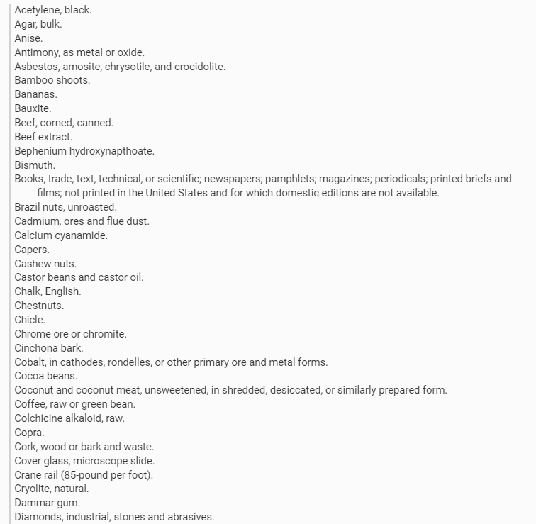
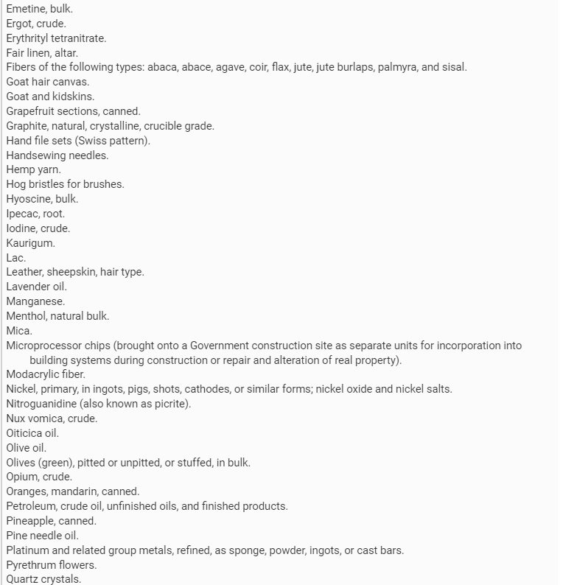
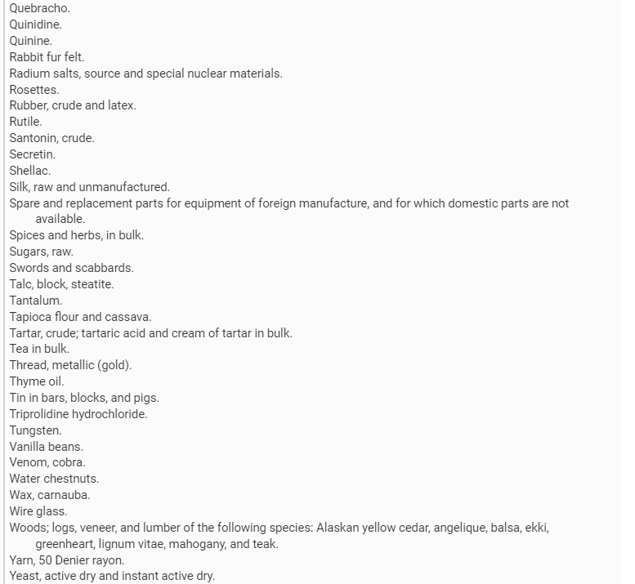


FAR: 48 CFR 25.104 Nonavailable Articles List
Notes:
The articles identified in this slide have been determined to be nonavailable in accordance with 25.103(b)(1)(i) and published in 48 CFR 25.104. This list will be published in the Federal Register for public comment no less frequently than once every five years.
Here are some of the items used in School Food Authority may use on this list:
Bananas
Beef Corned, Canned
Beef Extract
Cashew Nuts
Castrol Beans and Castrol Oil
Chestnut
Cocoa Beans
Coconut and Coconut Meat, unsweetened, in shredded or in similar prepared form
Grapefruit sections, canned
Olive Oil
Olives (green), pitted or unpitted, or stuffed in bulk
Oranges, Mandarin, Canned
Pineapple, Canned
Spices and herbs, in bulk
Sugar, Raw
Tea in Bulk
Thyme Oil
Vanilla Beans
Water Chestnuts
Yeast, Active Dry and Instant Active Dry

Slide 10
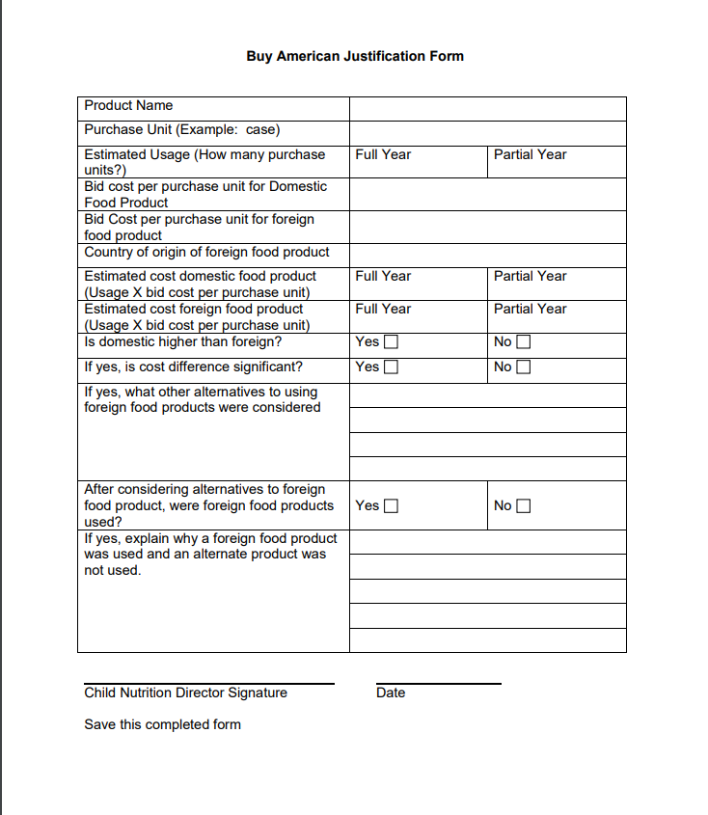
ODE CNP Buy American Exception Form
Notes:
School Food Authorities can use the ODE CNP Buy American Provision exception form if the item is not listed in the Nonavailable Articles List in 48 CFR 25.104 to document their exceptions.

Slide 11
USDA Exception Tracking Standard Form
The USDA Exceptions Tracking Standard Form is an optional template that school food authorities can use to document the use of exceptions to purchase non-domestic foods under the Buy American provision.
The purpose of this form is to track both the exceptions and costs related to non-domestic product purchases.
School food authorities can input data related to non-domestic product costs in the Exceptions Tracker tab
The Exceptions Summary tab will help the school food authority calculate its percentage of costs from non-domestic products within a specified time frame.
Notes:
The Exceptions Tracking Standard Form is an optional template that school food authorities can use to document the use of exceptions to purchase non-domestic foods under the Buy American provision. The purpose of this form is to track both the exceptions and costs related to non-domestic product purchases. School food authorities can input data related to non-domestic product costs in the Exceptions Tracker tab, and the Exceptions Summary tab will help the school food authority calculate its percentage of costs from non-domestic products within a specified time frame.

Slide 12
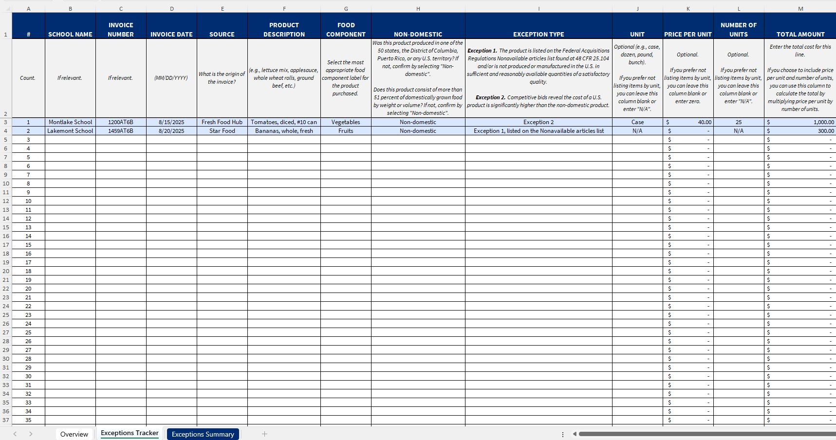
USDA Buy American Exceptions Tracking Standard Form
Notes:
Here is an example of the USDA Buy American Exceptions Tracking Standard Form to document and track the use of exceptions.

Slide 13
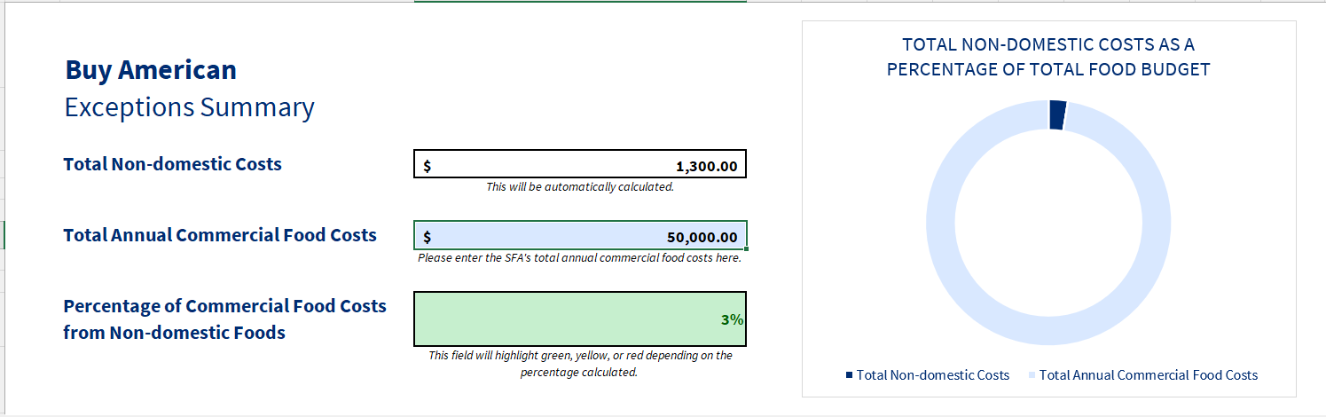
Buy American Exception Summary
Notes:
The Buy American Exception Summary is link to Exceptions Tracker and will calculate the percentage of non-domestic food purchased to meet the exception threshold tracking requirements.

Slide 14
Buy American Exception Threshold Accommodation Process for SY 2025-2026
The accommodation process provides the State Agency the ability to approve temporary relief for school food authorities (SFAs) that demonstrate they cannot meet the thresholds for non-domestic food purchases.
Only available for non-domestic purchases that qualify under one or more of the regulatory exceptions.
SFAs seeking a temporary accommodation from the Buy American threshold requirement must complete and submit to their State agency the “SFA Accommodation Plan SY 2025-2026.
State agencies must review complete requests for accommodation and may approve these requests.
State agencies should report to USDA WRO on a quarterly basis the total number of accommodations requested, the total number approved, and the types of non-domestic food products purchased by SFAs requesting the accommodation.
Notes:
USDA Memo SP 09-2025 provides a Buy American accommodation process for School Year 2025-2026. The accommodation process provides the State Agency the ability to approve temporary relief for school food authorities (SFAs) that demonstrate they cannot meet the thresholds for non-domestic food purchases established in 7 CFR 210.21(d)(5) and 7 CFR 220.16(d)(5). USDA also included the accommodation provision in Program regulations to provide temporary relief from the Buy American threshold as the State agency works with the SFA to increase their domestic purchases. A temporary accommodation for the threshold requirement is only available for non-domestic purchases that qualify under one or more of the regulatory exceptions. The streamlined accommodation process will allow SFAs to exceed the 10 percent threshold while making progress towards coming into compliance with the Buy American threshold requirement. SFAs seeking a temporary accommodation from the Buy American threshold requirement, using the streamlined process for SY 2025-2026, should complete and submit to their State agency the “SFA Accommodation Plan SY 2025-2026”. State agencies should review complete requests for accommodation in a timely manner and may approve these requests. State agencies should report to their Food and Nutrition Service (FNS) Regional Offices on a quarterly basis the total number of accommodations requested, the total number approved, and the types of non-domestic food products purchased by SFAs requesting the accommodation.

Slide 15
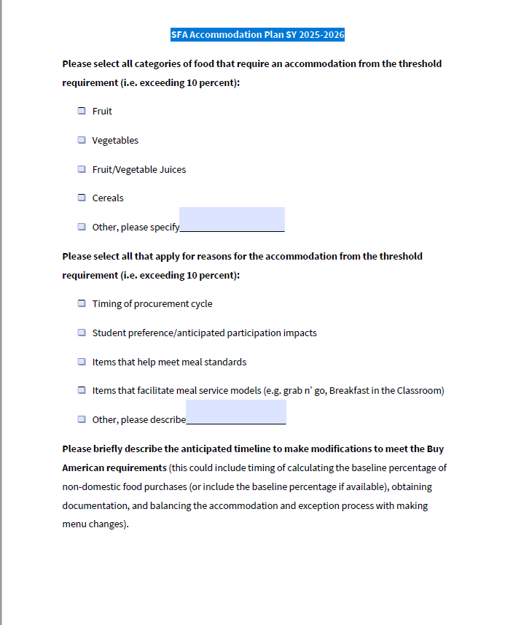
SFA Accommodation Plan SY 2025-2026
Notes:
Here is a copy of the USDA school food authority accommodation plan in USDA memo SP 09-2025 that must be submitted to the State agency for review and approval.

Slide 16
Implementation of the Buy American Provision
Include in Documented Procurement Procedures
Include in all Procurement Solicitations and Contracts for School Nutrition
Ensure Compliance Through Contract Monitoring
Verify if Items are listed in 48 CFR 25.104 Nonavailable Articles List
Verifying cost and availability of Domestic and Non-Domestic foods using data in the USDA Agricultural Marketing Service’s (AMS)
Track Exceptions using the USDA Exception Tracking Standard Form or Similar Tool
Submit Accommodation Plan for SY 2025-2026 to the State Agency as soon as you know you cannot meet the thresholds for non-domestic food purchases.
Notes:
To ensure compliance with the Buy American provision, the SFA must ensure solicitation and contract language includes the requirement for domestic agricultural commodities and products. The SFA must also include the Buy American requirement in its documented procurement procedures and retain records documenting any exceptions. SFAs should ask the supplier, i.e., manufacturer or distributor, for specific information about the percentage of U.S. content in any processed end product. In order for a SFA to be able to document the domestic content, they should include in their procurement process a requirement for certifying the domestic percentage of the agricultural food component of commodities and products.
Further, solicitation and contract language must be monitored by the SFA to determine contractor compliance as required in order to ensure that contractors perform in accordance with the terms, conditions, and specifications of their contracts or purchase orders. Monitoring is also accomplished by reviewing products and delivery invoices or receipts to ensure the domestic food that was solicited and awarded is the food that is received. SFAs also need to conduct a periodic review of storage facilities, freezers, refrigerators, dry storage, and warehouses to ensure the products received are the ones solicited, awarded, and comply with the Buy American provision.
SFA must track exceptions using the USDA Exception Tracking Standard Form or a Similar Tool.

Slide 17
Monitoring by State Agencies.
During a Procurement Review:
Determine if SFAs are purchasing domestic commodities as defined in 7 CFR 210.21(d)
Check that solicitations and contracts contain the Buy American certification language
Review a sample of supplier invoices or receipts to determine whether the solicited for domestic foods were provided by the awarded contractor
Verify the SFA has not exceeded establish exception threshold by the established deadlines
During an Administrative Review:
Look at the labels on a variety of food products in SFA storage facilities
Request documentation justifying the limited exception(s) for non-domestic that are not identified in 48 CFR 25.104
Verify the SFA has not exceeded establish exception threshold by the established deadlines
Notes:
Monitoring of the Buy American provision by State agencies. State agencies conducting procurement reviews in conjunction with, or as a separate review from, the administrative review process must ensure SFA compliance with the Buy American provision. During a procurement review, State agencies should:
Determine if SFAs are purchasing domestic commodities as defined in 7 CFR 210.21(d);
Verify the SFA has not exceeded establish exception threshold by the established deadlines
Check that solicitations and contracts contain the Buy American language.
Review a sample of supplier invoices or receipts to determine whether the solicited-for domestic foods were provided by the awarded contractor. If the SFA is non-compliant with the Buy American provision, the State agency must issue a finding and require corrective action which may include:
• Requiring contract amendments to include language to supply domestic foods, or a new solicitation if the contract amendment is determined, by the contracting parties or State agency, to be a material change;
• Attending a procurement training to increase compliance with procurement standards, including the Buy American provision; and
• Fiscal action for repeat or egregious findings, on a case-by-case basis with approval by the appropriate FNS Regional Office.
During an on-site administrative review, State agencies should look at the labels on a variety of food products in SFA storage facilities and if the State agency identifies non-domestic foods, the State agency must request documentation justifying the limited exception(s) outlined above. If such is not provided, the State agency must issue a finding and require corrective action, which may include:
• Verify the SFA has not exceeded establish exception threshold by the established deadlines
Requiring review of food deliveries for contractor compliance;
• Monitoring to ensure the correct domestic food components contracted for are delivered;
• Prior to accepting foods, ensuring that an alternative domestic food component, or an exception to purchase non-domestic foods, has been approved for delivery; and
• Fiscal action for repeat or egregious findings, on a case-by-case basis with approval by the appropriate FNS Regional Office.
Both the administrative review and procurement review teams should work together and communicate findings in order to provide comprehensive monitoring of the Buy American requirement.

Slide 18
References
7 CFR 210.21(d) and 7 CFR 220.16(d)- Buy American Provision
USDA Memo SP 09-2025 outlines Buy American Accommodation Process for School Year 2025-2026
USDA Policy Memo SP 23-2024 identifies the Buy American Provisions Related to the Final Rule
USDA Policy Memo SP 38-2017 outlines the compliance and enforcement of the Buy American Provisions in detail.
USDA Policy Memo SP 32-2019 provides clarification on the treatment of harvested fish under the Buy American Provision.
Notes:
Here are the reference identifying the requirements for the Buy American Provision the School Food Authorities should reference.

Slide 19
Non-Discrimination Statement
In accordance with federal civil rights law and U.S. Department of Agriculture (USDA) civil rights regulations and policies, this institution is prohibited from discriminating on the basis of race, color, national origin, sex (including gender identity and sexual orientation), disability, age, or reprisal or retaliation for prior civil rights activity. Program information may be made available in languages other than English. Persons with disabilities who require alternative means of communication to obtain program information (e.g., Braille, large print, audiotape, American Sign Language), should contact the responsible state or local agency that administers the program or USDA's TARGET Center at (202) 720-2600 (voice and TTY) or contact USDA through the Federal Relay Service at (800) 877-8339.
To file a program discrimination complaint, a Complainant should complete a Form AD-3027, USDA Program Discrimination Complaint Form which can be obtained online at: https://www.usda.gov/sites/default/files/documents/ad-3027.pdf, from any USDA office, by calling (866) 632-9992, or by writing a letter addressed to USDA. The letter must contain the complainant's name, address, telephone number, and a written description of the alleged discriminatory action in sufficient detail to inform the Assistant Secretary for Civil Rights (ASCR) about the nature and date of an alleged civil rights violation. The completed AD-3027 form or letter must be submitted to USDA by:
mail: U.S. Department of Agriculture Office of the Assistant Secretary for Civil Rights 1400 Independence Avenue, SW Washington, D.C. 20250-9410; or
fax: (833) 256-1665 or (202) 690-7442; or
email: Program.Intake@usda.gov,
This institution is an equal opportunity provider

