Slide 1
Geographic Preference
7 CFR 210.21(g)
USDA Memo SP 22-2024

Slide 2
Authority to Use Geographic Preference
Section 4302 of the Food Conservation and Energy Act of 2008 (P.L. 110-246) amended section 9(j) of the Richard B. Russell National School Lunch Act, 42 USC 1758(j) authorized use of a geographic preference.
The provision applied to schools, sponsors, and institutions participating in any Child Nutrition Program.
7 CFR 210.21(g) outlines the requirements when using a geographic preference.
Notes:
Section 4302 of the Food Conservation and Energy Act of 2008 (P.L. 110-246) amended section 9(j) of the Richard B. Russell National School Lunch Act, 42 USC 1758(j), authorized use of a geographic preference. The provision applied to schools, sponsors, and institutions participating in any CNP, including the National School Lunch Program (NSLP), School Breakfast Program (SBP), Fresh Fruit and Vegetable Program (FFVP), Special Milk Program (SMP), Child and Adult Care Food Program (CACFP), Summer Food Service Program (SFSP), and Seamless Summer Option (SSO), as well as to purchases made for these programs by State agencies and USDA DoD Fresh.

Slide 3

Application of Geographic Preference
Can only be used when procuring unprocessed locally grown or locally raised agricultural products.
May use the term “locally grown”, “locally raised”, or “locally caught” as procurement specifications or selection criteria for unprocessed or minimally processed food items.
School food authorities have the discretion to determine the local area to which the geographic preference option will be applied, so long as there are an appropriate number of qualified firms able to compete.
Notes:
A school food authority participating in the Child Nutrition Program, as well as State agencies making purchases on behalf of such school food authorities, may apply a geographic preference when procuring unprocessed locally grown or locally raised agricultural products, including the use of “locally grown”, “locally raised”, or “locally caught” as procurement specifications or selection criteria for unprocessed or minimally processed food items. When utilizing the geographic preference to procure such products, the school food authority making the purchase or the State agency making purchases on behalf of such school food authorities have the discretion to determine the local area to which the geographic preference option will be applied, so long as there are an appropriate number of qualified firms able to compete;

Slide 4
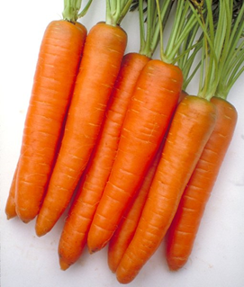


Definition of Unprocessed Agricultural Products
Means only those agricultural products that retain their inherent character.
The effects of the following food handling and preservation techniques shall not be considered as changing an agricultural product into a product of a different kind or character:
Cooling
Refrigerating
Freezing
Size adjustment made by peeling
Slicing
Dicing
Cutting
Chopping
Shucking
Pasteurization of milk
Grinding
Forming ground products into patties without any additives or fillers
Drying/dehydration
Washing; packaging (such as placing eggs in cartons)
Vacuum packing and bagging (such as placing vegetables in bags or combining two or more types of vegetables or fruits in a single package)
Addition of ascorbic acid or other preservatives to prevent oxidation of produce
Butchering livestock and poultry; cleaning fish
Notes:
For the purpose of applying the optional geographic procurement preference, “unprocessed locally grown or locally raised agricultural products” means only those agricultural products that retain their inherent character. The effects of the following food handling and preservation techniques shall not be considered as changing an agricultural product into a product of a different kind or character: Cooling; refrigerating; freezing; size adjustment made by peeling, slicing, dicing, cutting, chopping, shucking, and grinding; forming ground products into patties without any additives or fillers; drying/dehydration; washing; packaging (such as placing eggs in cartons), vacuum packing and bagging (such as placing vegetables in bags or combining two or more types of vegetables or fruits in a single package); the addition of ascorbic acid or other preservatives to prevent oxidation of produce; butchering livestock and poultry; cleaning fish; and the pasteurization of milk.

Slide 5
Implementation of Geographic Preference
CNP operators must ensure full and open competition when procuring goods.
Market research can help determine whether an adequate supply of local products exists in the marketplace.
Ensure you have an adequate number of local suppliers before applying local as a specification and/or applying a defined scoring advantage to one or more local unprocessed agricultural products.
Develop a solicitation that ensure an appropriate number of qualified firms are eligible to compete for the contract.
Notes:
In accordance with Federal procurement regulations at 2 CFR 200.319, CNP operators must ensure full and open competition when procuring goods by planning solicitations that ensure an appropriate number of qualified firms are eligible to compete for the contract. Market research can help determine whether an adequate supply of local products exists in the marketplace before applying local as a specification and/or applying a defined scoring advantage to one or more local unprocessed agricultural products. Market research on unprocessed local agricultural products may include a range of activities such as visiting local farmers’ markets, participating in local food vendor fairs, or issuing Requests for Information (RFIs), which are requests made by institutions for vendors to share information about the products and services they provide. Whether or not competition is adequately full and open is determined by the CNP operator and may be assessed as part of reviews of Program operations conducted by the State agency.

Slide 6
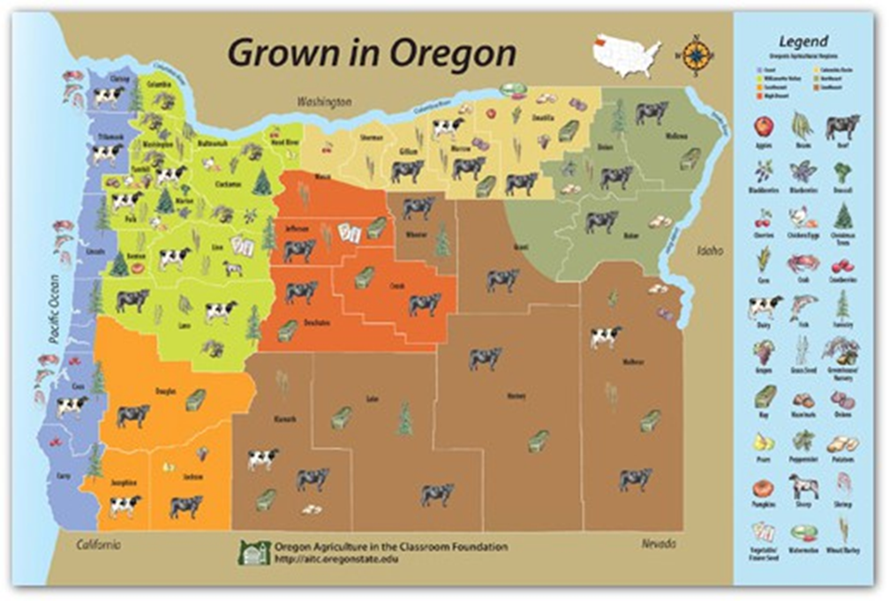
Grown In Oregon Image
Notes:
Here is a map of items grown and raised in Oregon to help with market research.

Slide 7
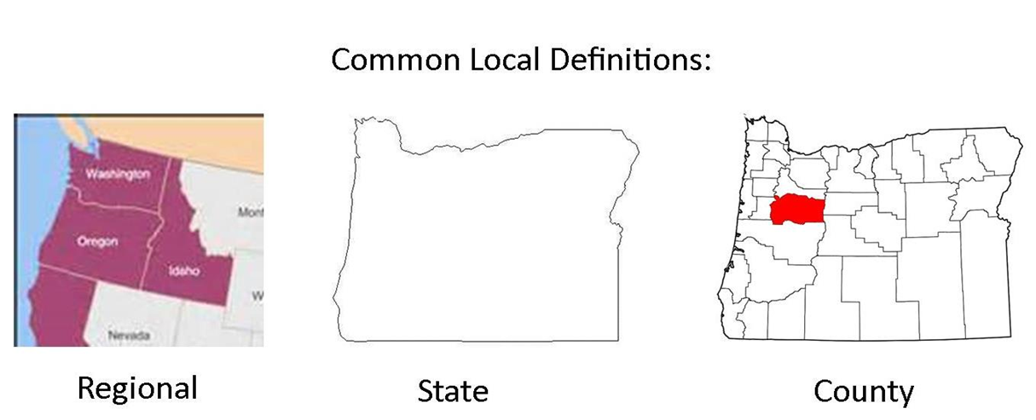
Including Geographic Preference in Solicitation
CNP operators may now use local (e.g., “locally grown”, “locally raised”, or “locally caught”) as a specification for local unprocessed agricultural products purchased for program meals.
CNP operators can require that an unprocessed agricultural product be locally grown, raised, or caught to meet the solicitation requirements and remove products or bids that do not meet this standard from consideration.
Notes:
Use local as a specification (i.e., the written description of a product or service that a vendor must meet to be considered responsive to a solicitation) for local unprocessed agricultural products;

Slide 8
Scoring Geographic Preference
Use local as a specification that a vendor must meet to be considered responsive to a solicitation
Use a defined scoring advantage (e.g., additional credit or points given to local unprocessed agricultural products during the evaluation of responses to a solicitation) for local unprocessed agricultural products.
Adopt a mix of both strategies; or
Elect not to use any of these approaches.
Notes:
CNP operators may choose to:
• Use local as a specification (i.e., the written description of a product or service that a vendor must meet to be considered responsive to a solicitation) for local unprocessed agricultural products;
• Use a defined scoring advantage (e.g., additional credit or points given to local unprocessed agricultural products during the evaluation of responses to a solicitation) for local unprocessed agricultural products;
• Adopt a mix of both strategies; or,
• Elect not to use any of these approaches.

Slide 9
Summary
CNP operators may now use locally grown, locally raised, or locally caught as a specification for local unprocessed agricultural.
Geographic Preference can only be used for unprocessed foods and that retain their inherent character.
May apply a geographic preference through additional points or credit during evaluation for local unprocessed agricultural products.
Require unprocessed agricultural product be locally grown, raised, or caught to meet the solicitation requirements and remove products or bids that do not meet this standard from consideration.
Must have an adequate number of suppliers to meet the full and open competition requirements.
Notes:
Here is a summary of the requirements when the geographic preference provision to a solicitation.
CNP operators may now use locally grown, locally raised, or locally caught as a specification for local unprocessed agricultural.
Geographic Preference can only be used for unprocessed foods and that retain their inherent character.
May apply a geographic preference through additional points or credit during evaluation for local unprocessed agricultural products.
Require unprocessed agricultural product be locally grown, raised, or caught to meet the solicitation requirements and remove products or bids that do not meet this standard from consideration.
Must have an adequate number of suppliers to meet the full and open competition requirements.

Slide 10
Non-Discrimination Statement
In accordance with federal civil rights law and U.S. Department of Agriculture (USDA) civil rights regulations and policies, this institution is prohibited from discriminating on the basis of race, color, national origin, sex (including gender identity and sexual orientation), disability, age, or reprisal or retaliation for prior civil rights activity. Program information may be made available in languages other than English. Persons with disabilities who require alternative means of communication to obtain program information (e.g., Braille, large print, audiotape, American Sign Language), should contact the responsible state or local agency that administers the program or USDA's TARGET Center at (202) 720-2600 (voice and TTY) or contact USDA through the Federal Relay Service at (800) 877-8339.
To file a program discrimination complaint, a Complainant should complete a Form AD-3027, USDA Program Discrimination Complaint Form which can be obtained online at: https://www.usda.gov/sites/default/files/documents/ad-3027.pdf, from any USDA office, by calling (866) 632-9992, or by writing a letter addressed to USDA. The letter must contain the complainant's name, address, telephone number, and a written description of the alleged discriminatory action in sufficient detail to inform the Assistant Secretary for Civil Rights (ASCR) about the nature and date of an alleged civil rights violation. The completed AD-3027 form or letter must be submitted to USDA by:
mail: U.S. Department of Agriculture Office of the Assistant Secretary for Civil Rights 1400 Independence Avenue, SW Washington, D.C. 20250-9410; or
fax: (833) 256-1665 or (202) 690-7442; or
email: Program.Intake@usda.gov,
This institution is an equal opportunity provider

