Slide 1

Fresh Fruit and Vegetable Program (FFVP) Training
FY 2025-2026
Updated September 2025

Slide 2

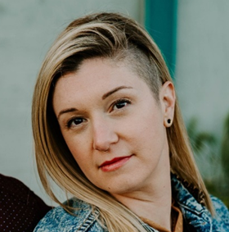
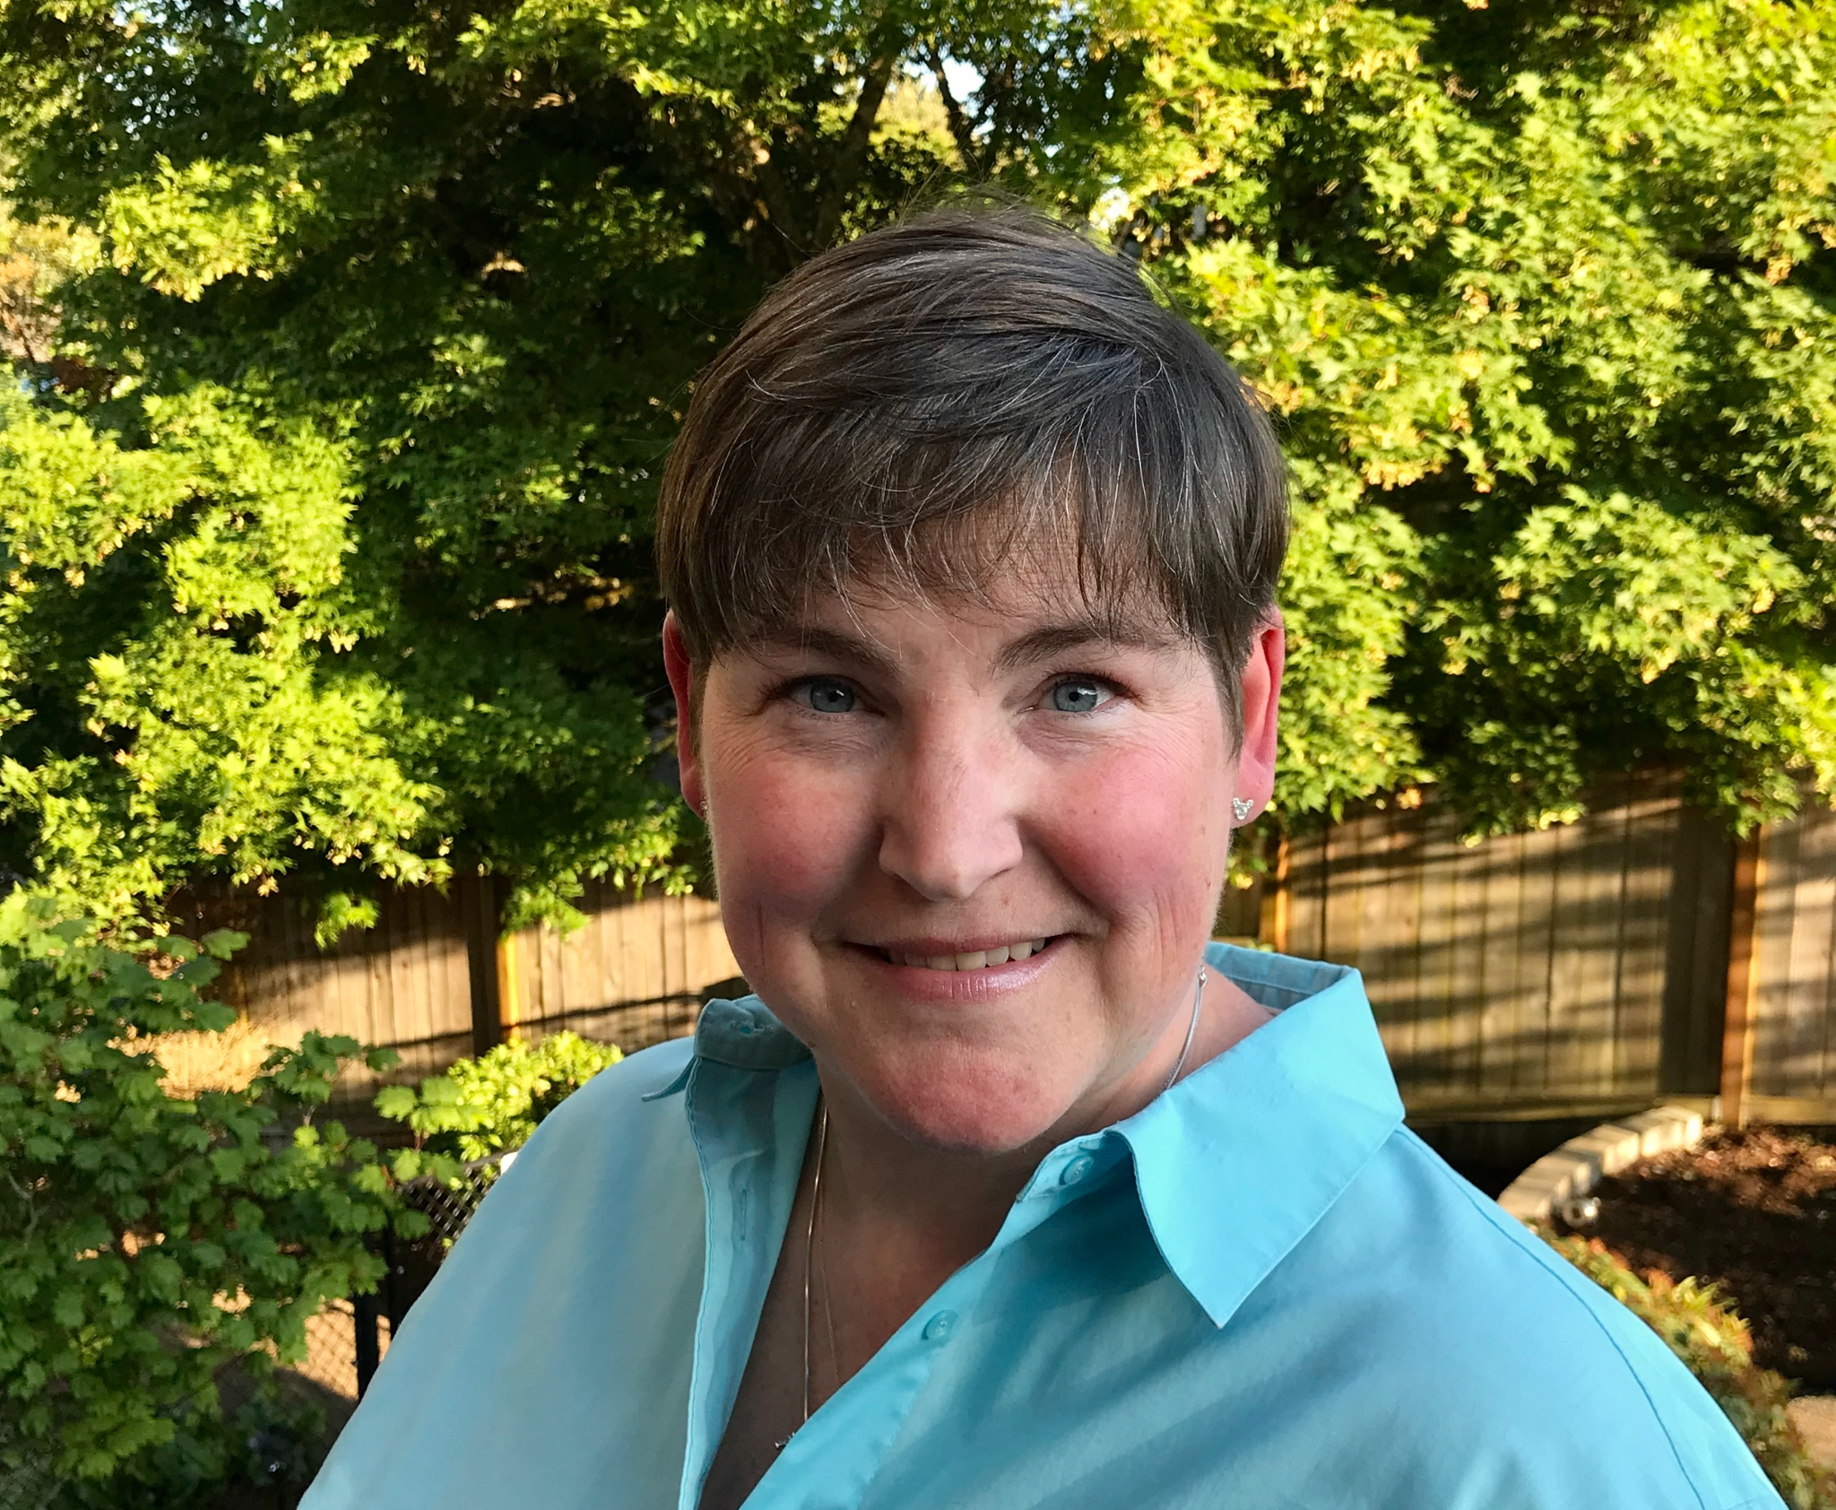
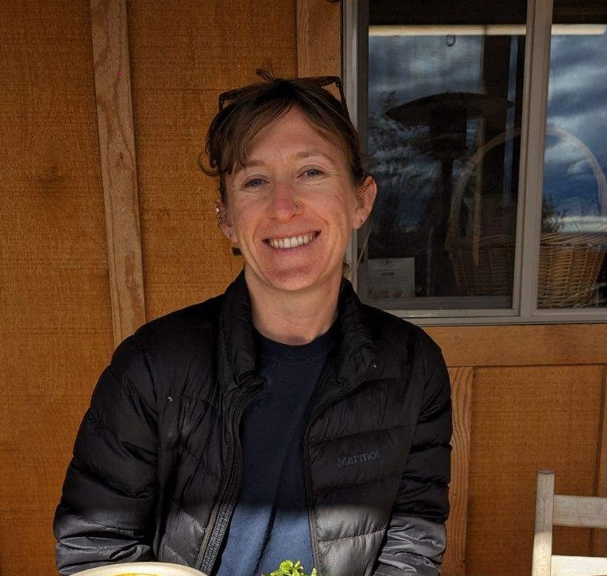
ODE’s
Team
Amy Lahrman
Program Analyst
D. Sanchez
Manager
Nadia Kelem
Office Specialist
ODE.FFVP@ode.oregon.gov
Notes:
ODE FFVP has it’s own email, please direct any FFVP related correspondence to ODE.FFVP@ode.oregon.gov

Slide 3

Who We Serve
547,424 Students*
“My vision is to make sure every child in Oregon is successful and has a safe place to receive a high-quality public education. I’ve seen firsthand how a positive student-teacher relationship can set a child on a successful path for the rest of their life. When we collaborate and build partnerships with students, educators and families we can advance equity and lead all students toward success.”
- Dr. Charlene Williams
More than 360 languages spoken
89,249 Educators
Staff of Color
14% of Teachers
14% of Administrators
20% of Counselors
25% of Educational Assistants
197 Districts
1,270 Schools
131 Charter Schools
19 Education Service Districts
*Numbers represent 2023-24

Slide 4


Purpose & Goals
Purpose: To provide free fresh fruits and vegetables to elementary students during the school day.
Goal: To introduce children to a variety of fresh, unprocessed fruits and vegetables they may not have had the opportunity to try, with the aim of increasing their acceptance and consumption over time.
Notes:
The purpose of the FFVP grant is to provide free fresh fruits and vegetables to elementary school students during the school day. The goal of the program is to introduce children to a variety of fresh, unprocessed fruits and vegetables they may not have had the opportunity to try, with the aim of increasing their acceptance and consumption over time. So rather than serving fruits and vegetables as a traditional snack program, the FFVP offers students a small taste or sampling experience to spark curiosity and increase their exposure to new produce.

Slide 5
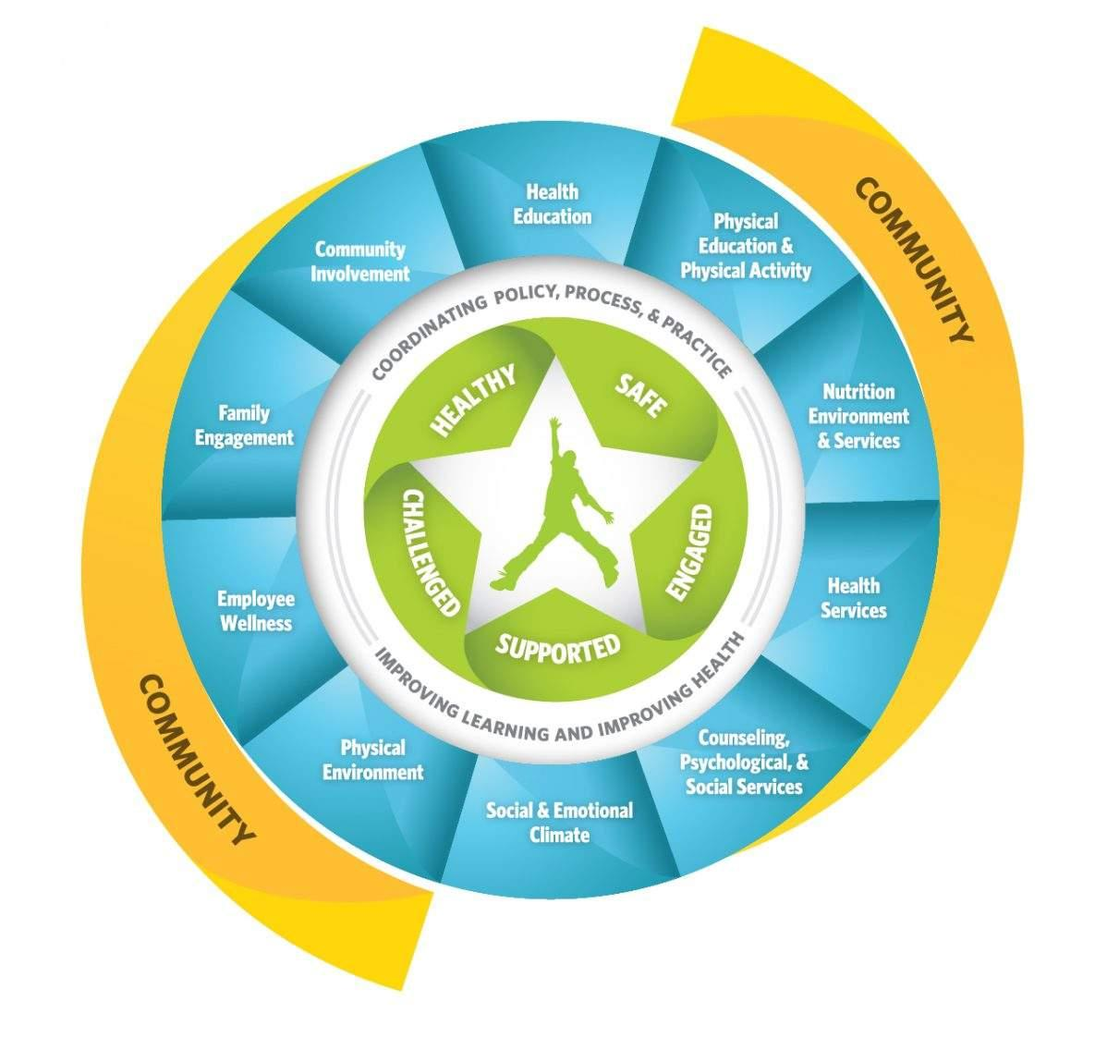
How FFVP Supports Whole Child Health
The FFVP supports the CDC's Whole School, Whole Community, Whole Child (WSCC) framework by aligning with two key components:
Nutrition Environment and Services
Health Education
Notes:
ODE’s Oregon Healthy Schools work that FFVP falls under is largely grounded in the CDC’s Whole School, Whole Community, Whole Child (WSCC) framework. The WSCC framework emphasizes that student success depends on safe, supportive environments and coordinated efforts, and can guide schools, families and communities to work together to keep kids healthy, safe, and ready to learn.
Several of the WSCC’s components are supported through the FFVP grant program:
Nutrition Environment and Services: FFVP improves the school nutrition environment by providing free fresh fruits and vegetables during the school day, encouraging healthier eating habits and increasing students’ exposure to a variety of produce.
Health Education is antoher: FFVP supports nutrition education by encouraging opportunities to teach students about healthy food choices, food origins, and the importance of fruits and vegetables in a nutritious diet.

Slide 6
Administration
The FFVP grant period follows the federal fiscal year: Oct. 1 - Sept. 30
USDA
ODE
Schools
Awards federal FFVP dollars to State agencies (such as ODE) according to a formula established by Congress.
Awards FFVP subgrants to schools that meet the FFVP eligibility criteria.
Provide free fresh fruits and vegetables to elementary students during the school day.
The FFVP is now part of the CNP Permanent Agreement.
There will not be a separate grant agreement.
Notes:
It’s important to note that the FFVP grant period follows the FEDERAL fiscal year, running October 1 through September 30th. This overlaps two school years, including August and September of the second year. This is important to consider when program planning and preparing your FFVP budget.
The USDA administers the FFVP at the federal level, awarding federal FFVP dollars to State agencies according to a formula established by Congress.
ODE administers the FFVP at the state level, awarding FFVP subgrants to schools that meet the grant’s eligibility criteria - which we’ll go into on the next slide.
Another important note - the FFVP is now part of the CNP Permanent Agreements, so there will not be a separate grant agreement issued for this grant.

Slide 7




Eligibility
There are four eligibility criteria that must be met before a school can participate in the FFVP.
Must serve elementary students (K-8)
Must participate in NSLP
40%+ F&R
(50%+ prioritized)
Must apply (if not already participating)
Notes:
There are four eligibility criteria that must be met before a school can participate in the FFVP
Schools must serve elementary students. In Oregon, elementary students are defined as K-8 students. This means that middle school students can participate in the program.
Schools must participate in the National School Lunch Program.
Schools must have 40% or more of students eligible for free or reduced-price meals, including Community Eligibility Provision (CEP). Schools with 50% or higher are prioritized, and we’ll discuss that on the next slide.
Lastly, schools must apply to participate, if they are not already participating.

Slide 8
Awards & Prioritization
Awards
$50–$75 per K–8 student.
Final per-student amount depends on:
  Funds availability
  Number of participating schools
Subgrants are awarded to individual schools, not school districts.
Districts may not move or reallocate funds from one school to another.
Funding Prioritization
50%+ students eligible for free or reduced-price (F&R) meals, including Community Eligibility Provision (CEP)
Schools with 40–49% F&R/CEP may apply.
  If funds remain after awarding 50%+, schools are awarded from highest to lowest %, until all funds are depleted.
Eligibility and awards are determined by using enrollment data from October of the prior year (Fall Membership Report)
Notes:
Awards and award calculations:
The USDA requires that FFVP award amounts are calculated between $50-$75 per student.
The final per-student amount ODE settles on depends on funds availability and the number of participating schools. Awards have been calculated at $68 per student for the last few years.
FFVP subgrants are award to individual schools, not school districts.
Districts may not shift funds from one FFVP school to another.
Funding Prioritization:
Schools with 50% or more of students eligible for free or reduced-price meals, including CEP are prioritized.
Schools between 40-49% F&R/ CEP may apply and be eligible - based on availability of funds.
If funds remain after all 50% and higher schools are awarded, school between 40-49% are awarded from highest to lowest percentage, until all funds are depleted.
Eligibility and awards are determined using enrollment data from last published ODE Fall Membership Report, which is data from October of the prior year. To calculate 2025-2026 awards, we used data from October 2024.

Slide 9
NEW: Automatic Rollover Eligibility
Each year 25% of FFVP funds are left unspent and returned to the USDA.
Participating schools will be automatically rolled over to the next FFVP grant period (FY26-27) if they meet the following eligibility criteria:
Programming deadline must be met
  Returning grantees - first month of the grant period (October).
  New grantees - second month of the grant period (November).
Grantees must claim at least 70% of their award
Must remain at least 50% F&R enrollment
  Those that fall between 40-49% may be awarded if funds allow.
Grantees that do not meet these criteria may be required to reapply to participate in the following FFVP grant period.
Notes:
Each year, Oregon awards all available FFVP funds; however, an average of over 25% goes unclaimed each year and is returned to USDA as unspent funds. Federal programs, such as the FFVP must demonstrate both effectiveness and financial accountability. For this reason, ODE is strengthening the eligibility requirements for automatic rollover into future grant cycles.
Participating schools will be automatically rolled over to the next FFVP grant period if they meet the following eligibility criteria:
Programming deadlines:
Returning grantees must begin programming within the first month of the grant period (October).
New grantees, those just starting their program, must begin programming by the second month of the grant period (November).
Claim percentage minimum:
Grantees must have claimed at least 70% of their award during the previous grant period.
To be eligible for automatic rollover into the 2026-2027 grant period, you must claim at least 70% of your 2025-2026 award.
Claim percentages will be reviewed after the April claim submission deadline (June 1). April marks the seventh month of the grant period and is considered a reasonable point by which schools should have claimed at least 70% of their FFVP award, and considering there are limited instruction days during the summer months that follow.
You are not required to accept your entire FFVP award if it exceeds your programming needs. More on budgeting and voluntary funds release in the next section.
Schools must remain at least 50% F&R enrollment
Participating schools must maintain a F&R percentage of 50% or higher. Those that fall between 40-49% may be awarded if funds allow. And schools that fall below 40% are no longer eligible.
Grantees that do not meet these criteria may be required to reapply to participate in the following FFVP grant period.
Certain exceptions may be made on a case-by-case basis.
The idea behind requiring the reapplication process is to have schools who aren’t meeting these expectations review their programming and budgeting and see where adjustments might be made to increase the success of their programs.

Slide 10
Program Planning
Buy-in:
District representatives must be aware of the plan to operate the FFVP in your school(s).
All staff designated to participate in the FFVP at your school(s) should have a clear understanding of the program and be prepared to engage in its implementation.
Notes:
Whether you are a successful FFVP applicant just starting the program or a returning grantee, you should already have your FFVP programming structured.
An essential component to keep in mind in your program planning is BUY IN. On the most basic level, district representatives need to be aware of the plan to operate the FFVP in your awarded school sites. All staff designated to participate in the FFVP, such as nutrition service directors and school cafeteria staff should have a clear understanding of the program and be ready to engage in its implementation. Teachers need to be involved and encouraged and educated on how to participate in the program. Based on feedback we received in listening sessions, we are working on developing TA to support your work to create buy-in with teachers
Also to keep in mind for your program planning is there are timelines to meet in starting your programming:
Returning grantees (Had an FFVP grant in 24-25) must begin programming within the first month of the grant period (October).
New grantees must begin programming by the second month of the grant period (November).

Slide 11
Program Planning
These programming aspects should be established:
FFVP draft menus.
Student feedback methods.
What days of the week you will serve FFVP.
Who will prepare items for service.
Who will deliver and serve the fresh fruits and vegetables.
When and where the students will be served.
How you will publicize the FFVP.
What nutrition education will be provided and what resources will be used.
Budgeting, purchasing, claims, and other administrative duties.
Notes:
In planning your program, these 9 items should be established:

Slide 12
Budgeting
Grantees must submit a preliminary budget for each awarded school by the given deadline.
Consider summer months.
Review your FFVP award and preliminary budget and consider voluntarily releasing any funds that exceed programming needs.
Through the voluntary fund release process this grant period, 7 additional schools were enabled to join the program.
Notes:
It is required that grantees submit a preliminary budget for each awarded school (this was due August 22 for returning grantees and new grantees must submit their preliminary budget before or with their first claim(s). Budget template is downloadable from the ODE FFVP webpage. includes food, operating costs, direct labor, and administrative labor. A budget template must be submitted for every awarded school.
Consider summer months: The FFVP grant period is October 1 2025 - September 30 2026: FFVP extends through the summer months, most schools have limited instructional days from June through August. FFVP may only be served during the regular school year. the grant period overlaps two school years, covering August and September of the 2026-2027 school year.
When you make your preliminary budget, Review your FFVP award and if you think the amount awarded to you won’t all get spent, consider voluntarily releasing any funds that exceed programming needs. Funds that exceed the programming needs at one FFVP school within a district cannot be reallocated to other participating FFVP schools in that district. Any voluntarily released funds will be added to additional schools applying to participate in the FFVP.
This grant period already, this voluntary review/ fund release process enabled 7 additional schools to join the program.

Slide 13
Purchasing
“Buy American” provision does not apply to FFVP purchases
Do not order FFVP items through FFAVORS
Maintain records
  District Administrative Reviews may include audits of FFVP claim records
  Retain FFVP records for 4 years (the current year + previous three years)
The school’s FFVP application
Purchase & procurement records
Invoices & receipts
Timesheets
Service calendars, menus, & production records, if applicable.
Notes:
The Buy American provision does not apply to FFVP
Buy American: The USDA has not updated their FFVP Handbook for Schools to reflect this information. Page 18 of the Handbook is incorrect. Additionally, the USDA informs readers that one way of ensuring compliance with the "Buy American" provision is by ordering through the DoD Fresh system. The USDA changed this in 2014
Schools may purchase produce for the FFVP from the DoD Fresh vendor of their choice, however, they may not use the FFAVORS system to do so.
Also remember to maintain your FFVP records for 4 years as District administrative reviews can include audits of FFVP claim records.

Slide 14
FFVP Service
Schools are strongly encouraged to serve the FFVP a minimum of two days per week.
Schools may choose how and where to distribute FFVP produce to students.
Student Eligibility and Service Guidelines
  Enrolled K-8 students; must be present during FFVP service
  Served during the school day, outside of reimbursable meal periods (ie breakfast or lunch)
  FFVP produce can not be used as gifts or rewards
  Schools can not withhold FFVP produce from students as a form of discipline
FFVP can benefit your school meal programs!
Notes:
Schools are strongly encouraged to serve the FFVP a minimum of two days per week.
Schools may choose their FFVP service methods and locations, however, FFVP may only be served to enrolled and present K-8 students, and it may only be served during the school day, outside of reimbursable meal periods.
Fruits and vegetables may not be used as gifts or rewards, and schools may not withhold FFVP service from students as a form of discipline.
FFVP can benefit your school meal programs as it’s a great way to introduce students to new fruits and veggies - track which items are popular and introduce them as regular offerings in your meal programs.

Slide 15
Teacher Participation
Teachers may participate in FFVP only if…
They are directly responsible for serving the fruit or vegetable to their students.
Best practices to consider while serving:
Encourage curiosity.
Encourage students to try a bite. Avoid pressuring them.
Acknowledge students who show a willingness to try new foods.
Avoid negative comments about fruits or vegetables.
Notes:
Teachers may participate in the consumption of FFVP offerings, only if they are directly responsible for serving the fruits and vegetables to their students.
The FFVP is not available to the general teacher population or other adults in the school. Teachers choosing to participate with their students are strongly encouraged to include a nutrition education component.
No additional FFVP funds are provided for teacher participation; schools must stay within their per student allocation.
Best practices to consider while serving:
Encourage curiosity.
Encourage students to try a bite. Avoid pressuring them.
Acknowledge students who show a willingness to try new foods.
Avoid negative comments about fruits or vegetables that you yourself may not enjoy.

Slide 16
Food Safety
To help prevent foodborne illness or injury from contaminated produce, ensure that all staff preparing and serving fruits and vegetables are trained in food safety.
Follow USDA Best Practices when handling produce for the FFVP.

Slide 17
Allowables Items
FRESH Fruits & Vegetables
  Cannot be canned, frozen, dried or otherwise processed.
  Can be pre-sliced, chopped, bagged, etc.
  Encourage children to try fruits and vegetables as they are - without dips or added ingredients
    Dips cannot be served with fruits. Dips can occasionally accompany vegetables. Low- or nonfat dip, or low-fat, yogurt-based dips. 1-2 tbl.
Cooked produce may be served up to one time per week
  Must be indicated on your monthly claim form AND be accompanied by a related nutrition lesson.
Best Practices: Present foods so children can easily recognize and identify them. If serving sliced, chopped, etc., display a whole version of the item.

Slide 18
UPDATED: Unallowable Items
“Standard fare” items
  Yellow bananas (cavendish)
    AKA “green tip”, “petite” on invoices
  Orange baby carrots, carrot sticks and coins.
  Golden Delicious, Red Delicious, Fuji, and Gala apples.
  Navel, Valencia and Cara Cara oranges
ODE allows and encourages serving lesser known varieties of bananas, carrots, apples and citrus!
Processed or preserved produce, fruit snacks (fruit strips or leather), carbonated fruit, flavored fruit, fruit juice, fruit dips, fruit or veggie pizza, non-fruit or vegetable items.
Notes:
There are certain varieties of fruits and vegetables ODE considers “Standard Fare” - these F&V are a very common variety, and regularly seen on the tray
Yellow bananas: Please note that 'petite' sometimes refers to a baby banana variety (such as Niños or Lady Fingers). If it’s simply referring to a smaller sized cavendish banana, those are unallowable. Labeling varies by supplier, so if you're unsure which type you're receiving, feel free to check with your distributor.
Carrots
Apples
Oranges.
Lesser known variety examples: Red or Burro bananas, Lady Fingers, or plantains. Rainbow carrots or carrots served with tops on. Apple varieties such as Honeycrisp, Opal, Pink Lady, Granny Smith, or Cosmic Crisp. Other citrus fruits, such as tangelos, pomelo, blood oranges, satsumas, or clementines.
Standard fare items will be accepted on claims on a case-by-case basis, and only when the situation cannot be avoided (vendor shortage, out of the ordinary circumstances that cause you to deviate from your plan)
Dips: While fruit dips are prohibited, dips can occasionally accompany vegetables. If serving a dip with a vegetable, it should be a low- or nonfat dip, or a low-fat, yogurt-based dip. Provide only a small serving size portion – usually about one or two tablespoons.

Slide 19
Nutrition Education
Nutrition education is most effective when paired with opportunities to taste fruits and vegetables.
Food service staff and instructional staff should collaborate on incorporating fruits and vegetables from the FFVP service into existing lesson plans.
Nutrition education is required when a fruit or veggie is served cooked (allowed 1x/week).
FFVP funds can not be used to purchase educational materials.
  Free resources are available on the USDA Team Nutrition webpage and ODE FFVP webpage.
Notes:
Nutrition education is greatly enhanced when paired with the opportunity to taste fresh fruits and vegetables.
Food service staff and instructional staff should collaborate on incorporating fruits and vegetables from the FFVP service into existing lesson plans.
Please note that Nutrition education is required when a fruit or veggie is served cooked (which is allowed 1x/week).
FFVP funds can not be used to purchase educational materials.
Free resources are available on the USDA Team Nutrition webpage and ODE FFVP webpage.

Slide 20
Program Promotion
Feature a “Produce of the Week”
Make Morning Announcements
Hold Poster or Art Contests
Share on School Websites, Social Media, & Newsletters
Incorporate into Class Lessons
Connect with Gardening Projects
Partner with Local Producers
Notes:
Feature a “Produce of the Week” – Share fun facts, nutrition info, and offer taste tests.
Make Morning Announcements – Highlight the daily fruit or veggie with a fun fact.
Hold Poster or Art Contests – Let students illustrate their favorite fruits and veggies.
Share on School Websites, Social Media, & Newsletters – Post photos, student quotes, and FFVP updates.
Incorporate into Class Lessons – Use FFVP in math, science, writing, or health lessons.
Connect with Gardening Projects – Tie these samples into to what students grow in school gardens.
Partner with Local Producers - Invite farmers to speak at school events or provide info about where the produce for FFVP came from.

Slide 21
Operating Costs
The majority of a school’s FFVP award must be spent on fresh produce
Operating Costs
Expenses directly related to the day-to-day functioning of the program.
    Supplies like napkins, plates, bowls, boats, etc.
    Smallwares like cutting boards, knives, mandolin, etc.
    Salaries and benefits for staff who prepare and serve the produce.
    Delivery and fuel charges.
May not exceed 30% of each monthly claim.
Notes:
The USDA has described FFVP operating costs as those “documented expenses for acquiring, delivering, preparing, and serving fruits and vegetables.”
That could include supplies like napkins, plates, bowls, smallwares like cutting boards, knives a mandolin, salaries and benefits for staff who prepare and serve the produce, and delivery and fuel charges related to procuring fruits and vegetables for this program.
Only the FFVP portion of operating and administrative costs (which we’ll talk about next) can be charged to the school’s FFVP grant.
For example, if produce is part of a larger shipment, only the FFVP portion may be charged. Similarly, if food service staff are preparing FFVP produce, only the time spent on FFVP tasks can be charged. The same applies to administrative costs—only those directly related to the program can be included in the grant.
These expenses May not exceed 30% of each monthly claim.
It is not required to claim operating costs in your reimbursement.

Slide 22
Administrative Costs
The majority of a school’s FFVP award must be spent on fresh produce
Administrative Costs
Expenses associated with FFVP programming that are not directly related to food or food preparation.
  Salaries and benefits for staff involved in administrative aspects of the FFVP.
May not exceed 10% of the total FFVP award.
Notes:
Expenses associated with FFVP programming that are not directly related to food or food preparation.
Salaries and benefits for staff involved in administrative aspects of the FFVP.
Only the FFVP portion of operating and administrative costs can be charged to the school’s FFVP grant.
May not exceed 10% of the total FFVP award.
Similarly to operating costs, administrative costs are not required to be claimed for reimbursement.

Slide 23
Equipment Purchases
Large equipment purchases may be reimbursed with a school's administrative funds (up to 10% of the total award).
Only the portion of time the equipment is used for FFVP purposes can be reimbursed.
$250+ must be approved prior to purchase.
Min. 1 month of FFVP programming before equipment requests are granted.
  Exceptions may apply for districts with prior FFVP participation requesting equipment for newly awarded schools.
Notes:
You can also use FFVP funds to purchase certain large equipment using administrative funds (up to 10% of the total award).
Large equipment examples: coolers, refrigerators
This is another case where If the equipment is used for both FFVP and other school activities, the time or usage related to FFVP must be prorated, and only that portion will be eligible for reimbursement. For example, if you purchase a cooler for $1000 but know you will be using half the space to store food for another program, you can only claim $500 for reimbursement.
To utilize administrative funds for large equipment purchases, any purchase over $250 must be approved prior to purchase, AND your FFVP programming must be underway for at least one month (as evidenced by claim submissions) before equipment requests are granted.
The FFVP Equipment Request Form is available on the ODE FFVP webpage

Slide 24
NEW: Claim Procedure Deadlines
Claims submissions indicate a school’s FFVP programming is underway.
Returning Grantees
Begin FFVP programming by the first month of the grant period (October).
New Grantees
Begin FFVP programming within the second month of the grant period (November).
30 Days
Monthly claim sheets must be submitted to ODE.FFVP@ode.oregon.gov for review within 30 days of the end of claim month.
60 Days
Reviewed and approved claims must be entered into ODE's Electronic Grants Management System (EGMS) within 60 days of the end of the claim month.
Notes:
New programming deadlines:
Returning Grantees - October
New grantees - November
Claim submissions indicate a school’s programming is underway.
30 day
60 days (federal claim deadline)

Slide 25
Late Claim Exceptions
If you miss a federal claim deadline (60 days), you may request a one-time late claim exception. ODE can grant this exception only once every 36 months per Child Nutrition Program, per Sponsor.
Notes:
The FFVP Equipment Request Form is available on the ODE FFVP webpage

Slide 26
Claim Workbook Template
Excel workbook available for download on the ODE FFVP webpage
FFVP claims must be submitted on the most updated version of the template.
  Changes may be made to the claim template throughout the grant period.
Submit a monthly claim workbook for each FFVP site.
There are seven sheets in the FFVP claim template workbook…

Slide 27
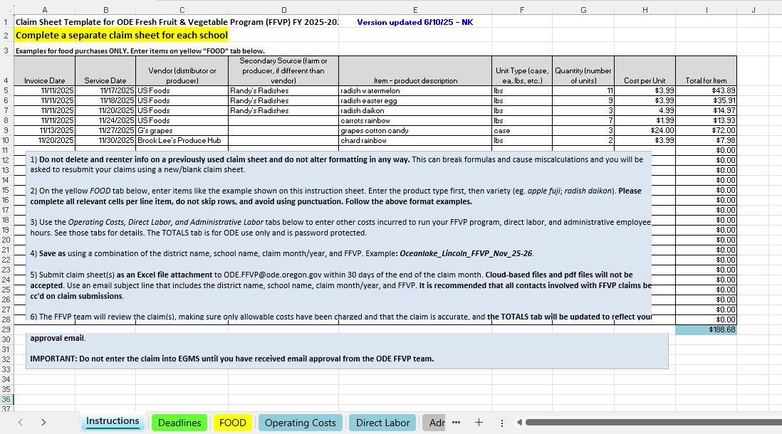
Instructions Tab
Examples for the FOOD tab, file name and email subject line formatting guidance, and claim submission instructions.
Notes:
Complete a claim sheet for each school, each month.
Instructions and Guidance - Read through the information when preparing your claims until you are familiar with the claim process.
Date the sheet was last updated - You should periodically check the ODE FFVP webpage for the most updated version of the claim sheet template.
Item formatting examples - Enter the item type first, then the variety.

Slide 28
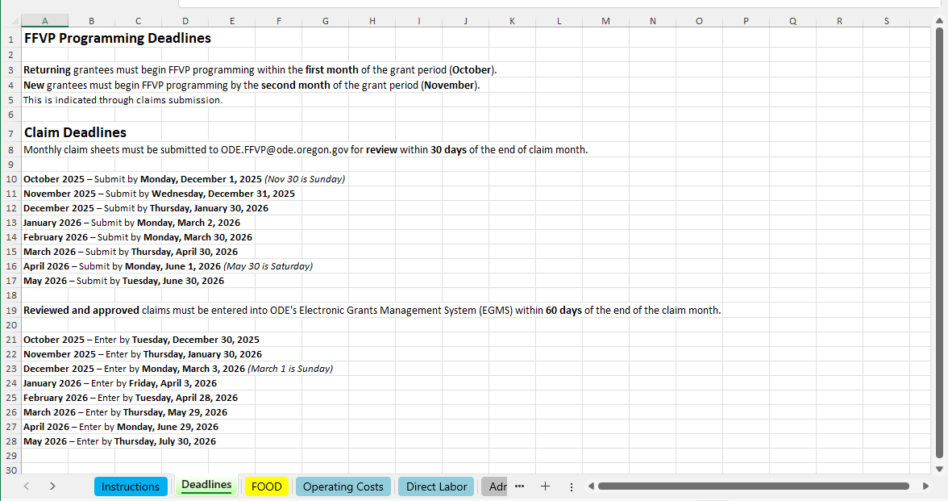
2. Deadlines Tab
Reference tab for FFVP programming, claim submission and claim entry deadlines.

Slide 29
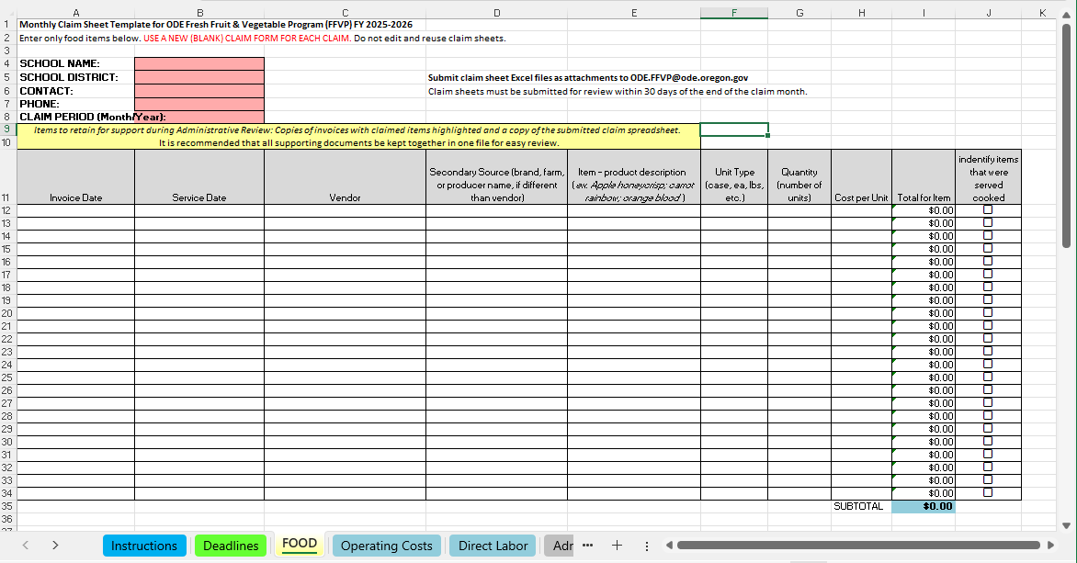
3. Food Tab
All fields on the Food tab must be completed. Do not skip lines. Each line item must have an invoice date and a service date.
Notes:
Please use a blank claim form for each claim - Do not delete or re-enter data on a previously used claim sheet, or alter its formatting in any way. Doing so can break the embedded Excel formulas, and you will be asked to resubmit your claims using a new, blank claim sheet.
Do not leave Invoice Date or Service Date lines blank.
Produce items: Please enter the product type first, then variety. (Apples Cosmic Crisp, Bananas red)
FFVP Only - Only the FFVP portion of these expenses may be charged to the school’s FFVP grant. If your school receives its FFVP produce as part of a larger shipment, only the portion used specifically for FFVP may be charged to the school’s subgrant award.
Subtotal will auto populate on the TOTAL tab
Do not submit invoices with claims. Do retain them for your records.

Slide 30
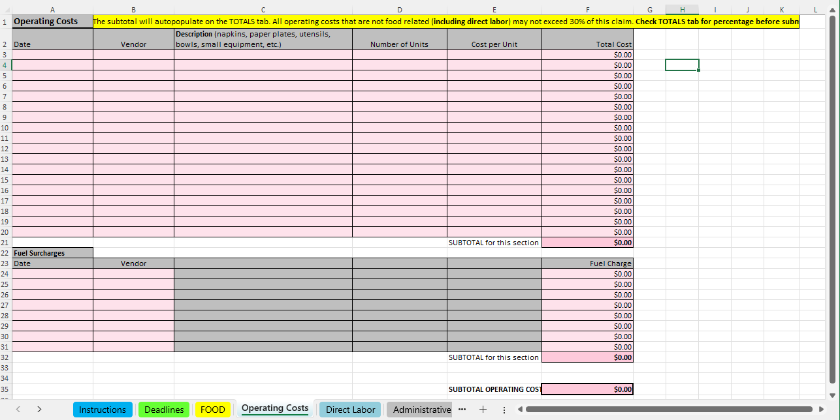
4. Operating Costs Tab
Notes:
The USDA has described FFVP operating costs as those “documented expenses for acquiring, delivering, preparing, and serving fruits and vegetables.”
On this tab, expenses may include costs associated with procuring fruits and vegetables; serving items, such as bowls, paper plates, and napkins; and delivery charges.
Totals will autopopulate on the TOTALS tab
30% cap: Operating costs—excluding food but including direct labor—should not exceed 30% of the total monthly claim. This includes expenses such as labor, fuel surcharges, and smallwares (e.g., knives, mandolin, cutting board). Check the totals tab once you have completed the claim sheet to ensure your operating costs do not exceed 30% of the claim.

Slide 31
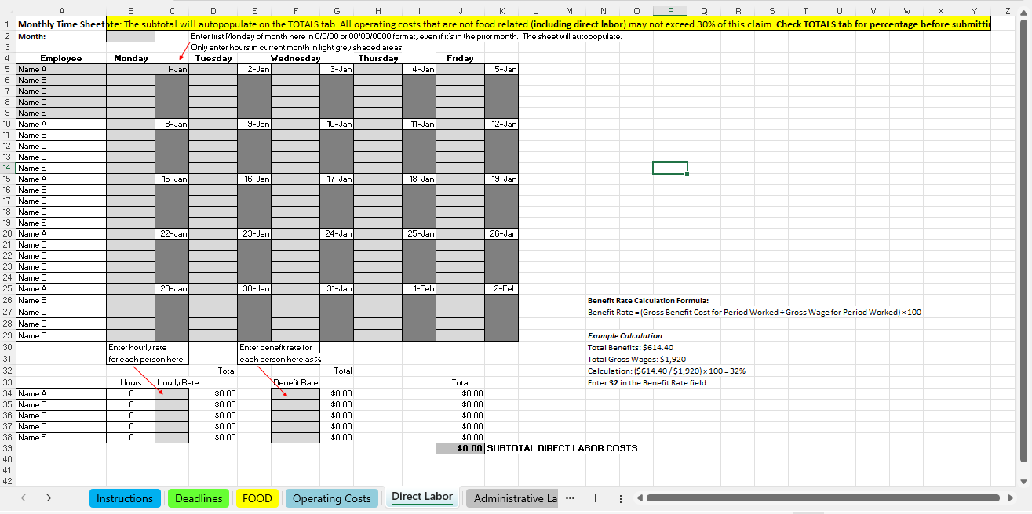
5. Direct Labor Tab
Notes:
FFVP Direct Labor refers to the time school staff spend specifically on Fresh Fruit and Vegetable Program activities. This can include tasks like preparing, portioning, and distributing the fruits and vegetables, as well as cleaning up after service. Only the time directly related to FFVP operations can be claimed as direct labor.
Enter employees names under “employee” column: Staff records showing FFVP time worked may be requested.
Enter the first Monday of the month where the red arrow points. Even if that Monday is in the previous month. The rest of the days in the month will auto-fill.
Enter hours in the light grey cells
Direct Labor is combined with Operating Costs. All Operating Costs, including Direct Labor, may not exceed 30% of a claim.
Enter benefit rate as a percent. To find the benefit rate, refer to the example on right side of this tab.
FFVP only - Only the FFVP portion of these expenses can be charged to the school’s FFVP grant. If your food service staff are preparing and serving the FFVP produce, then only their time spent working on the FFVP may be charged to the school’s subgrant award.

Slide 32
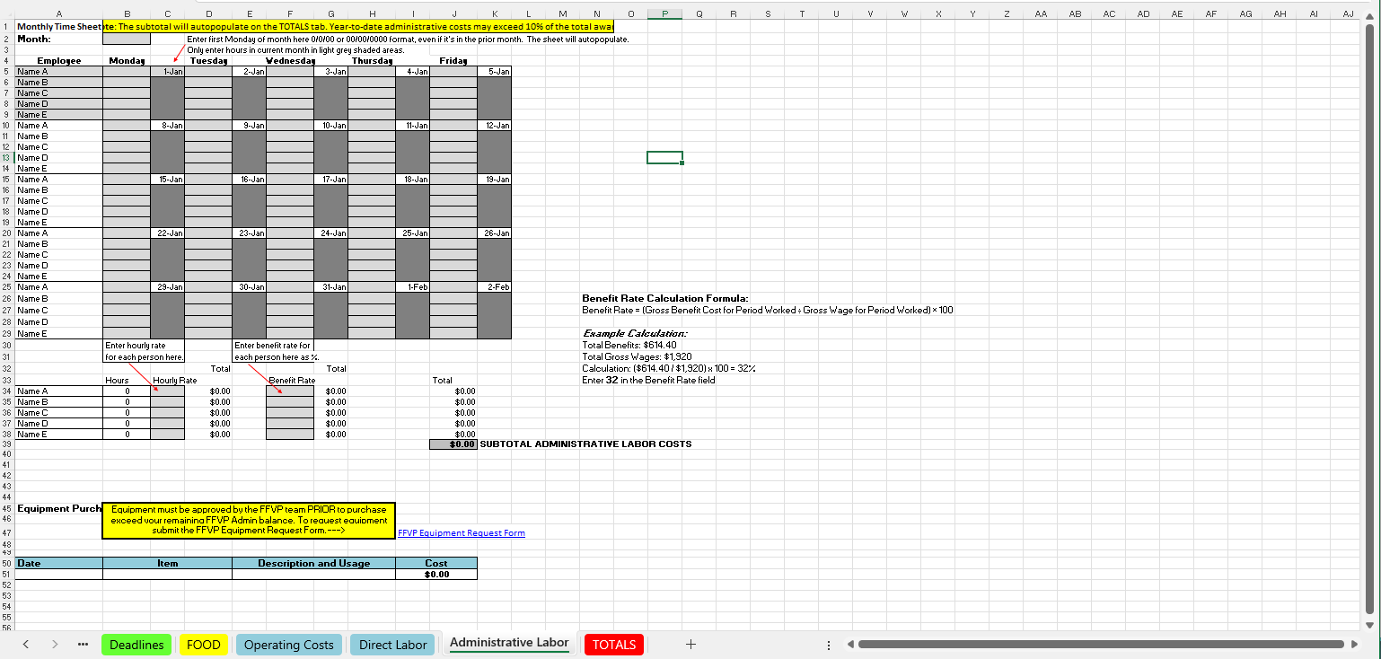
6. Administrative Labor Tab
Notes:
FFVP Administrative Labor is time spent on managing the program, such as paperwork, tracking expenses, ordering, and coordinating activities related to FFVP.

Slide 33
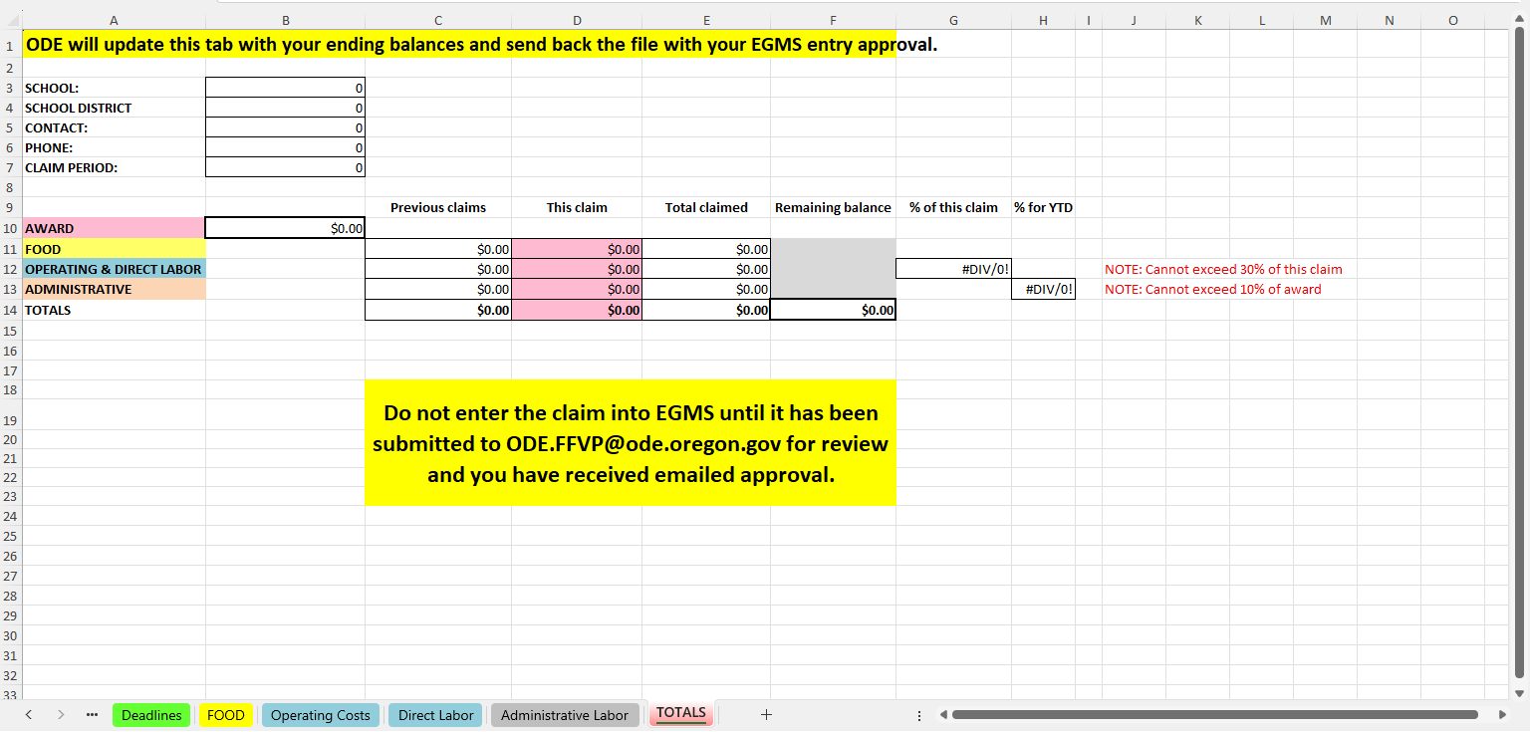
7. Totals Tab
This tab is for ODE use only and is password protected.
Notes:
School and contact info: info entered on the Food tab will autopopulate here
ODE will review the claim and update this tab. The reviewed claim sheet, with the updated Totals tab, will be returned with your claim approval email.
The combined operating cost percentage of the claim will calculate here. Verify that this percentage does not exceed 30%. If it does, adjust the claim accordingly to bring it to 30% or below.
You must receive approval to enter claims into EGMS. Claims entered into EGMS before they are approved will be automatically rejected.

Slide 34
Claims Steps
Each month, download and complete FFVP claim sheet Excel template from ODE FFVP webpage.
2. Save as: district name, school name, claim month/year, and FFVP.
(Waterloo_WaterElem_April26_FFVP)
3. Submit claim sheet(s) as an Excel file attachment within 30 days of the end of the claim month. CC all relevant individuals (NSD, Business Manager, etc.)
4. The FFVP team will review the claim(s) and complete the TOTAL tab.
5. The FFVP team will reply all with approval to enter the claim amount(s) into EGMS. The reviewed and approved claim sheet file(s) will be attached to the approval email.
6. After claims are approved by FFVP team, enter your claim amount(s) into EGMS.
7. FFVP subgrant recipients are reimbursed through EGMS. Approved claims in EGMS are processed weekly.
Notes:
1. Complete a separate claim sheet each month for every participating school.
3. Cloud-based files and pdf files will not be accepted. Use an email subject line that includes the district name, school name, claim month/year, and FFVP. It is recommended that all contacts involved with FFVP claims be cc'd on claim submissions.
4. The FFVP team will review the claim(s), making sure only allowable costs have been charged and that the claim is accurate, and the TOTAL tab will be updated to reflect your new ending balance.
5. FFVP Team make take up to 2 weeks to process claims, plan accordingly around monthly claim deadlines.
Claims must be submitted for review and pre-approved before they are entered into EGMS. This is to avoid unnecessary delays in processing due to errors or claims with potential unallowable items or charge: If a claim has already been entered into EGMS(opens in a new tab) and an error is discovered, the claim will have to be rejected, corrected, resubmitted, pre-approved and reentered. To avoid this, do not enter claims into EGMS(opens in a new tab) without first receiving approval.

Slide 35
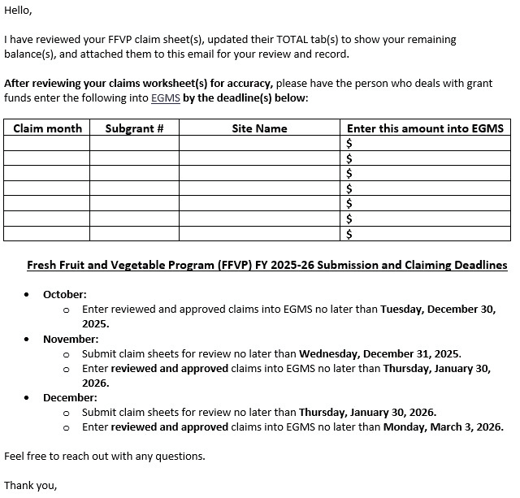
EGMS Entry Approval
Reviewed claim sheet(s) with the Totals tabs updated showing your ending balances will be attached to the approval email for your records.
You may enter the claims into EGMS only after you have received this email.
Notes:
The FFVP team will reply all to all individuals included on the claim submission email.
Includes subgrant number, amount, and a snapshot of upcoming deadlines.

Slide 36








Resources
The USDA FFVP Handbook
The USDA's Fresh Fruit and Vegetable Program Resource Center
USDA Team Nutrition education resources
The Oregon Harvest for Schools main page
ODE's Fresh Fruit and Vegetable Program webpage
ODE's Farm to Child Nutrition Programs webpage
Oregon Agriculture in the Classroom
Grow Portland
The USDA's Choose My Plate website
Oregon Healthy Schools webpage
Notes:
There are many resources available to you, everything from tools for how to find produce to purchase, to educational materials, and of FFVP specific documents like claim forms are available on the ODE FFVP webpage. These slides will be shared on our website with links after the training for you to access.

Slide 37

An attestation is required for official participation in the grant training. This slide deck is only a reference resource. Grantees must complete the self-guided online training, with the attestation linked at the end.
Notes:
An attestation is required for official participation in the grant training. This slide deck is only a reference resource. Grantees must complete the self-guided online training, with the attestation linked at the end.

Slide 38

In accordance with Federal civil rights law and U.S. Department of Agriculture (USDA) civil rights regulations and policies, the USDA, its Agencies, offices, and employees, and institutions participating in or administering USDA programs are prohibited from discriminating based on race, color, national origin, sex, disability, age, or reprisal or retaliation for prior civil rights activity in any program or activity conducted or funded by USDA.
Persons with disabilities who require alternative means of communication for program information (e.g. Braille, large print, audiotape, American Sign Language, etc.), should contact the Agency (State or local) where they applied for benefits. Individuals who are deaf, hard of hearing or have speech disabilities may contact USDA through the Federal Relay Service at (800) 877-8339. Additionally, program information may be made available in languages other than English.
To file a program complaint of discrimination, complete the USDA Program Discrimination Complaint Form, (AD-3027) found online at https://www.usda.gov/oascr(opens in a new tab), and at any USDA office, or write a letter addressed to USDA and provide in the letter all of the information requested in the form. To request a copy of the complaint form, call (866) 632-9992. Submit your completed form or letter to USDA by:
(1) mail: U.S. Department of Agriculture
Office of the Assistant Secretary for Civil Rights
1400 Independence Avenue, SW
Washington, D.C. 20250-9410;
(2) fax: (202) 690-7442; or
(3) email: program.intake@usda.gov

