Slide 1

2026-2027 FFVP Grant Training
Updated September 2026

Slide 2
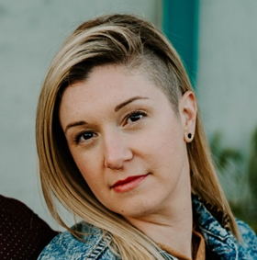
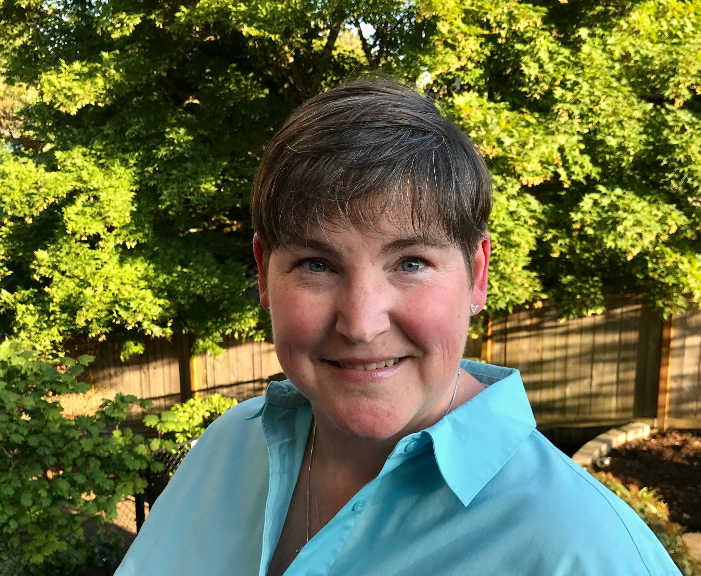
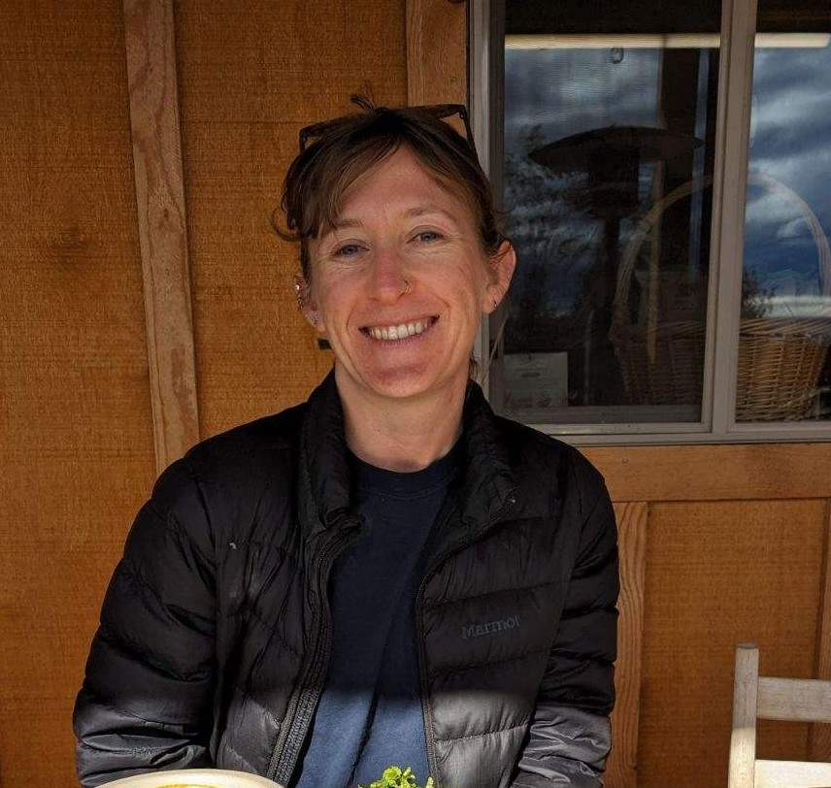
The ODE FFVP Team
Amy Lahrman
Program Analyst
D. Sanchez
Manager
Nadia Kelem
Office Specialist
ODE.FFVP@ode.oregon.gov

Slide 3
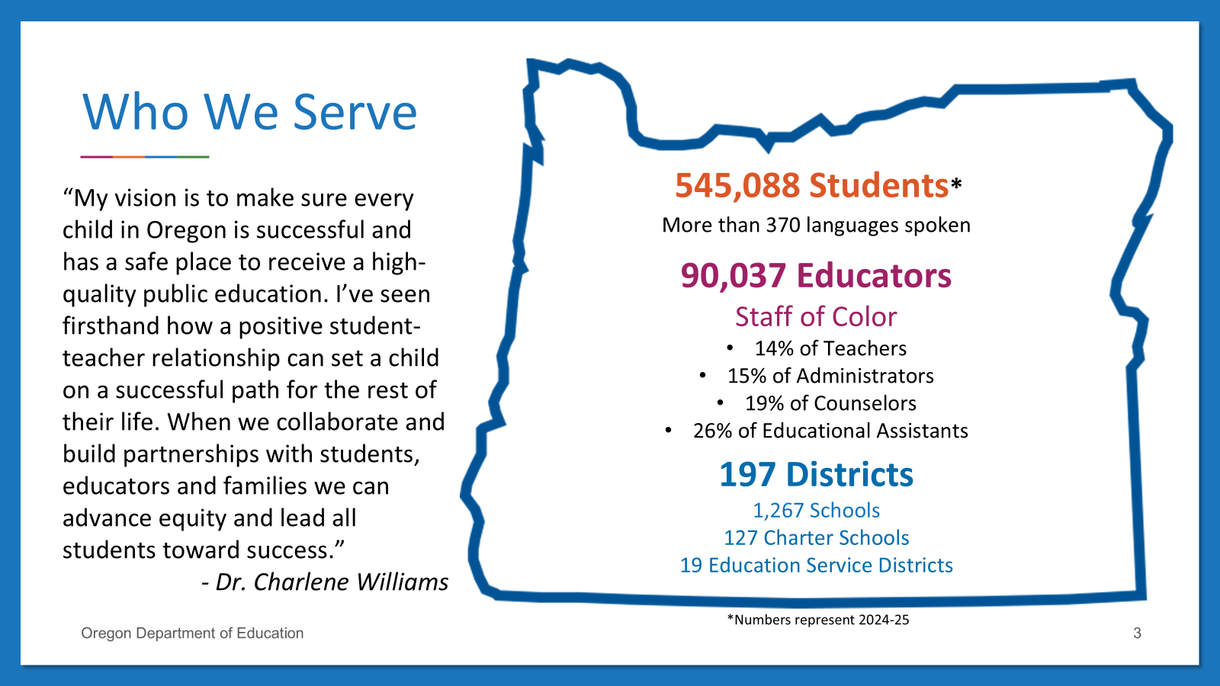

Who We Serve
547,424 Students*
“My vision is to make sure every child in Oregon is successful and has a safe place to receive a high-quality public education. I’ve seen firsthand how a positive student-teacher relationship can set a child on a successful path for the rest of their life. When we collaborate and build partnerships with students, educators and families we can advance equity and lead all students toward success.”
- Dr. Charlene Williams
More than 360 languages spoken
89,249 Educators
Staff of Color
14% of Teachers
14% of Administrators
20% of Counselors
25% of Educational Assistants
197 Districts
1,270 Schools
131 Charter Schools
19 Education Service Districts
*Numbers represent 2023-24

Slide 4


Purpose & Goals
Purpose: To provide free fresh fruits and vegetables to elementary students during the school day.
Goal: To introduce children to a variety of fresh, unprocessed fruits and vegetables they may not have had the opportunity to try, with the aim of increasing their acceptance and consumption over time.
Outcome: To build a foundation for lifelong nutrition and wellness.

Slide 5
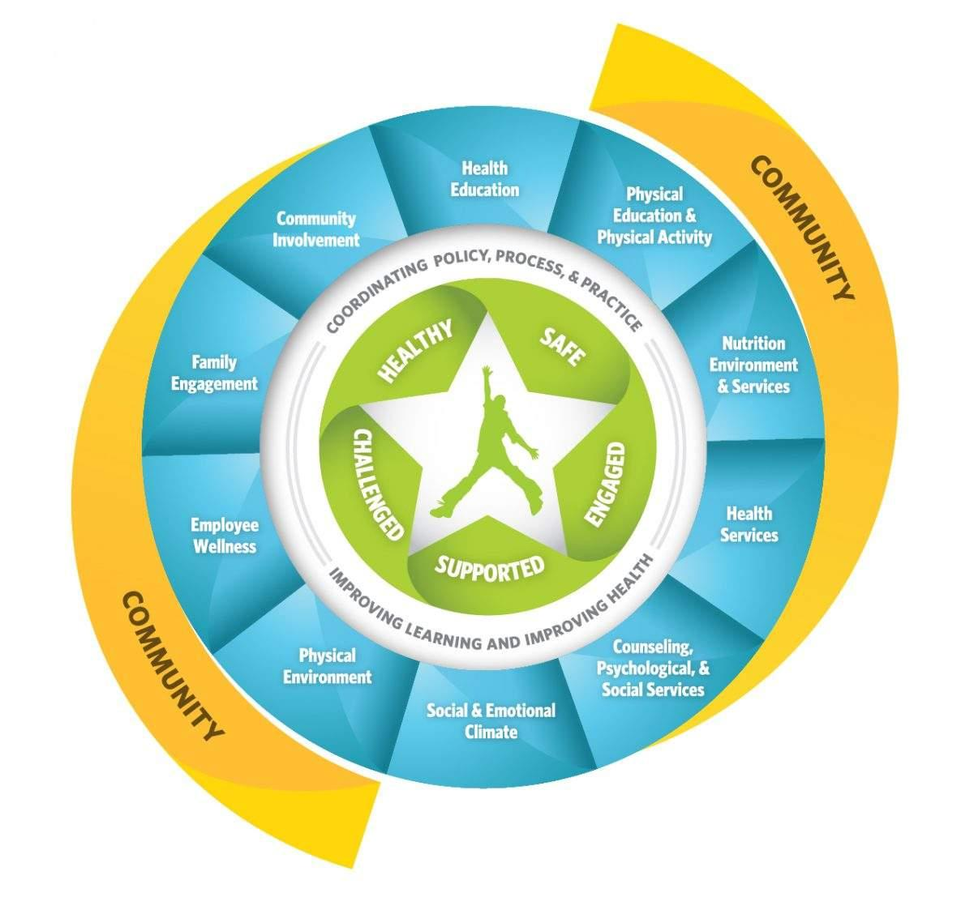
How FFVP Supports Whole Child Health
The FFVP supports the CDC's Whole School, Whole Community, Whole Child (WSCC) framework by aligning with two key components:
Nutrition Environment and Services
Health Education

Slide 6
Administration
USDA
ODE
Schools
Awards federal FFVP dollars to State agencies (such as ODE).
Awards FFVP subgrants to schools that meet the FFVP eligibility criteria.
Provide free fresh fruits and vegetables to elementary students during the school day, outside of regular mealtimes.
The FFVP grant period follows the federal fiscal year: Oct. 1 - Sept. 30
The FFVP is now part of the CNP Permanent Agreement.
There will not be a separate grant agreement.

Slide 7




Eligibility
There are four eligibility criteria that must be met before a school can participate in the FFVP.
Must serve elementary students (K-8)
Must participate in NSLP
40%+ F&R
(50%+ prioritized)
Must apply (if not already participating)

Slide 8
Awards & Prioritization
FFVP Awards
$50–$75 per K–8 student.
  Final per-student amount $68.
Subgrants are awarded to individual schools.
Districts may not move or reallocate funds from one school to another.
Funding Prioritization
50%+ students eligible for free or reduced-price (F&R) meals, including Community Eligibility Provision (CEP)
Eligibility and awards are determined by using enrollment data from October of the prior year.

Slide 9
Automatic Rollover Eligibility
Each year 25% of FFVP funds are left unspent and returned to the USDA.
ODE may wave the reapplication process for participating schools with continued high need operating successful programs = Automatic rollover.
Continued high need: Site must remain at least 50% F&R enrollment.
“Successful”:
Starts programming early in the grant period.
  Returning grantees: October
  New grantees: November
Demonstrates consistent program implementation.
Claims at least 70% of their total award.
Grantees that do not meet these criteria may be required to reapply to participate in the following FFVP grant period.

Slide 10
Automatic Rollover Eligibility Continued
Claimed percentage minimum
Grantees must claim at least 70% of their FFVP award during the previous grant period to be eligible for automatic rollover to the next grant period.
Claim percentages will be reviewed following the May claim submission benchmark (June 30).
  May represents the eighth month of the grant period and is considered a reasonable point by which schools should have claimed at least 70% of their award, given the limited instructional days remaining during the summer months.

Slide 11
Automatic Rollover Eligibility Continued 2
Because ODE must calculate awards for the upcoming grant period before the current grant period ends, automatic rollover eligibility for some sites may be determined using projections.
Eligibility determinations:
Eligible - Site has met all eligibility criteria.
Conditionally eligible - Site has claimed 50-69% and met programming start deadline. ODE projects site is likely to reach 70%+ by the end of the grant period. Claim projection submission is required.
Ineligible - Site has claimed 49% or less, and/or other factors identified. Must reapply.

Slide 12
Automatic Rollover Eligibility Continued 3
Grantees that do not meet these criteria will lose their priority for continued participation and must reapply for the next FFVP grant period.
Reapplicants will be placed back into the general applicant pool and awarded funding in order of need (FRL percentage).
You are not required to accept your entire FFVP award if it exceeds your programming needs.

Slide 13
Program Planning
One of the most important factors in a successful FFVP is buy-in from those responsible for supporting and implementing the program.
District representatives must be aware of the plan to operate the FFVP in your school(s).
All staff designated to participate in the FFVP at your school(s) should have a clear understanding of the program and be prepared to engage in its implementation.

Slide 14
Program Planning Continued
These programming aspects should be established:
FFVP draft menus.
Student feedback methods.
What days of the week you will serve FFVP.
Who will prepare items for service.
Who will deliver and serve the fresh fruits and vegetables.
When and where the students will be served.
How you will publicize the FFVP.
What nutrition education will be provided and what resources will be used.
Budgeting, purchasing, claims, and other administrative duties.

Slide 15
Budgeting
Grantees were required to submit a preliminary budget for each awarded school by September 11th.
Consider limited programming days during the summer months.
Review your FFVP award and preliminary budget and consider voluntarily releasing any funds that exceed programming needs.
Through the voluntary fund release process, additional schools are often able to join the program.

Slide 16
Purchasing
“Buy American” provision does not apply to FFVP purchases
Do not order FFVP items through FFAVORS
Maintain records
  District Administrative Reviews may include audits of FFVP claim records
  Retain FFVP records for 4 years (the current year + previous three years)
Records to Maintain:
The school’s FFVP application
Purchase & procurement records
Invoices & receipts
Timesheets
Service calendars, menus, & production records, if applicable.

Slide 17
FFVP Service
Schools are strongly encouraged to serve the FFVP a minimum of two days per week.
Schools may choose how and where to distribute FFVP produce to students.
Student Eligibility and Service Guidelines
  Enrolled K-8 students; must be present during FFVP service
  Served during the school day, outside of reimbursable meal periods (i.e. breakfast or lunch)
  FFVP produce can not be used as gifts or rewards
  Schools can not withhold FFVP produce from students as a form of discipline
FFVP can benefit your school meal programs!

Slide 18
Teacher Participation
Teachers may participate in FFVP only if…
They are directly responsible for serving the fruit or vegetable to their students.
Best practices to consider while serving:
Encourage curiosity.
Encourage students to try a bite. Avoid pressuring them.
Acknowledge students who show a willingness to try new foods.
Avoid negative comments about fruits or vegetables.

Slide 19
Food Safety
To help prevent foodborne illness or injury from contaminated produce, ensure that all staff preparing and serving fruits and vegetables are trained in food safety.
Follow USDA Best Practices when handling produce for the FFVP.

Slide 20
Allowables Items
FRESH Fruits & Vegetables
  Cannot be canned, frozen, dried or otherwise processed.
  Can be pre-sliced, chopped, bagged, etc.
    Dips cannot be served with fruits.
    Dips can occasionally accompany vegetables. Low- or nonfat dip, or low-fat, yogurt-based dips. 1-2 tbsp.
Cooked produce may be served up to one time per week
  Must be indicated on your monthly claim form AND be accompanied by a related nutrition lesson.

Slide 21
Unallowable Items
“Standard fare” items
  Yellow bananas (cavendish)
    AKA “green tip”, “petite” on invoices
  Orange baby carrots, carrot sticks and coins.
  Golden Delicious, Red Delicious, Fuji, and Gala apples.
  Navel, Valencia and Cara Cara oranges
ODE allows and encourages serving lesser-known varieties of bananas, carrots, apples and citrus!
Processed or preserved produce, fruit snacks (fruit strips or leather), carbonated fruit, flavored fruit, fruit juice, fruit dips, fruit or veggie pizza, non-fruit or vegetable items.

Slide 22
Best Practices
Produce should be presented in a way that helps children easily recognize and identify what they are being served.
When offering pre-sliced or packaged fruits and vegetables, it is best practice to also display a whole version of the item to show its original form.
Children should be encouraged to enjoy fruits and vegetables as they are, without dips or added ingredients.
Schools should generally serve a single fresh fruit or a single fresh vegetable at a time rather than combinations of fruits and vegetables.
  On occasion, closely related produce items may be served together when appropriate.

Slide 23
Program Promotion
Feature a “Fruit or Veggie of the Week”
Make Morning Announcements
Hold Poster or Art Contests
Share on School Websites, Social Media, & Newsletters
Incorporate into Class Lessons
Connect with Gardening Projects
Partner with Local Producers

Slide 24
Nutrition Education
Children who receive regular nutrition education are more likely to try and accept a wider variety of fruits and vegetables. Hands-on tasting experiences help reinforce learning and increase acceptance of new foods.
Food service staff and instructional staff should collaborate on incorporating fruits and vegetables from the FFVP service into existing lesson plans.
Nutrition education is required when a veggie is served cooked (allowed 1x/week).
FFVP funds can not be used to purchase educational materials.
  Free resources are available on the USDA Team Nutrition webpage and ODE FFVP webpage.

Slide 25
FFVP Local
FFVP Local is an initiative aimed at encouraging the service of Oregon-grown fruits and vegetables in participating schools’ Fresh Fruit and Vegetable Programs at least once per month.
The goals of FFVP Local are to:
Support FFVP nutrition education efforts.
Infuse federal FFVP dollars into Oregon’s economy.
Increase Oregon students’ awareness of the variety of fruits and vegetables grown in their state.
More details in the FFVP monthly newsletter and on the ODE FFVP webpage
FFVP Local calendar - Highlights up to four Oregon-grown fruits and vegetables each month.
Grade appropriate nutrition education resources.

Slide 26
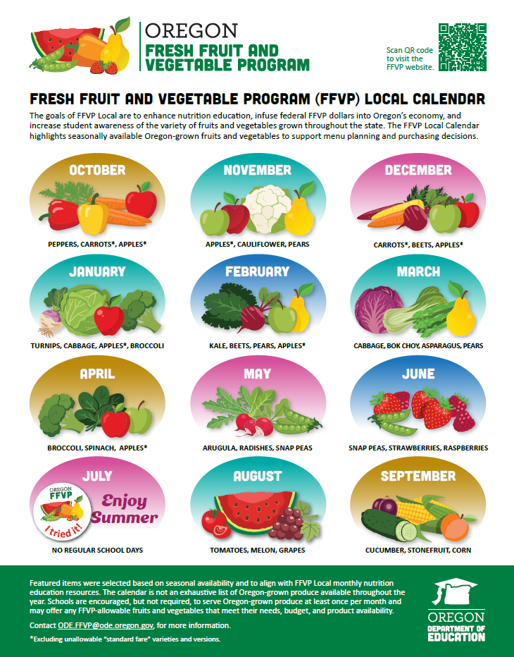
FFVP Local Calendar

Slide 27
FFVP Newsletter
All participating FFVP schools' CNPweb contacts will receive the ODE FFVP monthly newsletter. To add additional recipients, email the ODE FFVP inbox.
The FFVP newsletter includes important updates and information, resources, and claim deadlines.
The newsletter will now serve as the primary source for claim deadline reminders; individual reminder notices will no longer be sent.

Slide 28
Operating Costs
The majority of a school’s FFVP award must be spent on fresh produce
Operating Costs
Expenses directly related to the day-to-day functioning of the program.
    Supplies like napkins, plates, bowls, boats, etc.
    Smallwares like cutting boards, knives, mandolin, etc.
    Salaries and benefits for staff who prepare and serve the produce.
    Delivery and fuel charges.
May not exceed 30% of each monthly claim.
Operating Cost Distribution - Schools may request approval to distribute allowable FFVP operating costs across up to three consecutive monthly claims, once per grant period.

Slide 29
Administrative Costs
The majority of a school’s FFVP award must be spent on fresh produce
Administrative Costs
Expenses associated with FFVP programming that are not directly related to food or food preparation.
  Salaries and benefits for staff involved in administrative aspects of the FFVP.
May not exceed 10% of the total FFVP award.

Slide 30
Equipment Purchases
Large equipment purchases may be reimbursed with a school's administrative funds (up to 10% of the total award).
Examples of large equipment may be refrigerators, coolers, portable kiosks, carts, and portable food bars.
  Please email us if you have questions on what may be considered large equipment.
Only the portion of time the equipment is used for FFVP purposes can be reimbursed.
The FFVP Equipment Request Form is available on the ODE FFVP website under Claims.

Slide 31
Claim Procedure
Claims submissions indicate a school’s FFVP programming is underway.
Returning Schools
Begin FFVP programming by the first month of the grant period (October).
New Schools
Begin FFVP programming no later than the second month of the grant period (November).
30 Day Submission Target
Monthly claim sheets should be submitted to ODE.FFVP@ode.oregon.gov for review within 30 days of the end of claim month.
60 Day Entry Deadline
Reviewed and approved claims must be entered into ODE's Electronic Grants Management System (EGMS) within 60 days of the end of the claim month.

Slide 32
Late Claim Exceptions
If you miss a federal claim deadline (60 days), you may request a one-time late claim exception. ODE can grant this exception only once every 36 months per Child Nutrition Program, per Sponsor.

Slide 33
Claim Workbook Template
2026-27 Excel workbook available for download on the ODE FFVP webpage
FFVP claims must be submitted on the most updated version of the template.
Submit a monthly claim workbook for each FFVP site.
There are seven sheets in the FFVP claim template workbook…

Slide 34
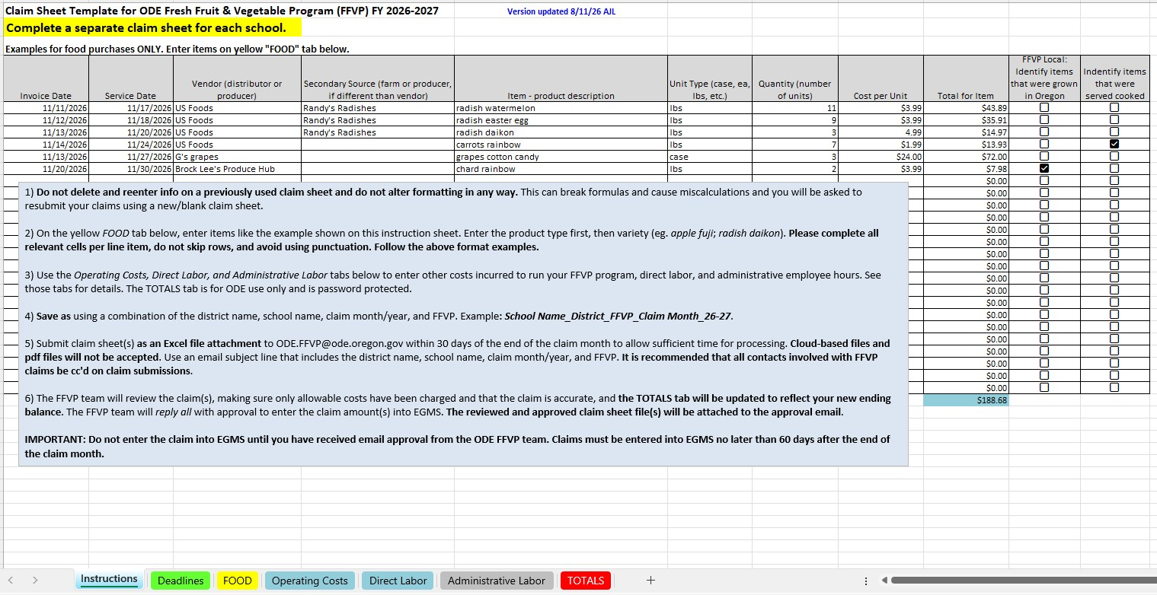
Instructions Tab
Examples for the FOOD tab, file name and email subject line formatting guidance, and claim submission instructions.

Slide 35
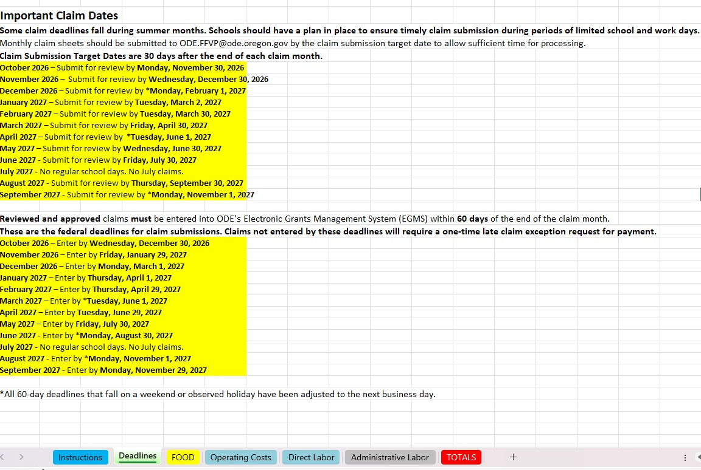
2. Deadlines Tab
Reference tab for claim submission target dates and claim entry deadlines.

Slide 36
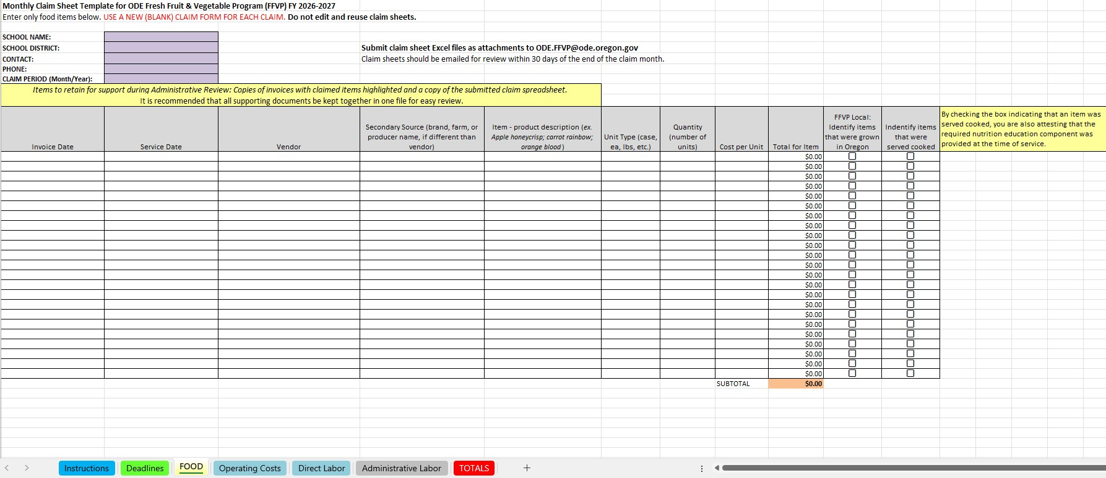
3. Food Tab
All fields on the Food tab must be completed. Do not skip lines. Each line item must have an invoice date and a service date.

Slide 37
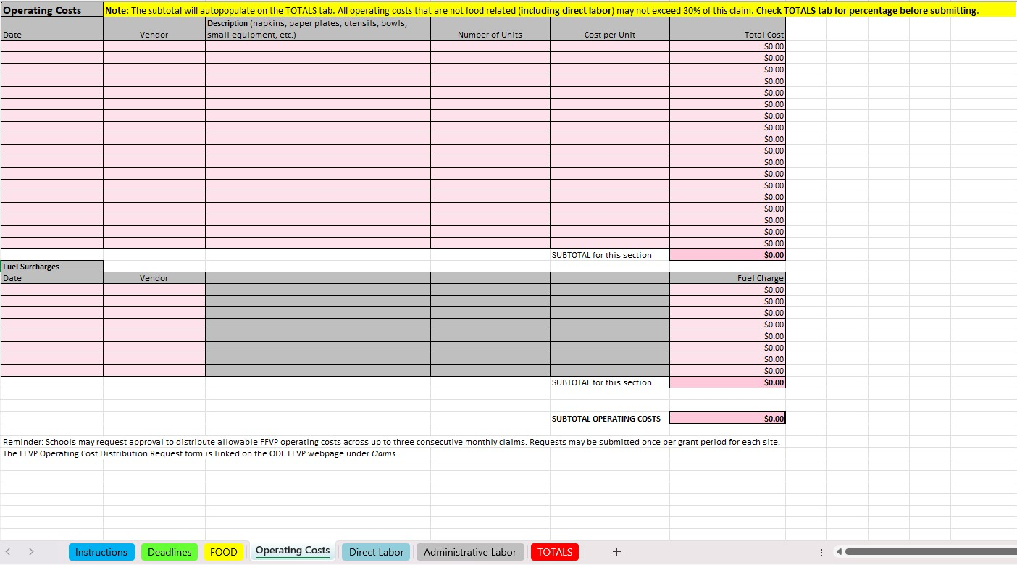
4. Operating Costs Tab

Slide 38
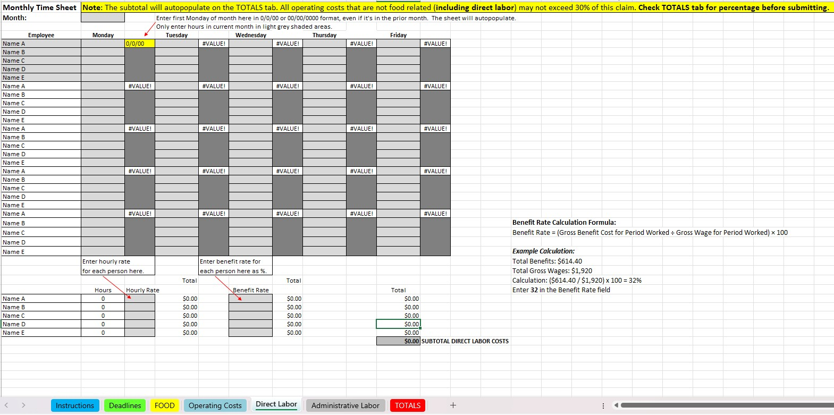
5. Direct Labor Tab

Slide 39
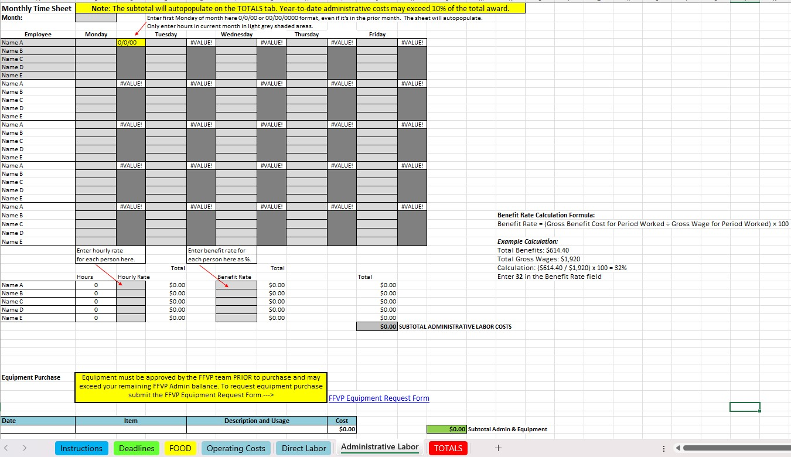
6. Administrative Labor Tab

Slide 40
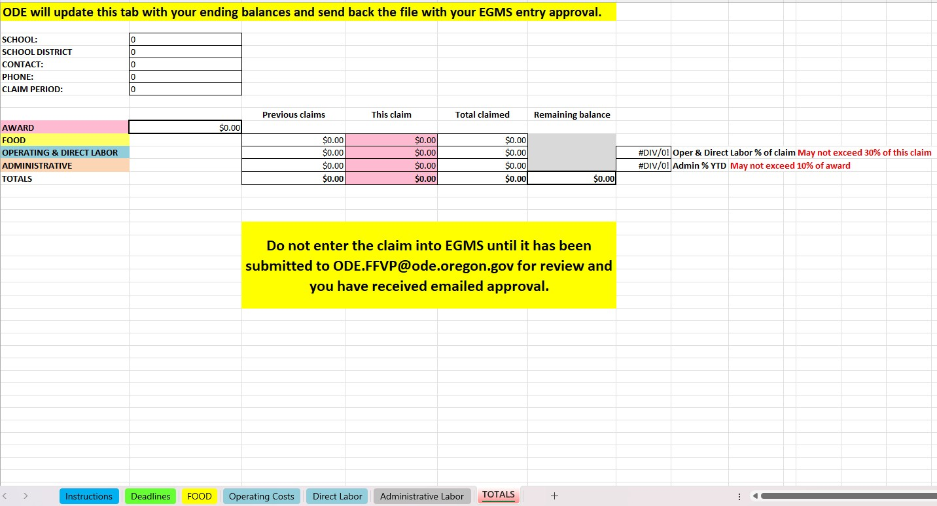
7. Totals Tab
This tab is for ODE use only and is password protected.

Slide 41
Claims Steps
Complete an FFVP claim sheet Excel template for each FFVP site, each month.
  Do not delete entries and reuse claim sheets!
Review Instructions tab. Save as using requested file name formatting.
Email claim sheet(s) as Excel file attachments to ODE.FFVP@ode.Oregon.gov. Cloud-based and pdfs will not be accepted.
The FFVP team will review the claim(s) and complete the TOTAL tab.
The FFVP team will reply all with approval to enter the claim amount(s) into EGMS. The reviewed and approved claim sheet file(s) will be attached to the approval email.
After claims are approved by FFVP team, enter your claim amount(s) into EGMS.
FFVP subgrant recipients are reimbursed through EGMS. Approved claims in EGMS are processed weekly.

Slide 42
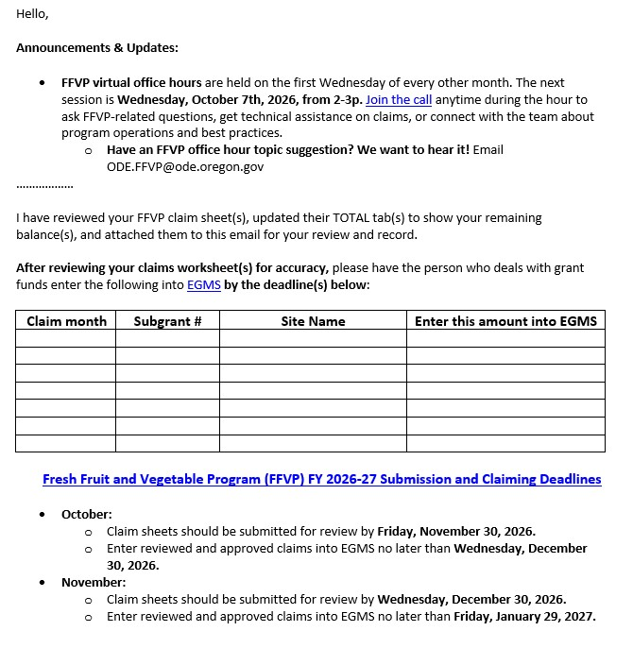
EGMS Entry Approval
Reviewed claim sheet(s) with the Totals tabs updated showing your ending balances will be attached to the approval email for your records.
You may enter the claims into EGMS only after you have received this email.

Slide 43









Resources
The USDA FFVP Handbook
The USDA's Fresh Fruit and Vegetable Program Resource Center
USDA Team Nutrition education resources
The Oregon Harvest for Schools main page
ODE's Fresh Fruit and Vegetable Program webpage
ODE's Farm to Child Nutrition Programs webpage
Oregon Agriculture in the Classroom
Oregon State University Food Hero / Growing Healthy Kids
The USDA's Choose My Plate website
Oregon Healthy Schools webpage

Slide 44

Thank you!

Slide 45

USDA Discrimination slide
In accordance with Federal civil rights law and U.S. Department of Agriculture (USDA) civil rights regulations and policies, the USDA, its Agencies, offices, and employees, and institutions participating in or administering USDA programs are prohibited from discriminating based on race, color, national origin, sex, disability, age, or reprisal or retaliation for prior civil rights activity in any program or activity conducted or funded by USDA.
Persons with disabilities who require alternative means of communication for program information (e.g. Braille, large print, audiotape, American Sign Language, etc.), should contact the Agency (State or local) where they applied for benefits. Individuals who are deaf, hard of hearing or have speech disabilities may contact USDA through the Federal Relay Service at (800) 877-8339. Additionally, program information may be made available in languages other than English.
To file a program complaint of discrimination, complete the USDA Program Discrimination Complaint Form, (AD-3027) found online at https://www.usda.gov/oascr(opens in a new tab), and at any USDA office, or write a letter addressed to USDA and provide in the letter all of the information requested in the form. To request a copy of the complaint form, call (866) 632-9992. Submit your completed form or letter to USDA by:
(1) mail: U.S. Department of Agriculture
Office of the Assistant Secretary for Civil Rights
1400 Independence Avenue, SW
Washington, D.C. 20250-9410;
(2) fax: (202) 690-7442; or
(3) email: program.intake@usda.gov

