Slide 1
Fueling Students for Success Software Needs
January 8, 2020
Heidi Dupuis, RDN
Notes:
Good Morning and welcome the Fueling Students for Success Software Needs Webinar. As you have question during the webinar, please enter them into the chat box in the lower right of your screen. Questions will be addressed that the end of the webinar.
I am Heidi Dupuis. I am leading the program development for school nutrition program initiatives in Oregon’s Student Success Act.
It is a privilege to be working with you on the Student Success Act nutrition initiatives. Oregon has a long history of supporting nutrition for children. In 1991, the Breakfast Mandate was passed. It requires schools to participate in the School Breakfast Program when 25% of their student population is eligible for free and reduced price meals. Next came 5 cents for summer breakfast and lunches, 30 cents for reduced price breakfast; start –up and expansion grants for after school snack and meals and summer meals; nutrition standards for a la carte food and beverages sold to student during the school day; and 40 cents for reduced price Lunches.
The Child Nutrition Program software providers have been instrumental in supporting Oregon’s school nutrition programs. Having data collection systems for eligibility certification and meal counting and claims has a positive impact on customer service.

Slide 2
Oregon Department of Education “Our Why”
Equity and Excellence for Every Learner
The Oregon Department of Education works in partnership with school districts, education service districts and community partners;
Together, we serve over 580,000 K-12 students;
We believe every student should have access to a high-quality, well-rounded learning experience;
We work to achieve the Governor’s vision that every student in Oregon graduates with a plan for their future.
Notes:
At ODE we are focused on Equity and Excellence for Every Learner. We work in partnership with you to make this a reality for the more than 580,000 K – 12 students we serve.
We believe every student should have access to a high-quality, well-rounded learning experience.
The Student Success Act’s nutrition initiatives will enhance our shared ability to improve students’ access to a high-quality, well-rounded learning experience in two ways. First, by removing hunger as a barrier to learning. Second, by ensuring that students receive the nutrition they need to learn and grow.

Slide 3
Oregon Department of Education Education Equity Stance
Education equity is the equitable implementation of policy, practices, procedures, and legislation that translates into resource allocation, education rigor, and opportunities for historically and currently marginalized youth, students, and families including civil rights protected classes. This means the restructuring and dismantling of systems and institutions that create the dichotomy of beneficiaries and the oppressed and marginalized.
Notes:
Our stance on education equity is the equitable implementation of policy, practices, procedures, and legislation that translates into resource allocation, education rigor, and opportunities for historically and currently marginalized youth, students, and families including civil rights protected classes. This means the restructuring and dismantling of systems and institutions that create the dichotomy of beneficiaries and the oppressed and marginalized.
The SSA initiatives in School Nutrition Programs gives us an opportunity to restructure these nutrition programs.

Slide 4
Student Success Act
Supporting students’
physical, social, emotional and academic development
by
Offering breakfast after the bell and
Meals at no charge to most students
Notes:
The purpose of the school breakfast and lunch program initiatives in the Student Success Act is to support students’ physical, social, emotional and academic development through nutrition. The initiatives build on the federal programs already being offered in public schools and charter schools. The specific initiatives require breakfast service after the school day starts in schools with at least 70% of students eligible for free and reduced price meals(referred to as Breakfast After the Bell), and offering breakfast and lunch at no charge to most student through Community Eligibility Provision Incentive and Expanded Income Guidelines.
We refer to these initiatives as Fueling Students for Success or FS squared.

Slide 5
Oregon Data: 2018-19
Daily Breakfast
134,603 out of 580,000 (23%)
Daily Lunch
266,963 out of 580,000 (46 %)
Notes:
The daily meal participation in 2018-19 was 23% for Breakfast and 46% for Lunch. Over the past ten years breakfast participation has stayed around 23% and lunch ranged from 46 to 50% of total students.

Slide 6
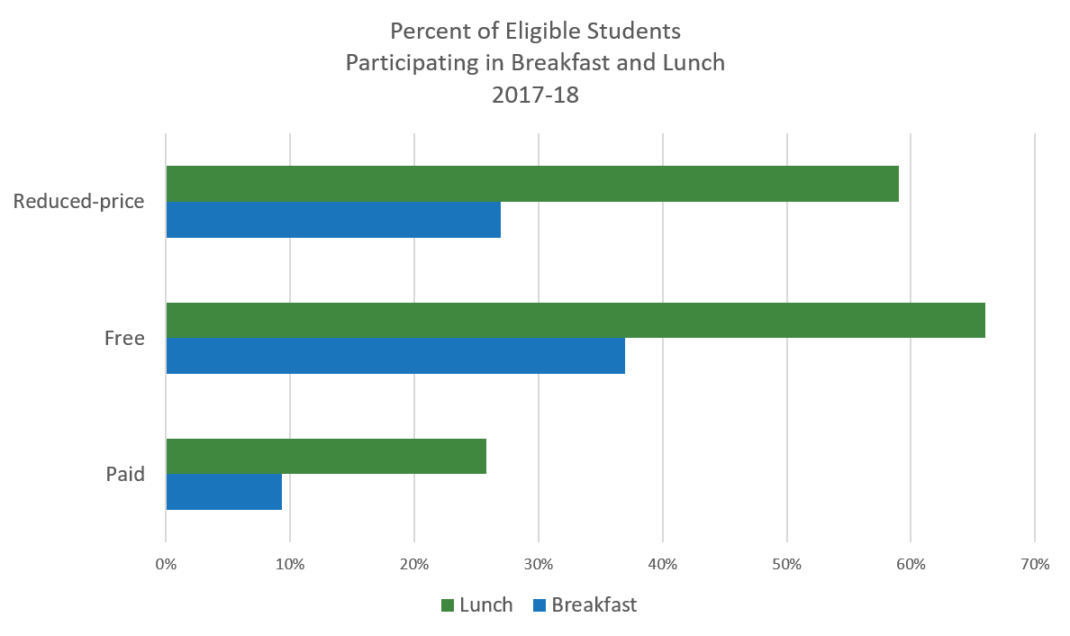
Oregon Participation by Benefit
Notes:
This graphic shows the percent of students in each eligibility category participating in breakfast and Lunch.
From bottom to top:
9% of paid eligible students eat breakfast at school and 26% eat a school Lunch
37% of free eligible student eat breakfast at school and 66% eat a school Lunch
27% of reduced eligible students eat breakfast at school and 59% eat a school lunch
With the Fueling Students for Success initiatives, we anticipate increasing participation by increasing availability of breakfast during the school day and removing the price barrier for students not eligible for free or reduced price meals

Slide 7
Funding
State-wide Business Revenue Tax
Hunger Free Schools Account
For 2020- 2021:
$41.6 million appropriated
$40.1 million for access to meals at no charge
$1.2 million for Breakfast after the Bell Equipment Grants
$ .3 million for staffing
Notes:
The funding for the Student Success Act is through a state-wide business revenue tax. The collections from this tax are dedicated to Student Success Act activities.
The funds for the school breakfast and lunch initiatives will go into the Hunger Free Schools Account
For School Year 2020-21, 41.6 million dollars was appropriated.
40.1 million for access to meals at no charge
1.2 million for Breakfast after the Bell Equipment Grants
.3 million for staffing at ODE to support the initiatives.

Slide 8
FS² Initiatives
Breakfast After the Bell
Breakfast After the Bell Equipment Grant
Community Eligibility Provision Incentive
Expanded Income Group Program
Notes:
School Breakfast and lunch initiatives are referred to a Fueling Students for Success or FS squared.
There are four initiatives:
Breakfast After the Bell in schools with 70% Free and Reduced eligible
Breakfast After the Bell Equipment Grants
Community Eligibility Provision Incentive
Expanded Income Group Reimbursement Program

Slide 9
FS² Implementation Activities
Administrative Rule Development
Software Specifications
Local Program supports
Program Agreements and implementation
Notes:
School Year 2020 is dedicated to building the foundation for the initiative. Through the Fall we met with program and community stakeholders to develop the administrative rules for implementing the initiatives. That work in mostly complete with the submission for the draft rules to the State Board of Education and Secretary of State. The first reading is January 16th. Anticipated adoption March 19th, 2020.
A result of the ruling making work was the Software Specifications.
January through March, technical assistance will be provide to school districts and charter schools to help with develop budgets and prepare for implementation in School Year 2020-21.
April through June school districts will be formalizing their operating agreements.
Let’s look at each initiative.

Slide 10
FS² Initiatives – Breakfast After the Bell
Breakfast After the Bell
Breakfast After the Bell Equipment Grant
Community Eligibility Program Incentive
Expanded Income Group Program
Notes:
This slide lists the Fueling Students for Success initiatives. We’ll begin with the two focused on increasing access to breakfast by moving service into the school day.

Slide 11
Breakfast After the Bell
Applies to schools with 70% of students eligible for free and reduced price meals
Breakfast served after the school day starts
All students have access regardless of grade or schedule
Up to $5,000 for equipment to support change
Exempt: 70% of Free and Reduced price students eating
Affected: 353 schools, 130,000 students
Notes:
Currently 92% of schools offer breakfast.
Beginning in school year 2020-21, The Breakfast after the Bell provision of SSA requires schools with 70% free and reduced priced eligible students to shift meal service time to after the first bell. All students must have access to breakfast regardless of grade or schedule. There are several service methods schools can use. They may adapt them as needed. ODE child nutrition Program team will provide technical assistance to schools for implementing Breakfast after the Bell.
The Student Success Act provides up to $5000 per for equipment to implement Breakfast After the Bell. Software to support Breakfast After the Bell may be funded through this grant.
Eligible schools are not required to comply with breakfast after the bell provision when 70% of their free and Reduced price eligible students are eating breakfast under the before school format.
This provision may impact around 350 schools and one hundred thirty thousand students.

Slide 12
FS² Initiatives - Community Eligibility Provision
Breakfast After the Bell
Breakfast After the Bell Equipment Grant
Community Eligibility Program Incentive
Expanded Income Group Program
Notes:
The Fueling Students for Success reimbursement initiatives use state funds to support meals at no charge to students in the paid or above scale category. Two approaches are used – Community Eligibility Provision and Expanded Income Group. As we go through these approaches keep in mind at the federal program requirements continue - Free meal eligibility is up to 130% of Federal Poverty. Reduced Price eligibility is between 130 and 185%. One meal per student per day per program.
Each approach will be handled separately. We will start with Community Eligibility Provision Incentive.

Slide 13
Community Eligibility Provision
At least 40% of students receive SNAP, TANF, FDPIR, Foster, Migrant, homeless, runaway services (ISP)
Can group high and low ISP schools to reach 40%
Breakfast and lunch at no charge to all students
ISP x 1.6 = Free claiming rate
4 year cycle
Potential to double number of schools
Notes:
The first provision to support meals at no charge to all students is the community eligibility provision. This is part of the federal programs. Community Eligibility uses participation by students in other programs to apply meal benefits to the student population. To be able to use the Community Eligibility Provision a school or group of schools must have at least forty percent of the students receiving services through Supplemental Nutrition Assistance Program(SNAP), Temporary Aid to Needy Families (TANF), Food Distribution Program on Indian Reservations (FDPIR), foster, migrant, homeless and runaway education programs. This percentage is called the Identified Student Percentage (ISP). Schools with high and low ISP can be grouped to reach the 40% threshold.
The ISP is extended to the school population through a multiplier of 1.6. The multiplier is established by the United States Department of Agriculture. It represents that for every ten children eligible through participation in the other services there are 6 eligible by income.
The federal cycle of 4 years will continue.
The Fueling Students for Success Community Eligibility Provision Incentive has the potential to approximately double the number schools using this provision.

Slide 14
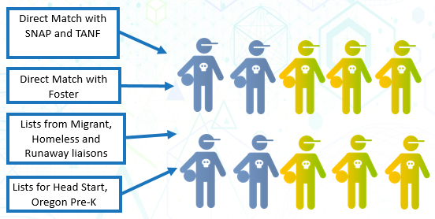
Identified Student Percentage (ISP)
Notes:
This image shows the programs used to create the Identified Student Percentage and the minimum eligibility of 4 out of ten students or 40 percent.
Community Eligibility Provision uses what we know about a subset of the student population to determine eligibility to apply the provision.
The number of students in families participating in SNAP and TANF; in foster care; receiving migrant, homeless and run away educational services or participating in Head Start, Oregon Pre-K are used to create the Identified Student Percentage.
Total students are those with access to at least one meal, including Pre-K children.
The eligibility threshold is 40% of students. This is represented by the four blue kids.

Slide 15
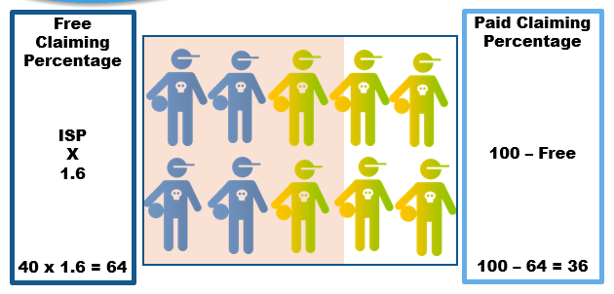
Meal Count Allocation
Notes:
This image shows the application of the 1.6 multiplier to the minimum Identified Student Percentage, 40 , to create the free claiming percentage.
The multiplier is based on USDA research, for every 10 directly certified students there are 6 income eligible students.
The Identified Student Percentage (ISP) x 1.6 equals the free claiming percentage. 40 x 1.6 = 64
In the image, 6 out of 10 students are shaded to show coverage of free claiming percentage beyond the 4 students with known free meal certification.
The Paid claiming percentage is 100 – the Free claiming percentage. 100 – 64= 36
The unshaded students represent the paid claiming percentage.

Slide 16
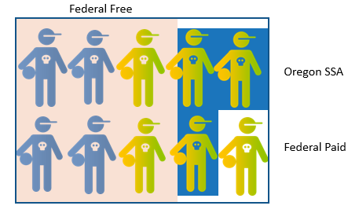
Community Eligibility Provision Incentive
Notes:
This image shows the meals receiving the federal free rate in the pink shaded area. The white behind the four kids on the right represents the federal paid rate received for these meals. The blue background area show the state funding.
Schools participating in CEP will receive funds from the Student Success Act for the difference between their federal free claiming rate and up to 90% free claiming. The state funds support a portion of paid meals.

Slide 17
CEP Incentive Funding
Notes:
This is another representation of the funding. The top blue bars represent federal funding. Using the minimum ISP of 40 time 1.6 equals a free claiming percentage of 64%. The difference between 100 percent and 64 percent is the paid claiming percentage of 36%. The state funding is the lower bar. It shows the state supplemental funding up to 90% and not to exceed the free rate less state and federal sources already received – the federal paid meal reimbursement.
Schools must elect CEP for both Breakfast and Lunch Program.

Slide 18
Software Needs: Data Elements
Community Eligibility Provision Data Elements
By Program Year
Reimbursement Goal - XX%
OR CEP Breakfast Rate - $X.XX
OR CEP Severe Need (SN) Breakfast Rate - $ X.XX
OR CEP Lunch Rate - $X.XX
Site Identified Student Percentage
Site Claiming Identified Student Percentage
Site Free Claiming Percentage
Notes:
The data elements needed to support the Community Eligibility Provision Incentive for calculating anticipated reimbursements are:
The Reimbursement Goal, the maximum level of meals to receive a supplement
The Oregon CEP breakfast meal rate
The Oregon CEP Severe Need breakfast meal rate
The Oregon CEP lunch meal rate
Site Identified Student Percentage
Site Claiming Identified Student Percentage
Site Free Claiming Percentage

Slide 19
Software Needs: Functionality
Claim Value for CEP Incentive
Same calculation for Breakfast and Lunch Programs
Calculation by program
Total Meals claimed X Reimbursement Goal = Goal Meals
Goal Meals – (Free Claimed meals) = the OR CEP meal count
OR CEP Meal count X OR CEP meal Rate = State Reimbursement
Notes:
To implement the Community Eligibility Provision Incentive there are no changes to eligibility, meal counting or meal claiming.
The claim value calculation will need to include the state payments.
The calculation is the same for breakfast and lunch programs. The calculation is by program.
Total Meals claimed times the Reimbursement Goal equals Goal Meals
Goal Meals – (Free Claimed meals) = the OR CEP meal count
OR CEP Meal count times the OR CEP meal Rate = State Reimbursement

Slide 20
FS² Initiatives - Expanded Income
Breakfast After the Bell
Breakfast After the Bell Equipment Grant
Community Eligibility Program Incentive
Expanded Income Group Program
Notes:
The second approach for supporting meals served at no charge under Fueling Students for Success is the Expanded Income Group Program.

Slide 21
Expanded Income Guidelines (EIG)
Oregon
Federal
Free
130% of poverty and below
Reduced Price
130 – 185% of poverty
Paid
Above 185% of poverty
Above 185 – 300% of poverty
Notes:
This approach is unique to Oregon and a national first. For schools that aren’t eligible for the Community Eligibility Provision, they may use this approach. It is intended to provide support for students in households with incomes greater than 185% and up to 300% Federal Poverty level. Under the federal program these students are in the Paid or above scale category. From Census data, about a third of our state’s school-aged above scale children are in families with incomes in the range of support.

Slide 22
EIG Methods
Application
Census
ODE establishes income guidelines above 185 and up to 300%
Household apply for benefits
Meals at no charge for certified students
Rate of school age children above 185% and up to 300% federal poverty from those above 185%.
School district level
Applied to paid meal count
All Paid meals at no charge
Notes:
There are two methods for implementing the Expanded Income Group – using household applications or a formula based on US Census data. When using EIG, a site may use one method for breakfast and a different for lunch.

Slide 23
EIG – Eligibility by Method
EIG by Applications
EIG by Census
Set paid lunch and breakfast price
Certify applications for Income group above 185 – 300% “OR Paid”
Verify only free and reduced price by federal guideline
No Paid meal Price
Process eligibility by Federal regulations and guidance
Verify approved Free and Reduced price applications
Notes:
Let’s look at how Eligibility is handled between the two Expanded Income Group methods.
By Applications
Sponsors will set the paid lunch and breakfast prices for the unitized meal. It will apply to students in household above 300% of poverty.
Applications will be certified for greater than 185, up to 300% of poverty. We are calling it Oregon Paid.
The application used for the federal program may be use for the accessing state benefits.
Only the free and reduced priced applications will be verified using federal guidance
By Census
There is no paid meal price. Meals are offered at no charge to all students.
Free and Reduced Price eligibility is determined using federal regulations and guidance.
Free and Reduced price certified applications are verified using federal guidance.

Slide 24
EIG Meal Counting by Method
EIG by Apps
EIG by Census
Meals counted into free, reduced price, paid and “OR paid” categories as certified
Meals counted into free, reduced price and paid according to federal regulation
Notes:
Let’s look at how meals are counted between the two Expanded Income Group methods.
Using the Application method, meals are counted at the Point of Service into free, reduced price, paid and OR Paid categories as the students were certified.
Paid category is through the federal lens. It is the count of meals served to students not in the free or reduced price categories.
The Census method retains current practice. Meals are counted into free, reduced price and paid categories according to federal regulation.

Slide 25
EIG Claiming by Method
EIG by Apps
EIG by Census
Meal count reported:
Free
Reduced price
Paid
OR Paid
Eligibility count for OR Paid
“OR Paid” subset of “Paid”
Meal count reported:
Free
Reduced price
Paid
Notes:
Next, let’s look at how meal claims ares handled between the two Expanded Income Group methods.
By Application,
meal counts by school are reported in Free, Reduced Price , Paid, Oregon Paid.
Count of students eligible for OR Paid ( greater than 185%, up to 300% of poverty)
Please know that Oregon Paid is a subset of the Paid Category. Meal count in the Paid, includes the meals served to OR Paid eligible students. The paid meal count will receive the federal reimbursement. Oregon Paid count will receive the state supplement.
By Census
meal counts by school are reported in Free, Reduced Price , Paid

Slide 26
EIG by Apps Reimbursement
Federal
As approved for additional $.02 and severe need:
Free Count X Federal Free rate by program
Reduced Count X Federal Reduced Price rate by program
Paid Count X Federal Paid Rate by program
State
OR Paid Count x State Paid Rate by program
Notes:
For school electing expanded Income Group (EIG) by Application, the reimbursement is calculated for each federal benefit category by program using the reimbursement rate for which the sponsor or site is approved.
The state supplement is calculated from the count of meals served to OR paid students by program, breakfast or lunch.
OR Paid meals X State Paid rate = State reimbursement

Slide 27
EIG by Census Reimbursement
Federal
As approved for additional $.02 and severe need:
Free Count X Federal Free rate by program
Reduced Count X Federal Reduced Price rate by program
Paid Count X Federal Paid Rate by program
State
Paid Count x Census Rate) = State Supplement meals
State Supplement meals X State Paid Rate = State $
Notes:
For schools electing expanded Income Group (EIG) by Census, the reimbursement is calculated for each federal benefit category by program using the reimbursement rate for which the sponsor or site is approved.
The state supplement is calculated from the count of paid meals by breakfast or lunch program.
Paid meals X Census rate equals = State supplement meals
State Supplement meal times State Paid rate = State reimbursement

Slide 28
EIG Software Needs: Data Elements
Expanded Income Group Data Elements
By Program Year
OR Paid Breakfast Rate - $X.XX
OR Paid SN Breakfast Rate - $ X.XX
OR Paid Lunch Rate - $X.XX
OR 185-299% income guidelines by family size
By Sponsor
Census Rate - .XXXX
Notes:
The new data elements needed to support the Expanded Income Group Program are:
For each Program Year, Oregon Paid Breakfast rate, Oregon Paid Severe Need Breakfast rate and Oregon Paid Lunch rate
For the sponsor, a census rate. The census rate is for the school district and applied at the site level meal counts.

Slide 29
EIG Apps Software Needs: Functionality
Indicate method of EIG by breakfast and lunch program
Approve Applications in the above 185 – 300 % poverty
Count meals served to students certified above 185-300%
Count students certified in above 185-300%
Consolidate site claims to a sponsor claim with EIG data
Calculate Reimbursements for EIG by Application and EIG by Census
Rounding = .1-.4 round down to whole number; .5 - .9 round up to whole number
Notes:
The functionalities needed to implement the Expanded Income Group Program are:
Indicate the EIG method for Breakfast and Lunch programs
Approve applications in the greater than 185, up to 300% of poverty
Count meals served to students in the greater than185, up to 300% of poverty group
Count students certified in greater than 185, up to 300% of poverty
Consolidate site claims to a sponsor claim with EIG data
Calculate Reimbursements for EIG by Application and EIG by Census
Rounding = .1-.4 round down to whole number; .5 - .9 round up to whole number

Slide 30
CNPweb SNP Claim Upload
Three data elements added at Site record end
Count of Breakfasts in “OR Paid” Category
Count of Lunches in “OR Paid” Category
Count of Students certified eligible in “OR Paid” Category
OR Paid data elements “0” if site is using CEP, EIG by Census or federal program only
Notes:
CNPweb, Oregon’s reimbursement web application, has a claim upload feature to accept meal count data from a comma delimited file or CSV. This can simplify claim data entry. To capture the Oregon data, the upload file format is changing. Three data elements will be added for School Year 2020-21. The elements are added to the end of the current file format, before the end character –
The count of breakfasts served to “OR Paid” eligible students
The count of Lunches served to “OR Paid” eligible students
The count of Student certified eligible for “OR Paid”
If a site is using CEP, Expanded Income Group (EIG) by Census or the federal program only a zero is entered for these three elements.

Slide 31
Contact Information
Heidi Dupuis, RDN
Oregon Department of Education
Child Nutrition Programs
503.947.5893
heidi.dupuis@state.or.us
Fueling Students for Success Web site
Ask your questions through the Collaboration Tool
Notes:
Keep the conversation going by using the Collaboration Tool on the Fueling Students for Success web site. Information gathered here will be used to in the development of program implementation supports.
You are welcome to contact me directly.
This webinar will be posted on the Fueling Students for Success web site.

Slide 32
Questions
Questions

