Slide 1
An Introduction to the USDA Food Distribution Program
Notes:
Welcome to an introduction to the USDA Food Distribution Program.

Slide 2

USDA Foods provides healthy foods to schools
Purchasing
Meeting
Providing
Adding
Notes:
USDA Foods provides healthy foods to schools by:
Purchasing more than two billion pounds of food from American farmers each year.
Meeting strict food safety and nutrition standards and using 100% American grown foods.
Providing high quality meals to more than 30 million students a day.
Adding versatility and being an economical way to provide our Nation’s children with appealing meals.

Slide 3
Purpose
Two Primary Goals:
#1: Support American Agricultural markets
    USDA Foods have to be 100% domestic
    Buy American exemptions do not apply
#2: Provide nutritious, USDA purchased food that assist with meeting nutritional goals of program
  i.e. canned fruit in light syrup, reduced sodium cheese, low-fat proteins, whole grain rich, etc.)
Notes:
The USDA Food Distribution Program has two primary goals:
#1: Support American Agricultural markets
USDA Foods have to be 100% domestic
Buy American exemptions do not apply (that is why you don’t see canned pineapple anymore, for example)
#2: Provide nutritious, USDA purchased food to sponsors that assist with meeting nutritional goals of program
i.e. canned fruit in light syrup, reduced sodium cheese, low-fat proteins, whole grain rich, etc.)

Slide 4
Entitlement
Over 17 million entitlement distributed
    Base rate (determined in July)
    12% adjustment increases base amount
      USDA Foods purchases must meet 12% of reimbursement nationally
      More reimbursement=increase in adjustment
    Preliminary meals based on prior year, finalized in fall
    Food purchase request breakout:
      Direct Delivery: 63%
      Diversion: 25%
      DoD: 10%, F&V Pilot: 2%
Notes:
Over 17 million entitlement was distributed in Oregon this year. This varies from year-to-year based on meal counts and entitlement rate.
How is the rate calculated?
Base rate (determined in July)
12% adjustment increases base amount
USDA Foods purchases must meet 12% of reimbursement nationally (bonus no longer included in calculation)
If we have more reimbursement nationally than estimated, the adjustment will be increased.
The meal count is taken against the rate. We have to use the prior year meal counts as an estimate, then in the fall we true it up against actuals.
Food purchase request breakout for Oregon (varies by state):
Direct Delivery: 63%
Diversion: 25%
DoD: 10%, F&V Pilot: 2%

Slide 5
Service Fees
Service fee covers:
  Warehouse/transportation services
  Some ODE admin
  Legal reviews, etc.
State law, DOJ interpretation of law
Direct Delivery and Diversion: $.10 per LB
DoD Fresh, Unprocessed F&V Pilot: $.0275 per LB
USDA State Survey:
  Oregon per case fee rank, middle of pack compared to other states
  Almost 300 sponsors, large geographic area
SAE Refunds = USDA Foods even better value!
Notes:
The USDA Food Distribution is self-supporting.
Service fee covers:
Warehouse/transportation contract
2 FTE Employees
Legal reviews, etc.
State law, DOJ interpretation of law
Direct Delivery and Diversion: $.12 per LB
DoD Fresh, Unprocessed F&V Pilot: $.025 per LB
USDA State Survey:
Oregon per case fee rank, middle of pack compared to other states
Almost 300 sponsors, large geographic area
Oregon has applied for and received SAE Reallocation Funds. This makes USDA Foods an even better value! Just in the last 4 years, ODE has refunded over 1 million dollars in service fees.

Slide 6
What kind of Foods can I receive?
Direct Delivery
  Finished products (Canned fruit and vegetables, proteins, etc.)
Processing
  1000’s of products from bulk product
USDA DoD Fresh Fruit and Vegetable Program
  Fresh fruit and vegetables delivered weekly
Unprocessed Fruit and Vegetable Pilot
  Wide variety of fruits and vegetables from USDA approved suppliers
Notes:
What kind of Food can I receive through the USDA Foods program?
There is a huge variety, we’ll just briefly mention them here and talk about the details later.
Direct Delivery
Canned fruit and vegetables, proteins, etc.
Processing
1000’s of products from bulk product diverted
USDA DoD Fresh Fruit and Vegetable Program
Fresh fruit and vegetables delivered weekly
Unprocessed Fruit and Vegetable Pilot
Wide variety of fruits and vegetables from USDA Approved suppliers

Slide 7
How does ODE and USDA order the food?
Sponsors place order with ODE
USDA Procures and purchases
Food shipped to ODE warehouse
ODE distributes to sponsor through contractor
Direct Delivery:
Diversion/Processing:
Sponsors place bulk order with ODE
USDA procures and purchases bulk product
Bulk food shipped to processor warehouse
Sponsor places order with processor and arranges for shipping
Notes:
There is a different ordering process for each of the USDA Foods. We’ll just briefly list the processes here and we’ll talk more about them later.

Slide 8
How does ODE and USDA order the fruits and vegetables?
USDA DoD Fresh Fruit and Vegetable Program:
Sponsors diverts entitlement
USDA sends funds to DLA/DoD
DLA/DoD procures produce
Sponsor places orders in DoD FFAVORS web system
Sponsors diverts entitlement
Sponsor looks at USDA approved vendor list
Sponsor completes procurement
Sponsor places order with USDA approved vendor
Vendor bills USDA directly
Unprocessed Fruit & Vegetable Pilot:

Slide 9
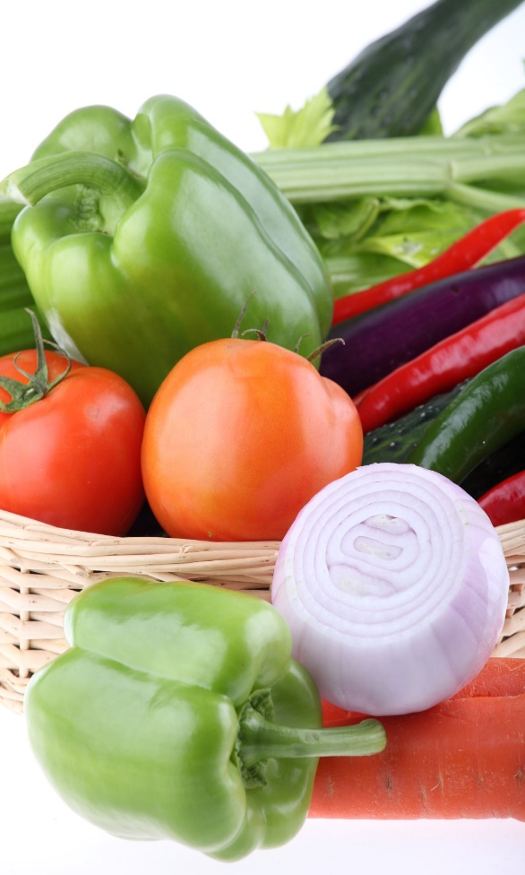
Nutritional Benefits of USDA Foods VEGETABLES
  • USDA offers fresh, frozen, canned, and dried options representing all 5 vegetable subgroups: dark green, red/orange, legumes, starchy, and other.
  • USDA only offers no salt added frozen vegetables and either low-sodium or no salt added canned vegetables and beans.
Notes:
Earlier we mentioned the nutritional benefits of USDA Foods. Let’s talk about that in more detail.
Vegetables
USDA offers fresh, frozen, canned, and dried options representing all 5 vegetable subgroups: dark green, red/orange, legumes, starchy, and other.
• USDA only offers no salt added frozen vegetables and either low-sodium or no salt added canned vegetables and beans.

Slide 10

Nutritional Benefits of USDA Foods FRUITS
• USDA offers fresh, frozen, canned and dried options in sizes ranging from individual portion to bulk sizes for processing.
• Canned fruits are packed in extra light syrup with the option of sucrose only syrup.
Notes:
Fruits
USDA offers fresh, frozen, canned and dried options in sizes ranging from individual portion to bulk sizes for processing.
• Canned fruits are packed in extra light syrup with the option of sucrose only syrup.

Slide 11
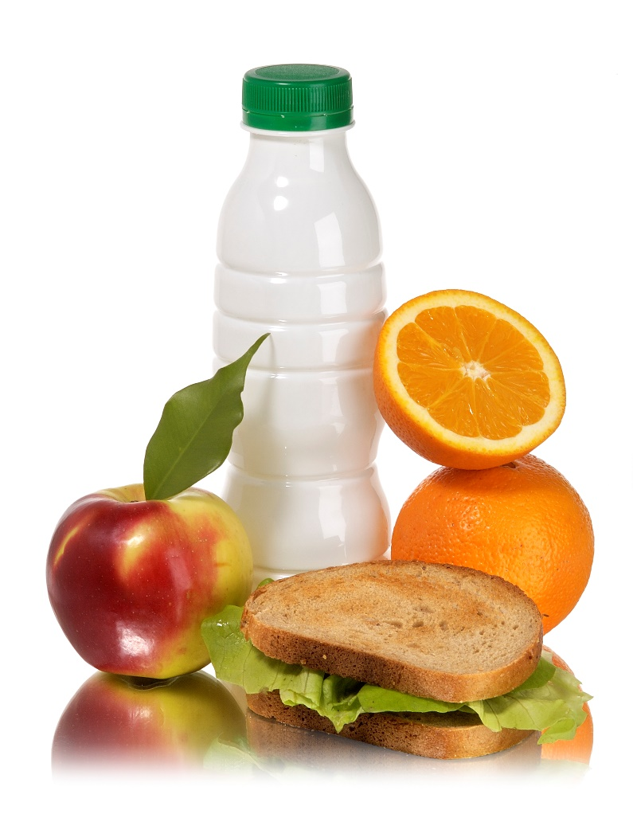
Nutritional Benefits of USDA Foods WHOLE GRAINS
• All items shipped to schools meet the whole grain-rich criteria.
• Schools can order ready-to-serve items and whole grain products for scratch cooking or baking.
Notes:
WHOLE GRAINS
• All items shipped to schools meet the whole grain-rich criteria.
• Schools can order ready-to-serve items and whole grain products for scratch cooking or baking.

Slide 12
Nutritional Benefits of USDA Foods MEAT/MEAT ALTERNATES
• USDA offers a variety of nutrient-dense protein options such as meat, fish, cheese, nuts and eggs.
• Specifications have been changed to lower the sodium and fat on many meat and cheese products.
• USDA continues to work with industry to make reductions to sodium
Notes:
MEAT/MEAT ALTERNATES
• USDA offers a variety of nutrient-dense protein options such as meat, fish, cheese, nuts and eggs.
• Specifications have been changed to lower the sodium and fat on many meat and cheese products.
• USDA continues to work with industry to make reductions to sodium while still achieving optimal product performance and acceptability.

Slide 13
USDA Foods Are High Quality, Versatile and Economical
USDA Foods offers:
  More than 50 agricultural products available in more than 200 different items, forms, and pack sizes.
Foods purchased:
  Comply with stringent specifications
  Processed under USDA grading and inspection services.
Notes:
USDA Foods Are High Quality, Versatile and Economical
USDA Foods offers:
More than 50 agricultural products available in more than 200 different items, forms, and pack sizes. For example, dried cranberries not only come in bulk bags for use in recipes and the salad bar, but also in individual wrapped single serving packages.
Foods purchased:
Comply with stringent specifications. USDA has multiple agencies that work together on specifications and also receive feedback from state agencies who in turn receive feedback from recipient agencies (sponsors).
Processed under USDA grading and inspection services. Be rest assured that the food comes from reputable suppliers with a known track record.

Slide 14

Questions?

Slide 15
Non-Discrimination Statement
In accordance with Federal civil rights law and U.S. Department of Agriculture (USDA) civil rights regulations and policies, the USDA, its Agencies, offices, and employees, and institutions participating in or administering USDA programs are prohibited from discriminating based on race, color, national origin, sex, disability, age, or reprisal or retaliation for prior civil rights activity in any program or activity conducted or funded by USDA.
Persons with disabilities who require alternative means of communication for program information (e.g. Braille, large print, audiotape, American Sign Language, etc.), should contact the Agency (State or local) where they applied for benefits. Individuals who are deaf, hard of hearing or have speech disabilities may contact USDA through the Federal Relay Service at (800) 877-8339. Additionally, program information may be made available in languages other than English.
To file a program complaint of discrimination, complete the USDA Program Discrimination Complaint Form, (AD-3027) found online at: http://www.ascr.usda.gov/complaint_filing_cust.html, and at any USDA office, or write a letter addressed to USDA and provide in the letter all of the information requested in the form. To request a copy of the complaint form, call (866) 632-9992.
Submit your completed form or letter to USDA by:
(1) mail: U.S. Department of Agriculture
Office of the Assistant Secretary for Civil Rights
1400 Independence Avenue, SW
Washington, D.C. 20250-9410;
(2) fax: (202) 690-7442; or
(3) email: program.intake@usda.gov
This institution is an equal opportunity provider.

