Slide 1

USDA Food Distribution Program WBSCM Ordering
This Recipient Agency (RA) Training Guide has been developed to assist our recipients (schools and other organizations) in utilizing USDA’s online ordering program – known as Web-Based Supply Chain Management, or WBSCM.

Slide 2
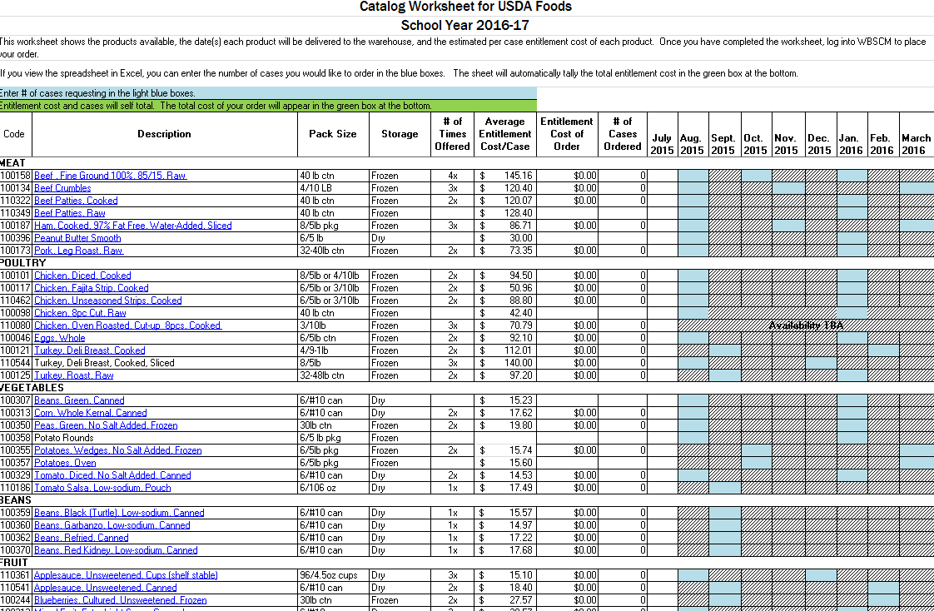
USDA Foods Catalog Worksheet
The USDA Foods Catalog Worksheet is NOT found in WBSCM. It is a spreadsheet, available in Excel and as a PDF, that the Oregon FDP creates each year to help schools plan their order. This spreadsheet will be emailed out to food service managers when the catalog opens each year in January or February, and it will also be available on the program website at ODE USDA Foods Site. There will be two spreadsheets available; one each for direct delivery and diversion.
Notes:
The USDA Foods Catalog Worksheet is NOT found in WBSCM. It is a spreadsheet, available in Excel, that the Oregon FDP creates each year to help schools plan their order.

Slide 3
Using the Direct Delivery Worksheet
Notes:
Description:
The available products are listed here – clicking on the links will open up the product fact sheet in your web browser.
Blue Boxes:
The blue boxes show the dates that the product will be delivered to the warehouse – fill in the number of cases you’d like in these boxes.
# of Cases Ordered:
If you use the excel version of the sheet, the total number of cases of the product will self-total
Entitlement Cost of Order:
the cost of your order of that product will self-total here. Scroll down further, and a green grand total box at the bottom will keep track of the cost of your full order.

Slide 4
Entering an Order for Delivery to the Warehouse In WBSCM
Once you have planned your order by finding your entitlement and filling out your catalog worksheet, you’re ready to log back into WBSCM and place that order.
Tip: The WBSCM application alerts users with a notification after 50 min. of idle time and provides them with the options to continue or cancel the session. If users do not take action within approximately 10 minutes, the system logs them out, and any unsaved data may be lost.
Therefore, we suggest breaking your order up into multiple small orders. For example, working off your catalog worksheet, put all your vegetables in your cart, and then go through the steps to page 24 (when you see the order confirmation page). Then go back to page 12 and put all your fruit in your cart, etc. There is no limit on the number of separate orders you place – just as long as it all adds up to your entitlement amount in the end.
Notes:
Once you have planned your order by finding your entitlement and filling out your catalog worksheet, you’re ready to log back into WBSCM and place that order.
Tip: The WBSCM application alerts users with a notification after 50 min. of idle time and provides them with the options to continue or cancel the session. If users do not take action within approximately 10 minutes, the system logs them out, and any unsaved data may be lost.
Therefore, we suggest breaking your order up into multiple small orders. For example, working off your catalog worksheet, put all your vegetables in your cart, and then go through the steps to page 25 (when you see the order confirmation page). Then go back to page 12 and put all your fruitin your cart, etc. There is no limit on the number of separate orders you place – just as long as it all adds up to your entitlement amount in the end.

Slide 5
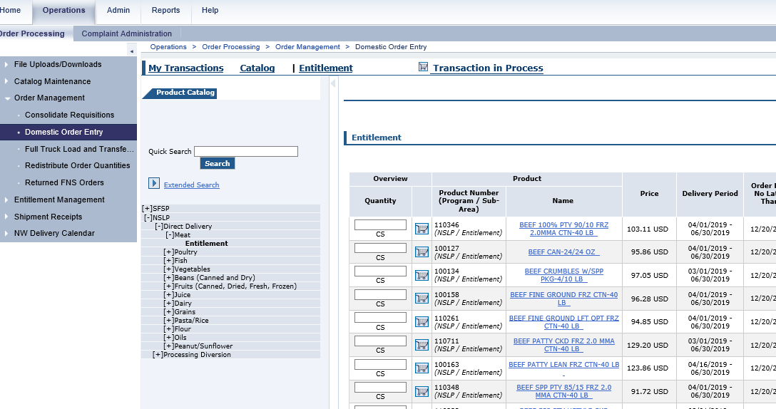
Domestic Order Entry
Click the “Operations” tab at the top of the page
On the left hand side of the page, click “Order Management”
Under “Order Management”, click “Domestic Order Entry”
4. When the order window loads, click “NSLP”
5. Under “NSLP”, click “Direct Delivery” or “Processing Diversion”
6. Click on the product category you want
7. Under the product category, click “Entitlement”
8. Now, products should appear!
Notes:
Click the “Operations” tab at the top of the page
Under the Detailed Navigation box on the left hand side of the page, click “Order Management”
Under “Order Management”, click “Domestic Order Entry”
4. When the order window loads, click “NSLP”
5. Under “NSLP”, click “Direct Delivery” or “Processing Diversion”
6. Click on the product category you want
7. Under the product category, click “Entitlement”
8. Now, products should appear!

Slide 6
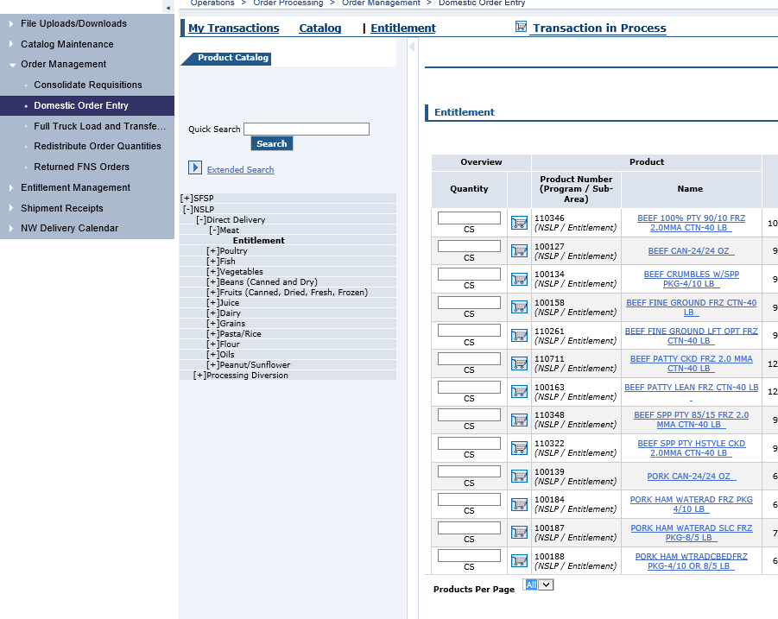
View All Items in the Catalog
Select All to ensure you view all the items under this category
Notes:
Select “All” to View All Items in the Catalog.

Slide 7
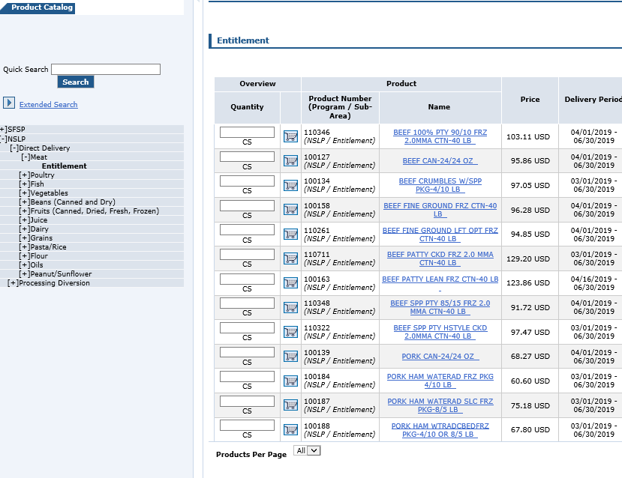
Select Shopping Cart Icon
Instead, click on the Shopping Cart Icon OR blue product name
DON’T ENTER ANYTHING HERE!
Notes:
Find the product you want to order, and click on the shopping cart icon next to it.
Don’t enter anything in the Quantity Column. Instead, click on the Shopping Cart Icon OR blue product name.

Slide 8
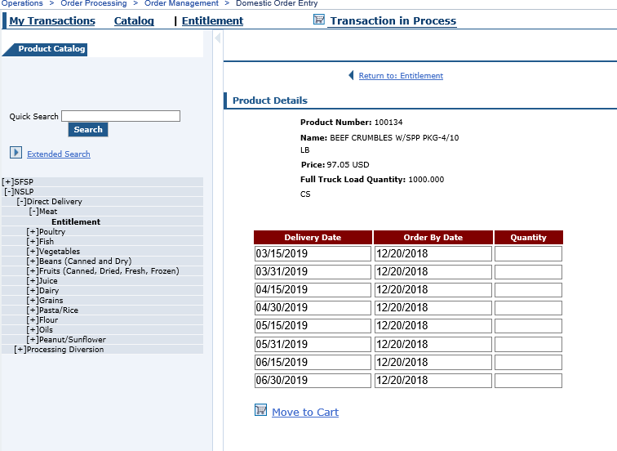
Enter Quantity & Move to Cart
Enter the quantity you’d like delivered to the warehouse for you for each delivery date (look at your catalog worksheet!)
When you’ve entered the number of cases you want, click “Move the Cart”
Notes:
Enter the quantity you’d like delivered to the warehouse for you for each delivery date (look at your catalog worksheet!).
When you’ve entered the number of cases you want, click “Move the Cart”.

Slide 9
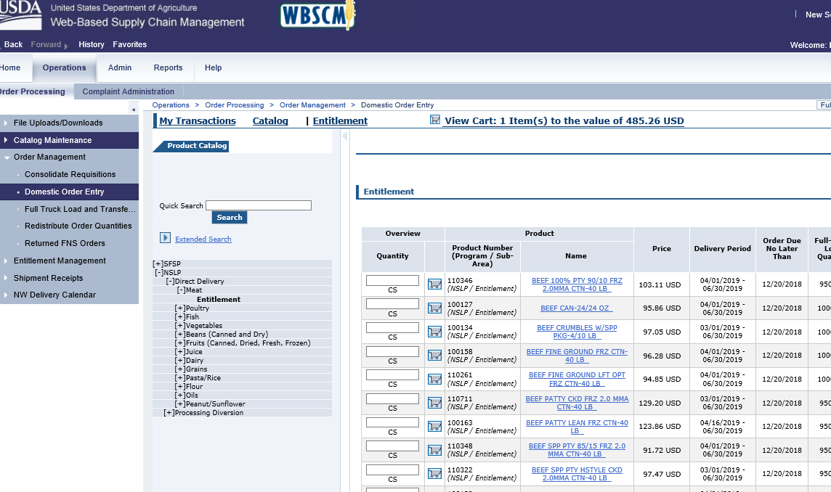
When you’re ready to submit your Order
Tip: As you add items to your cart, you will see the quantity and value increase here. Each date counts as an “Item.”
You can continue to add items from current category, search for new items or click on a different category.
If you’re done adding items, click “View Cart” to continue on and process your order or to add more to your order after viewing cart.
Tip: Do not click in this area, otherwise you will lose everything in your cart.
Notes:
You can continue to add items from current category, search for new items or click on a different category.
If you’re done adding items, click “View Cart” to continue on and process your order or to add more to your order after viewing cart.
Tips:
As you add items to your cart, you will see the quantity and value increase here. Each date counts as an “Item.”
Do not click in this area, otherwise you will lose everything in your cart.

Slide 10
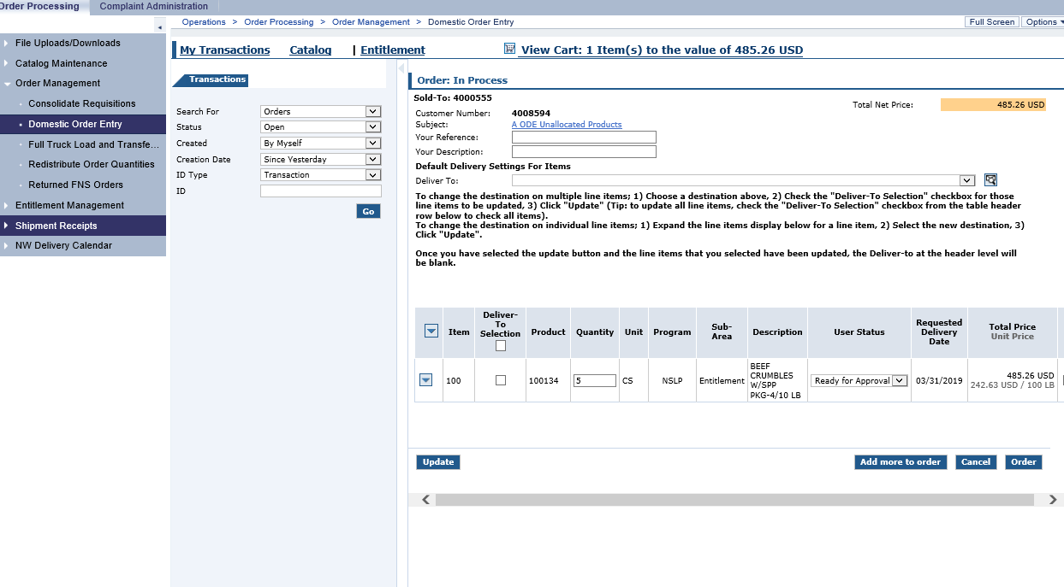
To Expand the View
Click hide navigator button (that sidewise triangle) to hide this view and make your items easier to see.
Then, click this triangle to see the expanded details for each of the items in your cart.
Notes:
Click hide navigator button (that sidewise triangle) to hide this view and make your items easier to see.
Then, click this triangle to see the expanded details for each of the items in your cart.

Slide 11
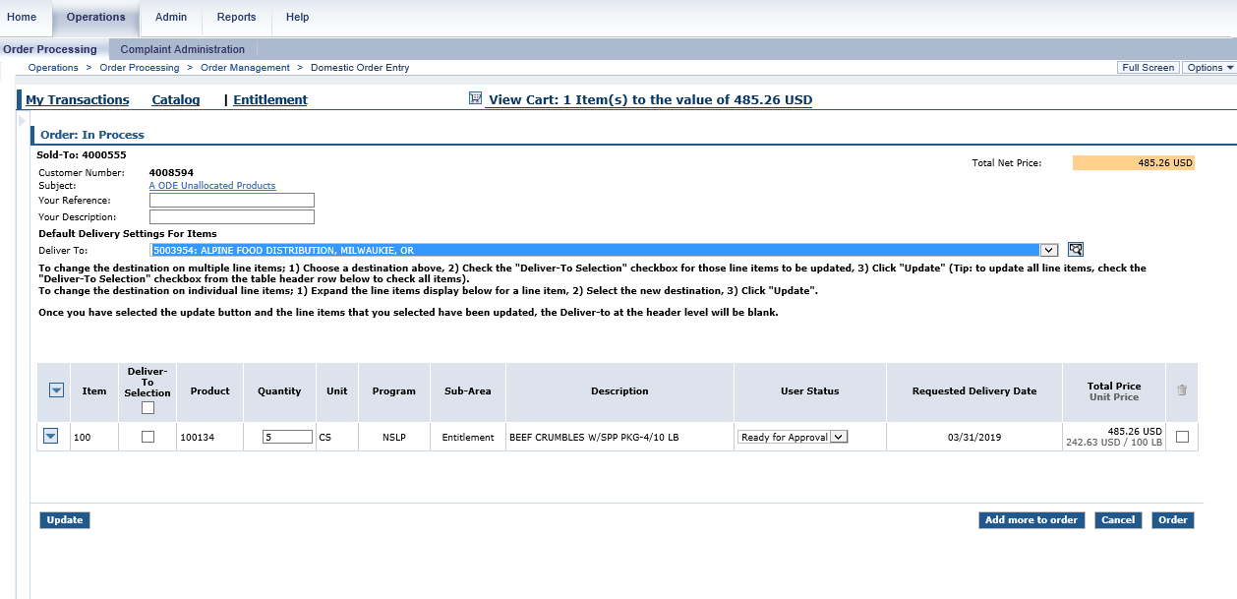
Assigning delivery location to your items
Tip: Checking this box will check the box next to all of your items.
If all of your items are going to the same warehouse, you can assign the deliver to locations all at once, by selecting the right location up top, and then putting a check mark next to the top “deliver-to-selection”.
The current USDA Foods storage and delivery sub-contractor (Alpine Food Distribution) has just one warehouse for direct delivery.
Processors for diverted foods have their own warehouses, please reference the processing spreadsheet for correct “deliver to” for each code.
Notes:
If all of your items are going to the same warehouse, you can assign the deliver to locations all at once, by selecting the right location up top, and then putting a check mark next to each item that’s going to that location.

Slide 12
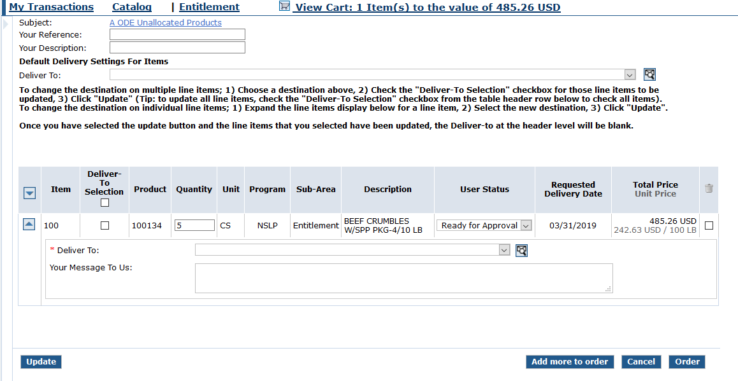
Update Quantity or Delete Items
You can change the quantity of cases in you order here. But, you can’t change the quantity to zero…
…if you want to delete an item, put a check mark in the box under the trash can.
After any changes are made, click “update” again, or these changes won’t “stick”
Notes:
You can change the quantity of cases in you order here. But, you can’t change the quantity to zero…
…if you want to delete an item, put a check mark in the box under the trash can.
After any changes are made, click “update” again, or these changes won’t “stick”.

Slide 13
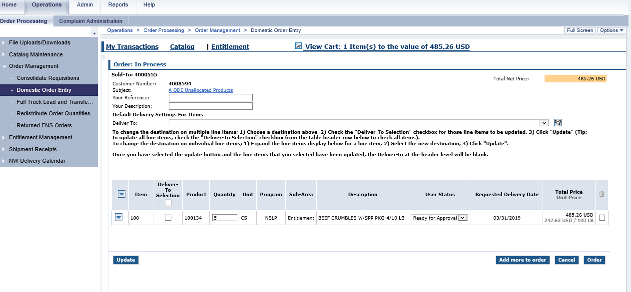
Adding More Items To Your Cart
If you want to add more items, click this button. DO NOT try to add more items by just clicking “Domestic Order Entry” on the left hand side of the page – since you haven’t submitted this cart yet, you would lose everything in it if you did that.
Remember: You can always create another order later, so if you’re happy with these items, it’s best to go ahead and submit this order now, then create a new order to add the rest of your items.
Notes:
If you want to add more items, click this button. DO NOT try to add more items by just clicking “Domestic Order Entry” on the left hand side of the page – since you haven’t submitted this cart yet, you would lose everything in it if you did that.
Remember: You can always create another order later, so if you’re happy with these items, it’s best to go ahead and submit this order now, then create a new order to add the rest of your items.

Slide 14
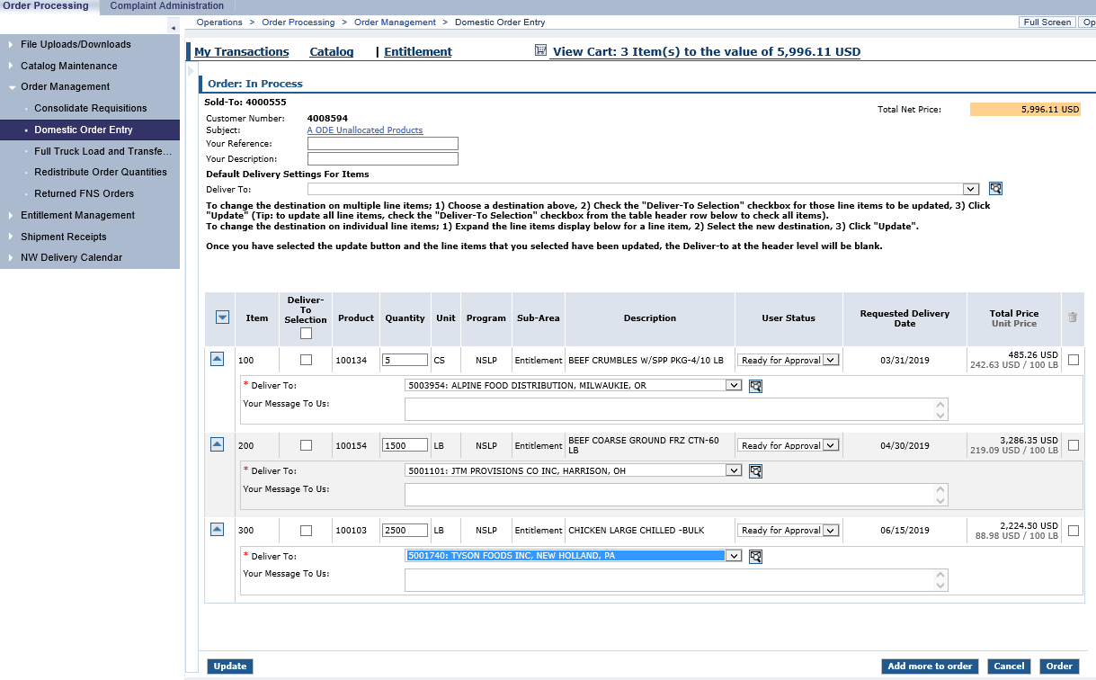
Submitting Your Order
Two more products were added to the existing beef order
Since this is a diverted/processed product, it has been assigned to that processor’s delivery location for that product code which is different than direct delivery.
Take a last look. Are your quantities correct? Did you select the correct delivery locations? Did you hit “Update” after making changes? If so, click “Order” to place this order!
Notes:
In this example, two more products were added to the existing beef order; diversion chicken and ground beef pounds.
Since this is a diverted/processed product, it has been assigned to that processor’s delivery location for that product code which is different than direct delivery.
Take a last look. Are your quantities correct? Did you select the correct delivery locations? Did you hit “Update” after making changes? If so, click “Order” to place this order!

Slide 15
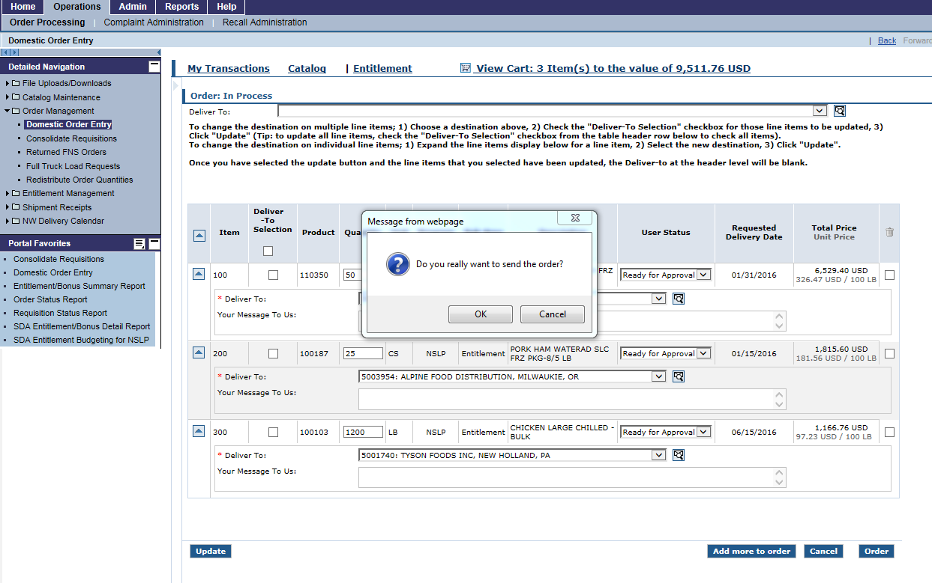
Confirm your Order
Click “OK” to process your order.
Tip: If you click “Cancel” at this step, you will lose your whole shopping cart.
Notes:
Click “OK” to process your order.
Tip: If you click “Cancel” at this step, you will lose your whole shopping cart.

Slide 16
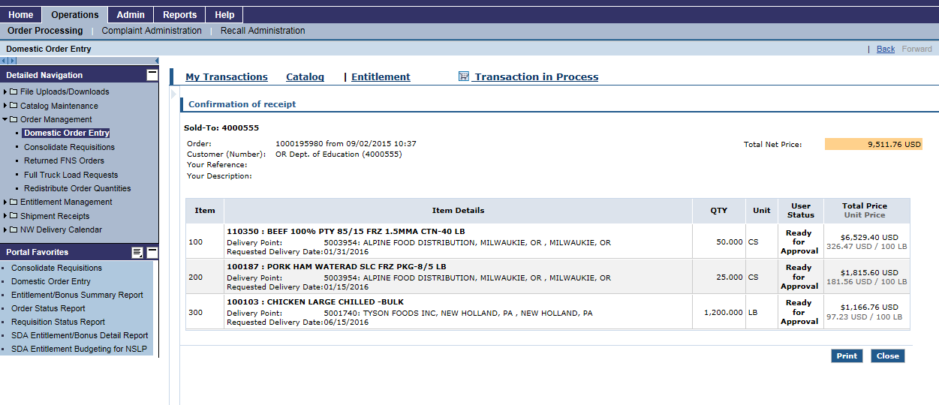
Confirmation of Receipt
Is everything correct? If not, you must e-mail ODE FDP (ode.fooddistribution@state.or.us) as soon as possible to have your order declined.
Click here to print the confirmation page for your records
IMPORTANT: If you don’t get to this confirmation page, you haven’t completed your order!!
Notes:
IMPORTANT: If you don’t get to this confirmation page, you haven’t completed your order!!
Is everything correct? If not, you must e-mail ODE FDP (ode.fooddistribution@state.or.us) as soon as possible to have your order declined.
Click here to print the confirmation page for your records.

Slide 17
If you have questions or need assistance with WBSCM, please contact the ODE USDA Foods Program Team at ode.fooddistribution@ode.oregon.gov

Slide 18

Oregon Department of Education “Our Why”
Equity and Excellence for Every Learner
The Oregon Department of Education works in partnership with school districts, education service districts and community partners;
Together, we serve over 580,000 K-12 students;
We believe every student should have access to a high-quality, well-rounded learning experience;
We work to achieve the Governor’s vision that every student in Oregon graduates with a plan for their future.
Notes:
You will notice that all ODE trainings have this slide and the following at this time. We are in an exciting time in Oregon Education with the Student Success Act. We are all charged with keeping our mission in mind as we work towards implementation

Slide 19
Non-Discrimination Statement
In accordance with Federal civil rights law and U.S. Department of Agriculture (USDA) civil rights regulations and policies, the USDA, its Agencies, offices, and employees, and institutions participating in or administering USDA programs are prohibited from discriminating based on race, color, national origin, sex, disability, age, or reprisal or retaliation for prior civil rights activity in any program or activity conducted or funded by USDA. Persons with disabilities who require alternative means of communication for program information (e.g. Braille, large print, audiotape, American Sign Language, etc.), should contact the Agency (State or local) where they applied for benefits. Individuals who are deaf, hard of hearing or have speech disabilities may contact USDA through the Federal Relay Service at (800) 877-8339. Additionally, program information may be made available in languages other than English. To file a program complaint of discrimination, complete the USDA Program Discrimination Complaint Form, (AD-3027) found online at: USDA Link, and at any USDA office, or write a letter addressed to USDA and provide in the letter all of the information requested in the form. To request a copy of the complaint form, call (866) 632-9992. Submit your completed form or letter to USDA by: (1) mail: U.S. Department of Agriculture Office of the Assistant Secretary for Civil Rights 1400 Independence Avenue, SW Washington, D.C. 20250-9410; (2) fax: (202) 690-7442; or (3) email: program.intake@usda.gov This institution is an equal opportunity provider.

