Slide 1
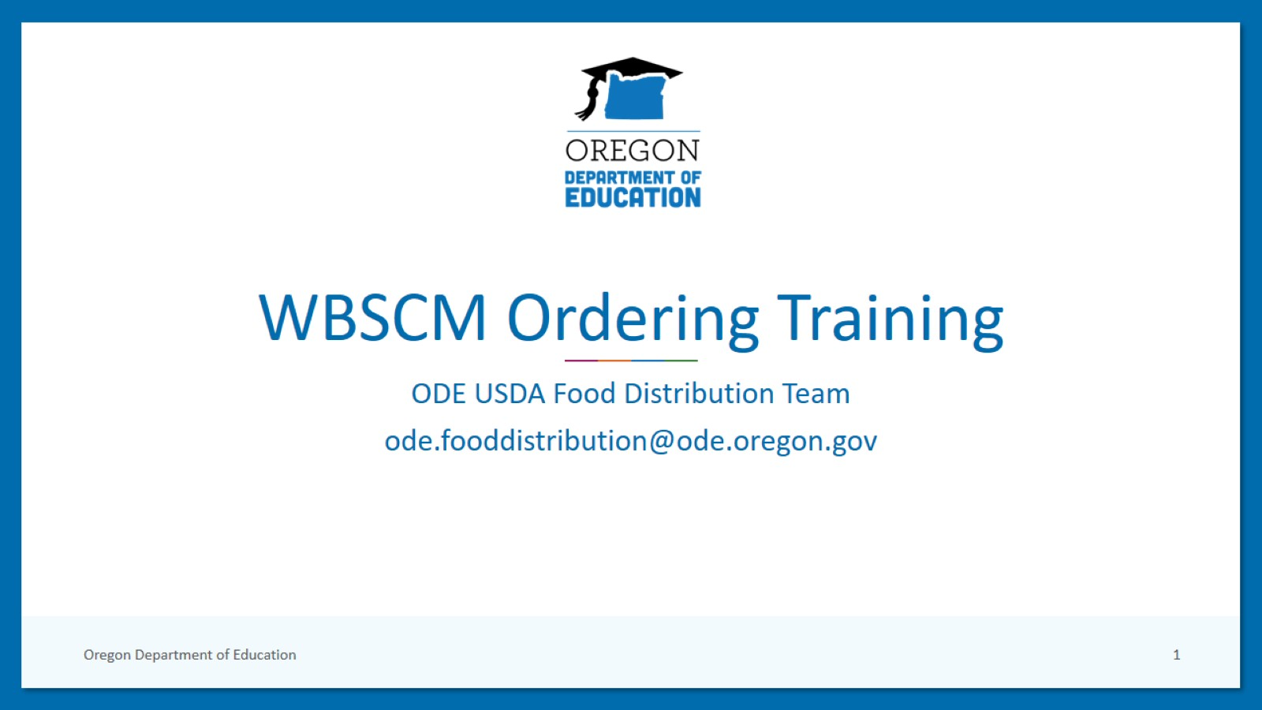
WBSCM Ordering Training

Slide 2
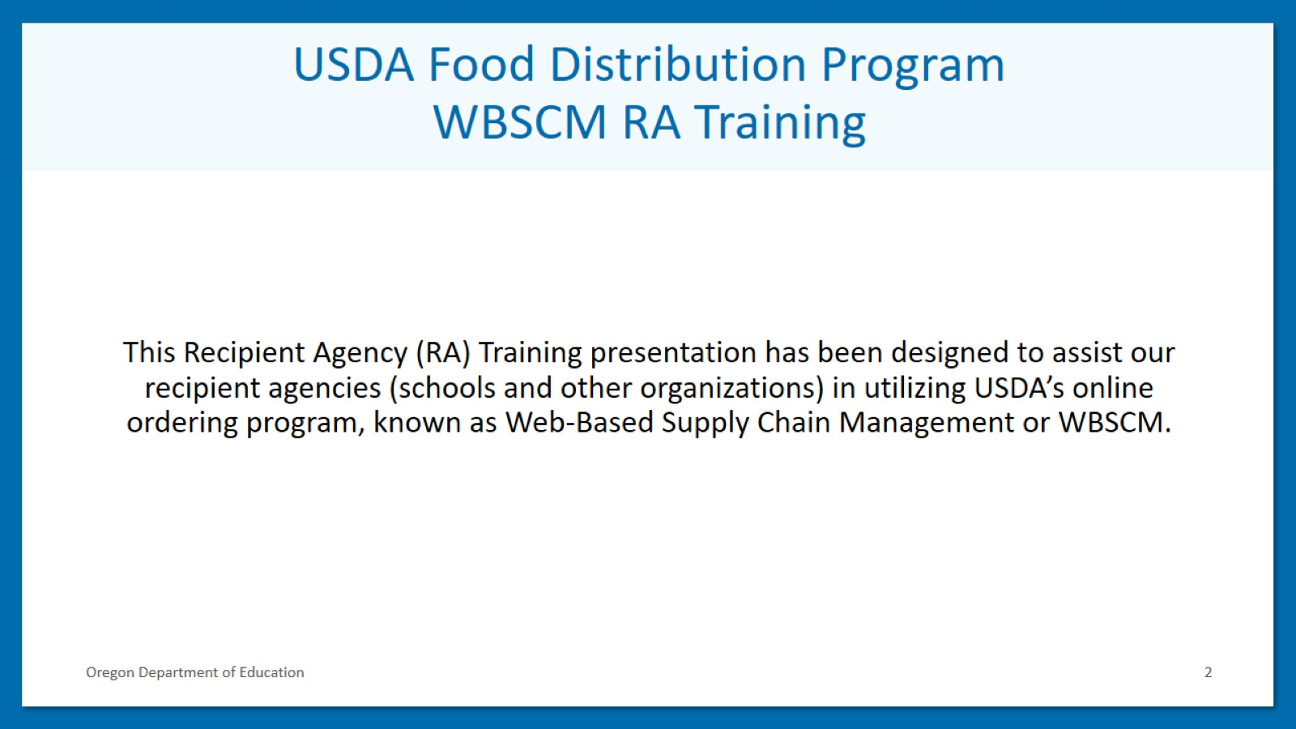
USDA Food Distribution Program
WBSCM RA Training

Slide 3
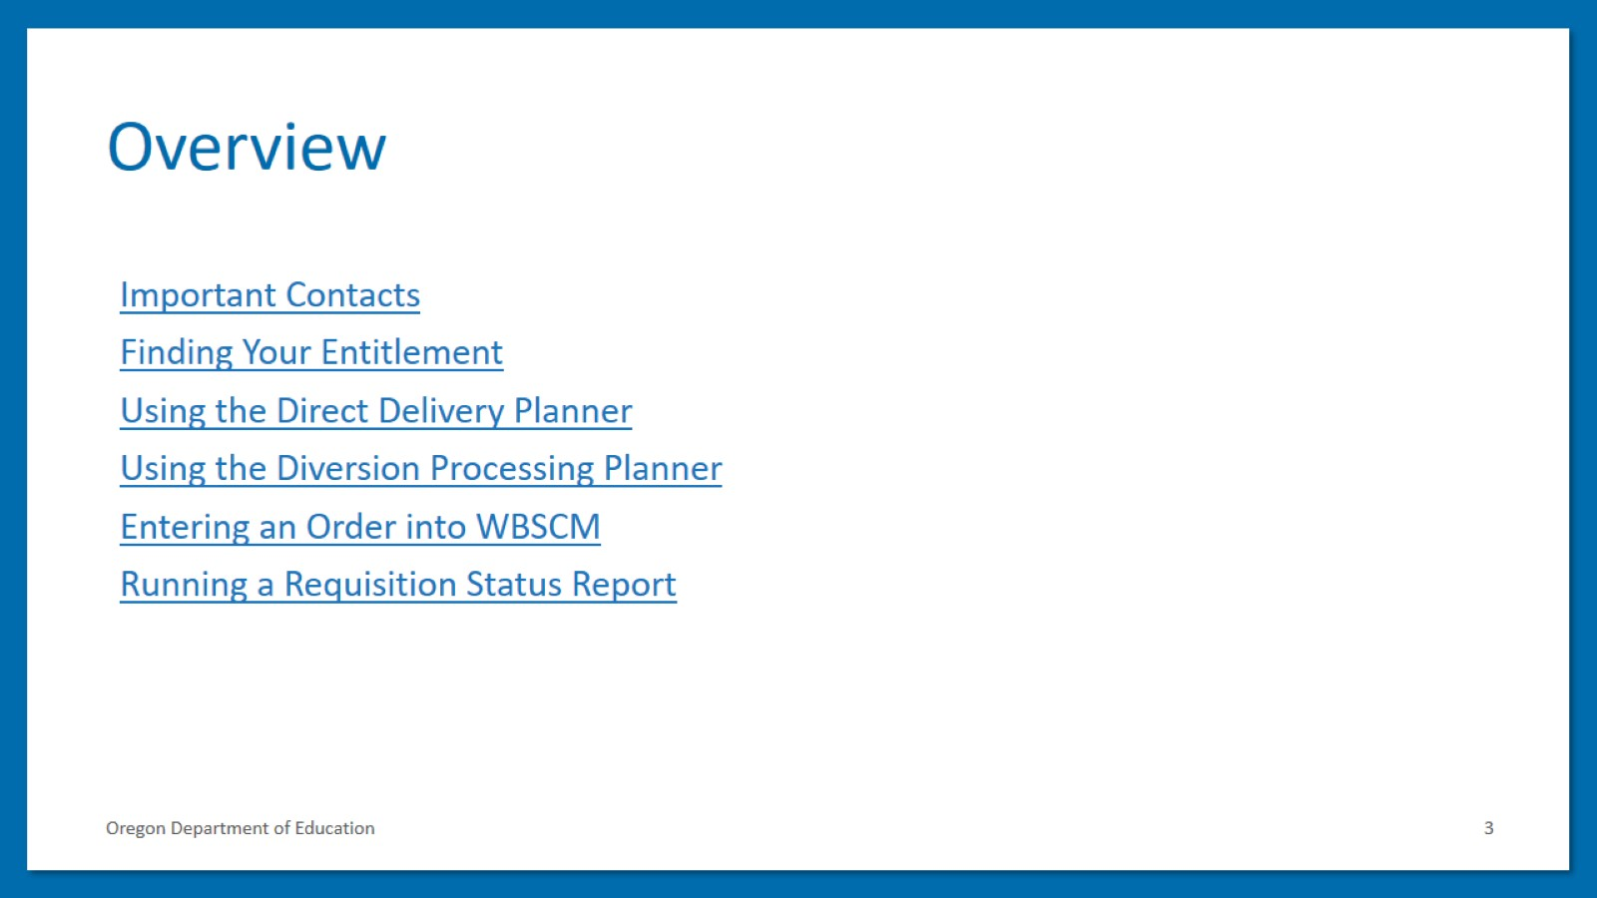
Overview

Slide 4
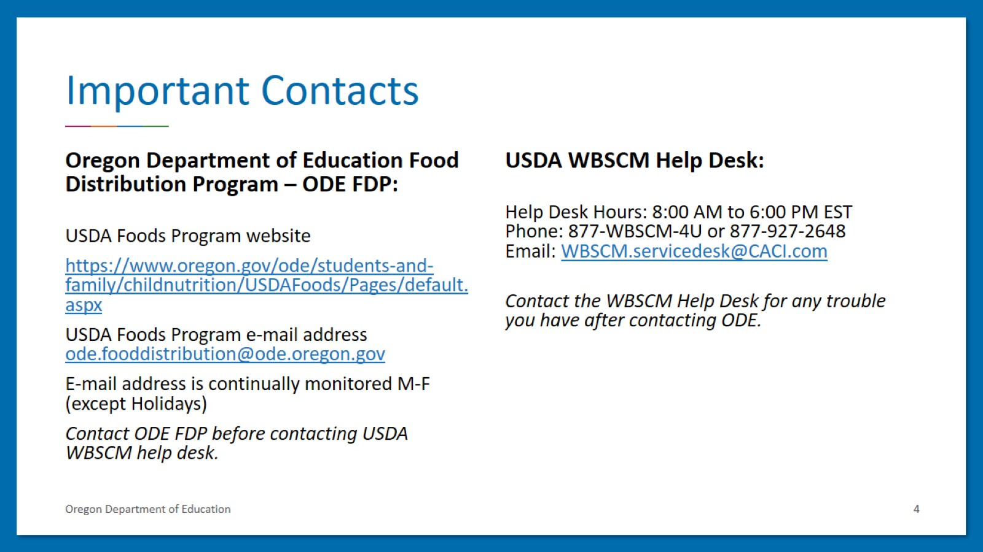
Important Contacts

Slide 5
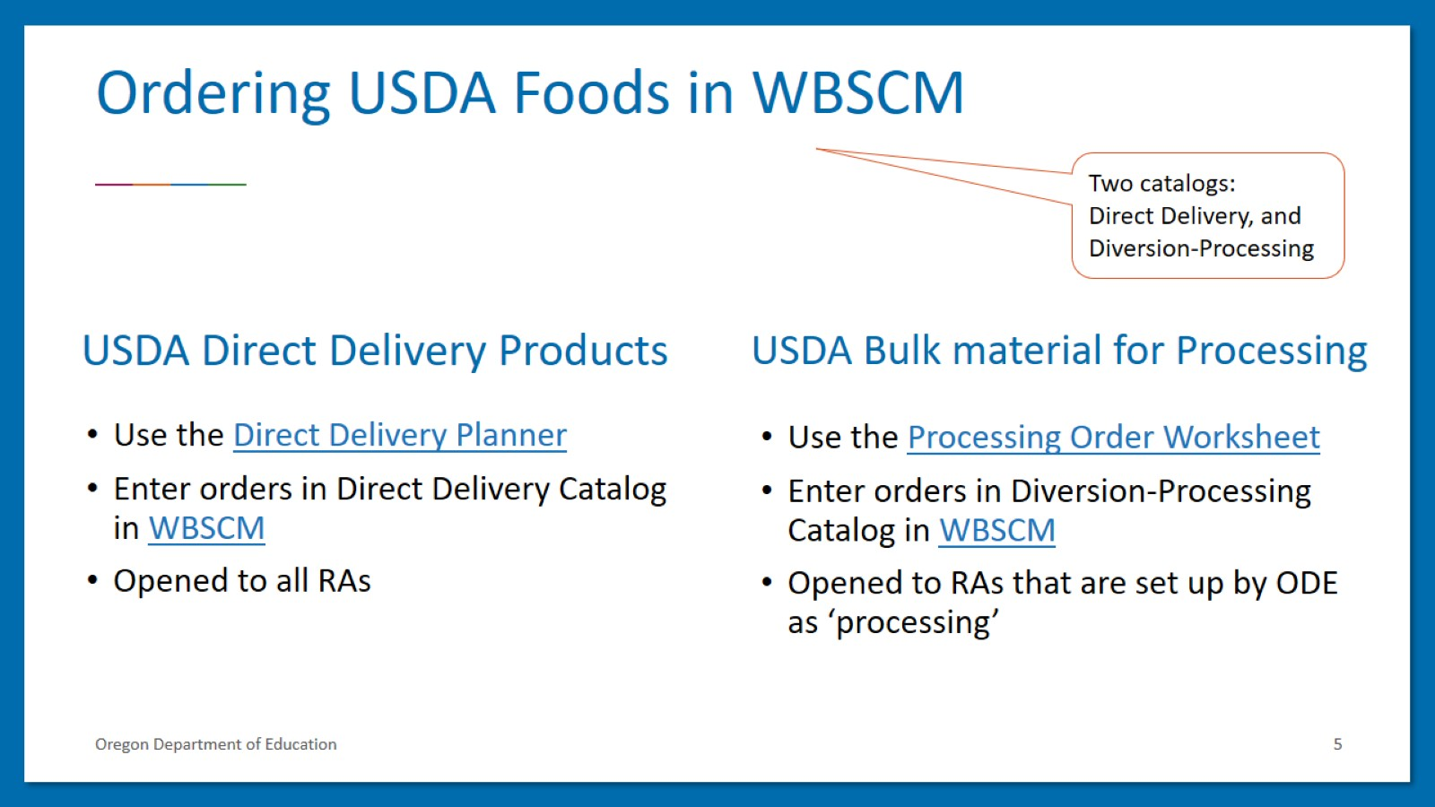
Ordering USDA Foods in WBSCM

Slide 6
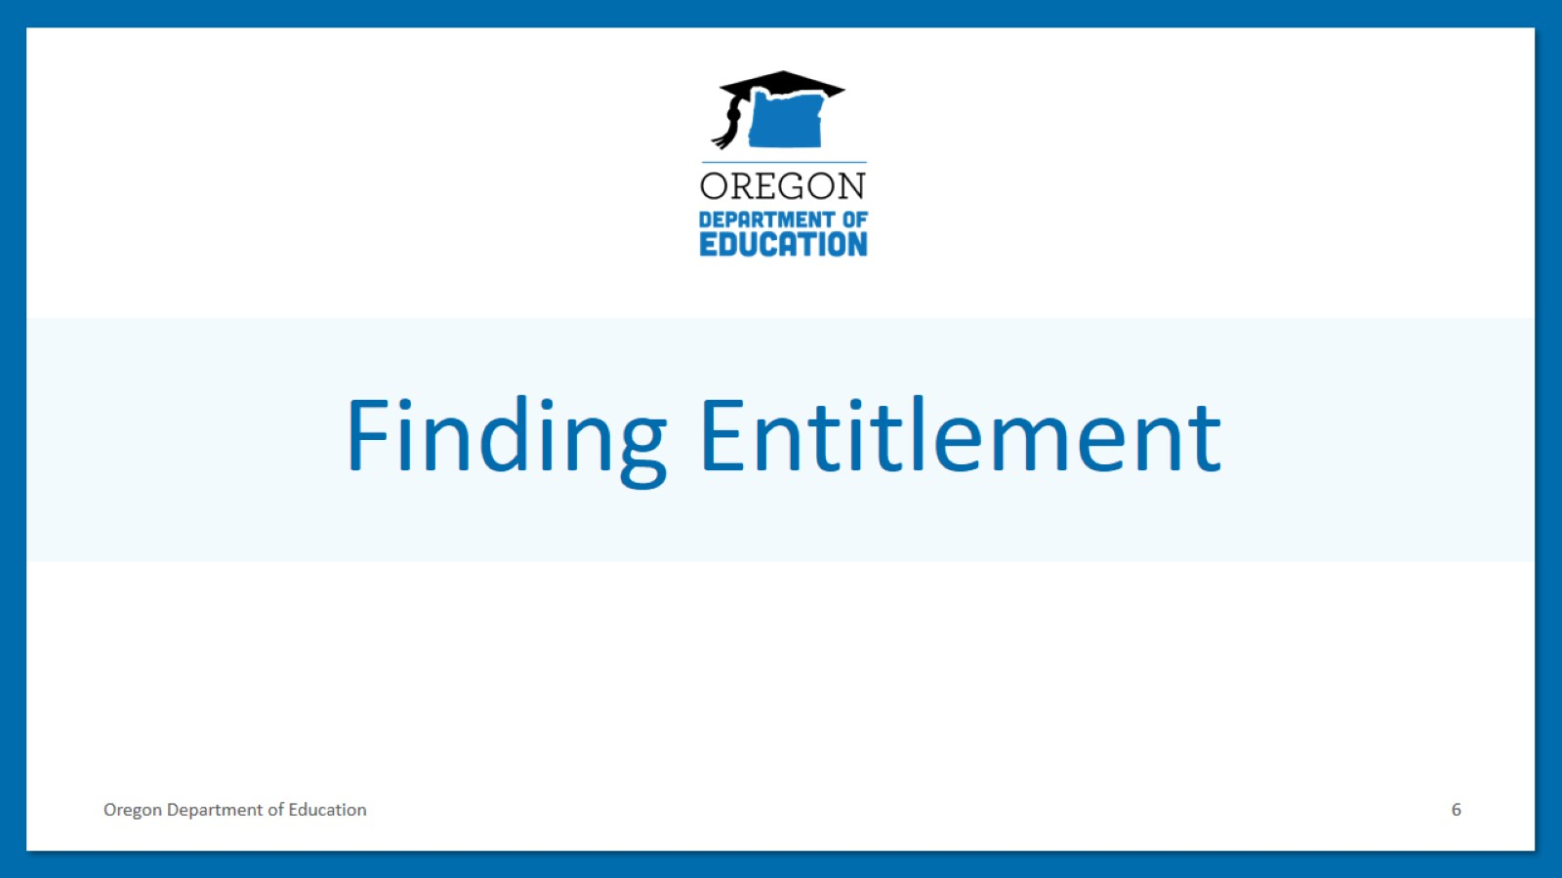
Finding Entitlement

Slide 7
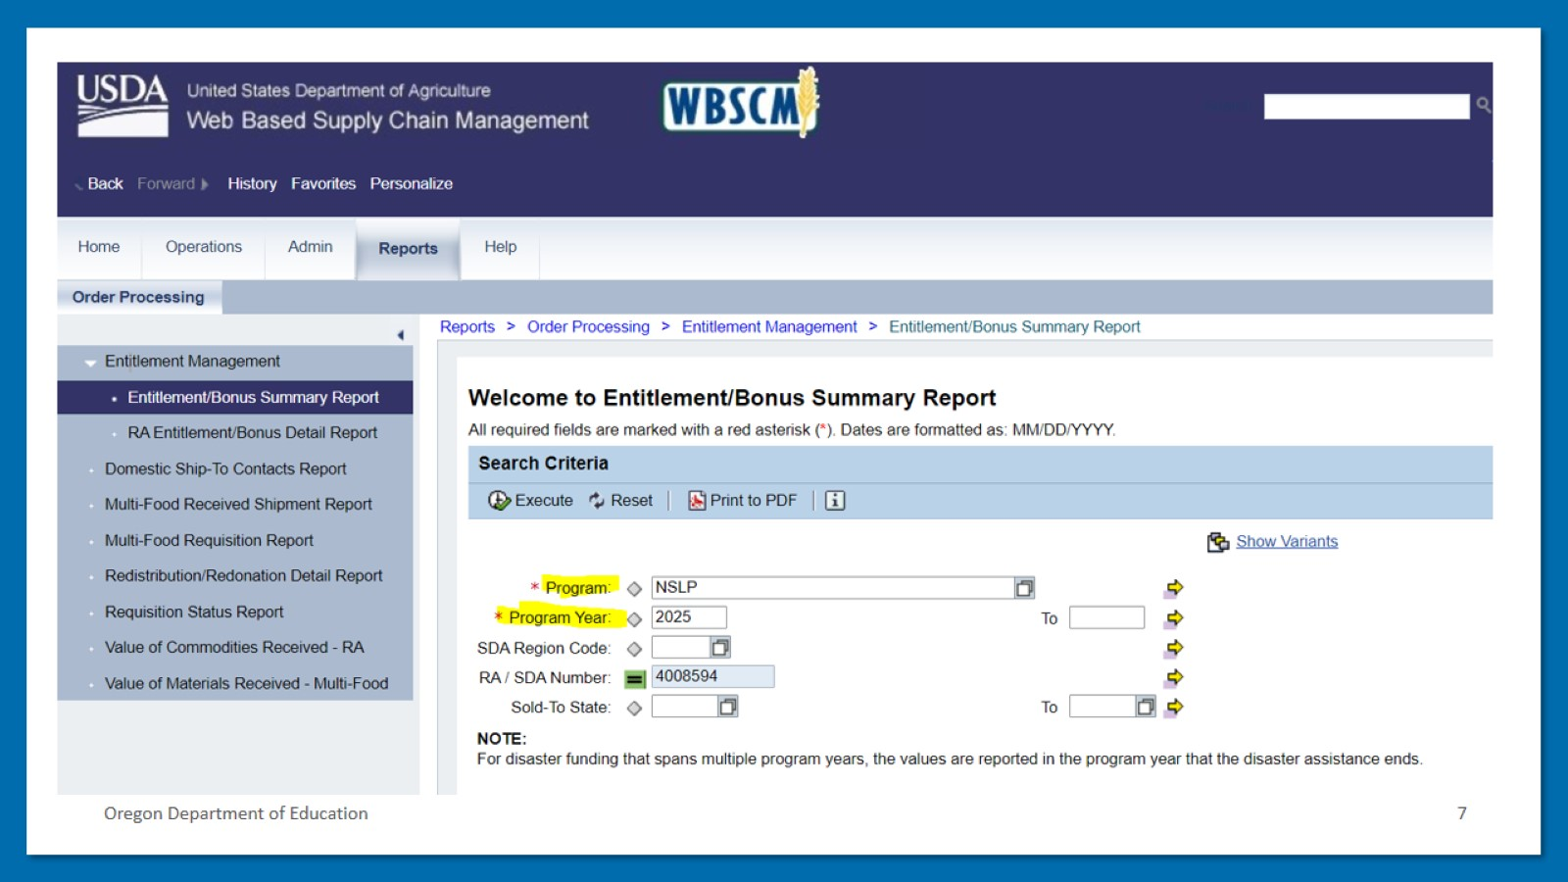
Oregon Department of Education

Slide 8
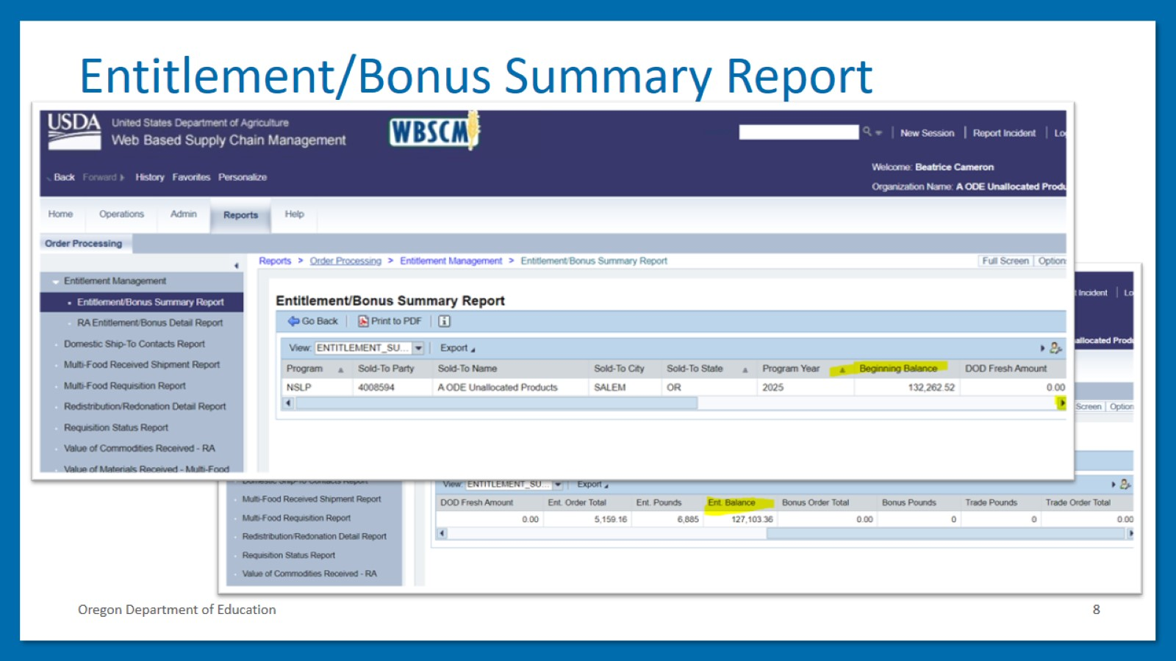
Entitlement/Bonus Summary Report

Slide 9
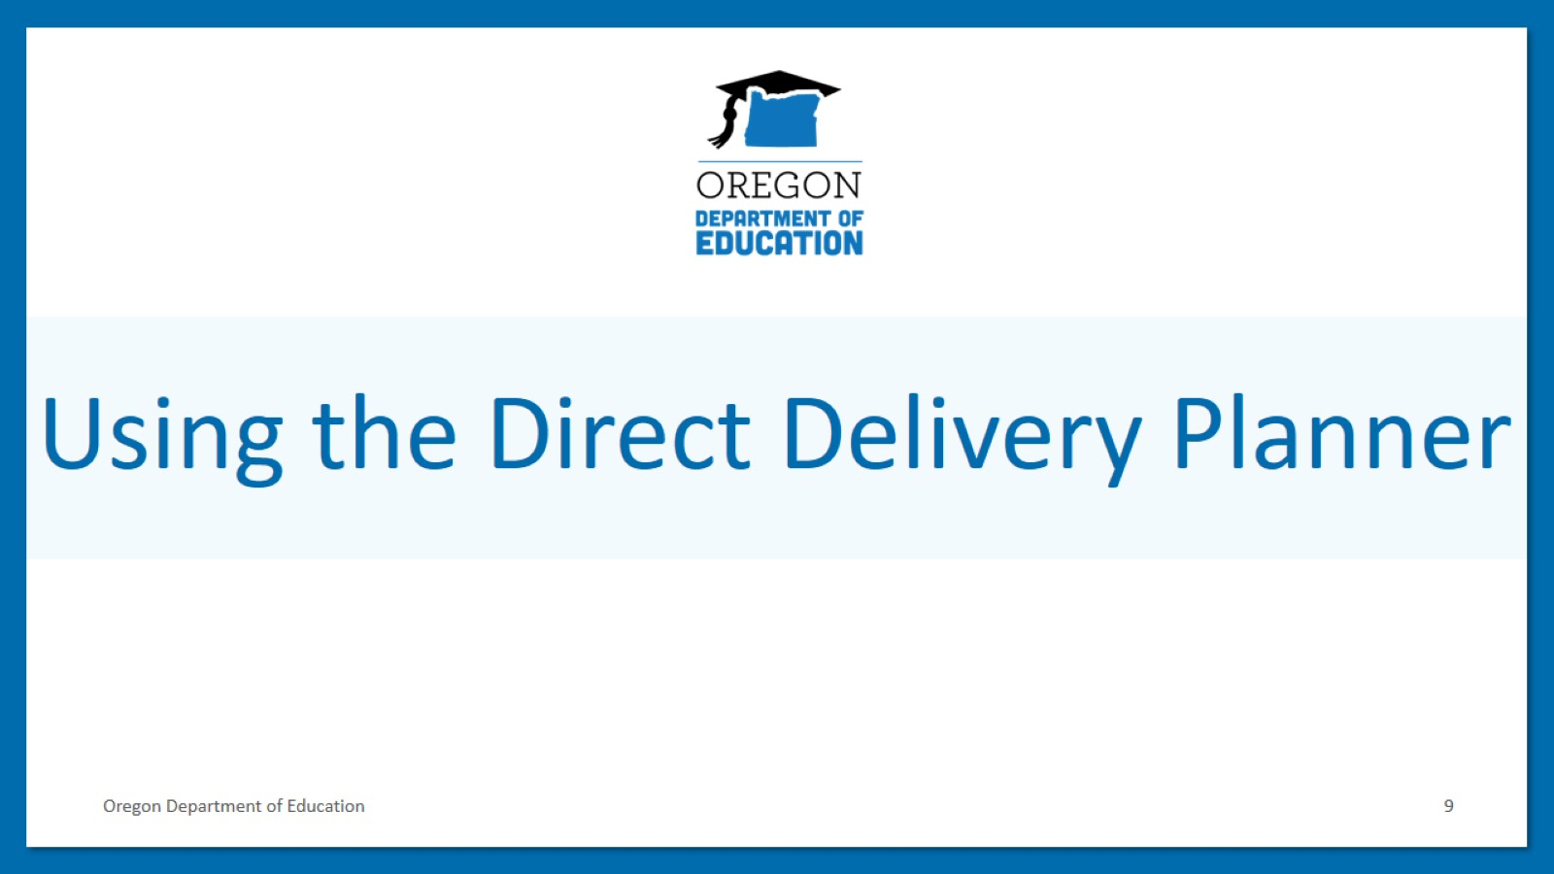
Using the Direct Delivery Planner

Slide 10
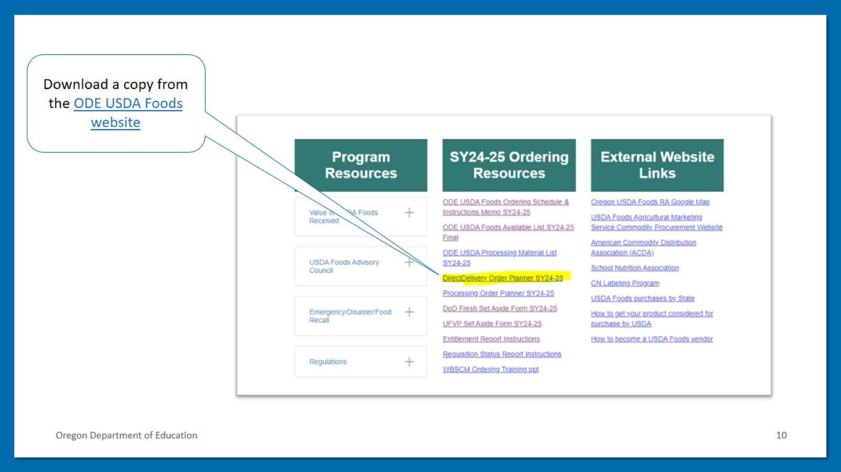
Download a copy from the ODE USDA Foods website

Slide 11
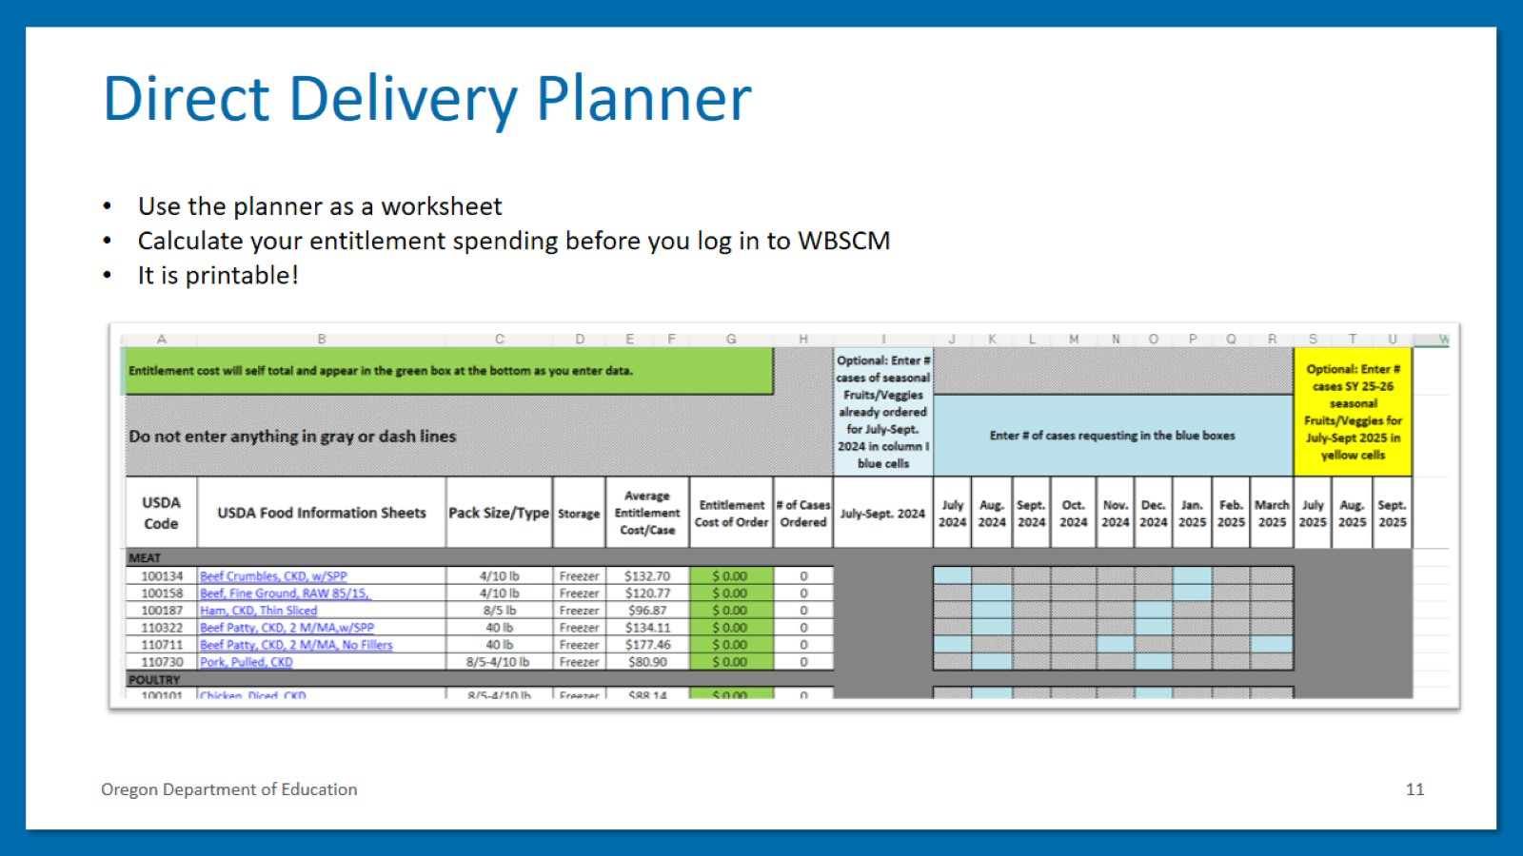
Direct Delivery Planner

Slide 12
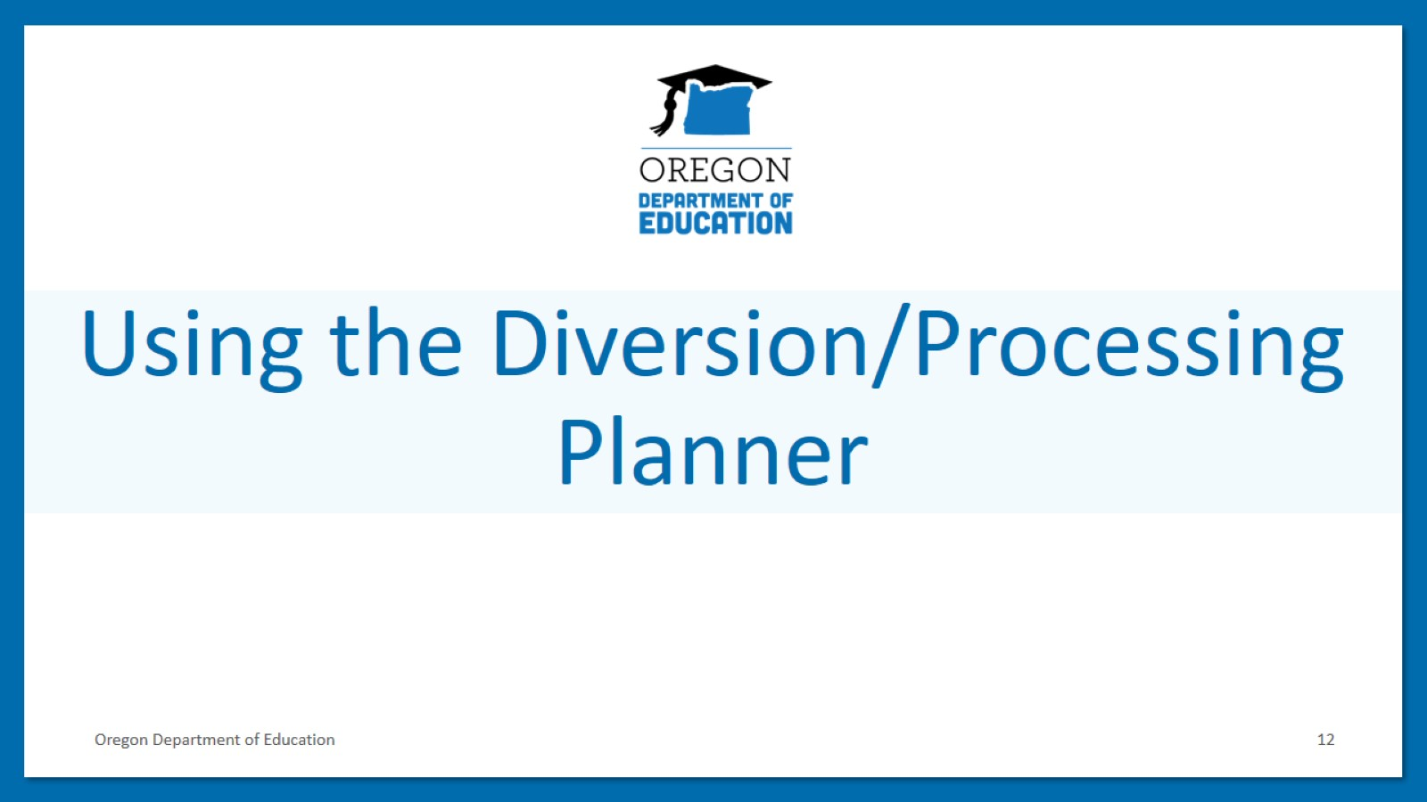
Using the Diversion/Processing Planner

Slide 13
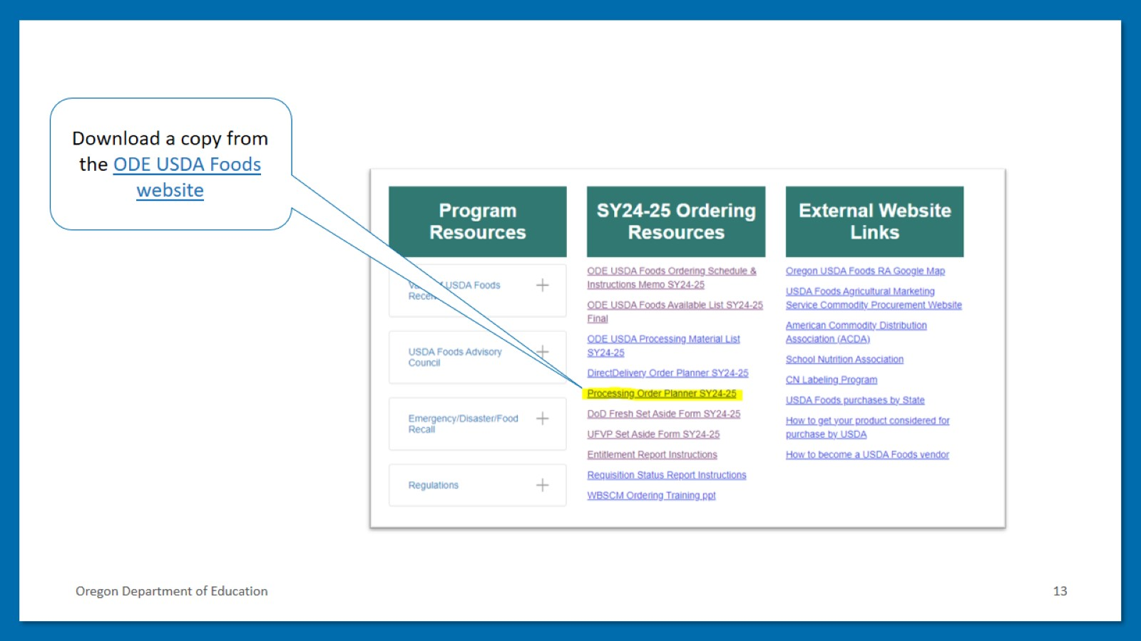
Download a copy from the ODE USDA Foods website

Slide 14
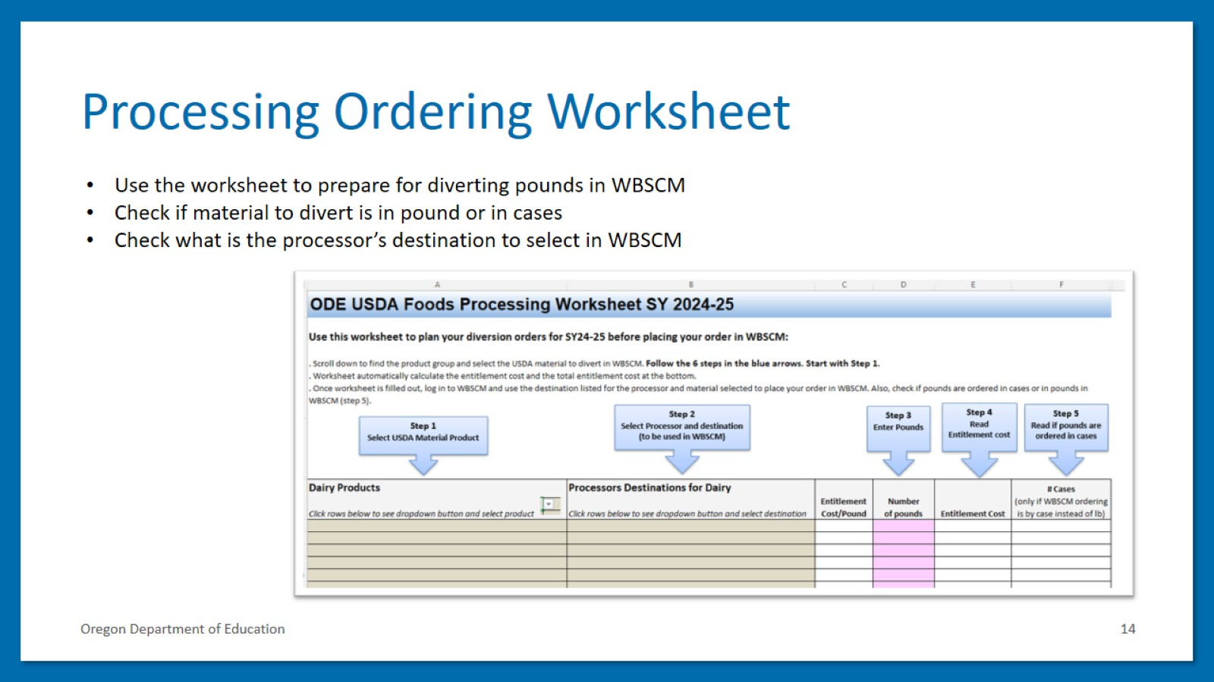
Processing Ordering Worksheet

Slide 15
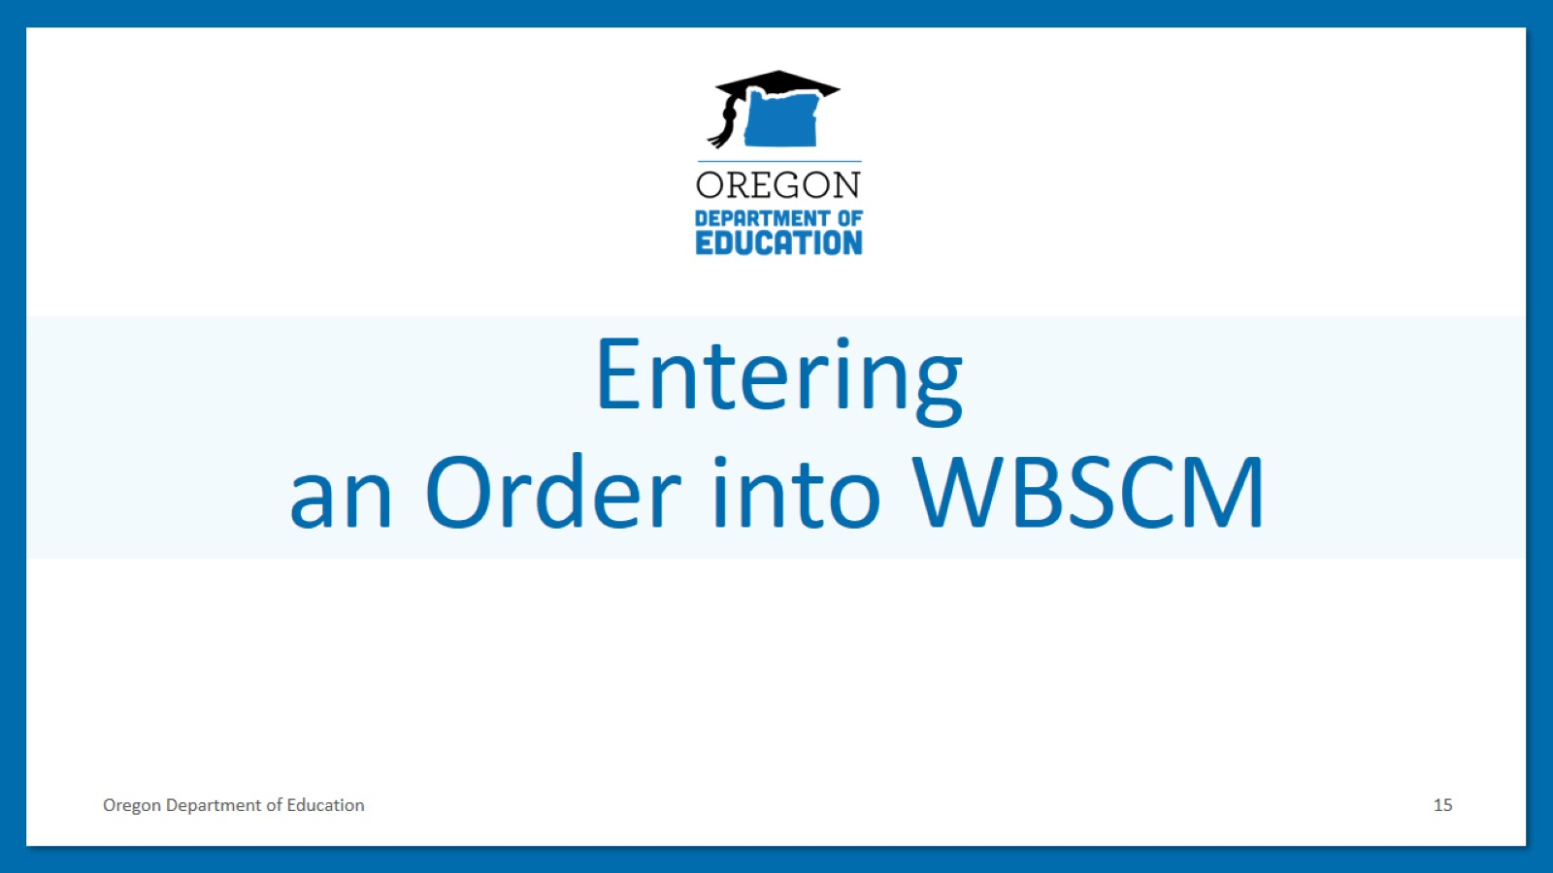
Entering an Order into WBSCM

Slide 16
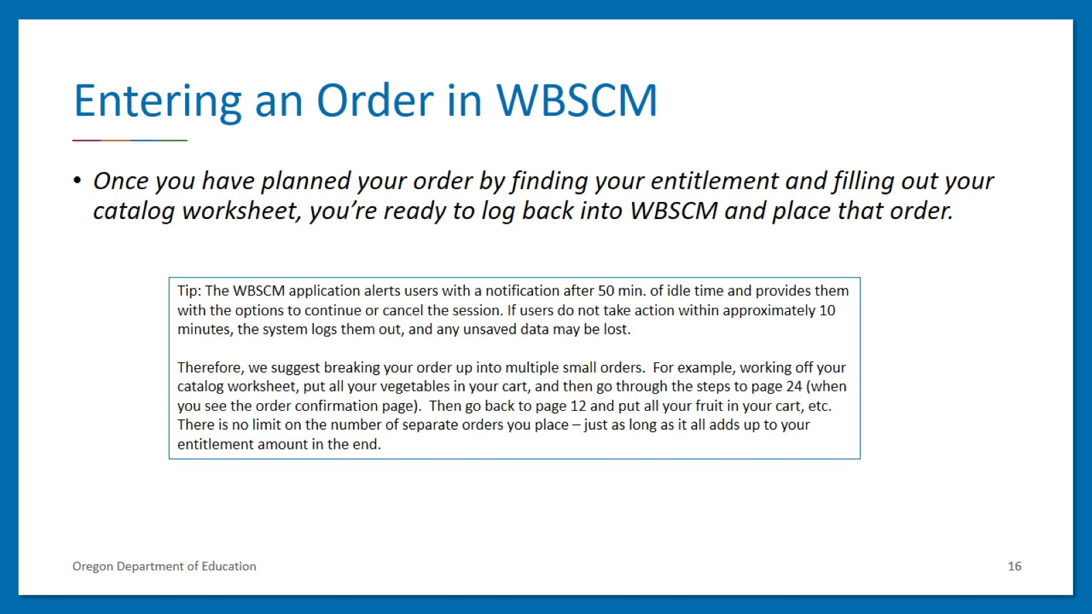
Entering an Order in WBSCM

Slide 17
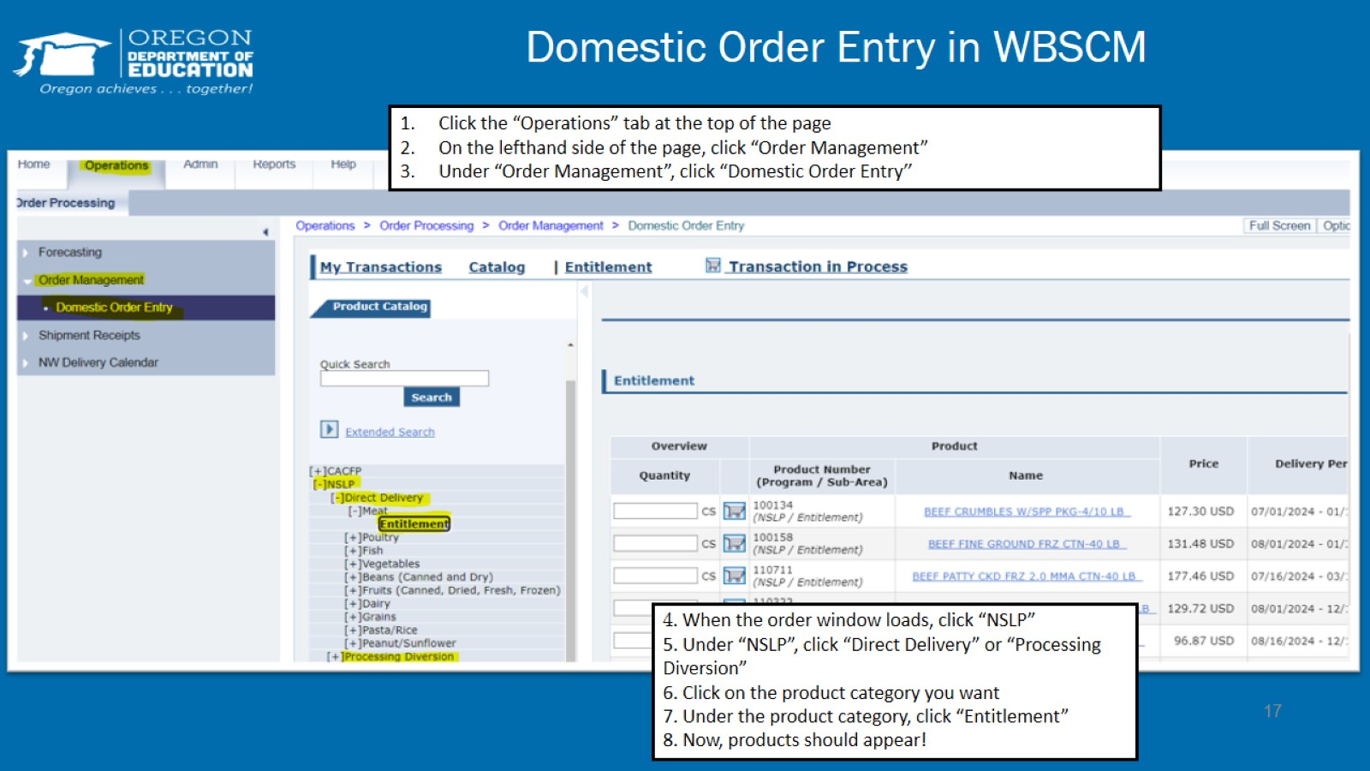
Domestic Order Entry in WBSCM

Slide 18
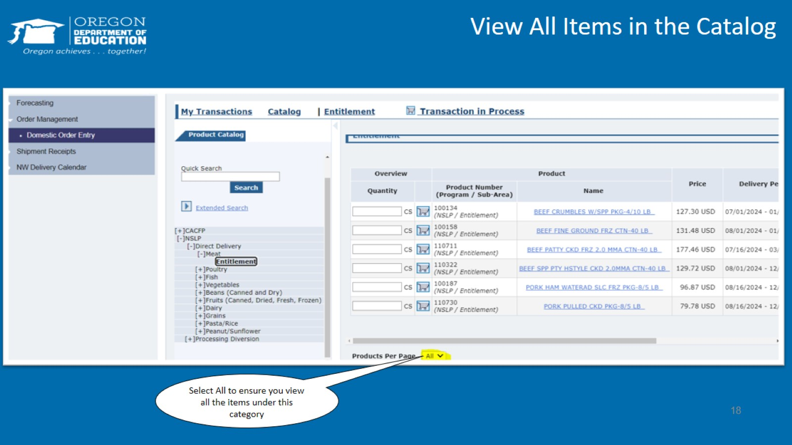
View All Items in the Catalog

Slide 19
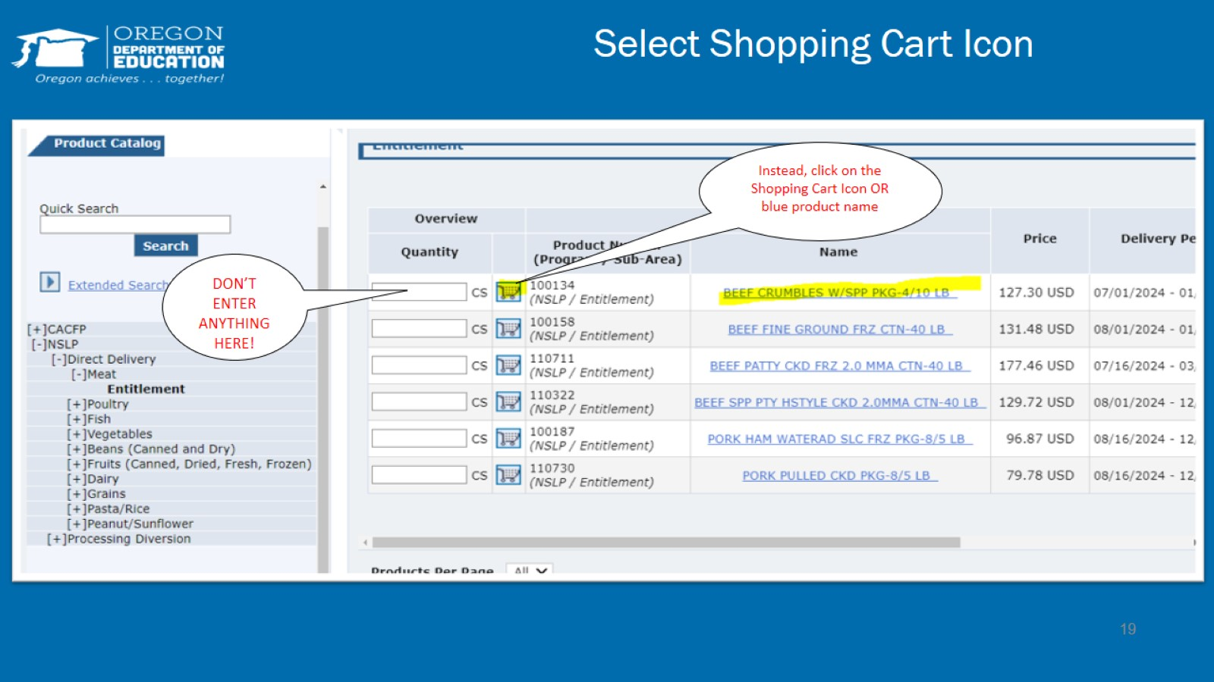
Select Shopping Cart Icon

Slide 20
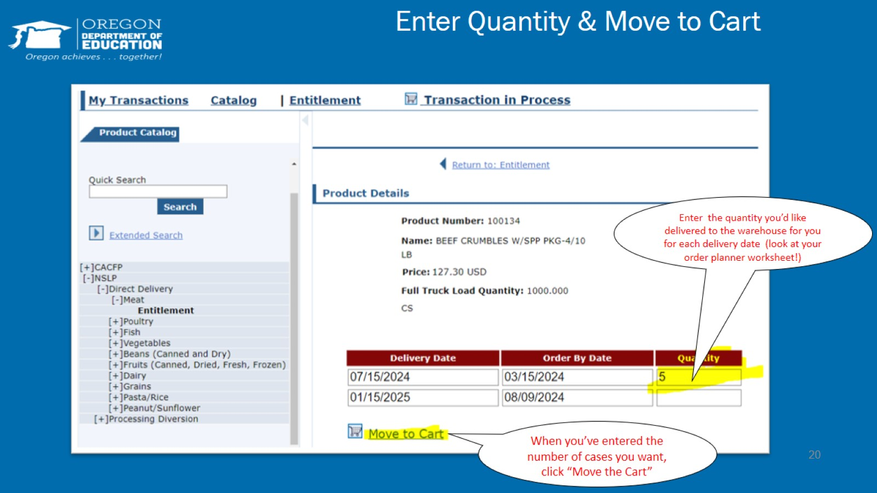
Enter Quantity & Move to Cart

Slide 21
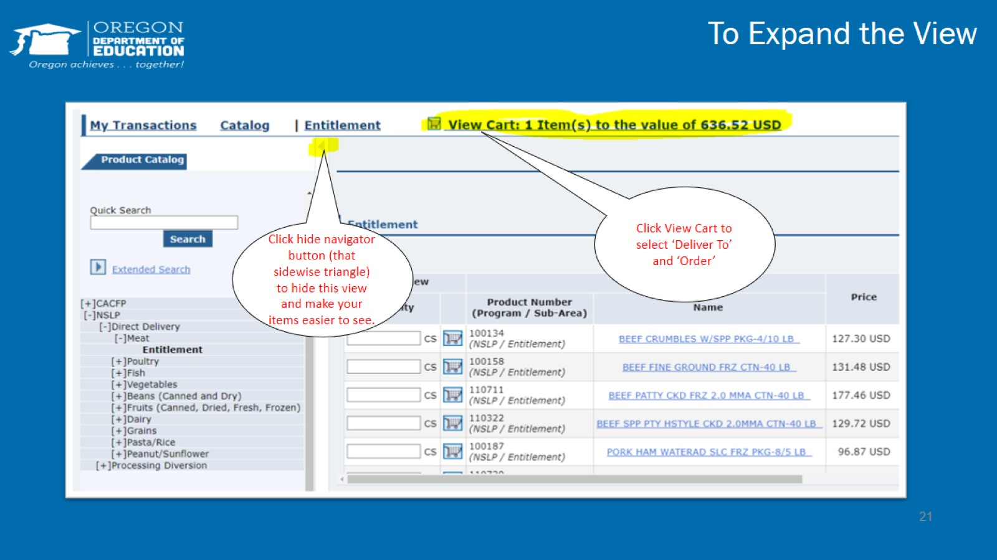
To Expand the View

Slide 22
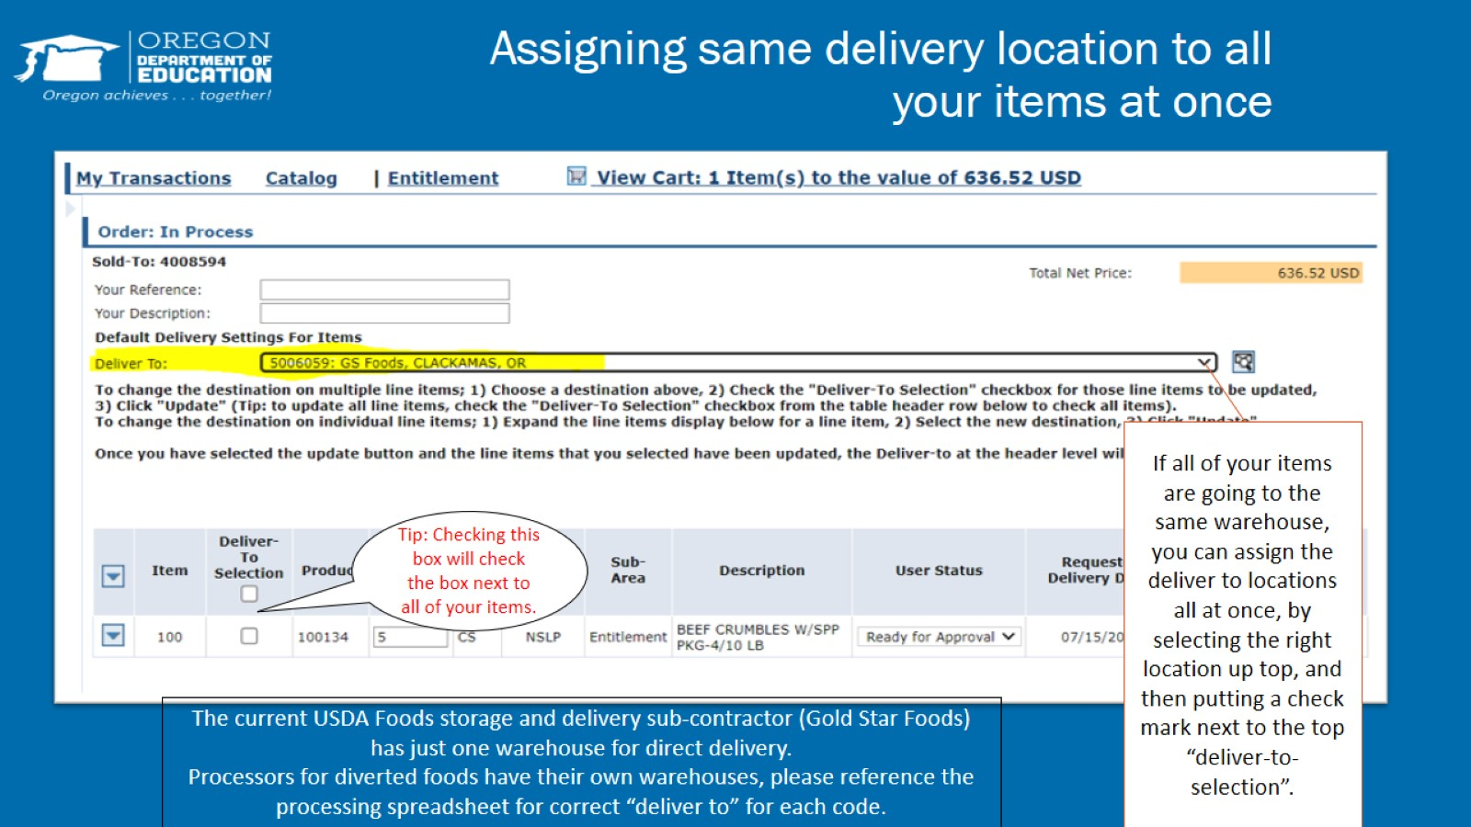
Assigning same delivery location to all your items at once

Slide 23
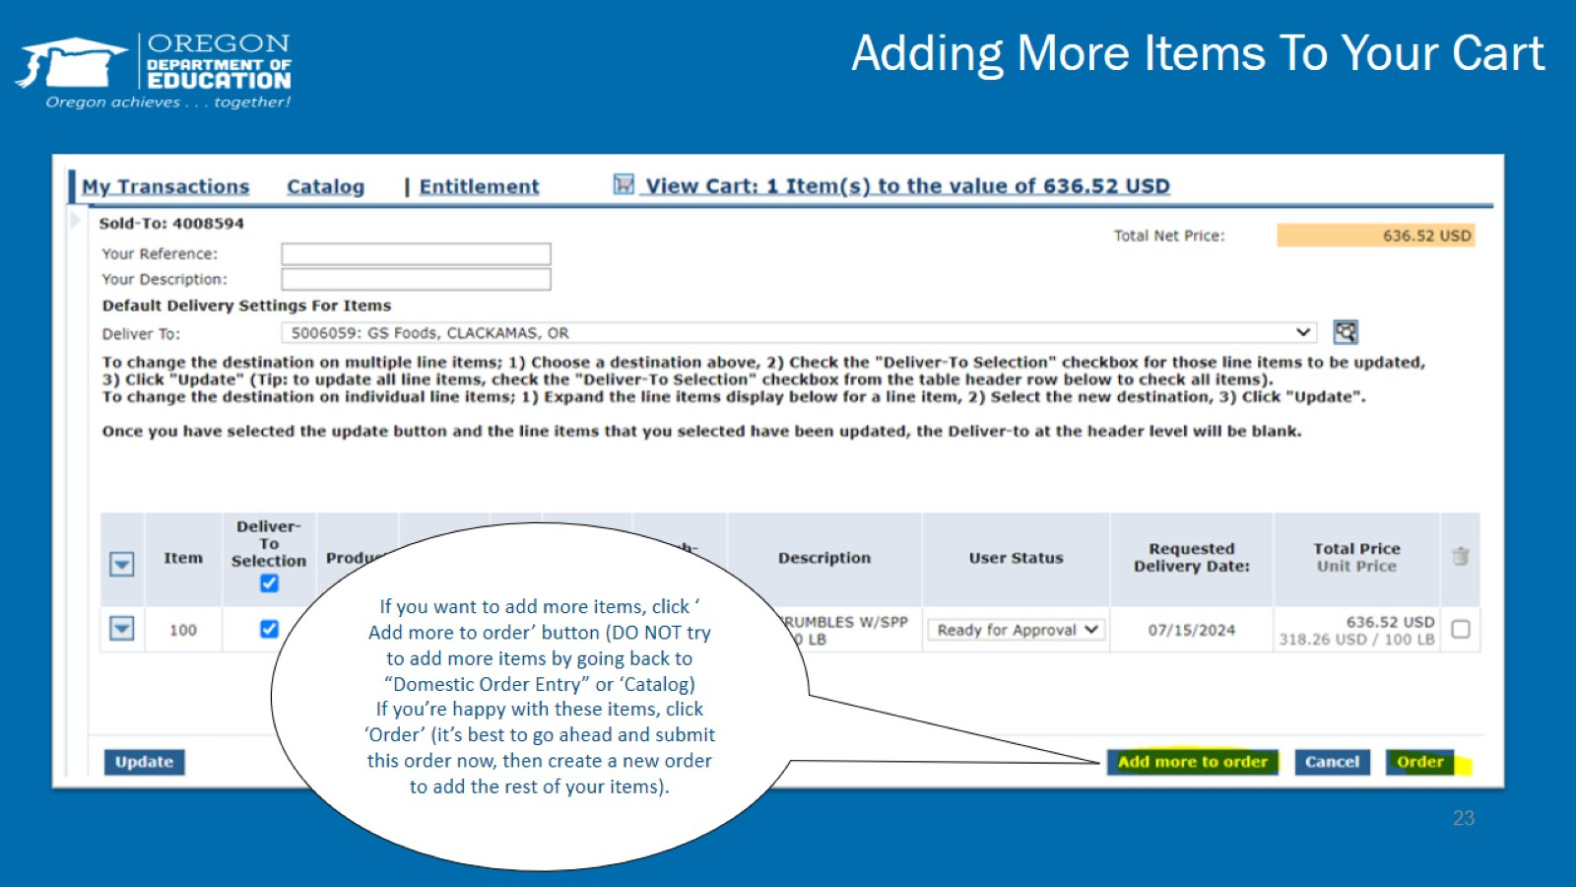
Adding More Items To Your Cart

Slide 24
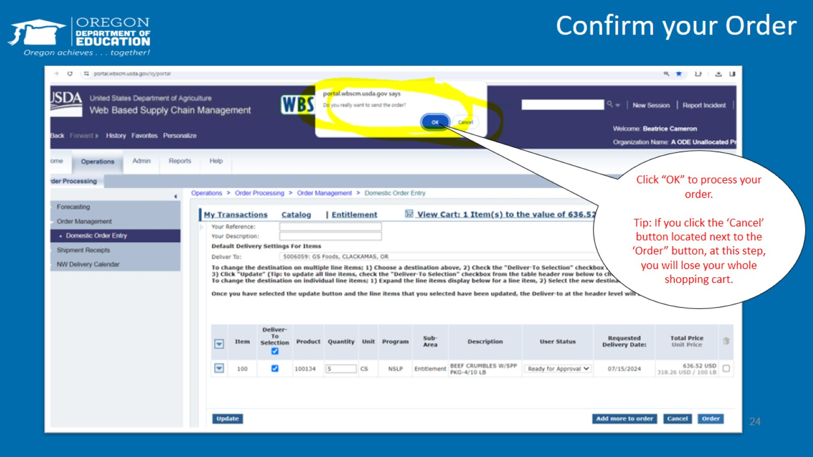
Confirm your Order

Slide 25
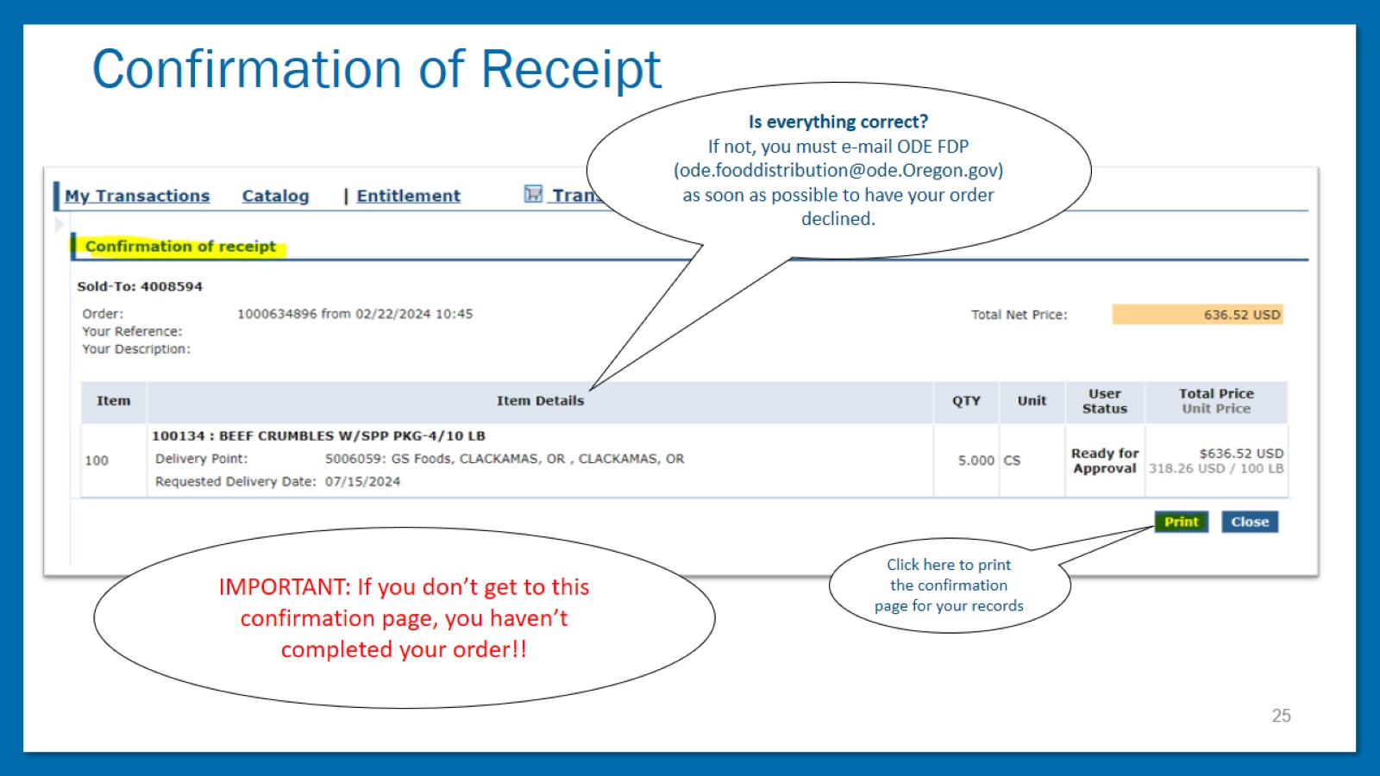
Confirmation of Receipt

Slide 26
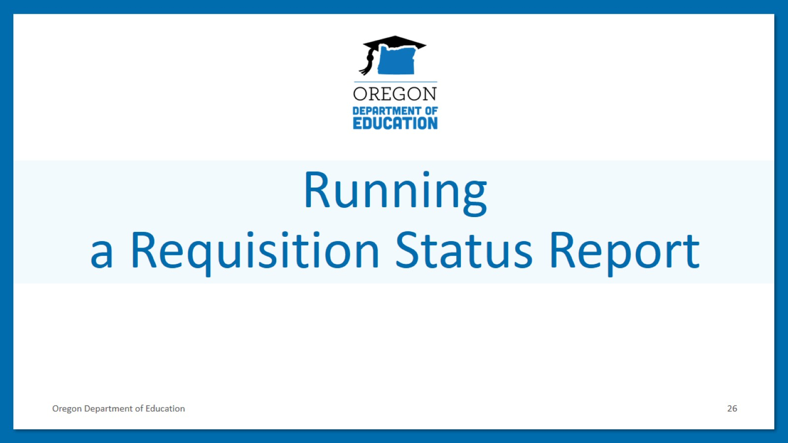
Running a Requisition Status Report

Slide 27
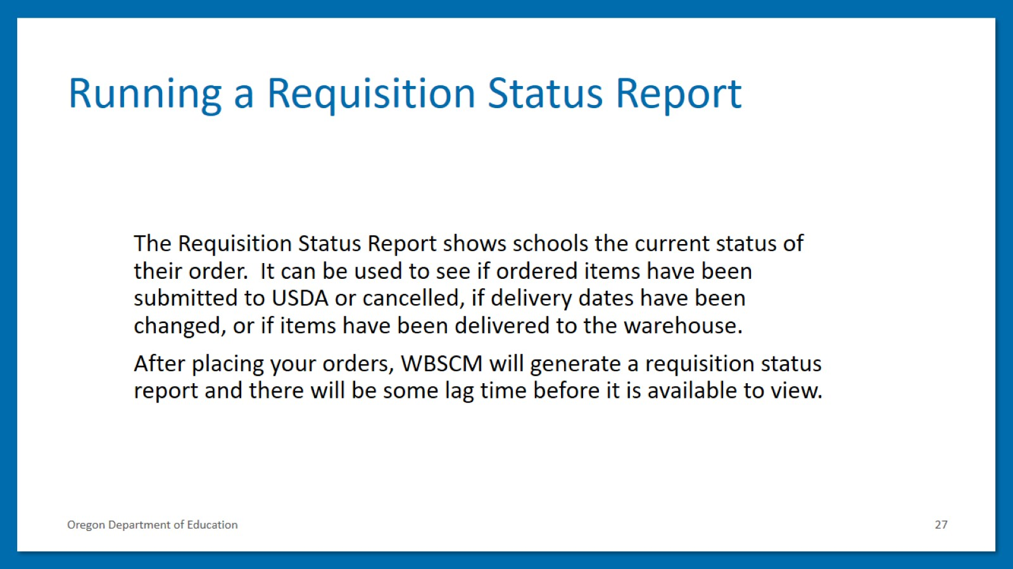
Running a Requisition Status Report

Slide 28
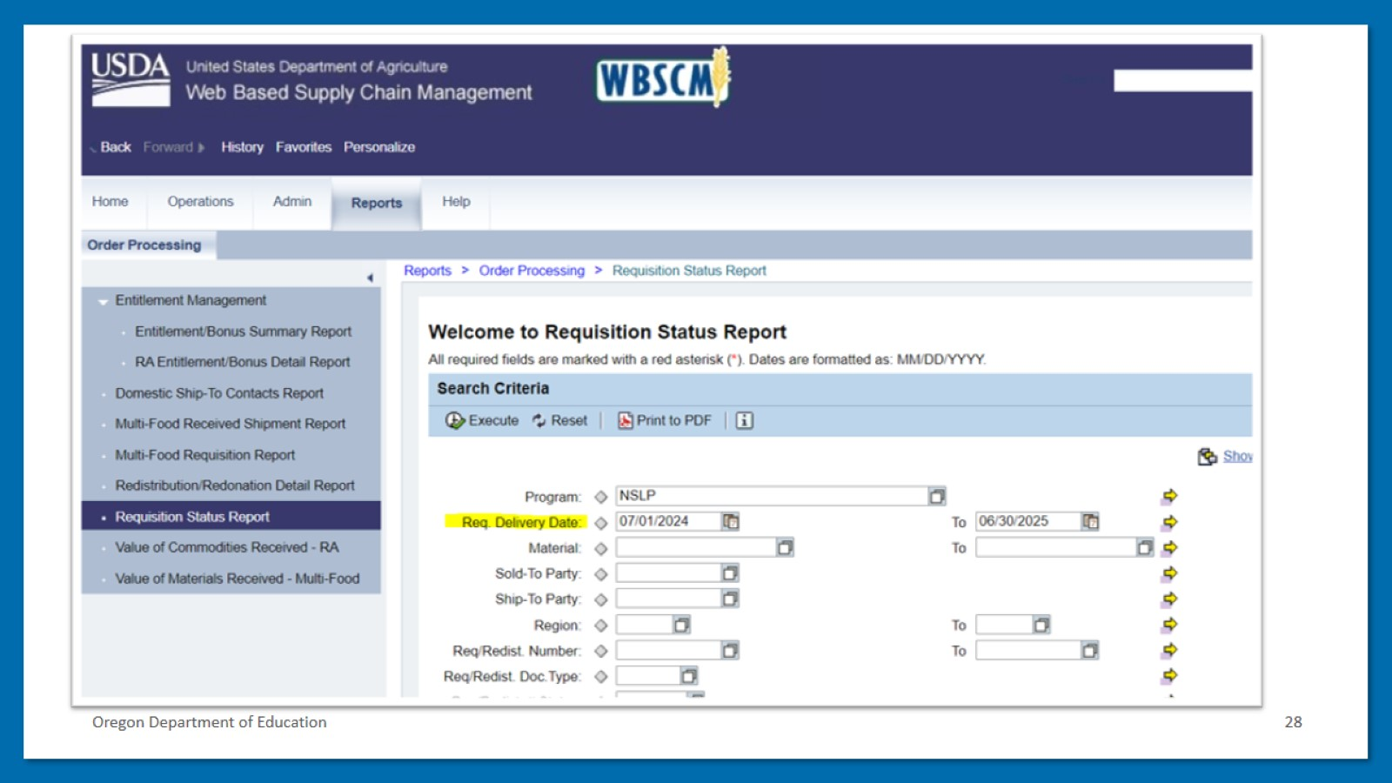
Oregon Department of Education

Slide 29
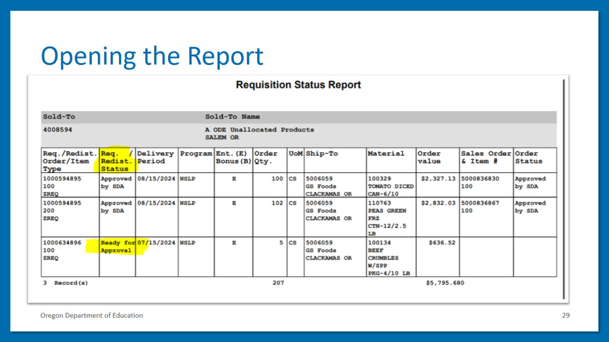
Opening the Report

Slide 30
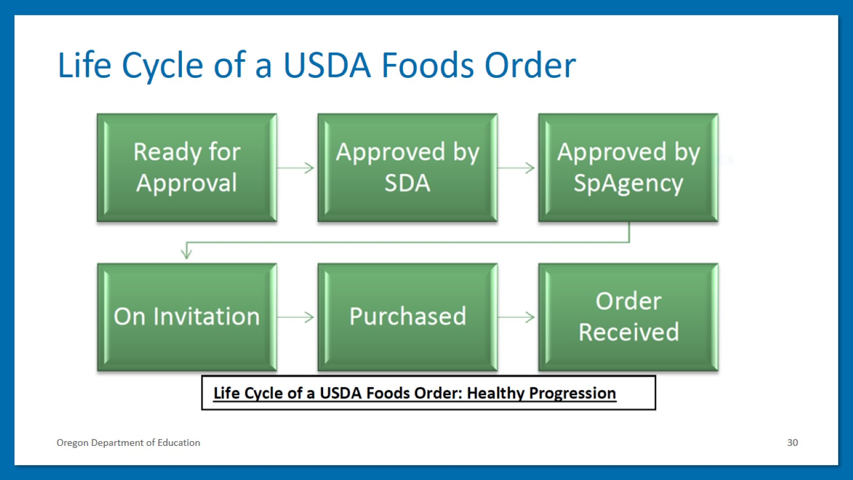
Life Cycle of a USDA Foods Order

Slide 31
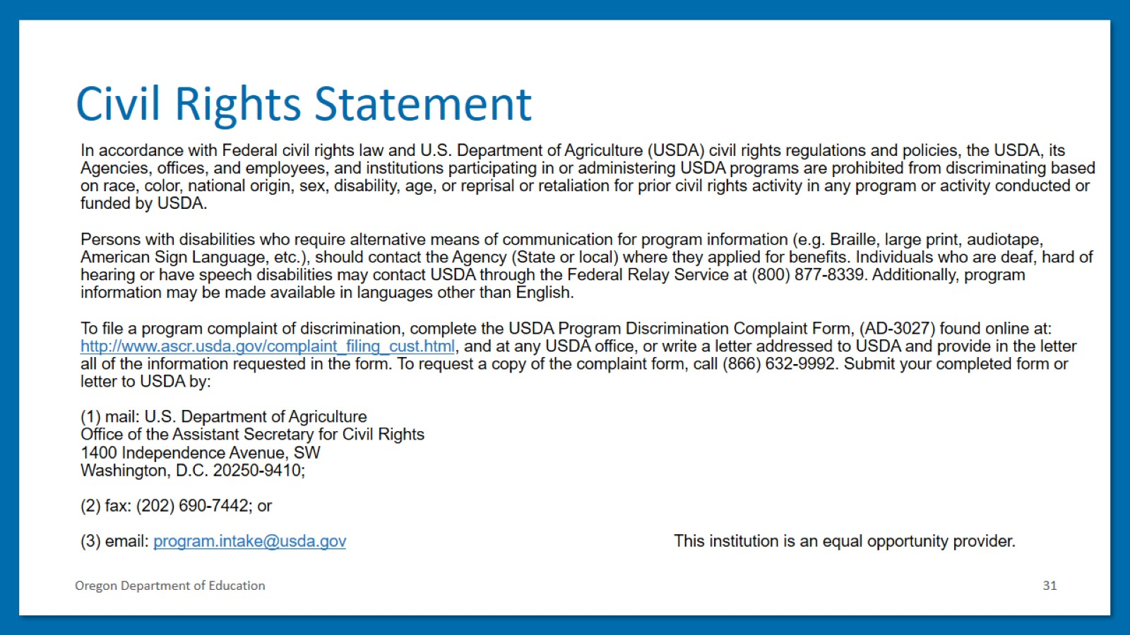
Civil Rights Statement

