Slide 1

USDA Food Distribution Program
WBSCM RA Training Guide
This Recipient Agency (RA) Training Guide has been developed to assist our recipients (schools and other organizations) in utilizing USDA’s online ordering program – known as Web-Based Supply Chain Management, or WBSCM.

Slide 2
Index
Important Contacts…Page 3
Finding Your Entitlement…Page 4
Using the Catalog Worksheet…Page 9
Entering an Order into WBSCM…Page 11
Running a Requisition Status Report…Page 25
Running A Value of Commodities Received – RA Report…Page 32

Slide 3
Important Contact Info
Oregon Help:
Program website http://www.oregon.gov/ode/students-and-family/childnutrition/USDAFoods
E-mail address ode.fooddistribution@ode.state.or.us
E-mail address is continually monitored M-F (except Holidays)
Contact ODE before contacting USDA WBSCM help desk.
USDA WBSCM Help Desk:
Help Desk Hours: 8:00 AM to 6:00 PM EST
Phone: 877-WBSCM-4U or 877-927-2648
Email: WBSCM.servicedesk@CACI.com
Contact the WBSCM Help Desk for any trouble you have after contacting ODE.

Slide 4
Finding Entitlement

Slide 5
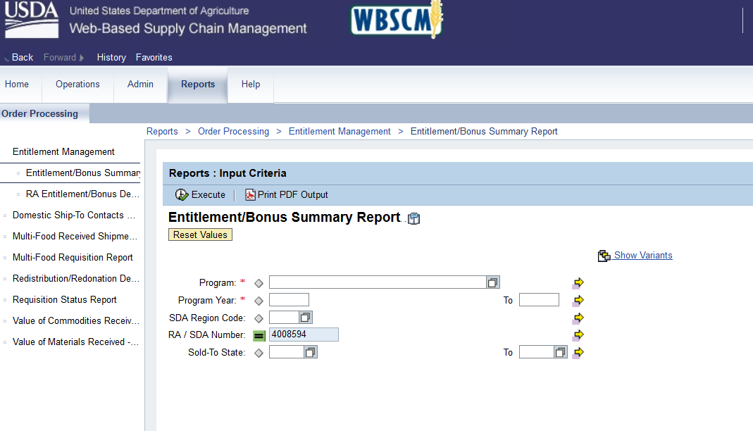
Locating the Entitlement Summary Report
Log in to WBSCM
Click on the “Reports” tab at the top of the page
Click “Entitlement Management” in the left hand column
Click “Entitlement/Bonus Summary Report”
Notes:
Log in to WBSCM.
Click on the “Reports” tab at the top of the page.
Click “Entitlement Management” in the left hand column.
Click “Entitlement/Bonus Summary Report”.

Slide 6
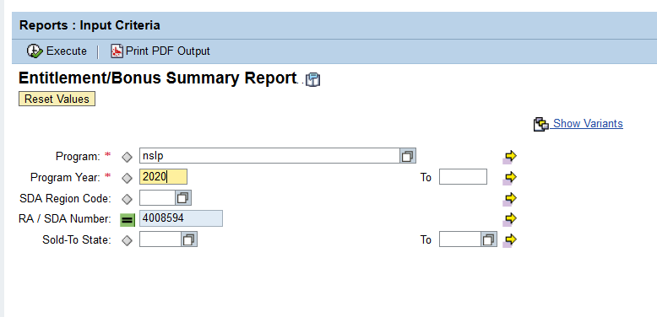
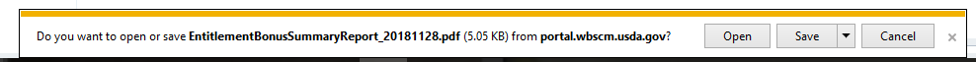
Opening Entitlement Summary Report
1. Fill in “nslp” for the Program
2. Fill in the Program Year ( for example 2020 for School Year 2019-20)
3. Click “Print PDF output”
4. Click Open
Notes:
1. Fill in “nslp” for the Program.
2. Fill in the Program Year ( for example 2020 for School Year 2019-2020).
3. Click “Print PDF output”.
4. Click Open
Click Print PDF output to get to the sheet that tells you what your entitlement value is.
Make sure you are linked to a printer to print the file. You can also click the execute button and export the report to excel or other format.

Slide 7
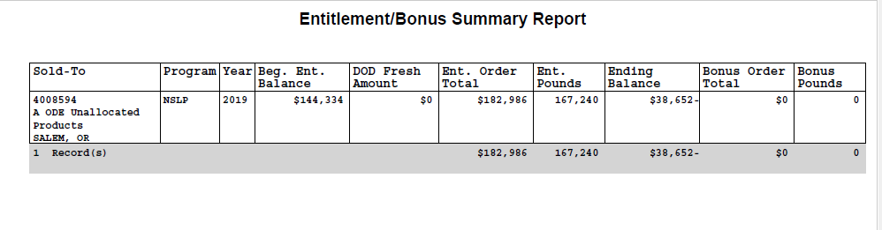
Entitlement/Bonus Summary Report Details
Scroll past the first page to get to the report.
You can see the beginning balance for the year, allocations for DoD, Orders and finally the ending balance.
This report can be saved or printed to retain for future reference.
Notes:
The first page of the report is not important – scroll to page 2, and this is what you’ll see.
Beg. Ent. Balance:
This is the dollar amount of USDA Foods that your school/organization is entitled to for this year.
Est. Order Total:
This is the entitlement dollar amount that you’ve spent on USDA Foods already.
Ending Balance:
This is the amount of entitlement remaining that you can still spend.
At this point you can print the Entitlement/Bonus Summary Report
Or save it to your computer –
Click on file and then Save as,
Then determine which folder you want to save it in for later reference

Slide 8
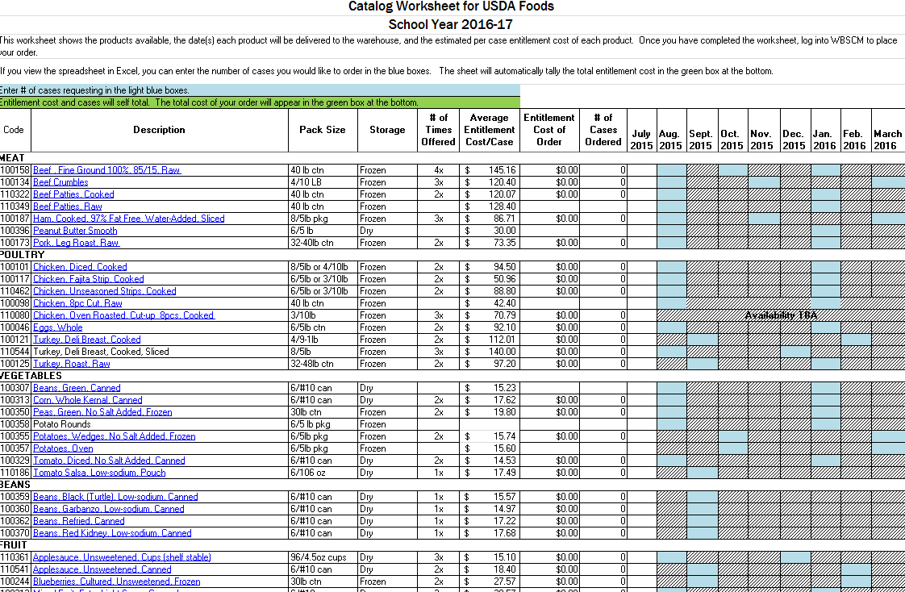
USDA Foods Catalog Worksheet
The USDA Foods Catalog Worksheet is NOT found in WBSCM. It is a spreadsheet, available in Excel and as a PDF, that the Oregon FDP creates each year to help schools plan their order. This spreadsheet will be emailed out to food service managers when the catalog opens each year in January or February, and it will also be available on the program website at ODE USDA Foods Site. There will be two spreadsheets available; one each for direct delivery and diversion.
Notes:
The USDA Foods Catalog Worksheet is NOT found in WBSCM. It is a spreadsheet, available in Excel, that the Oregon FDP creates each year to help schools plan their order. This spreadsheet will be emailed out to food service managers when the catalog opens each year in January or February, and it will also be available on the program website at http://www.oregon.gov/ode/students-and-family/childnutrition/USDAFoods. There will be two spreadsheets available; one each for direct delivery and diversion.

Slide 9
Using the USDA Foods Worksheet
Notes:
Description:
The available products are listed here – clicking on the links will open up the product fact sheet in your web browser.
Blue Boxes:
The blue boxes show the dates that the product will be delivered to the warehouse – fill in the number of cases you’d like in these boxes.
# of Cases Ordered:
If you use the excel version of the sheet, the total number of cases of the product will self-total
Entitlement Cost of Order:
the cost of your order of that product will self-total here. Scroll down further, and a green grand total box at the bottom will keep track of the cost of your full order.

Slide 10
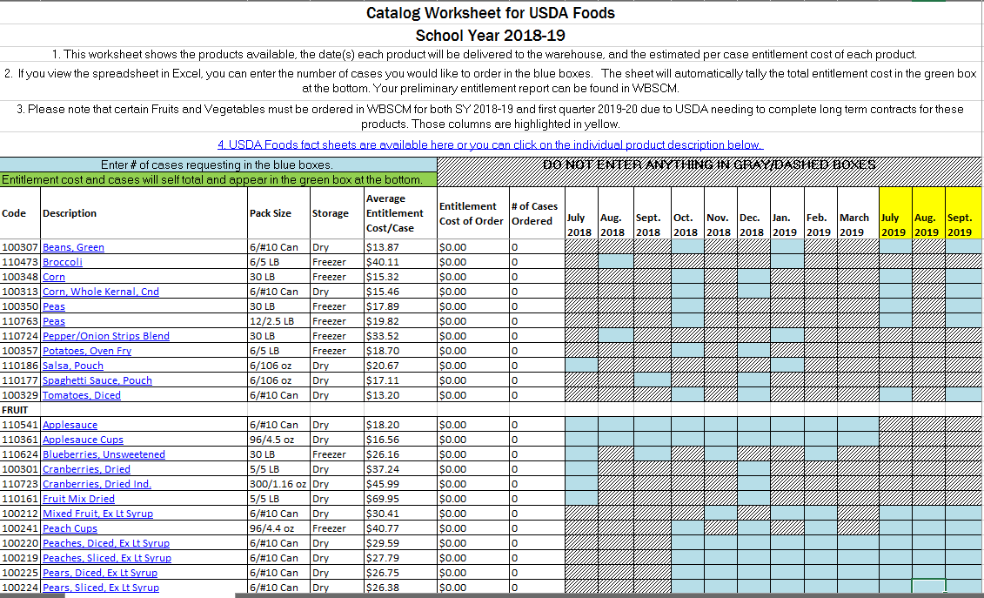
USDA Foods Catalog Worksheet
Don’t forget your Fruits and Vegetables to start the second school year out.
Seasonal Fruits and Vegetables will be ordered yearly on a calendar that runs October through September.
Notes:
Please do not forget to order seasonal fruits and vegetables for the first Quarter of school year after next. This will be your only opportunity to receive USDA Seasonal produce to start that school year.
Please note, you are charged entitlement for food delivered during the school year. As you order these foods entitlement will be utilized from the appropriate school year.

Slide 11
Entering an Order for Delivery to the Warehouse In WBSCM
Once you have planned your order by finding your entitlement and filling out your catalog worksheet, you’re ready to log back into WBSCM and place that order.
Tip: The WBSCM application alerts users with a notification after 50 min. of idle time and provides them with the options to continue or cancel the session. If users do not take action within approximately 10 minutes, the system logs them out, and any unsaved data may be lost.
Therefore, we suggest breaking your order up into multiple small orders. For example, working off your catalog worksheet, put all your vegetables in your cart, and then go through the steps to page 24 (when you see the order confirmation page). Then go back to page 12 and put all your fruit in your cart, etc. There is no limit on the number of separate orders you place – just as long as it all adds up to your entitlement amount in the end.
Notes:
Once you have planned your order by finding your entitlement and filling out your catalog worksheet, you’re ready to log back into WBSCM and place that order.
Tip: The WBSCM application alerts users with a notification after 50 min. of idle time and provides them with the options to continue or cancel the session. If users do not take action within approximately 10 minutes, the system logs them out, and any unsaved data may be lost.
Therefore, we suggest breaking your order up into multiple small orders. For example, working off your catalog worksheet, put all your vegetables in your cart, and then go through the steps to page 25 (when you see the order confirmation page). Then go back to page 12 and put all your fruitin your cart, etc. There is no limit on the number of separate orders you place – just as long as it all adds up to your entitlement amount in the end.

Slide 12
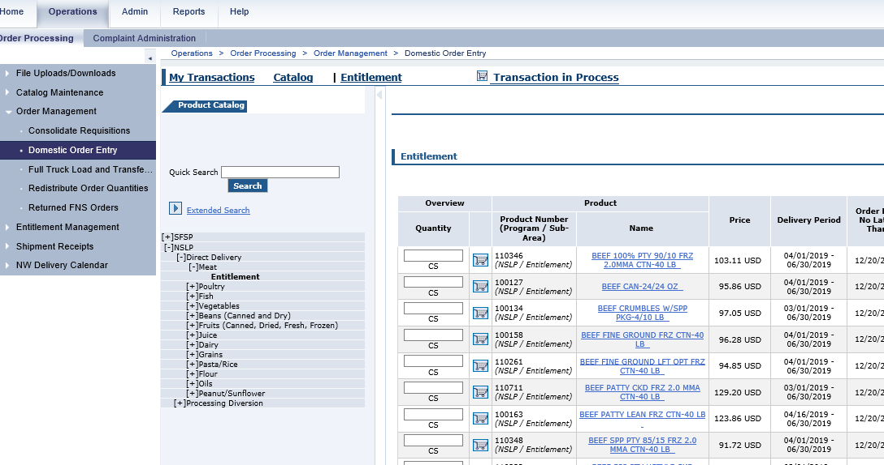
Domestic Order Entry
Click the “Operations” tab at the top of the page
On the left hand side of the page, click “Order Management”
Under “Order Management”, click “Domestic Order Entry”
4. When the order window loads, click “NSLP”
5. Under “NSLP”, click “Direct Delivery” or “Processing Diversion”
6. Click on the product category you want
7. Under the product category, click “Entitlement”
8. Now, products should appear!
Notes:
Click the “Operations” tab at the top of the page
Under the Detailed Navigation box on the left hand side of the page, click “Order Management”
Under “Order Management”, click “Domestic Order Entry”
4. When the order window loads, click “NSLP”
5. Under “NSLP”, click “Direct Delivery” or “Processing Diversion”
6. Click on the product category you want
7. Under the product category, click “Entitlement”
8. Now, products should appear!

Slide 13
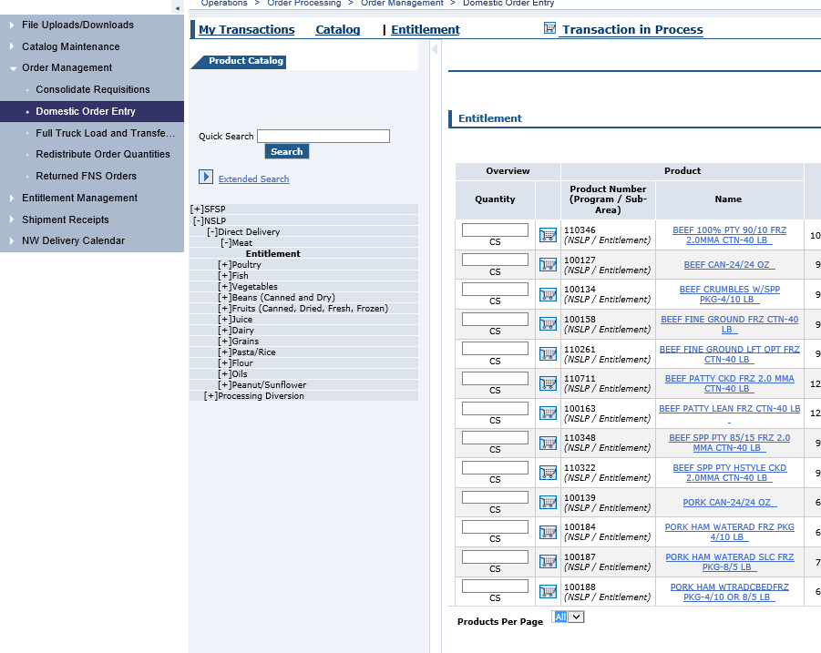
View All Items in the Catalog
Select All to ensure you view all the items under this category
Notes:
Select “All” to View All Items in the Catalog.

Slide 14
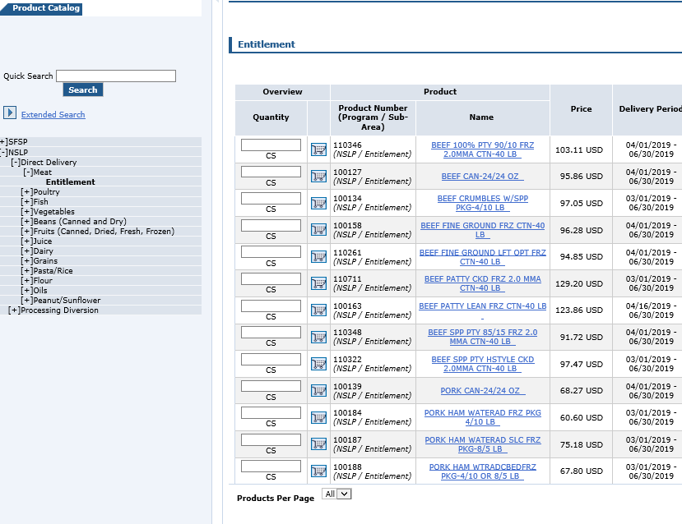
Select Shopping Cart Icon
Instead, click on the Shopping Cart Icon OR blue product name
DON’T ENTER ANYTHING HERE!
Notes:
Find the product you want to order, and click on the shopping cart icon next to it.
Don’t enter anything in the Quantity Column. Instead, click on the Shopping Cart Icon OR blue product name.

Slide 15
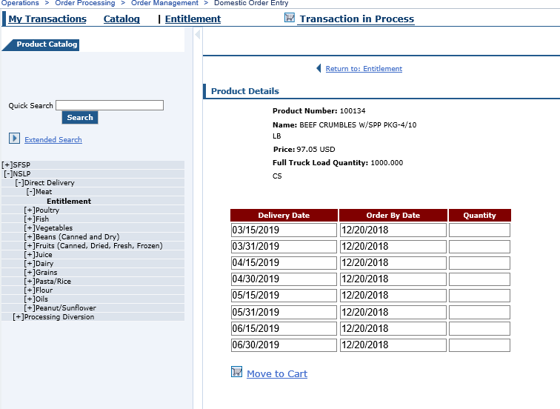
Enter Quantity & Move to Cart
Enter the quantity you’d like delivered to the warehouse for you for each delivery date (look at your catalog worksheet!)
When you’ve entered the number of cases you want, click “Move the Cart”
Notes:
Enter the quantity you’d like delivered to the warehouse for you for each delivery date (look at your catalog worksheet!).
When you’ve entered the number of cases you want, click “Move the Cart”.

Slide 16
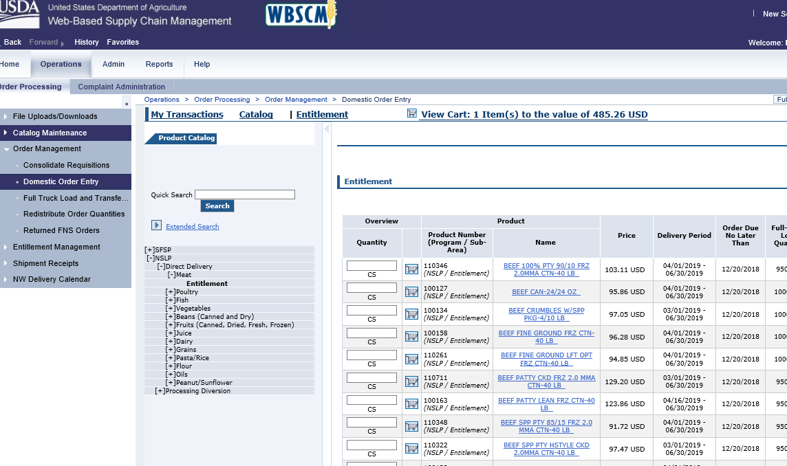
When you’re ready to submit your Order
Tip: As you add items to your cart, you will see the quantity and value increase here. Each date counts as an “Item.”
You can continue to add items from current category, search for new items or click on a different category.
If you’re done adding items, click “View Cart” to continue on and process your order or to add more to your order after viewing cart.
Tip: Do not click in this area, otherwise you will lose everything in your cart.
Notes:
You can continue to add items from current category, search for new items or click on a different category.
If you’re done adding items, click “View Cart” to continue on and process your order or to add more to your order after viewing cart.
Tips:
As you add items to your cart, you will see the quantity and value increase here. Each date counts as an “Item.”
Do not click in this area, otherwise you will lose everything in your cart.

Slide 17
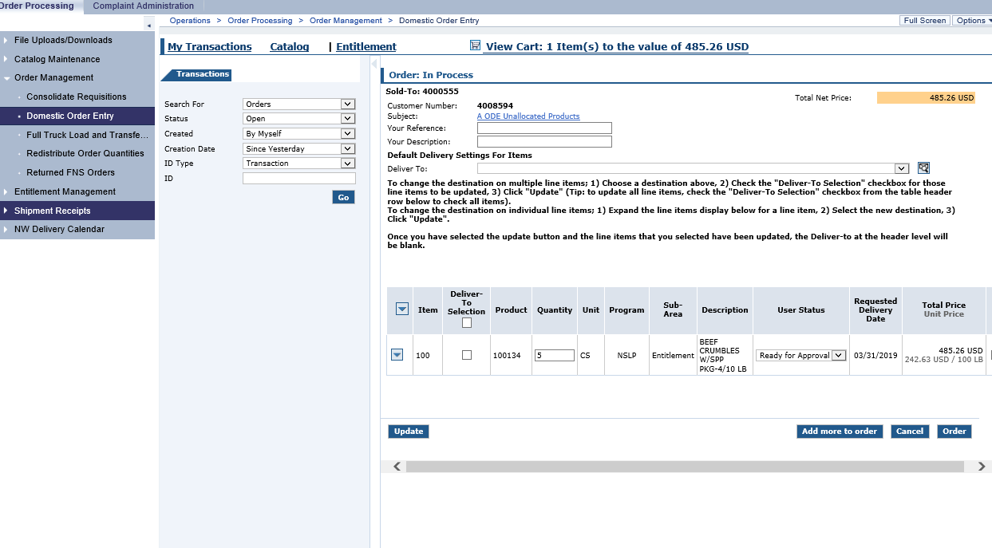
To Expand the View
Click hide navigator button (that sidewise triangle) to hide this view and make your items easier to see.
Then, click this triangle to see the expanded details for each of the items in your cart.
Notes:
Click hide navigator button (that sidewise triangle) to hide this view and make your items easier to see.
Then, click this triangle to see the expanded details for each of the items in your cart.

Slide 18
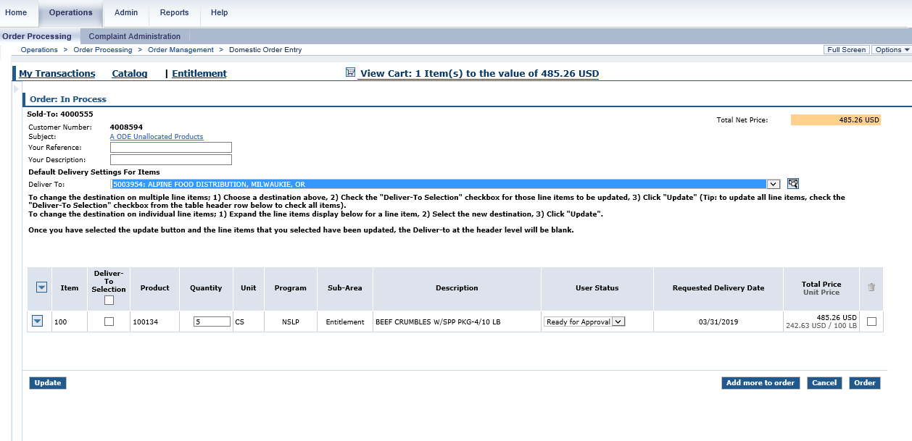
Assigning same delivery location to all your items at once
Tip: Checking this box will check the box next to all of your items.
If all of your items are going to the same warehouse, you can assign the deliver to locations all at once, by selecting the right location up top, and then putting a check mark next to the top “deliver-to-selection”.
The current USDA Foods storage and delivery sub-contractor (Alpine Food Distribution) has just one warehouse for direct delivery.
Processors for diverted foods have their own warehouses, please reference the processing spreadsheet for correct “deliver to” for each code.
Notes:
If all of your items are going to the same warehouse, you can assign the deliver to locations all at once, by selecting the right location up top, and then putting a check mark next to each item that’s going to that location.

Slide 19
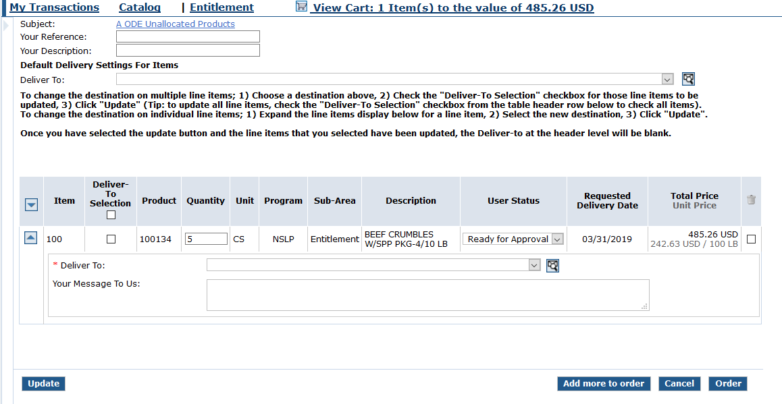
Delivery to multiple locations
Under each item, you now see a “Deliver To” box. Click on that box, and select the warehouse you want this item delivered to.
Tip: Check this box to expand the delivery detail.
Click update to save changes to delivery locations when you are finished.
The current USDA Foods storage and delivery sub-contractor (Alpine Food Distribution) has just one warehouse for direct delivery.
Processors for diverted foods have their own warehouses, please reference the processing spreadsheet for correct “deliver to” for each code.
Notes:
Clicking on the arrow next to each item will bring a dropdown for delivery detail. Under each item, you now see a “Deliver To” box. Click on that box, and select the warehouse you want this item delivered to. DO NOT select the default delivery dropdown at the top of the page.
The current USDA Foods storage and delivery sub-contractor (Alpine Food Distribution) has just one warehouse for direct delivery.
Processors for diverted foods have their own warehouses, please reference the processing spreadsheet for correct “deliver to” for each code.

Slide 20
Update Quantity or Delete Items
You can change the quantity of cases in you order here. But, you can’t change the quantity to zero…
…if you want to delete an item, put a check mark in the box under the trash can.
After any changes are made, click “update” again, or these changes won’t “stick”
Notes:
You can change the quantity of cases in you order here. But, you can’t change the quantity to zero…
…if you want to delete an item, put a check mark in the box under the trash can.
After any changes are made, click “update” again, or these changes won’t “stick”.

Slide 21
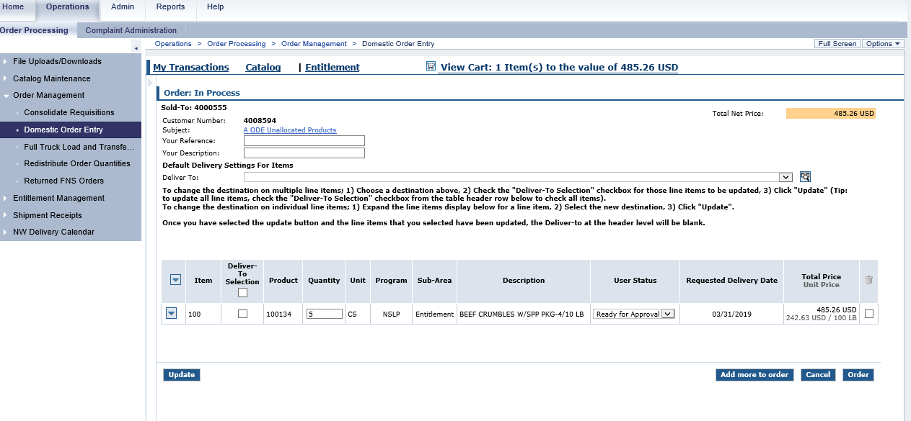
Adding More Items To Your Cart
If you want to add more items, click this button. DO NOT try to add more items by just clicking “Domestic Order Entry” on the left hand side of the page – since you haven’t submitted this cart yet, you would lose everything in it if you did that.
Remember: You can always create another order later, so if you’re happy with these items, it’s best to go ahead and submit this order now, then create a new order to add the rest of your items.
Notes:
If you want to add more items, click this button. DO NOT try to add more items by just clicking “Domestic Order Entry” on the left hand side of the page – since you haven’t submitted this cart yet, you would lose everything in it if you did that.
Remember: You can always create another order later, so if you’re happy with these items, it’s best to go ahead and submit this order now, then create a new order to add the rest of your items.

Slide 22
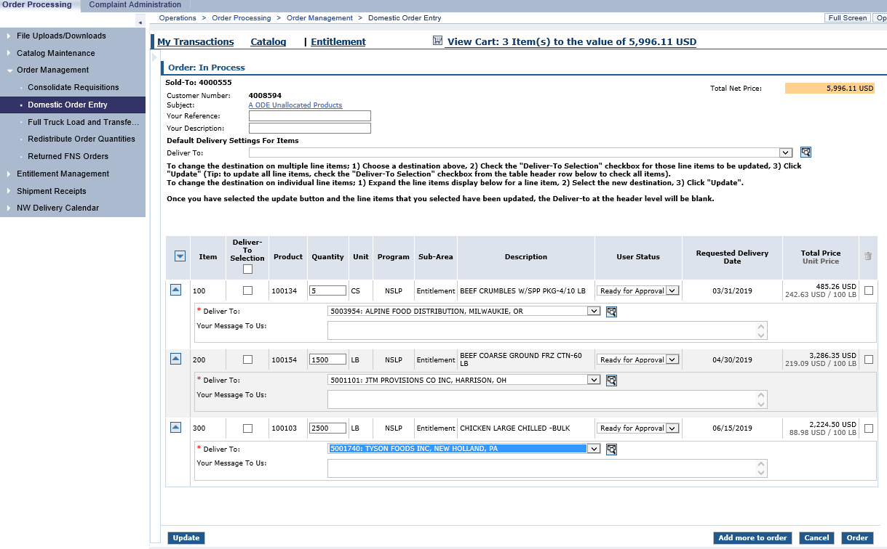
Submitting Your Order
Two more products were added to the existing beef order
Since this is a diverted/processed product, it has been assigned to that processor’s delivery location for that product code which is different than direct delivery.
Take a last look. Are your quantities correct? Did you select the correct delivery locations? Did you hit “Update” after making changes? If so, click “Order” to place this order!
Notes:
In this example, two more products were added to the existing beef order; diversion chicken and ground beef pounds.
Since this is a diverted/processed product, it has been assigned to that processor’s delivery location for that product code which is different than direct delivery.
Take a last look. Are your quantities correct? Did you select the correct delivery locations? Did you hit “Update” after making changes? If so, click “Order” to place this order!

Slide 23
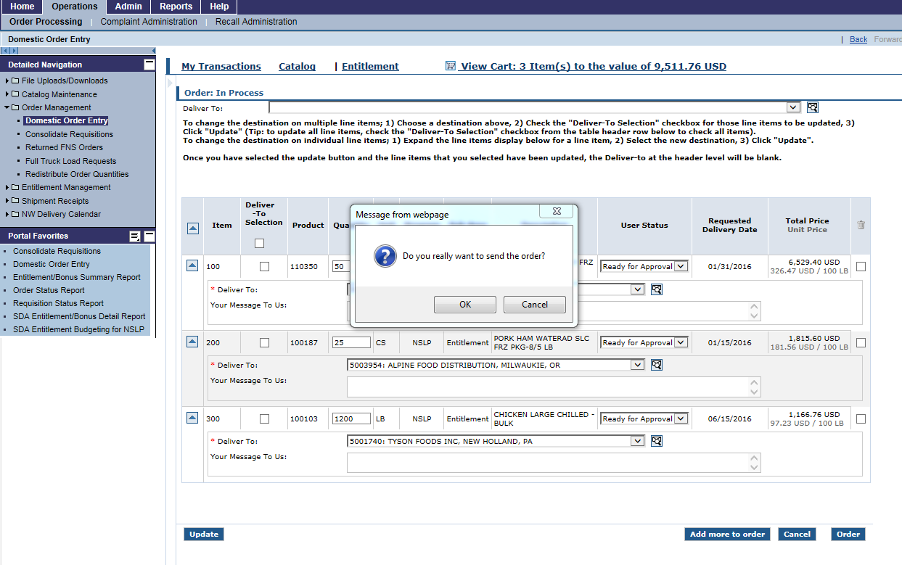
Confirm your Order
Click “OK” to process your order.
Tip: If you click “Cancel” at this step, you will lose your whole shopping cart.
Notes:
Click “OK” to process your order.
Tip: If you click “Cancel” at this step, you will lose your whole shopping cart.

Slide 24
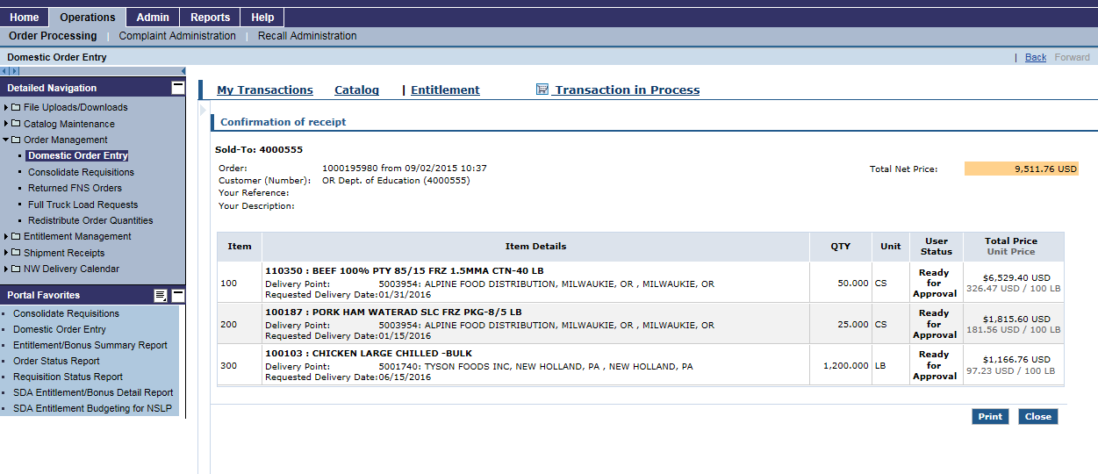
Confirmation of Receipt
Is everything correct? If not, you must e-mail ODE FDP (ode.fooddistribution@state.or.us) as soon as possible to have your order declined.
Click here to print the confirmation page for your records
IMPORTANT: If you don’t get to this confirmation page, you haven’t completed your order!!
Notes:
IMPORTANT: If you don’t get to this confirmation page, you haven’t completed your order!!
Is everything correct? If not, you must e-mail ODE FDP (ode.fooddistribution@state.or.us) as soon as possible to have your order declined.
Click here to print the confirmation page for your records.

Slide 25
Running A Requisition Status Report
The Requisition Status Report shows school’s the current status of their order. It can be used to see if ordered items have been submitted to USDA or cancelled, if delivery dates have been changed, or if items have been delivered to the warehouse.
Notes:
The Requisition Status Report shows school’s the current status of their order. It can be used to see if ordered items have been submitted to USDA or cancelled, if delivery dates have been changed, or if items have been delivered to the warehouse.
It is important to run this after ODE has finished processing orders and again throughout the year. Orders are moved, reduced, increased and cancelled primarily during consolidation but also throughout the procurement cycle.

Slide 26
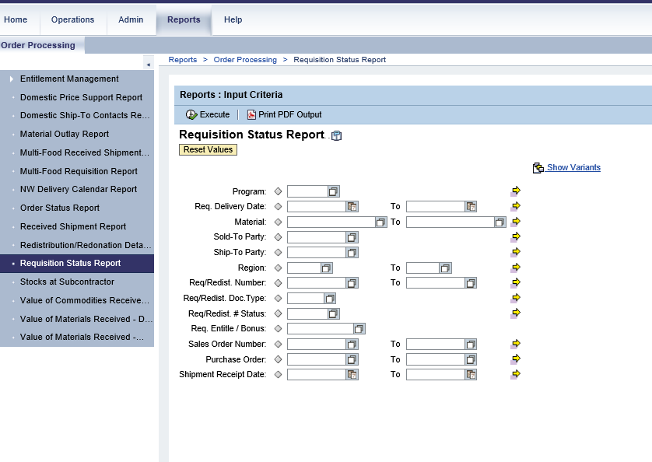
Accessing Requisition Status Report
Once you’ve logged into WBSCM, click on the “Reports” tab near the top of the page.
In the “Detailed Navigation” box, click on “Requisition Status Report”
Notes:
Once you’ve logged into WBSCM, click on the “Reports” tab near the top of the page.
In the “Detailed Navigation” box, click on “Requisition Status Report”.

Slide 27
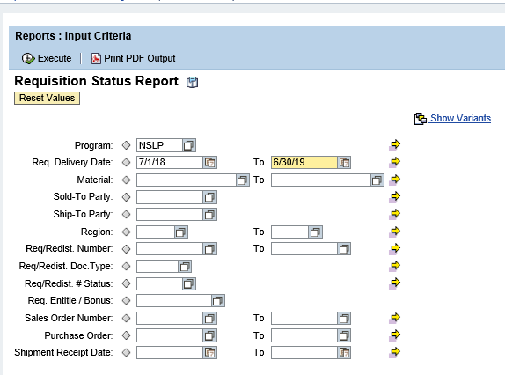
Entering Query Data
3. Under “Reports: Input Criteria” fill in the following information:
Enter “NSLP” for Program
Enter the dates for the school year in “Requested Delivery Date” –example, for the School Year starting August 2018, enter “07/01/18” to “06/30/19”
You do not need to fill in any of the other boxes!
4. Click “Print PDF Output” – this will create a PDF document that you can read on your computer. You can also click the execute button and export the report to excel or other format.
Notes:
3. Under “Reports: Input Criteria” fill in the following information:
Enter “NSLP” for Program
Enter the dates for the school year in “Requested Delivery Date” –example, for the School Year starting August 2018, enter “07/01/18” to “06/30/19”
You do not need to fill in any of the other boxes!
4. Click “Print PDF Output” – this will create a PDF document that you can read on your computer. You do not need to be hooked up to a printer to click this button. You can also click the execute button and export the report to excel or other format.

Slide 28
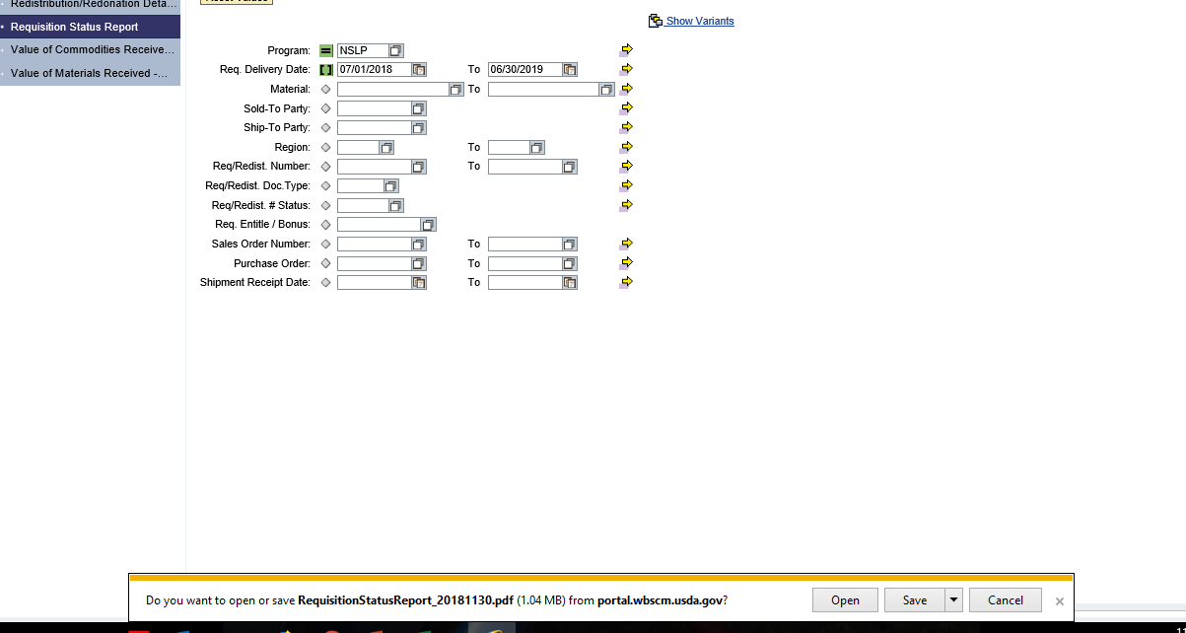
Opening the Report
5. When the file download box pops up, click “Open”
Notes:
5. When the file download box pops up, click “Open”

Slide 29
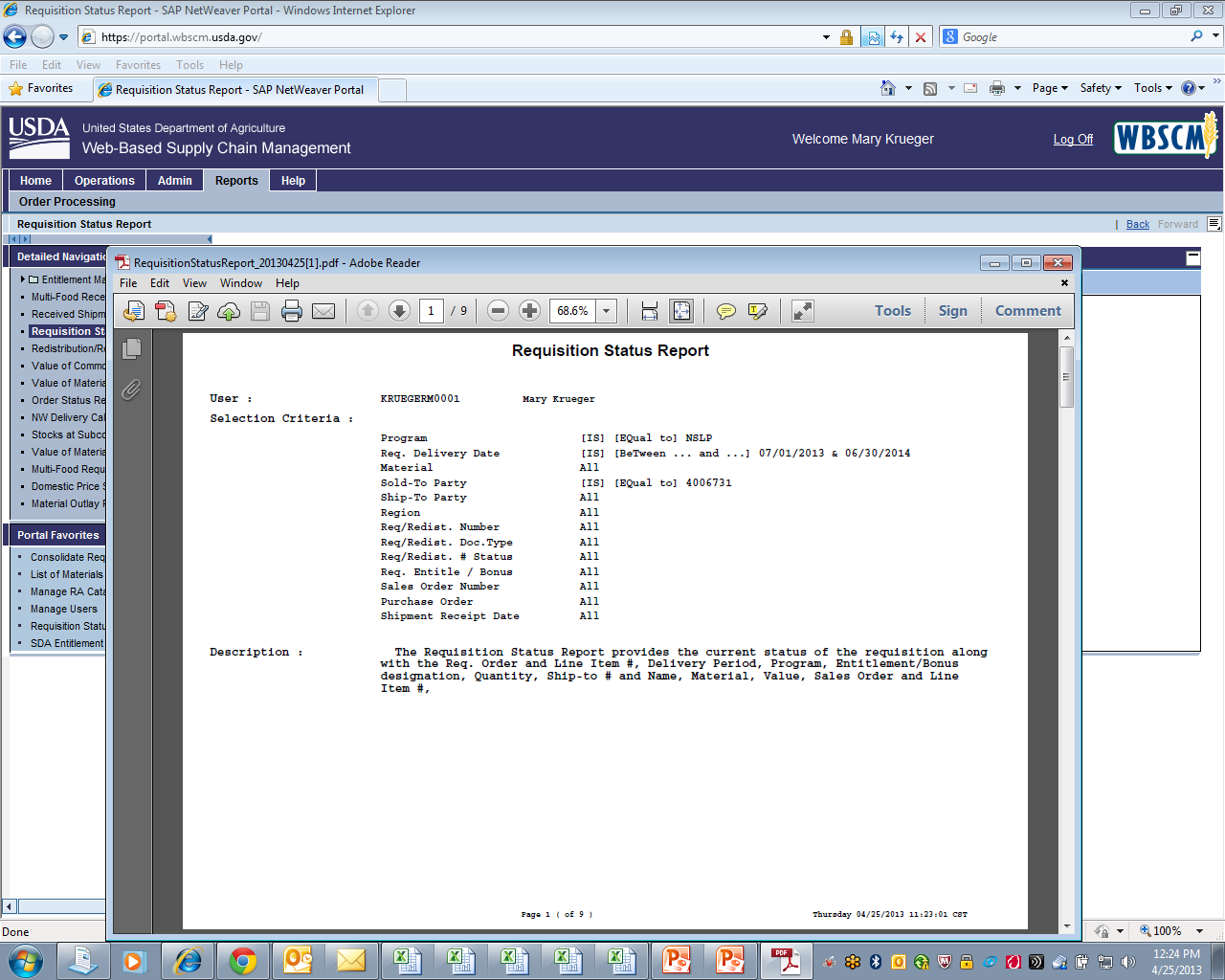
First page of Requisition Status Report
The PDF of the Requisition Status Report will open up. The first page will look like this – it’s nonsense – scroll through to the second page!
Notes:
The PDF of the Requisition Status Report will open up. The first page will look like this – it’s nonsense – scroll through to the second page!

Slide 30
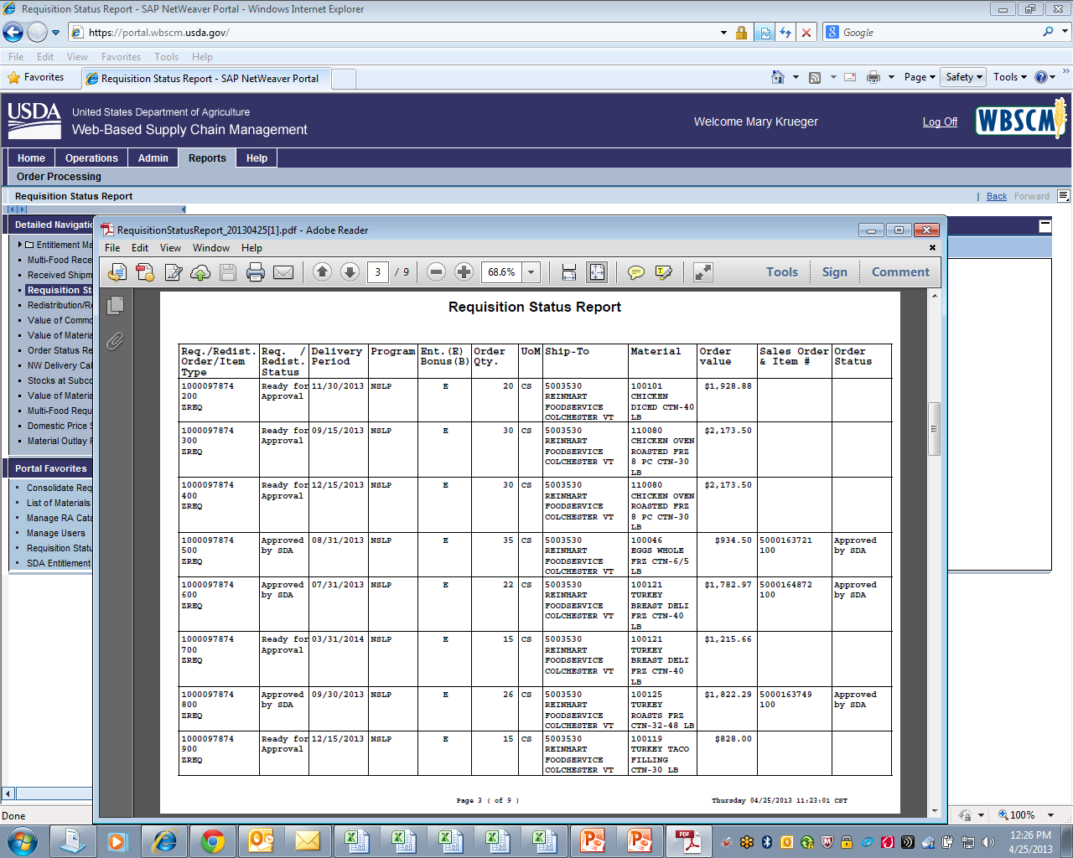
Requisition Status Report
You can Print or Save this Report
The “Req./ Redis. Status” column shows the current status of your order for that item.
“Ready for Approval” means the order has been submitted to the State, but the State has not yet submitted the order to USDA.
“Approved by SDA” means the State has submitted the order to USDA.
“Cancelled” means that the State or USDA cancelled your order for this item.
“On Invitation” and “Purchased”, appear as USDA moves through the procurement process for these items.
Notes:
The “Req./ Redis. Status” column shows the current status of your order for that item. “Ready for Approval” means the order has been submitted to the State, but the State has not yet submitted the order to USDA. “Approved by SDA” means the State has submitted the order to USDA. “Cancelled” means that the State or USDA cancelled your order for this item. Throughout the year, you will see other status messages listed here, such as “On Invitation” and “Purchased”, as USDA moves through the procurement process for these items.

Slide 31
Requisition Status Report
Once the Status has changed to “Approved by SDA”, check the “Delivery Period” column and the “Order Qty” column to see if there have been any changes.
For some items, the state may have moved a delivery period forward or back in order to share a truck with a neighboring state.
Larger schools may notice that the quantity they ordered was adjusted up or down by a few cases – this allows the State to order a full truckload.
Notes:
Once the Status has changed to “Approved by SDA”, check the “Delivery Period” column and the “Order Qty” column to see if there have been any changes.
For some items, the state may have moved a delivery period forward or back in order to share a truck with a neighboring state.
Larger schools may notice that the quantity they ordered was adjusted up or down by a few cases – this allows the State to order a full truckload.

Slide 32
Running A Value of Commodities Received – RA Report
The Value of Commodities Received Report shows schools the Value of the USDA Foods they have received during a certain time period. Business Managers often ask for this information at the end of the school year, and this is a report the Food Service Manager can run to provide that information.
Notes:
The Value of Commodities Received Report shows schools the Value of the USDA Foods they have received during a certain time period. Business Managers often ask for this information at the end of the school year, and this is a report the Food Service Manager can run to provide that information.
Note: This will have your values for both direct delivery and diversion/processing. It will not have values for DoD Fresh or the USDA Unprocessed Fruit and Vegetable Pilot. Those must be obtained elsewhere.

Slide 33
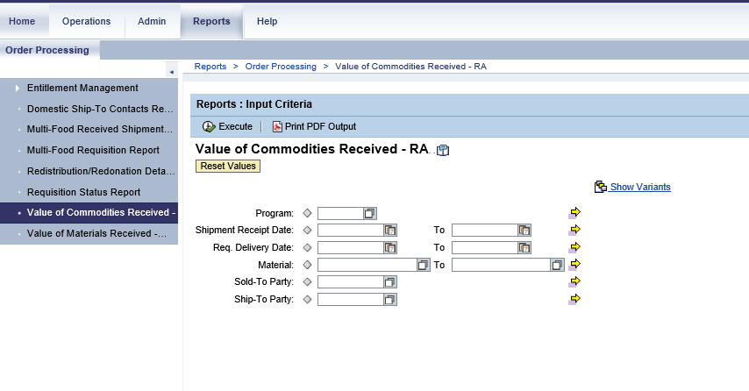
Accessing Value of Commodities Received Report
Once you’ve logged into WBSCM, click on the “Reports” tab near the top of the page. In the “Detailed Navigation” box, click on “Value of Commodities Received -RA”
Notes:
Once you’ve logged into WBSCM, click on the “Reports” tab near the top of the page.
In the “Detailed Navigation” box, click on “Value of Commodities Received -RA”

Slide 34
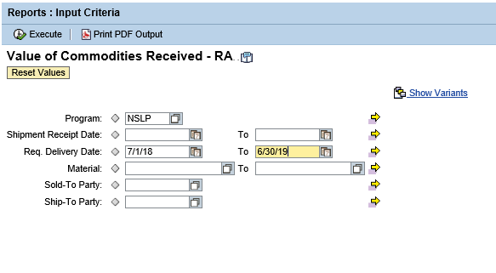
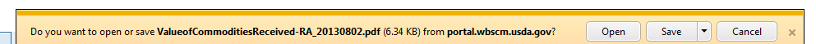
Required Query fields
Fill in “NSLP” for Program
Fill in the dates you’d like to check under “Req. Delivery Date”.
Click “Print PDF Output” to view a PDF or “Execute” to download in Excel
Click “Open”
Notes:
Fill in “NSLP” for Program or leave blank if you would like SFSP data as well
Fill in the dates you’d like to check under “Req. Delivery Date”. Typically the program year is what most people use, in that case it should by 07/01/YEAR to 06/30/YEAR.
Click “Print PDF Output” or “Execute” to download in Excel
Click Open to view the PDF

Slide 35
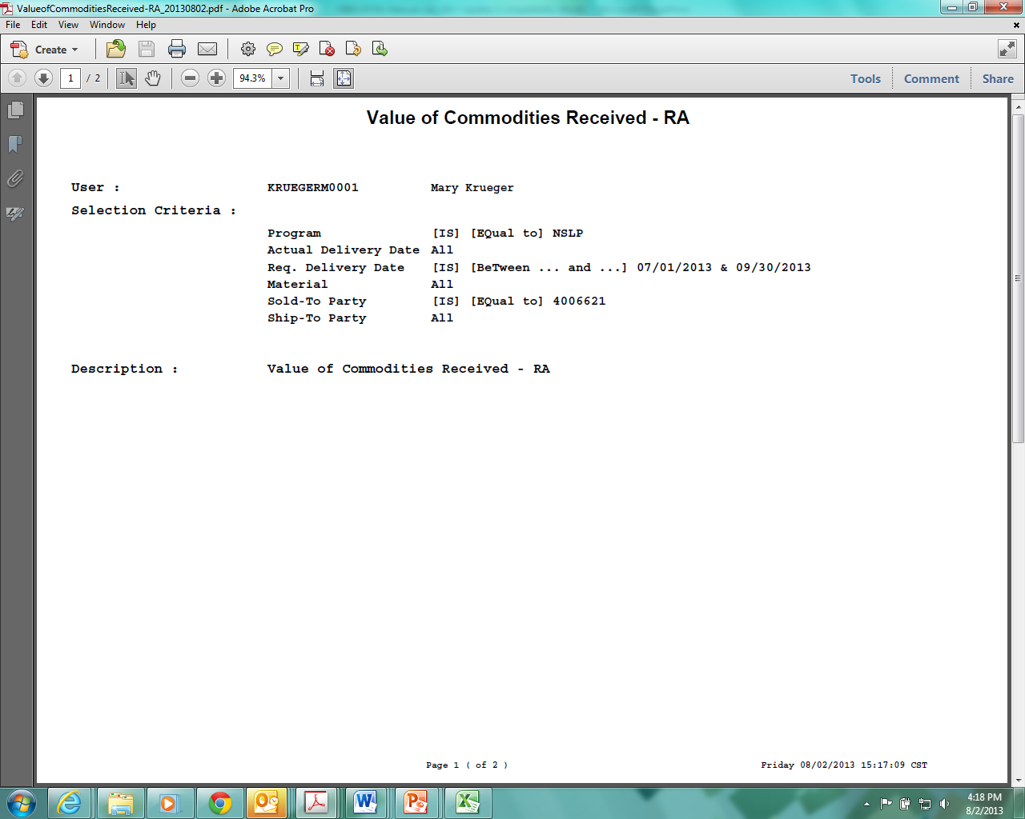
Page 1
The first page of the report is nonsense – use the arrow keys or the scroll bar to scroll down to page 2.
Notes:
1. The first page of the report is nonsense – use the arrow keys or the scroll bar to scroll down to page 2.

Slide 36
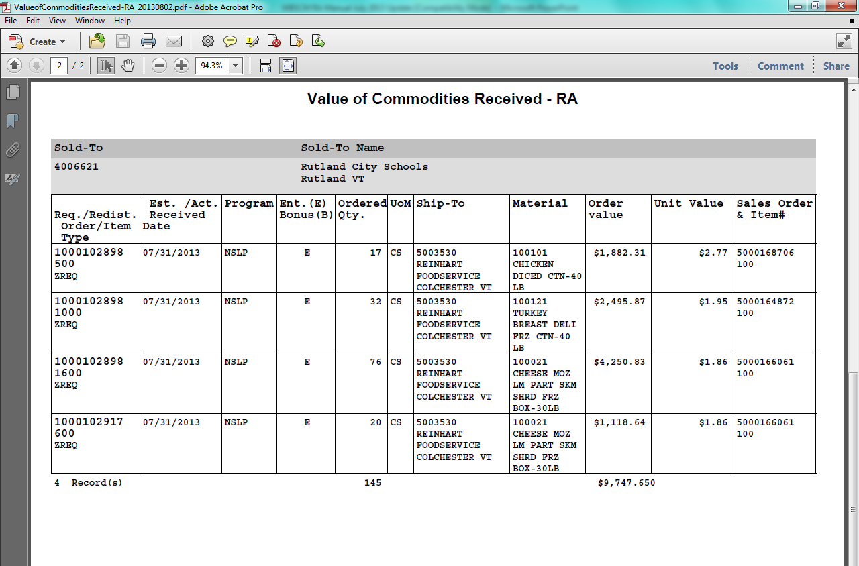
Value of Commodities Received PDF
At the bottom of the report, you will see the total value of the USDA Foods you received during this time period. You can save or print this report for your records.
Notes:
At the bottom of the report, you will see the total value of the USDA Foods you received during this time period.
You can save or print this report for your records.

Slide 37
Civil Rights Statement
In accordance with Federal civil rights law and U.S. Department of Agriculture (USDA) civil rights regulations and policies, the USDA, its Agencies, offices, and employees, and institutions participating in or administering USDA programs are prohibited from discriminating based on race, color, national origin, sex, disability, age, or reprisal or retaliation for prior civil rights activity in any program or activity conducted or funded by USDA.
Persons with disabilities who require alternative means of communication for program information (e.g. Braille, large print, audiotape, American Sign Language, etc.), should contact the Agency (State or local) where they applied for benefits. Individuals who are deaf, hard of hearing or have speech disabilities may contact USDA through the Federal Relay Service at (800) 877-8339. Additionally, program information may be made available in languages other than English.
To file a program complaint of discrimination, complete the USDA Program Discrimination Complaint Form, (AD-3027) found online at: http://www.ascr.usda.gov/complaint_filing_cust.html, and at any USDA office, or write a letter addressed to USDA and provide in the letter all of the information requested in the form. To request a copy of the complaint form, call (866) 632-9992. Submit your completed form or letter to USDA by:
(1) mail: U.S. Department of Agriculture
Office of the Assistant Secretary for Civil Rights
1400 Independence Avenue, SW
Washington, D.C. 20250-9410;
(2) fax: (202) 690-7442; or
(3) email: program.intake@usda.gov
This institution is an equal opportunity provider
Notes:
This institution is an equal opportunity provider

