Slide 1
USDA Foods Receiving
I ordered my food…now what?
Notes:
USDA Foods Receiving. I ordered my food…. Now what? That’s a good question!

Slide 2
Different processes for each USDA Foods Program
Direct delivery
Processing
Release inventory from Good Source/TFS E-commerce System
Good Source/TFS confirms delivery date
Food arrives on truck
Sponsor receives and validates quantities and condition
Place order with processor
Receives food from processor via direct ship, distributor or TFS/Good Source
Sponsor receives and validates quantities and condition
Sponsor checks value pass through method used and verifies credit.
Notes:
Receiving is slightly different for each of the 4 USDA Foods Programs.

Slide 3
Processes for receiving continued
USDA DoD Fresh Fruit & Vegetable Program
Unprocessed Fruit and Vegetable Pilot
Place order in DoD FFAVORS System
Duck Delivery confirms delivery date
Food arrives on truck
Sponsor receives and validates quantities and condition
Sponsor validates order received in FFAVORS
Place order with approved vendor
Vendor confirms delivery date
Food arrives on truck
Sponsor receives and validates quantities and condition
Sponsor signs invoice that vendor submits to USDA for payment

Slide 4

Inventory Basics for all Foods received
First-in-first-out (FIFO)
The most basic rule of inventory management is FIFO. This means using the oldest product first and tracking it.
Notes:
Inventory basics for all Foods received (should be applied to all foods not just USDA Foods)
First-in-first-out (FIFO)
The most basic rule of inventory management is FIFO. This means using the oldest product first and tracking it. You can achieve an acceptable level of accuracy by marking the cases, or individual cans/packages, with the date you receive them and practicing FIFO.

Slide 5
Inventory Basics for all Foods received
Storage conditions
Significant impact. The same product will last for different periods of time depending on the temperature of the storeroom, the humidity level, and air circulation.
Cool temperatures and low humidity provide the best storage conditions. Store food off the floor and away from contact with walls and ceilings.
Notes:
Storage conditions have a significant impact on the quality of food products. The same product will last for different periods of time depending on the temperature of the storeroom, the humidity level, and air circulation.
Cool temperatures and low humidity provide the best storage conditions. Store food off the floor and away from contact with walls and ceilings.

Slide 6
Expiration Dates
How can I tell when a product has gone out of condition?
Is there a single date I can refer to?
Not Really! Use your best judgement. When in doubt, toss!
Notes:
Expirations dates can be very confusing.
How can I tell when a product has gone out of condition?
Is there a single date I can refer to?
Not Really! Use your best judgement. When in doubt, toss!

Slide 7
Best-if-used-by Date
A “best-if-used-by” date means that the manufacturer recommends using the product by this date.
At some point after that date, product will change very gradually in taste, color, texture, or nutrient content. The product may still be wholesome and safe.
Notes:
A “best-if-used-by” date means that the manufacturer recommends using the product by this date for the best flavor or quality.
At some point after that date the product will change very gradually in taste, color, texture, or nutrient content. But, the product may be wholesome and safe long after that date.

Slide 8
Sell-by Date
A “sell-by” date on a food product means the manufacturer recommends that a store sell the product by that date. It is assumed that the product may then be stored for some period of time before it is used.
These various dating systems do not represent expiration dates, and do not indicate when product safety becomes an issue.
Notes:
A “sell-by” date on a food product means the manufacturer recommends that a store sell the product by that date. It is assumed that the product may then be stored for some period of time before it is used. Therefore, a “sell-by” date would be reached earlier in the life of a product than a “best-if-used-by” date.
These various dating systems do not represent expiration dates, and they do not indicate when product safety becomes an issue.

Slide 9
Sell-by Date Safety
If there are no visible signs of spoilage, but you have reason to question the product. Conduct sensory evaluation:
  Observe condition of the food including color, texture, and smell.
  If the food displays acceptable color, texture, and smell, use best judgment regarding the quality of the food and whether or not to serve it.
DO NOT taste any food that you have reasonable basis to suspect is unwholesome or unsafe.
Notes:
If there are no visible signs of spoilage, but you have reason to question the quality of the product, conduct a sensory evaluation
Observe the overall condition of the food including color, texture, and smell.
If the food displays acceptable color, texture, and smell, use best judgment regarding the quality of the food and whether or not to serve it.
DO NOT taste any food that you have reasonable basis to suspect is unwholesome or unsafe.

Slide 10
How can I tell if a product is safe?
If you have reason to question the wholesomeness or safety of a food product, open a case or individual package
  examine the cans or packages for rust, bulging, broken seals, insect infestation or other visible defects.
If any of these conditions are present, the food is generally considered NOT fit for human consumption.
Notes:
If you have reason to question the wholesomeness or safety of a food product, open a case or individual package
examine the cans or packages for rust, bulging, broken seals, insect infestation or other visible defects.
If any of these conditions are present, the food is generally considered NOT fit for human consumption.

Slide 11
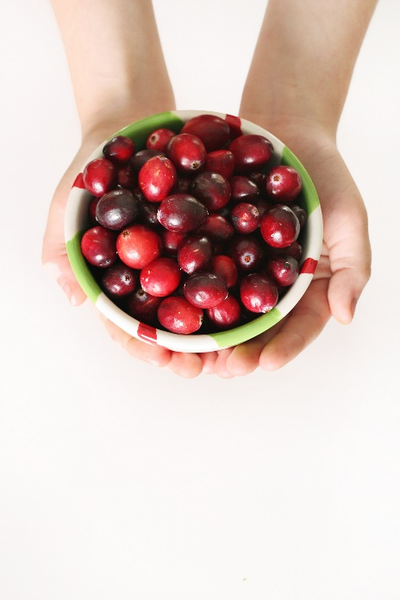
Value of Commodities Received
Official Record of Entitlement
Direct Delivery and Diversion – WBSCM
  Business Manager access
DoD Fresh – FFAVORS
Unprocessed Fruit and Vegetable Pilot – AMS report
Notes:
There are many reports in WBSCM. The Value of Commodities received reports will be required to run at the end of each year for your institutions financial records. USDA considers this the official record of entitlement.
There are three separate sources of the report that must be added together if RA’s use all programs.
WBSCM contains the report for Direct Delivery and Diversion. It is important that the persons in need of the report have access to WBSCM for the purpose of running this report. In most cases, this is the business manager. This is especially important if those with access do not work during Summer months and aren’t available to run the report when it’s needed.
There is a separate report that can be run in FFAVORS for what was spent in with DoD fresh entitlement.
AMS provides us with another report for spending in the Unprocessed Pilot.
The records that should be used are the actual spend not the amount set aside or planned.

Slide 12
Service Fee Billing
Based on Value of Commodities Received Report – WBSCM
Billing Timeline
  Direct Delivery/Diversion - after received to state/processor warehouse
  DoD – Billed twice yearly
  Unprocessed Pilot – Billed once yearly
Invoice Detail Report CNPweb - SNP
Notes:
The Value of Commodities received report reflect values as soon as the items are received at the state warehouse or the processor. We use this report to provide accurate representation of pounds and cases received. We use this report to complete service fee billing. This means that you could be charged fees prior to receiving the items at your institution. You also cannot match up bills with your receiving notices. It has nothing to do with when you chose to receive the product. We bill periodically, at least 6 times during the year.
DoD is billed twice yearly, once in January for July through December and once in June or July, for deliveries January through June.
The unprocessed fruit and vegetable program has been billed once yearly once all invoices have come in.
The details of the charges billed show up in CNPweb in the SNP Puzzle Piece under Reports. The report is called Invoice Details. This report matches up with the Value of Commodities Received report.

Slide 13
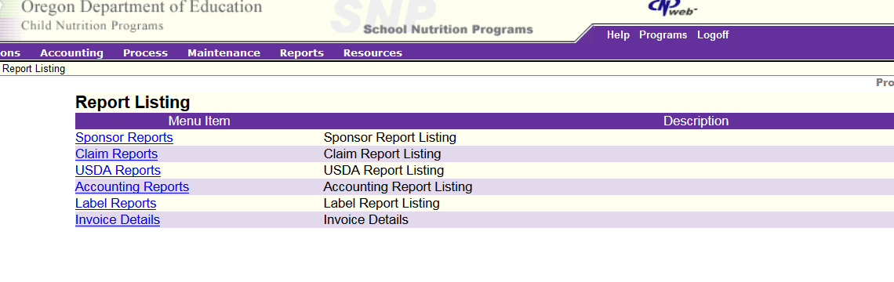
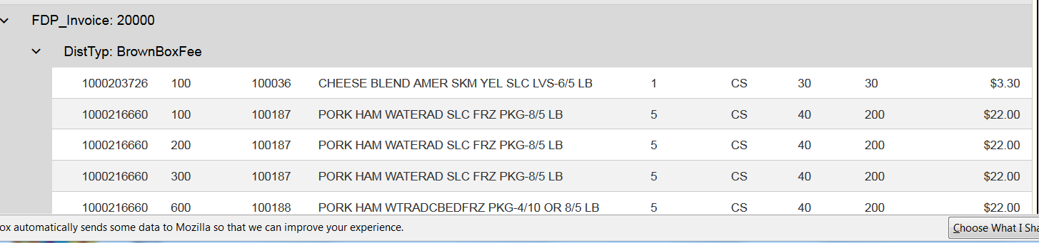
Invoice Detail Report
Notes:
In order to view the Invoice Detail Report – Access CNPweb, select the year, click Reports, Click Invoice Details. The report will appear. It will have all of the charges listed by order type.

Slide 14

Questions?

Slide 15
Non-Discrimination Statement
In accordance with Federal civil rights law and U.S. Department of Agriculture (USDA) civil rights regulations and policies, the USDA, its Agencies, offices, and employees, and institutions participating in or administering USDA programs are prohibited from discriminating based on race, color, national origin, sex, disability, age, or reprisal or retaliation for prior civil rights activity in any program or activity conducted or funded by USDA.
Persons with disabilities who require alternative means of communication for program information (e.g. Braille, large print, audiotape, American Sign Language, etc.), should contact the Agency (State or local) where they applied for benefits. Individuals who are deaf, hard of hearing or have speech disabilities may contact USDA through the Federal Relay Service at (800) 877-8339. Additionally, program information may be made available in languages other than English.
To file a program complaint of discrimination, complete the USDA Program Discrimination Complaint Form, (AD-3027) found online at: http://www.ascr.usda.gov/complaint_filing_cust.html, and at any USDA office, or write a letter addressed to USDA and provide in the letter all of the information requested in the form. To request a copy of the complaint form, call (866) 632-9992.
Submit your completed form or letter to USDA by:
(1) mail: U.S. Department of Agriculture
Office of the Assistant Secretary for Civil Rights
1400 Independence Avenue, SW
Washington, D.C. 20250-9410;
(2) fax: (202) 690-7442; or
(3) email: program.intake@usda.gov
This institution is an equal opportunity provider.

