Slide 1
Oregon Department of Education How to use the USDA Foods State Processing Agreements

Slide 2
USDA Foods
USDA allows State Distributing Agencies and school districts to contract with commercial food processors to convert raw and/or bulk USDA Foods into a variety of convenient, ready-to-use end products.

Slide 3
Who Makes the Rules?
Each level of government, from school boards to the U.S. Congress, can make regulations and policies about the use of nonprofit food service accounts, as long as the procurement process and contracting requirements are not less restrictive than the Federal regulatory requirements. Referencing these regulations and policies, the School Food Authority must develop their own documented operating procedures and processes of how they are meeting the minimum requirement for their non-profit food service account in accordance with 2 CFR 200 when using federal funds.
Oregon Revised Statutes 279A.030 states, “applicable federal statutes and regulations govern when federal funds are involved and the federal statutes or regulations conflict with any provision”.
Oregon Administrative Rule 581-051-0100 states “Authority and direction for the operation of school nutrition programs in Oregon shall be derived from the United States Department of Agriculture, the Oregon Revised Statutes, Oregon Administrative Rules and rules of district school boards”
All the Child Nutrition funds you receive are considered federal funds –The program applies the principle of federalism which allows the most restrictive federal, state or local statute, rule or policy to apply in the management of program operation and finances. The Federal regulations set the minimum standard that the School Food Authorities must follow.

Slide 4
State Agreement
Under a State agreement, the State Distributing Agency(ODE) negotiates prices, selects the processor and the end products which will be produced, and enters into an agreement with the processor.

Slide 5
Oregon Department of Education
ODE conducted a Requests for Proposal for Price Agreements of USDA Foods processed end products.
A committee of varying size school districts throughout Oregon participated in the tasting and scoring of products, to achieve the best product at the best price.
The products and prices are available to all Oregon National School Lunch Program sponsors (must meet processor minimums).
They have been competitively procured in compliance with all Federal and State Procurement regulations.
Sponsors are responsible for diverting USDA Foods to these processors and arranging for orders/delivery with the processor contact if they wish to use the agreements.
Processors may ship via direct delivery, through a distributor, or through the state contracted warehouse (Tools for Schools/GoodSource). Shipping terms/cost options are outlined on the products/pricing document.

Slide 6
How to use a Price Agreement
The Processing Agreements, by themselves, are not a binding contract.
The Authorized Purchaser (AP) and Contractor must enter into binding and enforceable Contract for the specific products listed in each of the PAs (ordering instrument).
The ordering instrument that you issue (purchase order or contract) must contain mandatory language referencing the Processing Agreement. A contract template is located on the ODE processing agreement website.
2 CFR 200.318(b): Non-Federal entities must maintain oversight to ensure that contractors perform in accordance with the terms, conditions, and specifications of their contracts or purchase orders.

Slide 7
Ordering Instrument Must Specify
Language stating that the ordering instrument is submitted under the Price Agreement
The specific goods, services, and quantity of each item ordered
The net price
The requested delivery schedule
The delivery location(s)
The invoicing address
The Authorized Sponsor’s authorized representative and relevant contact information, including an email address

Slide 8
Language that RA can use on their PO’s when using Price Agreements (if not using ODE contract template)
THIS PURCHASE IS SUBMITTED PURSUANT TO OREGON DEPARTMENT OF EDUCATION PRICE AGREEMENT #__________ (Ordering Organization will insert Agreement Number). THE PRICE AGREEMENT INCLUDING CONTRACT TERMS AND CONDITIONS AND SPECIAL CONTRACT TERMS AND CONDITIONS (T’s & C’s) CONTAINED IN THE PRICE AGREEMENT ARE HEREBY INCORPORATED BY REFERENCE AND SHALL APPLY TO THIS PURCHASE AND SHALL TAKE PRECEDENCE OVER ALL OTHER CONFLICTING T’s & C’s, EXPRESSED OR IMPLIED.

Slide 9
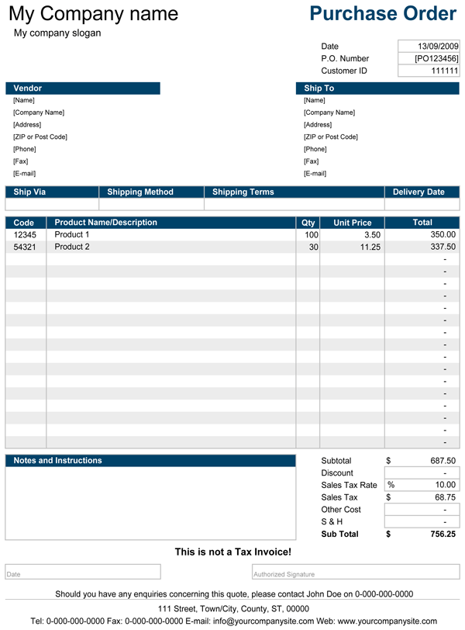
Purchase order example
THIS PURCHASE IS SUBMITTED PURSUANT TO OREGON DEPARTMENT OF EDUCATION PRICE AGREEMENT #__________ (Ordering Organization will insert Agreement Number). THE PRICEAGREEMENT INCLUDING CONTRACT TERMS AND CONDITIONS AND SPECIAL CONTRACT TERMS AND CONDITIONS (T’s & C’s) CONTAINED IN THE PRICE AGREEMENT ARE HEREBY INCORPORATED BY REFERENCE AND SHALL APPLY TO THIS PURCHASE AND SHALL TAKE PRECEDENCE OVER ALL OTHER CONFLICTING T’s & C’s, EXPRESSED OR IMPLIED.

Slide 10
Resources
http://www.oregon.gov/ode/students-and-family/childnutrition/USDAFoods/Pages/StatewideProcessingAgreements.aspx
http://www.oregon.gov/ode/students-and-family/childnutrition/Pages/Procurement.aspx
http://www.oregon.gov/ode/students-and-family/childnutrition/Documents/procurement-in-21st-century.pdf
2 CFR 200: UNIFORM ADMINISTRATIVE REQUIREMENTS, COST PRINCIPLES, AND AUDIT REQUIREMENTS FOR FEDERAL AWARDS
7 CFR 250: DONATION OF FOODS FOR USE IN THE UNITED STATES, ITS TERRITORIES AND POSSESSIONS AND AREAS UNDER ITS JURISDICTION

Slide 11
Oregon Department of Education “Our Why”
Equity and Excellence for Every Learner
The Oregon Department of Education works in partnership with school districts, education service districts and community partners;
Together, we serve over 580,000 K-12 students;
We believe every student should have access to a high-quality, well-rounded learning experience;
We work to achieve the Governor’s vision that every student in Oregon graduates with a plan for their future.
Notes:
You will notice that all ODE trainings have this slide and the following at this time. We are in an exciting time in Oregon Education with the Student Success Act. We are all charged with keeping our mission in mind as we work towards implementation

Slide 12
Oregon Department of Education Education Equity Stance
Education equity is the equitable implementation of policy, practices, procedures, and legislation that translates into resource allocation, education rigor, and opportunities for historically and currently marginalized youth, students, and families including civil rights protected classes. This means the restructuring and dismantling of systems and institutions that create the dichotomy of beneficiaries and the oppressed and marginalized.
Notes:
We know that every day you are working to support those marginalized youth. Nourishing them so that that have a chance at success. Thanks for all you do.

Slide 13
Non-Discrimination Statement
In accordance with Federal civil rights law and U.S. Department of Agriculture (USDA) civil rights regulations and policies, the USDA, its Agencies, offices, and employees, and institutions participating in or administering USDA programs are prohibited from discriminating based on race, color, national origin, sex, disability, age, or reprisal or retaliation for prior civil rights activity in any program or activity conducted or funded by USDA. Persons with disabilities who require alternative means of communication for program information (e.g. Braille, large print, audiotape, American Sign Language, etc.), should contact the Agency (State or local) where they applied for benefits. Individuals who are deaf, hard of hearing or have speech disabilities may contact USDA through the Federal Relay Service at (800) 877-8339. Additionally, program information may be made available in languages other than English. To file a program complaint of discrimination, complete the USDA Program Discrimination Complaint Form, (AD-3027) found online at: USDA Link, and at any USDA office, or write a letter addressed to USDA and provide in the letter all of the information requested in the form. To request a copy of the complaint form, call (866) 632-9992. Submit your completed form or letter to USDA by: (1) mail: U.S. Department of Agriculture Office of the Assistant Secretary for Civil Rights 1400 Independence Avenue, SW Washington, D.C. 20250-9410; (2) fax: (202) 690-7442; or (3) email: program.intake@usda.gov This institution is an equal opportunity provider.

