Slide 1
WBSCM Report Personalization
Automatically download reports with the data you need in the way you need it.

Slide 2
Personalization Options
Manually Enter Criteria
Set up Variant Queries
Create Custom Views
Notes:
Users can manually enter specific criteria for a report each time requested or set up a variant for those reports with standard fields to use throughout the year. This would be useful if you are always typing in the same information such as the full school year for NSLP.
Users can also create Customized Views of Reports to show specific columns in specific orders.
In the following slides, we will view these options.

Slide 3
Order Status Report
Provides order details throughout order cycle
Example report for personalizing
Notes:
The Order Status Report is used to provide details on orders throughout their cycle. Today we will use this report to demonstrate how reports and queries can be personalized. The same type of personalization can be done for every report.

Slide 4
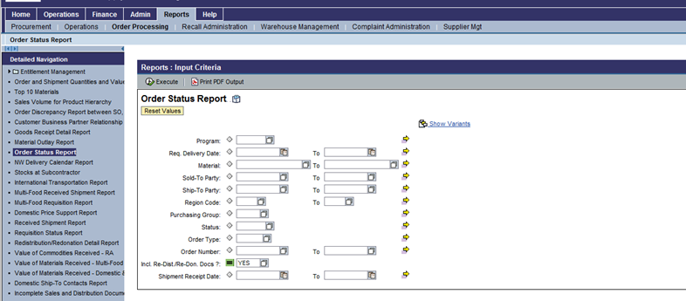
Order Status Report Location
Portal Path: Reports→Order Status Report
Notes:
To access the order status report in WBSCM, click reports and then order status report.
To run the order status report, users are required to enter one of the following fields: Delivery Date, Order Number OR Shipment Receipt Date
One or multiple fields can be filled to run a desired report. The more fields filled out, the more specific the report will be generated.

Slide 5
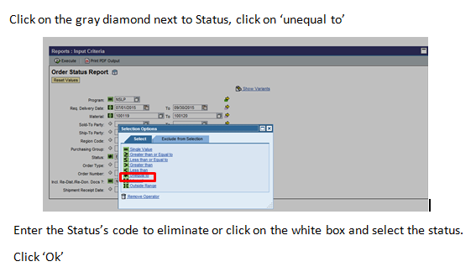
Searching for all except …
Always filtering out the same information?
  Exclude the information from the start
Notes:
Instead of running reports and then filtering the information you don’t want, you can set up reports to exclude certain information.
For example, you could exclude cancelled orders or exclude the Ship-to party of our state warehouse so you just see diversion orders.
To exclude cancelled orders, click the gray diamond next to status, click on ‘unequal to’ then enter or click the status code to eliminate and click ok.

Slide 6
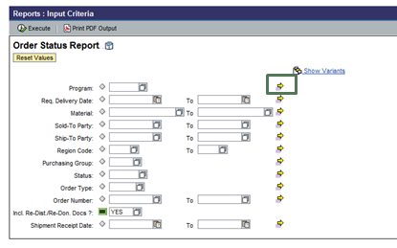
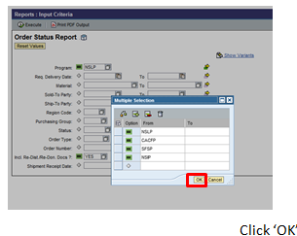
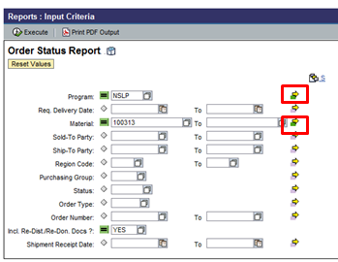
Reports with multiple selections
Notes:
Click on the yellow area to add multiple criteria to a search box
Select all the desired criteria and click ok
There will be a green line under the arrow when multiple criteria has been added

Slide 7
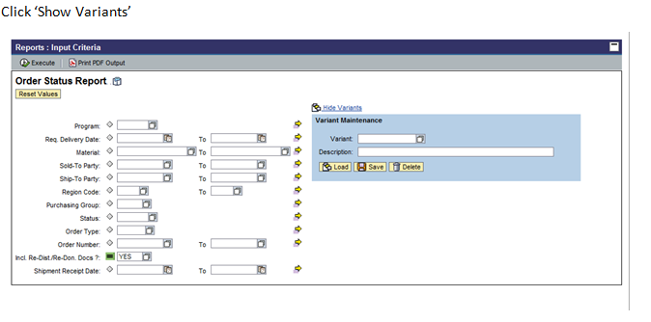
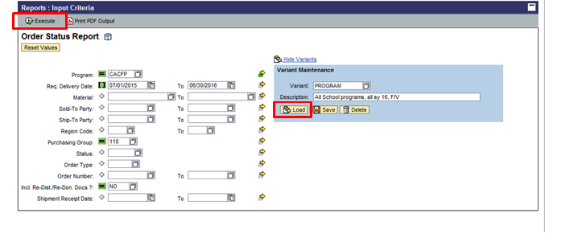
Variants (pre-filled queries)
Notes:
Variants are prefilled queries. These are used when you want to duplicate the same query throughout the year.
Click Show Variants, fill in your query as desired.
Title the Variant and Save.
To access variant, click Show Variant, type Variant name and click load and then execute

Slide 8
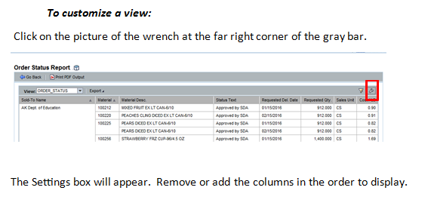
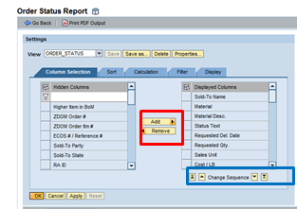
Custom Report Views
Notes:
Once you have run the query by pressing execute, you have the option of editing the columns and the order of the display of columns.
First click on the wrench icon, in the settings box you can add or remove columns and change the sequence of columns as they display on the report.
Once you are finished, click save as.

Slide 9
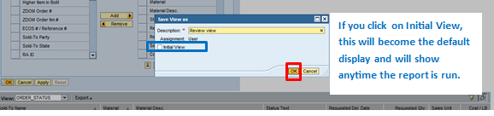
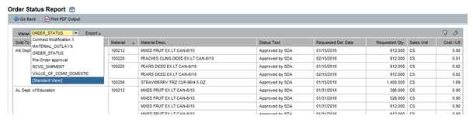
Saving Custom Views
Notes:
After clicking Save as, you will have a dialog box come up. You type in the description name and press ok. If you want it to be the default report view, click the initial view box.
Now every time you run the query, you will have a drop down box next to view. You can make any number of custom report views and choose the one that matches your needs.

Slide 10

Questions?

Slide 11
Non-Discrimination Statement
In accordance with Federal civil rights law and U.S. Department of Agriculture (USDA) civil rights regulations and policies, the USDA, its Agencies, offices, and employees, and institutions participating in or administering USDA programs are prohibited from discriminating based on race, color, national origin, sex, disability, age, or reprisal or retaliation for prior civil rights activity in any program or activity conducted or funded by USDA.
Persons with disabilities who require alternative means of communication for program information (e.g. Braille, large print, audiotape, American Sign Language, etc.), should contact the Agency (State or local) where they applied for benefits. Individuals who are deaf, hard of hearing or have speech disabilities may contact USDA through the Federal Relay Service at (800) 877-8339. Additionally, program information may be made available in languages other than English.
To file a program complaint of discrimination, complete the USDA Program Discrimination Complaint Form, (AD-3027) found online at: http://www.ascr.usda.gov/complaint_filing_cust.html, and at any USDA office, or write a letter addressed to USDA and provide in the letter all of the information requested in the form. To request a copy of the complaint form, call (866) 632-9992.
Submit your completed form or letter to USDA by:
(1) mail: U.S. Department of Agriculture
Office of the Assistant Secretary for Civil Rights
1400 Independence Avenue, SW
Washington, D.C. 20250-9410;
(2) fax: (202) 690-7442; or
(3) email: program.intake@usda.gov
This institution is an equal opportunity provider.

