Slide 1
How to Become a CACFP Sponsor
An Overview of the CACFP Application Process for
Center-Based Sponsors
Notes:
These slides review the application process to become a sponsor of the Child and Adult Care Food Program, referred to as the CACFP.

Slide 2
Types of Organizations Eligible for the CACFP
Child Care Centers, including for-profit and non-profit
Head Starts
Outside School Hours Care Centers
Homeless and emergency shelters
At-Risk Afterschool Meals and Snacks programs
Adult Day Care Centers
Notes:
The Child and Adult Care Food Program (CACFP) provides reimbursement to sponsors for nutritious meals and snacks served to eligible children and adults in care settings. Programs eligible to participate include:
Child Care Centers, including for-profit and non-profit
Head Starts
Outside School Hours Care Centers
Homeless and emergency shelters
At-Risk Afterschool Meals and Snacks programs, and
Adult Day Care Centers.
The CACFP is funded by the U.S. Department of Agriculture and administered in Oregon by the Oregon Department of Education (ODE). ODE administers the CACFP by approving eligible organizations to sponsor the CACFP (referred to as CACFP sponsors), providing reimbursement to CACFP sponsors for serving approved meals and snacks to eligible participants, and conducting administrative reviews of the operations of CACFP sponsors.

Slide 3
The CACFP Application Process
Step 1- CACFP Eligibility Assessment
Step 2- Training and Procedure Development
Step 3- CNPweb web Access
Step 4- Online and Offline Application Materials
Step 5- Pre-Approval Review
Notes:
How does your organization become a CACFP sponsor? There are 5 steps in the application process. The following slides detail each step in the CACFP application process.

Slide 4
Step 1- Eligibility Assessment
Use the CACFP Center Eligibility Quick Check to determine potential eligibility
Complete the CACFP Eligibility Assessment
  If eligible, an initial financial viability assessment must be completed
Notes:
The first step of the application process is to determine an applicant organization’s eligibility to become a CACFP Sponsor. Applicants should first use the CACFP Center Eligibility Quick Check to determine if their organization may be eligible to sponsor the CACFP.
If you think that your organization may be eligible based on the quick check, complete the CACFP Eligibility Assessment. If the assessment determines that the potential applicant may be qualified for participation, the potential applicant will be contacted to provide information to assess the organization’s financial viability. “Financial viability” means that the organization would be able to sustain the same level of service in the event CACFP funds were interrupted.

Slide 5
Step 2- Training and Procedures
Complete required training sessions specific to your organization
Complete required procedure templates specific to your organization
ODE Technical Assistance (TA) Call
Notes:
Once you have completed your eligibility assessment and your organization is determined to be eligible to apply for CACFP, you will be contacted by ODE CNP to move on to the second step of the application process. The second step in the application process is to complete required CACFP trainings and procedure templates.
Federal regulations require ODE CNP to provide training CACFP Sponsors. ODE CNP provides training for new sponsors and new staff online, which is available to be accessed 24/7 via the ODE CNP CACFP Training webpage.
Some trainings may not be applicable to your Program. For example, if you’re a nonprofit organization and only have nonprofit sites, it’s not necessary for your organization to complete For-Profit training. A detailed list will be given to applicants with which trainings your organization will be required to complete based on your organization and program(s) offered.
Sponsors of the CACFP are required to have procedures on how they implement the CACFP as well. In step 2, applicants are given procedure templates on key areas of the CACFP to document how their organization will implement the CACFP. These can used to used to start a CACFP procedure handbook specific to their organization. Technical assistance will be provided by ODE staff members on how to strengthen procedures throughout the application process.

Slide 6
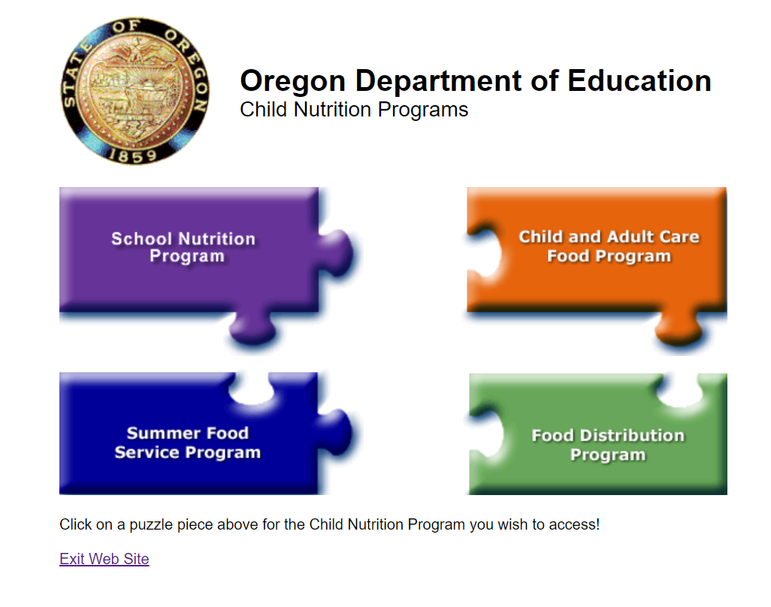
Step 3- CNPweb Access
Complete and submit required forms for CNPweb access
Notes:
In step 3, applicants will be given forms that are required to be completed in order to be granted to access to CNPweb. CNPweb is a web-based application and claiming system used by ODE CNP. Applicants are required to submit both online and offline forms as part of the application process. In order to submit the online application forms, applicants first must submit forms to gain access in CNPweb. Forms in this step will collect basic information on the organization through “New Sponsor” and “Add Site” forms as well as User Authorization forms for individuals who will need access to the online application system. All forms must be read and completed thoroughly and carefully to ensure information is accurate and all who sign understand what they are agreeing to.

Slide 7
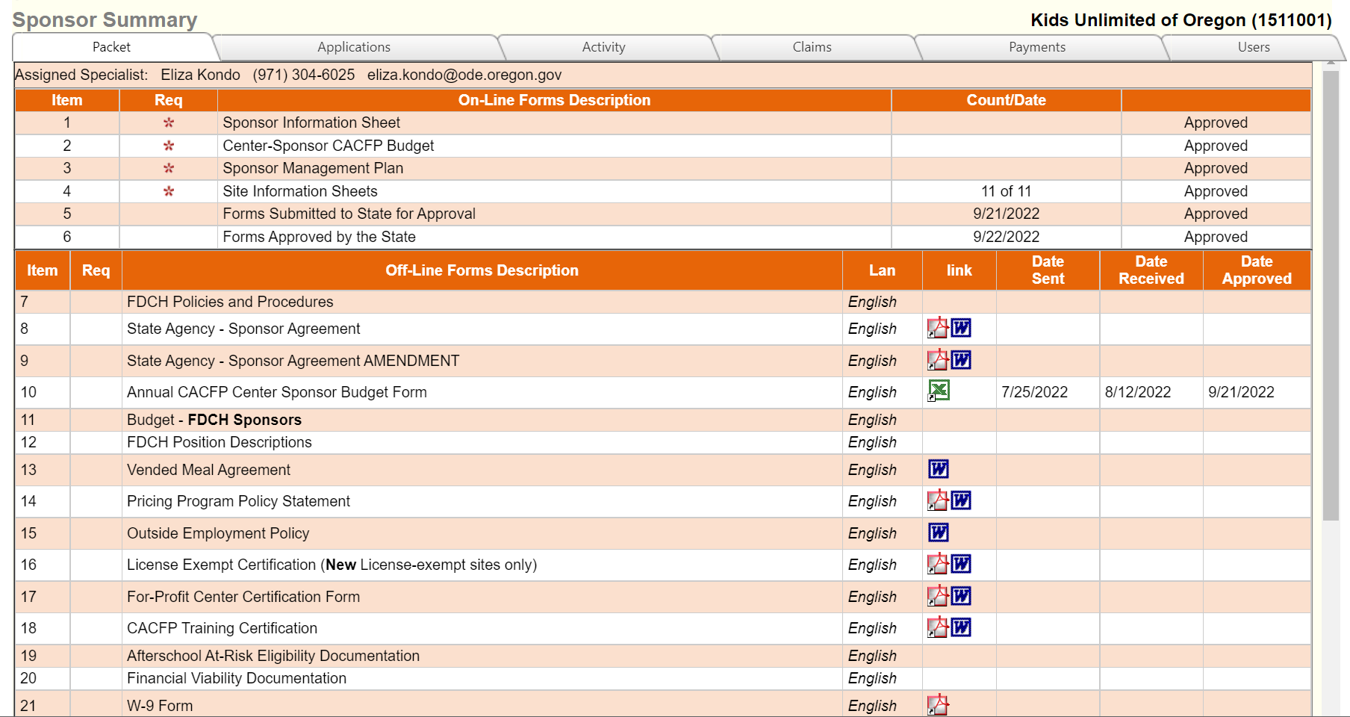
Step 4- Online and Offline Application Materials
Online (CNPweb) forms
Offline forms
Financial viability
documents
Offline Forms for Download
Notes:
Step 4 of the CACFP application process is where applicants will provide more specific information to ODE CNP about their organization and how they will implement the CACFP. All required application forms must be completed and submitted for the application to be reviewed by ODE CNP. As stated earlier, application forms are both offline and online. The online forms, which are part of CNPweb in the Applications tab, include a sponsor information sheet, management plan, budget overview, and information sheets for each site. The offline forms are available as a download from CNPweb in the Packet tab. Those with CNPweb access to will need to log in to CNPweb and download, complete, and submit the required forms per the application instructions.
In addition to the application forms, your organization will also be required to submit additional financial documents, such as bank account statement, to complete verification of financial viability. ODE CNP staff will hold a webinar or call with applicants to detail all documents that must be submitted as part of this step. ODE CNP will give a due date for these items and review them. If the documents meet all requirements and deadlines, the application will move on to the final step of the application process.

Slide 8
Step 5- Pre-Approval Review
ODE CNP reviews applicant‘s implementation of CACFP operations
Notes:
The final step in the application process is the Pre-Approval Review. An applicant cannot move to step 5 until the application materials have been reviewed by a Child Nutrition Specialist and any/all corrections made to the application materials.
A specialist from ODE CNP will make an appointment, typically onsite, to review the applicant’s operation and implementation of the CACFP prior to final approval. Applicants must implement all meal and record keeping requirements, as described in the trainings, completed procedure templates, and the management plan, prior to the pre-approval review. If requirements are not implemented, approval of the application may be potentially denied. It is during the pre-approval visit the applicant demonstrates that they are accountable and capable of operating the CACFP.
After completion of the Pre-Approval review, if the applicant is determined to be accountable and capable of operating the CACFP, the Child Nutrition Specialist will review with the applicant any areas that need correction prior to approval of the application. Once all corrections received and determined to be acceptable, or if corrections are not required, the application may be approved and the agreement may be executed..

Slide 9
Questions?
Please contact ode.communitynutrition@ode.oregon.gov

Slide 10
USDA Nondiscrimination Statement
In accordance with federal civil rights law and U.S. Department of Agriculture (USDA) civil rights regulations and policies, this institution is prohibited from discriminating on the basis of race, color, national origin, sex (including gender identity and sexual orientation), disability, age, or reprisal or retaliation for prior civil rights activity.
Program information may be made available in languages other than English. Persons with disabilities who require alternative means of communication to obtain program information (e.g., Braille, large print, audiotape, American Sign Language), should contact the responsible state or local agency that administers the program or USDA's TARGET Center at (202) 720-2600 (voice and TTY) or contact USDA through the Federal Relay Service at (800) 877-8339.
To file a program discrimination complaint, a Complainant should complete a Form AD-3027, USDA Program Discrimination Complaint Form which can be obtained online at: https://www.usda.gov/sites/default/files/documents/ad-3027.pdf, from any USDA office, by calling (866) 632-9992, or by writing a letter addressed to USDA. The letter must contain the complainant's name, address, telephone number, and a written description of the alleged discriminatory action in sufficient detail to inform the Assistant Secretary for Civil Rights (ASCR) about the nature and date of an alleged civil rights violation. The completed AD-3027 form or letter must be submitted to USDA by:
mail:
U.S. Department of Agriculture
Office of the Assistant Secretary for Civil Rights
1400 Independence Avenue, SW
Washington, D.C. 20250-9410; or
fax:
(833) 256-1665 or (202) 690-7442; or
email:
Program.Intake@usda.gov
This institution is an equal opportunity provider.
Notes:
This slide is the USDA Nondiscrimination Statement.
This concludes the application process overview.

