Slide 1
Presentation African American / Black Advisory Panel
February 5, 2016
Notes:
Introductions
Who is in the room
Agenda

Slide 2
History
Existing plan at ODE (mid-80’s)
Staffing to support plan (building capacity)
AI/AN Advisory Panel
Alignment to ODE Strategic Plan Goals
Finalized and approved by State Board of Education
Notes:
There was an existing AI/AN state plan since the mid-80’s. However, there was a lack of attention and support for implementation. Additionally, there was a full time position in the 80’s which overtime dropped to .10 staff position. In 2013, ODE leadership and the legislation supported a one fulltime staff.
AI/AN Advisory Panel – 26 members geographically & educator diverse. Panel was co-facilitated by ODE & Ed NW. Which included Gov to Gov members which was great because G2G had existing education priorities and conversations dating back to 1996. Oregon law outlines a G2G relationship with tribes and facilitated through G2G Cluster. The G2G cluster focuses on areas of partnership which expands P-20 (cradle to career). Met monthly for 10 months and between meetings each member would take information back to community, organization, tribe and stakeholders to gather more input.
Brought together a wide-range of exercise yet the panel built consensus (priorities different)
Organized by Learners, Educators, Schools & Districts, Communities, and ODE – we decided to align the language with ODE’s strategic plan to streamline implementation within ODE & out to districts.

Slide 3
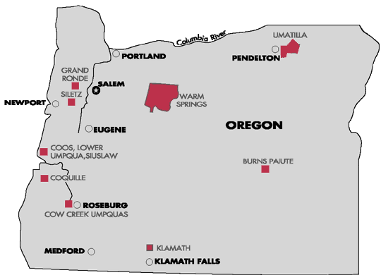
Oregon Map

Slide 4
Nine Tribes
Oregon has nine federally recognized tribes. The members of these tribes live throughout the state.
The members of other tribes live throughout the state and country.

Slide 5
How many Native American or AI/AN people are there?
Native American or American Indian/Alaska Native people make up about 1 percent of the American population. In Oregon we are 1.8 percent. In Oregon classrooms, 1.5 percent of students identify as AI/AN.
☻☻☻☻☻☻☻☻☻☻☻☻☻☻☻☻☻☻☻☻☻☻☻☻☻☻☻☻☻☻☻☻☻☻☻☻☻☻☻☻☻☻☻☻☻☻☻☻☻☻☻☻☻☻☻☻☻☻☻☻☻☻☻☻☻☻☻☻☻☻☻☻☻☻☻☻☻☻☻☻☻☻☻☻☻☻☻☻☻☻☻☻☻☻☻☻☻☻☻☻
Roughly 2 in 100 or about 9,161 of
567,098 all Oregon students.

Slide 6
Native people in Oregon are members or descendants of over 567 tribal communities.
1 | Not all Native Americans live on or near their reservation.
Not all AI/AN students are enrolled in a tribe. | 4
2 | Some students will have limited or no contact with their native heritage and traditions.
Not all Native students will receive benefits from a tribe. | 5
3 | Some AI/AN students are multi-racial.
Not all Native students attend Bureau of Indian Education Schools | 6

Slide 7
AGENDA
The plan itself
What can ODE do?
Why do we need a plan?
Landscape of Indian Country in Oregon

Slide 8
Timeline 1930 to 1900
Indian Self-Determination and Education Assistance Act: Declares that the U.S. Congress recognizes a Federal obligation to be responsive to the principle of self-determination through Indian participation, decision-making and administration of educational and service programs.
Impact Aid Law: Provides assistance to local school districts with concentrations of children residing on Indian lands, military bases, low-rent housing properties, or other Federal properties.
1950
1975
“”
1930
1972
1978
1990
Johnson O’Malley Act: Provides financial assistance for supplemental programs designed to meet the specialized and unique educational needs of eligible Indian students.
Indian Education Act: Provides formula grant and competitive grant assistance to local education agencies and Indian-controlled schools for programs to address the special educational and culturally related academic needs of Indian children.

Slide 9
Timeline 1972 to 1900
Indian Self-Determination and Education Assistance Act: Declares that the U.S. Congress recognizes a Federal obligation to be responsive to the principle of self-determination through Indian participation, decision-making and administration of educational and service programs.
1975
1988
1972
1978
1990
Indian Education Act: Provides formula grant and competitive grant assistance to local education agencies and Indian-controlled schools for programs to address the special educational and culturally related academic needs of Indian children.
Tribally Controlled Community Colleges Act: Provides financial and technical assistance for the establishment, operation, and improvement of tribally controlled community colleges.

Slide 10
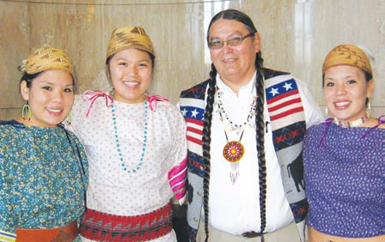
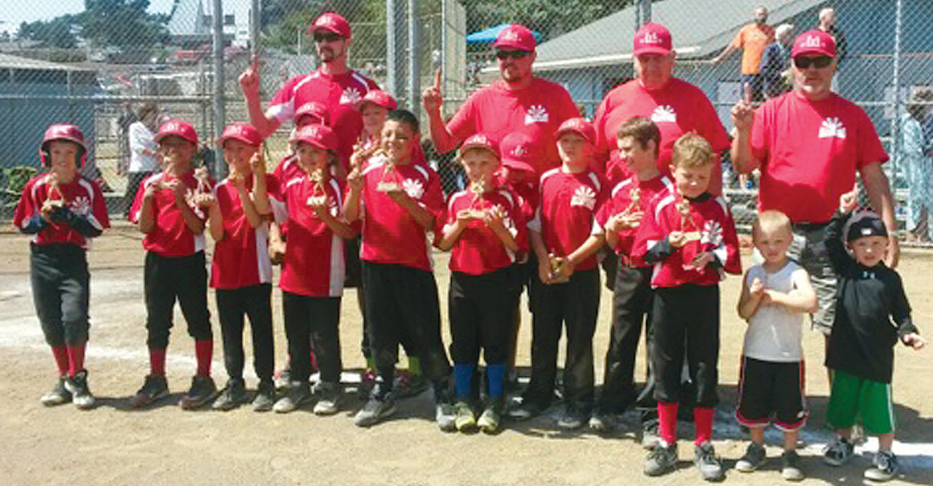
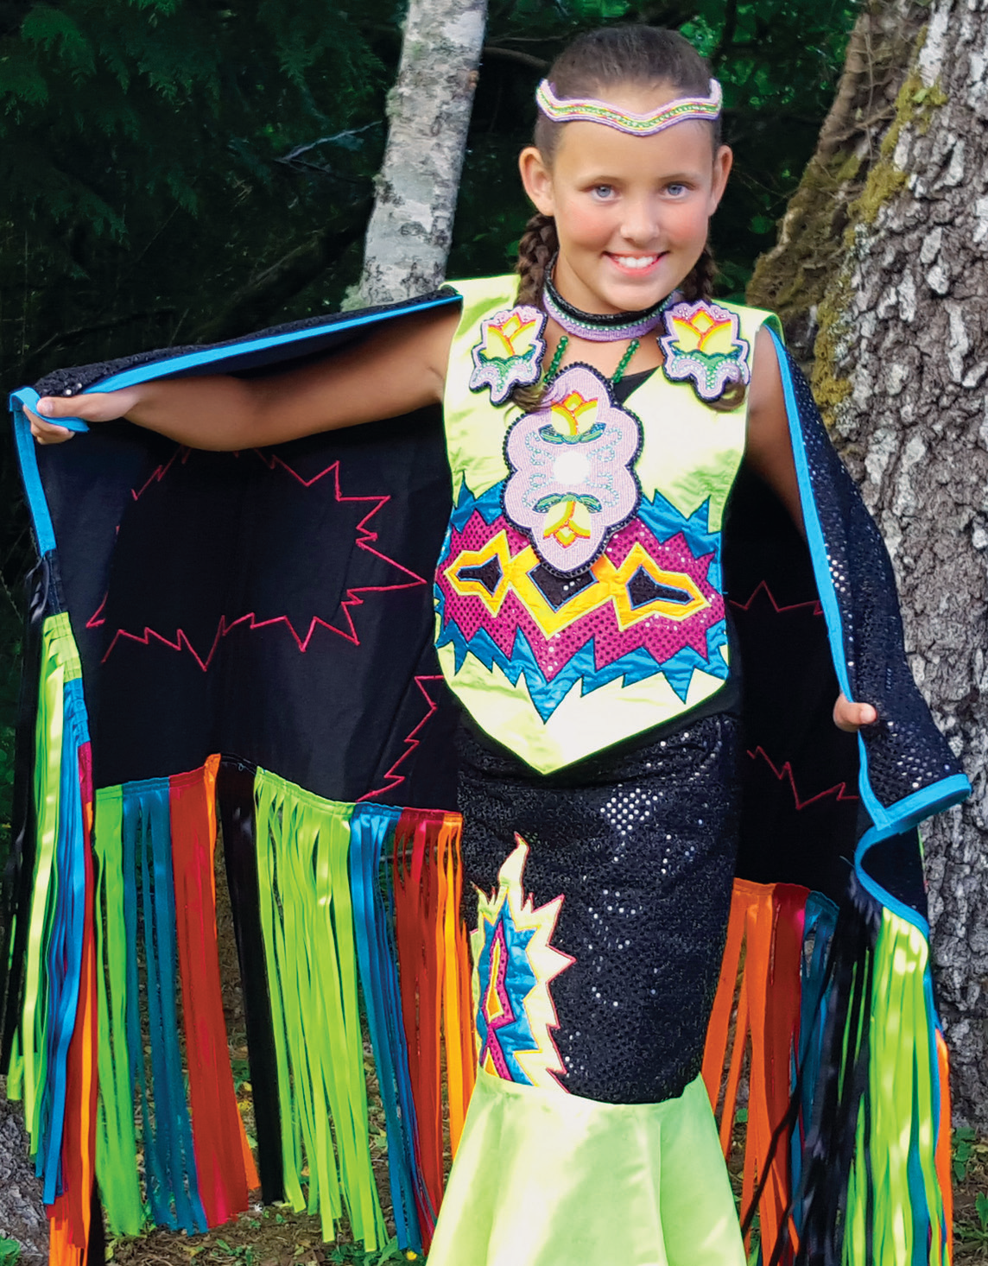
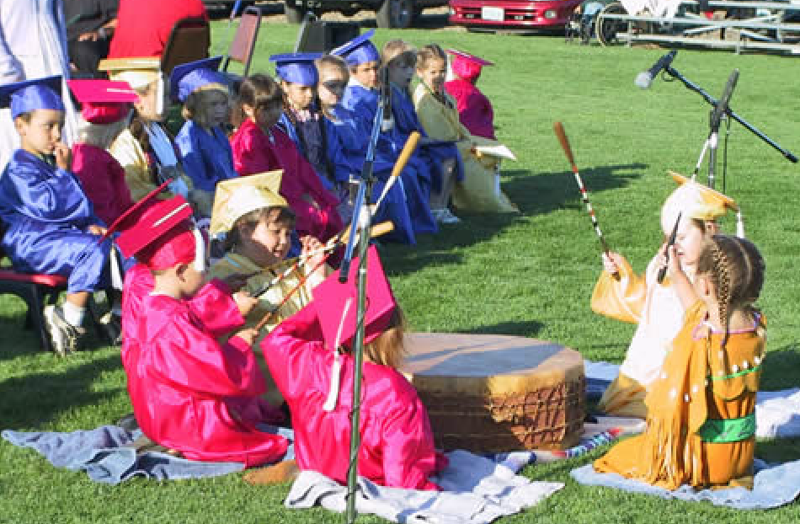
Images
Notes:
I want you to hold this slide in your hearts and minds because this is Oregon. They are musicians, scholars, athletes, graduates, dancers, beaders, believers and more. The next few slide are going to create a different narrative in your mind. I want you to not associate the narratives with the Native community but rather as a fault of our system.

Slide 11
AI/AN students:
From 2011-2014, the percentage of American Indian/Alaska Native students who were proficient on the reading and math tests (OAKS) was consistently around 13% lower than ALL students across grades 3, 5 and high school
Have higher incidence of absenteeism and discipline referrals issues
Dropout at a higher rate
Are identified for learning disabilities at a greater rate
Are over-represented for free and reduced lunch
Have a lower rate of attending and successfully completing college and vocational training
As adults have a high rate of unemployment
Notes:
THIS TEXT IS FILLER – I AM GOING TO REPLACE IT WITH OREGON FACTS.

Slide 12
Education pathway

Slide 13
Poverty Data

Slide 14
Returning to the AGENDA
The plan itself
What can ODE do?
Why do we need a plan?
Landscape of Indian Country in Oregon

Slide 15
Special Education
Statewide in Oregon, Black/African American and Native American students are over-represented in Special Education

Slide 16
Returning to the AGENDA, again
The plan itself
What can you do?
Why do we need a plan
Landscape of Indian Country in Oregon

Slide 17
The Plan
01
LEARNERS:
Increase grad rates
Increase CCR, vocational training
Increase attendance
EDUCATORS:
Recruit, hire, and retain a diverse workforce
Professional development
TPP alignment
02
THE PLAN
COMMUNITIES:
Educational agency outreach
Culturally relevant engagement
04
03
SCHOOLS/DISTRICTS:
Curriculum, assessment tools, & materials that are:
historically accurate,
culturally embedded,
place-based,
contemporary, and developmentally appropriate
ODE:
Accurate data
Accountability framework
Internal capacity
05

Slide 18
The ROLE of the State (1)
LEARNERS
INCREASE GRAD | RATE
OBJ 2
OBJ 3
EDUCATORS
OBJ 1
OBJ 2
OBJ 3
SCHOOLS/DISTRICS
OBJ 1
COMMUNITIES
OBJ 1
ODE
OBJ 1
OBJ 2
OBJ 3
STRATEGIES
Create campaign to elevate awareness of resources that are available to AI/AN students that could increase graduation rates.
Partner with tribes and other stakeholders to identify and advocate culturally responsive approaches to increase graduation rates.
Share and disseminate culturally relevant best practices and strategies for closing the opportunity gap for AI/AN students
Kindergarten Readiness data – ODE
Early Learning Supports – ELD
Monitor 9th Grade on Track data – ODE
Graduation rates (4th year & 5th year) – ODE
Middle School early warning data - ODE
SPED, TAG, Diploma Types - ODE*
METRICS/MILESTONES

Slide 19
Common Core
LEARNERS
OBJ 1
OBJ 2
OBJ 3
EDUCATORS
OBJ 1
OBJ 2
OBJ 3
SCHOOLS/DISTRICS
OBJECTIVE | 1
COMMUNITIES
OBJ 1
ODE
OBJ 1
OBJ 2
OBJ 3
Every school district in Oregon implements (K-12) historically accurate, culturally embedded, place-based, contemporary,
and developmentally appropriate AI/AN curriculum, assessment tools, and instructional materials that are developed in collaboration with local tribes and are
aligned with the Common Core State Standards and state standards.

Slide 20
The ROLE of the State (2)
LEARNERS
OBJ 1
OBJ 2
OBJ 3
EDUCATORS
OBJ 1
OBJ 2
OBJ 3
SCHOOLS/DISTRICS
OBJECTIVE | 1
COMMUNITIES
OBJ 1
ODE
OBJ 1
OBJ 2
OBJ 3
ODE will support efforts to develop legislative language which mandates implementation of (K-12) historically accurate, culturally embedded, place-based, contemporary, and developmentally appropriate AI/AN curriculum, assessment tools, and instructional materials.
ODE will continue to collect AI/AN curriculum which is, or can be aligned to the Common Core.
ODE will provide a framework for districts to share and disseminate culturally relevant best practices, strategies, and curriculum to successfully increase educational opportunities for AI/AN students.
Continue efforts with Advisory Panel, Oregon Tribes, OIEA, and other AI/AN stakeholders to develop legislative language for the 2017 session – ODE & et al
STRATEGIES
METRICS/
MILESTONES
Repository of curriculum and resources

Slide 21
AGENDA-The Plan
The plan itself
What can ODE do?
Why do we need a plan
Landscape of Indian Country in Oregon
How does this plan serve all students?
What is your role?

Slide 22
Strategies
1 | Strategies to increase grad rates for AI/AN student benefits all students.
2 | Culturally responsive teaching benefits all students.
3 | Attendance strategies benefits all students.
4 | Diversifying the workforces benefits all students.
5 | Historically accurate curriculum benefits all students.
6 | Dissemination of best and promising practices benefits all students.

Slide 23
AGENDA-Returning to The Plan
The plan itself
What can ODE do?
Why do we need a plan
Landscape of Indian Country in Oregon
How is this plan good for all kids? Answered
What is your role? Identify ways to support this plan.

Slide 24
Images of Native Americans
Notes:
Let’s go back to the first exercise. Most educators cannot identify tribe in Oregon nor do can they describe the landscape of Indians in Oregon. Your role is to begin learning the landscape and to dig into the plan for your part. Reviewing your curriculum for accurate information

Slide 25
Quote from Leslie Riggs
“We are not bookmarks in history. We are thriving, living people of culture. We are among you right now – in your classrooms. We are a living history. We’re not relegated to the past; we’re among you.”
- Leslie Riggs
Notes:
Leslie Riggs was quoted when the plan was announced. The striking thing is not the quote though it is powerful, it’s the fact that he had to say this out loud – we are among you. If we can’t see them how can we expect them to see themselves and imagine their own futures. Your role is to identify in this plan where you can add value. Or identify what you are already doing that needs to be scaled up. Learn the landscape, identify areas. We are happy to come out and work with your departments to understand all aspect of this plan.

Slide 26
For more information…..
Tabitha Whitefoot, Indian Education Specialist
tabitha.whitefoot@state.or.us (503) 947-5695
April Campbell, Indian Education Advisor to Deputy Superintendent of Public Instruction
april.campbell@state.or.us (503) 947-5810

