Slide 1
EL Advisory Group
November 10, 2021

Slide 2



Meeting Overview
Welcome & Introductions
ODE EL Strategic Plan
Charter Review
Norms
Chair Selection Process
EL Resource Bank
WRAP Program
ELPA 21 Updates
Title III Updates
•
2

Slide 3



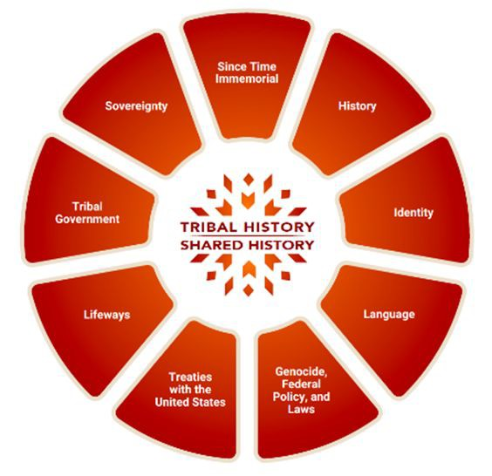
Asst. Superintendent Lange’s Land
Acknowledgement
Although I was born in Oregon and have lived here my entire life, I consider myself a guest on this land. It is an honor to offer this land acknowledgement.
An acknowledgement is both a recognition and an invitation; it serves to keep us
ever present to the fact that unless you are a descendent of the Indigenous peoples of this land… we are standing on stolen land, working on stolen land, and living on stolen land. It is an invitation to understand and feel that truth. As we strive to serve Indigenous students and families every day:
We should be in right relationship with our Indigenous educators, principals, teacher,
Title VI Indian Ed coordinators, and the Office of Indian Education.
Being in right relationship means learning who the nine federally recognized tribes in Oregon are and
Being in right relationship means making the time in our buildings to teach
our staff members, students, and families about the Essential Understandings of Native Americans in Oregon, a foundational document created through the Tribal History/Shared History project.

Slide 4

T

Slide 5
Oregon Department of Education
Education Equity Stance
Education equity is the equitable implementation of policy, practices, procedures, and legislation that translates into resource allocation, education rigor, and opportunities for historically and currently marginalized youth, students, and families including civil rights protected classes. This means the restructuring and dismantling of systems and institutions that create the dichotomy of beneficiaries and the oppressed and marginalized.
5

Slide 6




We’re Raising the Bar
Office of Equity,
Diversity and Inclusion
LGBTQ2SIA+
Student Success Plan
Safe and Inclusive Schools
INITIATIVES
English
African American/ Black Student Success Plan
Latino/a/x & Indigenous Student Success Plan
Oregon State Seal of BIliteracy
Language Learner (HB3499)
Plan

Slide 7
Oregon’s EL Strategic Plan
Time to Update!
2017~ latest version of the Plan
2022~Updating the Strategic Plan
Support from EL Advisory

Slide 8
Norms – Pre - Thinking Prompt
What are 3-5 norms that would contribute to successful EL Advisory Group Meetings for you?

Slide 9
Breakout Rooms
Share the 3-5 norms that you identified
As a team, discuss each member’s contributions and decide on 3-5 norms as a team
Brainstorm practices that uphold these norms

Slide 10
EL Advisory Group Charter
Statement of Purpose
Scope
Formation
Decision Making Authority
Membership
Responsibilities
Meetings
Workgroups
  Terms of Service
  Conflicts of Interest

Slide 11
EL Advisory Group Chair
Provides leadership
Helps ODE develop agendas for EL Advisory Group
meetings
Collaborates with other Advisory Group Chairs, such as African American Black Student Success, LGBTQ2SIA+ Student Success, and Latino/a/x
Student Success Advisory Groups
Helps Facilitate EL Advisory Group Meetings

Slide 12
Chair Selection Process
Advisory Group members interested in assuming the position of EL Advisory Group Chair will send a letter of interest to Ana.Salas@state.or.us by November 24, 2021
ODE will create a Google folder with letters of interest and resumes
ODE will send out a survey for member voting- vote by December 10, 2021
The member with the most votes by December 10, 2021 will hold the position of EL Advisory Group Chair

Slide 13
EL Resource Bank
OAR 581-020-0624
ELL District and School Improvement: Best Practices and Promising
The Department shall create an online resource bank for sharing national, state and local best practices and promising practices in serving ELL students and engaging families of ELL students. The best practices and promising practices must be culturally responsive.
The online resource bank shall include resources for best practices and promising practices and should address at a minimum:
  The provision of support for students who are in grades 6 to 12 and have been identified as ELL students for six or more years;
  The provision of support for students who are former ELL students;
  Engagement of families and delivering essential notifications relating to ELL programs; and
  Identification of students who are eligible to be enrolled as ELL students.

Slide 14
Structure
Organizing principles:
Put users/educators at the center of the experience and create a repository with resources designed to meet student needs.
Create a comprehensive, curated online repository that will include evidence-based,
equity-focused, culturally responsive research and practice articles, reports, analysis, and implementation resources about English learner programs and services.
Build an interactive, community-based best and promising practices component, where
practitioners will be able to engage with each other and explore the ways in which they can use resources in support of English learners.
Questions to consider:
What is the best way to get the information to users (practitioners, researchers, policy makers, other users)?
What is the criteria for including information in the resource bank?
What is the resource bank structure? How will the information in the resource bank be organized?

Slide 15
Planning and Implementation
ODE will lead and coordinate the work, ensure compliance with the law, facilitate relationship building and research-practice connection.
Stakeholders and thought partners will be engaged in the process through multiple forms of involvement, including but not limited to meetings, surveys, roundtables, small groups, webinars, and other means as needed to:
  Consider, weigh in, and recommend project direction;
  Provide input about the project on an ongoing basis.
  Provide feedback on the components of the resource bank.

Slide 16
Planning and Implementation
Phase 1: Initial building and testing of the concept
Phase 2: Feedback and revision
Phase 3: Full development and implementation
Phase 4: Maintenance and future development

Slide 17
Framework
The conceptual framework and organization of the material in the EL Resource Bank is based on the integrated Student Success and MTSS Frameworks
Student Success Framework Domains
  Academic preparation and rigor
  Student connection and belonging
  Student well-being
MTSS Framework Domains
  Leadership
  Talent development
  Stakeholder engagement and partnership
  Well-rounded, coordinated learning principles
  Inclusive policy and practice

Slide 18
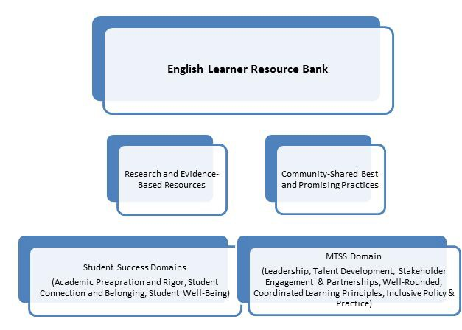
Framework

Slide 19
Next Steps
Develop a list of topics and subtopics for the resource bank
  Created a draft list of topics and subtopics
  Get feedback from the stakeholders about a draft list of topics/subtopics
    Survey will be distributed late November/early December
  Get input from the stakeholders about additional topics/subtopics
    Survey will be distributed late November/early December
  Finalize the list of topics and subtopics
Develop a prototype research-practice brief (template and a sample brief on one topic)
  The brief development is in the process
  Conduct feedback sessions through surveys, individual and/or group meetings, other methods as needed
  Revise the template based on the feedback
  Complete the template and the sample brief
Note: Please look for the email with the survey in the next few weeks.

Slide 20
EL Resource Bank
Thank You!
Mirela Blekic mirela.blekic@state.or.us 503-947-5617

Slide 21

Well-Rounded Access Program (WRAP)
Presenters:
Beth Blumenstein, Senior Strategist for Well-Rounded Learning Caitlin McRae, Well Rounded Courses Grant Research Analyst

Slide 22

Grant Highlights
5 years (1st year planning year)
October 2020 - September 2025
$9.8 million
STEM/STEAM and The Arts
Photo by Allison Shelley/ The Verbatim Agency for EDUimages images.all4ed.org

Slide 23

Well-Rounded Definition
Well-rounded education:
Moves beyond the courses students take
Essential knowledge and skills
Live, learn, work, create, and contribute
Each and every student is known, heard, and supported
Focuses on the whole student
Photo by Allison Shelley/ The Verbatim Agency for EDUimages images.all4ed.org

Slide 24


Courses
1
Course Topics
Arts: Dance, Theater, Media Arts, Music, Visual Arts Arts Integration: Professional Development and Course Development
STEAM/Career Technical Education (CTE):
Computer Science, High School Science (Physics, Chemistry, Biology), Middle School CTE Exploration
Course Content
Curriculum that includes diverse perspectives and examples from historically and currently marginalized groups; Multilingual Content
2
Instructional Practices
Project-Based Learning, Universal Design for Learning, and content-integration (like STEAM practices), Culturally & Linguistically Responsive and Relevant Teaching Practices
3

Slide 25
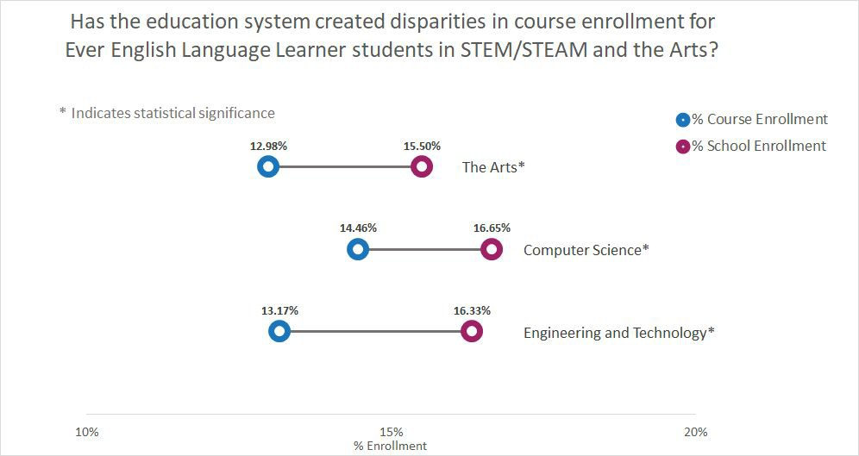
Why are We Doing This?

Slide 26
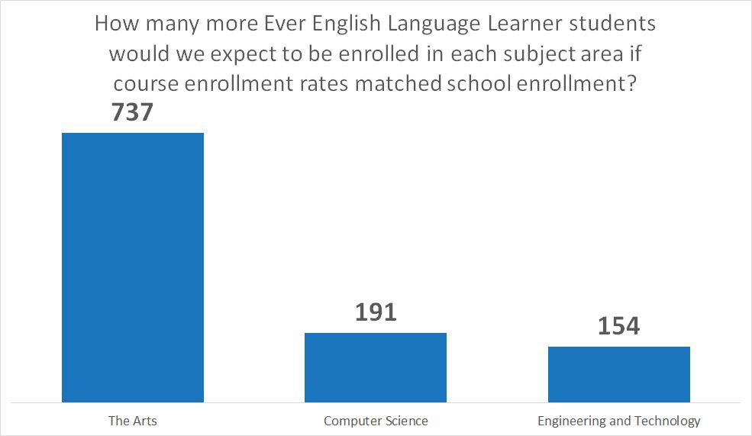
Needs Assessment Disparities

Slide 27

Well-Rounded Access is Equity Focused
Engagement Partners - Who is at the table?
Needs Assessment - Which students do not have access to which courses and why?
Evaluation - Deeper look into why do these students not have access? (Access vs Availability)
Course Development - How does each student see themselves in the content?
Access Structures - Are all students receiving high quality options?
Photo by Allison Shelley/ The Verbatim Agency for EDUimages images.all4ed.org

Slide 28

Needs Assessment Barriers
Sustainable Funding and Availability of Resources
Material Resources
Staff Capacity
Community Resources
Photo by Allison Shelley/ The Verbatim Agency for EDUimages images.all4ed.org
Course Access Barriers for Underserved and Underrepresented Students
Staff Bias and Gatekeeping
Course Scheduling
Cost of Courses
Location and Time
Students Feeling Unsafe or Unwelcome in the Course

Slide 29
Needs Assessment Feedback
Are there additional groups that we should engage with who represent English Learner students and their families, and what other organizations should we connect with that are creating multilingual content?
What additional course content, course topics, and instructional practices would you like to see included with the Well-Rounded Access Program?
What additional barriers/needs exist for English Learner students and their families?
Do you have any other feedback for the Well-Rounded Access Program?
Need more time to reflect on these questions? Email us with comments or to set up an individual meeting: ODE.WRCoursesGrant@ode.state.or.us.

Slide 30
Staying Informed
Join the Well-Rounded Courses Access Listserv Visit our webpage
Email: ODE.WRCoursesGrant@ode.state.or.us Contacts:
Beth Blumenstein beth.blumenstein@state.or.us 503-931-9174
Caitlin McRae caitlin.mcrae@state.or.us 503-934-0831

Slide 31
ELPA 21
Remote identification
Remote ELPA Summative testing
Honoring Student Proficiency on the HS ELPA Summative

Slide 32
Remote identification
Remote Identification was re-implemented for the 2021-22 school year.
For students whose families are declining in-person interactions for health and safety reasons
If student would normally be screened, they are temporarily assumed to have EL status (“presumptive” status)
Status is resolved as soon as possible via screening
For more information: Administering the ELPA Screener and Summative in 2021-22

Slide 33
Remote testing
ODE is pursuing remote testing on the English Language Proficiency Assessment (ELPA) Summative, for those students whose families are declining in-person interactions due to health and safety reasons.
Students will require in-home assistance (from parents, guardians, or other adults)
Guidance, training, and resources forthcoming; will be added to both ODE Assessment pages and to Administering the ELPA Screener and Summative in 2021-22

Slide 34
Honoring HS Proficiency on ELPA Summative
This new policy automatically retains Proficient student performance on individual domains of the Grade 9-12 ELPA Summative.
Student responses are saved and “re-inserted” in future
tests--student no longer sees items from previously Proficient domains
Grade 9-12 students can now demonstrate proficiency all at once, or one domain at a time
Process is automatic; no district responsibilities
For more information: Honoring Student Proficiency on the HS ELPA Summative

Slide 35
Thank You!
Ben Wolcott ELPA Specialist
ben.wolcott@state.or.us 503-947-5835

Slide 36
Language Instruction for ELs and Immigrant Students Title III Update
Requesting Your Voice Input Language Use Survey (LUS):
•We are starting the process to develop
the Oregon LUS
•The Oregon LUS will be developed
with voice and input from our Tribes /
districts / ESDs / parents / community partners
•We welcome your voice and input in this process
The State of Oregon honors the language and culture of its people and respects the over 166 languages in our schools.
The purpose of the Language Use Survey is to help the school determine if the student qualifies for additional Title III supports in language instruction for English learners.

Slide 37
Thank You!
Susy Mekarski Title III Specialist
susan.mekarski@state.or.us
Kim Miller Title III Specialist
kim.a.miller@state.or.us

Slide 38
Wrap-Up
Conference line and/or youtube streaming

Slide 39

Next Meeting December 16, 2021

Slide 40


We’re Here to Help
Please Contact Us!
Ana.Salas@ode.state.or.us
Follow us on Twitter! @ORDeptEd
40

