Slide 1

GRADE 4 LESSON Lewis and Clark: A Native American View

Slide 2

History: What’s Missing?
Notes:
Source: https://pixabay.com/photos/glasses-broken-black-lens-vision-593006/

Slide 3
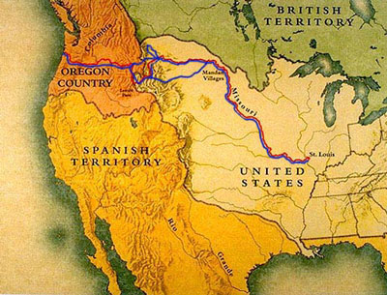
How the U.S. and Europe Saw North America
Notes:
Source: https://upload.wikimedia.org/wikipedia/commons/4/4c/Lewis_and_Clark_Expo_Map.jpg

Slide 4
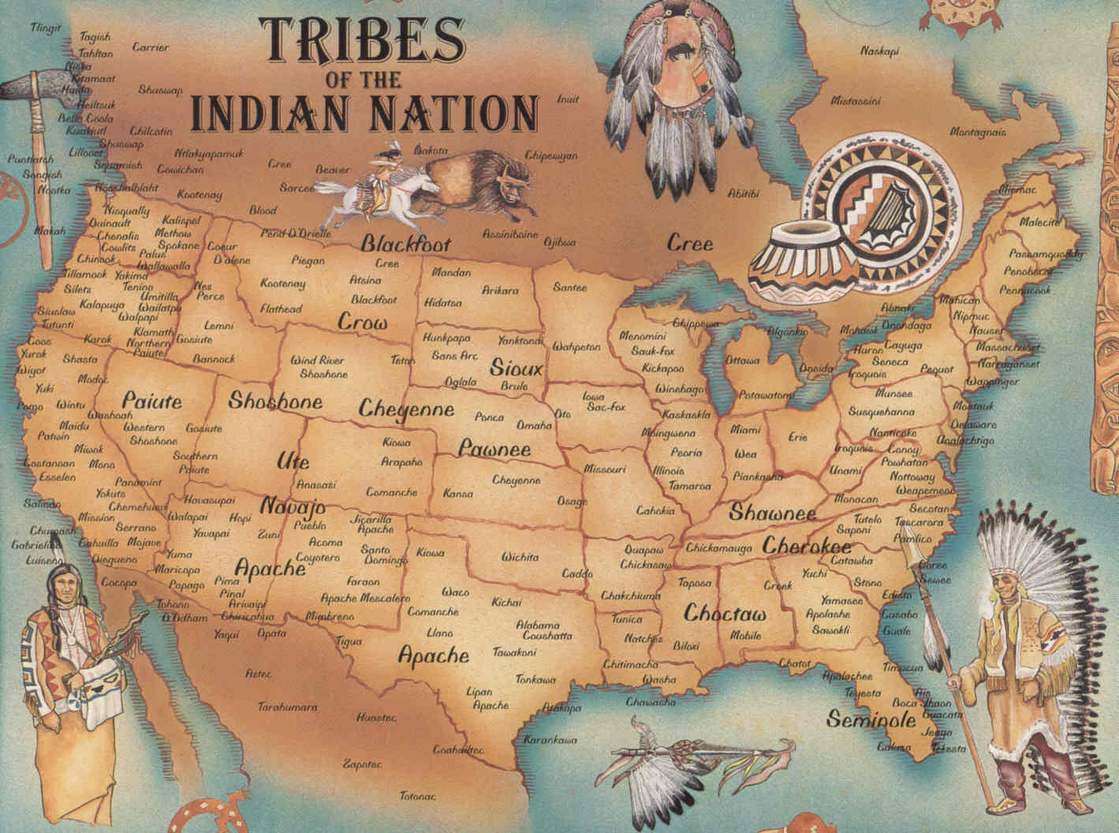
What North America Was Really Like
Notes:
Source: http://www.emersonkent.com/map_archive/native_american_tribes_map.htm

Slide 5
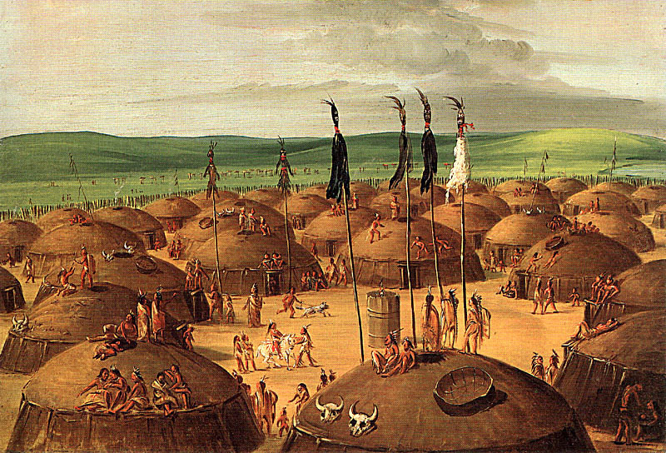
“Wilderness” for Whom?
Notes:
Source: http://academic.emporia.edu/aberjame/student/salley4/index.htm

Slide 6
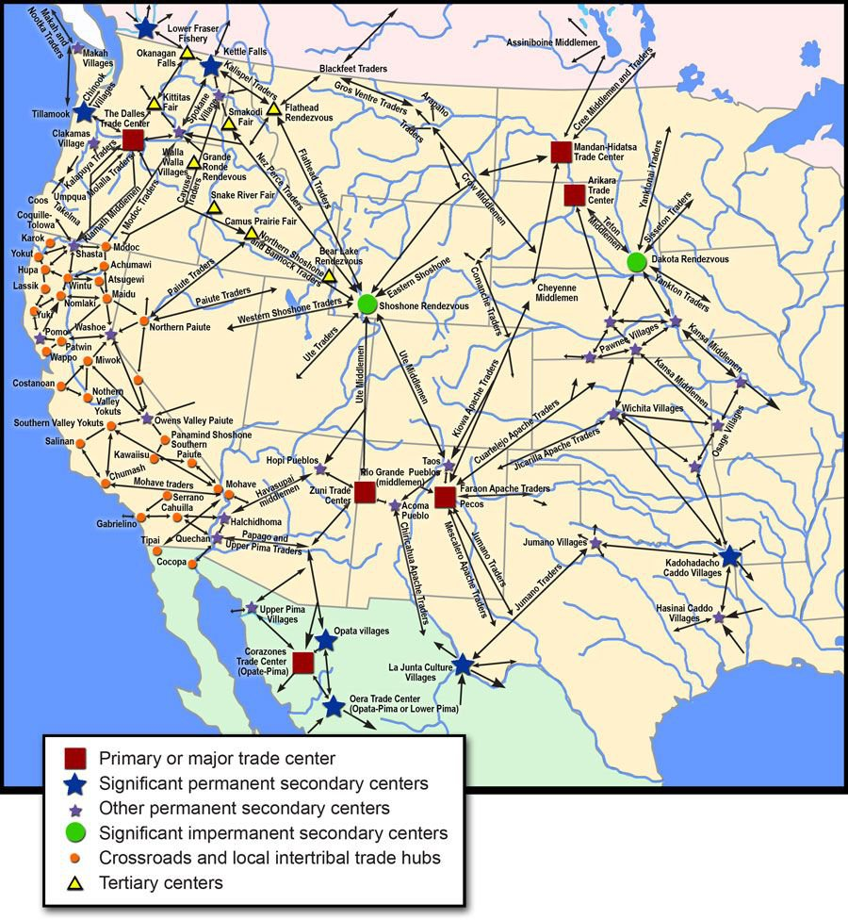
American Entrepreneurs
Notes:
Source: https://i.pinimg.com/originals/70/4d/cc/704dccd8bafae4a4b0fd86aa3d4907b2.jpg

Slide 7
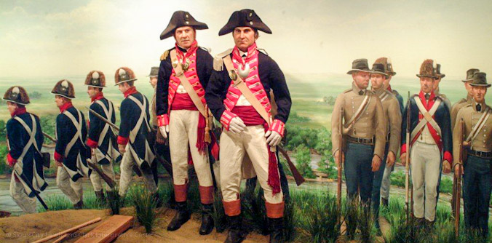
Do You Come in Peace?
Notes:
Source: https://lewisandclark.travel/nomination/sioux-city-lewis-clark-interpretive-center/

Slide 8
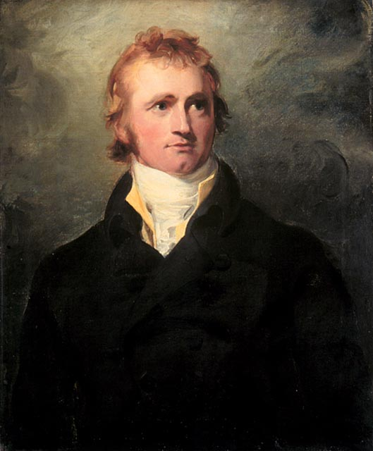
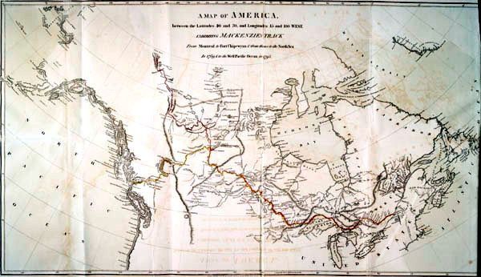
Not the First
Alexander Mackenzie
Notes:
Source: https://lewisandclark.travel/nomination/sioux-city-lewis-clark-interpretive-center/

Slide 9
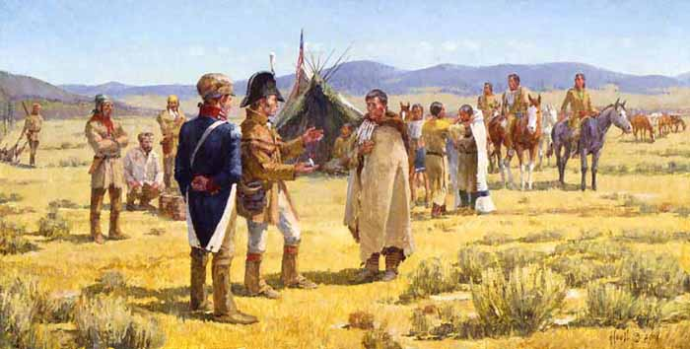
Could We Have Some Horses, Please?
Notes:
Source: https://sites.google.com/a/apps.district196.org/lewis-clark-expedition/meeting-the-shoshone-and-the-continental-divide

Slide 10
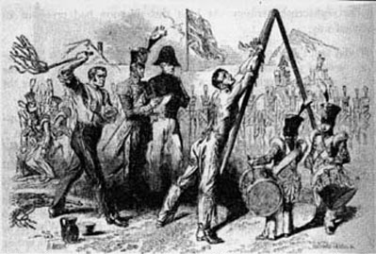
Who’s the “Savage”?
Notes:
Source:http://vfpuk.org/articles/times-of-terror-by-the-cat/

Slide 11
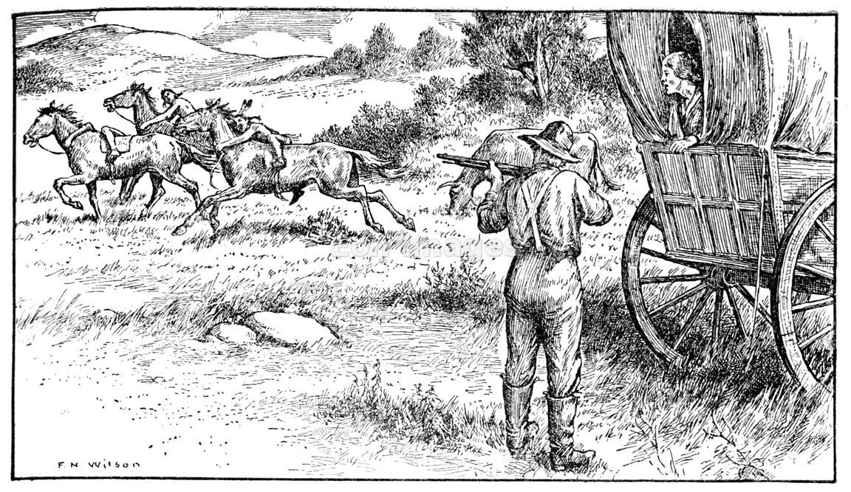
An Unhappy Ending
Notes:
Source: http://www.eonimages.com/media/dc42a262-3b14-11e0-ab2c-29e368a0f27a-oregon-trail-pioneers-encounter-native-americans

