Slide 1

GRADE 10 LESSON
What is sovereignty?

Slide 2
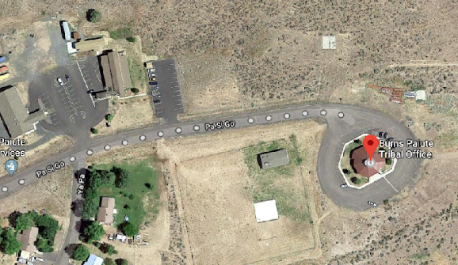

Sovereignty- The inherent authority of a state or group of people to govern itself or another state
Imagery from Google Maps data
This Photo by Unknown Author is licensed under CC BY-NC-ND
Notes:
Say: These pictures help me think of sovereignty. The picture on the left is an overhead view of the Burns Paiute Tribal Government offices and the Health Services center. It’s not a city, county, state or federal government, it is in fact their own location for tribal decision making. The picture on the right are a bunch of tribal flags, which reminds me that flags are a symbol of identity for a group of people with their own laws and ways of being. These tribal flags remind me that there are many tribal governments because each tribe is different and has their own authority to govern their people.

Slide 3
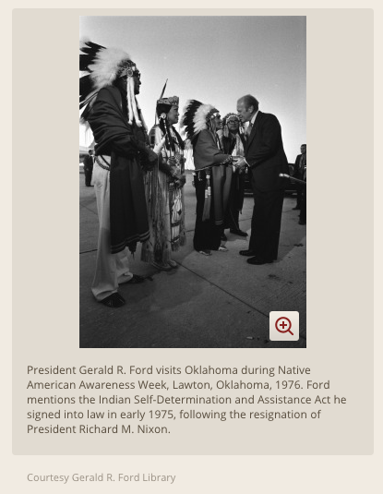
What is self-determination
The Self-determination and Education Act of 1975 (PL-93-638) allowed tribal governments to contract for programs such as police, maintenance, education, social services, timber management, and health clinics.
Native American self-determination refers to the social movements, legislation, and beliefs by which the Native American tribes in the United States exercise self-governance and decision making on issues that affect their own people.
Notes:
The period after the late 1960s came to be known as the "Self-determination Era," where U.S. policy toward American Indian tribes provided greater opportunities for Indian people to manage local government and local issues.

Slide 4
Example of an Act that supports self-determination
Johnson-O’Malley Act of 1934
The Johnson-O’Malley act of 1934 was passed on April 16, 1934, to subsidize education, medical attention, and other services provided by States or Territories to Indians living within their borders.
What is the Johnson-O’Malley Act? Years ago, JOM was funded to provide operational support in which schools used funds to buy busses, school equipment, and more. The JOM program was redesigned to be a supplementary program instead of a basic support program to provide special services to meet the unique specialized needs of Indian children attending public schools.
What is the Purpose of the Johnson-O’Malley? Its basic purpose has also remained the same: To provide supplementary financial assistance to meet the unique and specialized education needs of Indian children. Johnson-O’Malley funds are supplementary funds and are not to take the place of federal, state or local funds.
How does the Program work? To receive contract for funds, a state, a school district, an Indian tribe, or an Indian corporation may contract with the Bureau of Indian Affairs. Broad general regulations outline the requirements for the contract, allowing the programs to be developed to meet local needs and differences.

Slide 5
What is self-determination
EXAMPLES:
Self-determination contains an element of support for human rights and decolonization for Indigenous people.
Self-determination is manifested in self-sufficiency, reduced dependency on the U.S. government, and devolution
of formerly federal authorities to local governmental units.
Language revitalization
Curriculum in schools by Native Americans about Native Americans
Men not cutting their hair for jobs
Wearing culturally appropriate
attire (e.g., eagle feathers,
ribbon dresses) during
graduation ceremonies

Slide 6
What is Tribal Sovereignty?
[AUDIO FILE]
Notes:
Say: You will hear Harlan McKosato (Sac and Fox), former host of Native American Calling, a radio call in show, and others talk about Tribal Sovereignty and the Right to Self-Rule. As you watch, I want you to think about how you would define sovereignty, some examples and some images you think of.

Slide 7
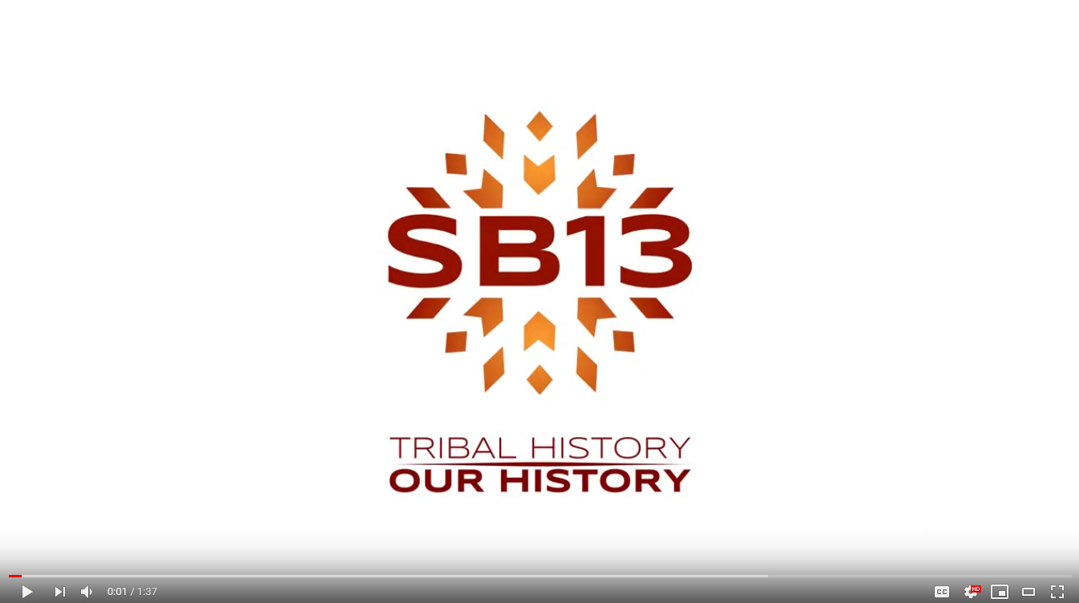
What is tribal self-determination?

Slide 8
Sovereignty Worksheet
SOVEREIGNTY-(NOUN)
Example or synonyms | Picture
Sentence
Notes:
Say: Please define, give examples or synonyms, provide a sketch or symbol related to the term. Compose a meaningful sentence using the term in context.

