Slide 1

GRADE 10 LESSON
Food Sovereignty and Environmental Sustainability

Slide 2
How do humans get food?
Hunting and Gathering | Agriculture
Pros Diverse, nutritious sources of food Less impact on the land More egalitarian; everyone contributes Requires physical activity that contributes to health | Pros More predictable supply of food Supports larger groups of people Allows for specialization (some people farm, others do different jobs)
Cons Lots of hard, sometimes risky work Can only support families or small bands of people Unpredictability of food supplies | Cons Risk of crop failures Inequality Can use a lot of resources (land, fuel, etc.)

Slide 3
What are first foods?
Foods eaten by Indigenous people prior to contact with or colonization by non-Indigenous people.

Slide 4
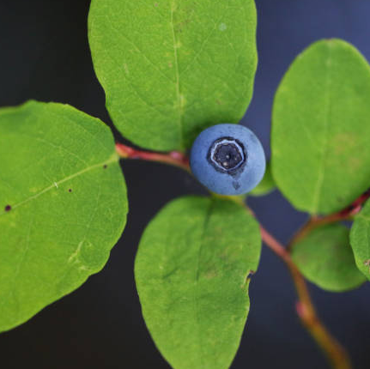
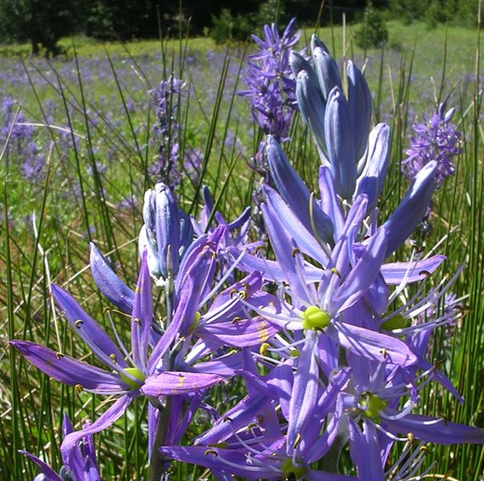
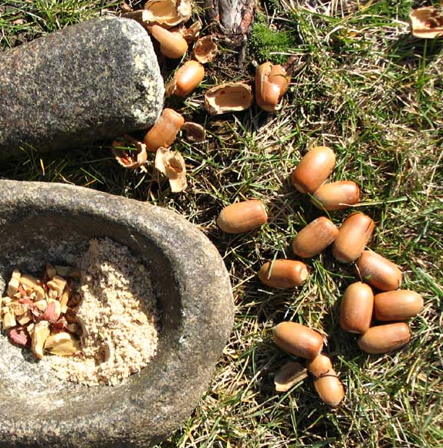
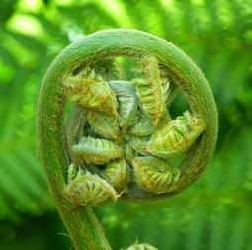
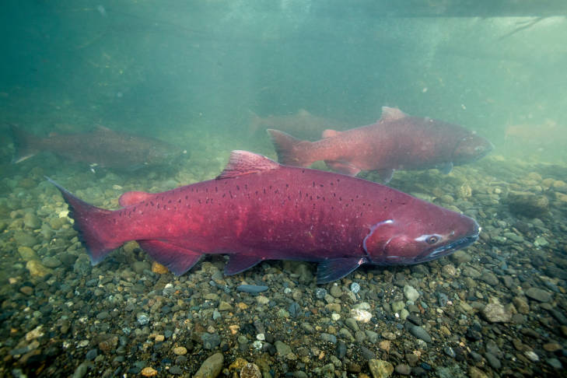
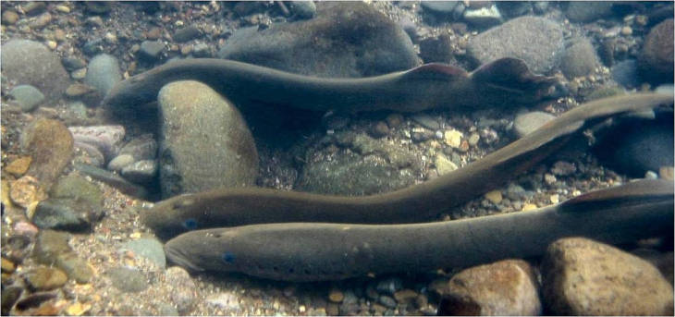
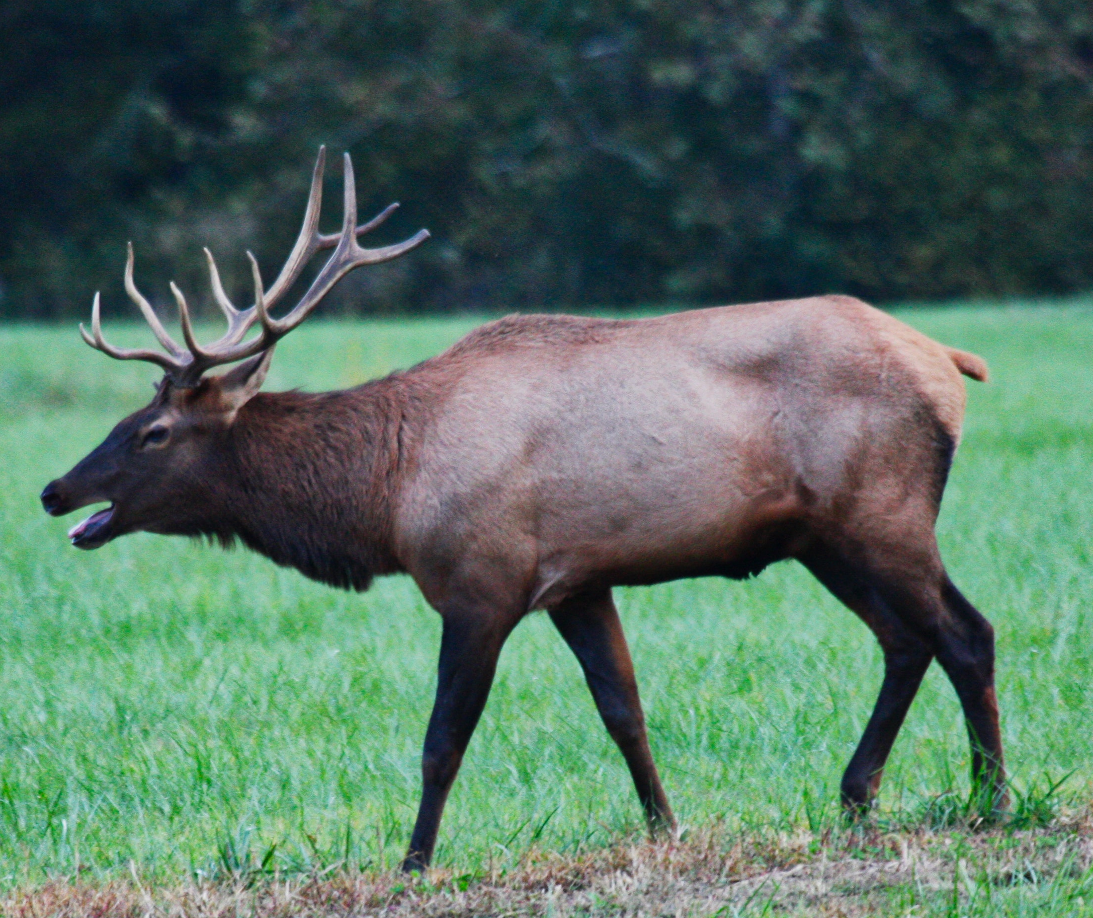
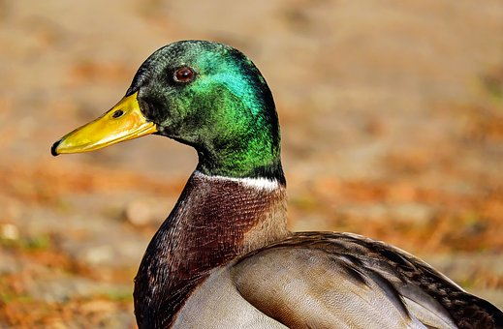
Oregon First Foods (A Sampling)
Huckleberries
Camas bulbs
Acorns
Fiddleheads (ferns)
Salmon
Lamprey
Elk
Duck

Slide 5
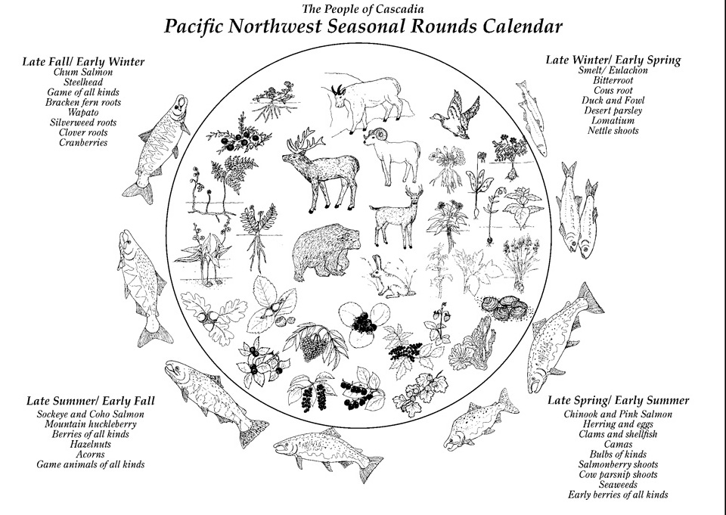
The Oregon Native Plate
The Oregon Native Plate
Source: The People of Cascadia, http://peopleofcascadia.com

Slide 6
Valerie Segrest quote
The land is our identity and holds for us all the answers we need to be a healthy, vibrant, and thriving community. In our oral traditions, our creation story, we are taught that the land that provides the foods and medicines we need are a part of who we are. Without the elk, salmon, huckleberries, shellfish and cedar trees we are nobody. … This is our medicine; remembering who we are and the lands that we come from.”
- Valerie Segrest (Muckleshoot)

Slide 7
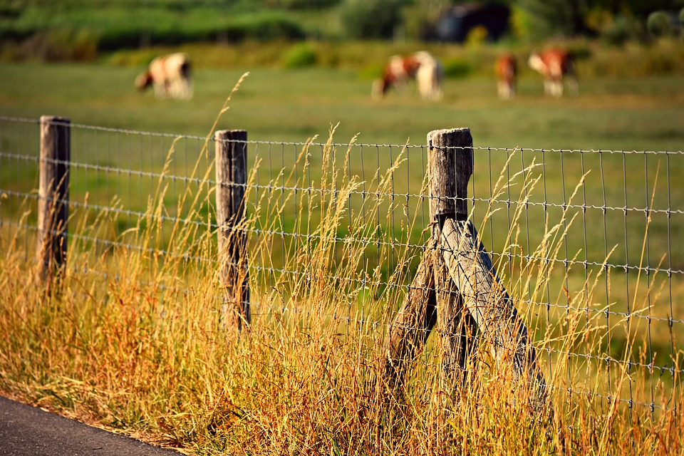
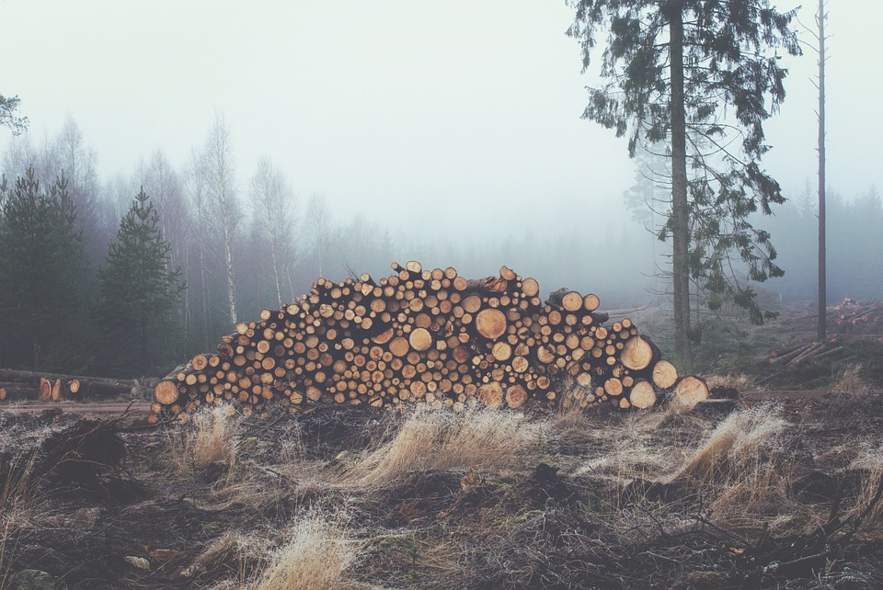
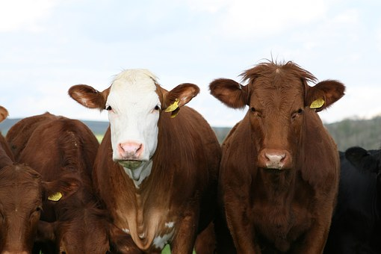
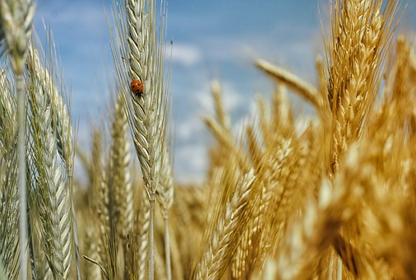
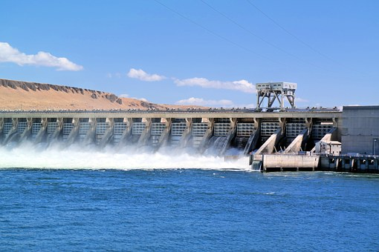
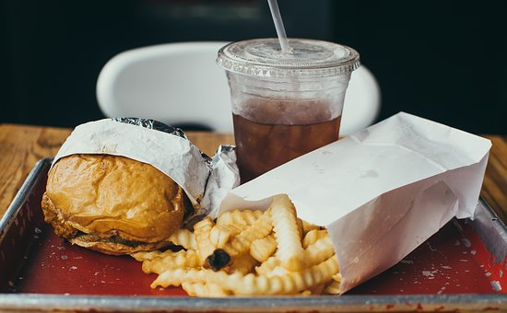
Effects of Colonization on First Foods

Slide 8
Definitions
Sovereignty
The power of a people or community to make decisions for itself without interference from others. Tribal sovereignty in the United States refers to the inherent rights of indigenous tribes to govern themselves within the borders of the United States.
Food sovereignty
The right of peoples to healthy and culturally appropriate food produced through ecologically sound and sustainable methods, and their right to define their own food and agriculture systems.¹
¹U.S. Food Sovereignty Alliance

Slide 9
Oregon Indigenous Food
Sovereignty Projects
First Foods Policy Program
Confederated Tribes of the Umatilla Indian Reservation
Columbia River Inter-Tribal Fish Commission
Nez Perce Tribe (Idaho)
Confederated Tribes of the Umatilla Indian Reservation
Confederated Tribes of the Warm Springs Reservation of Oregon
Confederated Tribes and Bands of the Yakama Nation (Washington)
Healthy Traditions
Confederated Tribes of Siletz Indians

Slide 10
Image Citations
Oregon First Foods (a sampling)
Huckleberries: https://digitalmedia.fws.gov/digital/api/singleitem/image/natdiglib/30223/default.jpg?highlightTerms=huckleberry
Camas bulbs: https://www.nps.gov/articles/camas.htm
Acorns: https://www.blm.gov/programs/recreation/recreation-activities/oregon-washington/tablerocks/cultural-history/seasonal-rounds
Fiddleheads (ferns): Image #123533 by LoggaWiggler (Pixabay License)
Salmon: https://digitalmedia.fws.gov/digital/collection/natdiglib/id/26887/rec/8
Lamprey: https://digitalmedia.fws.gov/digital/collection/natdiglib/id/12687/rec/23
Elk: Image #436035 by werner22Brigitte (Pixabay License)
Duck: Image #1893080 by Couleur (Pixabay License)
Effects of Colonization on First Foods
Barbed wire: Image #3556022 by MabelAmber (Pixabay License)
Logs: Image #336547 by Free-Photos (Pixabay License)
Cattle: Image #1238273 by Robert-Owen-Wahl (Pixabay License)
Wheat: Image #195642 by realworkhard (Pixabay License)
Dam: Image #929406 by russmac (Pixabay License)
Fast food: Image #2564658 by StockSnap (Pixabay License)

