Slide 1
ODEG10 SCIENCE LESSON 3 Land Management and Tribal Partnerships

Slide 2
Manifest Destiny, Resource Extraction, and Treaty Rights
Notes:
Video may be found at: https://www.youtube.com/watch?v=pJxrTzfG2bo

Slide 3
Manifest Destiny, Resource Extraction, and Treaty Rights, continued
Notes:
Video may be found at: http://lc-triballegacy.org/video.php?vid=756&query=resource%20management Adobe Flash must be enabled

Slide 4
Treaty of 1855-Land Restoration and Ecosystem Restoration: Confederated Tribes of Umatilla
Notes:
Video may be found at: http://lc-triballegacy.org/video.php?vid=760&era=5&subcat=5B Adobe Flash must be enabled

Slide 5
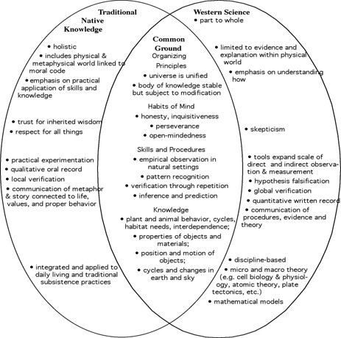
Principles of Indigenous Knowledge or Traditional Ecological Knowledge (TEK) Example
Notes:
From: https://i2.wp.com/schoolingtheworld.org/wp-content/uploads/2013/01/CommonGroundCircles.jpg

Slide 6
Sandy River Restoration
Notes:
Video available at http://lc-triballegacy.org/video.php?vid=808&era=6&subcat=6D Adobe Flash must be enabled

Slide 7
Case Study Activity
Questions
What Oregon tribes are involved in the project?
What is the project?
What kind of ecosystem is the project working to restore?
What are the impacts on the tribe?
What are the outside partners helping with the project?
Look at the traditional ecological knowledge diagram and describe how the project you read about reflects these principles.

Slide 8
Group Share Out
Burns Paiute Tribe
Columbia River Inter-Tribal Fish Commission
Confederated Tribes of Grand Ronde
Confederated Tribes of Siletz Indians
Coquille Indian Tribe

Slide 9
Coquille Partnerships
Ecotrust Forest Management website

