Slide 1
GRADE 4 LESSON Language Revitalization

Slide 2
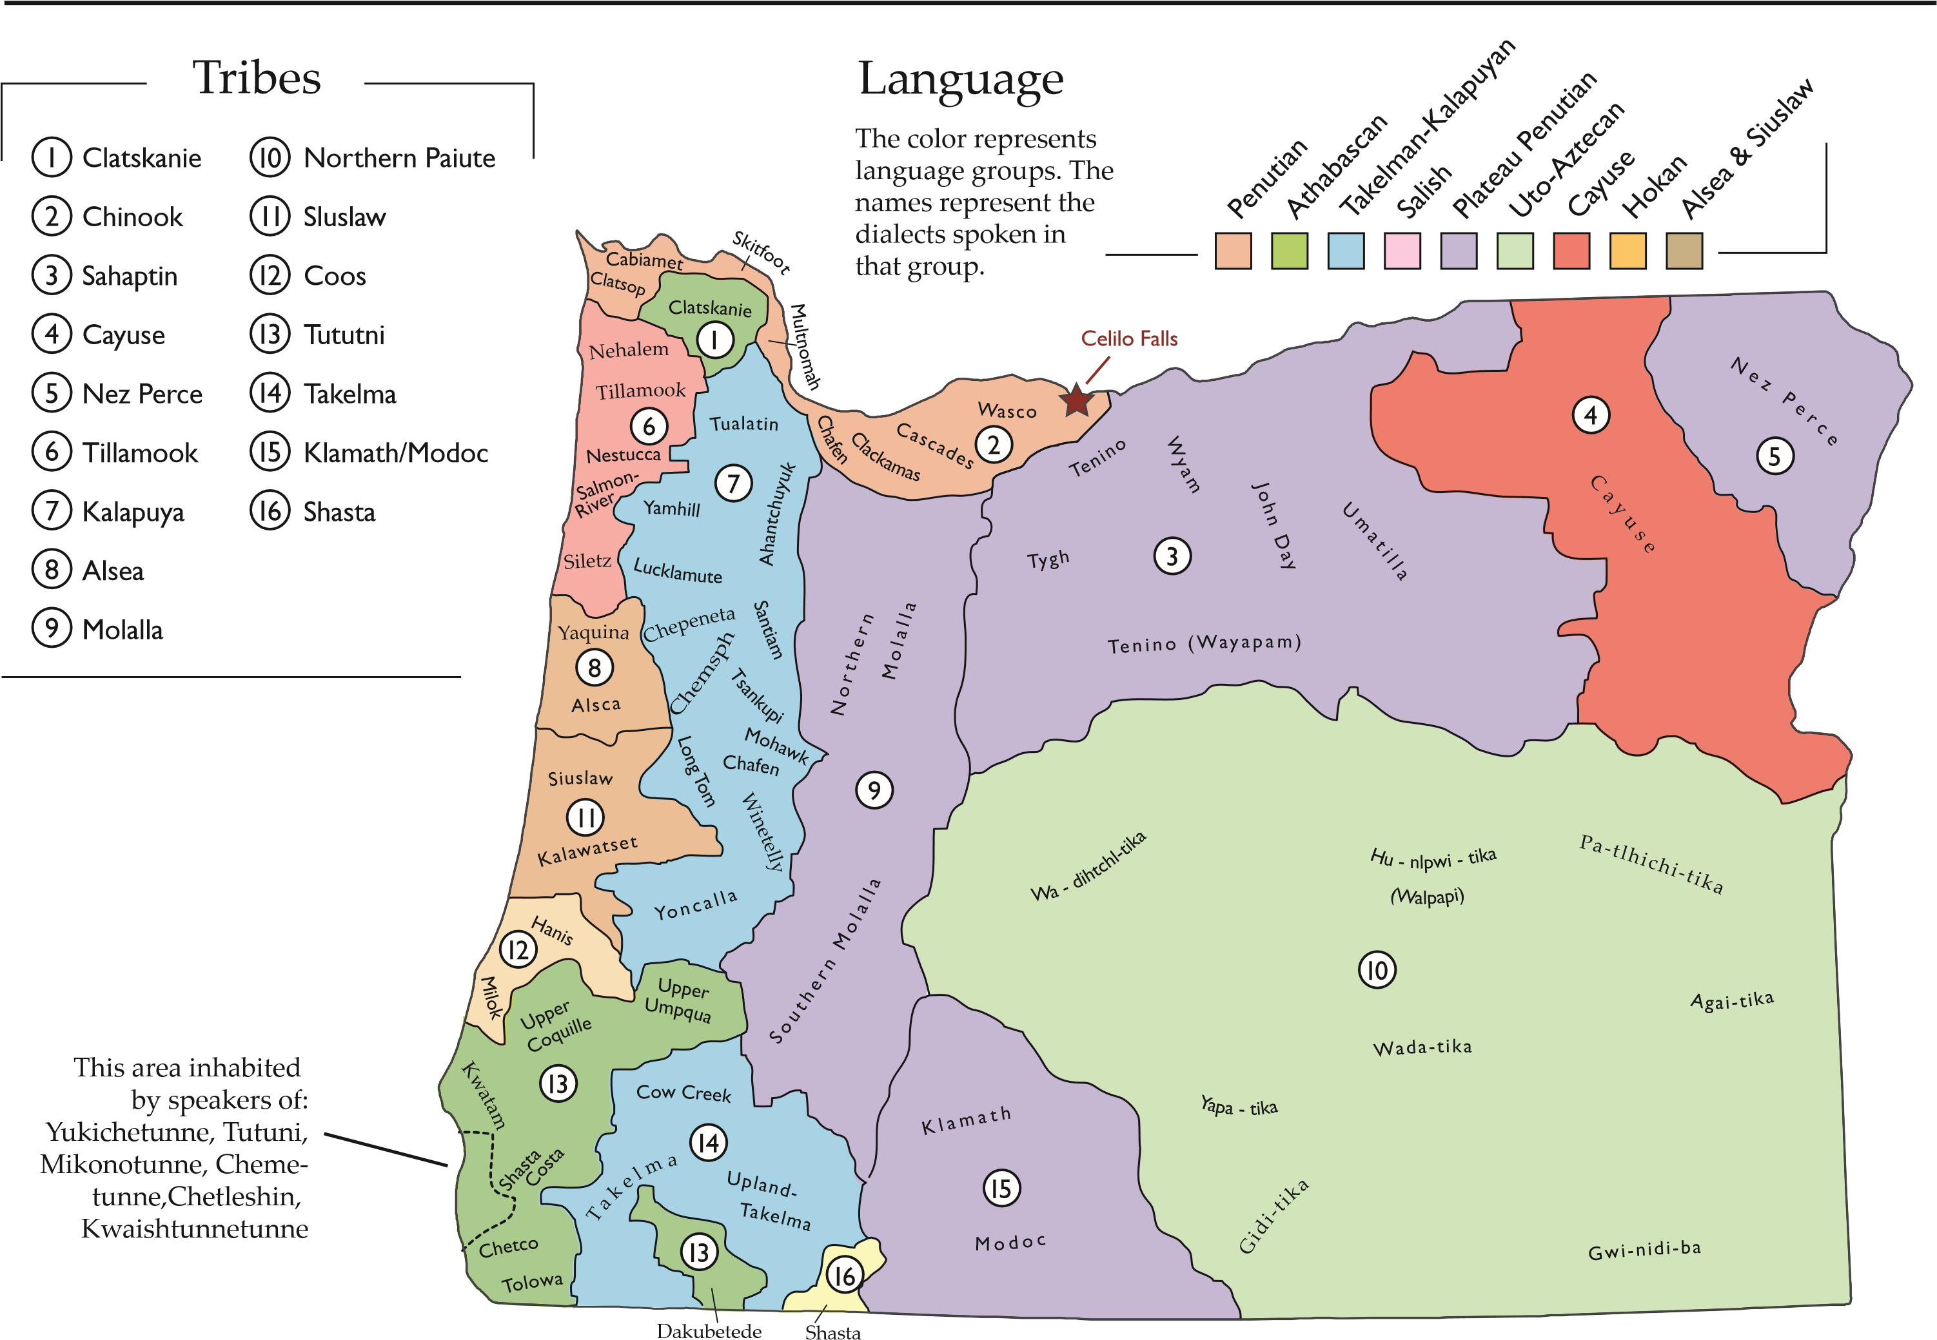
Native American Tribes in Oregon and Language Groups
Notes:
Source: Center for Geography Education in Oregon, Portland State University. The Student Atlas of Oregon. Used with permission.

Slide 3
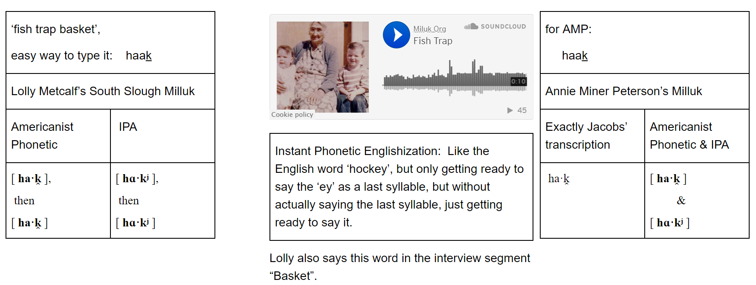
Documenting
Notes:
Source: http://www.miluk.org/index/lolly/fish-trap

Slide 4
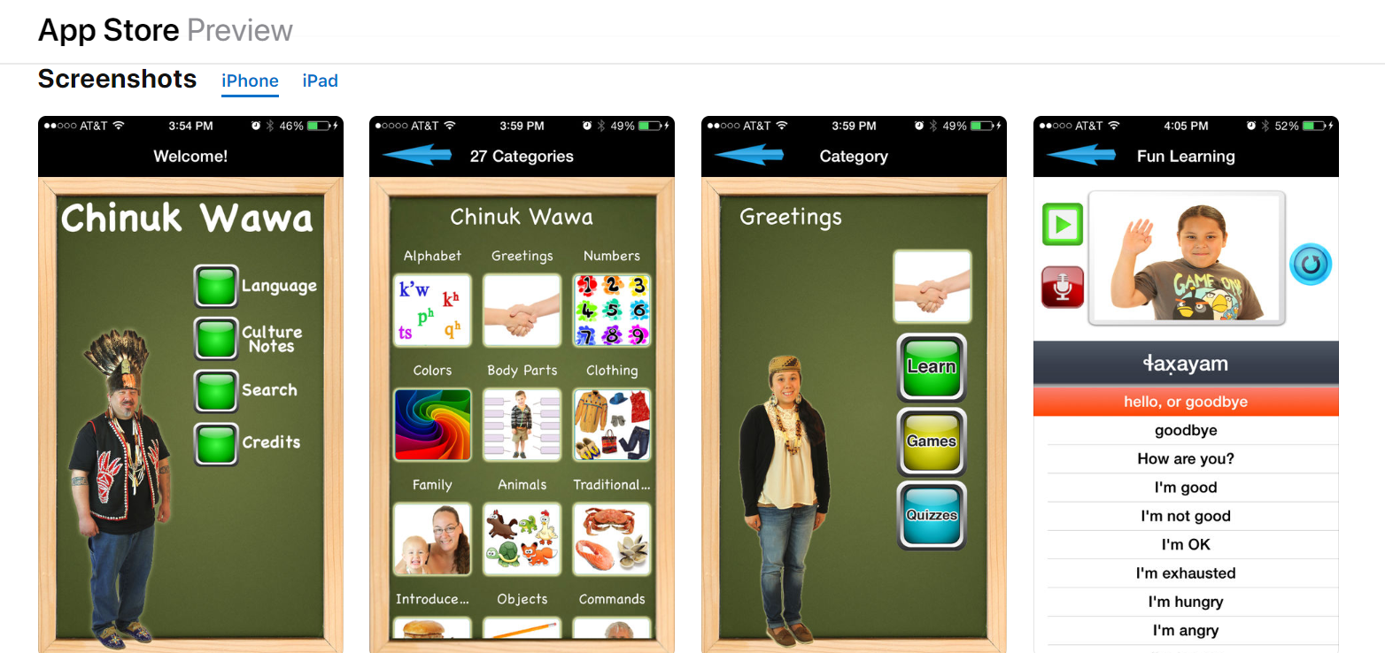
Creating Language Tools
Notes:
Source: https://apps.apple.com/us/app/chinuk-wawa/id908108231

Slide 5
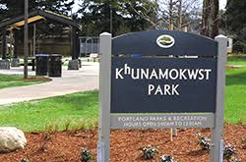
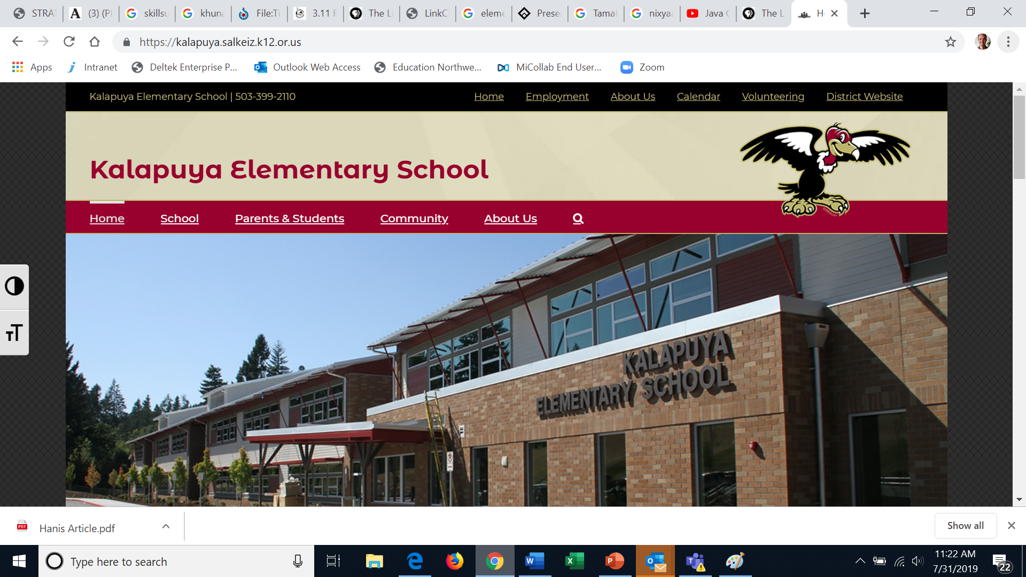
Naming (or Renaming) Places
Notes:
Sources: https://www.portlandoregon.gov/parks/finder/index.cfm?action=ViewPark&PropertyID=1456
https://kalapuya.salkeiz.k12.or.us/
http://www.mahlum.com/projects/tap%CA%B0oyt%CA%B0a%CA%BC-hall/

Slide 6
Using Laws to Protect Languages
2017 ORS 342.144
American Indian languages teaching license
(1) As used in this section, “American Indian tribe” means an Indian tribe as that term is defined in ORS 97.740 (Definitions for ORS 97.740 to 97.760).
(2) The Legislative Assembly declares that teaching American Indian languages is essential to the proper education of American Indian children.
(3) The Teacher Standards and Practices Commission shall establish an American Indian languages teaching license.
Notes:
Source: https://www.oregonlegislature.gov/bills_laws/ors/ors342.html; emphasis added.

Slide 7
Using Laws to Protect Languages (cont.)
2017 ORS 342.144
American Indian languages teaching license
(4) Each American Indian tribe may develop a written and oral test that must be successfully completed by an applicant for an American Indian languages teaching license in order to determine whether the applicant is qualified to teach the tribe’s native language. When developing the test, the tribe shall determine:
(a) Which dialects will be used on the test;
(b) Whether the tribe will standardize the tribe’s writing system; and
(c) How the teaching methods will be evaluated in the classroom.
… (continued)
Notes:
Source: https://www.oregonlegislature.gov/bills_laws/ors/ors342.html; emphasis added.

Slide 8
Language Classes and Events
Notes:
Source: https://www.facebook.com/events/burns-paiute-tribe-gathering-center/wadatika-yaduan-tribal-community-language-night/115705469104828/

Slide 9
Language Immersion for Children
Notes:
Link to video: https://youtu.be/NSsKLFo2B10

