Slide 1

Oregon’s First Geologists

Slide 2
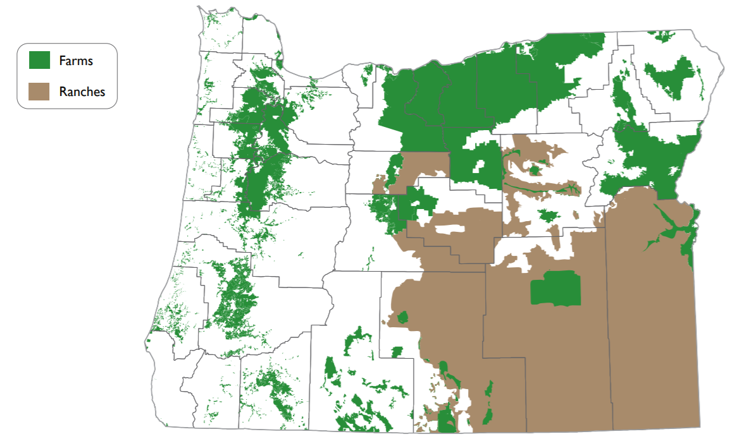
Farm and Ranch Land
Source: Center for Geography Education in Oregon, Portland State University. The Student Atlas of Oregon. Used with permission.

Slide 3
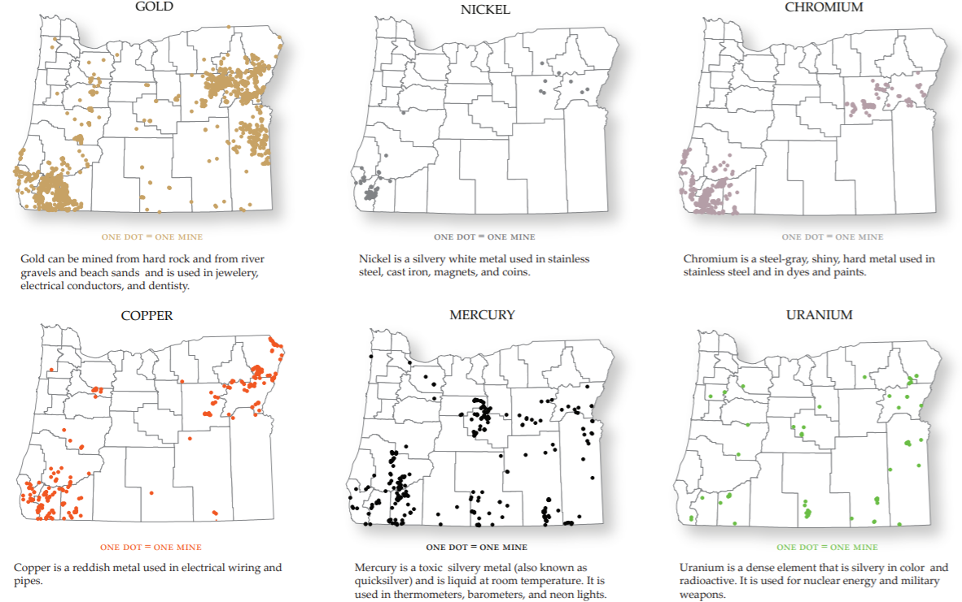
Mineral Deposits (not actively mined)
Source: Center for Geography Education in Oregon, Portland State University. The Student Atlas of Oregon. Used with permission.

Slide 4
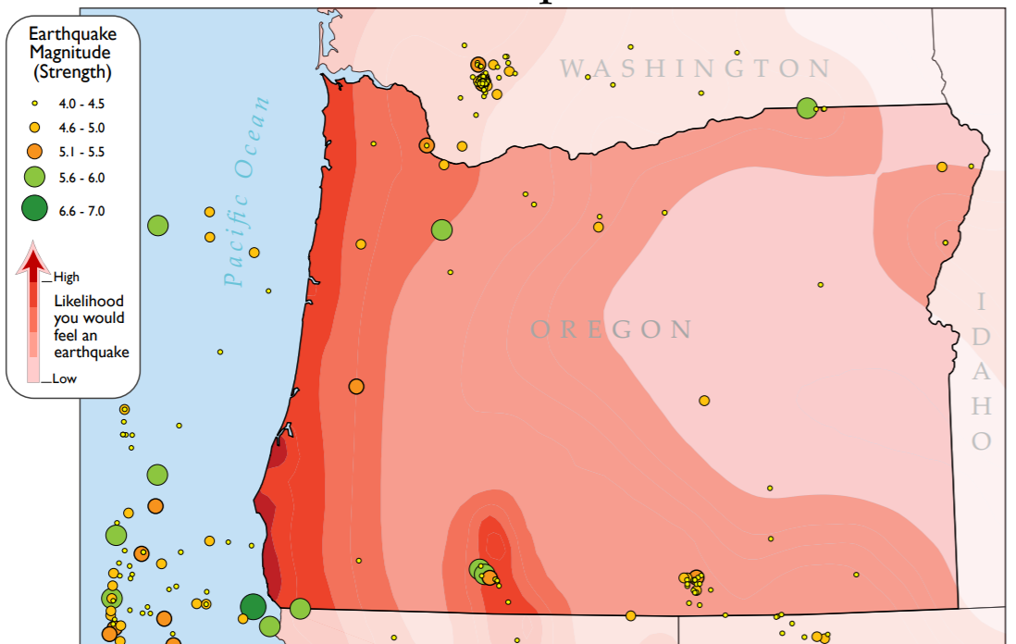
Natural Hazards: Earthquakes
Source: Center for Geography Education in Oregon, Portland State University. The Student Atlas of Oregon. Used with permission.

Slide 5
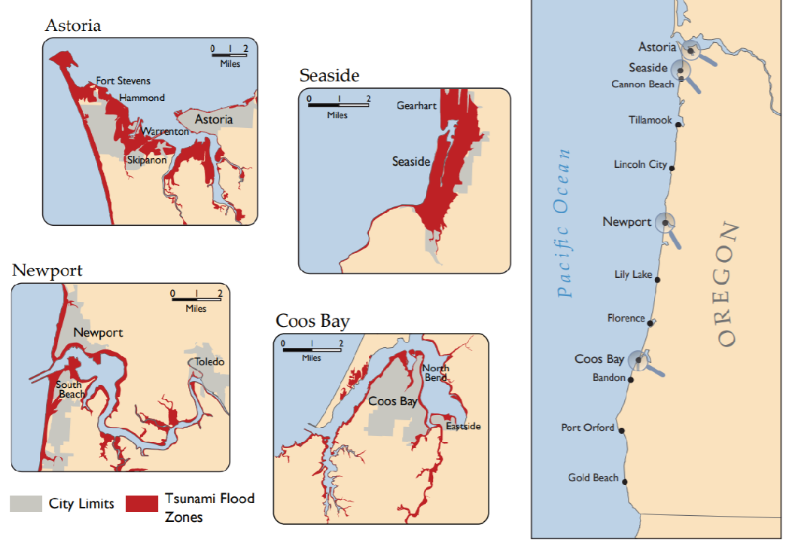
Natural Hazards: Tsunamis
Source: Center for Geography Education in Oregon, Portland State University. The Student Atlas of Oregon. Used with permission.

Slide 6

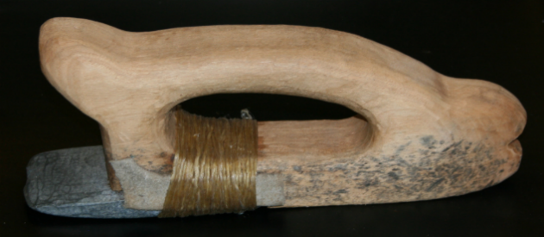
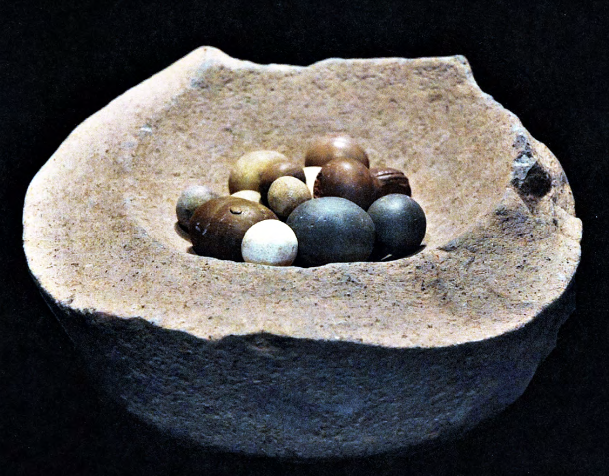
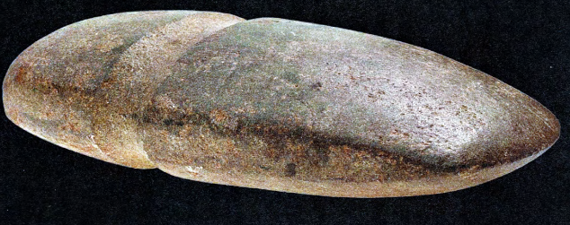
Tools
Projectile points (arrowheads)
Chisel
Gaming stones
Axe head
Sources: Projectile points: ProjectilePoints.net http://www.projectilepoints.net/Search/Oregon_Notched.html Used with permission.
Chisel: Coquille Indian Tribe. | Axe head: Ivy, J., & Norris, N. (2011). Tah’s Tools. North Bend, OR: Coquille Indian Tribe.
Gaming stones: Ivy, J., & Norris, N. (2011). Tah’s Tools. North Bend, OR: Coquille Indian Tribe.

Slide 7
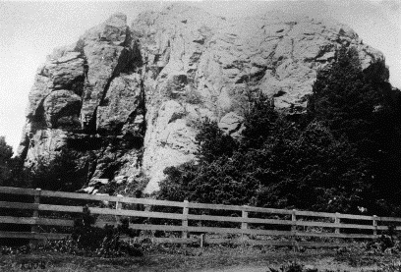
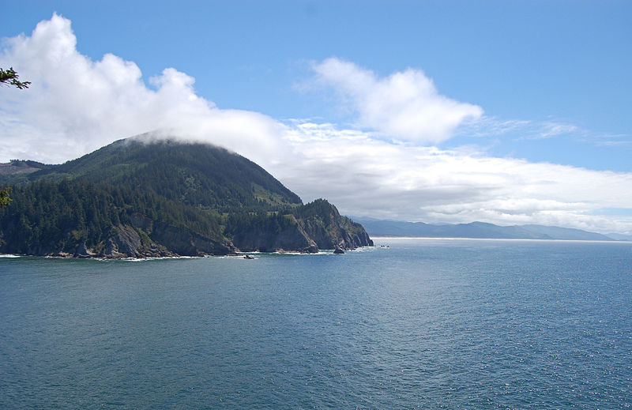
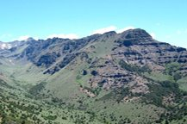
Special Places
Grandmother Rock
Near present-day Bandon
Neahkahnie Mountain
(“Place of the Creator”)
Tillamook County
Steens Mountain
Harney County
Sources: Grandmother Rock: Coquille Indian Tribe | Neahkahnie Mountain: Eric Baetscher (via Wikimedia Commons: https://commons.wikimedia.org/wiki/File:Neahkahnie_Mountain_North.JPG) | Steens Mountain: Wildhorse Gorge, Steens Mountain (prog_rec_orwa_steens_hero_wildhorse.jpg), by the Bureau of Land Management (public domain)

Slide 8
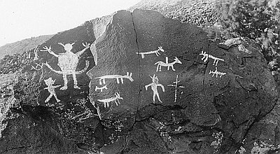
Art
Petroglyphs (Rock Carvings)
Picture Rock Pass (Lake County)
Source: Oregon Historical Society (Catalog Number 94226), https://oregonhistoryproject.org/articles/historical-records/indian-rock-art-picture-rocks-pass/#.XjDNQGhKjcs Used with permission.

Slide 9
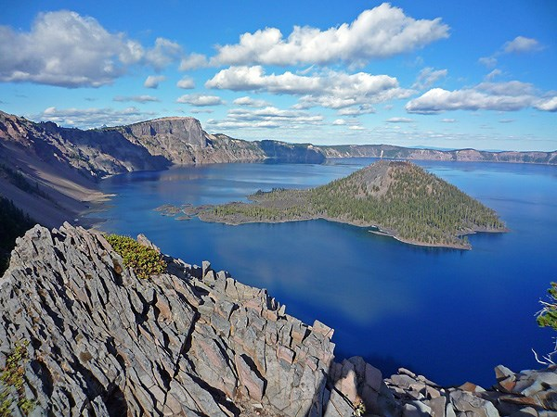
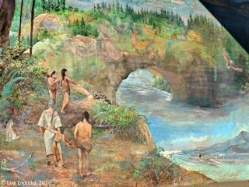
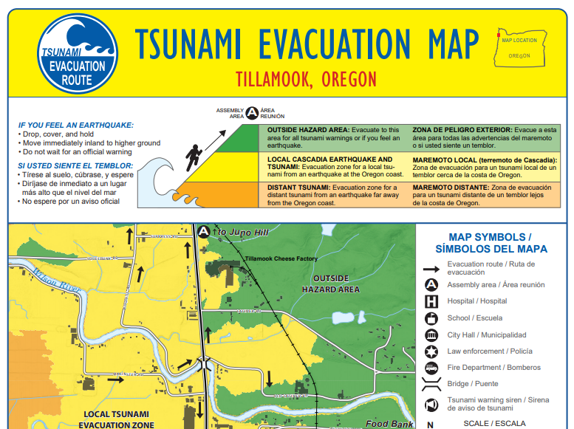
Geologic Events
Mt. Mazama (Crater Lake)
Bridge of the Gods
Earthquakes and Tsunamis
Sources: Crater Lake: National Park Service (https://www.nps.gov/crla/planyourvisit/index.htm) | Bridge of the Gods: Lyn Topinka. (2010). ColumbiaRiverImages.com. Used with permission. (Source: http://columbiariverimages.com/Images10/bridge_of_the_gods_mural_legend_10-18-10.jpg | Earthquakes and Tsunamis: State of Oregon Department of Geology and Mineral Industries, Tillamook, Oregon, Tsunami Evacuation Map 02/22/2012 revision, https://www.oregongeology.org/pubs/tsubrochures/TillamookEvac_onscreen.pdf

