Slide 1

Grade 8 Lesson
Games of Mental Skill and Endurance

Slide 2
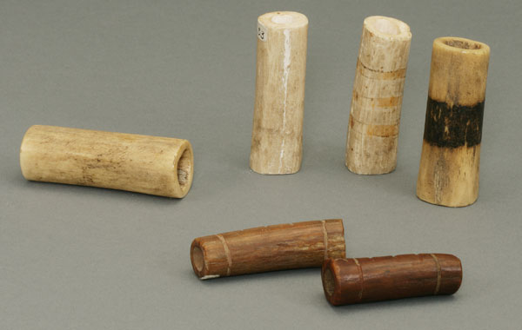
Stick Game Pieces
Bones
From: National Park Service- Nez Perce National Historic Park
https://www.nps.gov/museum/exhibits/nepe/exb/dailylife/GenderRoles/NEPE81_82_83_84_2156A_21568.html

Slide 3
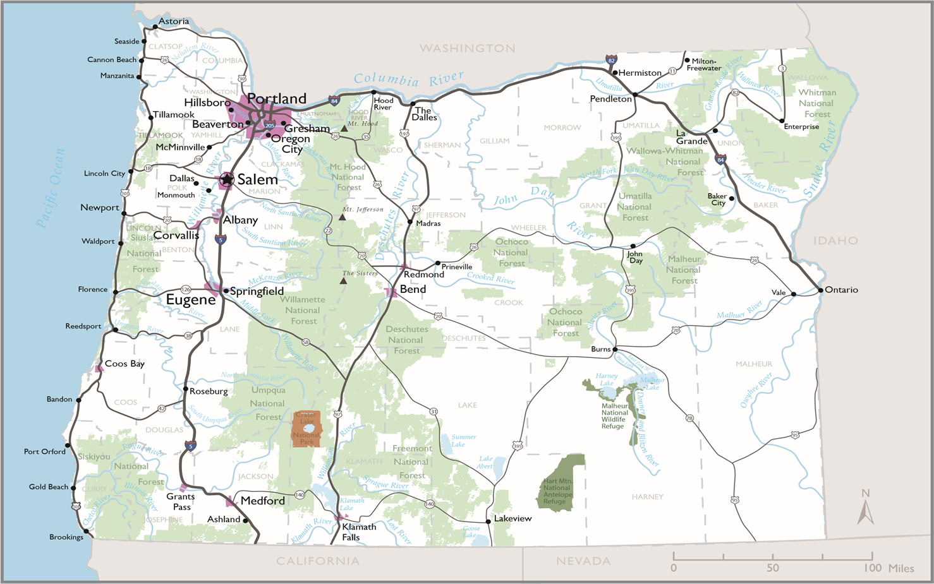
Map of Oregon
Source: Center for Geography Education in Oregon, Portland State University. The Student Atlas of Oregon. Used with permission.

Slide 4
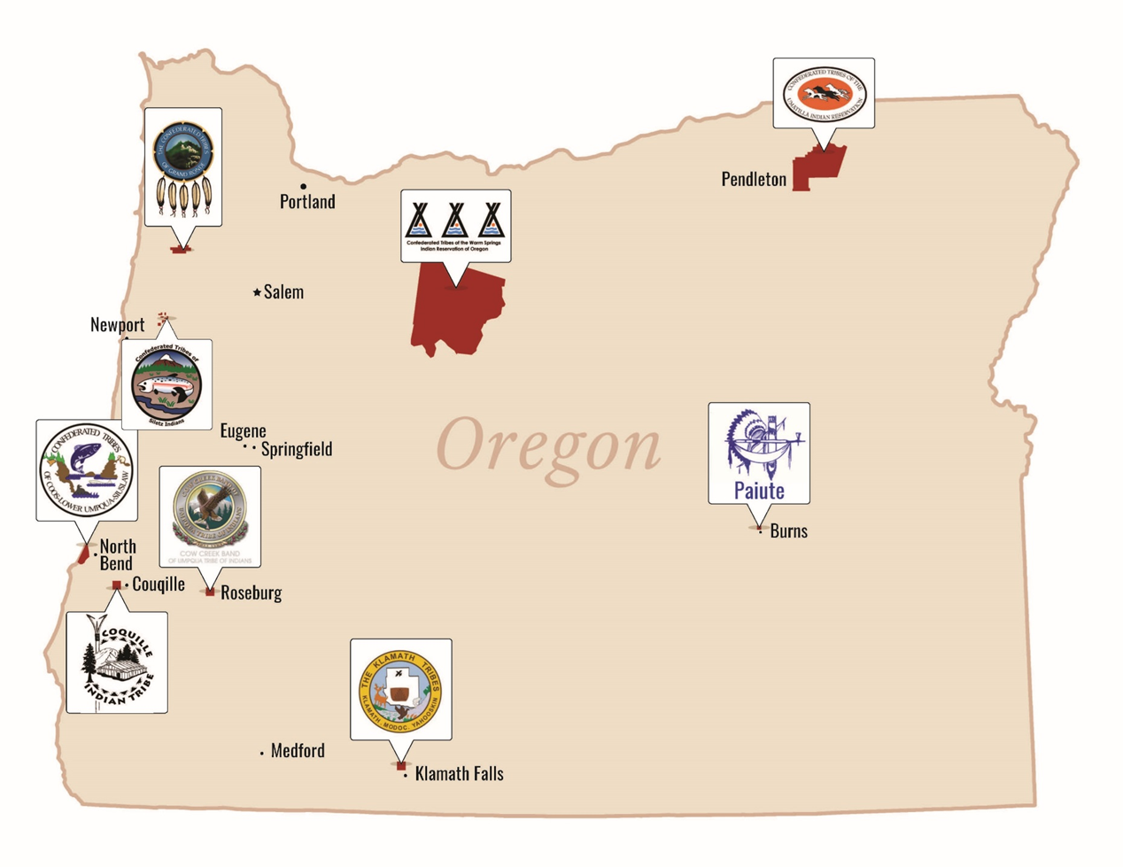
Reference Map of Tribal
Nation Locations

Slide 5
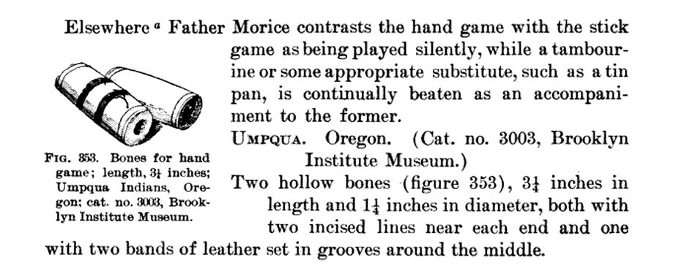
Examples from Umpqua Indians
Images from: Games of the North American Indians. p.260

Slide 6
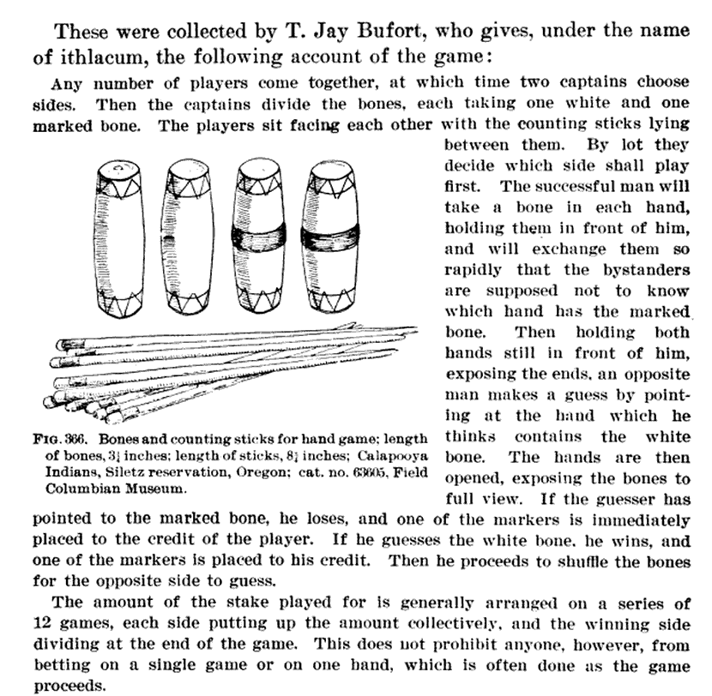
Examples from Umpqua Indians
Images from: Games of the North American Indians. p.270

Slide 7
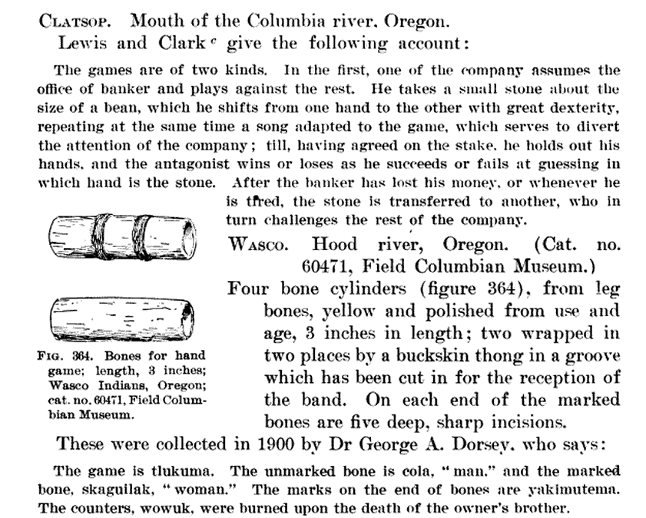
Examples from Umpqua Indians
Images from: Games of the North American Indians. p.268

Slide 8
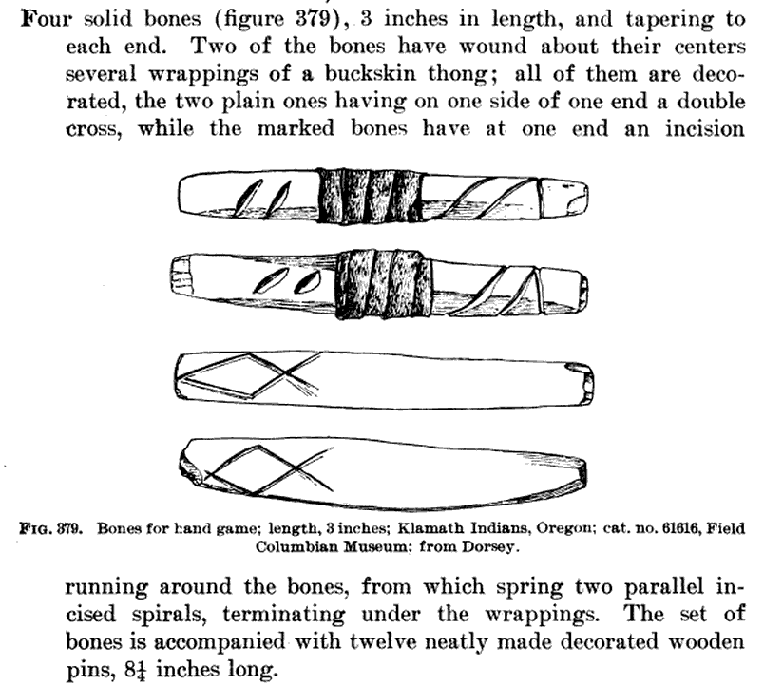
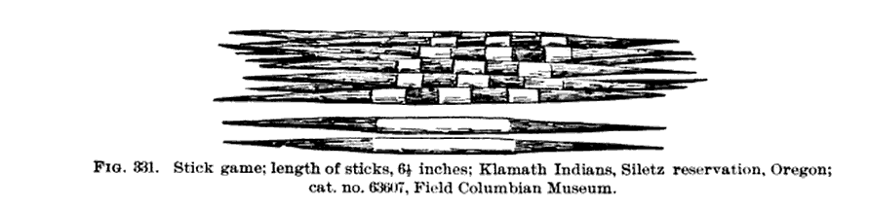
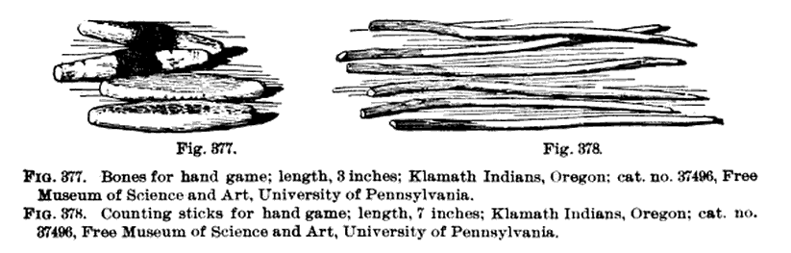
Examples from Klamath Tribe
Images from: Games of the North American Indians. Top right: p 232, bottom right and left, p.278

Slide 9
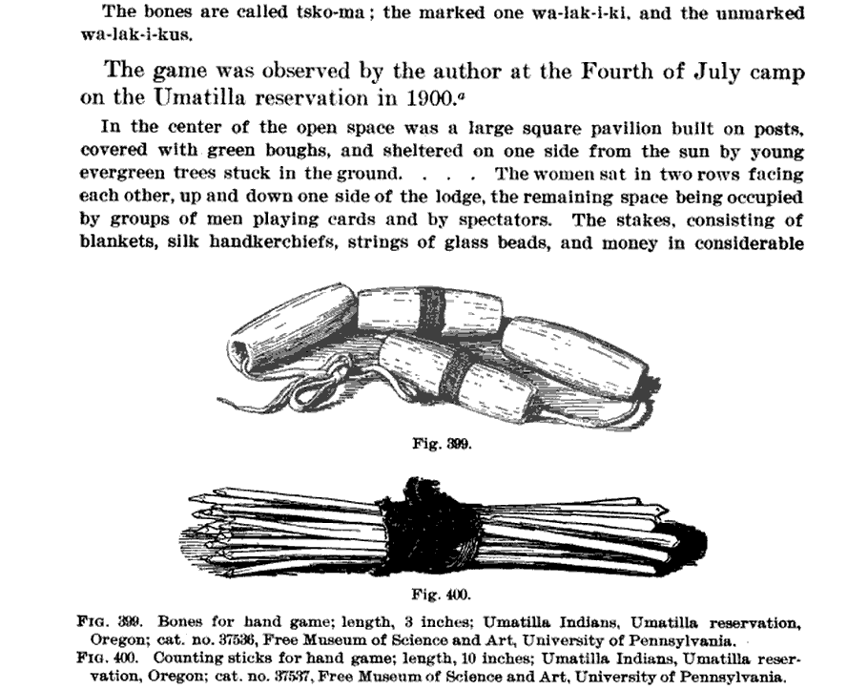
Umatilla Reservation, 1900
Images from: Games of the North American Indians. p.292

