Slide 1
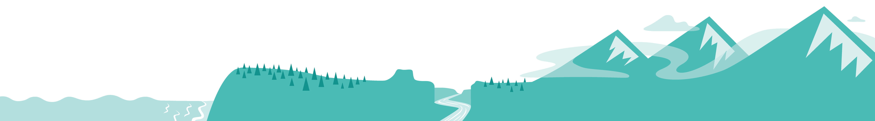
FISHING FOR TREATY RIGHTS AND SUSTAINABILITY
How does math help tell the story of history, governance, and people?

Slide 2
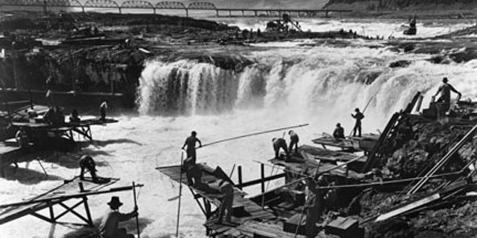
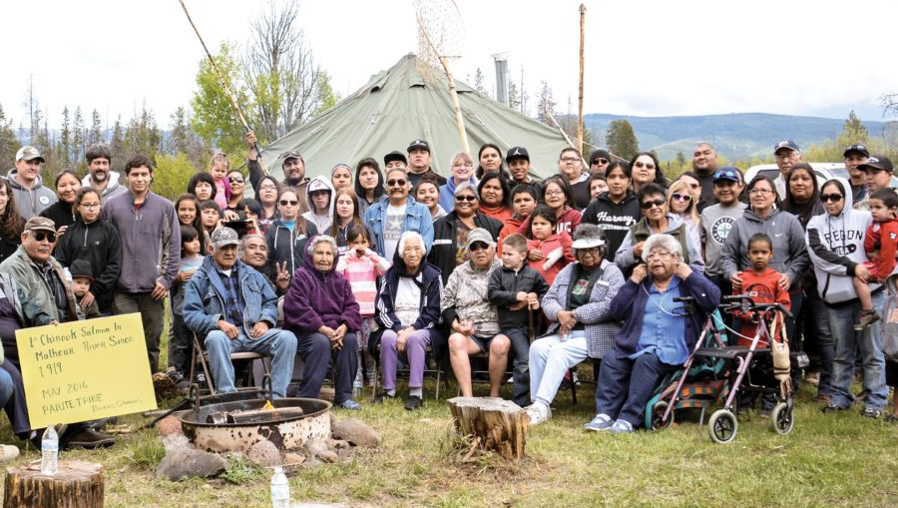
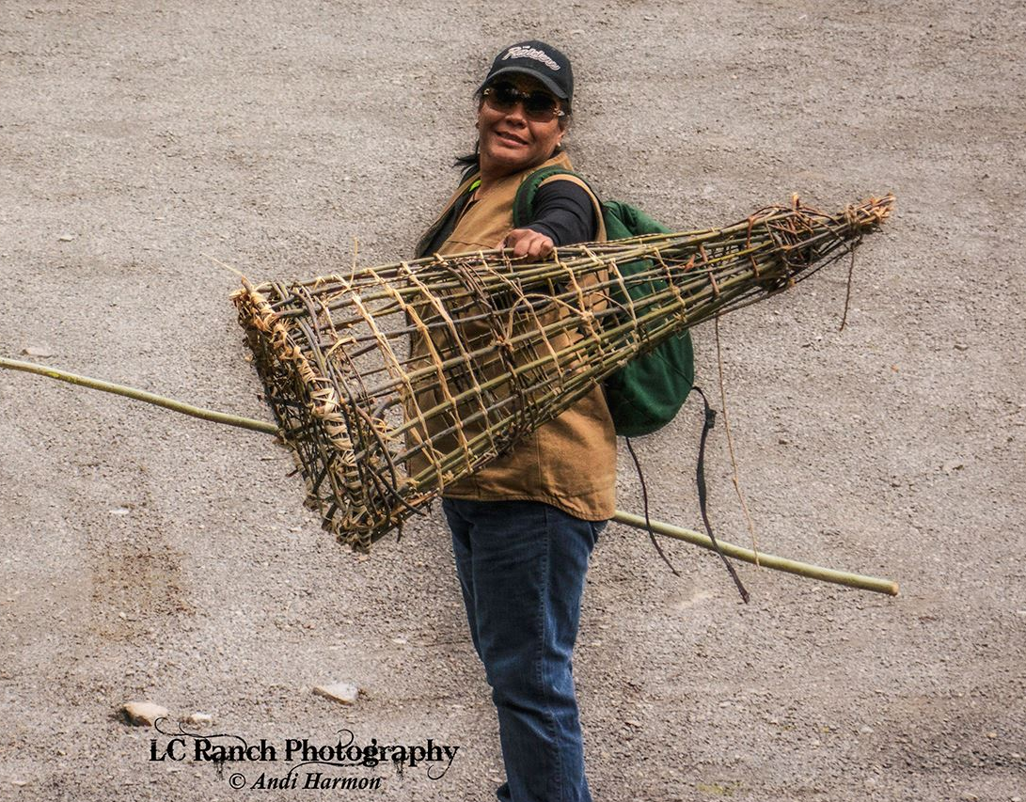
Fishing in Oregon

Slide 3
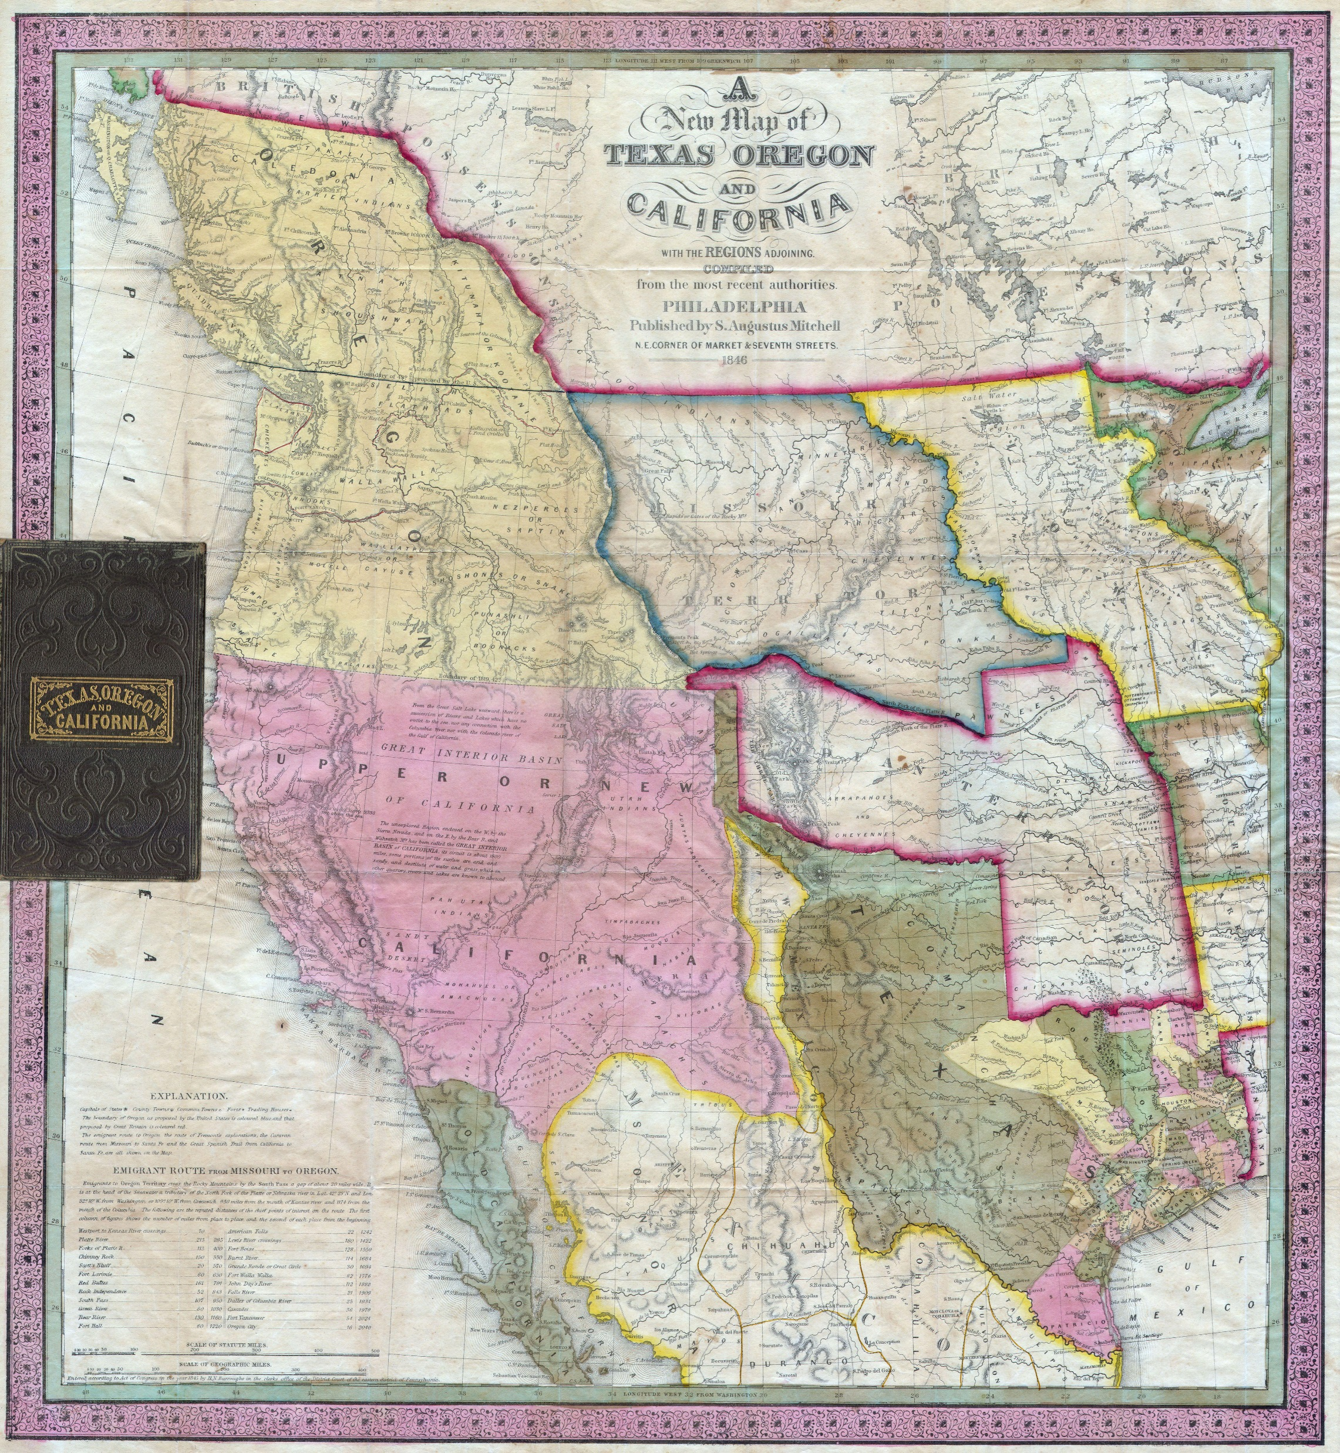
Map
This map is from 1846.
Later the same year, the United States and Great Britain decided to split the land known as the Oregon Territory at the line between modern-day Canada and Washington state.
The outline of modern-day Oregon has been added in black on top of the original map to make it easier to find, but the state did not take this shape until it attained statehood in 1859.
Notes:
This map is from 1846. Later the same year, the United States and Great Britain decided to split the land known as the Oregon Territory at the line between modern-day Canada and Washington state. The outline of modern-day Oregon has been added in black on top of the original map to make it easier to find, but the state did not take this shape until it attained statehood in 1859.

Slide 4
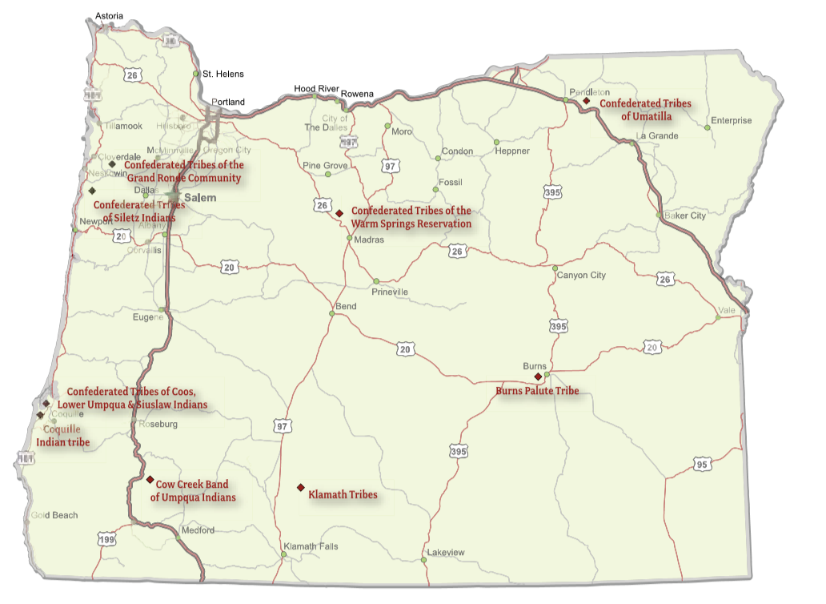
Tribal Locations

Slide 5
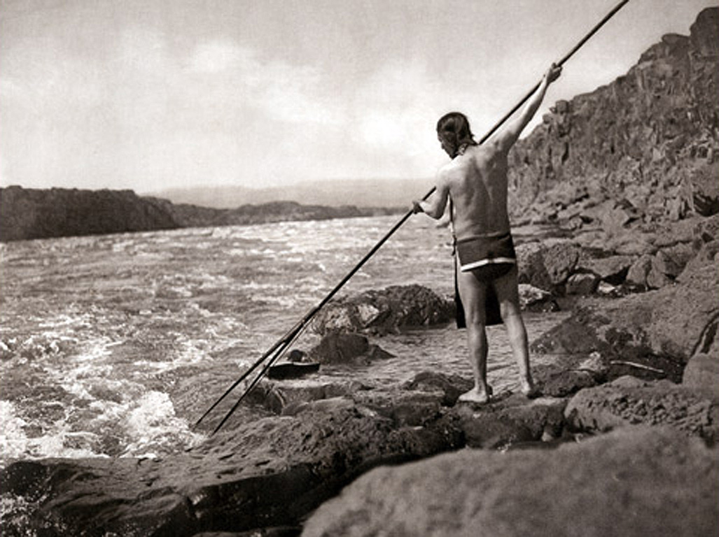
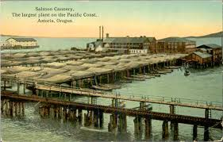
Fishing in Oregon
Early 1900’s photo by Edward C. Curtis from https://www.critfc.org/about-us/fisheries-timeline/
http://columbiariverimages.com/Regions/Places/canneries_columbia_river.html

Slide 6
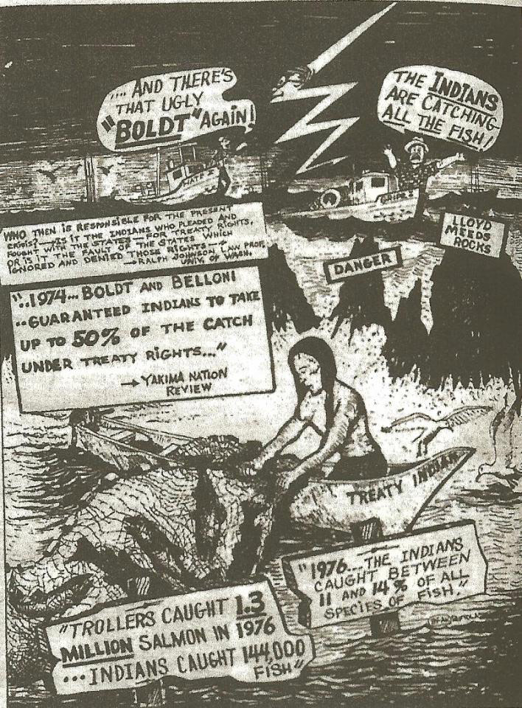
Fishing in Oregon
United States v. Washington
(Boldt Decision)
Reaffirmed treaty-protected rights
Established tribes as co-managers
of resources
Entitled Tribal Nations people access to 50 percent of the salmon returning to the usual and accustomed places

Slide 7
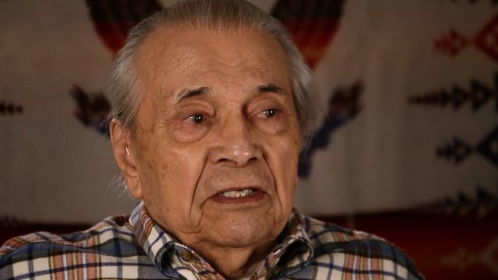
Bryson Liberty - Learning to Fish
How did changes to the land, made by others, affect one man?
If he doesn’t have a place at which it is “usual and accustomed” for him to fish, how does he teach others about the area?
Notes:
https://vimeo.com/230026513

Slide 8
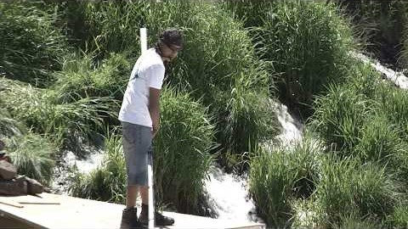
The Confederated Tribes of Warm Springs on their sacred connection to the Deschutes River
Why would people risk their lives in such fishing conditions?

Slide 9
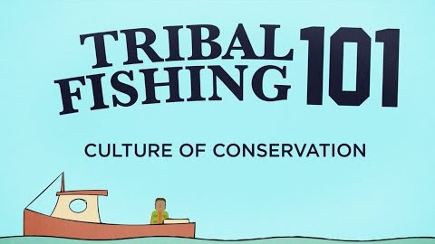
Tribal Fishing 101 from Northwest Treaty Tribes
Notes:
https://www.youtube.com/watch?v=F-ADN0oWQkQ

Slide 10
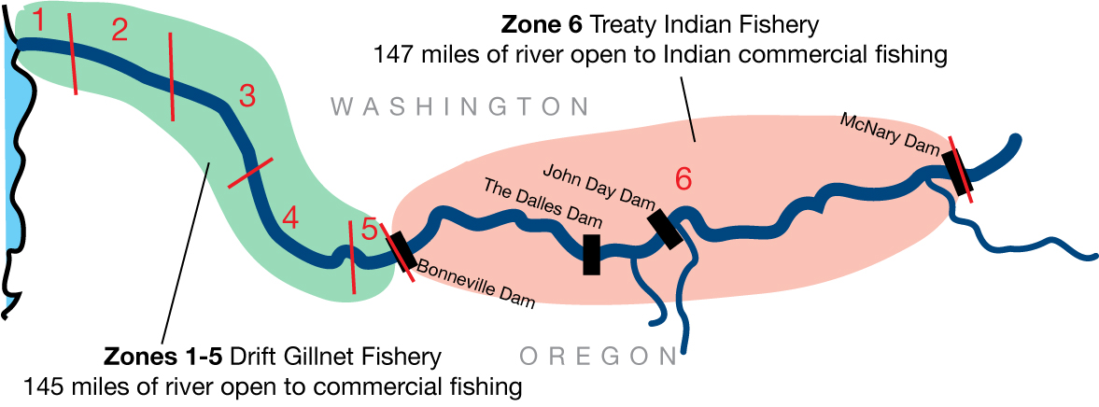
Fishing Zones
Indian fishers are legally entitled to half the harvestable surplus of fish in the river. To meet that requirement, Oregon and Washington must set their fisheries in Zones 1-5 in order to leave enough fish for harvest in Zone 6. Indian fishing is regulated under the ongoing U.S. District Court litigation known as U.S. v. Oregon.
Notes:
All four Columbia River treaty tribes enjoy fishing rights along the Columbia from the Bonneville to McNary dams. This 147-mile stretch of the river is called Zone 6.
For fisheries management purposes, the 292-mile stretch of the Columbia River that creates the border between Washington and Oregon is divided into six zones. Zones 1-5 are between the mouth of the river and Bonneville Dam, a distance of 145 miles. Oregon and Washington manage the commercial fisheries that occur in these zones. Zone 6 is an exclusive treaty Indian commercial fishing area. This exclusion is for commercial fishing only. Non-commercial sports fishers may still fish in this stretch of the river

Slide 11
You solve!
Two sisters went fishing and caught 52 pounds of salmon. They planned to give their grandmother 16 pounds and to divide the rest between them and two other family members.
How many pounds did each sister get to keep?
Notes:
4x+16=52

Slide 12
You solve!
Three families shared a meal and ate some salmon. They put two whole salmon away for another time. All 14 fish were captured near the Dalles Dam.
Write the equation and solve for how many salmon each
family ate.
Notes:
3x+2=14
X=4
Each family ate 4 salmon.

Slide 13
You solve! - Advanced
Two brothers went fishing along the river. The boat traveled 228 miles downstream and back. The trip downstream (with the current) took them six hours. The trip upstream (against the current) took eight hours.
What was the speed of the boat going downstream
(with the current)?
What was the speed of the boat going upstream
(against the current)?

