Slide 1

Traditional Housing Styles of Native Americans in Oregon

Slide 2
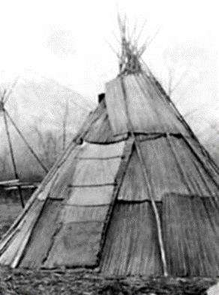
Mat Houses
Mats were typically made of tule (pronounced TWO-lee), a tall, grass-like plant that grows along rivers and streams and is similar to cattails
Tule were woven together into large mats that were placed over a frame made of poles
The frame was usually cone-shaped, although sometimes it was a more elongated, lodge-type shape or even a dome shape
Tule mats were layered to make the houses water and wind resistant

Slide 3
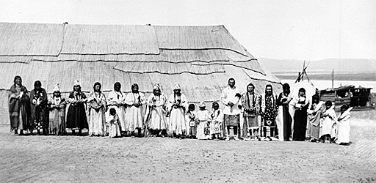
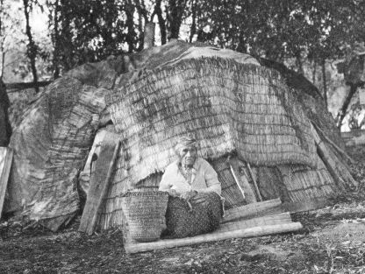
More Mat Houses
Mat house of the Umatilla Tribe
Klamath mat house
with domed roof

Slide 4
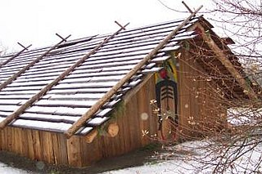
Plank Houses
Good style for cold climates with a lot of tall trees
Common throughout the Pacific Northwest for coastal tribes
Many plank houses included art as part of the design
Common style of winter housing
Typically made from red cedar wood
Chinook plank house
Image from: https://oregonencyclopedia.org/articles/chinookan_plank_houses/#.XhU-8shKiUk

Slide 5
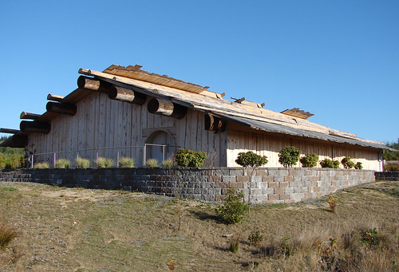
More Plank Houses
Plank houses are still built today
This is a plank house built by the Coquille Indian Tribe
Built of long, flat planks of cedar
Sides and roof can be removed to open the building
Image from: https://www.usda.gov/media/blog/2010/10/08/oregons-coquille-indian-tribe-hosts-usda-consultation-traditional-native

Slide 6

What kind of housing could you make if you only had the materials available in this classroom?
Traditional Native American housing was based on a deep knowledge of the natural environment and its available materials, as well as a keen understanding of structural requirements

Slide 7

Pythagorean Theorem
Describes the relationship between three sides of a right triangle
C is the hypotenuse
A and B are the sides of the triangle that form a right angle
c
a
b

Slide 8
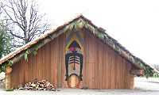
Pythagorean Theorem in Use
How could you use the Pythagorean Theorem when building a plank house like this?

Slide 9
Can you figure out how to make a right triangle?
6 inches
6 inches
6 inches

