Slide 1

LESSON 4
Assimilation and Indian Boarding Schools

Slide 2
Cultural Assimilation
Assimilation - The process of becoming similar to something.
Cultural assimilation - The process in which a racial/ethnic group comes to resemble a dominant racial/ethnic group and assumes the values, behaviors, and beliefs of the dominant group. This is often accomplished through coercion or other forcible means.

Slide 3
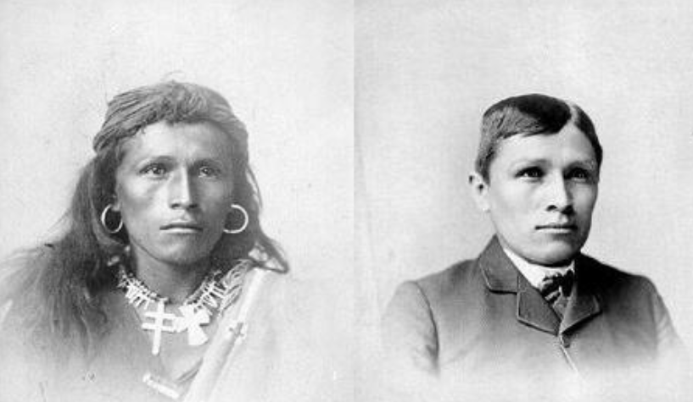
Forced Assimilation of Native Americans
First attempts in the 16th century: Spaniards began a program to educate American Indians in European customs and convert them to Christianity
U.S. government programs in 19th
and 20th centuries:
Indians forbidden from practicing
traditional ceremonies
Forced to give up land
Forced to attend public
school and church
Tom Torino, Navajo youth, before and after attending the Carlisle Indian Boarding School

Slide 4
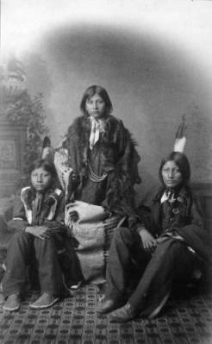
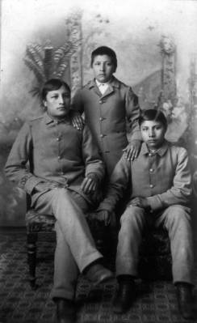
Before and After Assimilation

Slide 5
American Indian Education System
Indian nations had their own education systems firmly in place
Those education systems were:
Both formal and informal
Deliberate and planned
Designed by tribal elders to reflect the social, cultural, political, and economic needs of the Tribe
Contrary to popular belief, education—the transmission and acquisition of knowledge and skills—did not come to the North American continent on the Nina, Pinta, and Santa Maria. We Native Americans have educated our youth through a rich and oral tradition.”
Dr. Henrietta Whiteman-Mann

Slide 6
U.S. Church & State: Working Together
The U.S. government created the so-called “Civilization Fund” in 1819
The legislative act gave money to churches and missionary organizations to run schools that “educate Native Americans in the ways of the white man.”
The goal was to “civilize” Native Americans by cutting them off from their customs and traditions.
The act specifically designated that Native students learn to read and write
in English only.
Bureau of Indian Affairs created in 1824
The original purpose of the bureau was to administer and manage the money given to these schools.

Slide 7
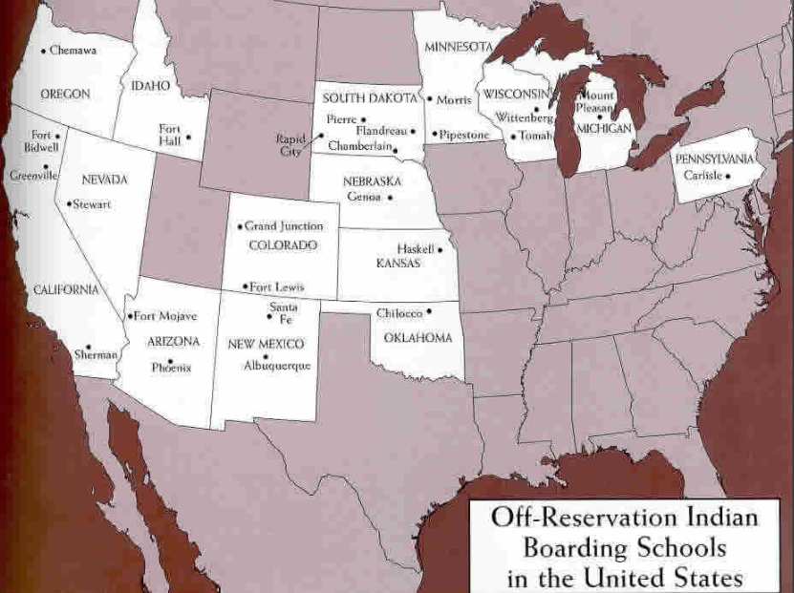
Indian Boarding Schools in the United States

Slide 8
Indian Boarding Schools
Served the purposes of the government, not the Indian children
Young children forcibly removed from their homes and tribes and taken to unfamiliar places
Attendance for American Indian youth was mandatory; families did not have a say in the decision
Schools were often overcrowded and students’ health needs were ignored

Slide 9
Indian Boarding Schools cont.
COMPLEXITIES
Two Indigenous scholars Dr. Brenda Child, Red Lake Ojibwe, and Dr. Tsianina Lomawaima, Mvskoke/Creek Nation, have also cited that experiences vary:
There were trials and tribulations for everyone, but some students created lasting friendships, learned valuable skills, and participated in group sports.
It does not erase the trials nor excuse it, but it is important to note that boarding schools were complex and while horrors did occur resilience and survivance were also present.

Slide 10
Richard H. Pratt
Richard H. Pratt had a long and active military career, which included going to war against Native Americans. President Grant put Pratt in charge of a group of Indian prisoners and Pratt began to experiment with educating the prisoners with an Anglo-centric curriculum. These efforts led to the founding of the Carlisle Indian Industrial School in 1879. Pratt also developed compulsory education programs for many different demographic minorities in the United States.
Kill the Indian in him, and save the man”
Captain Robert H. Pratt, founder of Carlisle Indian Industrial School

Slide 11
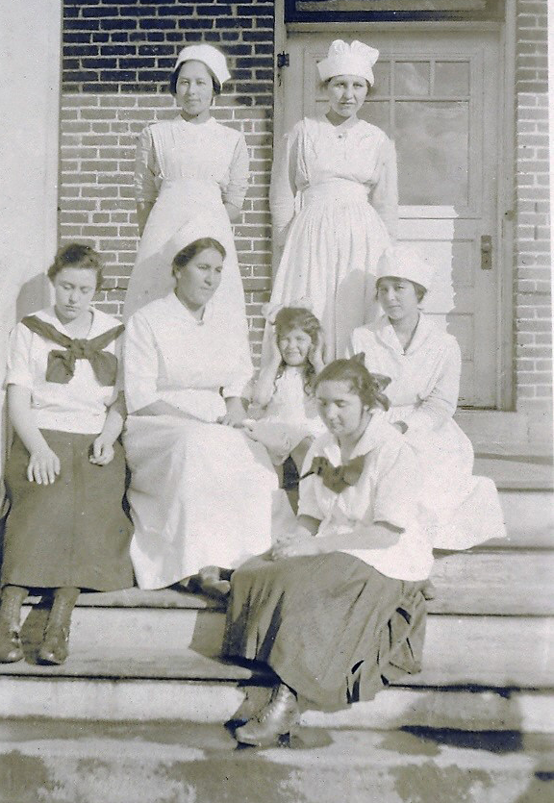
Chemawa Indian School
What parts of the school’s history ring true to what you learned about Indian boarding schools in the previous activity?
How did the school adapt and change over time?
The article ends by saying “Chemawa belongs to the Indians”
How so?
Students and nurses at Chemawa Indian School

Slide 12
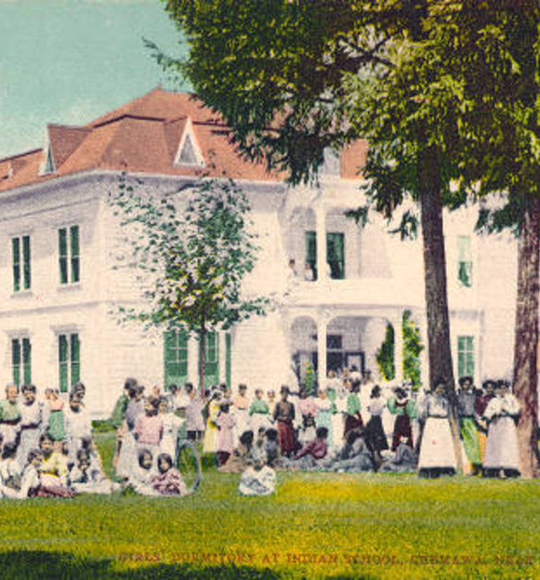
Chemawa Indian School Today
How is the school successful and unsuccessful at meeting student needs?
How are the school’s struggles connected to the idea of cultural assimilation?

Slide 13
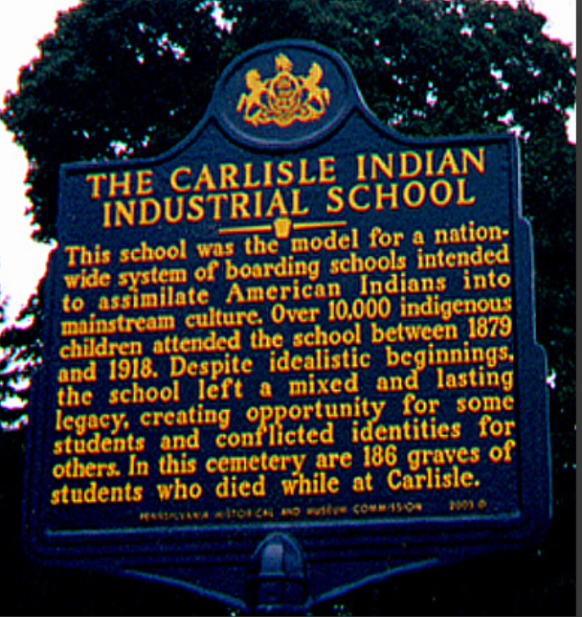
Reflection/Closure
Write and design a historical marker similar to the one on the right.
Write 3 to 5 sentences to educate the public on the significance and history of the Chemawa Indian School

