Slide 1

Treaty

Slide 2
Essential Questions
Why are treaties important?
How do historical events impact the present?

Slide 3
Vocabulary Graphic Organizer

Slide 4

What are treaties and why are they created?
Notes:
This video 5:20-minute video is found at https://www.youtube.com/watch?v=bexVE4IZRGo

Slide 5
Vocabulary
Treaty ‒ Formal (written) agreement between independent governments that have been ratified. An exchange of promises between governments.
Governance ‒ To have the authority to make decisions for a larger group
of people, land, or resources.
Sovereignty ‒ A type of political power, exercised through a form of government over people, land, and resources.
Ratify ‒ The act of formally approving a treaty. All parties must ratify
a treaty before it can take effect.

Slide 6
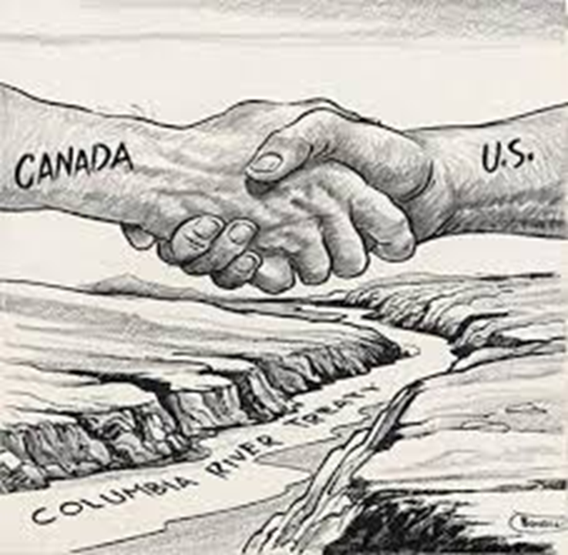


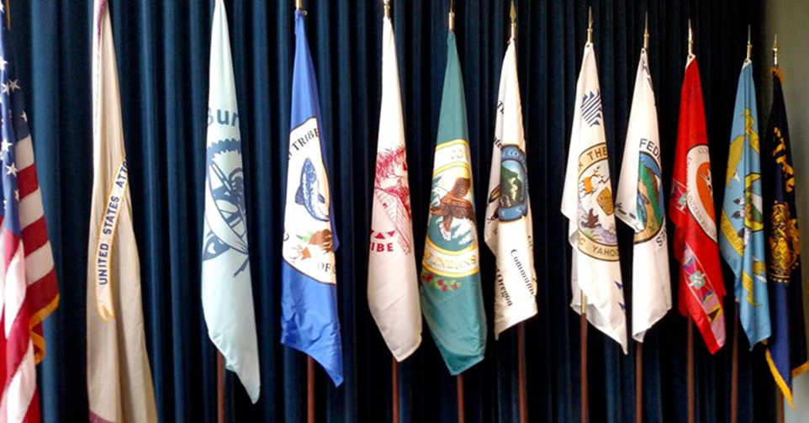
Vocabiulary 2
Treaty
Formal (written) agreement between independent governments that have been ratified. An exchange of promises between governments.
Governance
To have the authority to make decisions for a larger group of people, land or resources.
Ratify
Approved by all of the parties to the treaty before the treaty can take effect.
Sovereignty
A type of political power, exercised through a form
of government over people, land, and resources.
Notes:
(Monitor students to see how students are doing, provide scaffolding as needed.)

Slide 7
Treaty Elements
Education
Home/House
Family
Religion/Faith
Food
Culture
(e.g., language, music, art)

Slide 8
In your groups, discuss these questions:
What did you keep at the end of the rounds and why?
How did it feel giving up these things from round 1 to round 5?
If you were responsible for a group of people would you make different choices?
How do you think leaders of tribes felt as they experienced so much being taken?

Slide 9
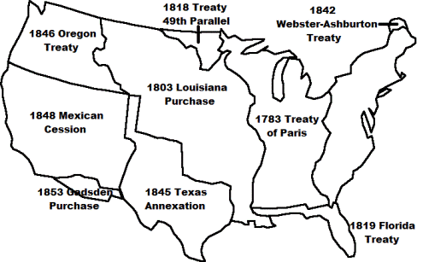
Where the U.S Got its Land
Much of our current U.S. land was acquired by treaties from Tribes and European nations

Slide 10
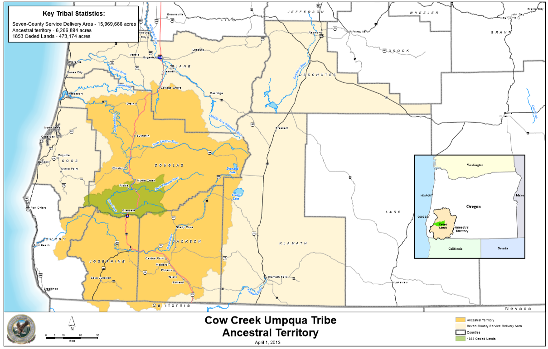
Ancestral Territory Map

Slide 11
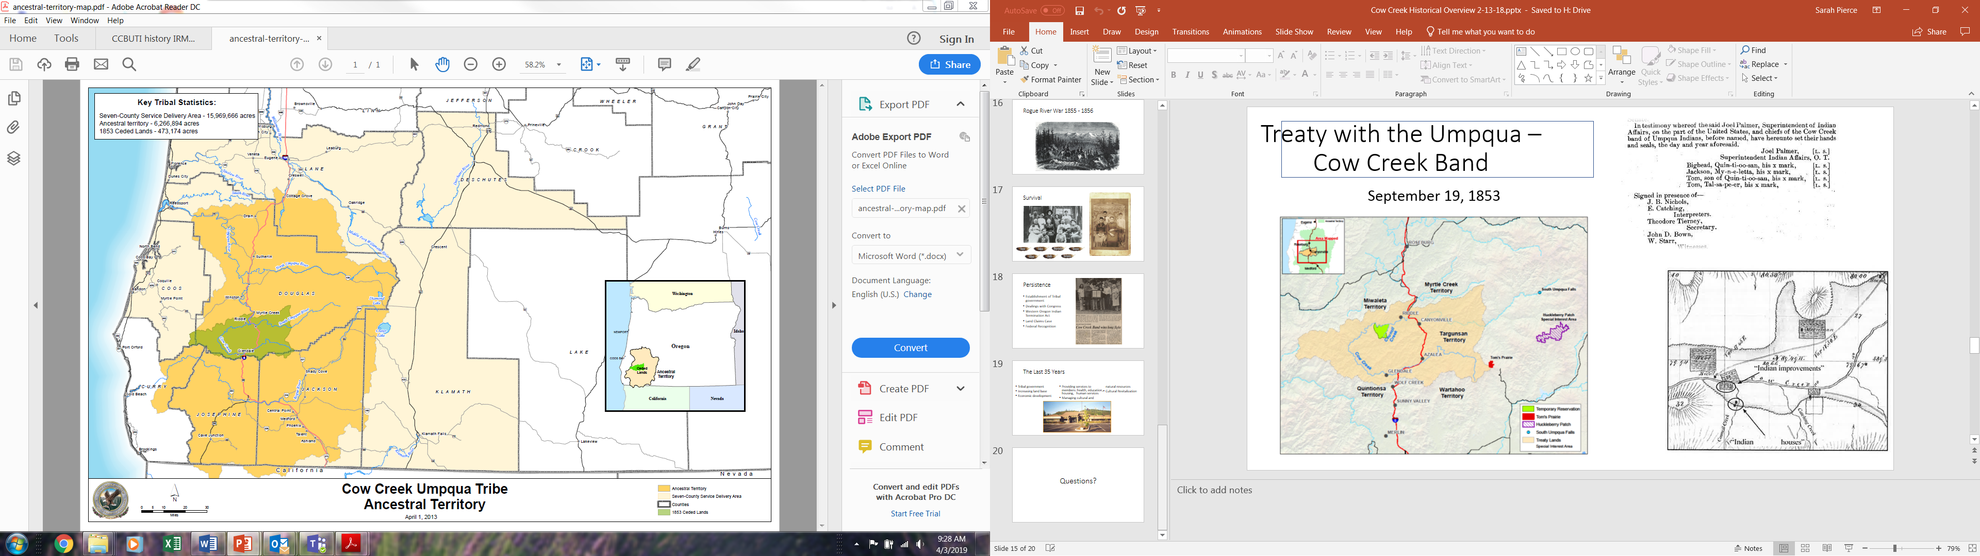
Famous Treaties
Cow Creek Umpqua Treaty of 1853
Drafted and entered on September 19, 1853, between Joel Palmer, Quin-ti-oo-san, My-n-e-letta, and Tom.
Ratified April 12, 1854, and proclaimed by President Pierce in February 1855.
Tribal leaders signed an X next to the names Bighead, Jackson, and Tom.

Slide 12
Journal Reflection
How are treaties important? | What is important to know about using treaties in government-to-government relationships? | How do historical evens (such as treaties) impact the present?

