Slide 1

Tribal History / Shared History
Lesson Plan Preview Event
August 20, 2019

Slide 2
AGENDA

Slide 3
• Welcome/Blessing/Introductions
• Housekeeping items
• SB 13 Video
• Establish safe environment/Ice Breaker
• Critical Orientations for Indigenous Studies Curriculum (6 P’s)
• Educator Toolkit
• Break
• Essential Understandings Overview/Activity
• Lunch/Optional Videos
• Lesson Plan Preview Carousel Activity
• Break
• Siletz Culture Presentation
• Closing/Evals/Teacher Focus Groups
AGENDA

Slide 4
SB 13 VIDEO https://www.youtube.com/watch?v=7JKpIH0-5ro

Slide 5
►Create a “safe” space for discussion – establish rules for collaborative conversation
►Please be respectful, patient and understanding – we are all in this learning process together.

Slide 6
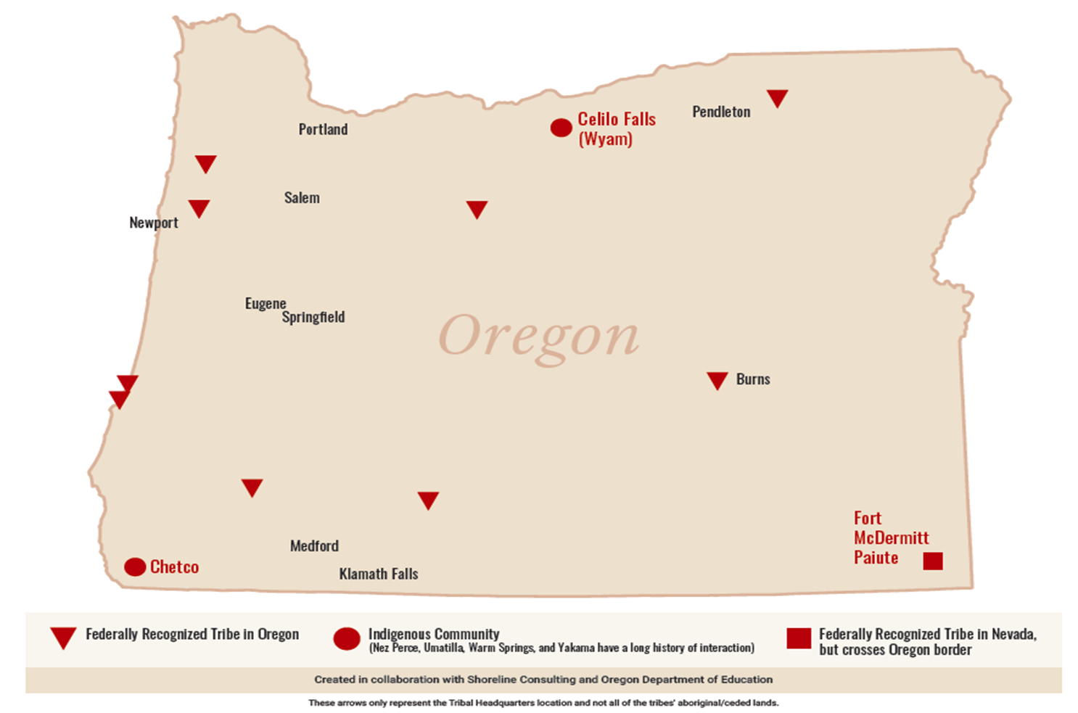
ICEBREAKER ACTIVITY

Slide 7
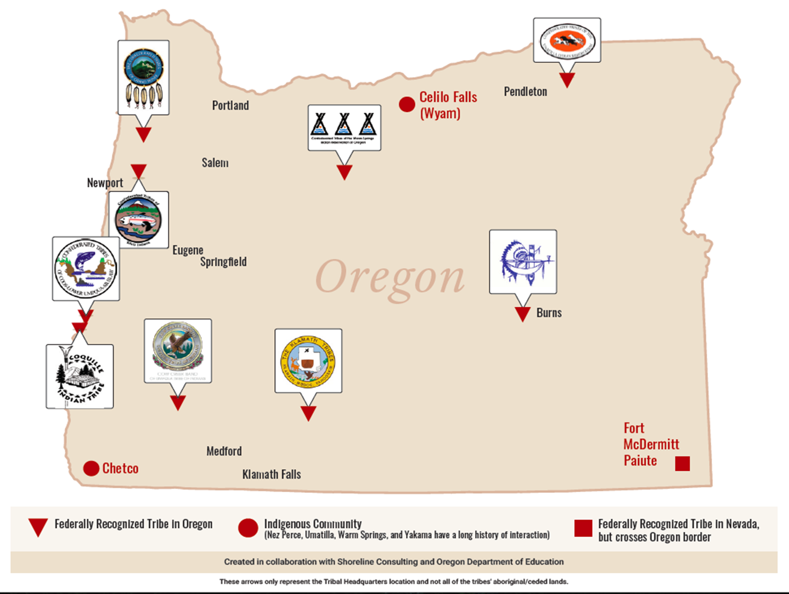
ANSWERS

Slide 8
6 P’S:
Critical Orientations for Indigenous Studies Curriculum

Slide 9
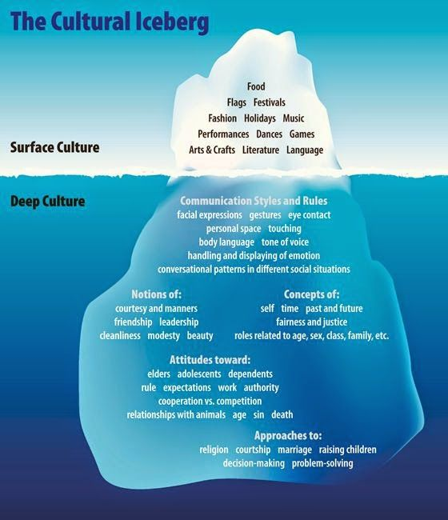
The Cultural Iceberg

Slide 10
Critical Orientations (6 P’s)
PLACE
PRESENCE
PERSPEC- TIVES
POLITICAL NATION-HOOD
POWER
PARTNER-SHIPS
Acknowledge Indigenous homelands where you teach
Focus on the diverse presence of Indigenous peoples today
Challenge power dynamics within curricula and affirm Indigenous power and agency
Emphasize the political nationhood, sovereignty, and citizenship of Indigenous peoples
Incorporate Indigenous perspectives into the curriculum
Relationships matter in this work. It needs to be purposeful
Notes:
Need to add the stuff under..

Slide 11
ORIENTATION:
BEGIN WITH THE PLACE YOU LIVE/TEACH

Slide 12
ORIENTATION:
BEGIN WITH THE PLACE YOU LIVE/TEACH

Slide 13
ORIENTATION:
RECOGNIZE INDIGENOUS PRESENCE
OVER 6 MILLION AI/AN PEOPLE
573+ NATIVE NATIONS

Slide 14
ORIENTATION:
RECOGNIZE INDIGENOUS PRESENCE

Slide 15
ORIENTATION
INCLUDE INDIGENOUS PERSPECTIVES

Slide 16
ORIENTATION
INCLUDE INDIGENOUS PERSPECTIVES

Slide 17
ORIENTATION:
FOCUS ON POLITICAL NATIONHOOD

Slide 18
ORIENTATION:
FOCUS ON POLITICAL NATIONHOOD
Do you know what year the Yakama Nation Treaty was signed and who was the main signer?
Do you know how many tribes and bands signed the Yakama treaty?
Do we have a flag?
Who the current executive chairman of the Yakama Nation?
Are there two branches of government for the Yakama Nation?
How many elected positions are there?
What is the formal name of this nation?
When do the Yakama elections occur and who can vote?

Slide 19
ORIENTATION
CHALLENGE POWER DYNAMICS
“Father Serra helped convert thousands of American Indians to Christianity…Many Indians died from overwork and diseases. But the missions kept going because of Father Serra's preaching and care.”
“Have you ever won a prize? Early settlers in Oregon saw free land as a prize for settling there.”
“Settlers Bring Change”

Slide 20
ORIENTATION
RECOGNIZE INDIGENOUS POWER

Slide 21
ORIENTATION CULTIVATE PARTNERSHIPS

Slide 22
EDUCATOR TOOLKIT

Slide 23
►One page connect sheet that shows everything
►Native American Resource List & Youth Reading List
►Approaches in Indigenous Education
►Critical Orientations for Indigenous Studies Curriculum
►Introductory Letter
►SB 13 General Overview/Talking points
►SB 13 flyer
►FAQ page information
EDUCATOR TOOLKIT

Slide 24
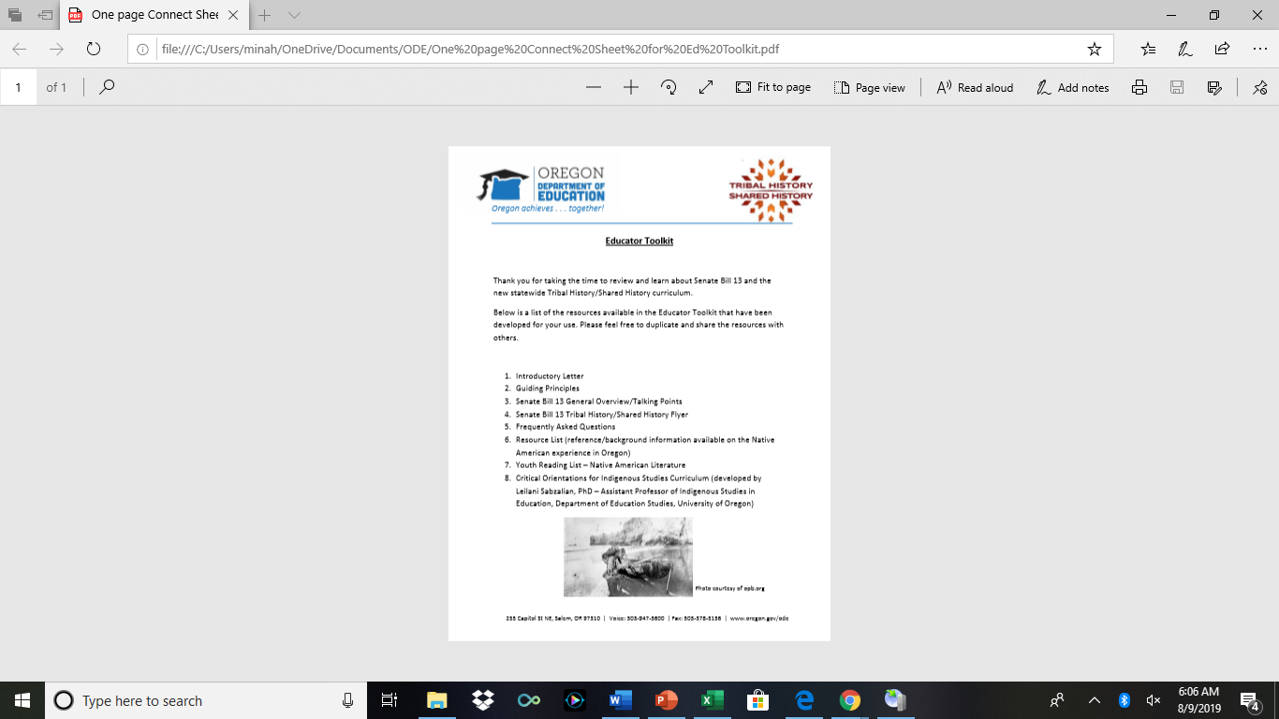
One page connect sheet

Slide 25
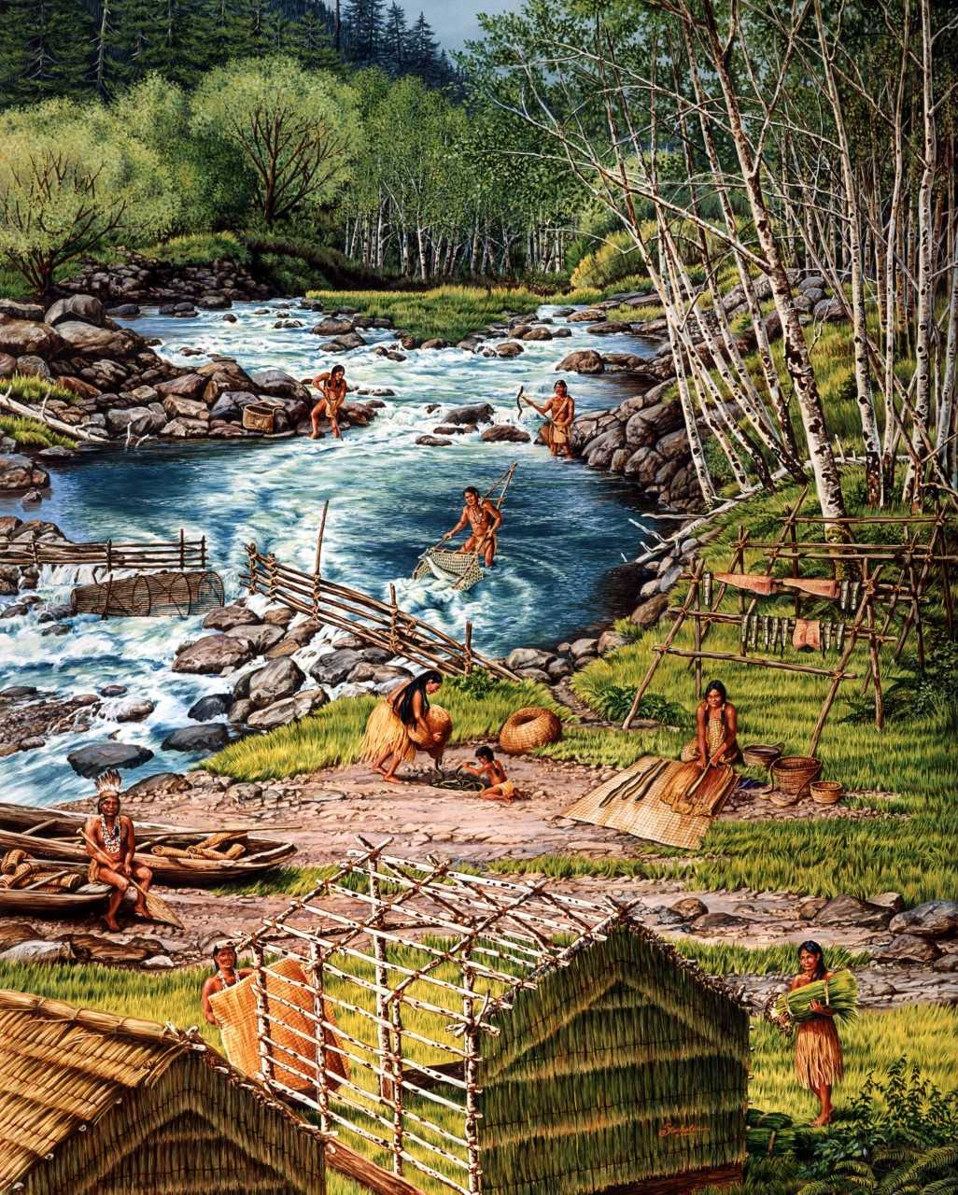
Native American Resource List &
Youth Reading List
►This listing of resources was developed for teachers and students in an effort to provide a reference and gain background information on the Native American experience in Oregon.
►This list was prepared by the Oregon Department of Education with assistance from representatives of Oregon tribes and the Confederated Tribes of Grand Ronde (CTGR) Tribal Library.
Image courtesy of the Confederated Tribes of Coos, Lower Umpqua and Siuslaw Indians

Slide 26
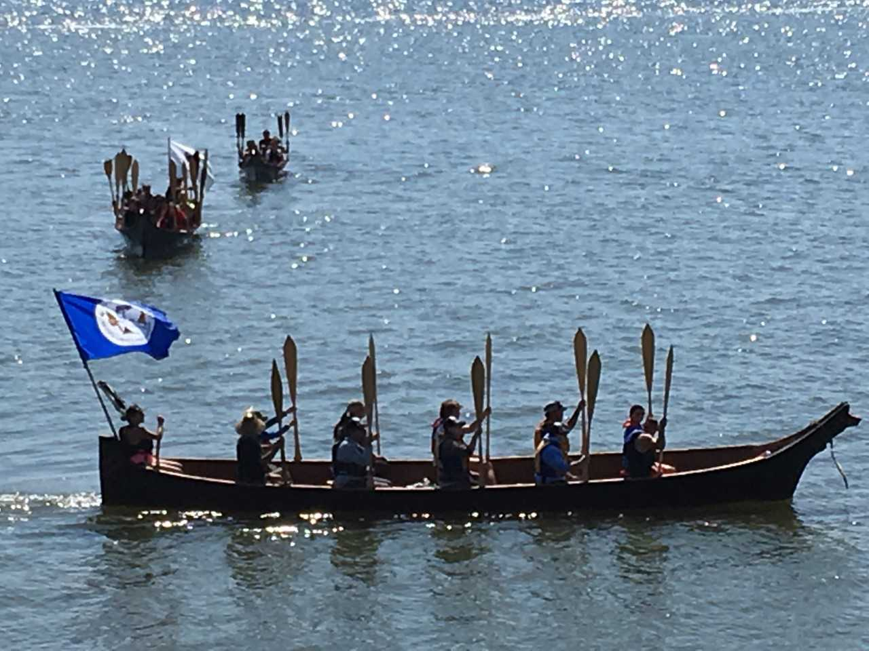
Approaches in Indigenous Education
• By implementing these approaches, you will be influencing tomorrow’s leaders and shaping a new future for Oregon and its relationship with our tribes.
• Thank you to Leilani Sabzalian, PhD, Assistant Professor, Indigenous Studies in Education, Department of Education Studies, University of Oregon for use of the integration of her work: Critical Orientations for Indigenous Studies Curriculum
Image courtesy of the Confederated Tribes of Coos, Lower Umpqua and Siuslaw Indians

Slide 27
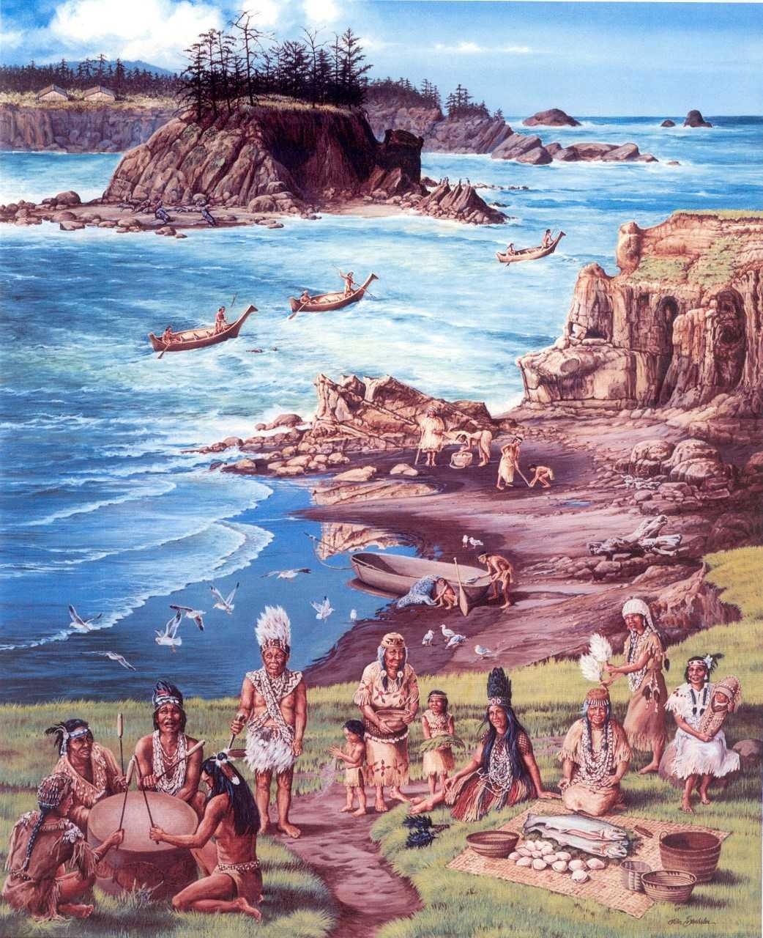
Critical Orientations for Indigenous Studies Curriculum (6 P’s)
Place
Presence
Perspectives
Political Nationhood
Power
Partnerships
Image courtesy of the Confederated Tribes of Coos, Lower Umpqua and Siuslaw Indians

Slide 28
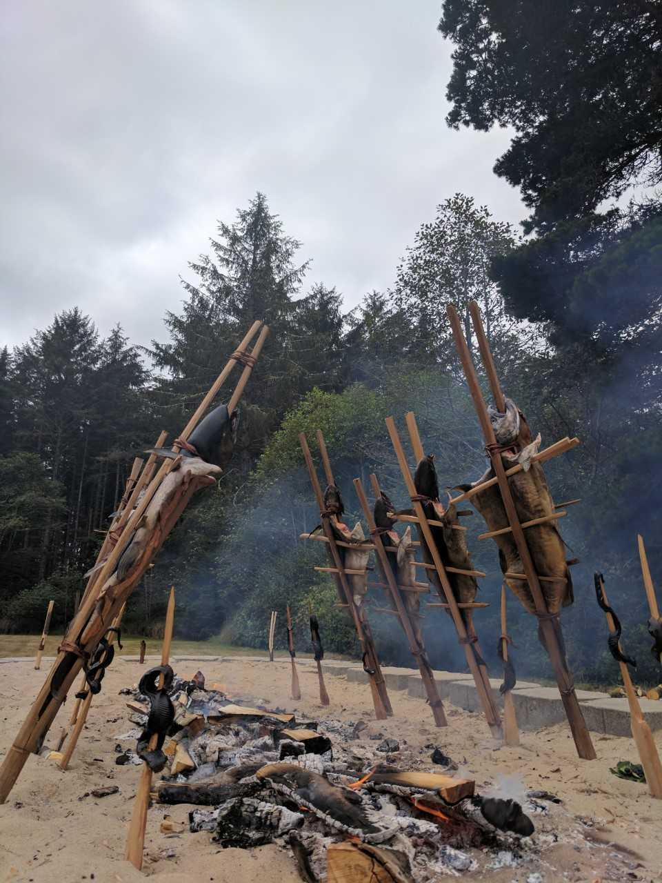
Introductory Letter
Image courtesy of the Confederated Tribes of Coos, Lower Umpqua and Siuslaw Indians

Slide 29
SB 13 General Overview/Talking points
WHAT: As a result of Senate Bill 13, Oregon Department of Education in partnership with federally recognized Tribes in Oregon developed the Essential Understandings of Native Americans in Oregon.
WHY: This is a historic investment in Oregon’s education system. Senate Bill 13 is far more than a state law. It is an agreement between the State of Oregon, its government and the governments of each of the nine tribes that reside here in this state.

Slide 30
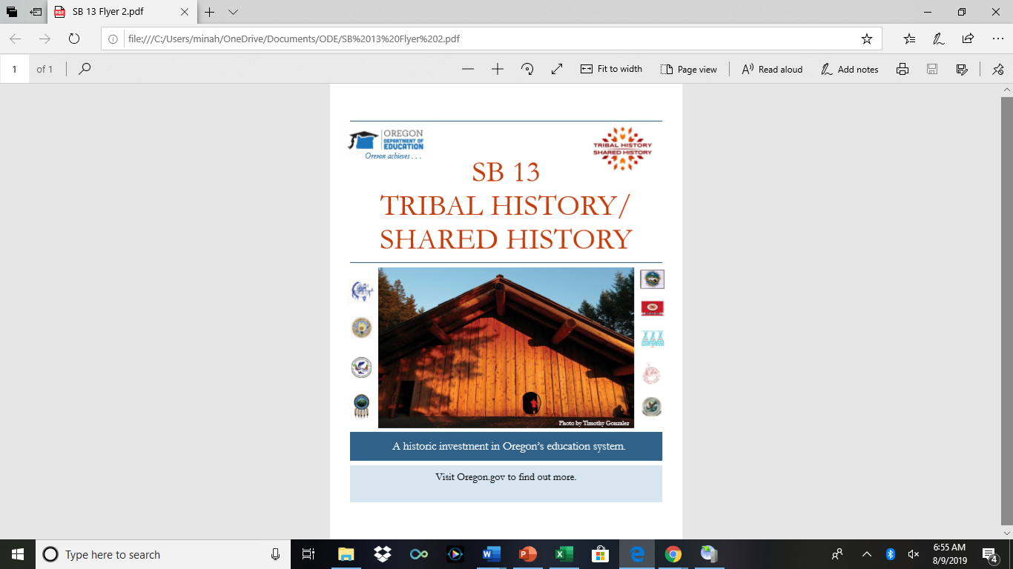
SB 13 FLYER

Slide 31
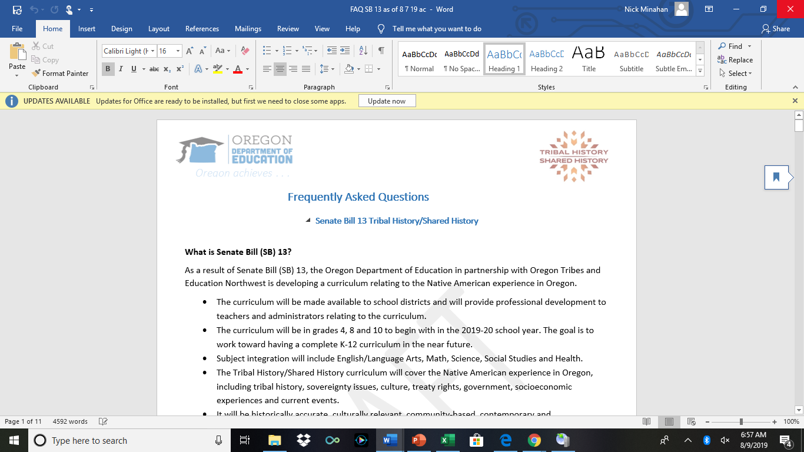
FAQ Page Information

Slide 32
BREAK

Slide 33
ESSENTIAL UNDERSTANDINGS
PROCESS/OVERVIEW

Slide 34

►The Essential Understandings of Native Americans in Oregon were developed as a framework and foundation for the creation of lesson plans in the new statewide curriculum.
►ODE partnered with the nine federally recognized tribes in Oregon to develop this document. It is a collection of heart, expertise, and knowledge. The process began in May 2018 and in June 2019, Tribal representatives agreed to bring the document forward to Tribal leadership for approval.

Slide 35
Overview
Essential Understandings
• Respectful of all tribes
• The information the tribes desired/truth
and accuracy
• 50,000 foot level
• Framings:
►Indigenous worldview
►Mindful of euphemisms and neutrality
►Strength-based
►Puts into context; tells the whole
(untold) story
Photo by Timothy Gonzalez
Notes:
9th annual plankhouse gathering

Slide 36
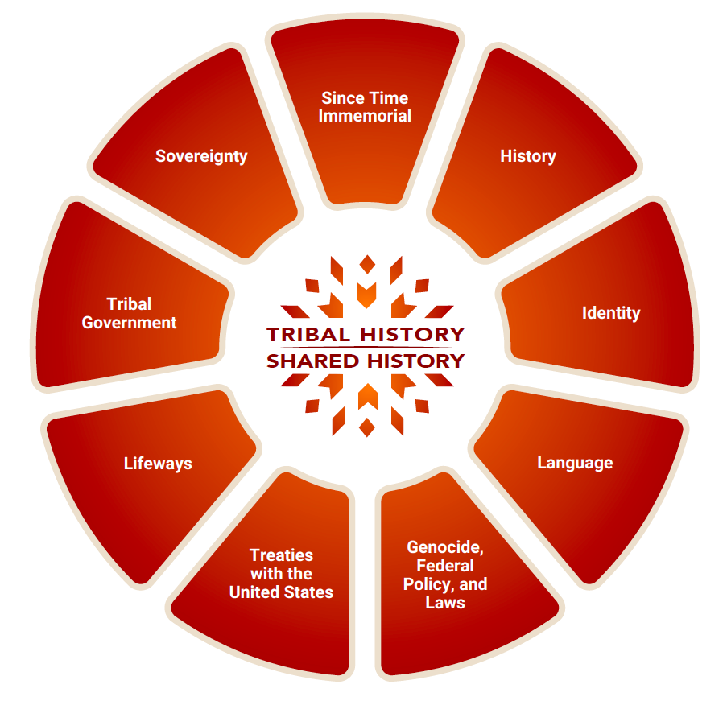
Tribal History/Shared History

Slide 37
Group Activities
Two Activities
1. Prior Knowledge Activity
1. Since Time Immemorial”” | 2. Sovereignty | 3. History
4. Tribal Government | 5. Identity | 6. Lifeways
7. Language | 8. Treaties with the US | 9. Genocide, Federal Policy and Laws
2. Diving Deeper/Making Meaning Activity

Slide 38
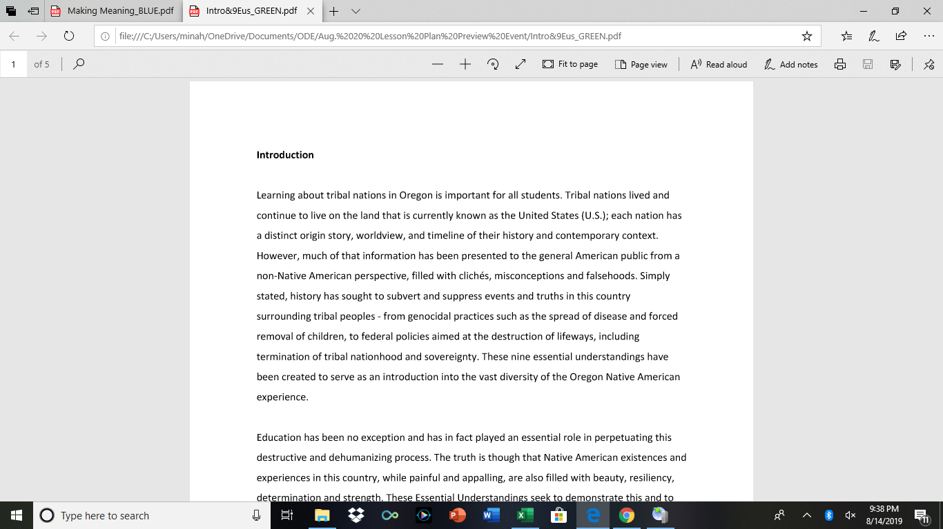

Prior Knowledge Activity
Prior Knowledge Activity
Take 5 minutes to skim the Introduction and then get a pack of sticky notes in front of you.

Slide 39
Table Activity
Here is what you are going to do at your table. See the first column one row 1 “Since Time Immemorial”
Write down what you think you know/understand STI to mean. Write down as many thoughts as you have.
Say out loud with a partner what is on your stickies and put them in the box (column one, row one).
Everyone takes a turn.
Continue this process for all 3 EU’s. If time discuss/share out with the whole group at your table.

Slide 40
Table Activity Instructions
Part II: Making Meaning (Instructions on tables)
1. One person in the group open the envelope. That person passes out the unfolded pieces of paper to each member. Each person unfold and the match is your partner. If there is no match, feel free to join a pair or work individually (your choice).
2. Grab a copy of the EU document and Making Meaning handout.
3. With your pair complete the first assigned EU.
When you have finished your first one, write your “tweet” on the sticky note and place it on the chart paper with the corresponding EU (on the wall).
Repeat with your next two EU’s. If time share out as a whole.

Slide 41
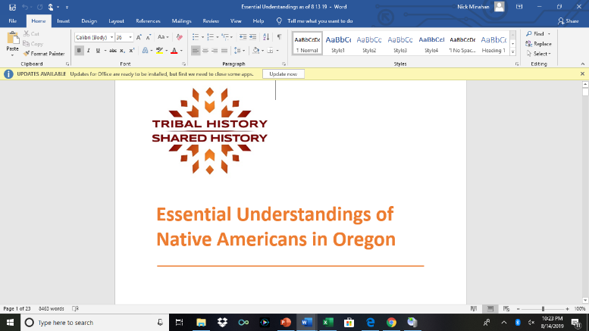
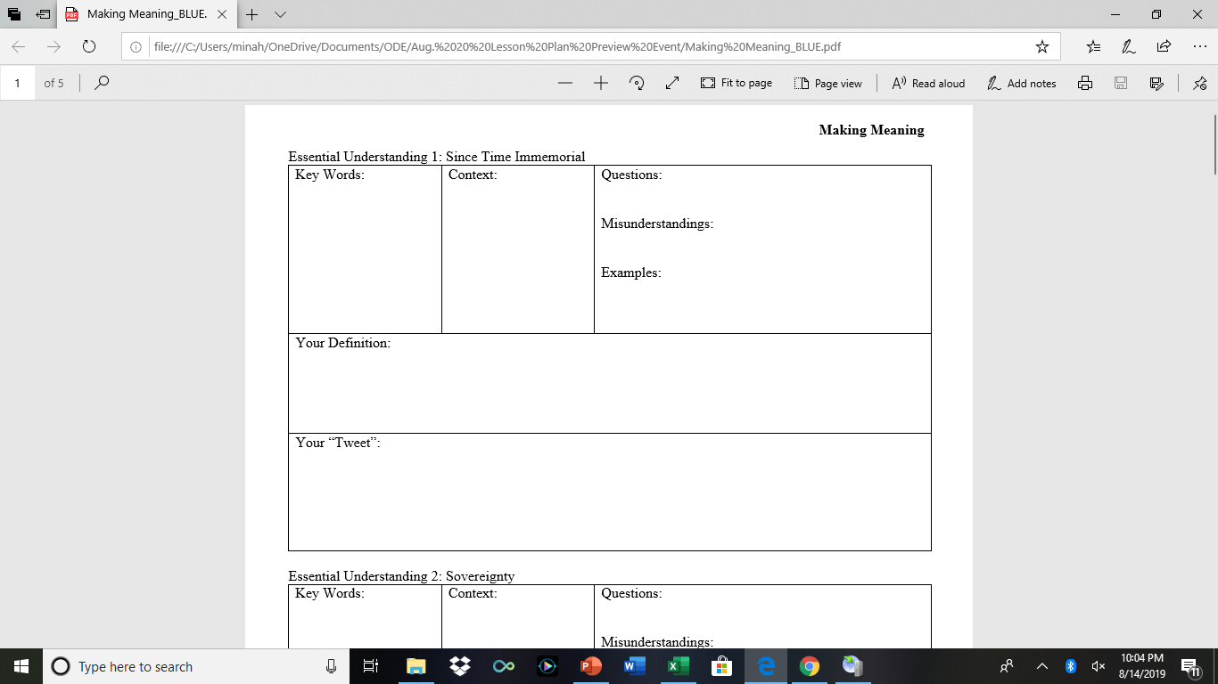
Toolkit items

Slide 42
LUNCH/OPTIONAL VIDEOS

Slide 43
LESSON PLAN PREVIEW CAROUSEL ACTIVITY

Slide 44
Lesson Plan List (16 Total) 3 Grade Levels – 5 subject areas
4_ELA_Oral Traditions
4_Health_Traditional Games of Oregon Tribal Nations
4_Math_Oregon Indians by the Numbers
4_Science_Seasonal Rounds
4_Social Studies – People Groups of Oregon
8_ELA_News in Indian Country
8_ELA_Health-Stick Games
8_Math-How Federal Policy Affects Tribes in Oregon
8_Science_Native Nutrition
8_Social Studies_Mapping Traditional Lands
10_ELA_Indigenous Peoples’ Day Part I
10_ELA_Indigenous Peoples’ Day Part 2
10_Math_On the Pow Wow Trail
10_Social Studies_Supreme Court Decisions
10_Science_Food Sovereignty and Environmental Sustainability
10_ELA_Elizabeth Woody

Slide 45

Siletz culture presentation by sonya moody-jurado

Slide 46
Closing/Exit slips/
Teacher Focus Groups

Slide 47
Hayu masi (Many thanks) for coming!

Slide 48
Contact Information
April.Campbell@ode.state.or.us
Ramona.Halcomb@ode.state.or.us
Mercedes.Jones@grandronde.org
Chris.Mansayon@ode.state.or.us
Trinity.Minahan@ode.state.or.us
Sonyamj@ctsi.nsn.us

