Slide 1
TAPP Family Advocate Monthly Meeting
Saturday Dec 21
January 9, 2025 - 12:30-2:30PM
✅ Welcome! Please say hello to your colleagues in the Zoom. Rename yourself to your Name, school district initials, Tribal Partner(s), and pronouns.
✅ Materials Needed - Street Data book, Writing utensils, notebook, ambo (water), snacks, reading glasses, any other materials to help you feel comfortable.

Slide 2
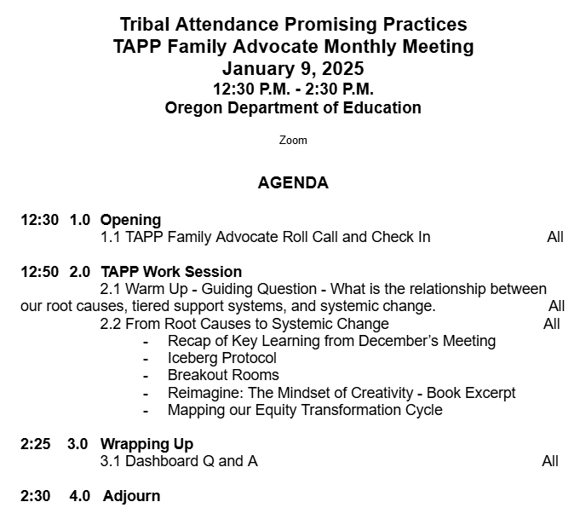

TAPP January Monthly Meeting Agenda
Notes:
Based upon timing I believe that today we will only make it to the uncover stage. this stage is all about evaluating the street data that you are receiving. both that street data you inevitably collect on the Fly - you know - through daily attendance phone calls to morning check-ins with students when teachers stop you in the hallway to also the intentional methods in which you collect Street data. for example, empathy interviews, reviewing student data from surveys the district administers, from circles you do with your Native American clubs. our Focus for the work session today is to practice and sharpen our skill at identifying root causes that can help us shift our support and our tiered responses so that we are leveraging educators, resources, and all of the systems that help with attendance or do work that is aligned to attendance, are being developed address what our students need. the activities will do today might feel a bit redundant, but we're working on that skill of moving from root causes to putting forth a plan that impacts systems in place to support students. as we wind down today, and if we only get to the uncover stage, if you notice if you notice that you are getting itchy for the Next phase of this work, then I will make sure to leave you with the slides and the activities to start diving in to the planning phase of the equity transformation cycle.

Slide 3
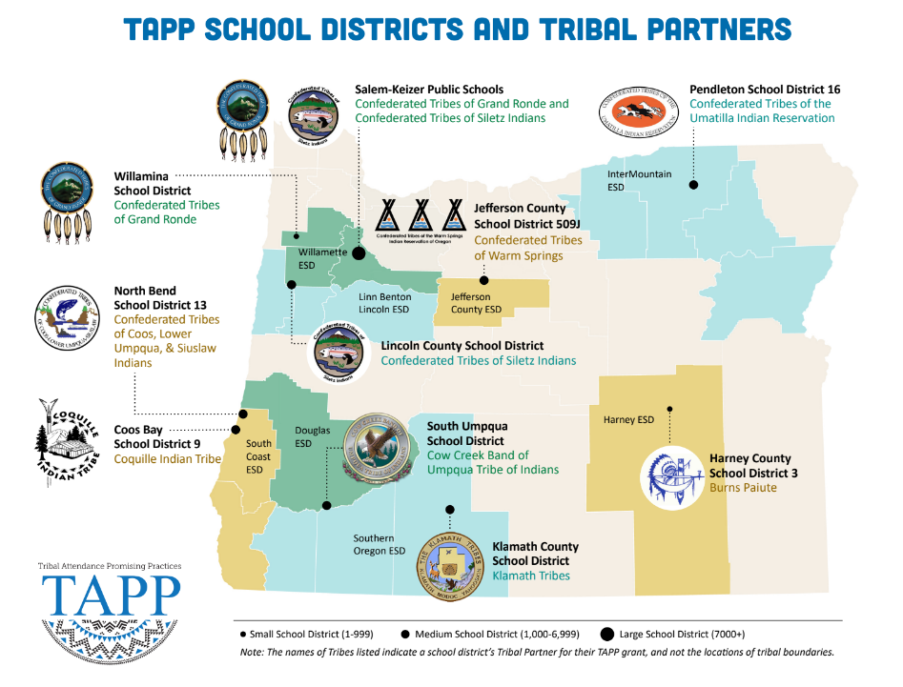
⭐ Indicates TAPP Expansion Position
Mona Smith
Stacey Jacobs
Ray Fox ⭐
Rebecca Arredondo
Mike Solem ⭐
Atcitty Begay
[TBD] ⭐
[TBD] ⭐
RuthEllen Melton
Crystal Hinds
Bre Landrum
Vacancy
Scott Smyth
Janelle Emard
[TBD] ⭐

Slide 4

TAPP Family Advocate Check-In
Roll Call.
It is a New Year. What intentions have you set for yourself for the second half of the school year? These can be personal or professional. They can be intense intentions or simple/straightforward.

Slide 5
TAPP Work Session
from Root Causes to Systemic Change
Notes:
12:50AM -

Slide 6

Warm Up - Reflection
Quick Write - 3 Minutes
Map it out.
Consider the relationship between your district’s (or school’s) root causes, tiered support systems, and systemic change.
To what extent do you see alignment and misalignment between the three?

Slide 7
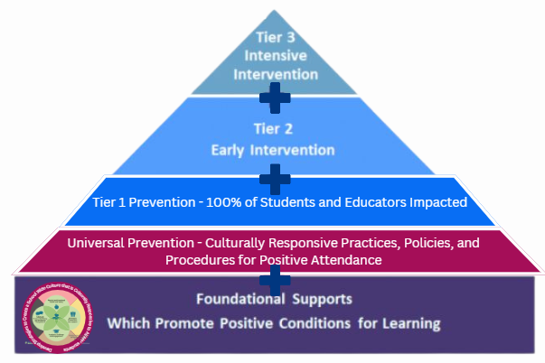
Guiding Question - What is the relationship between our root causes, tiered support systems, and systemic change?
For today’s Work Session -
Never lose sight of your identified Root Cause.
Think about your Street Data.
We will dig deeper into the Equity Transformation Cycle. Think about it as a mental and transparent collaborative model for change, by -
Refining our Root Causes
Working through our Icebergs in Breakout Rooms
Sketching our first Equity Transformation Cycle

Slide 8
Systemic Change - What is it?
Sustainable, long-lasting changes at a systemwide level - district, school, department, classroom - that alter the status quo, including outcomes and people’s experiences in and with the system.
Systemic change requires shifts in the structures of a system and how it operates. This includes changes in the system’s values, policies, resources, practices, relationships, and power structures.
Notes:
Say: Let’s calibrate, because like all other great educational concepts, Systemic Change has become a buzzword and worse, a trend, and it isn’t cute. It is not a pinterest board. It is mucky, but satisfying work.
READ THE SLIDE.
Then ask, “What words are sticking out to you from this definition?”
Because if our moral compass or North Star is not deeply committed to Systemic Change, we will fall and fall hard into these Equity Traps and Tropes.

Slide 9
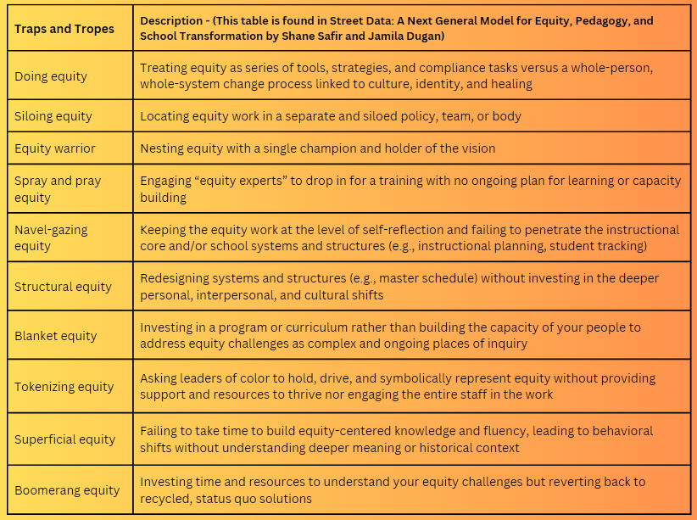
Always keep this list nearby, so you avoid falling into these Traps and Tropes and can remain committed to systemic change. P. 32-33
Notes:
Say: So that we are REALLY CALIBRATED on what Systemic Change is, let’s talk about what it is not. Take out your notebook or journal.
READ SLIDE -
5 Minutes for READING and REFLECTING, then share out.

Slide 10
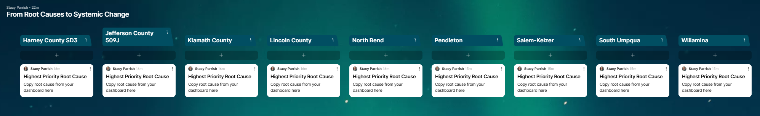
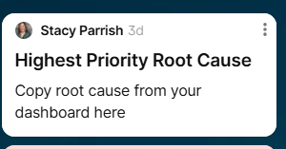
Let’s Dive Back In -
Open up the Padlet and re-read your Highest Priority Root Cause.
If you did not attend the last meeting, identify a root cause from your Strategy Tracking Log from the TAPP Dashboard and copy it under your district’s name.
Notes:
Now let’s go back to our existing root cause statements. Highest Priority only means it is highest priority that you really workshop, interrogate and unpack it today. This Padlet will be used in January as well.

Slide 11
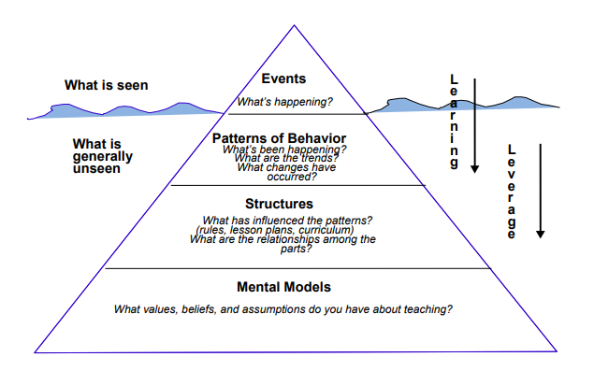
From Last Month - The Iceberg Protocol
The Iceberg Model is a systems thinking tool designed to help an individual or group discover the patterns of behavior, supporting structures, and mental models that underlie a particular event – in our case – a particular Root Cause.
policies, procedures
supporting AI/AN+ students with positive attendance
Notes:
Say: This chapter provides you with two protocols on how to take the multitude of STreet Data you are receiving and intentionally seeking (empathy interviews, from student surveys, etc).
Talk through – Let’s unpack this graphic. Let’s start with the far right down arrows. You see the “Learning arrow”. It aligns to the top of the pyramid, Specifically questions to ask to learn more about what's happening in regards to the root cause and what's been happening in relation to the root cause. What are the trends you're seeing in the street data in particular for this root cause? What changes have occurred with the root cause perhaps over time or perhaps in relation to a new initiative being enacted. Maybe changes have occurred with the root cause due to staff turnover or significant events which have happened in the school, district, or local or tribal community. Then you see the second down arrow that has to do with Leverage. The further down on the pyramid you get the more you start seeing that both the structures and the mental models are two things that can be leveraged in relation to a particular root cause, but while you are doing this iceberg protocol, you are interrogating the Structures in place which influence the patterns you see with the root cause (time of year? Grade levels? Schools? etc). With this section you ask yourself what are the relationships among the parts to this root cause — Think about that question in terms of in what ways are the various structures in the school and in the district related to the root cause? Furthermore, what mental models are impacting the root cause? I will push you to not see the “you” here as “just you, the advocate”, but “you” as the system, as the school, as the district representative, as the district itself – What values, beliefs, and assumptions does the system have about supporting AI/AN + students with positive attendance? This is not a time for broad strokes – not a time for “we” statements. It is more a time for considering the values, beliefs, and assumptions of all entities – support staff, department teams, grade level teams, district teams, attendance teams, SPED teams, discipline deans, school leaders, etc. Reflecting on this part of the triangle is about interrogating all of these parts in relation to the root cause. Each mental model held by different educators and different teams and maybe at different locations matters.Try not to just reflect on these mental models as binary – as black and white or good or bad – sometimes the biggest threat to our Native youth is mediocrity and not overt harm.

Slide 12
Find your Completed Iceberg Protocol
Turn a piece of paper sideways. Draw the Iceberg Protocol.
Make it BIG (fill your paper), so you have lots of space to add your reflections and thoughts.
Include the labels, but not the questions. This slide will be up as you engage in your reflection.
policies, procedures
supporting AI/AN+ students with positive attendance

Slide 13

As educators, the need to justify, to excuse, to explain, to empathize, and to protect our peers from unpleasant feelings and difficult emotions is in our nature. While at the same time, the work as advocates surfaces inequities unconsciously and consciously perpetuated by our colleagues and as advocates, we must address them.
In the book, “Against Civility: The Hidden Racism in our Obsession with Civility by Alex Zamalin”, it shares the following -
Civility is beneficial for a society beset by extremism…civility appeals to the mainstream because it conjures a common ground, a nonpolitical arena where agreement isn’t too far away, where consensus is within reach, where moderation counters aggression, where reason trumps the irrational…
Civility sounds like a good thing. If we think about our daily lives and our relationships with neighbors and friends, the word suggests warmth and affection, forgiveness and humility – and good manners – things to which we should aspire. In truth, most people won’t want to come off as rude or impolite at a dinner party, on the sidewalk, or on the street corner…
But, [equity work] isn’t everyday life. [Equity work] is about organizing the competing interests within a community, distributing socioeconomic resources, making determinations about what lives matter and whose don’t…
Once we think about [equity work] this way, we need to ask ourselves this: Does civility take us one step closer to our goal of liberation for all people? Does it sway [leadership] to make sweeping changes in [educational] policy? Is it something to which we should aspire in public life as we do with our friends and neighbors?

Slide 14
The Iceberg Protocol
5 minutes -
Think about your Root Cause.
Go back to your Iceberg Protocol reflections.
Re-read them, adding any additional reflections and details to them.
policies, procedures
supporting AI/AN+ students with positive attendance

Slide 15
Peer Share Out and One-Way Feedback Cycle
PROTOCOL
In groups, take turns. First sharer –
1 MINUTE - Succinctly share your Root Cause from the Padlet.
2 MINUTES - Read through your Iceberg Protocol in this order -
Events (What is seen…)
Patterns of Behavior (What is generally unseen…)
2 MINUTES - After “a and b” have been shared, each listener speaks to the same prompt in order. You can respond multiple times to the same prompt. The sharer does NOT respond, but they remain silent and takes notes -
What I heard the presenter say is….
One assumption that seems to be part of the dilemma is…
2 MINUTES - The sharer continues sharing out on -
Structures and Mental Models (What you can leverage to address this…)
2 MINUTES - After “a” has been shared, each listener speaks to the same prompt in order, responding multiple times to the same prompt if needed. The sharer does NOT respond, but takes notes -
A question that raises for me is….
What if…..? Or “Have we thought about…” or “I wonder…”
3 MINUTES - The sharer reviews their notes and reflects aloud on what they are learning and thinking more deeply about. The process repeats.
Group 1 - Ray, Bre, RuthEllen, Mike
Group 2 - Scott, Rebecca, Crystal
Group 3 - Atcitty, Stacey, Stacy
Designate a timer; use the elder interruption - “We’re gonna move on now.”
Notes:
We cannot do this alone. The last chapter talked about “ It is critical to do that in a collaborative fashion by studying the data with a team.”
So now, we are going to move into a Peer Share Out and Feedback Cycle on our respective Iceberg Protocols.
Note to facilitator - Create groups -
Copy this in a stand along slidedeck

Slide 16
Coming Back Together -
What about this process was useful? Frustrating? Interesting?
What new insights did it bring up?
Notes:
Now let’s go back to our existing root cause statements.

Slide 17
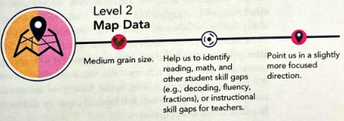
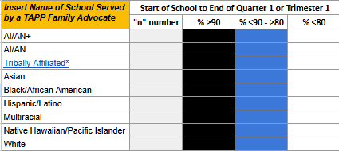
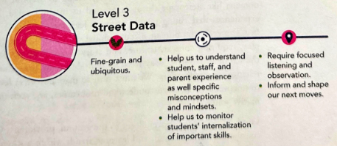
Uncover: The Mindset of Curiosity
The “Re-Imagine” and the “Move” stage of the Equity Transformation Cycle is where we start planning for our change idea and implementing it.
Read page 88-92 to the first paragraph on page 87.
As you read, think about your strengthened Root Cause. Remind yourself of all of the Street Data you have collected from empathy interviews, surveys, 1:1 conversations, etc. Hold that in your mind.
When you think about how you will address this root cause, ask yourself, “What are you trying to disrupt or build?”
Notes:
Page 86-93 - scroll to 88

Slide 18
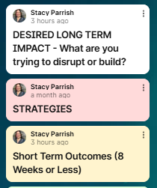
Step 2 - Return to your Padlet.
Using your new insights and reflections, complete the following in the Padlet –
Desired Long Term Impacts you hope to see as you address your Root Cause
Strategies - What strategies will you (and your TAPP team) implement to address the Root Cause?
Short Term Outcomes - By implementing the strategies, what do you hope to see is changing in the next 8 weeks?
Notes:
Now let’s go back to our existing root cause statements. Highest Priority only means it is highest priority that you really workshop, interrogate and unpack it today. This Padlet will be used in January as well.

Slide 19
From Root Causes to Systemic Change
TAPP Street Data and the Map Data guides us in –
the identification of Root Causes
the creation of Tiered Support
Fundamental Understanding - Our tiered support must be in service to systemic change.
We can’t stop at identifying the problem, because we will miss moving from the problem to the outcome. This is one of the biggest barriers to systemic change efforts.
We don’t give space and time to how change is going to happen to when it will happen to what kinds of change to who will be involved.
Notes:
So today we are going to talk about a concept known as a Theory of Change. A Theory of Change is how we can make sure we are giving space and time to how we are addressing a root cause in our respective schools or communities SYSTEMICALLY.

Slide 20
Root Cause to Problem of Practice to an Equity Transformation Cycle
Your root causes become your Problem of Practice.
Your Root Causes are nagging issues or challenges that emerge within your spheres of work that do not have a single solution, but require discussion and collective problem-solving to address.
The Equity Transformation Cycle is how change is going to happen, when it will happen, what kinds of change will happen, and who will be involved.
The ETC is how you are going to disrupt the Problem of Practice - transparently - and build something new.

Slide 21
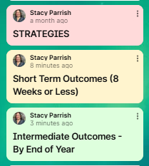
Step 3 - Return to your Padlet.
Using your new insights and reflections, respond to this question –
Build out your Equity Transformation Cycle
Notes:
Now let’s go back to our existing root cause statements. Highest Priority only means it is highest priority that you really workshop, interrogate and unpack it today. This Padlet will be used in January as well.

Slide 22
[School District]
Equity Transformation Cycle: [Our Problem of Practice]
ENTRY POINTS
STRATEGIES
SHORT TERM OUTCOMES
WHAT INVISIBLE MENTAL MODELS may be shaping the outcomes we currently have?
DESIRED LONG TERM IMPACT
INTERMEDIATE OUTCOMES
Notes:
You are not starting from scratch. You all are already implementing a Theory of Change. This activity is to go deeply

Slide 23
2024-2025 TAPP Districts’ Dashboard
Key Resources and Documents
2024-2025 TAPP Districts’ Dashboard
Dashboard Orientation Video - 11 minutes
TAPP Shared Folder
TAPP Program Promising and Best Practices – This document underwent a comprehensive revision this summer. It is important to revisit this document individually and as a team. There are four key sections to the document –
SECTION I. General TAPP Grant Execution - Lessons Learned
SECTION II. Setting the TAPP Family Advocate Up for Success NEW Advocate? START HERE!
SECTION III. Foundational Supports for AI/AN Students that Lead to Positive Conditions for Learning (Includes a self-assessment to utilize with school teams!)
SECTION IV. Culturally Responsive Tiered Attendance Systems (also includes a self-assessment to utilize with school teams!)

Slide 24
Text Parrish anytime at 971-208-0270
Or - send me an email. Call if you must.
There is no such thing as, “I know you are busy”. I am here for you.

