Slide 1

TAPP Family Advocate Monthly Meeting
November 14, 2024 - 12:30-2:30PM
✅ Welcome! Please say hello to your colleagues in the Zoom. Rename yourself to your Name, school district initials, Tribal Partner(s), and pronouns.
Materials Needed - Writing utensils, notebook, ambo (water), snacks, reading glasses, any other materials to help you feel comfortable.

Slide 2
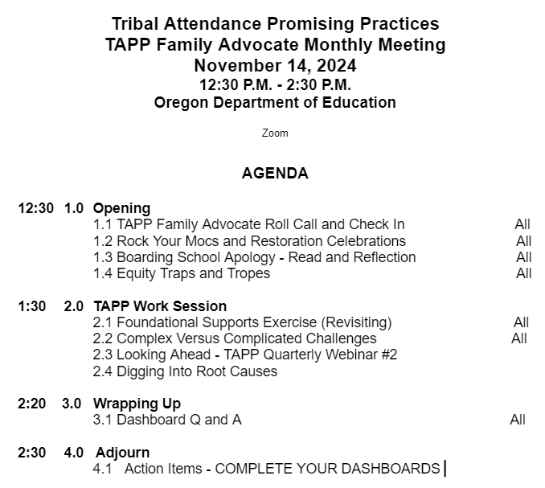

TAPP November Monthly Meeting Agenda

Slide 3
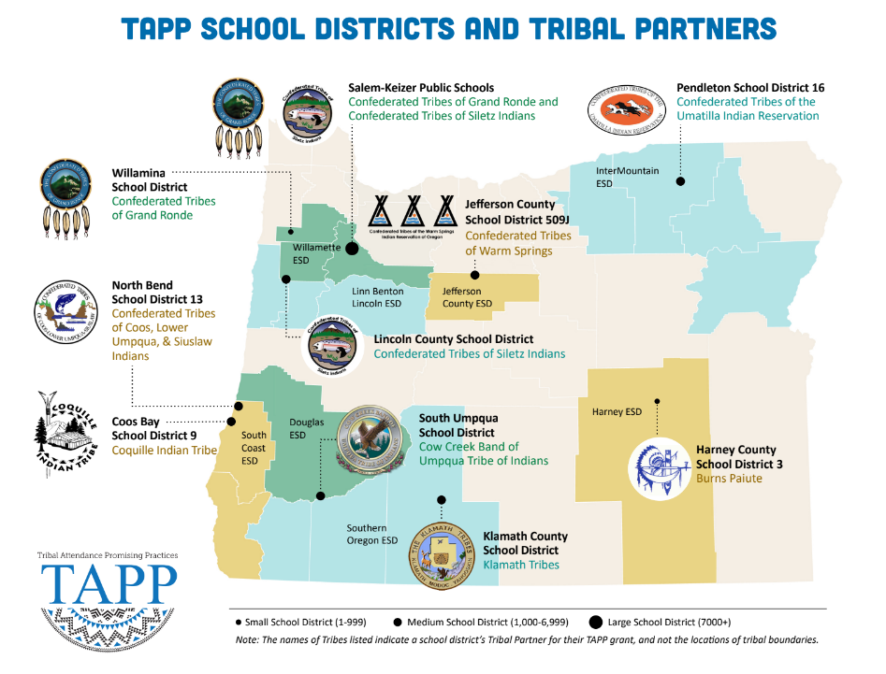
⭐ Indicates TAPP Expansion Position
Mona Smith
Stacey Jacobs
Ray Fox ⭐
Rebecca Arredondo
Mike Solem ⭐
Atcitty Begay
[TBD] ⭐
[TBD] ⭐
RuthEllen Melton
Crystal Hinds
Bre Landrum
Vacancy
Scott Smyth
Janelle Emard
[TBD] ⭐

Slide 4

TAPP Family Advocate Check-In
Roll Call.
What color best represents how you are feeling right now and why?

Slide 5
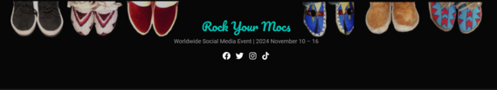
Rock Your Mocs Week - Official Day Nov. 15

Slide 6

Recognition of Upcoming Restoration Celebrations!
Confederated Tribes of Siletz Indians 47th Restoration Celebration November 16th, 2024
In 1956, the Bureau of Indian Affairs ended formal recognition of the Confederated Tribes of Siletz Indians. This resulted in the selling or deeding of the remaining parcels of Siletz reservation land to non-Native people,
“With no tribal business to conduct, tribal meetings lapsed and gatherings were now held by families rather than the larger tribal community. There was a lingering sadness, broken hearts, at a life with few dances, songs, and stories—and no land.” (Wilkinson, 2010, p. 306)
In the 1970s, several Siletz families began meeting to discuss how to organize a campaign to restore federal recognition of the Confederated Tribes of Siletz Indians. Ultimately, the Tribe succeeded, and the Siletz Restoration Act was passed and signed into law on November 18, 1977.
-Excerpts from the CTSI Tribal Curriculum, available for public use

Slide 7
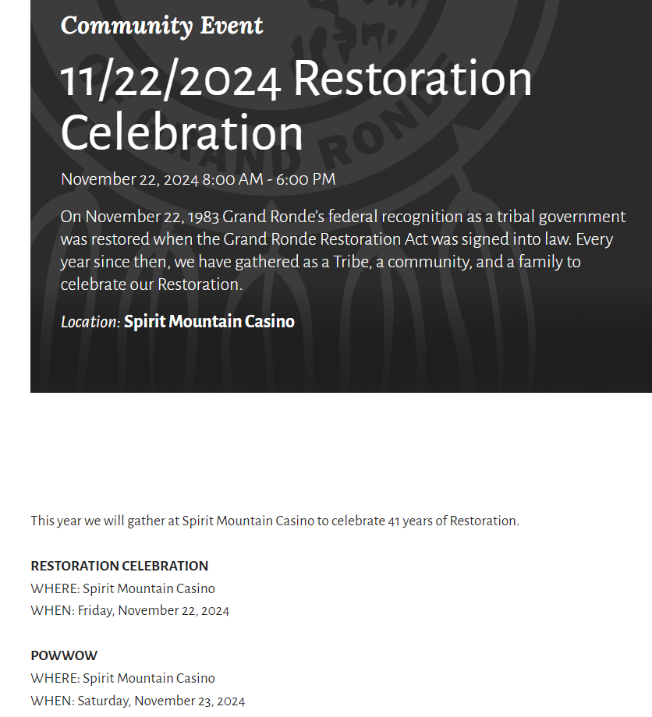

Recognition of Upcoming Restoration Celebrations!
Confederated Tribes of Grand Ronde Restoration Holiday November 22nd - 23rd
August 13, 1954 - Public Law 588, Western Oregon Indian Termination Act was signed into law by President Dwight D. Eisenhower.
This act terminated the Tribes’ federal recognition and removed all agreements that had been negotiated through treaties between the United States government and the Confederated Tribes of Grand Ronde.
63 tribes total were terminated in Oregon. More tribes were terminated in Western Oregon than any other region of the U.S.
In the early 1970s, efforts began to reverse the tide of termination. Tribal people, with the help of a few select politicians on the state and federal level, worked for nearly 11 years to regain their status as a Federally Recognized Tribes. On November 22, 1983, with the signing of Public Law 98-165, the Grand Ronde Restoration Act, the task was accomplished.
-Excerpts from the CTGR Tribal Curriculum, available for public use

Slide 8
Boarding School Apology
Even if you watched the speech, please take a few minutes to read this excerpt from President Joe Biden’s speech, regarding the apology on American Indian Boarding School policy –
Excerpt
The acknowledgement and apology was the first step named by the Department of the Interior from their findings from the Federal Boarding Schools Initiative. Here was the second volume of the report.
After reading the excerpt, we will have a discussion on both the apology and the impacts of termination and restoration on tribes.

Slide 9
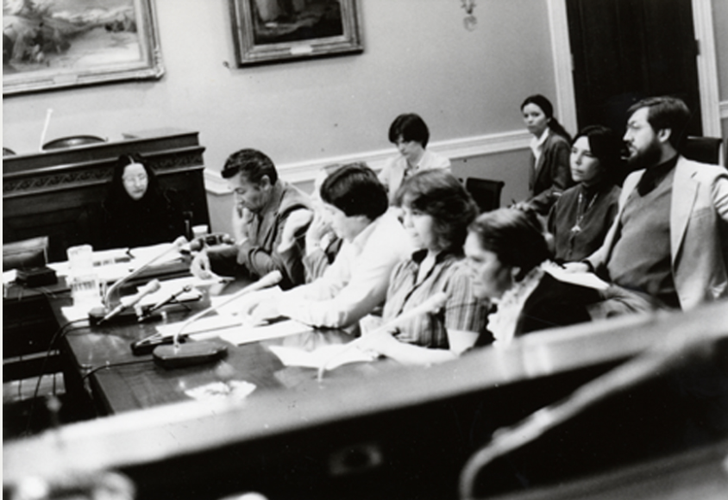
Whole Group Reflection
If we [educators hired to support Native students and their families and one of many educators serving in unique geographical contexts because we are neighbors to Sovereign Nations] do not take the time and attention to understand the impacts of this Nation’s history of policy as a whole, we will never be able to contextualize the origins and impacts of targeted systemic racism on Native Nations and Native people.
And we certainly won’t be able to address the root causes of chronic absenteeism of Native students.
Share your reactions to this [termination, restoration, boarding school apology, etc] and what you are sitting with after reading the above statement.
Grand Ronde Restoration Hearing, 1983. Grand Ronde Restoration Hearing, 1983 Courtesy Oreg. Hist. Soc. Research Lib., OrHi 101587
Notes:
My hope is that this whole group discussion will help us better understand the importance of why we are taking more time this year to talk about the Attendance Works frameworks. Without

Slide 10
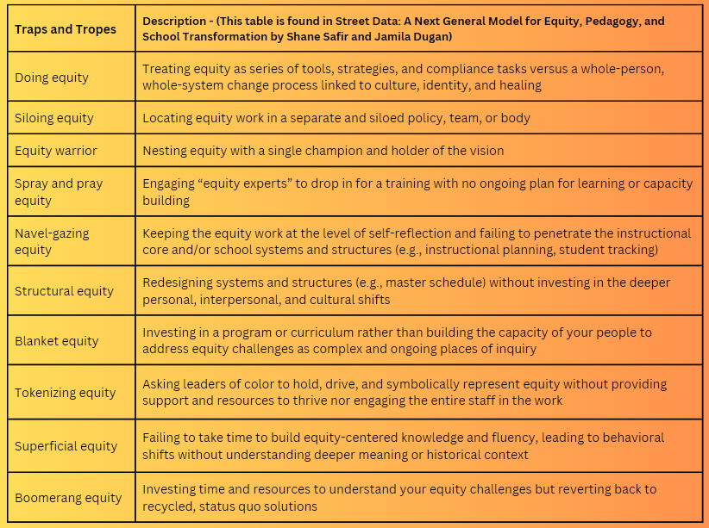
-Which traps and tropes sound or feel familiar to you?
-Where do you see a trap or trope playing out in your school or organizational context?
-What traps or tropes might students and families identify in your context? Are they the same or different from the ones you identified? Why might that be?

Slide 11
TAPP Work Session
TAPP Best Practices - Always Refining

Slide 12
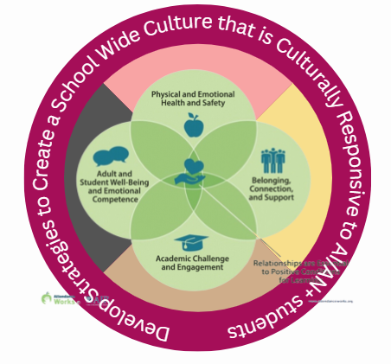
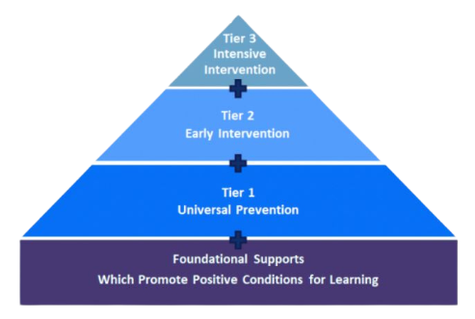

Attendance Works Foundational Supports with TAPP Promising Practices
Adapted from Attendance Works: 3 Tiers of Intervention
https://www.attendanceworks.org/chronic-absence/addressing-chronic-absence/3-tiers-of-intervention/
Notes:
I want us to be anchored and I want us to be able to both be affirmed in our work and also have a visual that helps us capture what TAPP work looks like.

Slide 13
Complex Versus Complicated Challenges
Complex Challenges
The solution to the challenge is not immediately obvious but can be known prior to taking action. These challenges are hard to solve, but can be addressed by assembling the right technical expertise. Examples of complicated challenges include -
Designing a TAPP program to address the root causes of chronic absenteeism in Native students
Increasing diversity by hiring more staff of color
Complicated Challenges
The solution to the challenge is not known and can only be seen or known during or after the action unfolds. Equity challenges are complex in nature. There is no set of steps or algorithm that will tell you how to respond. Examples include -
Shifting a school culture so all students are taught rigorous and engaging content using culturally responsive methods in trauma informed classrooms.
Creating an inclusive and collaborative staff culture in which Black, Indigenous, and brown staff are valued, empowered, and able to be authentic.

Slide 14
Last Month We…
Reflected on the Foundational Conditions present at a school we serve by identifying concrete examples for each condition. We added them in this Padlet.
We read this passage from Street Data: A Next Generation Model for Equity, Pedagogy, and School Transformation by Shane Safir and Jamila Dugan.
We reflected on the Street Data we have collected and gathered since the start of the year.
Then, based on your individual “street data” you reflected on what that data might be saying about one or more of the Foundational Conditions present at a school we serve.

Slide 15
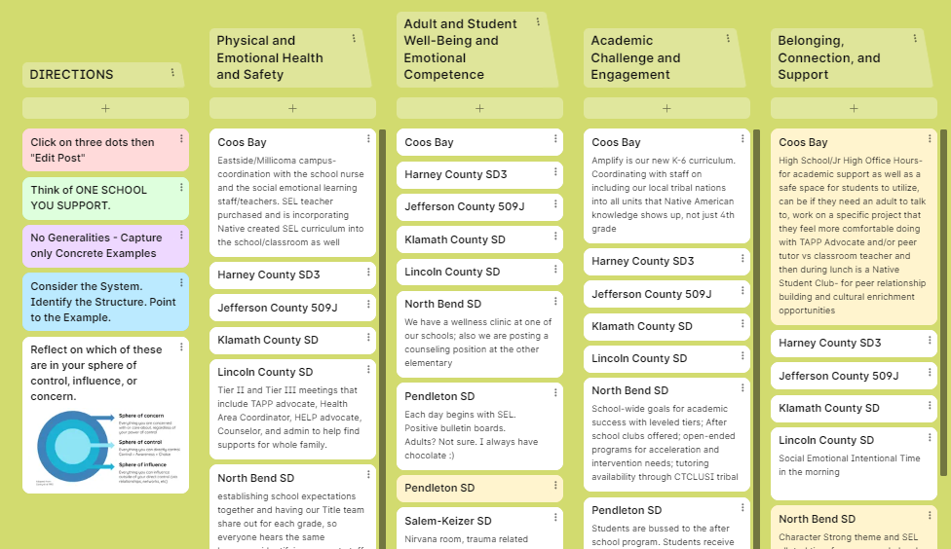
Looking Back on Last Month’s Learning
Last month you identified a foundational area which could be strengthened given the Street Data you have received from students, families, and educators this school year.
Physical and Emotional Health and Safety
Adult and Student Well-Being and Emotional Competence
Academic Challenge and Engagement
Belonging, Connection, and Support
What have you further observed about that foundational area or other areas since we last met? What have your noticings been? Did you have the opportunity to address the gap you identified in any way, no matter how small?

Slide 16
Attendance Works Foundational Supports with TAPP Promising Practices
Adapted from Attendance Works: 3 Tiers of Intervention
https://www.attendanceworks.org/chronic-absence/addressing-chronic-absence/3-tiers-of-intervention/
Notes:
I want us to be anchored and I want us to be able to both be affirmed in our work and also have a visual that helps us capture what TAPP work looks like.

Slide 17
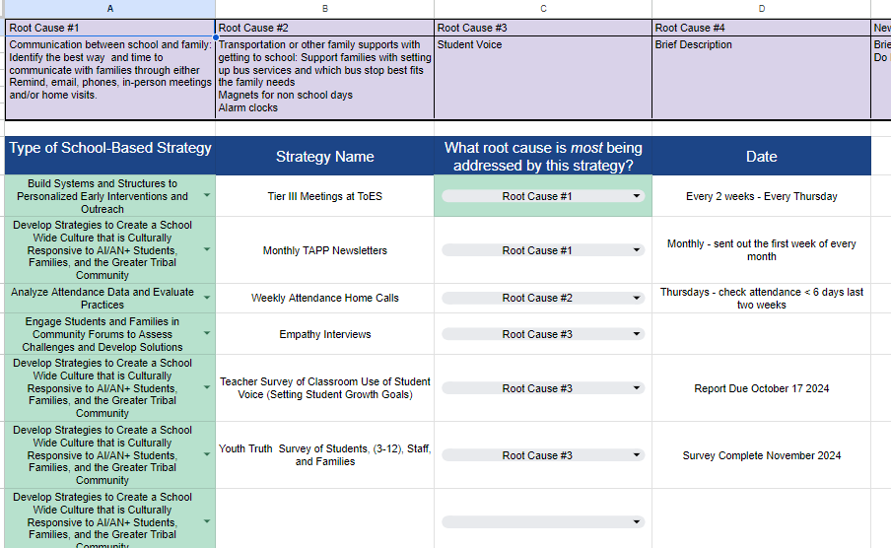
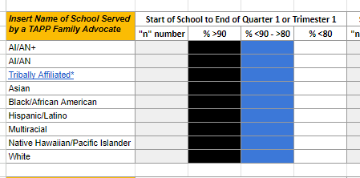
Looking Ahead - TAPP Quarterly Webinar #2
Reflection of Quarter 1 or Trimester 1
What is the data [satellite, map, and street] revealing to us?
To what extent is our balanced approach to addressing the root causes of chronic absenteeism effective for all tiered levels of students?
Where do we need to adjust?
Are our Root Causes the right Root Causes?
Pre-Work
Strategy Tracking and Data Justice Logs
Attendance Tracker
Tiered Attendance Systems Self-Assessment

Slide 18
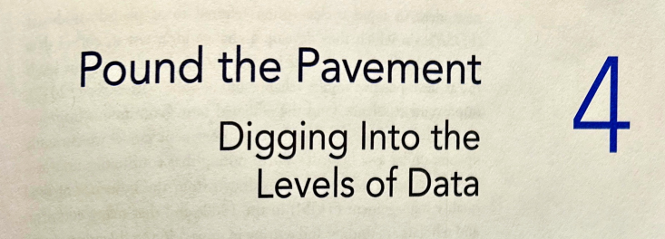
Digging Deeper into Root Causes
Read this excerpt from Street Data Chapter 4.
Reflect on what is resonating with you as you read this section.
First, what phrases stuck out to you and why.
What are you learning about deep listening and what does it make you think about in relation to your TAPP work.

Slide 19
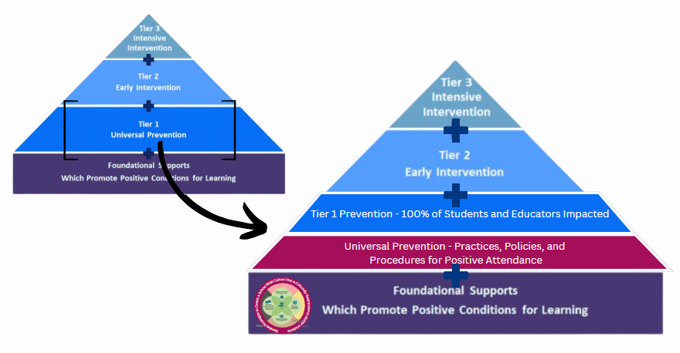

Slide 20
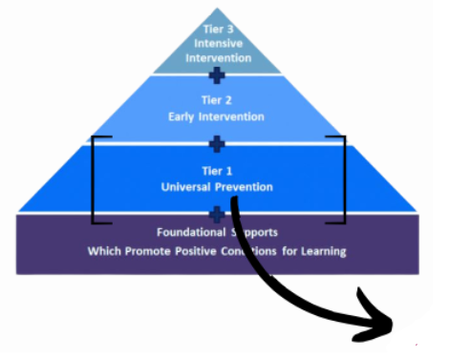
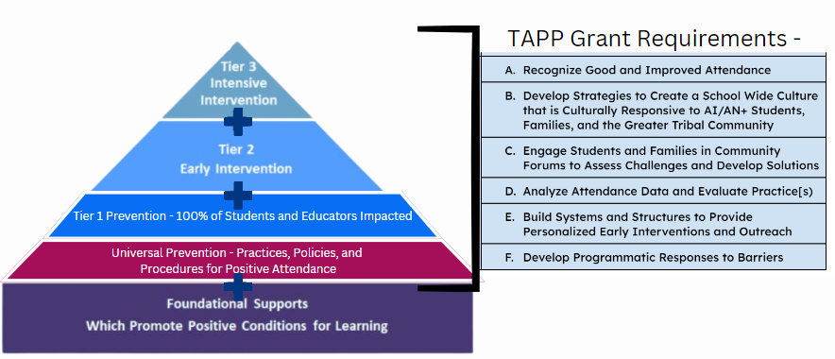

Slide 21
Notes:
This will be the primary focus of our work in the monthly TAPP Family Advocate meetings this school year.
If you have not already, please take the Self-Assessment linked in the previous slide individually and then as a team to determine the health of your tiered attendance systems.
The Spring TAPP Site Visits from last school year revealed two key areas of improvement for all TAPP sites.
Many TAPP Family Advocates are working in isolation, most in buildings without a structured attendance team or a tiered support team (or, they are not invited to join these teams). This limits their ability to build systems and structures to provide proactive interventions to students and to elevate barriers impacting AI/AN+ students to individuals with positional power and authority in the schools to address them.
Second, while TAPP Family Advocates are working diligently to support students and their families in attending school regularly, they are doing it in environments where the Tier 1 structures in a school require immediate (at times) and ongoing attention – a responsibility of building and district leaders. TAPP Family Advocates are in a unique position to “see” both the strengths of a school community and the gaps and deficits which greatly impact our Native youth. I challenge all of our Project Directors to listen-in to the experiences of our TAPP Family Advocates, because their knowledge and stories have the power to strengthen every system, structure, and educator in the buildings they serve – and beyond!

Slide 22
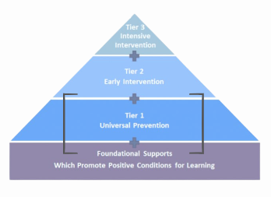
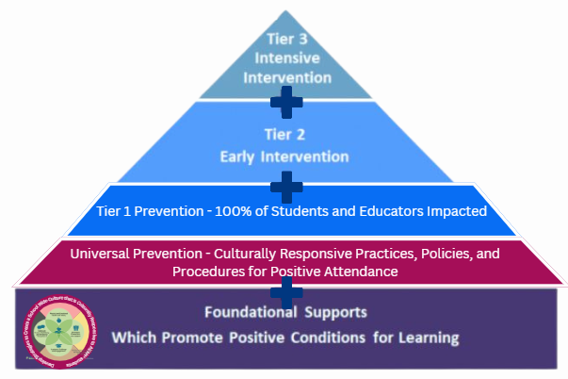
Attendance Works Foundational Supports with TAPP Promising Practices
]
Students and families attending <80%
Students and families attending 80-89%
All students, families, support staff, and educators
All students, families, support staff and educators; influenced by TAPP
All students, families, support staff, and educators; influenced by TAPP

Slide 23
Important Reminders
TAPP Activity Named in the Grant - “Grantee will be responsive to Agency’s Grant Manager request for information or data, trainings, or reporting requirements, and allow site visits from Agency.”

Slide 24
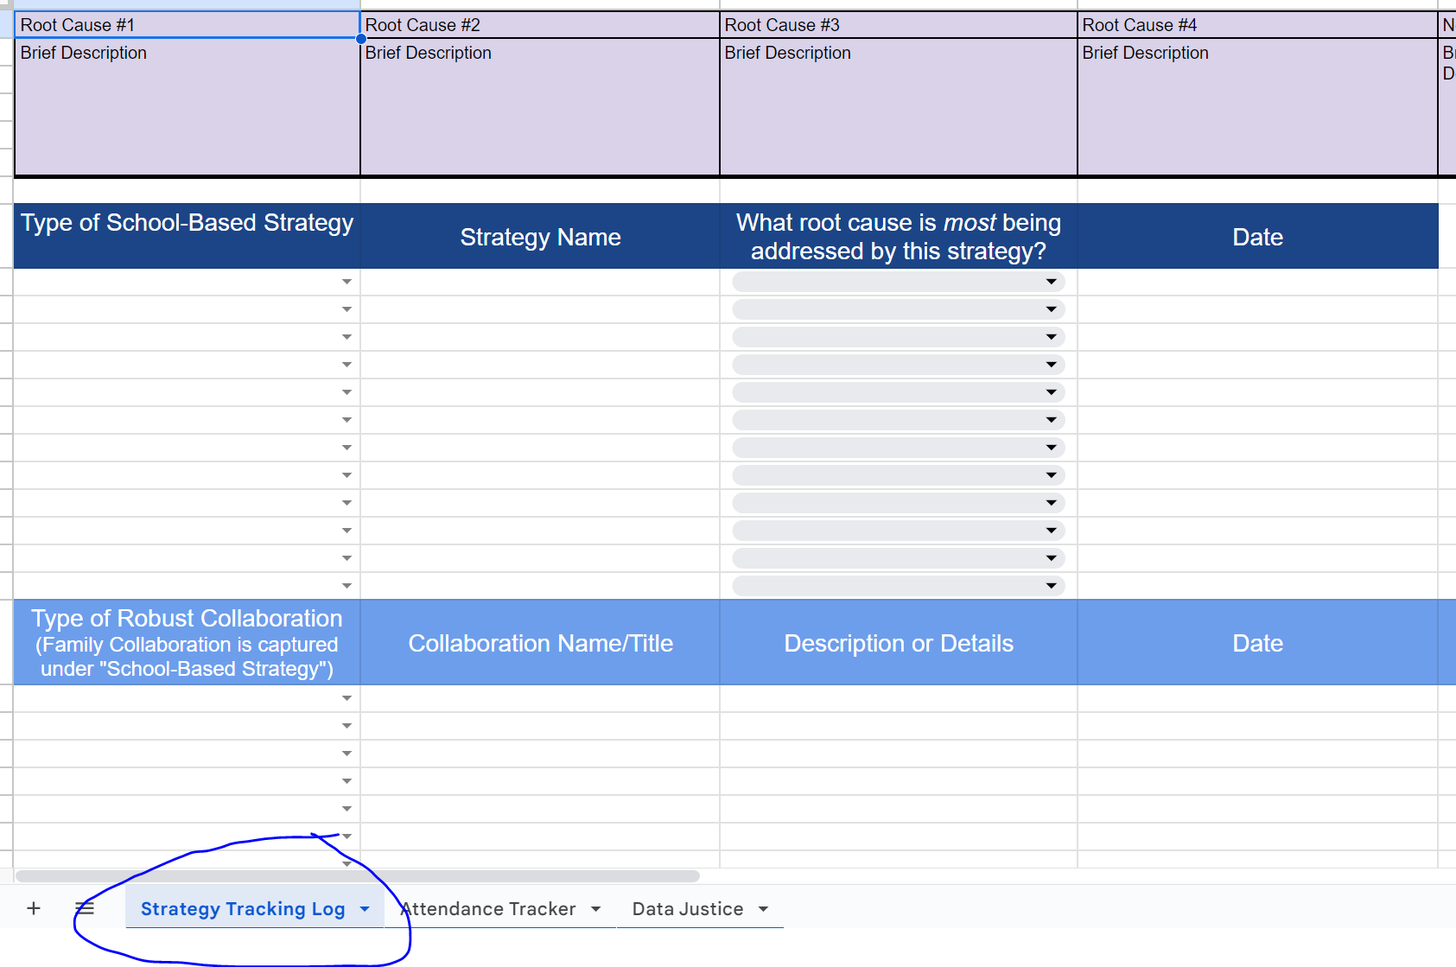
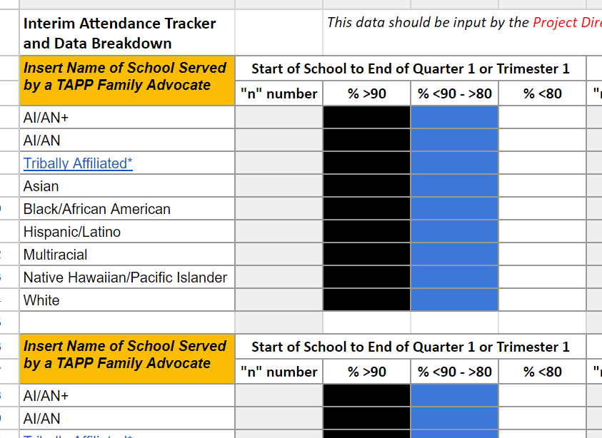
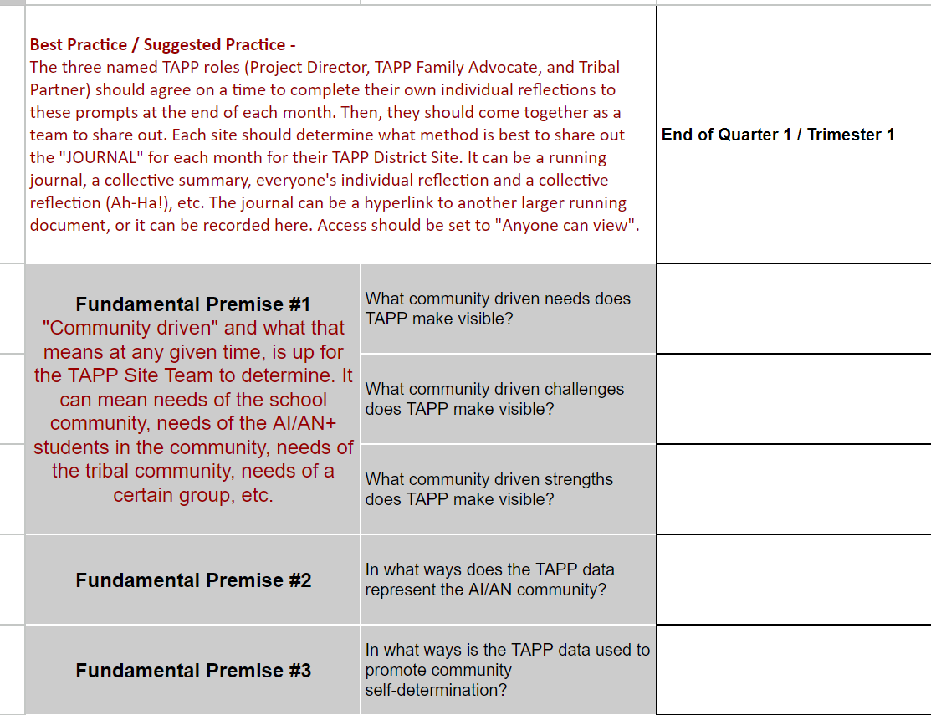
Updating the TAPP Dashboard
Who: TAPP Family Advocate
When: At least monthly, ideally is twice monthly
Note: Multiple Advocates means multiple Strategy Tracking Logs
STRATEGY TRACKING LOG
Who: Project Director or their proxy
When: Quarterly or Trimesterly
ATTENDANCE TRACKER
DATA JUSTICE LOG
Who: The Entire TAPP Team
When: Quarterly or Trimesterly

Slide 25
2024-2025 TAPP Districts’ Dashboard
Key Resources and Documents
Dashboard Orientation Video - 11 minutes
TAPP Program Promising and Best Practices – This document underwent a comprehensive revision this summer. It is important to revisit this document individually and as a team. There are four key sections to the document –
SECTION I. General TAPP Grant Execution - Lessons Learned
SECTION II. Setting the TAPP Family Advocate Up for Success NEW Advocate? START HERE!
SECTION III. Foundational Supports for AI/AN Students that Lead to Positive Conditions for Learning (Includes a self-assessment to utilize with school teams!)
SECTION IV. Culturally Responsive Tiered Attendance Systems (also includes a self-assessment to utilize with school teams!)

Slide 26
Text Parrish anytime at 971-208-0270
Or - send me an email. Call if you must.
There is no such thing as, “I know you are busy”. I am here for you.

