Slide 1

TAPP Family Advocate Monthly Meeting
Saturday Dec 21
December 12, 2024 - 12:30-2:30PM
✅ Welcome! Please say hello to your colleagues in the Zoom. Rename yourself to your Name, school district initials, Tribal Partner(s), and pronouns.
✅ Materials Needed - Street Data book, Writing utensils, notebook, ambo (water), snacks, reading glasses, any other materials to help you feel comfortable.

Slide 2
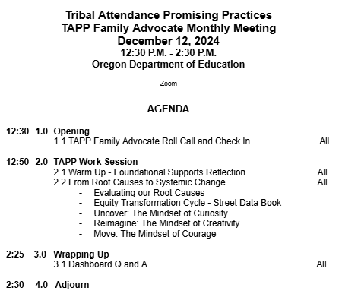

TAPP December Monthly Meeting Agenda
Notes:
Based upon timing I believe that today we will only make it to the uncover stage. this stage is all about evaluating the street data that you are receiving. both that street data you inevitably collect on the Fly - you know - through daily attendance phone calls to morning check-ins with students when teachers stop you in the hallway to also the intentional methods in which you collect Street data. for example, empathy interviews, reviewing student data from surveys the district administers, from circles you do with your Native American clubs. our Focus for the work session today is to practice and sharpen our skill at identifying root causes that can help us shift our support and our tiered responses so that we are leveraging educators, resources, and all of the systems that help with attendance or do work that is aligned to attendance, are being developed address what our students need. the activities will do today might feel a bit redundant, but we're working on that skill of moving from root causes to putting forth a plan that impacts systems in place to support students. as we wind down today, and if we only get to the uncover stage, if you notice if you notice that you are getting itchy for the Next phase of this work, then I will make sure to leave you with the slides and the activities to start diving in to the planning phase of the equity transformation cycle.

Slide 3
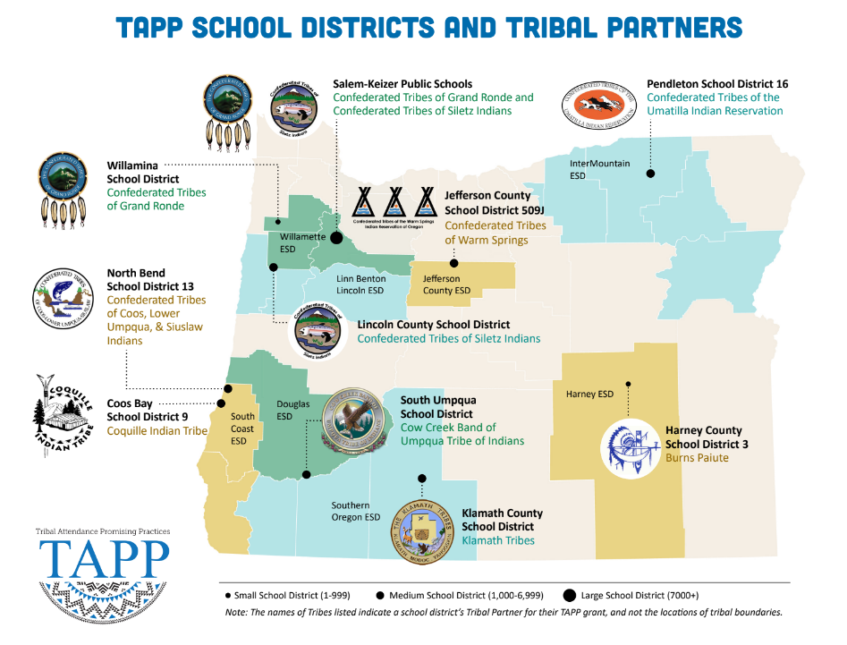
⭐ Indicates TAPP Expansion Position
Mona Smith
Stacey Jacobs
Ray Fox ⭐
Rebecca Arredondo
Mike Solem ⭐
Atcitty Begay
[TBD] ⭐
[TBD] ⭐
RuthEllen Melton
Crystal Hinds
Bre Landrum
Vacancy
Scott Smyth
Janelle Emard
[TBD] ⭐

Slide 4

TAPP Family Advocate Check-In
Roll Call.
What winter symbol or image best represents how you are feeling right now and why?

Slide 5
TAPP Work Session
from Root Causes to Systemic Change
Notes:
12:50AM -

Slide 6
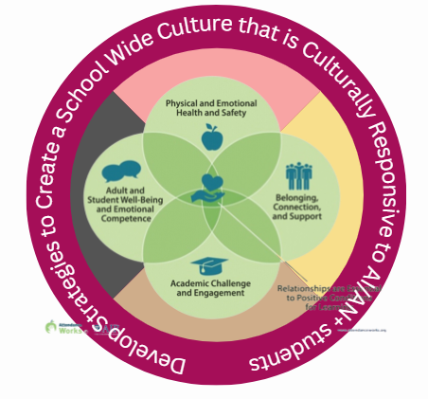
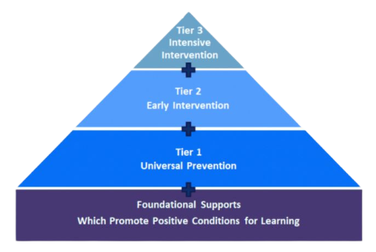

Attendance Works Foundational Supports with TAPP Promising Practices
Adapted from Attendance Works: 3 Tiers of Intervention
https://www.attendanceworks.org/chronic-absence/addressing-chronic-absence/3-tiers-of-intervention/
Notes:
Say: this school year we've really tried to ground ourselves in these two visuals that we have now adapted from attendance works as a way to discipline ourselves To ask questions about the supports, the very intentional supports in place in our respective top schools, that tend to these four quadrants. given the high percentages of chronic absenteeism in place in our school districts, the data pushes us to go back to these four areas to make sure we are doing all that we can in collaborations with others, to best develop a school-wide culture that is culturally responsive to our native students.

Slide 7
Warm Up
60 seconds silent think time then
Whole Group Share Out
Think of your highest need TAPP site (school).
At this point in the year, which domain is the strongest for all students? What is in place in that domain that is positively impacting the conditions for students engaging in learning.
What domain is the strongest for AI/AN+ students? Why?
Notes:
I want us to be anchored and I want us to be able to both be affirmed in our work and also have a visual that helps us capture what TAPP work looks like.
Say: Let's do a quick warm up. [Read slide]. It is important that we are making the distinction between efforts for all student and then efforts for our Native youth. (TAPP grant requirement)

Slide 8
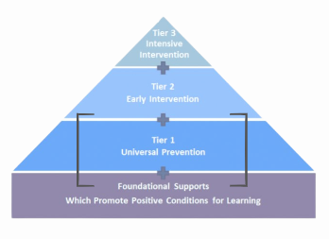
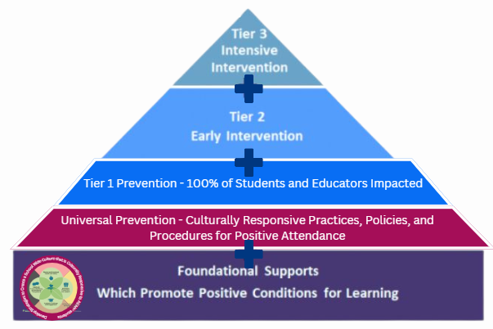
Tiered Support for Attendance
Students and families attending <80%
Students and families attending 80-89%
All students, families, support staff, and educators
All students, families, support staff and educators; influenced by TAPP
All students, families, support staff, and educators; influenced by TAPP
Notes:
MAKE SCRIPT
During the last quarterly webinar we were able to dip our toes in our teams to start completing the self-assessment in relation to our tiered supports and talking as a group about adjustments we need to make with our tiered response based on attendance needs.
For any student and family falling within these attendance threshhold, we have an obligation to implement supports and strategies to respond to need.

Slide 9
Guiding Question - What is the relationship between our root causes, tiered support systems, and systemic change?
For today’s Work Session -
Never lose sight of your Root Causes
Think about your TAPP work and the work your school(s) do with attendance
We will dig deeper into the Equity Transformation Cycle. Think about it as a mental and collaborative model for change.
  Refining our Root Causes
  Understand the relationship between addressing your Root Causes and Systemic Change

Slide 10
Systemic Change - What is it?
Sustainable, long-lasting changes at a systemwide level - district, school, department, classroom - that alter the status quo, including outcomes and people’s experiences in and with the system.
Systemic change requires shifts in the structures of a system and how it operates. This includes changes in the system’s values, policies, resources, practices, relationships, and power structures.
Notes:
Say: Let’s calibrate, because like all other great educational concepts, Systemic Change has become a buzzword and worse, a trend, and it isn’t cute. It is not a pinterest board. It is mucky, but satisfying work.
READ THE SLIDE.
Then ask, “What words are sticking out to you from this definition?”
Because if our moral compass or North Star is not deeply committed to Systemic Change, we will fall and fall hard into these Equity Traps and Tropes.

Slide 11
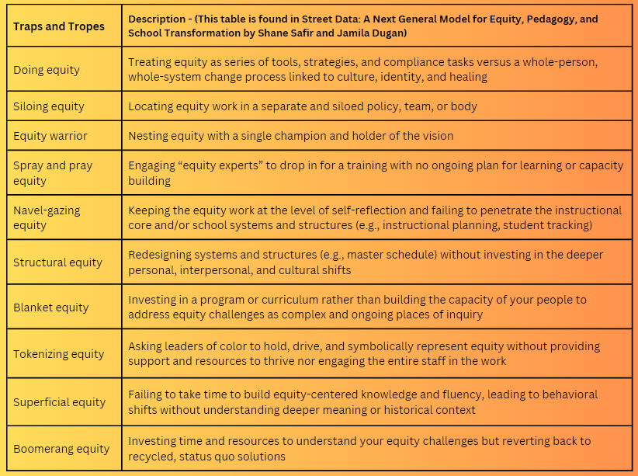
Turn to pages 32-33
First, READ the chart, jotting notes as you go along in response to the three questions below.
-Which traps and tropes sound or feel familiar to you?
-Where do you see a trap or trope playing out in your school or organizational context?
-What traps or tropes might students and families identify in your context? Are they the same or different from the ones you identified? Why might that be?
Notes:
Say: So that we are REALLY CALIBRATED on what Systemic Change is, let’s talk about what it is not. Take out your notebook or journal.
READ SLIDE -
5 Minutes for READING and REFLECTING, then share out.

Slide 12
Systemic Change - What is it?
Sustainable, long-lasting changes at a systemwide level - district, school, department, classroom - that alter the status quo, including outcomes and people’s experiences in and with the system.
Systemic change requires shifts in the structures of a system and how it operates. This includes changes in the system’s values, policies, resources, practices, relationships, and power structures.
Notes:
Say: Remember, as we dive into this work session, we are talking about Systemic Change.

Slide 13
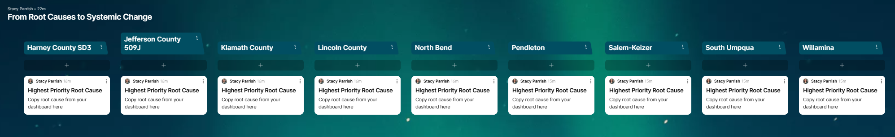
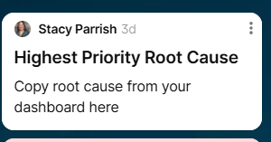
Step 1 -
Open your TAPP Dashboard.
Toggle to the Strategy Tracking Log
Identify a Root Cause from the purple section you want to workshop today.
Copy it into the Padlet by clicking on the three dots of the prompt “Highest Priority Root Cause” and select “Edit Post”.
Notes:
Now let’s go back to our existing root cause statements. Highest Priority only means it is highest priority that you really workshop, interrogate and unpack it today. This Padlet will be used in January as well.

Slide 14
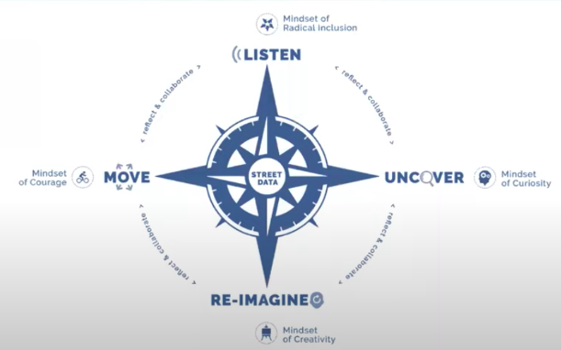
Quick Read - Equity Transformation Cycle
5 minutes - Read with a pen in hand.
Pages 74-76 provide a high level overview of the Equity Transformation Cycle.
Study the graphic and then read the two pages to help shape how this is a mental and collaborative model for “systemic change”.
Identify powerful or compelling statements to share with the group.
Notes:
Note to facilitator - Create groups -

Slide 15
Uncover: The Mindset of Curiosity
3 Minutes
The “Uncover” stage of the Equity Transformation Cycle is where we start surfacing our root causes by listening deeply to the people and groups we serve.
Read page 86 to the first paragraph on page 87.
While you read, track the most important attributes of this stage as you “uncover” root causes of chronic absenteeism.
Also, what are tactics you use to collect street data to examine for root causes.
Note: After this reflection, have a whole-group discussion. Then, we will all engage in the Iceberg activity, while also using pieces from Peeling the Onion.
Notes:
Say: Read the slide. Remind everyone at the last meeting, we read about Listen: Mindset of Radical Inclusion. No one is left out. No one is pushed out. No one is made to feel they are not part of the community. No one is made to feel less than anyone else – and with our Native youth, they are made to feel centered in their schools because of the richness they bring from being a member of a Sovereign Nation.

Slide 16
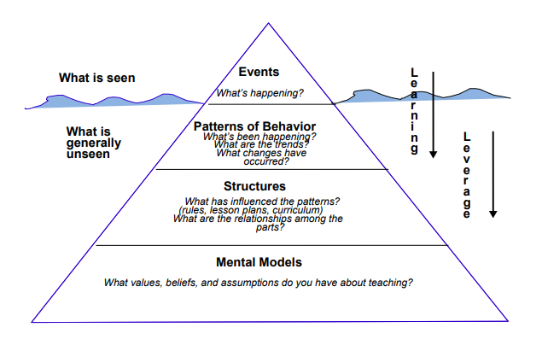
The Iceberg Protocol
The Iceberg Model is a systems thinking tool designed to help an individual or group discover the patterns of behavior, supporting structures, and mental models that underlie a particular event – in our case – a particular Root Cause.
policies, procedures
supporting AI/AN+ students with positive attendance
Notes:
Say: This chapter provides you with two protocols on how to take the multitude of STreet Data you are receiving and intentionally seeking (empathy interviews, from student surveys, etc).
Talk through – Let’s unpack this graphic. Let’s start with the far right down arrows. You see the “Learning arrow”. It aligns to the top of the pyramid, Specifically questions to ask to learn more about what's happening in regards to the root cause and what's been happening in relation to the root cause. What are the trends you're seeing in the street data in particular for this root cause? What changes have occurred with the root cause perhaps over time or perhaps in relation to a new initiative being enacted. Maybe changes have occurred with the root cause due to staff turnover or significant events which have happened in the school, district, or local or tribal community. Then you see the second down arrow that has to do with Leverage. The further down on the pyramid you get the more you start seeing that both the structures and the mental models are two things that can be leveraged in relation to a particular root cause, but while you are doing this iceberg protocol, you are interrogating the Structures in place which influence the patterns you see with the root cause (time of year? Grade levels? Schools? etc). With this section you ask yourself what are the relationships among the parts to this root cause — Think about that question in terms of in what ways are the various structures in the school and in the district related to the root cause? Furthermore, what mental models are impacting the root cause? I will push you to not see the “you” here as “just you, the advocate”, but “you” as the system, as the school, as the district representative, as the district itself – What values, beliefs, and assumptions does the system have about supporting AI/AN + students with positive attendance? This is not a time for broad strokes – not a time for “we” statements. It is more a time for considering the values, beliefs, and assumptions of all entities – support staff, department teams, grade level teams, district teams, attendance teams, SPED teams, discipline deans, school leaders, etc. Reflecting on this part of the triangle is about interrogating all of these parts in relation to the root cause. Each mental model held by different educators and different teams and maybe at different locations matters.Try not to just reflect on these mental models as binary – as black and white or good or bad – sometimes the biggest threat to our Native youth is mediocrity and not overt harm.

Slide 17
Your Turn - The Iceberg Protocol
Turn a piece of paper sideways. Draw the Iceberg Protocol.
Make it BIG (fill your paper), so you have lots of space to add your reflections and thoughts.
Include the labels, but not the questions. This slide will be up as you engage in your reflection.
policies, procedures
supporting AI/AN+ students with positive attendance

Slide 18
The Iceberg Protocol
12 minutes -
Consider the Root Cause you want to think more deeply about.
Being as detailed as possible, respond to each section of the triangle.
Remember, this is the “Uncover” state. Maintain a Mindset of Curiosity as you do this.
policies, procedures
supporting AI/AN+ students with positive attendance

Slide 19
Peer Share Out and One-Way Feedback Cycle
PROTOCOL
In groups, take turns. First sharer –
1 MINUTE - Succinctly your Root Cause from the Padlet.
2 MINUTES - Read through your Iceberg Protocol in this order -
  Events (What is seen…)
  Patterns of Behavior (What is generally unseen…)
2 MINUTES - After “a and b” have been shared, each listener speaks to the same prompt in order. You can respond multiple times to the same prompt. The facilitator does NOT respond, but they remain silent and takes notes -
What I heard the presenter say is….
One assumption that seems to be part of the dilemma is…
2 MINUTES - The sharer continues sharing out on -
  Structures and Mental Models (What you can leverage to address this…)
2 MINUTES - After “a” has been shared, each listener speaks to the same prompt in order, responding multiple times to the same prompt if needed. The facilitator does NOT respond, but takes notes -
A question that raises for me is….
What if…..? Or “Have we thought about…” or “I wonder…”
3 MINUTES - The sharer reviews their notes and reflects aloud on what they are learning and thinking more deeply about. The process repeats.
Group 1 -
Group 2 -
Group 3 -
Designate a timer; use the elder interruption.
Notes:
We cannot do this alone. The chapter talked about “ It is critical to do that in a collaborative fashion by studying the data with a team.”
So now, we are going to move into a Peer Share Out and Feedback Cycle on our respective Iceberg Protocols.
Note to facilitator - Create groups -
Copy this in a stand along slidedeck

Slide 20
Coming Back Together -
What about this process was useful? Frustrating? Interesting?
What new insights did it bring up?
Notes:
Now let’s go back to our existing root cause statements.

Slide 21
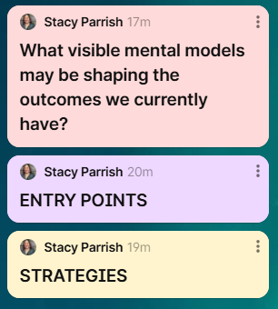
Step 2 - Return to your Padlet.
Using your new insights and reflections, take some time to capture three things –
  What visible mental models may be shaping the outcomes you currently have?
  Entry Points – consider the systems and structures in place; current focus of professional development of educators, etc
  Strategies - What approaches can you use to address this root cause?
Notes:
Now let’s go back to our existing root cause statements. Highest Priority only means it is highest priority that you really workshop, interrogate and unpack it today. This Padlet will be used in January as well.

Slide 22
[School District]
Equity Transformation Cycle: [Our Problem of Practice]
ENTRY POINTS
STRATEGIES
SHORT TERM OUTCOMES
WHAT INVISIBLE MENTAL MODELS may be shaping the outcomes we currently have?
DESIRED LONG TERM IMPACT
INTERMEDIATE OUTCOMES
Notes:
You are not starting from scratch. You all are already implementing a Theory of Change. This activity is to go deeply

Slide 23
Next Meeting
A Look Ahead…

Slide 24
Remember this?
From Root Causes to Systemic Change
We can’t stop at identifying the problem, because we will miss moving from the problem to the outcome. This is one of the biggest barriers to systemic change efforts.
We don’t give space and time to how change is going to happen to when it will happen to what kinds of change to who will be involved.
Notes:
So today we are going to talk about a concept known as a Theory of Change. A Theory of Change is how we can make sure we are giving space and time to how we are addressing a root cause in our respective schools or communities SYSTEMICALLY.

Slide 25
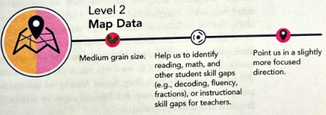
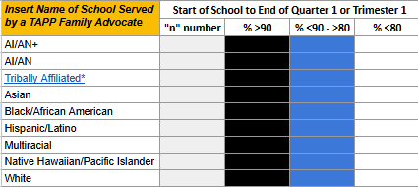
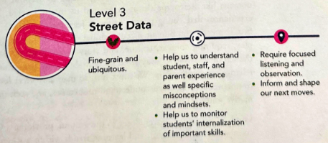
Uncover: The Mindset of Curiosity
The “Re-Imagine” and the “Move” stage of the Equity Transformation Cycle is where we start planning for our change idea and implementing it.
Read page 88-92 to the first paragraph on page 87.
As you read, think about your strengthened Root Cause. Hold it in your mind.
When you think about how you will address this root cause, ask yourself, “What are you trying to disrupt or build?”
Notes:
Participants should add this to the Padlet.

Slide 26
From Root Causes to Systemic Change
TAPP Street Data and the Map Data guides us in –
the identification of Root Causes
the creation of Tiered Support
Fundamental Understanding - Our tiered support must be in service to systemic change.
We can’t stop at identifying the problem, because we will miss moving from the problem to the outcome. This is one of the biggest barriers to systemic change efforts.
We don’t give space and time to how change is going to happen to when it will happen to what kinds of change to who will be involved.
Notes:
So today we are going to talk about a concept known as a Theory of Change. A Theory of Change is how we can make sure we are giving space and time to how we are addressing a root cause in our respective schools or communities SYSTEMICALLY.

Slide 27
Root Cause to Problem of Practice to Theory of Change
Your root causes become your Problem of Practice.
Your Root Causes are nagging issues or challenges that emerge within your spheres of work that do not have a single solution, but require discussion and collective problem-solving to address.
The Equity Transformation Cycle is how you are going to address the Problem of Practice.

Slide 28
[School District]
Equity Transformation Cycle: [Our Problem of Practice]
ENTRY POINTS
STRATEGIES
SHORT TERM OUTCOMES
WHAT INVISIBLE MENTAL MODELS may be shaping the outcomes we currently have?
DESIRED LONG TERM IMPACT
INTERMEDIATE OUTCOMES
Notes:
You are not starting from scratch. You all are already implementing a Theory of Change. This activity is to go deeply

Slide 29
2024-2025 TAPP Districts’ Dashboard
Key Resources and Documents
2024-2025 TAPP Districts’ Dashboard
Dashboard Orientation Video - 11 minutes
TAPP Shared Folder
TAPP Program Promising and Best Practices – This document underwent a comprehensive revision this summer. It is important to revisit this document individually and as a team. There are four key sections to the document –
SECTION I. General TAPP Grant Execution - Lessons Learned
SECTION II. Setting the TAPP Family Advocate Up for Success NEW Advocate? START HERE!
SECTION III. Foundational Supports for AI/AN Students that Lead to Positive Conditions for Learning (Includes a self-assessment to utilize with school teams!)
SECTION IV. Culturally Responsive Tiered Attendance Systems (also includes a self-assessment to utilize with school teams!)

Slide 30
Text Parrish anytime at 971-208-0270
Or - send me an email. Call if you must.
There is no such thing as, “I know you are busy”. I am here for you.

