Slide 1
TAPP Family Advocate Monthly Meeting Part 2
Saturday Dec 21
January 23, 2025 - 12:30-2:30PM
✅ Materials Needed - Iceberg protocol notes, Street Data book, Writing utensils, notebook, ambo (water), snacks, reading glasses, any other materials to help you feel comfortable.

Slide 2
TAPP Work Session
from Root Causes to Systemic Change
Notes:
12:50AM -

Slide 3
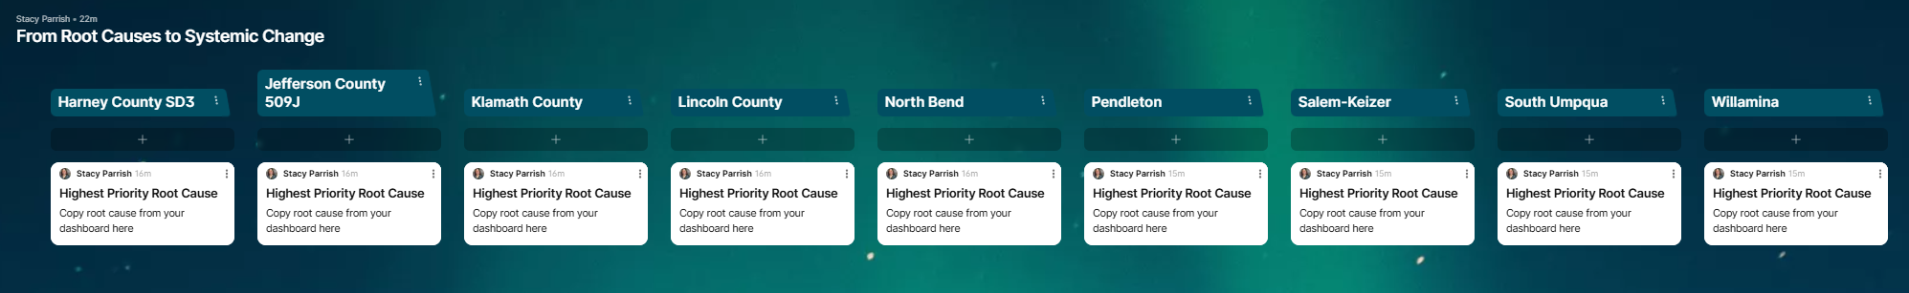
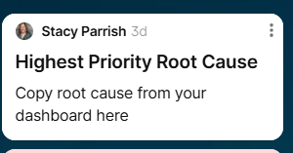
Diving Back In -
Open up the Padlet.
Re-read your Root Cause and the comments I have added to it.
Make any edits or adjustments to your Root Cause based on the feedback I have provided and any new insights you have gained since we last met.
Notes:
Now let’s go back to our existing root cause statements. Highest Priority only means it is highest priority that you really workshop, interrogate and unpack it today. This Padlet will be used in January as well.

Slide 4
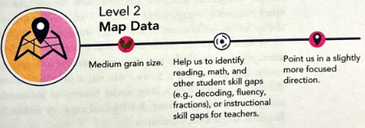
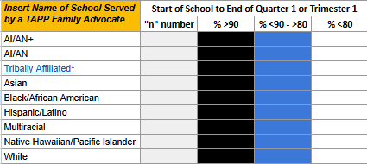
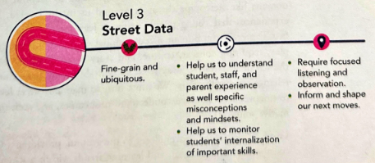
Uncover: The Mindset of Curiosity
The “Re-Imagine” and the “Move” stage of the Equity Transformation Cycle is where we start planning for our change idea and implementing it.
Read page 88-92.
As you read, think about your strengthened Root Cause. Remind yourself of all of the Street Data you have collected from empathy interviews, surveys, 1:1 conversations, etc. Hold that in your mind.
When you think about how you will address this root cause, ask yourself, “What are you trying to disrupt or build?”
Notes:
Page 86-93 - scroll to 88

Slide 5
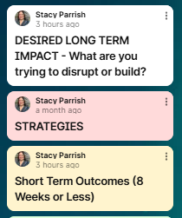
Step 2 - Return to your Padlet.
Using your new insights and reflections, complete the following in the Padlet –
  Desired Long Term Impacts you hope to see as you address your Root Cause
    What are you trying to disrupt or build?
    WILL YOUR LONG TERM IMPACTS LEAD TO SYSTEMIC CHANGE?
    Make any revisions you see necessary after the reading.
Notes:
Now let’s go back to our existing root cause statements. Highest Priority only means it is highest priority that you really workshop, interrogate and unpack it today. This Padlet will be used in January as well.

Slide 6
Root Cause to Problem of Practice to an Equity Transformation Cycle
Your root causes become your Problem of Practice.
Your Root Causes are nagging issues or challenges that emerge within your spheres of work that do not have a single solution, but require discussion and collective problem-solving to address.
The Equity Transformation Cycle is how change is going to happen, when it will happen, what kinds of change will happen, and who will be involved.
The ETC is how you are going to disrupt the Problem of Practice - transparently - and build something new.

Slide 7
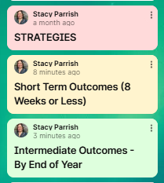
Step 3 - Return to your Padlet.
Using your new insights and reflections, respond to this question –
  Build out your Equity Transformation Cycle
Notes:
Now let’s go back to our existing root cause statements. Highest Priority only means it is highest priority that you really workshop, interrogate and unpack it today. This Padlet will be used in January as well.

Slide 8
Fundamental Question - Will our Equity Transformation Cycle lead us to Systemic Change?
Sustainable, long-lasting changes at a systemwide level - district, school, department, classroom - that alter the status quo, including outcomes and people’s experiences in and with the system.
Systemic change requires shifts in the structures of a system and how it operates. This includes changes in the system’s values, policies, resources, practices, relationships, and power structures.
Notes:
Say: Let’s calibrate, because like all other great educational concepts, Systemic Change has become a buzzword and worse, a trend, and it isn’t cute. It is not a pinterest board. It is mucky, but satisfying work.
READ THE SLIDE.
Then ask, “What words are sticking out to you from this definition?”
Because if our moral compass or North Star is not deeply committed to Systemic Change, we will fall and fall hard into these Equity Traps and Tropes.

Slide 9
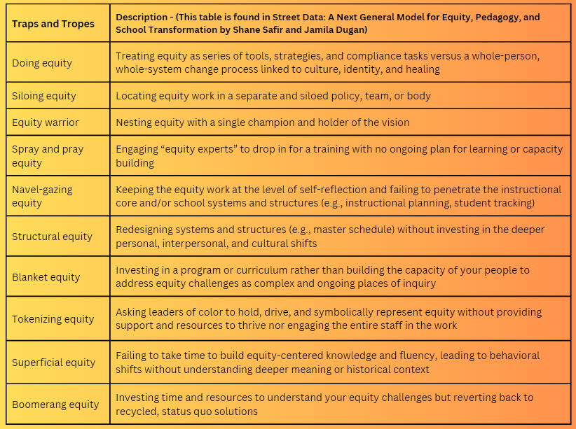
Are we are risk of falling into any of these traps and tropes? P. 32-33
Notes:
Say: So that we are REALLY CALIBRATED on what Systemic Change is, let’s talk about what it is not. Take out your notebook or journal.
READ SLIDE -
5 Minutes for READING and REFLECTING, then share out.

Slide 10
[School District]
Equity Transformation Cycle: [Our Problem of Practice]
ENTRY POINTS
STRATEGIES
SHORT TERM OUTCOMES
WHAT INVISIBLE MENTAL MODELS may be shaping the outcomes we currently have?
DESIRED LONG TERM IMPACT
INTERMEDIATE OUTCOMES
Notes:
You are not starting from scratch. You all are already implementing a Theory of Change. This activity is to go deeply

Slide 11
[School District]
Equity Transformation Cycle: [Our Problem of Practice]
ENTRY POINTS
STRATEGIES
SHORT TERM OUTCOMES
WHAT INVISIBLE MENTAL MODELS may be shaping the outcomes we currently have?
DESIRED LONG TERM IMPACT
INTERMEDIATE OUTCOMES
Notes:
You are not starting from scratch. You all are already implementing a Theory of Change. This activity is to go deeply

Slide 12
[School District]
Equity Transformation Cycle: [Our Problem of Practice]
ENTRY POINTS
STRATEGIES
SHORT TERM OUTCOMES
WHAT INVISIBLE MENTAL MODELS may be shaping the outcomes we currently have?
DESIRED LONG TERM IMPACT
INTERMEDIATE OUTCOMES
Notes:
You are not starting from scratch. You all are already implementing a Theory of Change. This activity is to go deeply

Slide 13
[School District]
Equity Transformation Cycle: [Our Problem of Practice]
ENTRY POINTS
STRATEGIES
SHORT TERM OUTCOMES
WHAT INVISIBLE MENTAL MODELS may be shaping the outcomes we currently have?
DESIRED LONG TERM IMPACT
INTERMEDIATE OUTCOMES
Notes:
You are not starting from scratch. You all are already implementing a Theory of Change. This activity is to go deeply

Slide 14
[School District]
Equity Transformation Cycle: [Our Problem of Practice]
ENTRY POINTS
STRATEGIES
SHORT TERM OUTCOMES
WHAT INVISIBLE MENTAL MODELS may be shaping the outcomes we currently have?
DESIRED LONG TERM IMPACT
INTERMEDIATE OUTCOMES
Notes:
You are not starting from scratch. You all are already implementing a Theory of Change. This activity is to go deeply

Slide 15
[School District]
Equity Transformation Cycle: [Our Problem of Practice]
ENTRY POINTS
STRATEGIES
SHORT TERM OUTCOMES
WHAT INVISIBLE MENTAL MODELS may be shaping the outcomes we currently have?
DESIRED LONG TERM IMPACT
INTERMEDIATE OUTCOMES
Notes:
You are not starting from scratch. You all are already implementing a Theory of Change. This activity is to go deeply

Slide 16
[School District]
Equity Transformation Cycle: [Our Problem of Practice]
ENTRY POINTS
STRATEGIES
SHORT TERM OUTCOMES
WHAT INVISIBLE MENTAL MODELS may be shaping the outcomes we currently have?
DESIRED LONG TERM IMPACT
INTERMEDIATE OUTCOMES
Notes:
You are not starting from scratch. You all are already implementing a Theory of Change. This activity is to go deeply

Slide 17
[School District]
Equity Transformation Cycle: [Our Problem of Practice]
ENTRY POINTS
STRATEGIES
SHORT TERM OUTCOMES
WHAT INVISIBLE MENTAL MODELS may be shaping the outcomes we currently have?
DESIRED LONG TERM IMPACT
INTERMEDIATE OUTCOMES
Notes:
You are not starting from scratch. You all are already implementing a Theory of Change. This activity is to go deeply

Slide 18
[School District]
Equity Transformation Cycle: [Our Problem of Practice]
ENTRY POINTS
STRATEGIES
SHORT TERM OUTCOMES
WHAT INVISIBLE MENTAL MODELS may be shaping the outcomes we currently have?
DESIRED LONG TERM IMPACT
INTERMEDIATE OUTCOMES
Notes:
You are not starting from scratch. You all are already implementing a Theory of Change. This activity is to go deeply

Slide 19
[School District]
Equity Transformation Cycle: [Our Problem of Practice]
ENTRY POINTS
STRATEGIES
SHORT TERM OUTCOMES
WHAT INVISIBLE MENTAL MODELS may be shaping the outcomes we currently have?
DESIRED LONG TERM IMPACT
INTERMEDIATE OUTCOMES
Notes:
You are not starting from scratch. You all are already implementing a Theory of Change. This activity is to go deeply

Slide 20
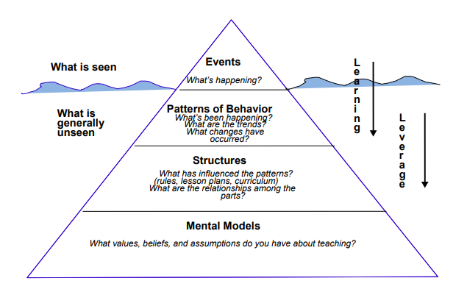
The Iceberg Protocol
5 minutes -
Think about your Root Cause.
Go back to your Iceberg Protocol reflections.
Re-read them, adding any additional reflections and details to them.
policies, procedures
supporting AI/AN+ students with positive attendance

