Slide 1
Treaties Signed by Oregon Tribes
1st grade
Math Lesson
Native American Tribes use treaties today to protect their people and traditions.
Notes:
Introduce the lesson topic to students. Let them know they will be learning about Native American Tribes in Oregon and agreements they made with the U.S. called treaties. Tell students they will be counting how many treaties were signed a few hundred years ago.

Slide 2
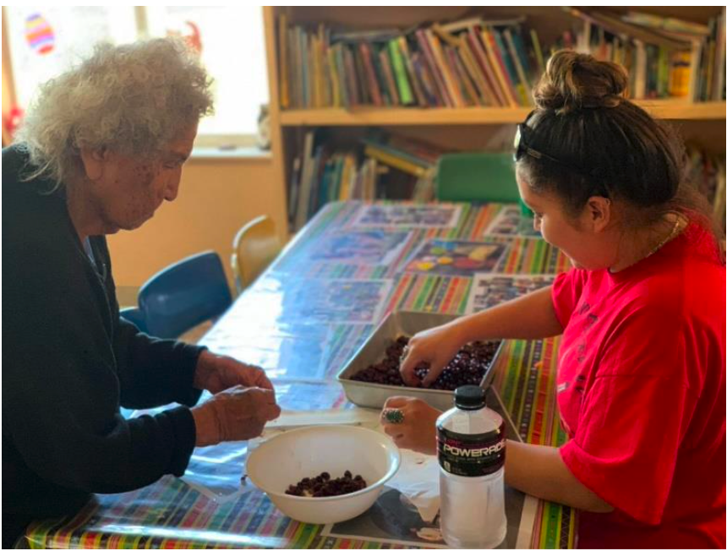
A Tribe
is a group of families who come from this land and share ways of doing things for a long, long time.
Tribes are made up of people called Native Americans.
Photo courtesy of the Burns Paiute Tribe
Notes:
Explain to students what a Tribe is and how they are made up of Native Americans. Share that there are many Native American Tribes in Oregon today.

Slide 3
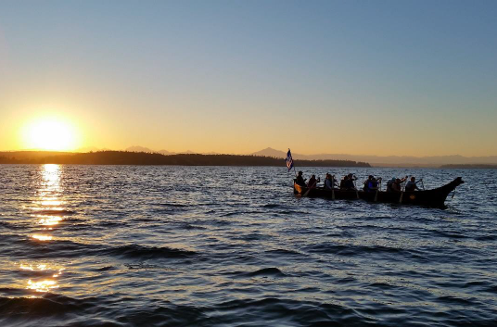
A Treaty
is a legal document with promises and agreements.
Oregon Tribes signed treaties with the United States.
Photo courtesy of The Confederated Tribes of Coos, Lower Umpqua and Siuslaw Indians
Notes:
Explain to students that Native American Tribes in Oregon signed treaties with the United States to protect their people and traditions. Treaties are agreements between the tribal nations and the United States for the sale of the tribal lands. Tribes may be promised money, supplies, and services to remove to a permanent reservation for their home.
Image: iStock: Credit:stella levi

Slide 4
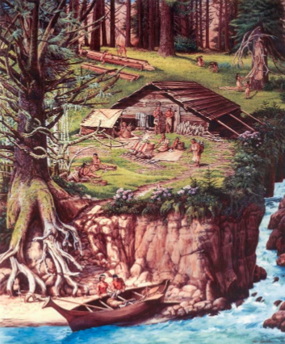
Short Story
“A long time ago, there were many Native American Tribes living all across the land we now call Oregon…”
Photo courtesy of The Confederated Tribes of Coos, Lower Umpqua and Siuslaw Indians
Notes:
Read aloud the following short story:
“There are many Native American Tribes living all across the land we now call Oregon. They have been here since time immemorial, since before anyone can remember. They have their own languages, their own ways of living, and special places that are important to them. Today, there are nine federally recognized Tribes in Oregon.
A few hundred years ago, people from far away came to Oregon and demanded that the Native American Tribes give them their land and move away to places far from their homes. Native people were in danger from these outsiders, including the U.S. government. The U.S. government promised Tribes that if they signed treaties agreeing to move away, the U.S. government would help protect them. Even though the U.S. government broke many of the promises they made in those treaties, Tribes use them today as a way to get the U.S. government to honor their promises and get back their lands.”

Slide 5
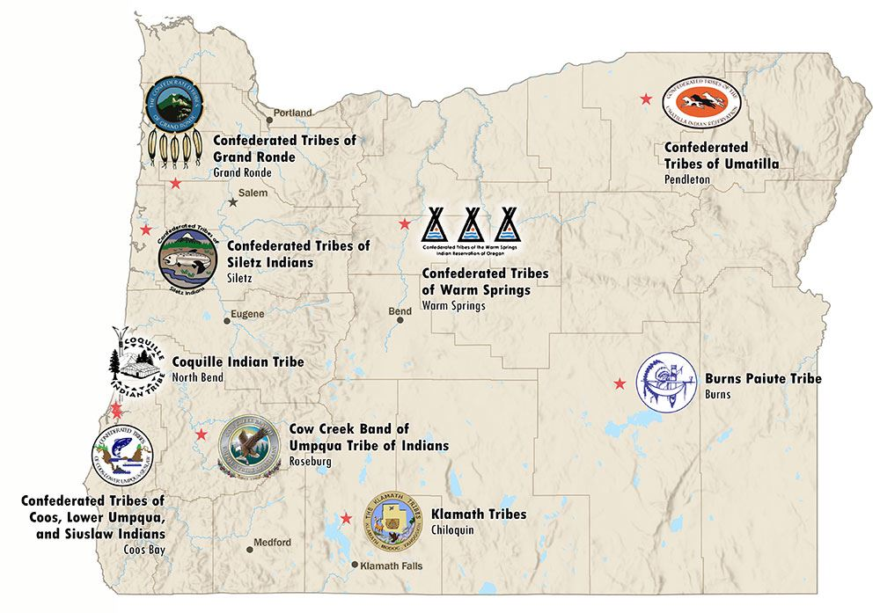
How many Oregon Tribes are there?
You may count the small pictures.
Notes:
Let students know that this is a map of Oregon. Ask students if they can count how many Tribes are on the map. Tell students each icon/picture represents a tribe.

Slide 6
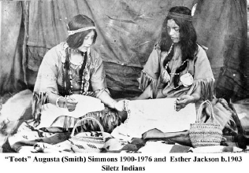
Essential Question
Why are treaties important to Tribes today?
Tribes use them to protect their people and traditions!
Photo courtesy of The Confederated Tribes of Siletz Indians
Notes:
Read and discuss what this might mean.

Slide 7
Number of Treaties
Tribe Name | Treaties Signed
Burns Paiute Tribe | 0
Confederated Tribes of Coos, Lower Umpqua, and Siuslaw Indians | 1
Confederated Tribes of Grand Ronde | 7
Confederated Tribes of the Umatilla Indian Reservation | 1
Confederated Tribes of Warm Springs | 1
Confederated Tribe of Siletz Indians | 8
Coquille Indian Tribe | 1
Cow Creek Band of Umpqua Indians | 1
Klamath Tribes | 1
Notes:
Counting Treaties Activity (15 minutes):
This is a chart with the nine tribes and the number of treaties they signed. Review the chart with the nine Tribes with students. Explain what information is in each column. Echo read the names of the Tribes and invite students to try the pronunciation. Explain that the numbers on the right show how many treaties each Tribe signed.

Slide 8
Math Tasks
Count how many treaties in total
TOTAL Number of Treaties is = ________
Notes:
Math Task:
Count how many treaties in total
Use the table to sum the number of treaties

Slide 9
Which Tribe signed more treaties?
9 | . | . | . | . | . | . | . | . | .
8 | . | . | . | . | . | . | . | . | .
7 | . | . | . | . | . | . | . | . | .
6 | .. . | .. . | .. . | .. . | .. . | .. . | .. . | .. . | .. .
5 | . | . | . | . | . | . | . | . | .
4 | . | . | . | . | . | . | . | . | .
3 | . | . | . | . | . | . | . | . | .
2 | . | . | . | . | . | . | . | . | .
1 | . | . | . | . | . | . | . | . | .
. | Burns Paiute | Coquille | Klamath | Grand Ronde | Coos, Lower Umpqua & Siuslaw | Cow Creek | Warm Springs | Siletz | Umatilla
Bar Graph
Number of Treaties
Tribes

Slide 10



Comparing Numbers
“Less than”
Compare who had more or fewer treaties.
“More than”
“Equal”
Notes:
Ask students:
Which Tribe has 8 treaties?
Which Tribe has 7 treaties?
Which Tribes have 1 treaty?
Which Tribe has 0 treaties?
Students can then compare who had more or fewer treaties. You can write out the names of various Tribes and ask students to use the greater than, less than, or equal symbol. For example:
Siletz __ Grand Ronde
Grand Ronde __ Klamath
Coquille __ Umatilla

Slide 11
Closing Discussion and Reflection
“I saw that some Tribes had more treaties than others. For example…”
“One thing I learned about Oregon Tribes is…”
Notes:
Reflection & Share (10 minutes)
Let students turn to a partner and share:
“One thing I learned about Oregon Tribes is…”
“I saw that some Tribes had more treaties than others. For example…”

Slide 12


Self-assessment
# | Can I… ? | Not yet | Yes
1 | explain what a treaty is in my own words? | . | .
2 | count how many treaties a tribe signed? | . | .
3 | explain why treaties are important to Oregon Tribes? | . | .
Notes:
Ask students to self-assess based on the success criteria. They can pick their level of learning (not yet or yes) and share with a peer, or you can print out the self-assessment and ask students to fill it out and turn it in.

Slide 13
Thank you!

