Slide 1
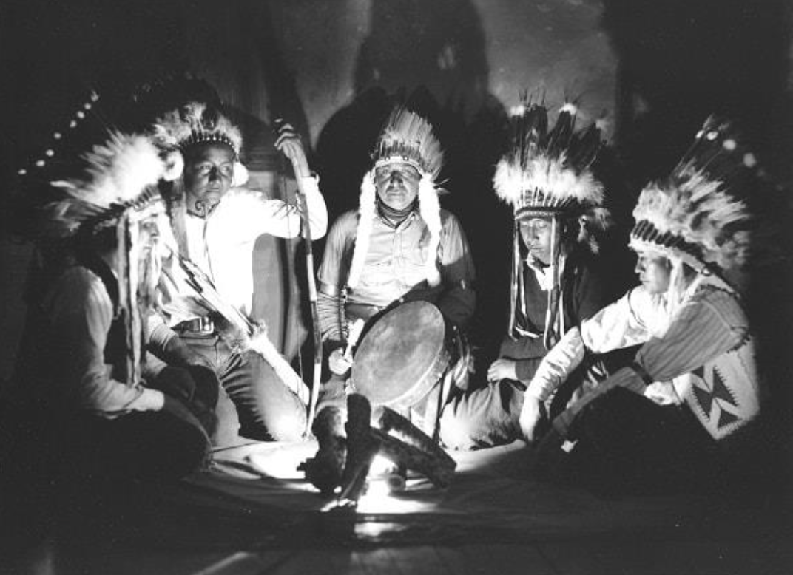
Trading Among Oregon Tribes
1st Grade
Math Lesson
Photo courtesy of The Burns Paiute Tribe
History shows that Native Tribes are strong and resilient.
Notes:
Note to teachers: In this lesson, students will learn about the importance of trade to sovereign Native nations in Oregon. They will focus on the historic experiences of Oregon Tribes and have the opportunity to explore these themes through math activities.
Say, “Today we’re going to be learning about Oregon Tribes and how long ago they used a different kind of money to trade things they needed with one another. We’re also going to try out trading ourselves and use math to help us understand if our trades are good for us.
Photo from the Essential Understandings,
Photo courtesy of The Burns Paiute Tribe

Slide 2
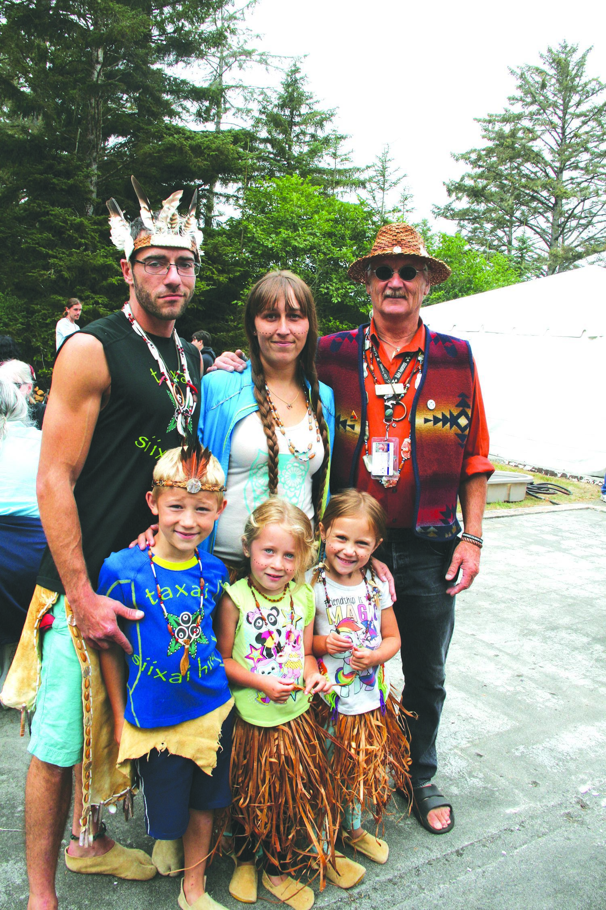
A Tribe
is a group of families who come from this land and share ways of doing things for a long time.
Tribes are made up of people called Native Americans.
Photo courtesy of the Confederated Tribes of Coos, Lower Umpqua, and Siuslaw Indians
Notes:
Introduce the idea of a tribe.
Say, “To get started, we’re going to talk about what a tribe is. A tribe is a group of families who come from this land and share ways of doing things for a long time. Tribes are made up of people called Native Americans. They are the first people of Oregon. They lived here before this place was even called Oregon. There are many Native American Tribes in Oregon today.”
Ask students to turn and talk to a peer, taking turns explaining what they heard in their own words. (1 minute)
Photo by Paige Gagner, courtesy of the Confederated Tribes of Coos, Lower Umpqua, and Siuslaw Indians
[Need permission for photo: https://clusi.maps.arcgis.com/apps/Cascade/index.html?appid=27e3174e06514e55b45d7a0cef5a59f9]

Slide 3
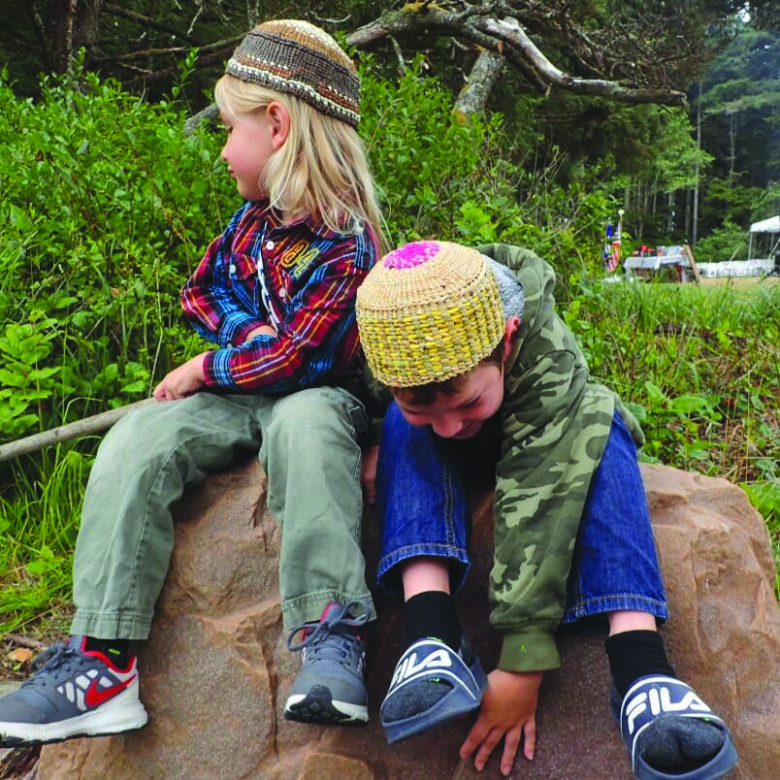
Sovereignty
is having the power to make your own rules and take care of your own people.
Tribes have sovereignty.
Image from CTCLUSI, Photographer Morgan Gaines
Notes:
Say, “Many Native American tribes have sovereignty. This means they have the power as a nation to make their own rules and care for their own people. Tribes have governments that help them do that. Other types of governments also have sovereignty, like the U.S. government.
Ask students to turn and talk to a peer, taking turns explaining what they heard in their own words. (1 minute)
Image credit: iStock:stellalevi

Slide 4
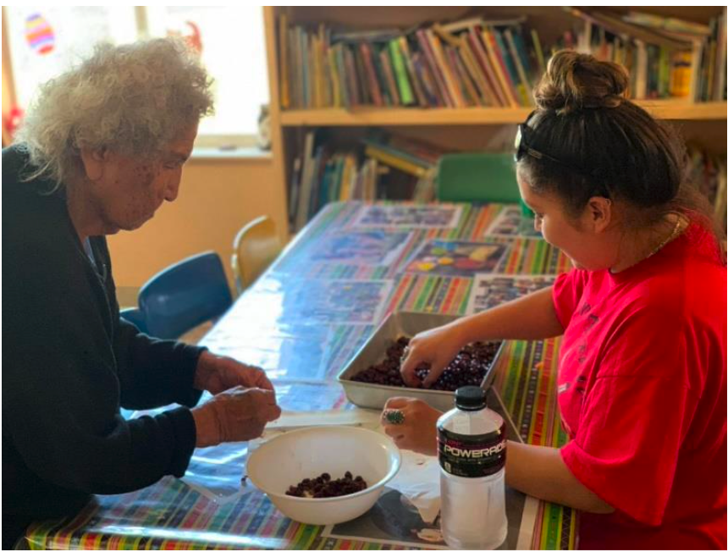
Trade
means to give something you have to someone else and get something you want from them in return.
Tribes make their own trading rules as part of their sovereignty.
Photo courtesy of The Burns Paiute Tribe
Notes:
Explain how these ideas relate to trading.
Say, “As part of their sovereignty, Tribes make their own rules for how they want to trade. To trade means to give something you have to someone else and get something you want from them in return.”
Share that trade looks different between tribes today compared to how it looked 300+ years ago.
Ask students to think about what might make trade different today compared to the past. You can prompt students, or they may suggest ideas like
technology
types of things people need and want today
type of money
Ask students to turn and talk to a peer, taking turns explaining what they heard in their own words. (1 minute)
Photo from the Essential Understandings doc, Photo courtesy of The Burns Paiute Tribe

Slide 5
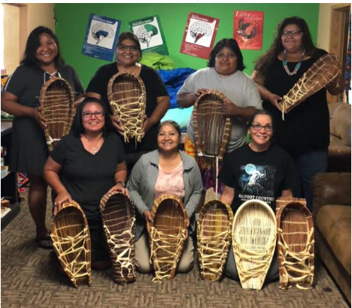
Group Talk
Have you ever traded something with a friend?
Photo courtesy of The Burns Paiute Tribe.
Notes:
Ask students, “Have you ever traded something with a friend?, What did you trade? Were you both happy with what you got in the end?”
Ask students questions about how they decided the trade was equal. Guide students to the idea that people place different values on objects based on what they need or want.
Photo from The Essential Understandings, Photo courtesy of The Burns Paiute Tribe.

Slide 6
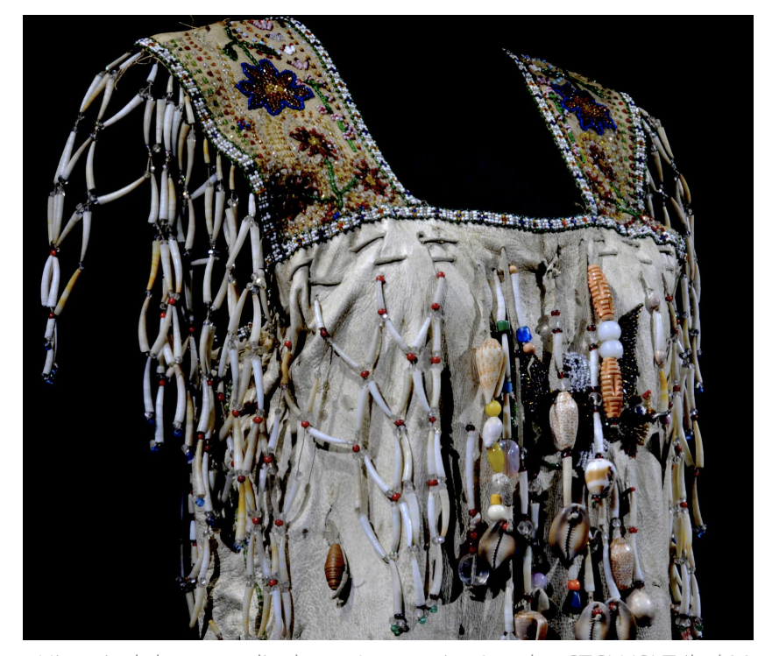
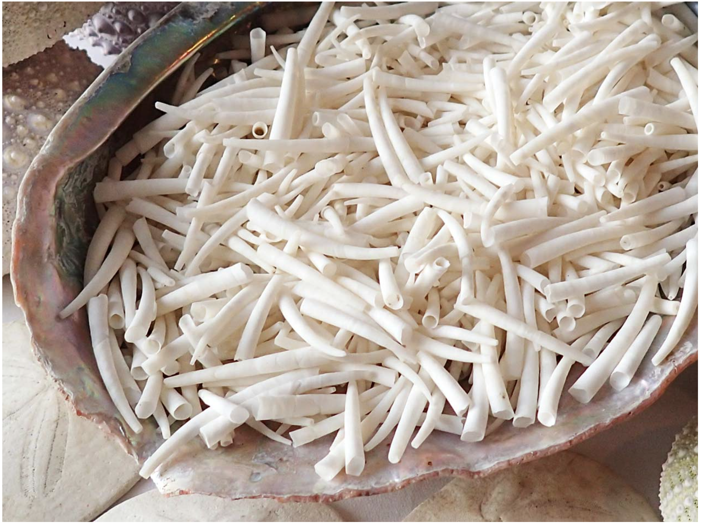
Dentalium!
Photo by Morgan Gaines, courtesy of the Confederated Tribes of Coos, Lower Umpqua, and Siuslaw Indians
Photo by Morgan Gaines, courtesy of the Confederated Tribes of Coos, Lower Umpqua, and Siuslaw Indians
Notes:
Say, “For many Oregon Tribes, the most valuable thing to trade was called dentalium. This is a shell of a small animal found in the ocean. People traded for dentalium, which was very precious. People used it to decorate their special clothing called regalia, and sometimes used it for money.
Create a modern connection. Ask questions such as, "What types of money do we use now in the United States?"
Images: https://clusi.maps.arcgis.com/apps/Cascade/index.html?appid=27e3174e06514e55b45d7a0cef5a59f9
Image information: Historical dress on display at Laqauwiyat'as, the CTCLUSI Tribal Museum / Middle photograph is a contemporary display of dentalium adornment on regalia.
Left photo: Photo by Morgan Gaines, courtesy of the Confederated Tribes of Coos, Lower Umpqua, and Siuslaw Indians.
Right photo: Photo by Morgan Gaines. Photos courtesy of the Confederated Tribes of Coos, Lower Umpqua, and Siuslaw Indians.

Slide 7
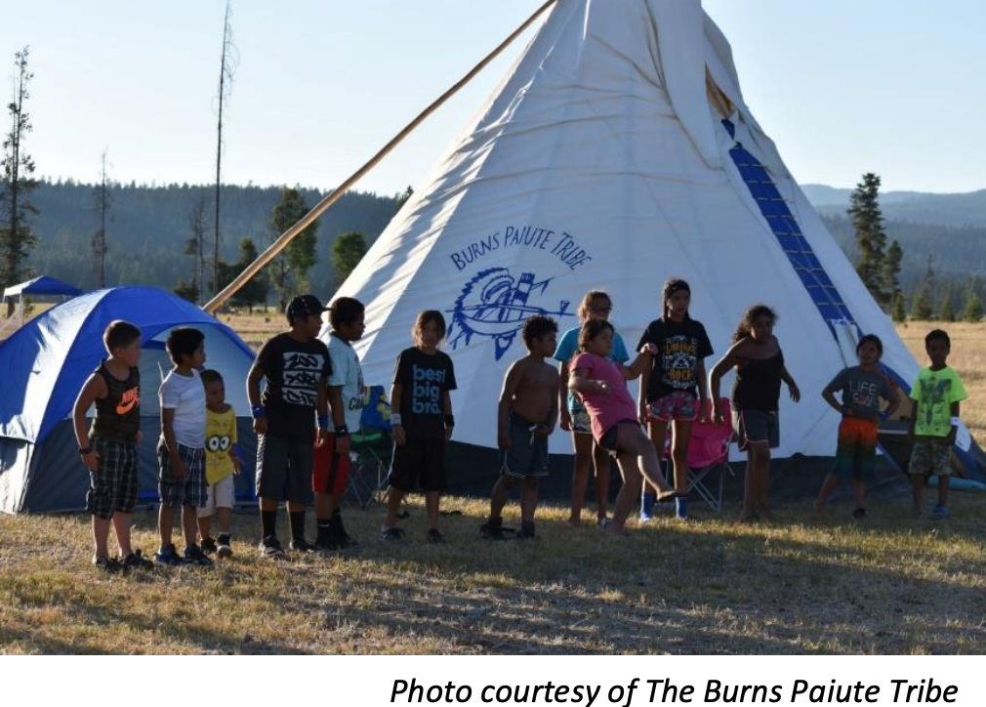
Essential Questions
Why would it be important to understand and use math when trading?
Photo courtesy of The Burns Paiute Tribe
Notes:
Read and discuss what this might mean.
Photo from The Essential Understandings, Photo courtesy of The Burns Paiute Tribe.

Slide 8
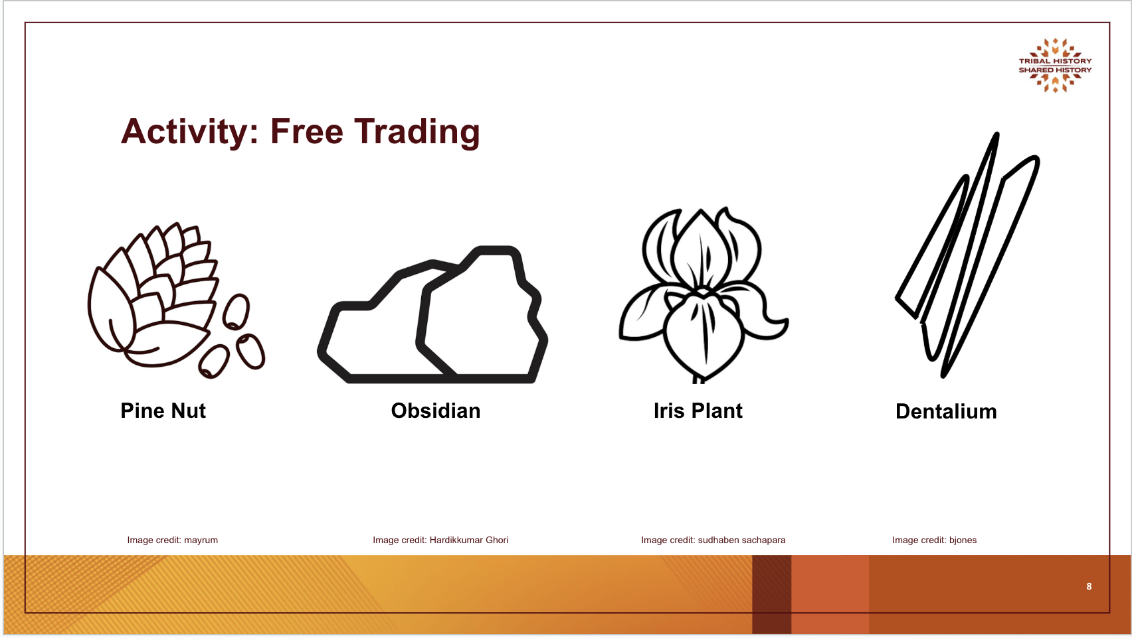
Activity: Free Trading

Slide 9
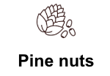



Student Record Sheet
. | Pine nuts | Obsidian | Iris plant | Dentalium
Amount at start of trade | . | . | . | .
Amount after first trade | . | . | . | .
Amount after second trade | . | . | . | .
Amount after third trade | . | . | . | .
The difference between the beginning and end amounts | . | . | . | .
Notes:
Math Connection: Student groups record the number of each item they start with. Students record each trade, e.g., three obsidian for two pine nuts. After trading, students record how many items they gained or lost (basic addition/subtraction) and what their new total is.
Say, “In your record sheet, you’ll write down information about your trades. The top row shows each type of object you’re trading. The first below that has places to write in the number of each object you have to start with. Then, after each trade, write down the new number of objects you have in the rows below. After making four trades, see if you can figure out the difference between the number of objects you started with and the number of objects you ended up with. Write this in the bottom row. Also write “more” or “less” to show if you have more or less than you started with.”
When you’re done, write a group explanation of how the trading went at the bottom of the record sheet. Answer, “How do you feel about what you ended up with? Explain if you got what you wanted in the trades.”
Note to the teacher: You may need to model the process along with a think-aloud to help students understand how to conduct the process and how to decide which math operation to use.

Slide 10
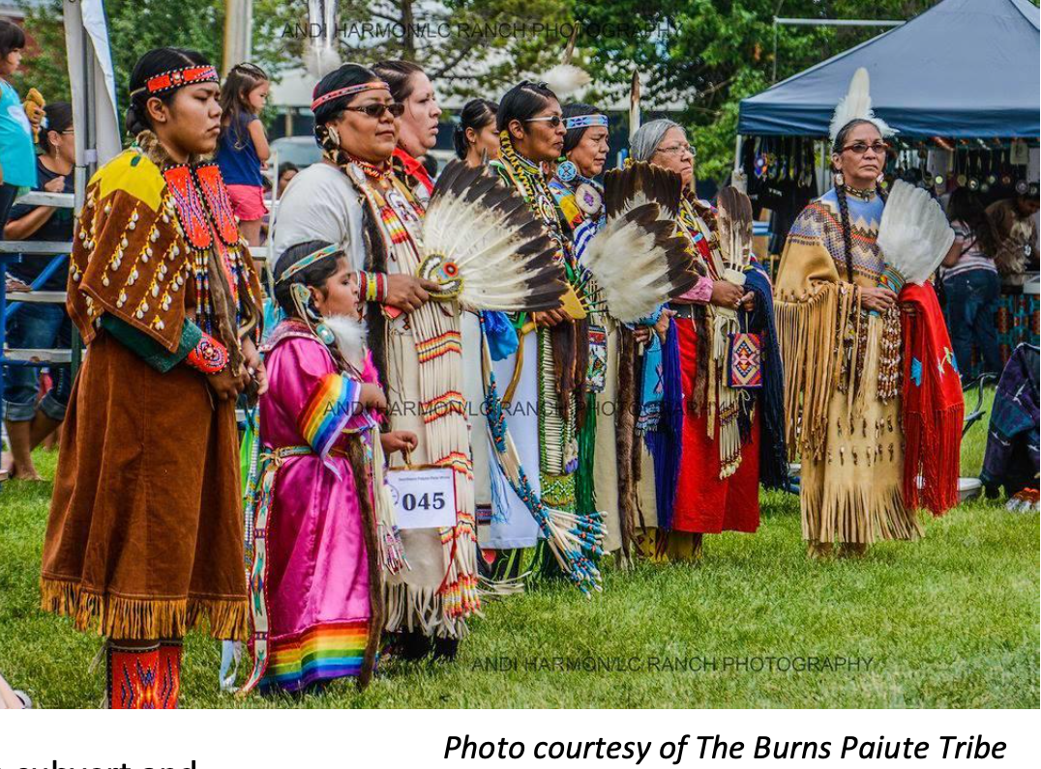
Closing Discussion
Photo courtesy of The Burns Paiute Tribe
Notes:
Have a discussion where students compare and discuss data:
Students look at their records and compare before and after trading.
Ask: “Did you have more or fewer resources after the trading?”
Ask student groups to share out.
Ask: “How do you feel about the quality of your trades?” Students may respond that even if they have a smaller total, they have more of a highly valued item, which they feel makes it a quality trade for them.
Discuss what the rules of trade meant for them:
“What were some of the rules you used while you were trading?” For example, how did you decide what you wanted to trade and how much each object was worth to you?
“How does making your own rules for trade have to do with sovereignty?”
Photo from The Essential Understandings, Photo courtesy of The Burns Paiute Tribe

Slide 11


Self-assessment
# | Success Criteria | Sort of | Yes
1 | Can I explain what trading and sovereignty mean in my own words? | . | .
2 | Can I describe how math helps in trading? | . | .
3 | Can I use a math strategy to decide if a trade is good? | . | .
Notes:
Ask students to self-assess based on the success criteria. They can pick their level of learning (sort of or yes) and share with a peer, or you can print out the self-assessment and ask students to fill it out and turn it in.
Success Criteria
I can explain what trading and sovereignty mean in my own words.
I can describe how math helps in trading.
I can use a math strategy to decide if a trade is good.

Slide 12
luuwii!
“thank you” in hanis,
language of the Coos Tribe
pronounced “loo – wee”

