Slide 1
Let’s Play Hand Game
1st grade
PE Lesson
Physical and mental endurance promote Native values such as teamwork and fairness.
Notes:
Note to teachers: This lesson focuses on the Essential Understanding, Since Time Immemorial, which refers to the deep, ancestral connection that Oregon’s Tribal Nations have to their lands, cultures, and traditions. Students will learn about Tribes’ traditional ecological knowledge (TEK) and how this type of knowledge enables them and others to engage in sustainable harvests and ecosystems.

Slide 2
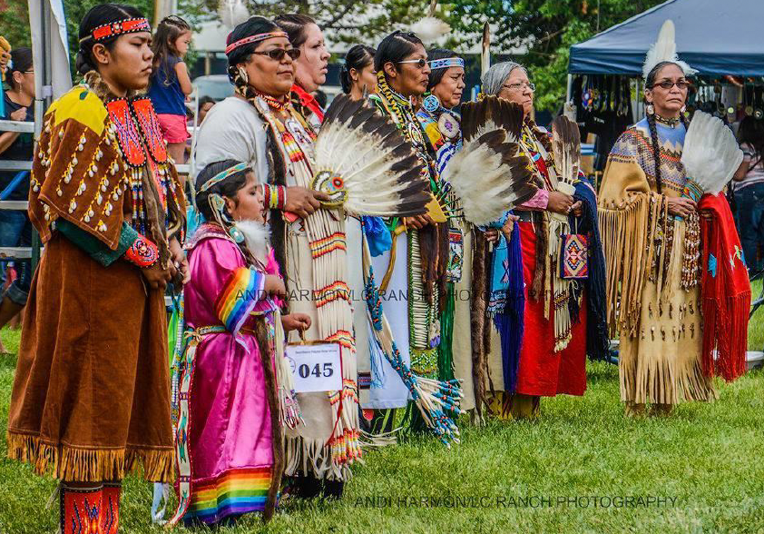
Key Words and Ideas
Hand Game (Slahal)
Guess
Respect
Time Immemorial
Identity
Tradition
Photo courtesy of The Burns Paiute Tribe
Notes:
Talk about the key words and ideas:
Time Immemorial – A very long time ago; before memory or records.
Identity – Who you are; your family, culture, and traditions.
Hand Game / Slahal – A traditional Native American game involving guessing and hiding.
Guess – To try and choose the correct answer without knowing for sure.
Respect – Treating others kindly and fairly.
Tradition:

Slide 3
Essential Questions
Why are Native American traditions like the Hand Game still important today?
Notes:
Go over the Essential Questions with your students. Give time for students to answer, question, wonder. If students are unfamiliar with terms or ideas, they can be included in their wondering.

Slide 4
“Have you ever played a game where someone hides something, and you try to find it?”
Share your experience.
Notes:
Activate prior knowledge:
Ask: “Have you ever played a game where someone hides something and you try to find it?”
Let a few students share their experiences

Slide 5
Learning Outcomes
Success Criteria
I can explain that the Hand Game is a Native game played for a very long time.
I can play the game by following the rules and working with my team.
I can show respect for my classmates while playing.
I understand how to play a traditional Native American game.
I understand that the Hand Game has been played since time immemorial.
I understand how to demonstrate teamwork, respect and focus during gameplay.
Notes:
Review the learning outcomes and success criteria with students so they understand what the intended learning is and what it looks like when they’ve achieved it.

Slide 6
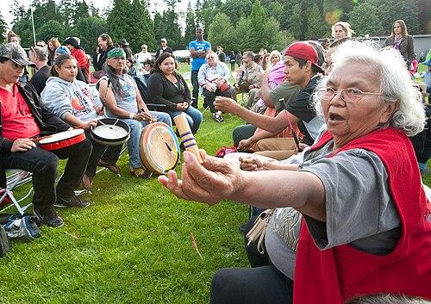
Hand Game
Also known as Slahal or Stick Game
It is a special guessing game Native American Tribes have played for a very long time.
https://en.wikipedia.org/wiki/Slahal
Notes:
Facilitate a discussion by introducing the hand game. What it is and provide some information from the background section of the lesson plan.

Slide 7
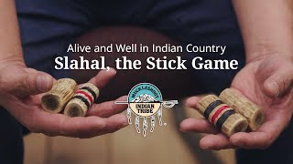
Alive and Well in Indian Country: Slahal, the Stick/Hand Game
Notes:
Introduce the Hand Game as a special guessing game that Native kids have played for a very long time.
Show video of a Tribal member talking about the game
https://www.youtube.com/watch?v=Nga2DRzvuh4

Slide 8
The Rules
One team, the “Hiders”, hides a small object (e.g., a bead or token or a coin) in their hands.
The other team, the “Guessers”, guesses which hand it’s in, left hand or right hand.
The team with the best guesses wins the round.
Notes:
Teach the Game
Explain the basic rules: This will be a simplified game format
One team, “The Hiders,” hides a small object, “the bones” (e.g., a bead, a token or a coin) in their hands.
The other team, “The guessers,” guesses which hand it’s in, left hand or right hand.
The team with the best guesses wins the round.
You may also demonstrate the hand gestures and respectful guessing (the video presents some examples)
Members of the team “The hiders” may sing and clap to distract the other team “The guessers”

Slide 9
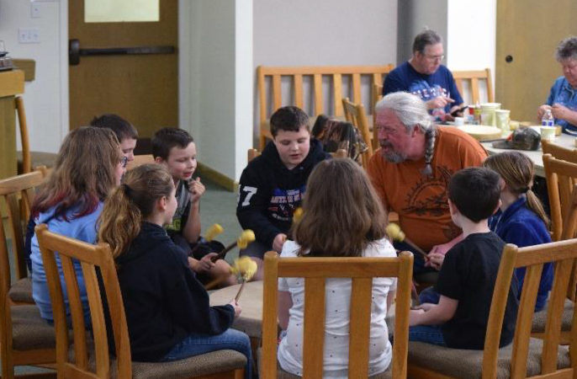
Practice
Play one round as a whole group.
Divide into small teams.
Play several rounds.
Rotate roles of hiders and guessers.
Photo courtesy of The Cow Creek Band of Umpqua Tribe of Indians
Notes:
Practice Round
Play one round as a whole group.
Focus on modeling turn-taking and respectful responses.
Small Group Play
Divide into small teams (3–4 students per group).
Play several rounds. Rotate the roles of hiders and guessers.
Encourage cheering, teamwork, and taking turns.

Slide 10
Closing Discussion and Reflection
“How did it feel to play this game?”
“Why do you think this game is important to Native people?”
“What did we learn about respect and teamwork?”
Notes:
Reflect and share

Slide 11


Self-assessment
# | Can I… ? | Not yet | Yes
1 | explain what is the Hand Game? | . | .
2 | play the game by following the rules and working with my team? | . | .
3 | show respect for my classmates while playing? | . | .
Notes:
Ask students to self-assess based on the success criteria. They can pick their level of learning ( not yet or yes) and share with a peer, or you can print out the self-assessment and ask students to fill it out and turn it in.

Slide 12
luuwii!
“thank you” in hanis,
language of the Coos Tribe
pronounced “loo – wee”

