Slide 1
Potlatch: Supporting One Another
First Grade
Health
Lifeways: how a group of people live, work and play together.
Notes:
Let students know that today they will be learning about the potlatch ceremony, which is important to Native American Tribes in Oregon. It is part of their lifeways, which means how they choose to live, work, and play together.

Slide 2
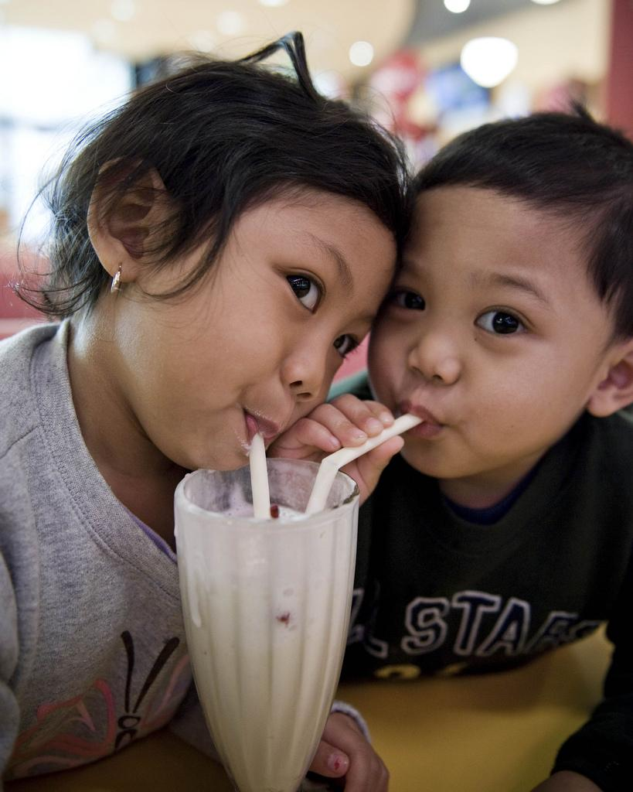
Group Talk
How does it feel to share something?
krzyboy2o, CC BY 2.0 , via Wikimedia Commons
Notes:
Ask: "Has anyone ever shared something special with you? How did it make you feel?"
Allow 2–3 students to share briefly.
Say: "Today we're going to learn about a special way that tribal leaders in Tribes across Oregon share with their community members. This tradition is called a potlatch. Today, we’re going to learn how just one of the many tribes that practice potlatch. That tribe is called the Coquille Indian Tribe.”

Slide 3
Essential Questions
Why is it important for Oregon Tribes to practice potlatch?
How does the potlatch tradition support caring for community members?
Notes:
Read and discuss. Give time for students to answer, question and wonder.

Slide 4
Learning Goals
Success Criteria
I understand what a potlatch is.
I understand how tribes use the potlatch to show care for their community.
I understand why sharing is important.
I can describe what a potlatch is.
I can explain why tribal governments hold potlatch.
I can discuss feelings around sharing.
Notes:
Review the Learning Goals and Success Criteria with students so they understand what the intended learning is and what it looks like when they’ve achieved it.

Slide 5
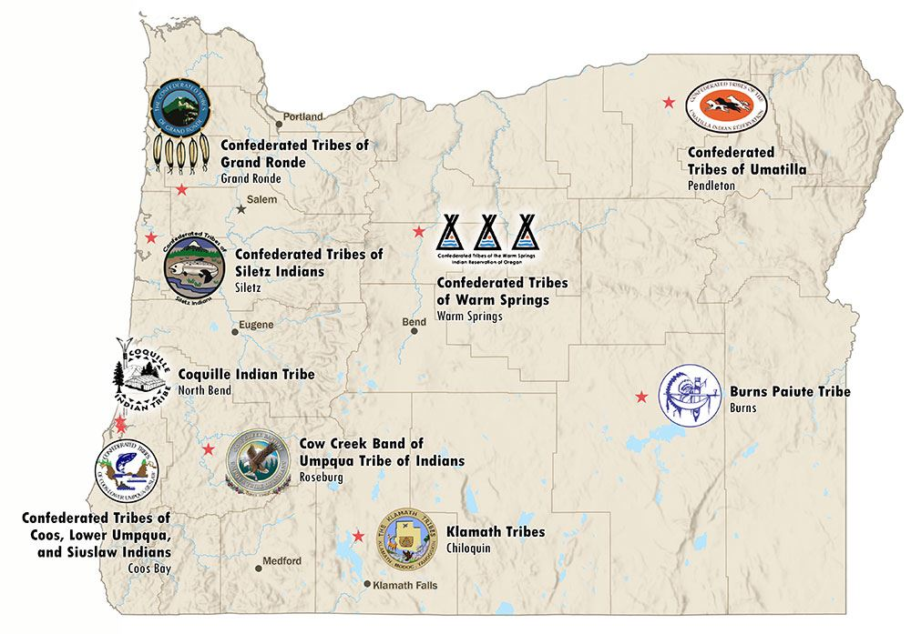

Can you find this picture on the map?
Oregon
Notes:
PRONUNCIATION NOTE: The Coquille Tribe is pronounced “ko-kwel” the town and river are “ko-keel”
Say, “This is a map of Oregon. It shows where the nine Oregon Native American Tribes are located. Can you find the Coquille Indian Reservation on the map? You can look for their picture.”
The Coquille Tribe is one of the many tribes in Oregon that practice potlatch. Today, we are going to learn what potlatch is and how the Coquille Tribe practices the potlatch.
You can let students know that the Coquille Indian Tribe flourished in Oregon’s southwestern corner for thousands of years, cherishing the bountiful forests, rivers and beaches of a homeland encompassing more than 750,000 acres. Now, they have 1200 members and 10,000 acres of ancestral homeland. (from:https://www.coquilletribe.org/our-people/)

Slide 6
Key Words and Ideas
Potlatch: A ceremony and tradition of gift giving practiced by Tribes all across Oregon
Tribe: A group of Native Americans who share the same culture, language, and history
Community: A group of people who live together and take care of each other
Tribal government: The leaders who take care of the Tribe
Notes:
Review the Key Words and Ideas with students. Ask them to pick one word and use it in a sentence with an elbow partner.

Slide 7
The Coquille Tribe and Their Potlatch Tradition (1)
The Coquille Tribe loves to give gifts.
Long ago, the Coquille people had special parties called potlatch on the beach near Bandon.
For many months, they would get ready for potlatch. They collected lots of food. They made beautiful baskets and other handmade items to give as gifts.
People came from far away to the potlatch. Some even traveled all the way from the Rogue Valley.
At the potlatch, everyone wore their best clothes. They ate delicious foods from the ocean and forest.
They sang songs and danced together.
Young people got to meet new friends.
Notes:
Read aloud the text on the slide to students or have them read it themselves. You can print a handout of this text from the lesson plan.
[Leveled to first grade from: https://theworldlink.com/potlatch-means-sharing-tribe-carries-on-ancestral-tradition-of-generosity/article_ad4a813d-0a1e-5777-b83b-ca279541b3a1.html]

Slide 8
The Coquille Tribe and Their Potlatch Tradition (2)
The best part of potlatch was that everyone who came got gifts from the Coquille people. No one went home empty-handed.
Today, the Coquille Tribe still loves to share. They give money to help schools and food banks. They help build museums where people can learn about history.
Not long ago, the tribe had a big celebration. They gave over 2,000 gifts to visitors. Some gifts were pretty beaded necklaces made by tribal members. Other gifts were T-shirts, blankets, coffee mugs, canned salmon and flashlights.
Brenda Meade, a Coquille leader, says sharing traditions are important. The Coquille Tribe works hard to keep these old traditions alive today.
The Coquille people believe that when everyone in the community does well, they do well too. It's like saying “When the water rises, all canoes go up!"
Notes:
Read the text aloud.
[Leveled to first grade from: https://theworldlink.com/potlatch-means-sharing-tribe-carries-on-ancestral-tradition-of-generosity/article_ad4a813d-0a1e-5777-b83b-ca279541b3a1.html]

Slide 9
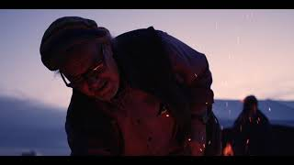
Coquille Indian Tribe, 30th Restoration Potlatch
Notes:
Listen to tribal government leader, Brenda Meade, the Chairman of the Coquille Indian Tribe, describe the potlatch. Video link: https://youtu.be/lFFExJxkvjA?feature=shared
Explain that the video is from the 30th year the Tribe’s government was able to hold a large public potlatch. For many years, the United States government made the Native American Tribe’s celebrations difficult or illegal to hold.
Ask students to turn and talk and explain in their own words what a potlatch is.
Then, lead a discussion after students watch the video.
Ask them questions such as:
"What kinds of things did the Coquille Tribe share at the potlatch?"
"Why do you think the Tribe shared what they had with others?
"How do you think people felt when they received gifts?"

Slide 10
Potlatch-inspired Activity
Everyone gets three items.
Practice sharing. Think: How can I be fair?
After you are done sharing, go back to your spot.
Notes:
Potlatch-inspired activity:
Give each student three small items (stickers, erasers, etc.)
Ask them to think about each item and how to share fairly.
Explain: "Now we'll practice the potlatch tradition of sharing. Think about which friends might like your items. Find friends who haven’t received any items yet."
Students take turns giving away their items to classmates.
After everyone has received something, gather back in a circle.

Slide 11
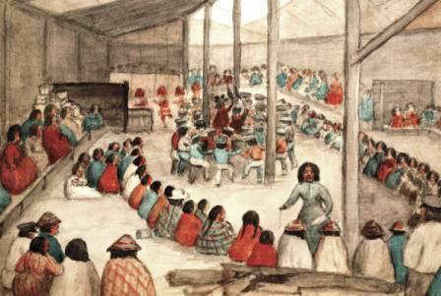
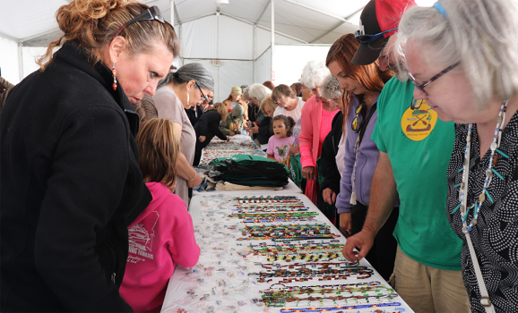
Group Talk: Potlatch
Long ago
Now (2019 )
Image from: https://quizlet.com/339401306/social-studies-chapter-2-lesson-4-the-northwest-coast-flash-cards/
Image from: https://www.coquilletribe.org/potlatch-july-2019/
Notes:
Hold a whole group discussion
Ask students
"How did it feel to receive something from your classmate?"
"How did it feel to give something away?"
"Why is sharing important in a community?"
"Why do you think Native communities in Oregon believe sharing is important?"
"When leaders share with their community, how does this help take care of everyone?"

Slide 12


Self-assessment
 | Success Criteria | Sort of | Yes
1 | Can I describe what a potlatch is?
2 | Can I explain explain why the tribal government hold potlatch?
3 | Can I discuss feelings around sharing?
Notes:
Ask students to self-assess based on the Success Criteria. They can pick their level of learning (sort of or yes) and share with a peer.

Slide 13
hayu masi!
pronounced “hah-yoo mah-see”
“thank you” in chinuk wawa,
a hybrid language established due to the relocation of Tribes and bands to the Grand Ronde Reservation – often called a “community language”

