Slide 1
Our Words, Our Stories: Exploring chinuk wawa
1st grade
ELA Lesson
Language helps you express yourself and understand others.
Notes:
In this lesson, students will learn about the importance of language to Oregon Tribes. Specifically focusing on chinuk wawa*, historically a trading language used by many tribes in the Northwest, including members of the Confederated Tribes of Grand Ronde and Siletz Indians. Students will learn about why tribal languages matter, hear chinuk wawa being spoken, and practice saying a few simple words. The lesson emphasizes that Native languages are alive and being used today.

Slide 2
Essential Questions
Why are languages important to Tribes in Oregon?
How does learning words from another language help us understand different cultures?
Notes:
Read and discuss. Give time for students to answer, question and wonder.

Slide 3
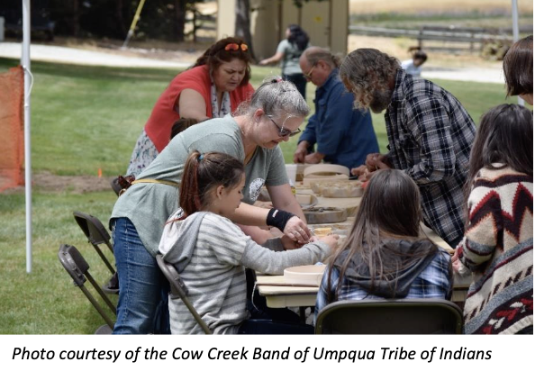
Group Talk
Has anyone ever heard someone speak a language different from the one we speak in school?
By a relative?
On the radio?
On TV?
On YouTube?
What was that like?
Notes:
Begin by asking students: "Has anyone ever heard someone speak a language different from the one we speak in school? By a relative? Or on the radio, TV or YouTube? What was that like?”
Allow 2–3 students to share their experiences.
Have students pair-share, then allow 2–3 students to share their experiences with the whole group.
[Image from the Essential Understanding doc]

Slide 4
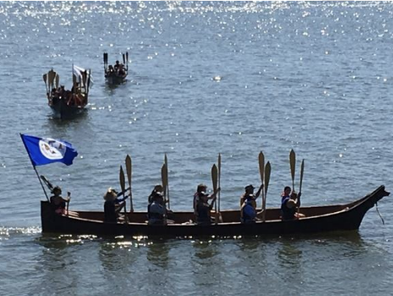
chinuk wawa
is a language spoken by many Oregon Tribes.
It connects people to their
ancestors
traditions
stories
Photo courtesy of Timothy Gonzalez, The Confederated Tribes of Grand Ronde.
Notes:
Share: "Today, we're going to learn about languages that Oregon Tribes have spoken for many generations. We'll focus on a language called chinuk wawa that has been spoken by many tribes, especially by the Confederated Tribes of Grand Ronde and Siletz."
Explain: "For tribal communities, language is very special. It connects people to their ancestors, their traditions, and their stories. Language helps people share their ideas, feelings, and knowledge."

Slide 5
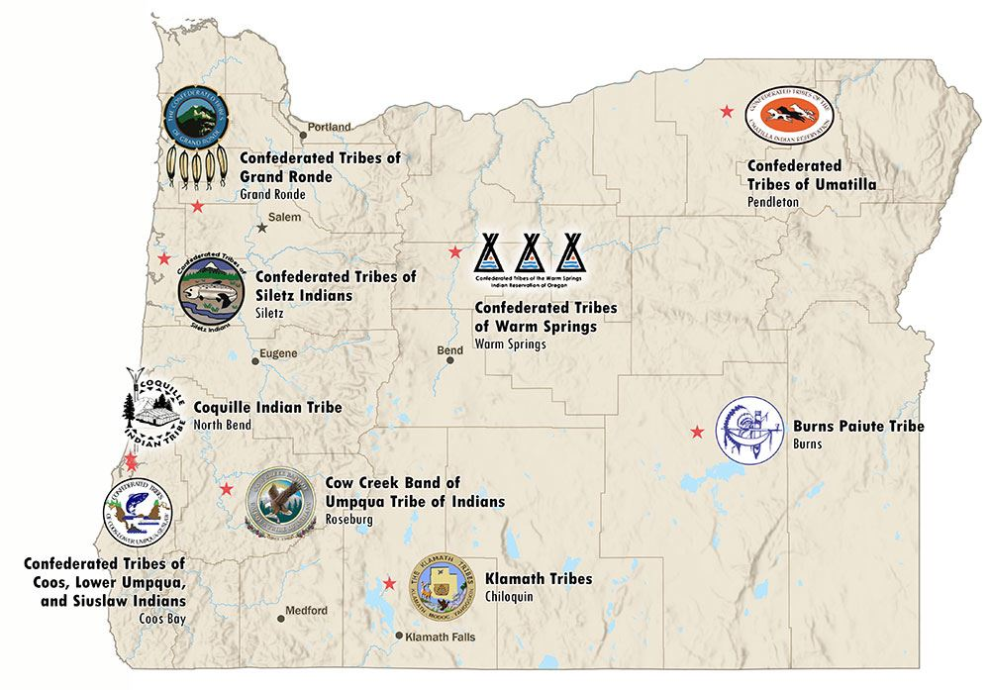
Nine Federally Recognized Tribes in Oregon
Can you find the Confederated Tribes of the Grand Ronde and
the Confederated Tribes of Siletz?
Notes:
Show the map of Oregon highlighting the traditional territory of the Confederated Tribes of the Grand Ronde and Siletz.
Ask, “Can you locate the Grand Ronde and Siletz Tribes?”

Slide 6
Key Words and Ideas
chinuk wawa: A language used by many different Oregon Tribes and others for trading.
Confederated Tribes of Grand Ronde: A Tribe in Oregon.
Greeting: A way to say hello.
Tradition: Customs passed down from generation to generation.
Notes:
Review the vocabulary with students. Ask them to turn to an elbow partner, pick one word, and use it in a sentence verbally with a peer.

Slide 7
Learning Outcomes
Success Criteria
I understand why chinuk wawa is important.
I understand a chinuk wawa greeting.
I can explain why chinuk wawa is important to Oregon Tribes.
I can pronounce two or three chinuk wawa words.
I can identify one thing I like about learning new words from another language.
Notes:
Review the learning goals and success criteria with students so they understand what the intended learning is and what it looks like when they’ve achieved it.

Slide 8
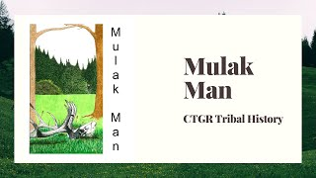
A Story About Elk Hunting
Notes:
Tell students: “Now, we’re going to hear a story about Mulak Man. Mulak means “elk” in chinuk wawa. After we are done listening to the story, we will hear a part of the same story in the chinook wawa language.
Video: https://www.youtube.com/watch?v=rThPzxz9DR8
Tell the students these videos were created by the Confederated Tribes of the Grand Ronde and are narrated by tribal members.
Play the video. Stop for questions.

Slide 9
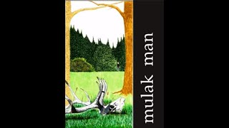
Coyote and the Fish Trap: chinuk wawa
Notes:
Tell students that now they will hear the story in chinuk wawa. Play the beginning of the video so that students can hear the sound of the language. Stop when it seems like students are ready to move on. video: Mulak Man (chinuk wawa)
Ask students: "What did you notice about how this language sounds? Does it sound similar to or different from English?"
Let students know they will be learning a few greetings in chinuk wawa.

Slide 10

Let’s learn together!
Notes:
Play the first 30 seconds or so of the video: chinuk wawa greetings and introductions. Stop after each word is pronounced to explain what it means in English.
Give students an opportunity to try it out in the whole group. After a chorus response, have students turn to a partner and take turns trying out saying the greeting.
You can also write the words on the whiteboard or chart paper for students to reference.

Slide 11
Closing
Why do you think it's important for Oregon Tribes like The Confederated Tribe of Grand Ronde and Siletz to keep speaking their languages?
It’s important because _____________.
One thing I like about learning new words is _____________________
Notes:
Share: "Languages carry stories, traditions, and knowledge. When the Confederated Tribes of Grand Ronde members speak chinuk wawa, they are connecting with their ancestors and keeping their traditions alive."
Read aloud the question on the slide and ask students to complete the sentence stems, either in writing or verbally to an elbow partner.
Share "Today we learned about why language is important to Oregon Tribes, especially the chinuk wawa language used by the Confederated Tribes of Grand Ronde. We practiced saying some chinuk wawa words ourselves."

Slide 12



Self-assessment
# | Success Criteria | Not Yet | Sort of | Yes
1 | Can I explain why chinuk wawa is important to Oregon Tribes?
2 | Can I pronounce two or three chinuk wawa words?
3 | Can I identify one thing I like about learning new words from another language?
Notes:
Say, “Today we learned about why language is important to Oregon Tribes, especially the chinuk wawa language. We practiced saying some chinuk wawa words ourselves.”
Revisit the learning objectives and success criteria.
Ask students to complete the self-assessment, either verbally to a peer or by completing the self-assessment form, indicating their learning relative to the success criteria.

