Slide 1
First Geologist: Oregon Tribes Use Rock to Make Tools
Kindergarten
English Language Arts
Lifeways: How a group of people live, work and play together.
Notes:
Tool Talk: Show students a modern tool or an image (hammer, scissors, etc.). Ask students: "What is this tool used for? What is it made of?"
Then say to students, "Today we're going to learn about tools that Oregon Tribes made from rocks. Native people in Oregon have been making rock tools since time immemorial - that means for a very, very long time." (Option to define Tribe and discuss the 9 Federally Recognized Tribes in Oregon).

Slide 2
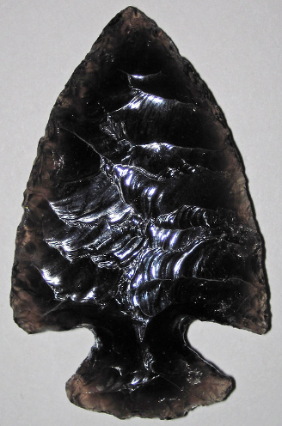
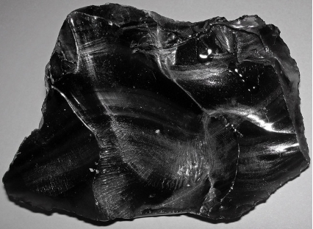
Projectile Point
Arrowhead
Obsidian
Photos by James St. John, https://creativecommons.org/licenses/by/2.0/
Notes:
Photos by James St. John, https://creativecommons.org/licenses/by/2.0/

Slide 3
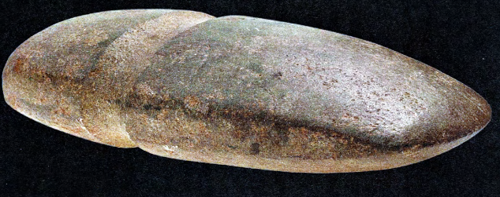
Axe Head
Source: Ivy, J., & Norris, N. (2011). Tah’s Tools. North Bend, OR: Coquille Indian Tribe.
Notes:
Say, "This type of axe head was used in many ways like chopping trees to build houses, making dugout canoes, and splitting wood to make fires."
Image source: Axe head: Ivy, J., & Norris, N. (2011). Tah’s Tools. North Bend,

Slide 4
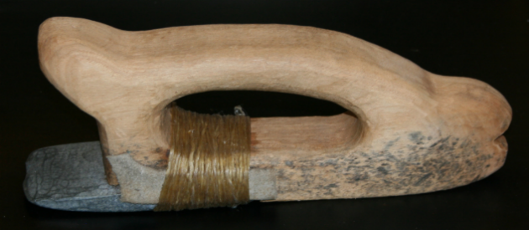
Chisel
Notes:
Chisel: Coquille Indian Tribe.https://www.facebook.com/ncai1944/photos/a.276175439685/10158530128359686/?type=3
A distinctly #Coquille product was the blueschist adze. Because of its extraordinary hardness, blueschist was difficult to shape, but it yielded a tough, durable tool. It was integral to the Coquilles’ production of cedar canoes.

Slide 5
hayu masi!
pronounced “hah-yoo mah-see”
“thank you” in chinuk wawa,
a hybrid language established due to the relocation of Tribes and bands to the Grand Ronde Reservation – often called a “community language”

