Slide 1
TAPP Family Advocate Monthly Meeting
Saturday Dec 21
February 13, 2025 - 12:30-2:30PM
✅ Welcome! Please say hello to your colleagues and NEWEST COLLEAGUE in the Zoom. Rename yourself to your Name, school district initials, Tribal Partner(s), and pronouns.
✅ Materials Needed - Writing utensils, notebook, ambo (water), snacks, reading glasses, any other materials to help you feel comfortable.

Slide 2
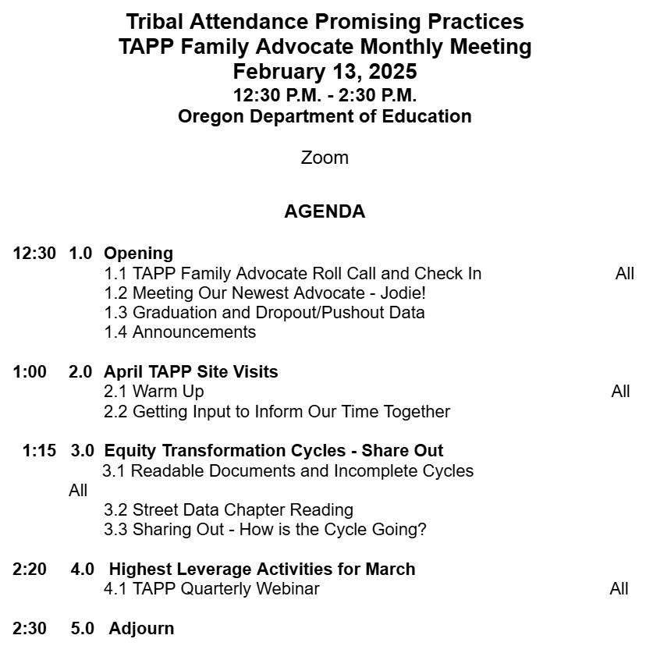

TAPP February Monthly Meeting Agenda

Slide 3
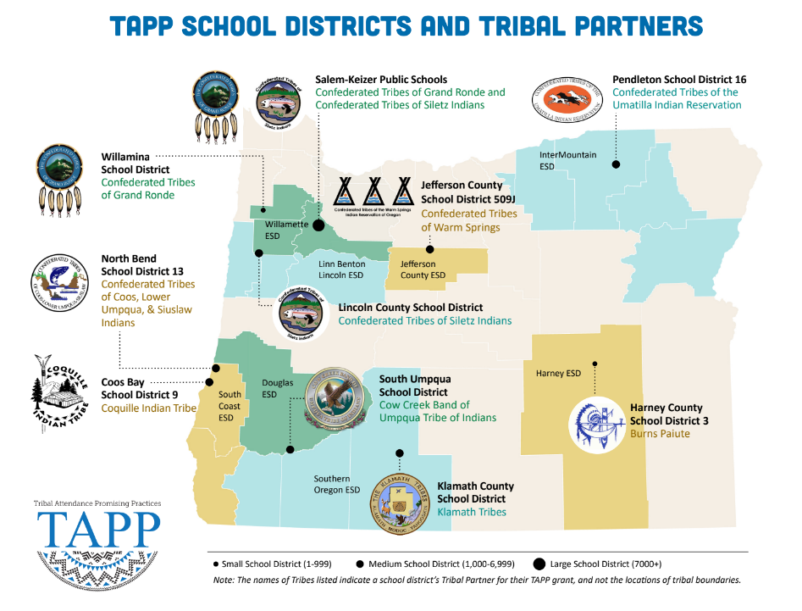
⭐ Indicates TAPP Expansion Position
Mona Smith
Stacey Jacobs
Ray Fox ⭐
Rebecca Arredondo
Mike Solem ⭐
Atcitty Begay
[TBD] ⭐
[TBD] ⭐
RuthEllen Melton
Crystal Hinds
Bre Landrum
Vacancy
Scott Smyth
Janelle Emard
Jodie Woodman ⭐

Slide 4

Welcoming our Newest TAPP Family Advocate
Jodie Woodman - Stearns Elementary, Peterson Elementary, and Brixner Junior High School
Klamath County School District
⭐TAPP Expansion District

Slide 5

TAPP Family Advocate Check-In
Roll Call.
It is February. Where have you found solace and peace since we last met. You can share out on personal or professional things.

Slide 6
Friendly, Yet Nagging Reminders
TAPP Data Dashboards
These need updated to reflect Quarter 2 and Trimester 2 efforts and progress.
Attendance Tracker - Should be completed by the Project Director or their District-level proxy at the END of a QUARTER or a TRIMESTER for every school served directly by a TAPP Family Advocate.
Strategy Tracking Log - Should be completed by the TAPP Family Advocate at least monthly, but twice a month is highly recommended; add as many rows as you need.
Data Justice Log - Should be completed at the END of a QUARTER or a TRIMESTER in collaboration with the Project Director, TAPP Family Advocate, and Tribal Partner(s)

Slide 7
Four Year Graduation Cohort Highlights
In the statewide news release from ODE Class of 2024 Overcame Historic Obstacles to Graduate at Second-Highest Rate in Oregon, celebrations were shared on the statewide graduation rate for the class of 2024 at 81.8%. Those graduates began high school during remote learning of the pandemic, ending their 9th grade year with only 73.6% of them On-Track.
🥳 American Indian and Alaska Native students had a four year cohort graduation rate of 70.1%, reflecting a 1.9% increase from the previous graduating class. This is quite an achievement, as 57.6% of AI/AN students were On-Track after their 9th grade year, demonstrating their resilience to overcome the challenges of the pandemic.
🥳 Six districts receiving the Tribal Attendance Promising Practices grant had an average rate of 72%, surpassing the state AI/AN average. Four of those same TAPP districts’ AI/AN graduation rate exceeded the statewide overall average. North Bend, Pendleton, Jefferson County, and Willamina
The average graduation rate for districts receiving the benefits of a Title VI program was 62.5%, reflecting a significant gap even from the state AI/AN average.
However, we cannot lose sight of the fact that 183 AI/AN students failed to graduate last year, with only 35 of those Native young people continuing their enrollment to a 5th year of schooling.

Slide 8
Dropout/Pushout Data
Definition: Dropout/Pushout - A student who withdrew from school and did not graduate or transfer to another school that leads to graduation is included in this dropout/pushout data.
Statewide the Dropout/Pushout rate is 3.2%; however, the AI/AN rate is 6.9%. Last school year alone, 154 American Indian and Alaska Native dropped out or were pushed out of school.

Slide 9
Graduation and Dropout/Pushout Data is Now Public
Definitions -
A graduate - Student who earned an Oregon Regular Diploma, participated in a Post Graduate Scholars program, or received an Oregon Modified Diploma.
Dropout/Pushout - A student who withdrew from school and did not graduate or transfer to another school that leads to graduation is included in this dropout/pushout data.
Where to Access It
ODE’s Cohort Graduation site
Dropout/Pushout Rates in Oregon’s Schools site
Suppressed and Unsuppressed Data
State suppression rules for all data published publicly. Rules for a data set can be found in a “Notes” tab.
You will need to seek permission from District leadership to review the unsuppressed data (i.e. “all data, regardless of cohort size”), as it is a FERPA violation for this data to be published or available to the public.

Slide 10
Critical Lens of Analysis
Our Native students are overrepresented in Alternative and Online schools. When analyzing data, look at how AI/AN students did at the local high school(s) and then the alternative or local online schools.
Regardless of cohort size, losing any of our AI/AN students has negative implications on tribal sovereignty. What will you say when someone says, “Well, the data looks bad, because there were only five Native students represented in that data.”

Slide 11

Street Data Podcast
You can listen to the author Shane Safir of Street Data with her co-host Alcine Mumby in their podcast, “Street Data Pod”.
https://streetdata.podbean.com/

Slide 12

OIEA March Youth Conference
Monday, March 24, 2025, 10AM-5PM
NAYA Youth and Family Center in Portland
Registration Link:
https://forms.gle/4cw4ir7S6dkxjxBV9
For More Information:
https://nayapdx.org/event/oiea-youth-conference/

Slide 13
April TAPP Site Visits
Getting Input to Inform our Sacred Time Together
Notes:
12:50AM -

Slide 14
April
Mon | Tues | Wed | Thurs | Friday
7 District and School Site Klamath County School District Chiloquin Schools | 8 Hold for OIE Business | 9 District and School Site Klamath County School District TAPP Expansion sites in town. | 10 District and School Site Coos Bay School District Team chooses sites to visit. | 11 District and School Site North Bend School District All TAPP Schools
14 District and School Site Salem-Keizer School District Scott Elem and Waldo Middle School | 15 District and School Site Willamina School District Willamina Elementary School | 16 District and School Site Lincoln County School District Toledo Elem and Siletz Valley School | 17 District and School Site Harney County School District 3 All TAPP Schools | 18 District and School Site Jefferson County 509J Warm Springs K-8

Slide 15
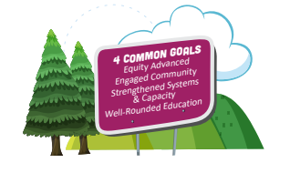
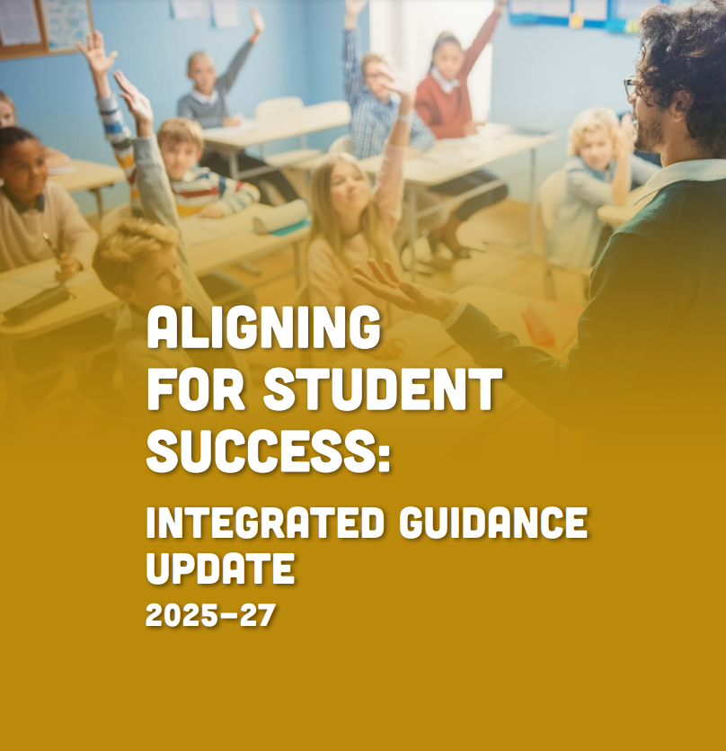
Big Picture - Purpose
American Indian and Alaska Native Student Success Plan
The purpose of the American Indian/ Alaska Native Student Success Plan is to share a vision and identify actionable strategies that will increase attendance rates, high school graduation rates and create a pathway for equity and excellence for all AI/AN students.
Goal 1 and Objective 4 identifies TAPP for increasing attendance of AI/AN students.
Aligning for Student Success: Integrated Guidance
Equity Advanced
Engaged Community
Well-Rounded Education
Strengthened Systems and Capacity

Slide 16
Logistics for TAPP Site Visits
A template is sent to all TAPP Site Team members to create the agenda for the day. The TAPP Family Advocate typically leads the planning, but must work closely with the Project Direct and the Building Leaders.
I am accompanied by 2-3 colleagues from ODE and/or the EAC.
Tribal Partners are highly encouraged to attend.
Project Directors do not have to be there all day and should attend the TAPP Share Out
Family Advocates are present all day, minus the empathy interviews.
This year I will write a comprehensive summary of the visit for each school district.

Slide 17
General Template For TAPP Site Visits
Focus Area | Agenda Item | Description
Equity Advanced and Strengthened Systems and Capacity | TAPP Site Team Share Out | Overview of TAPP Program Data - Analysis and Celebrations School-wide Culture that is Culturally Responsive to AI/AN+ (Foundational Conditions) Tiered Supports (Early Personalized Interventions and Develop Programmatic Responses to Barriers)
Engaged Community | Educator Empathy Interviews | The Empathy Interview will be conducted by the Agency. The focus of the Empathy Interview is “Supporting Indigeneity” within the school system.
Well-Rounded Education | Classroom Observations of core instruction, prioritizing literacy blocks in elementary | Use of Transparent Classroom Observation Tool The focus of classroom observation will be on the learning environment, instructional moves and methods used to engage students, and what grade level instruction and academic rigor looks like in our unique school context.

Slide 18
TAPP Work Session
from Root Causes to Systemic Change
Notes:
12:50AM -

Slide 19
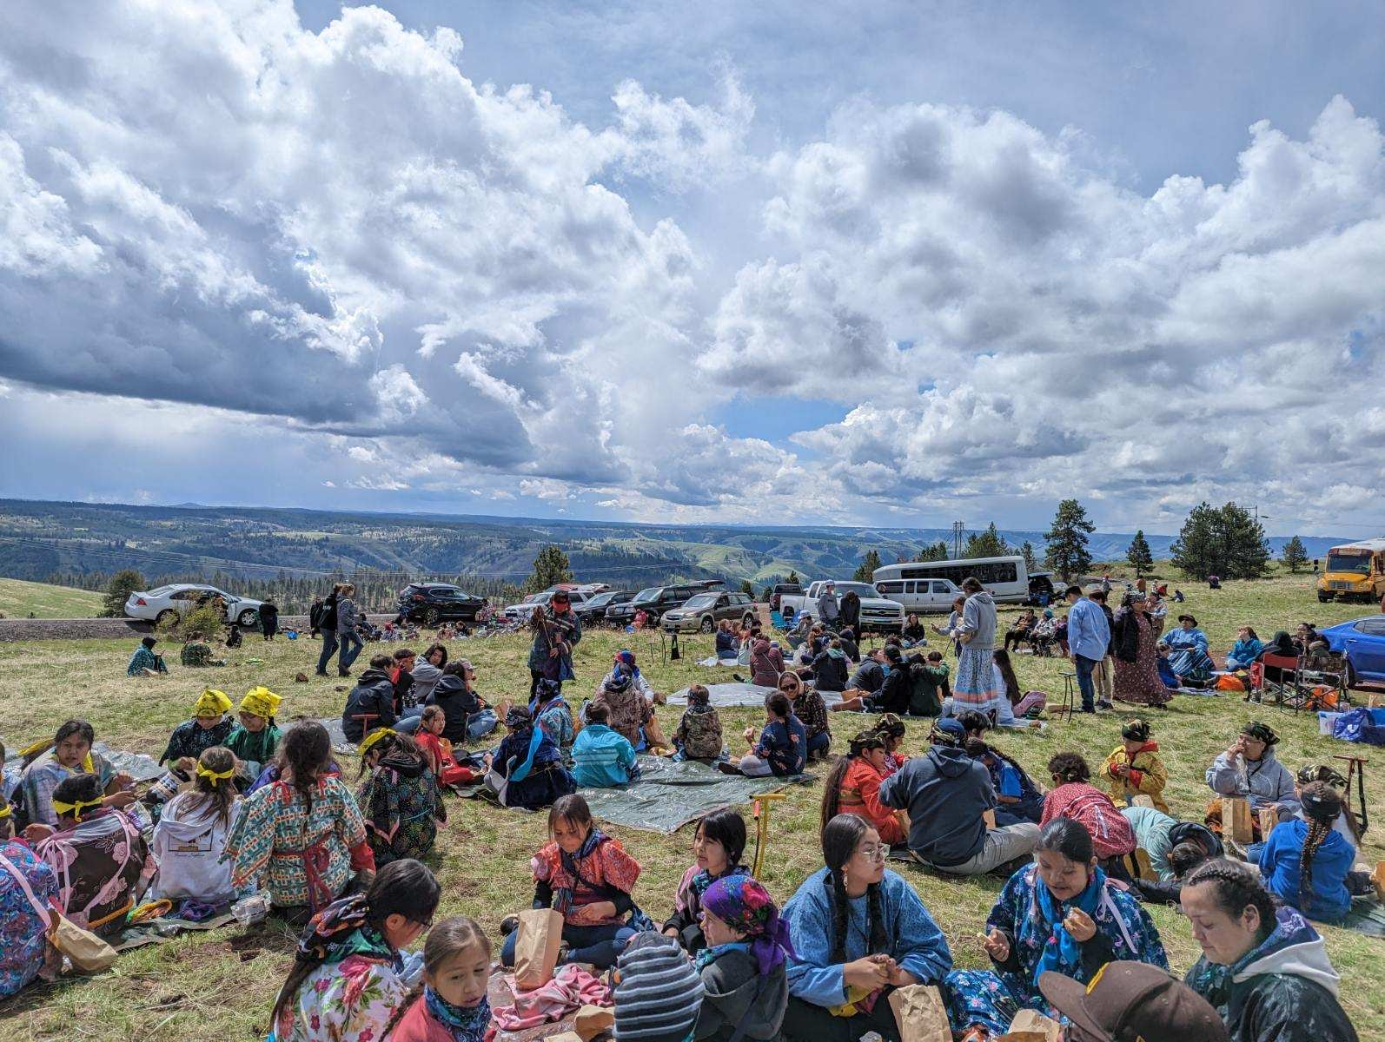
Next Steps for our Equity Transformation Cycles
Readable Documents
Willamina Elementary School- WSD
Washington Elementary School - PSD
Sunridge Middle School - PSD
Lincoln County School District
Harney County School District 3
North Bend School District
All TAPP Family Advocates should complete their Padlets by Tuesday end of day.
Book Time to Meet with Stacy if needed, to help you think through your cycles using this link - Book time with STACY PARRISH * ODE
More than 300 students, family members, and educators travelled to a traditional gathering spot on the Umatilla Indian Reservation on May 8. | Photo contributed by Erika Wilson.

Slide 20
Build Coherence: Focus, Holism, and Well-Being
Chapter 6 asks a central question, “How do you bring an entire school or system toward a pedagogy of voice” (defined as shifting the locus of control and power to the student, i.e. “street data” and the elevation of their voices and experiences) and states that a missing link in transformation efforts is what Fullan and Quinn call a “focusing direction” to ensure coherence.
Coherence, here, is defined as “a shared depth of understanding about the purpose and nature of this work…in the minds and actions, individually and especially collectively.” (p. 122-123)

Slide 21
Build Coherence: Focus, Holism, and Well-Being
Coherence, engendered over time through board stakeholder engagement, offers an antidote to program-itis, that phenomenon whereby layer upon layer of underfunded mandates are piled on teachers as demands to personalize learning for an increasingly diverse student body mount (Berry 2020). By investing in human conversation around the purpose and nature of the work, we accomplish a few crucial things:
Focus: The ability to know where we are going as a community and reinforce it consistently through our messages. (Less is more: focus is everything)
Holism: A tenet of Indigenous epistemology, holism helps us account for the whole of the system and the individual learner - the emotional, spiritual, physical, intellectual, and cultural dimensions - rather than fragment people into parts.
Well-Being: An experience of holism as integration of mind, body, spirit, and identity.

Slide 22

Embracing Vulnerability - Sharing Out on our Equity Transformation Cycles
By investing in human conversation around the purpose and nature of the work, we accomplish a few crucial things:
Focus: The ability to know where we are going as a community and reinforce it consistently through our messages. (Less is more: focus is everything)
Holism: A tenet of Indigenous epistemology, holism helps us account for the whole of the system and the individual learner - the emotional, spiritual, physical, intellectual, and cultural dimensions - rather than fragment people into parts.
Well-Being: An experience of holism as integration of mind, body, spirit, and identity.
Hearing from each of you, share out the ways in which you have conveyed the purpose and nature of the Equity Transformation Cycle to others.
Share out some initial “wins” on beginning your cycles.

Slide 23
Grounding Our Conversation
Chapter 5 talks about the concept of “Toward a Pedagogy of Voice.” It is described as -
Critical pedagogy, a teaching approach popularized by Paolo Freire, helps students question and challenge the status quo, develop habits of mind that go beneath surface meaning, uncover root causes of oppression, engage in deep thinking, and create counter narratives about their lived experiences. It is a practice that cultivates critical consciousness in students whose voices and ideas have been marginalized.
Culturally responsive education invokes a pedagogy that recognizes the importance of including students’ cultural references in all aspects of instruction and calls for a deep cognitive engagement of learners whose cultures and experiences have been relegated to the margins (Ladson-Billings, 1994).

Slide 24
Grounding Our Conversation
A pedagogy of voice emerges at the intersection of critical pedagogy and culturally responsive education, offering an instructional technology and way of being that shifts the locus of learning and power to the student.
A pedagogy of voice transcends numbers and metrics to create street-level learning experiences that foster healing, cognitive growth, and agency. It centers street data through dynamic student dialogue and rich student work, and it decenters compliance, grading, the quest for “answers”, competition, and all the other features of dominant classroom culture that uphold the testing-industrial complex.

Slide 25
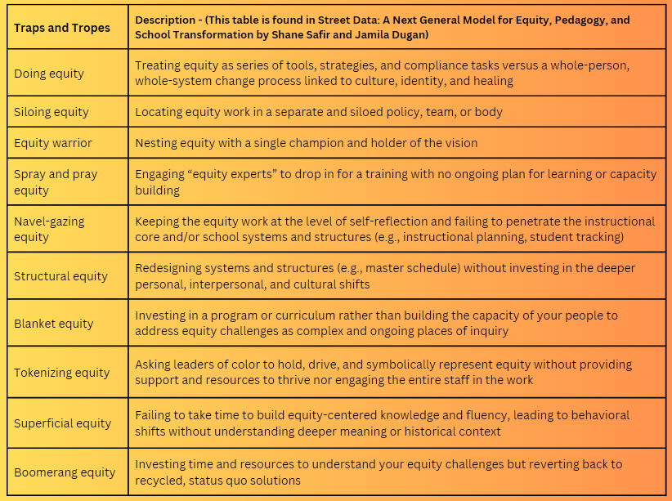
Always keep this list nearby, so you avoid falling into these Traps and Tropes and can remain committed to systemic change. P. 32-33
Notes:
Say: So that we are REALLY CALIBRATED on what Systemic Change is, let’s talk about what it is not. Take out your notebook or journal.
READ SLIDE -
5 Minutes for READING and REFLECTING, then share out.

Slide 26
2024-2025 TAPP Districts’ Dashboard
Key Resources and Documents
2024-2025 TAPP Districts’ Dashboard
Dashboard Orientation Video - 11 minutes
TAPP Shared Folder
TAPP Program Promising and Best Practices – This document underwent a comprehensive revision this summer. It is important to revisit this document individually and as a team. There are four key sections to the document –
SECTION I. General TAPP Grant Execution - Lessons Learned
SECTION II. Setting the TAPP Family Advocate Up for Success NEW Advocate? START HERE!
SECTION III. Foundational Supports for AI/AN Students that Lead to Positive Conditions for Learning (Includes a self-assessment to utilize with school teams!)
SECTION IV. Culturally Responsive Tiered Attendance Systems (also includes a self-assessment to utilize with school teams!)

Slide 27
Text Parrish anytime at 971-208-0270
Or - send me an email. Call if you must.
There is no such thing as, “I know you are busy”. I am here for you.

