Slide 1
Sustaining Tribal Languages
2nd Grade
English Language Arts
Language: Creator, holder and transmitter of culture.

Slide 2
Essential Question
Why is it important to sustain tribal languages in Oregon?
Notes:
Read and discuss. Give time for students to answer, question, wonder.

Slide 3
Learning Outcomes
Success Criteria
I understand why its important to sustain Native languages,
I understand ways Tribes work to develop language speakers, and
I understand the similarities and differences between three Tribes’ efforts to maintain their languages.
I can explain the importance of sustaining tribal languages
I can describe two strategies to develop language speakers
I can identify the similarities and differences between the two Tribes’ work to sustain their languages
Notes:
Review the learning outcomes and success criteria with students so they understand what the intended learning is and what it looks like when they’ve achieved it.

Slide 4

What is language?
What languages have you heard?
Does anyone know any words in another language?
How many languages do you think are spoken in Oregon?
Image source: https://pixy.org/4155061/; copyright: CC BY-NC-ND 4.0
Notes:
Ask students questions about language:
"What is a language?" Encourage simple answers like "Words we use to talk to each other."
What languages have you heard?
Does anyone know any words in another language?
How many languages do you think are spoken in Oregon?

Slide 5
Native American Languages in Oregon
Before Europeans arrived, 25–35 different Native languages were spoken in Oregon.
Today, 9 Native languages are spoken fluently in Oregon.
Oregon Tribes are bringing other languages back to life.
Today, we will learn about
Dee-'ni: the Siletz Tribes’ language
Wadatika Neme Yaduan: the Burns-Paiute language
chinuk wawa: the Confederated Tribes of the Grand Ronde, the Siletz Tribe and other Native Tribes’ ancestral trade language
Notes:
Explain: "Did you know there are many kinds of languages all over the world? Some languages are very special because they belong to certain groups of people called Native Americans." Explain:
Each Native American Tribe has its own language.
Native languages have been under attack by laws and policies that have tried to erase the languages in places like schools.
Tribes have and do work hard to sustain their languages, but it is not always enough.
Explain: Today, we will learn a bit about three languages from three tribes:
Dee-'ni (pronounced (DAY-u-knee): the Siletz Tribes language
Wadatika: the Burns-Paiute language
chinuk wawa: the language of the ancestors of the Confederated Tribes of the Grand Ronde, the Siletz tribe, and other Native Tribes.

Slide 6
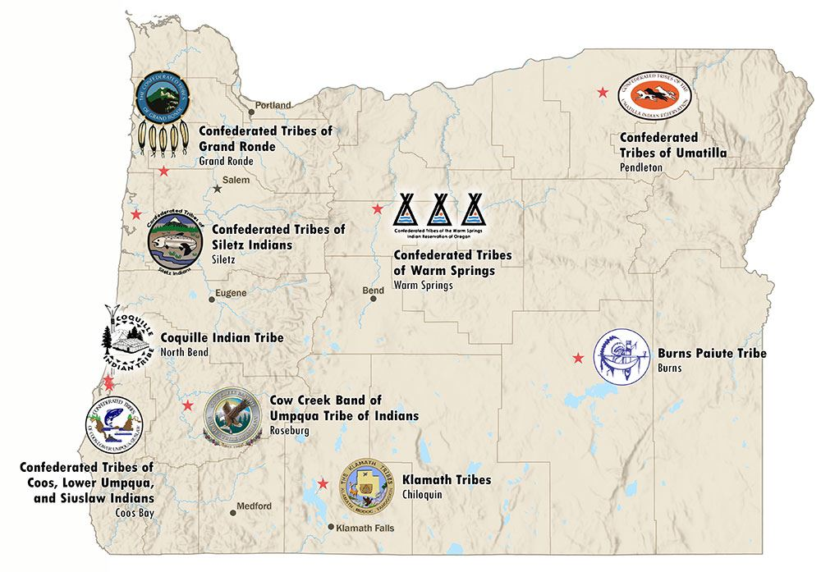
Nine Federally Recognized
Tribes in Oregon
Can you find the Confederated Tribes of Siletz Indians?
Notes:
Can you find the Confederated Tribes of the Siletz Indians Reservation on the map?
The Confederated Tribes of the Siletz Indians are the most diverse confederation of Tribes and Bands on a single reservation in the United States. Their ancestors spoke 10 completely different languages, each with multiple dialects! (from Siletz official website https://ctsi.nsn.us/)

Slide 7
Nine Federally Recognized
Tribes in Oregon
Can you find the Burns Paiute Tribe?
Notes:
The Burns Paiute Tribe Burns Paiute Tribe is primarily comprised of the descendants of the Wadatika Band of Northern Paiutes. These tribal members did not start using English as a first language until the 1960s, so many traditional cultural practices and language have remained strong. (paraphrased from https://burnspaiute-nsn.gov/about-the-tribe/)
Can you find the Burns Paiute Tribe Reservation on the map?
Today, we will learn how the Burns Paiute tribe is working to sustain their language.

Slide 8
Nine Federally Recognized
Tribes in Oregon
Can you find the Confederated Tribes of Grand Ronde?
Notes:
The Confederated Tribes of Grand Ronde includes over 30 tribes and bands from Western Oregon, Northern California, and Southwest Washington. Many of their ancestors used a language called chinuk wawa that we will learn about today.
Can you find the Confederated Tribes of Grand Ronde on the map?
Today, we will learn how the Confederated Tribes of Grand Ronde are working to sustain their language.

Slide 9
Key Words and Ideas
Sustain: strengthen or support, physically or mentally
Tribe: A group of people who share the same culture, language, and history.
Revitalize: To restore something to life or give it new life.
Compare: To look at two things and see how they are different or the same.
Contrast: To find the differences between two or more similar things.

Slide 10
Words Help Us Talk to Each Other
Today, we will read about three Tribes who are working hard to revitalize their languages
As we read, find out what the Tribes are doing to sustain their language.
Fill out the graphic organizer.
What is the Tribe?
What is the language of the Tribe?
What is the Tribe doing to keep their language alive?
Notes:
The student reading and graphic organizer are in the lesson plan.

Slide 11
Group Talk: Comparing and Contrasting
How are the Tribes taking similar actions?
How are the Tribes taking different actions?
Notes:
Ask students to share their thinking about Tribes’ language revitalization efforts.

Slide 12
Closing
Why is it important to keep languages like Dee-’ni, Wadatika Neme Yaduan, and chinuk wawa alive?
What are Tribes doing to keep languages alive?
Notes:
Ask students to explain why it is important to keep languages like Dee-'ni, Wadatika Neme Yaduan and chinuk wawa alive.
Languages help people communicate.
Languages help people describe and show their traditions and ways of life.
Explain that languages like English are taught in schools for these very reasons: to help people communicate, describe their world, and describe their ways of being. Yet, for many years, tribal languages were made illegal to learn in school, and young people were punished for speaking these languages in schools for many years. This is why it is so important for tribal leaders to keep these languages alive.

Slide 13


Self-assessment
# | Can I… | Sort of | Yes
1 | explain the importance of sustaining tribal languages?
2 | describe two strategies to develop language speakers?
3 | identify the similarities and differences between three Tribes’ work to sustain their languages?
Notes:
Ask students to self-assess based on the success criteria. They can pick their level of learning (sort of or yes) and share with a peer, or you can print out the self-assessment and ask students to fill it out and turn it in.

Slide 14
hiis!
pronounced “heess”
“Thank you”
In Sha’yuushtɬ’a uɬ quuiich
Language of the Siuslaw and Lower Umpqua Tribes

